Slide 1





Modelling of D/T ratio control experiments in JET
52nd EPS Conference on Plasma Physics (EPS 2026), Edinburgh, Scotland
K. K. Kirov, P. Fox, M. Lennholm, L. Piron, D. Valcarcel, M. Baruzzo, M. van Berkel, T. Bosman, L. Ceelen, L. Garzotti, B. Kool, J. Mitchell, B. Sieglin, H. Sun, JET contributors and the EUROfusion Tokamak Exploitation Team
United Kingdom Atomic Energy Authority, Culham Campus, Abingdon, Oxon, OX14 3DB, UK
Dipartimento di Fisica "G. Galilei", Università degli Studi di Padova, Padova, Italy,
Consorzio RFX, Corso Stati Uniti 4, 35127, Padova, Italy,
ENEA, Fusion and Nuclear Safety Department, ENEA Frascati, C.P. 65, 00044, Frascati, Italy,
DIFFER—Dutch Inst. for Fundamental Energy Research, De Zaale 20, 5612 AJ Eindhoven, The Netherlands
Department of Mechanical Engineering, Eindhoven University of Technology, Eindhoven, The Netherlands
Max Planck Institute for Plasma Physics, Boltzmannstr. 2, 85748 Garching, Germany
This work has been carried out within the framework of the EUROfusion Consortium, funded by the European Union via the Euratom Research and Training Programme (Grant Agreement No 101052200 — EUROfusion). Views and opinions expressed are however those of the author(s) only and do not necessarily reflect those of the European Union or the European Commission. Neither the European Union nor the European Commission can be held responsible for them.

Slide 2
Modelling of D/T ratio control experiments in JET
Outline of the talk
Motivation
Numerical tools
Workflow validation versus JET DTE3 data
  Particle sources
  Transport
Case studies
  Control D/T ratio with homogeneous D or T pellets
  Control n_{eL} with mixed D/T pellets
  Network #1, controlling line integrated density in range and D/T ratio
  Network #2, controlling D/T ratio and line integrated density
  Network #3, controlling line integrated density and D/T ratio
Summary and conclusions

Slide 3
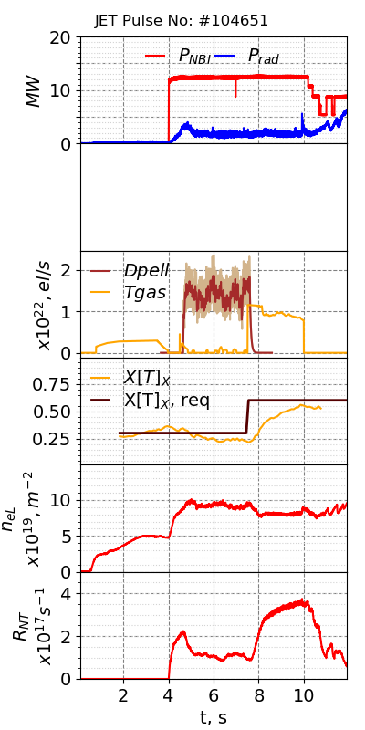
Particle transport modelling for D/T ratio control experiments in JET
Motivation
D/T ratio need to be controlled in future fusion devices: ITER, BEST, SPARC, STEP
JET DTE3 featured D/T ratio control experiments
The models used are capable to accurately reproduce the experimental observations for JET DTE3 D/T ratio control experiments
[Maggi C. et al 2024 Nucl. Fusion 64 112012]
[Lennholm M.et al 2025 PRX Energy 4 023007]
[Baruzzo M. et al 2025 30th IAEA FEC2025, Chengdu, China]
X[T]=n_{T}/(n_{T}+n_{D})
[K. K. Kirov et al, Nucl Fusion 65 (2025) 106016]
Numerical tools
JETTO - transport code used in JET, ITER, STEP
External component to simulate real-time (RT) controllers with JETTO

Slide 4
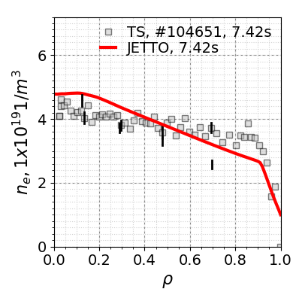
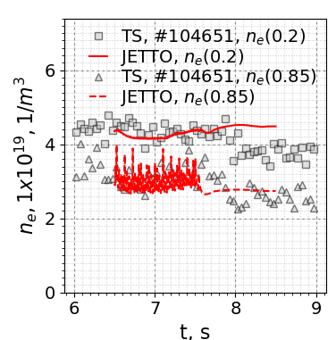
Particle sources and transport
Sources
NBI, gas injection, pellets
Transport
Bohm-gyro-Bohm model
Note, workflow is independent on transport model and can accommodate more advanced modelling approaches
Workflow validation
The new workflow
  pellets only, JETTO with NGPS, 25ms (40Hz)
  size, species, composition by external component
  validated versus experimental observations for JET DTE3 pulse #104651
[L. Garzotti et al Nucl. Fusion 43 (2003) 1829]
[K. K. Kirov et al, Nucl Fusion 65 (2025) 106016]
[C. Angioni et al 2009 Plasma Phys. Control. Fusion 51 124017]
[V. K. Zotta, oral, this conference]
[L. Garzotti, poster, this conference]
This study reports on simulations of the behaviour of D/T ratio and n_{eL} RT controllers with JETTO
=> Not a predictive transport simulation, but a plasma pulse simulator with RT control of D/T ratio and n_{eL}

Slide 5
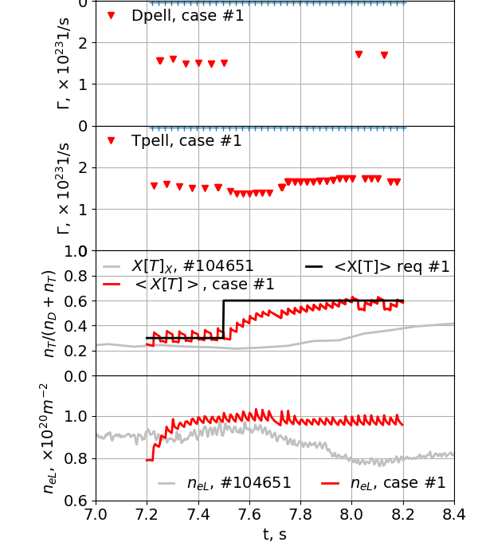
Case study: D/T ratio control
D/T ratio control
Actuator: pure D or T pellets; observer: <X[T]>=<n_{T}>/<n_{T}+n_{D}>
<X[T]>=0.3 requested for t<7.5s, then <X[T]>=0.6
Requested <X[T]> achieved within 0.5s
n_{eL} is not controlled, and increase to ~1×10²⁰m⁻²

Slide 6
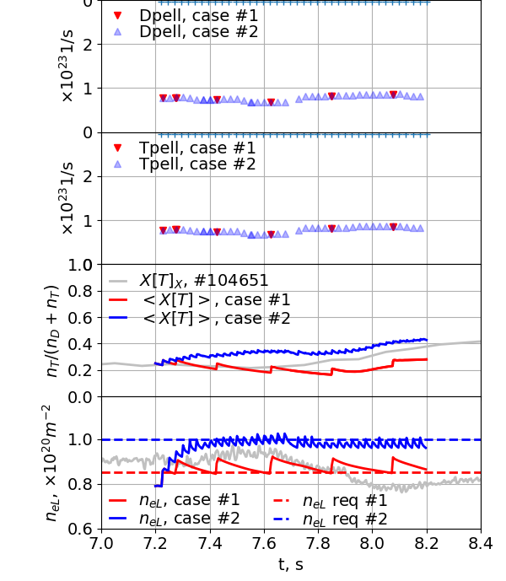
Case study: n_{eL} control
Line integrated density control
Actuator: mixed D/T=0.5/0.5 pellets; observer: line-integrated n_{eL}
n_{eL} requested 8.5×10¹⁹m⁻² and 1×10²⁰m⁻²
D/T ratio is not controlled
Requested densities are achieved and maintained while D/T ratio remain unchanged
Note, n_{eL} increase via pellets as actuator, n_{eL} decrease via transport losses

Slide 7
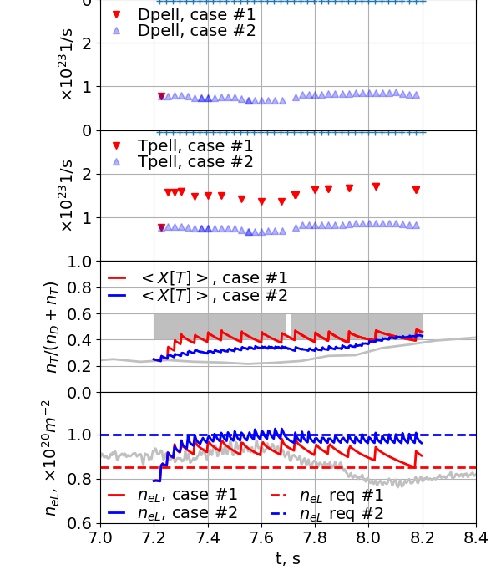
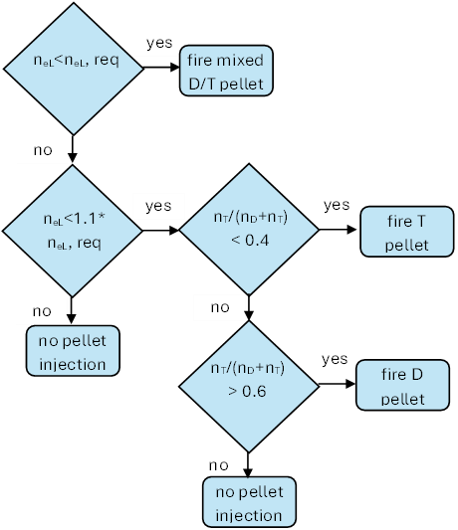
Network #1, controlling n_{eL} in range and D/T ratio
Combining two controllers into a network:
Actuators are coupled and influence each other
Prioritisation between the two controlled quantities must be considered
Test of combined controllers with JETTO with external component for <X[T]> in [0.4, 0.6] and
Case 1, n_{eL} req = 8.5×10¹⁹m⁻²
Case 2, n_{eL} req = 1×10²⁰m⁻²
1×10²⁰m⁻²
Network #1
Maintains n_{eL}=1×10²⁰m⁻² but cannot achieve <X[T]> in [0.4,0.6]
Lower request, n_{eL}=8.5×10¹⁹m⁻² is achieved on transport time scale
8.5×10¹⁹

Slide 8
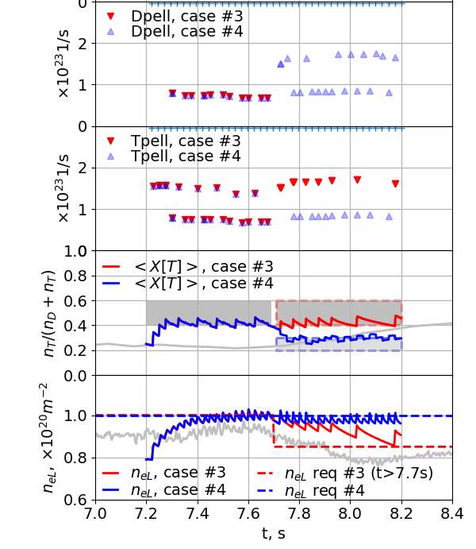
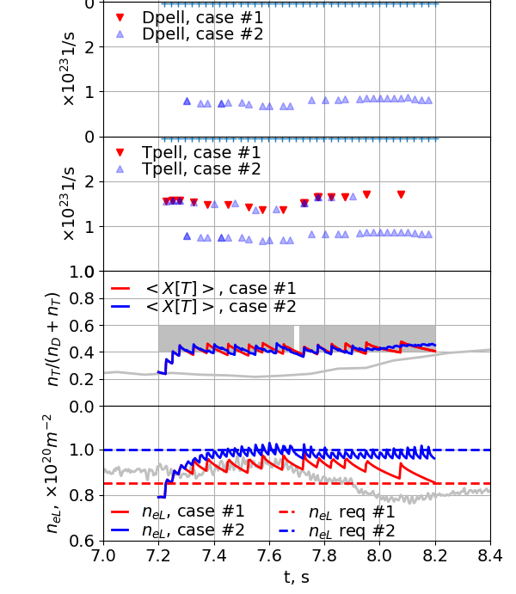
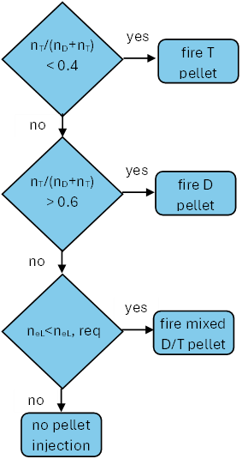
Network #2, controlling D/T ratio and n_{eL}
Network #2
Maintains somewhat n_{eL}= 8.5×10¹⁹ m⁻² and better 1×10²⁰m⁻²
Excellent in controlling <X[T]> in [0.4,0.6]
Dynamic response:
  Case #3, drop n_{eL} request from 1×10²⁰m⁻² to 8.5×10¹⁹m⁻² and sustain <X[T]> in [0.4,0.6]
  n_{eL} req 8.5×10¹⁹m⁻² achieved slowly
  Case #4, sustain 1×10²⁰m⁻² and drop <X[T]> to [0.2,0.3]
<X[T]> in [0.2,0.3] achieved quickly

Slide 9
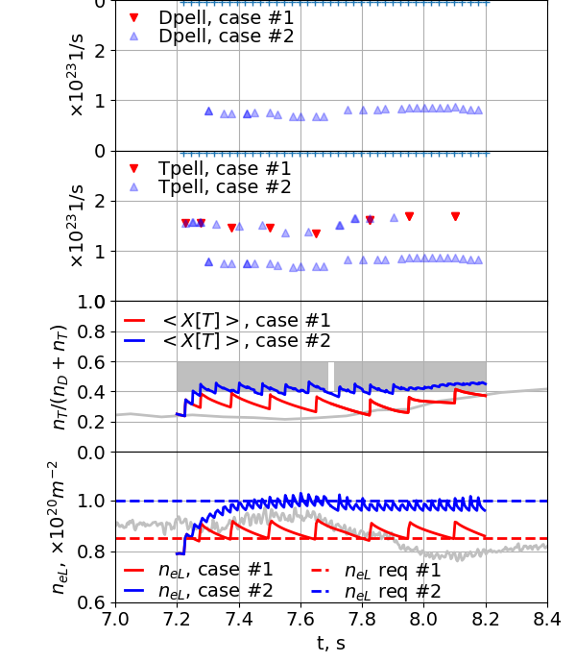

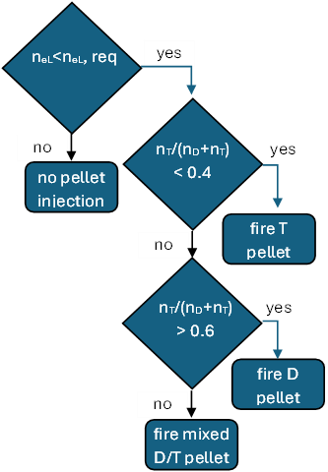
Network #3, controlling n_{eL} and D/T ratio
Network #3
Maintains better both requests for n_{eL}: n_{eL}= 8.5×10¹⁹m⁻² and 1×10²⁰m⁻²
Controlling <X[T]> in [0.4,0.6] only for higher density request
Dynamic response:
Case #3, drop n_{eL} request from 1×10²⁰m⁻² to 8.5×10¹⁹m⁻² and sustain <X[T]> in [0.4,0.6]
n_{eL} req ×10¹⁹m⁻² is better but cannot keep constant <X[T]>
Case #4, sustain 1×10²⁰m⁻² and drop <X[T]> to [0.2,0.3]
<X[T]> in [0.2,0.3] achieved quickly

Slide 10
Summary and conclusions
The RT networks investigated in this study operate based on two control references: n_{eL} and the D/T ratio, allowing for multiple possible configurations.
Three configurations were assessed.
The results demonstrate that not all configurations provide effective RT control within the explored parameter space.
This finding highlights the necessity of systematically validating RT controllers prior to deployment.
The workflow proposed in this work provides a robust framework for such validation and is therefore strongly recommended for the evaluation of future control schemes.

