Slide 1

52nd European Physical Society Plasma Physics Conference
June 28 –July 4, 2026, Edinburgh , UK
  Disruption mitigation in EAST with metal walls:
  a comparative study of SPI and MGI
J.S. Hu^{1，2}, J.S. Yuan¹, S.B. Zhao^{1，3}, L. Li^{1，3}, T. Tang¹, Y.M. Duan¹, H.D. Zhuang¹, S.T. Mao¹,D.L. Chen¹, B. Zhang¹, J.H. Yang¹, G.Z. Zuo¹, and EAST team¹
*Email: hujs@ipp.ac.cn
^{1.}Institute of plasma physics, HIPS, Chinese academy of sciences, 230031, Hefei, China
^{2.}School of Fusion Science and Engineering, Hefei university of technology, Hefei, 230009, China
^{3.}University of Science and Technology of China, Hefei, 230026, China

Slide 2


Content
  Disruption mitigation in EAST with full metal walls
  Comparison on disruption mitigation using SPI and MGI
    Plasma shutdown, Radiation evolution
    Halo current and cold VDE, MHD instability
  Comparison on disruption mitigation using SPI and ISPI
    Disruption Characteristics, Radiation evolution
    Halo current , Influence of SPI and ISPI Parameters
  Runaway electrons using MGI&SPI@ISPI
  Summary and outlook

Slide 3
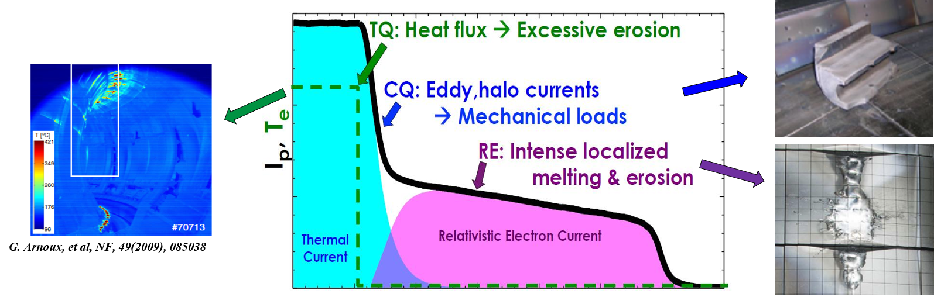
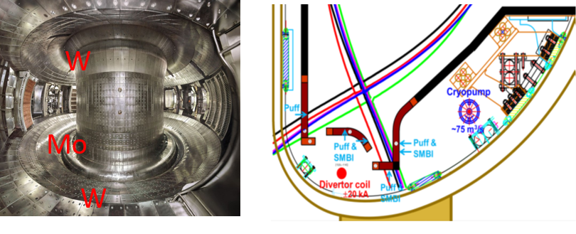
Disruption mitigation in tokamak with metal walls
Enlengthen TQ and control CQ to reduced thermal shock and EM stress on PFCs
Suppress/reduce RE production
Explore effective ways: SPI or MGI
Application in future fusion reactor with full metal walls
G.F. Matthews, et al, Phys. Scr. 16(2016), 014070
EAST fully superconducting tokamak
  ITER-like divertor structure
  Mo wall + Upper W div. + Lower C div. since 2014
  Mo wall + Upper W div. + Lower W div. since 2021
  W limiters since 2020
  C tiles with a small area facing NBI Penetration‌

Slide 4
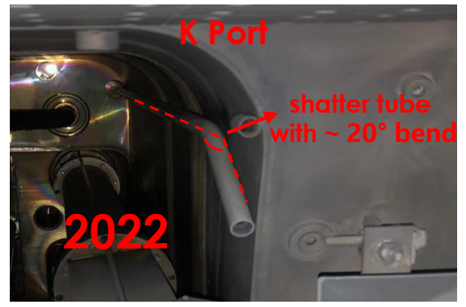
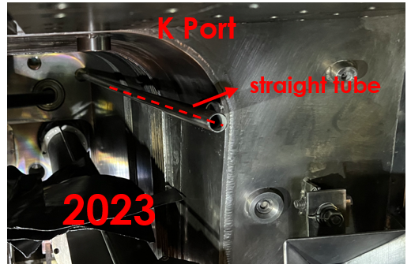
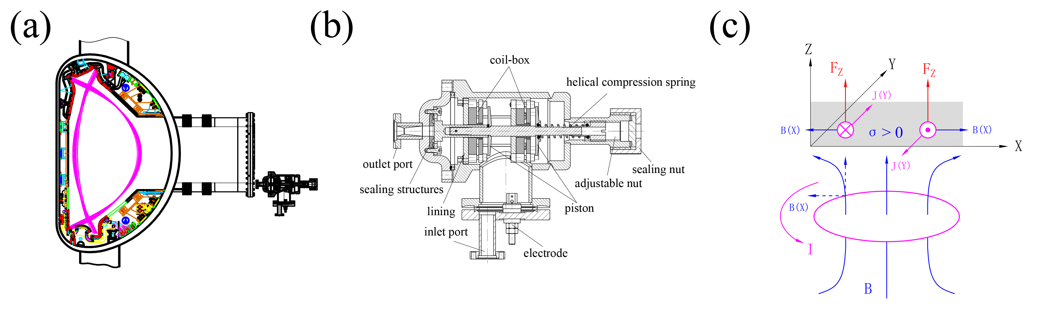
Main methods for disruption mitigation in EAST
In-situ condensation and freezing Shattered Pellet Injection (SPI) in middle K Port
  ~20°tube (R, Z) = (2.5 m, 0.4 m), straight tube (R, Z) = (2.5 m, 0.6 m)
  A straight tube replaced in 2023, named Insufficiently Shattered Pellet Injection(ISPI)
Fast Massive gas Injection (MGI)
  Eddy current drive
  Inject gas: Ne, Ar, He, etc.
  Response time: 0.15 ms
  Inject quantity: < 30 Pa· m³/s (1-4 ms)
Pellet diameter: 5mm²
Pellet length: 7-15 mm adjustable
Max. injected particles ~14 Pa· m³
Pellet velocity: 100-400 m/s
Pellet gas：H₂, Ne, H₂+Ne
  J.S. Yuan, et al. FED, 205(2024) 114551;
  J.S. Yuan, et al. FED, 191 (2023) 113567;
  S.B. Zhao, et al. JFE, (2023) 42:49；
  H.D. Zhuang, et al, PST, 15(2013) 8：745-749;
  H.D. Zhuang, et al, RSI, 86(2019) 053502;

Slide 5
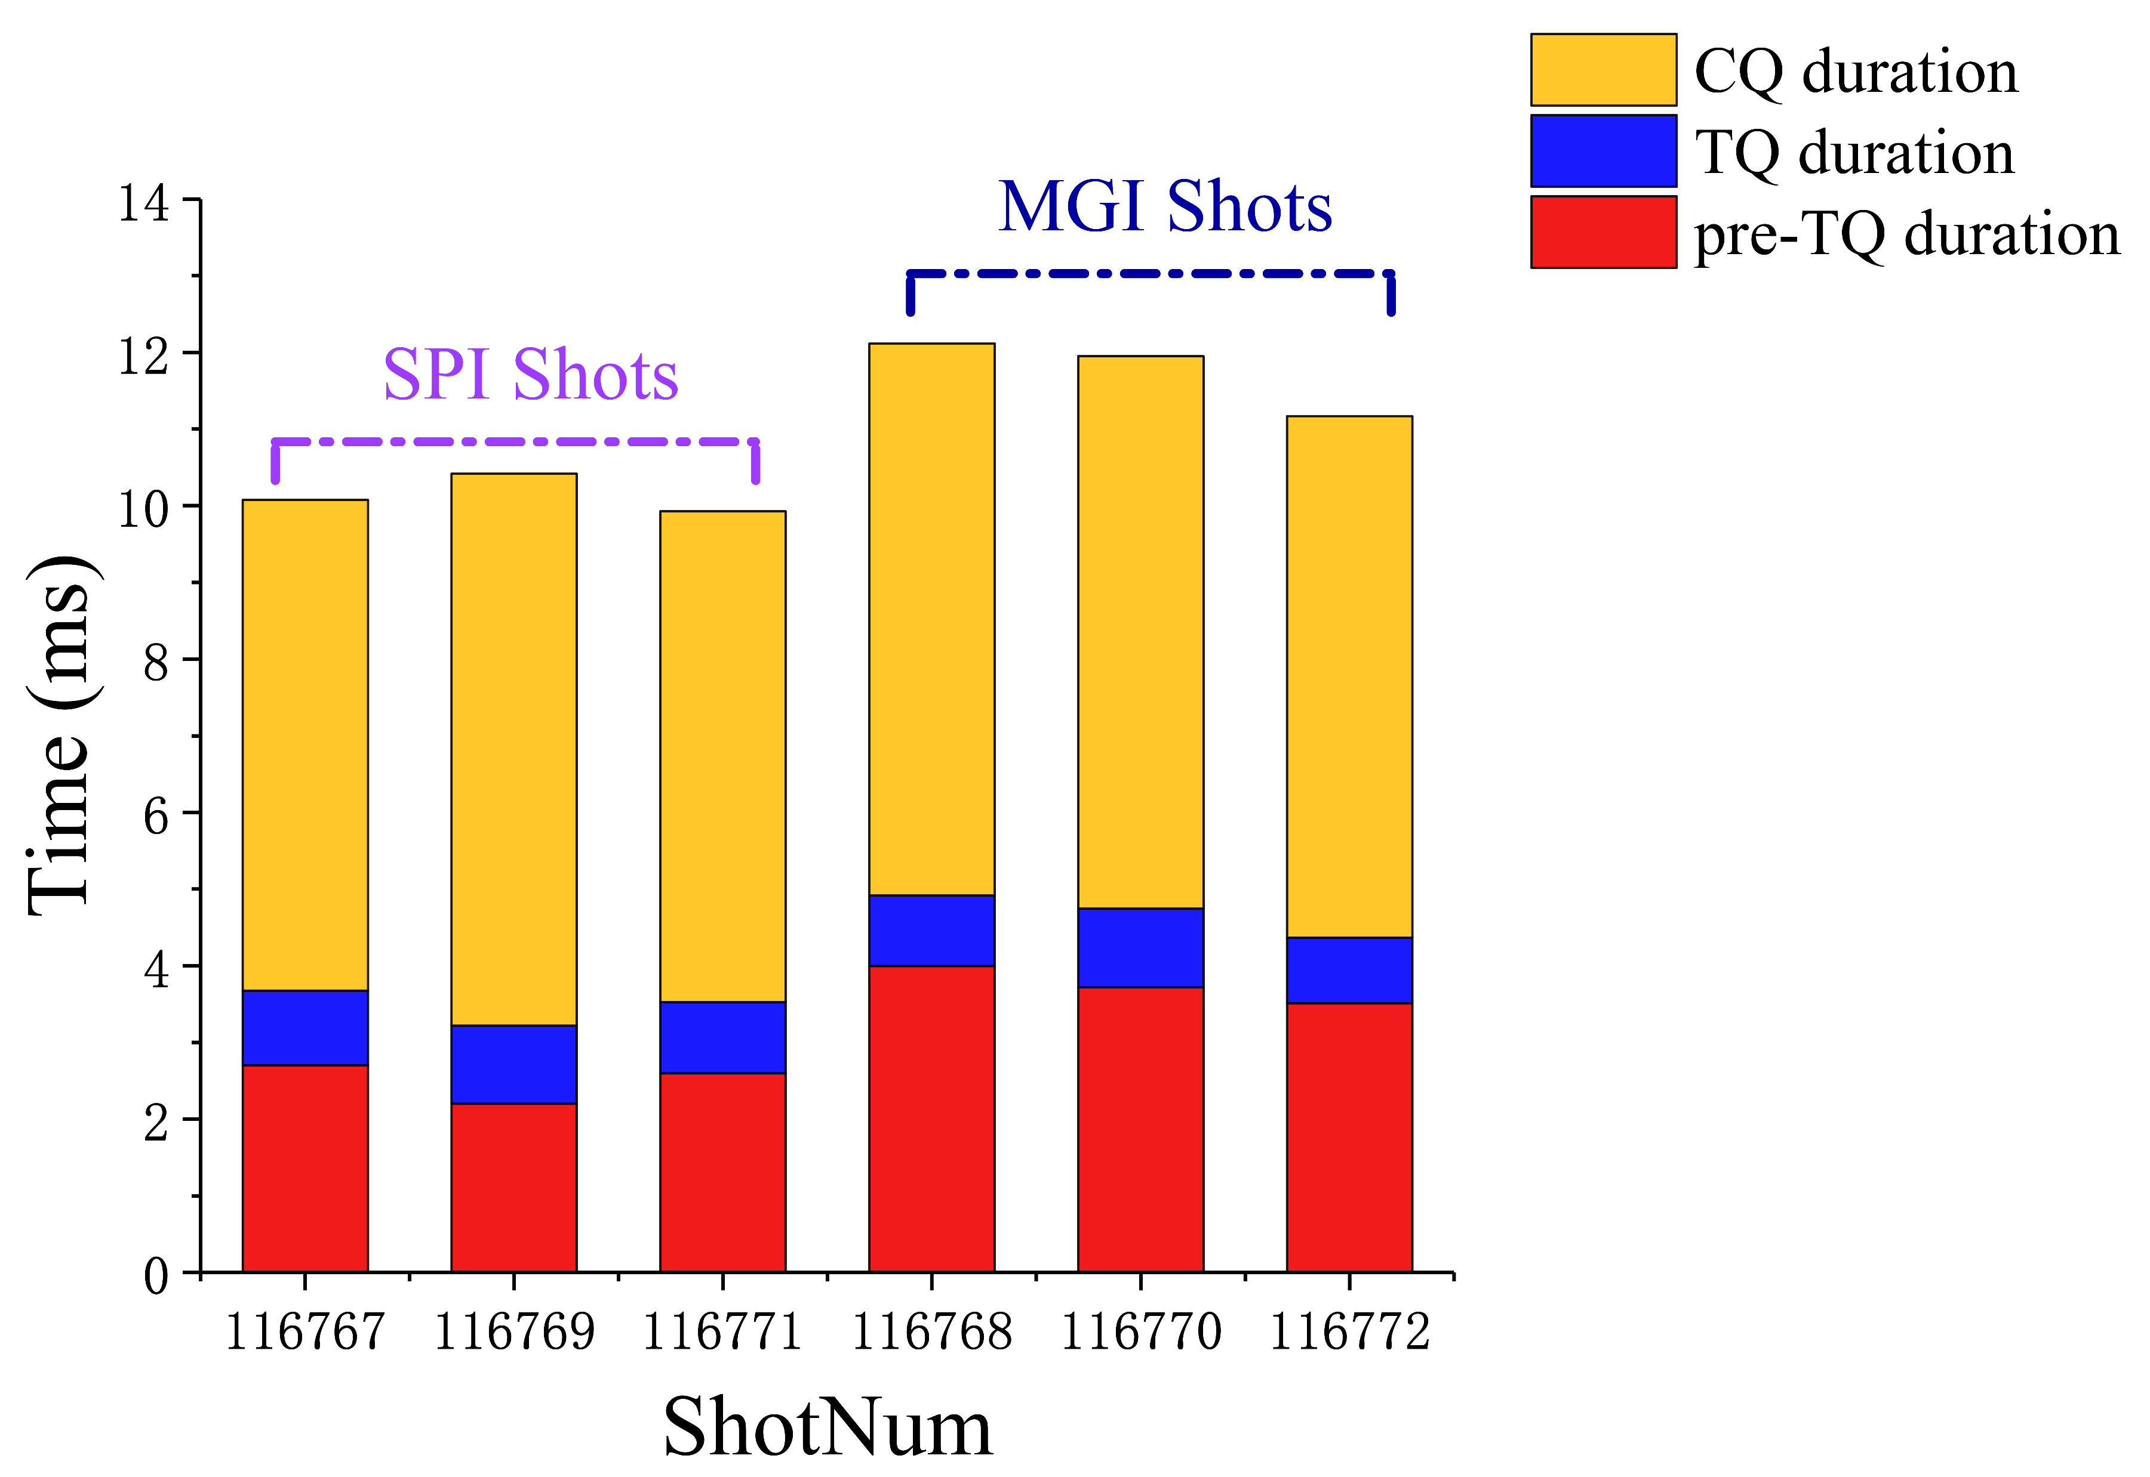
Comparison: Plasma shutdown using SPI and MGI
Plasma: I_{p}~400 kA, B_{t}~2.7 T, P_{heating}~5.1 MW, W_{dia}~155 kJ；
Similar rapid shutdown process, and SPI with shorter t_{pre-TQ} and t_{CQ}
higher core radiation, lower T_{e} and heat flux on divertor
  J.S. Yuan, et al. NF, 63 (2023) 106008;

Slide 6
Comparison: Radiation evolution using SPI and MGI
Significant increase of P_{rad} for MGI and SPI during disruption phase
  J.S. Yuan, et al. NF, 63 (2023) 106008;
Compared to MGI, SPI a has more uniform poloidal radiation distribution
Higher radiation peak for SPI than MGI, but slightly higher total Prad energy for MGI than SPI
SPI injection closer to the plasma core and facilitating the dissipation of core thermal energy
Partial fragments of SPI still injected into the plasma during CQ phase due to larger SPI L/D (~2)

Slide 7
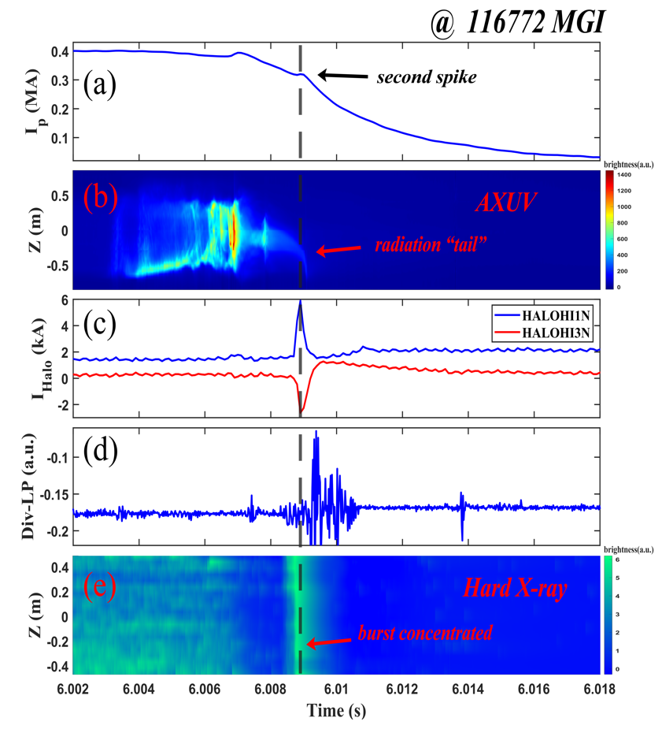
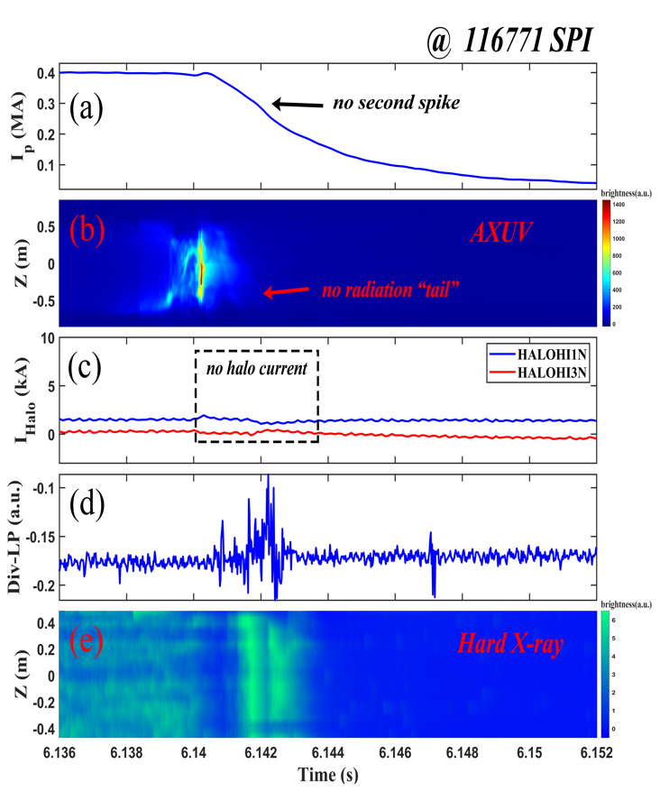
Comparison: Halo current and cold VDE using SPI and MGI
Using MGI injection, a second current spike appears together with a radiation tail, halo current generation, and hard X-ray burst.
But the SPI injection has not induced such kind second current spike. Indicating that SPI is not same as MGI to induce a cold VDE.
  S.B. Zhao, et al. NF, 65 (2025) 016048;

Slide 8
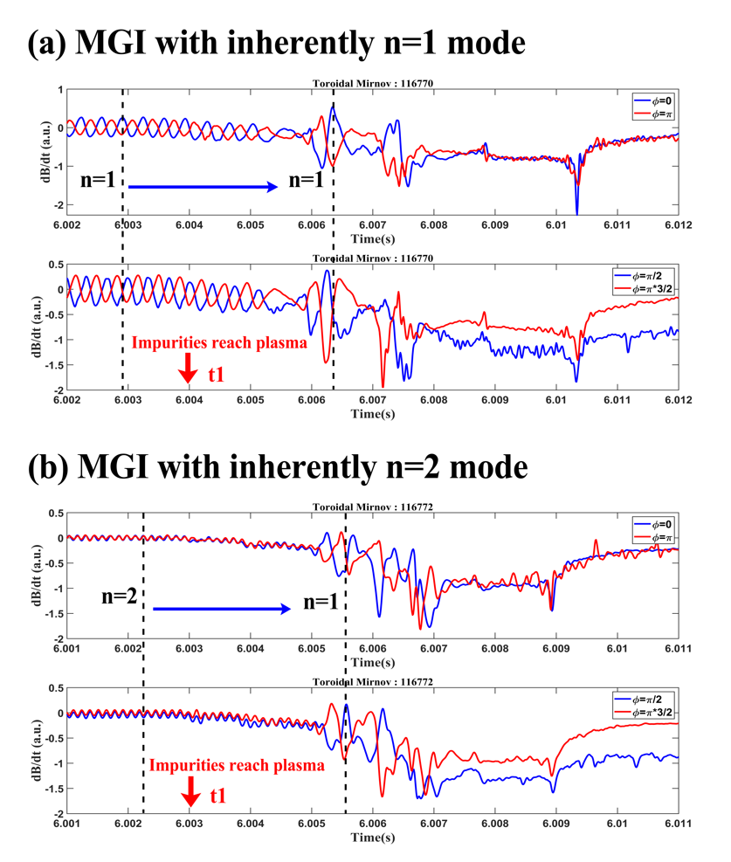
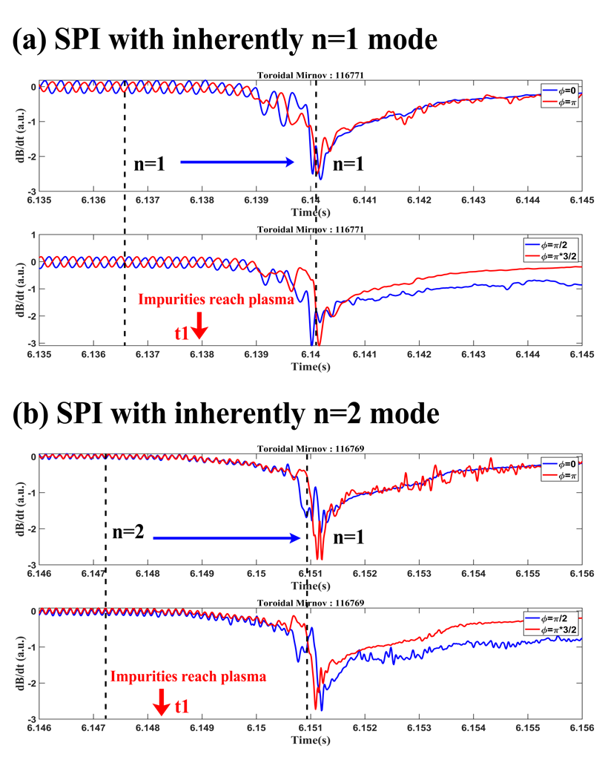
Comparison: MHD instability using MGI and SPI
After impurity injection—either by MGI or SPI—both the inherent n =1 or n=2 mode transforms into a new n=1 mode with larger amplitude, longer period
  S.B. Zhao, et al. NF, 65 (2025) 016048;

Slide 9
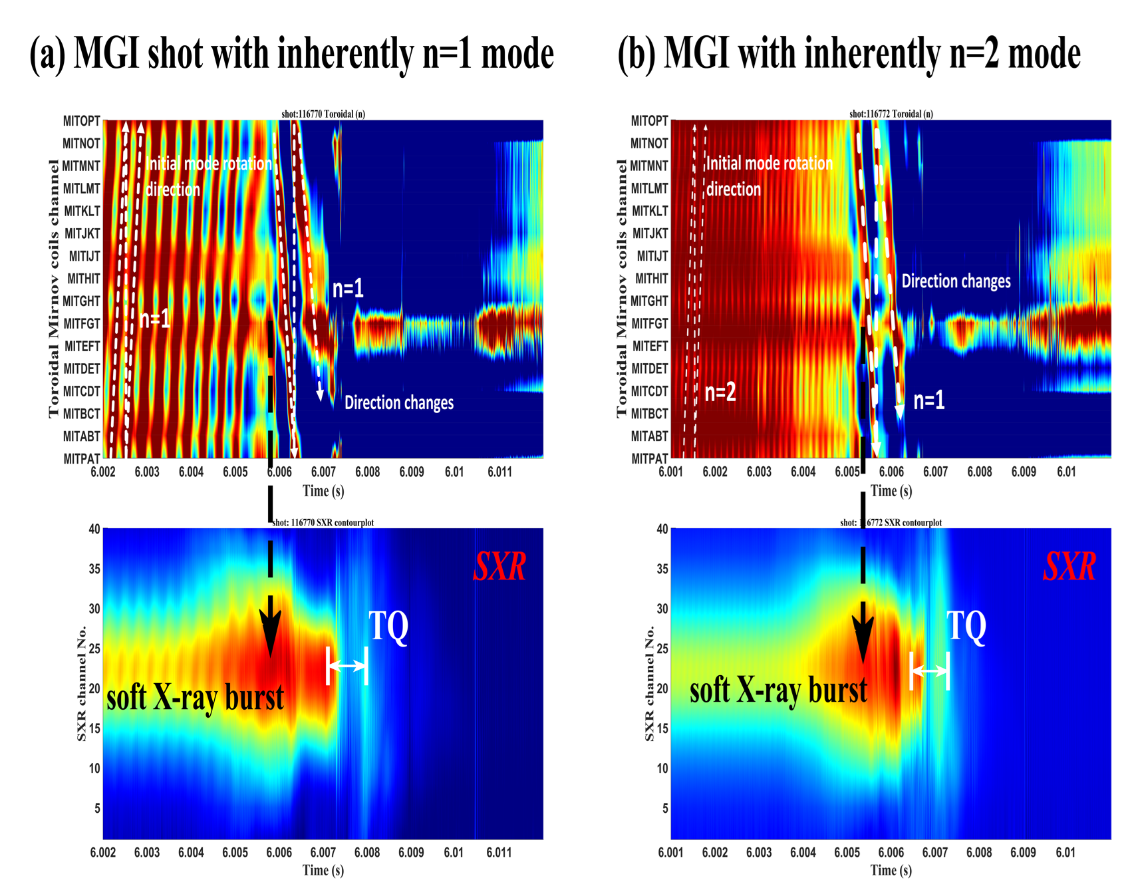
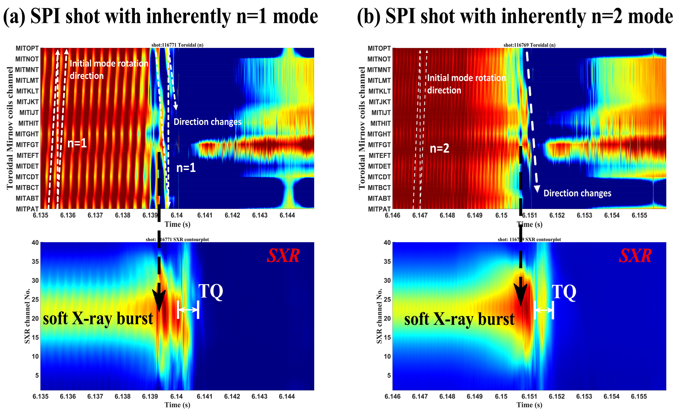
Comparison: MHD instability using MGI and SPI
The transformed n=1 mode reversed rotation direction, accompanied by strong bursts of soft X-ray.
Indicating MHD mode transition is driven by impurity–plasma interactions rather than the specific injection method.
  S.B. Zhao, et al. NF, 65 (2025) 016048;

Slide 10
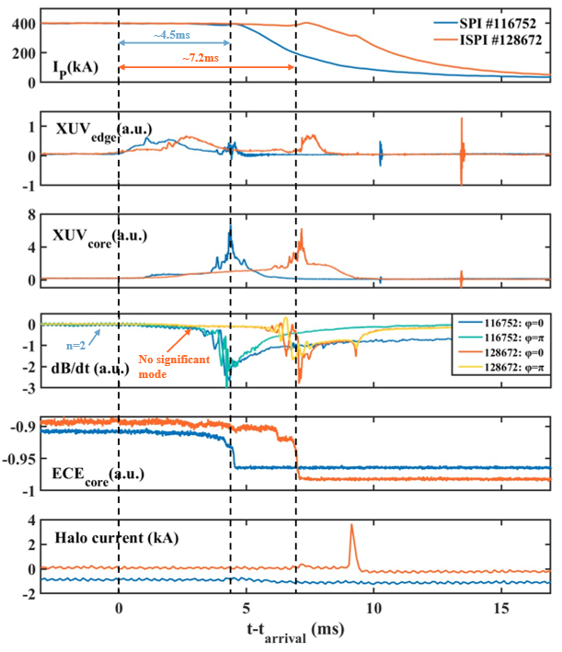
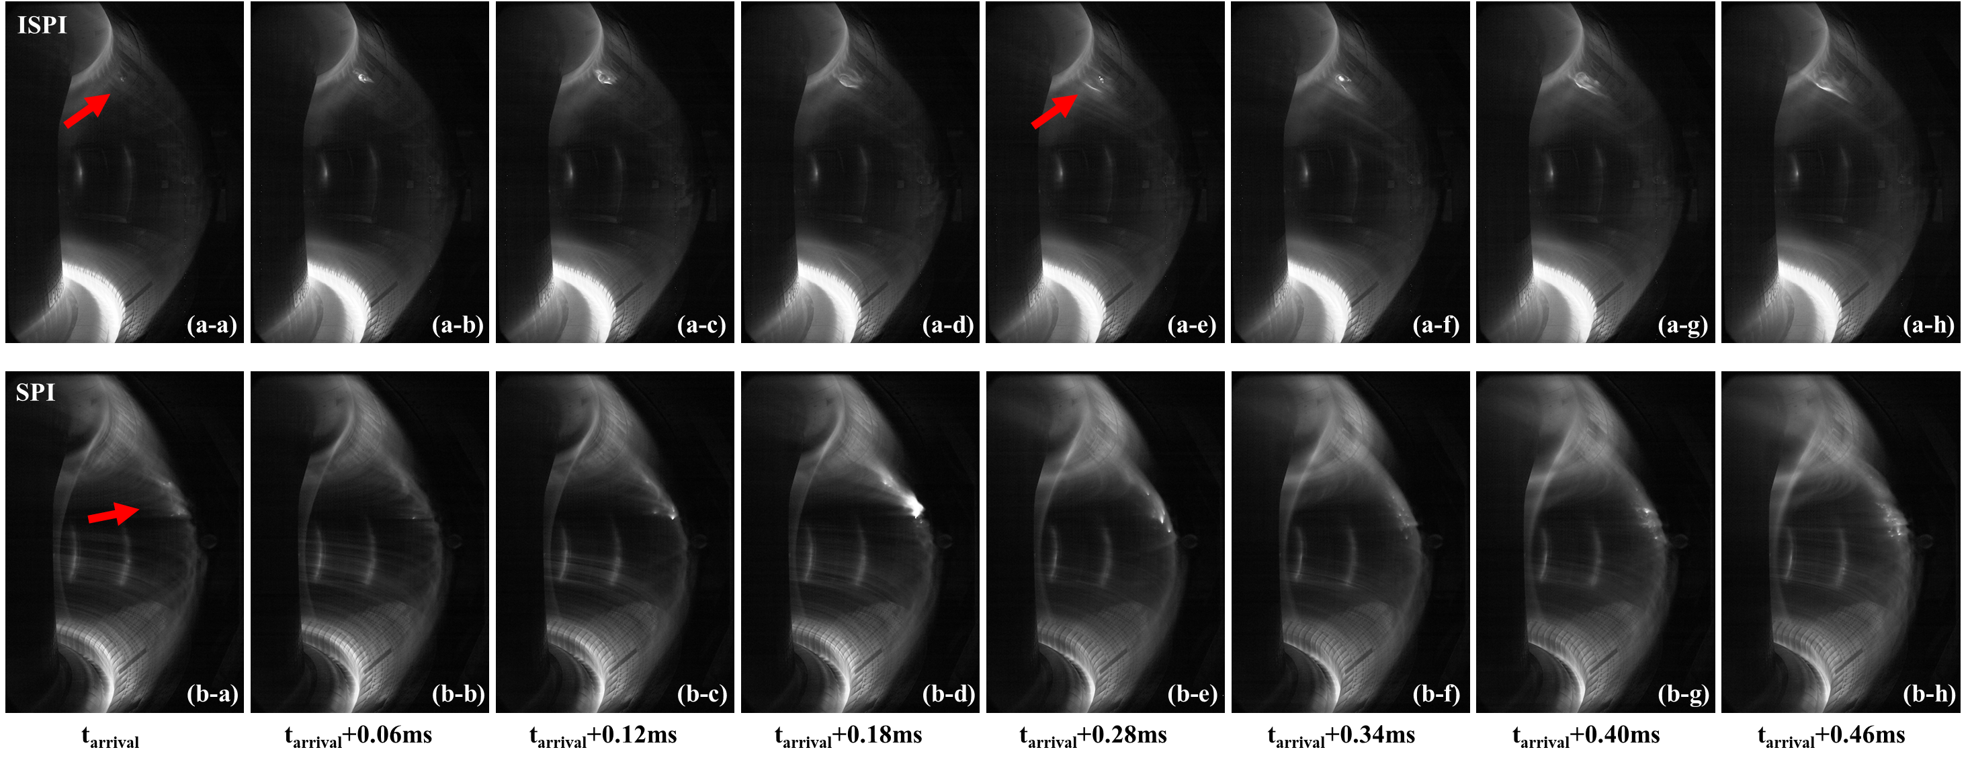
Comparison: Disruption Characteristics using SPI and ISPI
Plasma: I_{p}~400 kA, B_{t}~2.7 T, P_{heating}~5.1 MW, W_{dia}~150 kJ
ISPI: Ne~7 Pa· m³，v~280 m/s and ~160 m/s
ISPI (Insufficiently Shattered Pellet Injection, straight tube ) has larger fragments, slower ablation by CCDs
ISPI cause a longer pre-TQ, a faster CQ decay, and a stronger halo current, compared to SPI
  L. Li, et al. NF, 65 (2025) 086012;

Slide 11
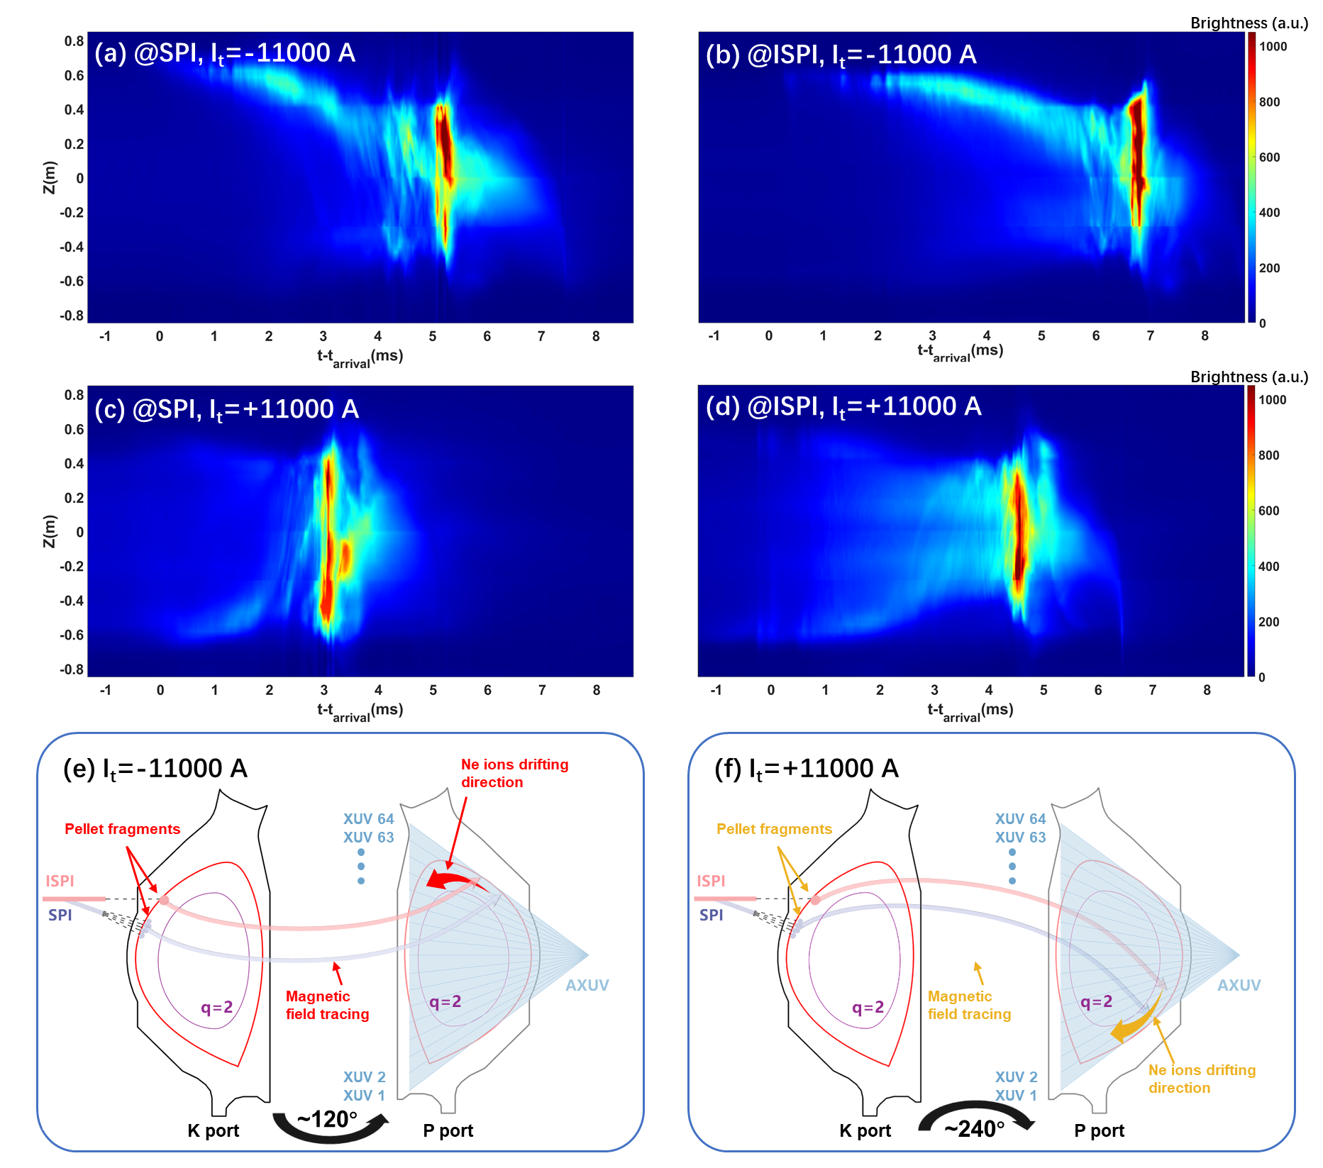
Comparison: Radiation Evolution using SPI and ISPI
Different I_{t} caused AXUV changes: pattern depends on rotation path and E×B drift
ISPI seems has a longer pre-TQ and a more uniform poloidal radiation, possibly due to larger segment and long ablation
  L. Li, et al. NF, 65 (2025) 086012;

Slide 12
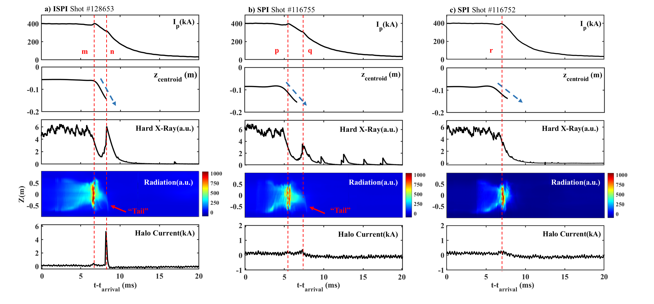
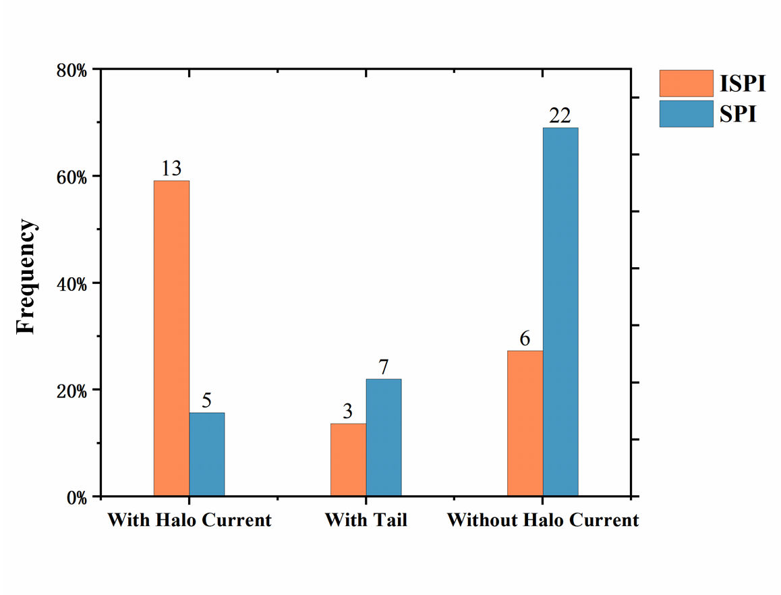
Comparison: Halo Current using SPI and ISPI
Three type halo current during CQ after SPI or ISPI
Second current spike, strong hard X-ray, a radiation tail, strong halo current (No halo mitigation).
Second current spike, but weak and small sparks hard X-ray, small halo current tails(Partial halo mitigation).
No second spike no clear hard X-ray, no tail, and no halo current (full halo mitigation).
  L. Li, et al. NF, 65 (2025) 086012;
SPI has a higher probability to mitigate halo current than ISPI

Slide 13
Comparison: Influence of SPI and ISPI Parameters
  L. Li, et al. NF, 65 (2025) 086012;
Clear negative correlation: Pre-TQ vs velocity, CQ vs injected particles
ISPI easily cause a longer Pre-TQ and a faster CQ than SPI

Slide 14
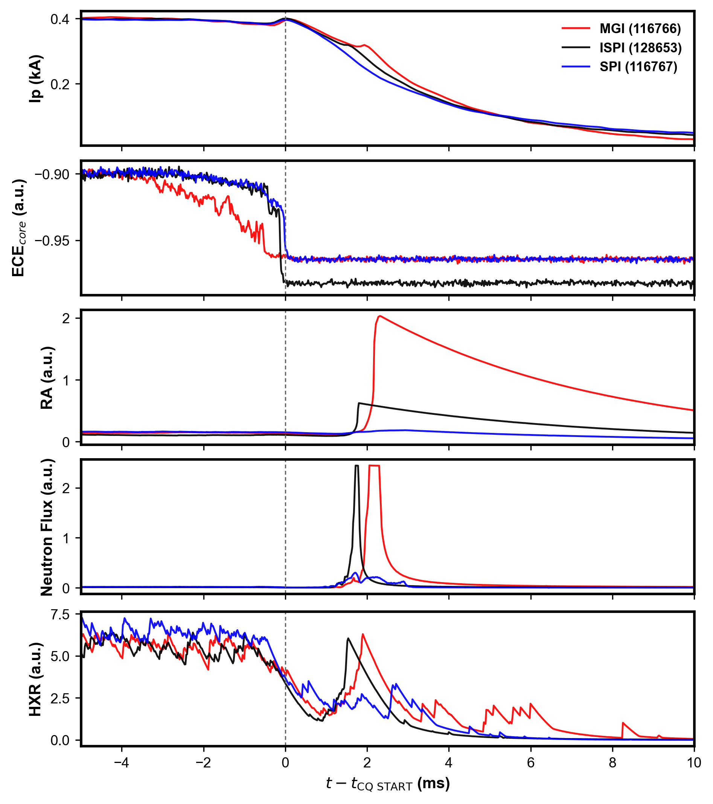
Comparison: Runaway electrons using MGI&SPI@ISPI
MGI produces the strongest RA and neutron burst, indicating the most intense prompt neutron response
ISPI shows a strong CQ-time HXR/neutron response, but the HXR signal decays rapidly after CQ onset
SPI exhibits the weakest RA and neutron response, with a relatively lower post-CQ HXR level

Slide 15
Summary
Disruption mitigation using SPI(ISPI) and MGI have been investigated in EAST with full metal walls
  Further verified the superiority using SPI than MGI: higher core radiation, lower Te and heat flux on divertor; more uniform poloidal radiation distribution
  SPI enables rapid core cooling without cold VDE risks, while both SPI and MGI trigger similar MHD mode transitions with reversed rotation and core soft X-ray bursts
  ISPI’s larger, compact fragments ablate more slowly, causing longer pre-TQ, faster CQ, stronger halo current, and also more uniform TQ poloidal radiation
Mitigation method | Pre-TQ | TQ | CQ
 | t_{pre-TQ} | Poloidal radiation | CQ decay | halo current
SPI | Mod. | Mod. | Mod. | Max.
ISPI | Min. | Max. | Max. | Mod.
MGI | Max. | Min. | Min. | Min.

Slide 16
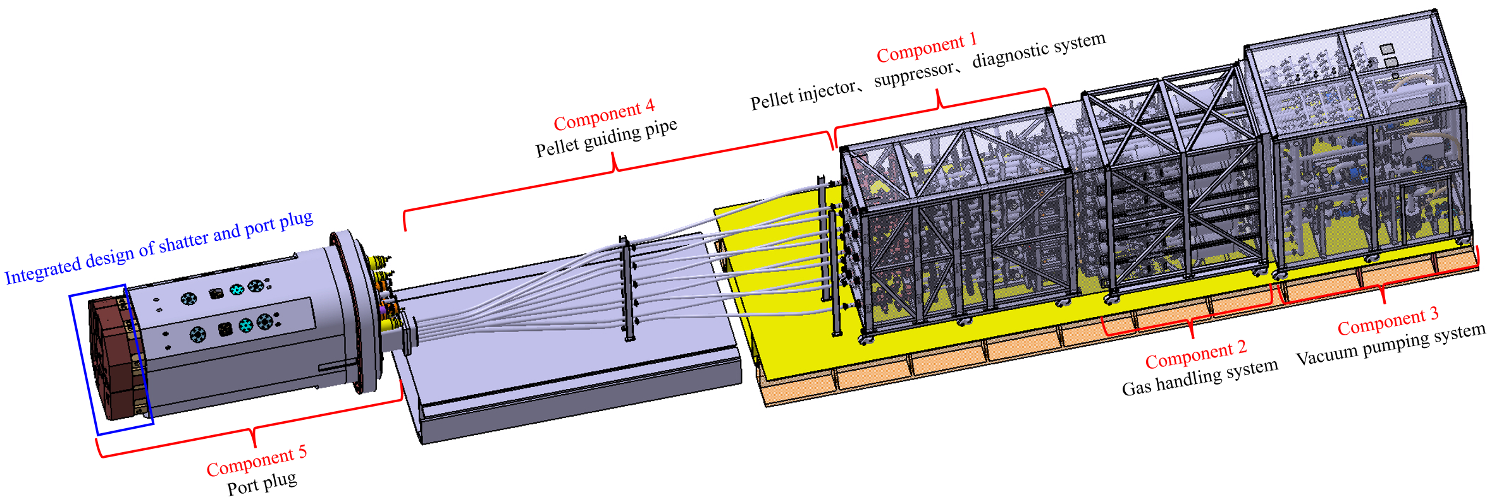
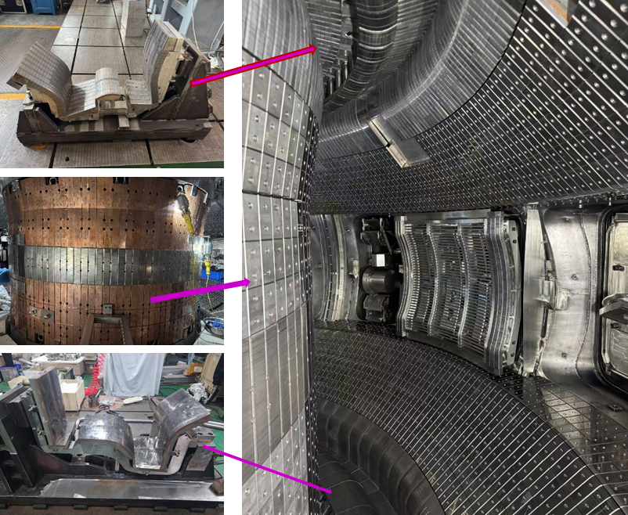
Next step
Further experiments on EAST with upgradation to full W walls
Plasmoid suppression for optimizing mixture SPI in support of ITER and BEST
RE suppression using SPI and MGI staggered injection with different timing sequence
Design of SPI for BEST

Slide 17
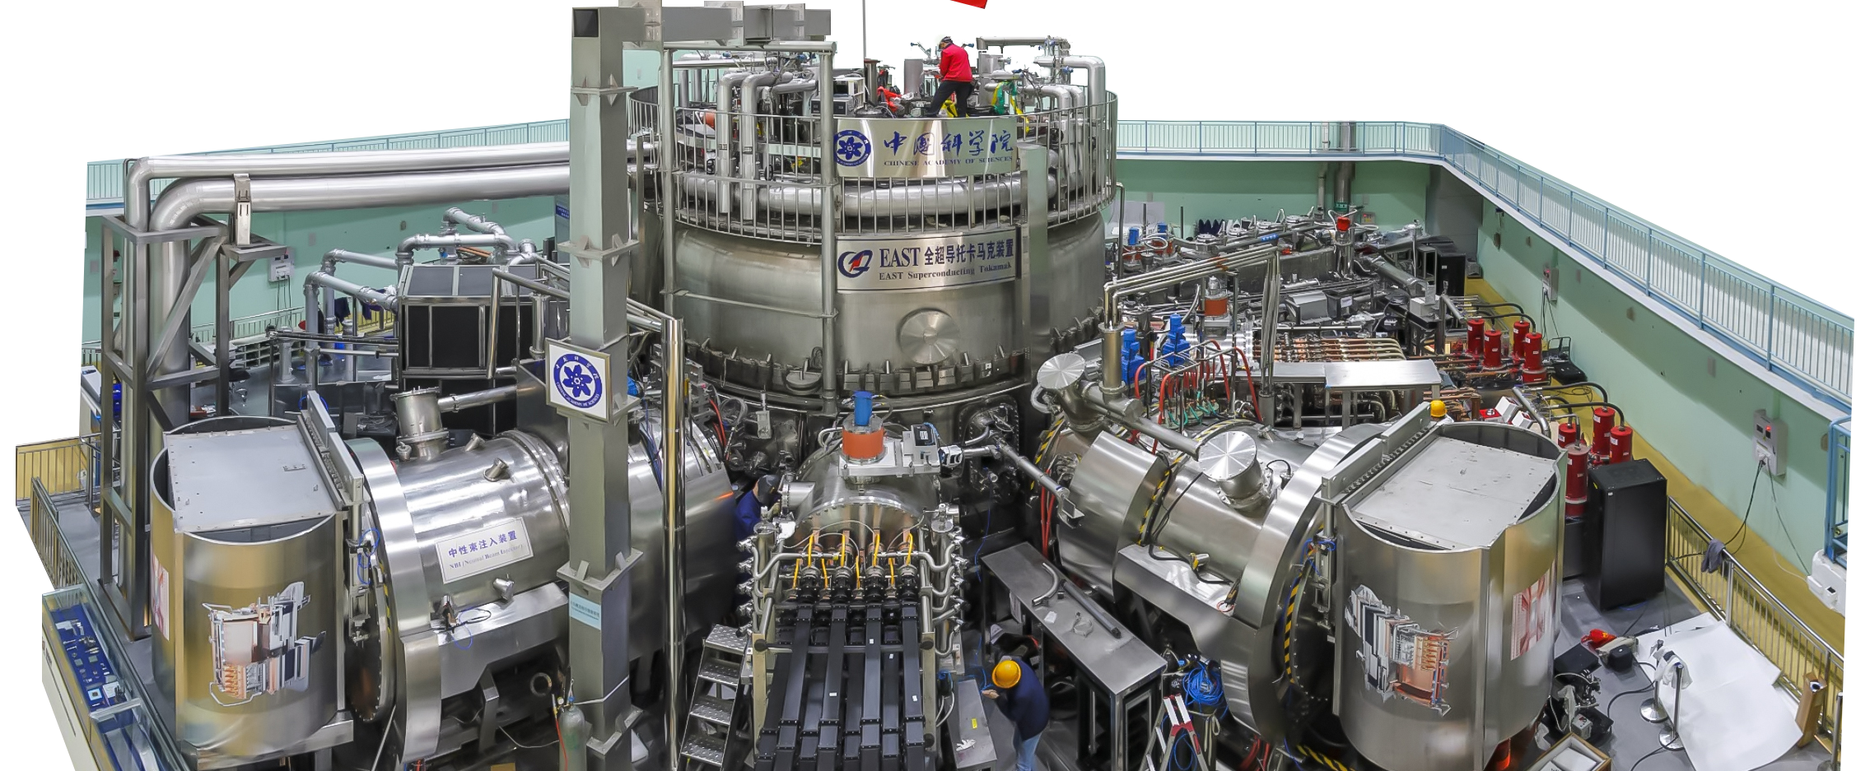
Thank you for your attention!

Slide 18
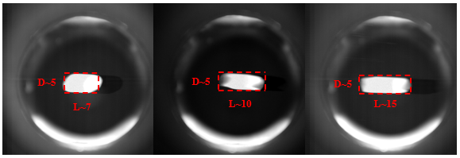
Main methods for disruption mitigation in EAST
Shattered Pellet Injection (SPI) in middle K Port
  In-situ condensation and freezing
  shatter tube position: ~20°tube (R, Z) = (2.5 m, 0.4 m), straight tube (R, Z) = (2.5 m, 0.6 m)
  a straight tube replaced in 2023, named Insufficiently Shattered Pellet Injection(ISPI)
Pellet diameter: 5mm²
Pellet length: 7-15 mm adjustable
Max. injected particles ~14 Pa· m³
Pellet velocity: 100-400 m/s
Pellet gas：H₂, Ne, H₂+Ne
  J.S. Yuan, et al. FED, 205(2024) 114551;
  J.S. Yuan, et al. FED, 191 (2023) 113567;
  S.B. Zhao, et al. JFE, (2023) 42:49；

Slide 19
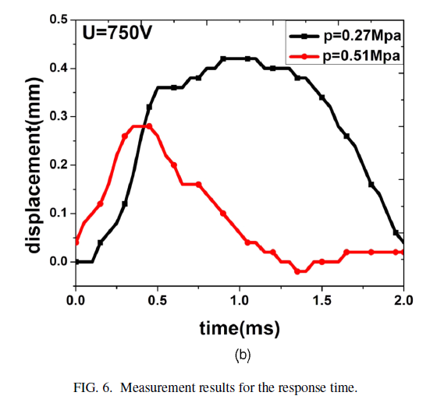
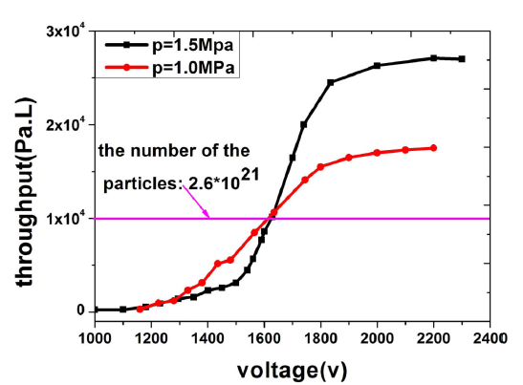
Main methods for disruption mitigation in EAST
fast Massive gas Injection (MGI)
  Eddy current drive with good electromagnetic compatibility
  Inject gas: Ne, Ar, He, etc.
  Response time: 0.15 ms
  Inject quantity: < 30 Pa· m³/s (1-4 ms)
  H.D. Zhuang, et al, PST, 15(2013) 8：745-749;
  H.D. Zhuang, et al, RSI, 86(2019) 053502;

Slide 20
Plasma disruption and its mitigation
Plasma disruption is one of the most threatening transient events in tokamak with high plasma current.
Rapid loss of plasma energy（W_{th}+W_{mag}）induce high thermal deposition, strong electromagnetic stress, and high energy runaway electrons.
Disruption mitigation
  Enlengthen TQ and CQ to reduced thermal shock and EM stress on PFCs
  Suppress/reduce RE production
  Explore effective ways: SPI or MGI
  Application in future fusion reactor with full metal walls
G.F. Matthews, et al, Phys. Scr. 16(2016), 014070

Slide 21
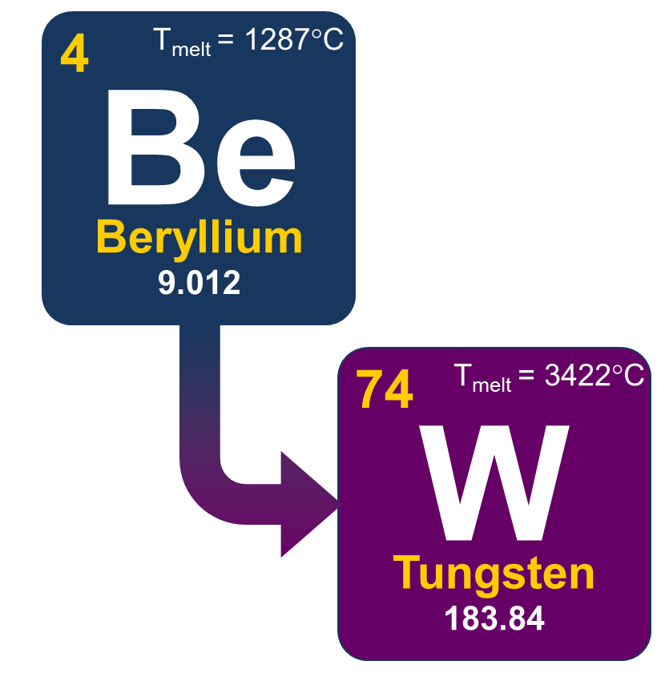
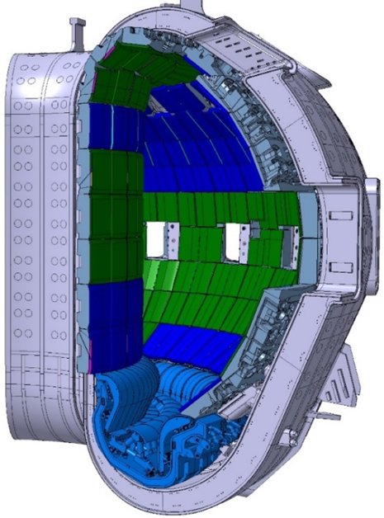
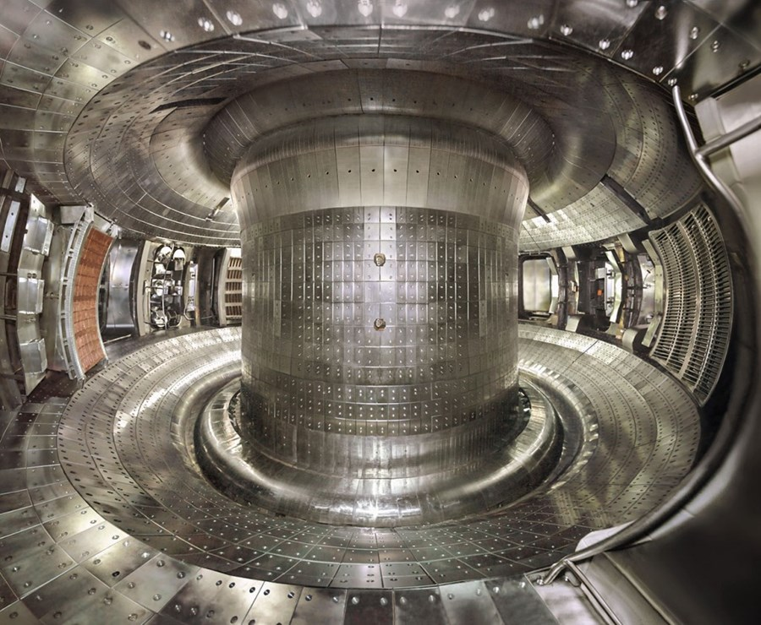
Disruption mitigation in tokamak with metal walls
Tungsten (W)
High melting point (3410℃)
Low sputtering yield
Low Tritium retention
ITER Re-baseline：
  Divertor: W
  First Wall: Be → W
R. A. Pitts, PSI-26
BEST and CFEDR designed directly using full W walls (first wall and divertor)
EAST fully superconducting tokamak
  ITER-like divertor structure
  Mo wall + Upper W div. + Lower C div. since 2014
  Mo wall + Upper W div. + Lower W div. since 2021
  W limiters since 2020
  C tiles with a small area facing NBI Penetration‌
W
Mo
W

