Slide 1
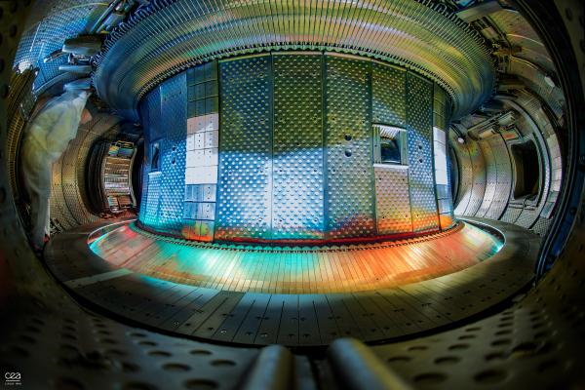
First experiments on electron density and plasma position control using X-mode real-time reflectometry, conducted on the WEST tokamak
Maylis Carrard, 3rd year PhD student
R. Sabot, Y. Moudden, R. Nouailletas, E. Lerche, and the WEST team
EPS Plasma Physics, June 29th – July 3rd of 2026

Slide 2
Outline
Real-time X-mode reflectometry measurements for control
Density and position control experiments
Application to ICRH coupling optimization
Perspectives

Slide 3
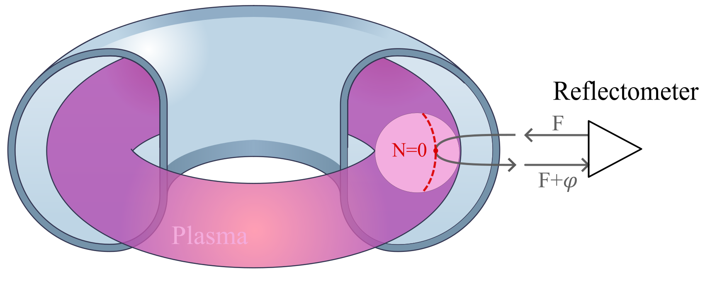
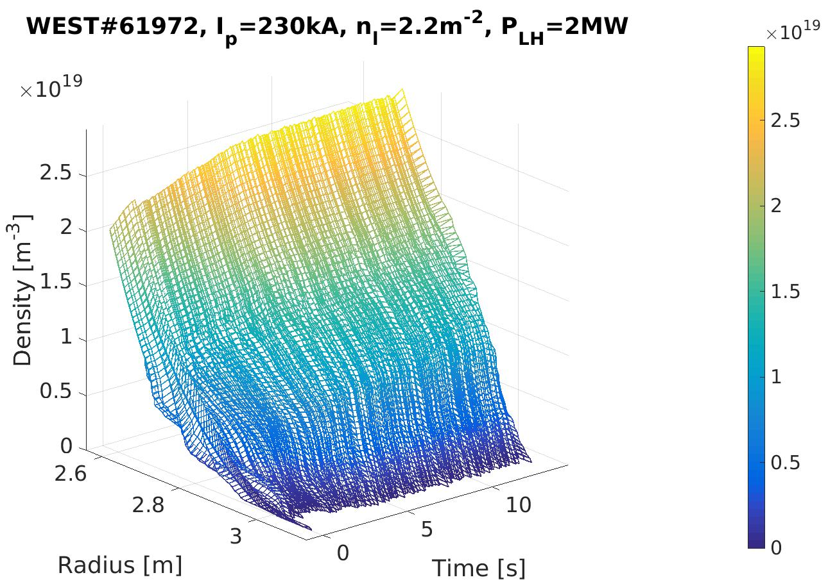
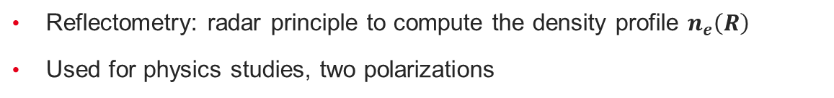
Real-time reflectometry measurements
X-mode real-time measurements
Existing edge reflectometer
New acquisition system and reconstruction algorithm
2ms time step [Carrard, PPCF 2025]
Real-time measurements for plasma control
F. Clairet, RSI, 2010.
C. Bouchand IEEE TNS, 2024
Reflectometry: radar principle to compute the density profile $n_{e}\left(R\right)$
Used for physics studies, two polarizations
Reflectometry for plasma control
Compact and flexible, suitable for reactor environment: planned for control in future devices (DEMO)
O-mode: Proof-of-concept [Santos, NF 2012], but requires external information on plasma position
X-mode: Interesting because it provides absolute plasma position

Slide 4
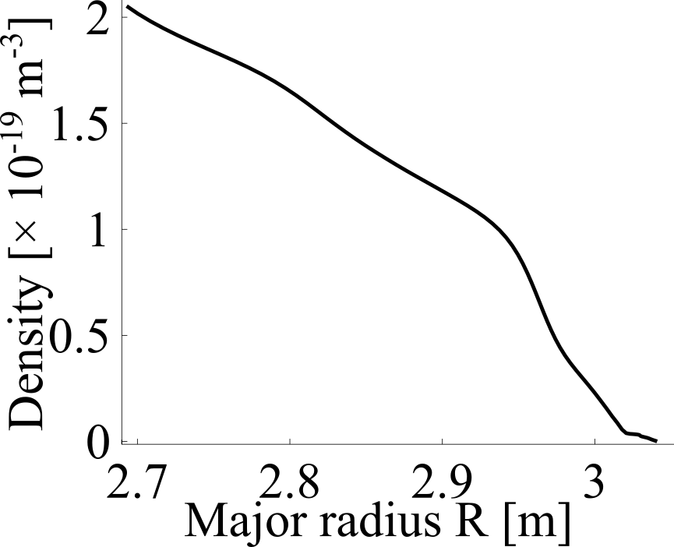
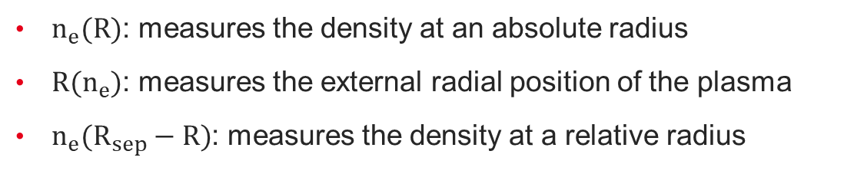
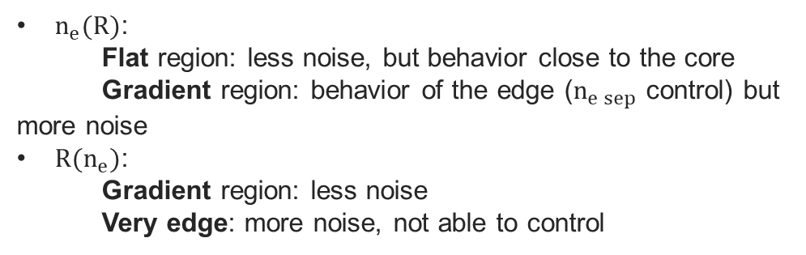
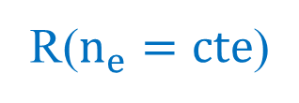
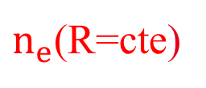
Control inputs from the real-time profiles
Requirements for the control inputs:
Measurement delay: the data processing must be fast enough; the delay from real-time averaging must be low
Measurement reliability: the noise must be low; the quantity must reflect the desired plasma behavior.
$n_{e}(R)$: measures the density at an absolute radius
$R(n_{e})$: measures the external radial position of the plasma
$n_{e}(R_{sep}−R)$: measures the density at a relative radius
$n_{e}$(R=cte)
$n_{e}(R)$:
Flat region: less noise, but behavior close to the core
Gradient region: behavior of the edge ($n_{e sep}$ control) but more noise
$R(n_{e})$:
Gradient region: less noise
Very edge: more noise, not able to control
R($n_{e}=cte$)
Balance between reliability and delay to extract useful information for specific control experiments

Slide 5
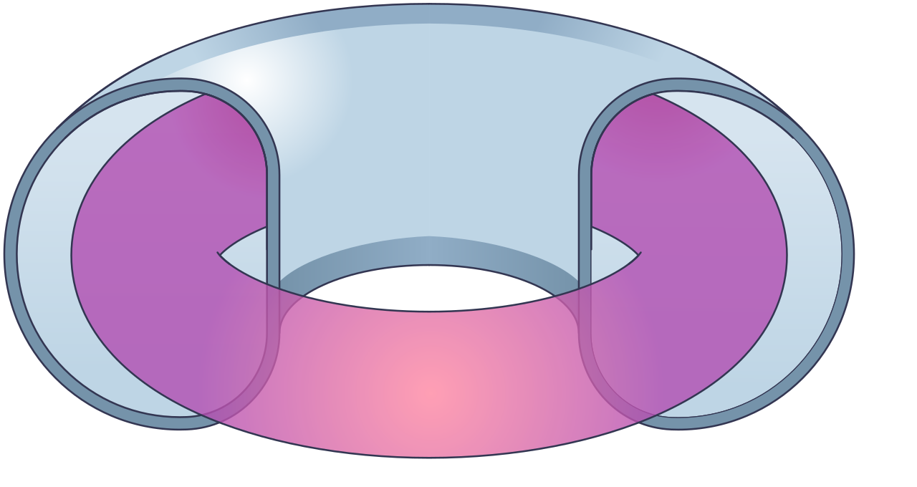
Reflectometry for control on WEST
Plasma Control System (PCS): drives the plasma discharge depending on scenario reference
Sensors (real-time diagnostics, real-time reconstruction) provide information about the plasma state
Actuators act on the plasma following the PCS requests
Reference
Sensors
WEST Plasma Control System
Actuators
Density control: Interferometry sensor ; Gas injection actuator ; Timescale ~ 40ms
Position control: magnetic reconstruction sensor ; PF coils actuators ; Timescale ~ 3ms
Novelty of this work: Use the reflectometry measurements as sensors
Edge density control validated with still plasma

Slide 6
Outline
Real-time X-mode reflectometry measurements for control
Density and position control experiments
Application to ICRH coupling optimization
Perspectives

Slide 7
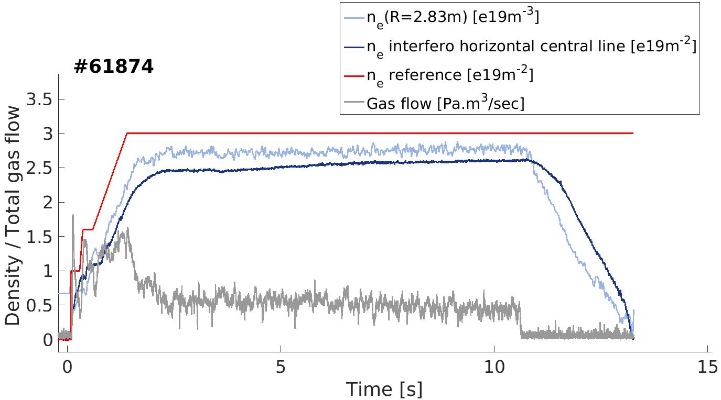
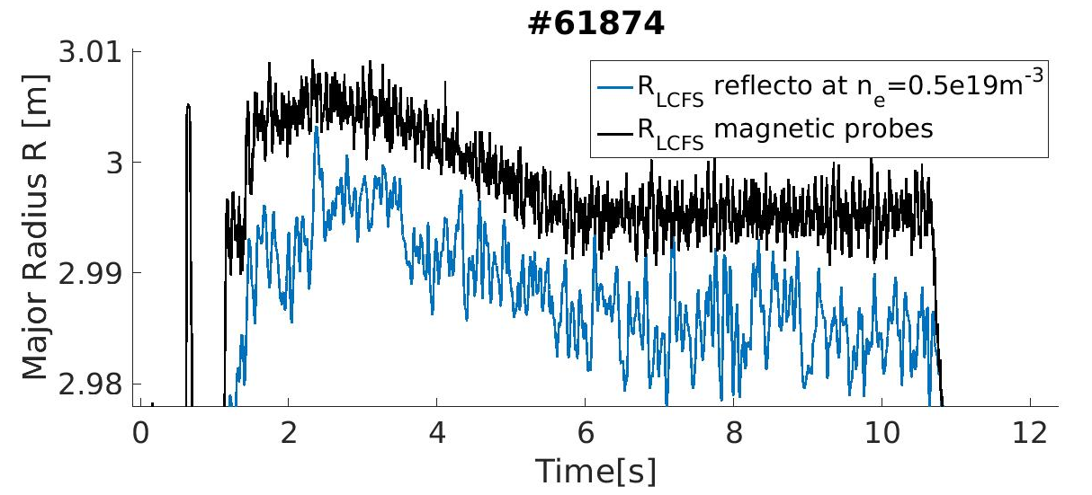
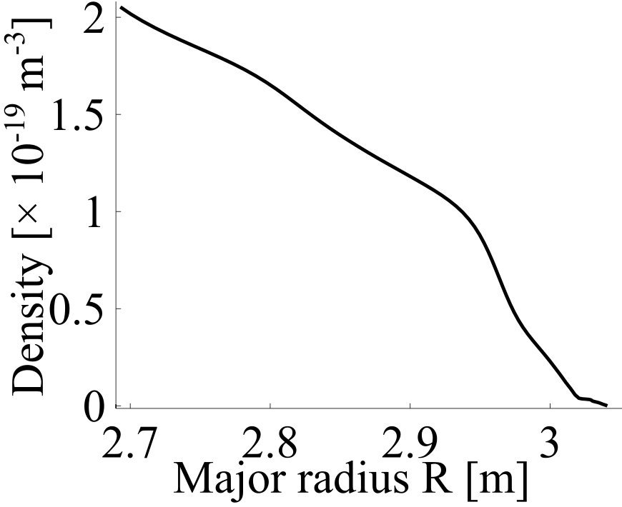
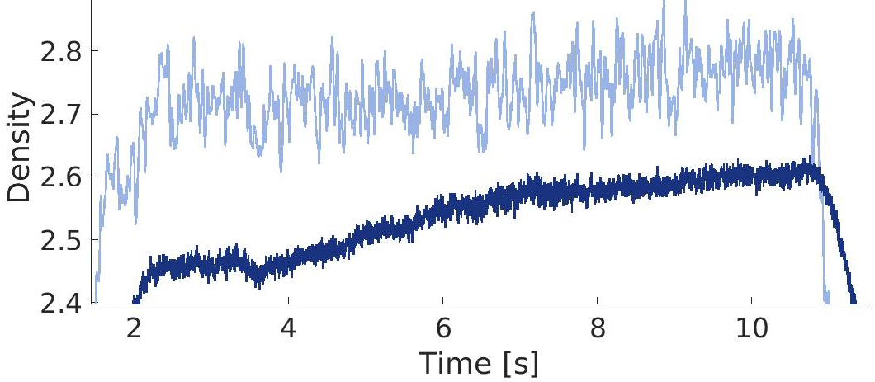

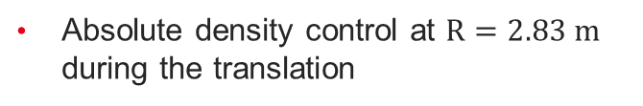
Absolute density control with plasma translation
Plasma translation of 1 cm inward
Absolute density control at $R=2.83 m$ during the translation
$$R=2.83 m$$
Control of edge density at a fixed position
Application for RF heating coupling, to move plasma without changing density in front of antennas
Overall density increases
Steepening of the gradient
Plasma translation

Slide 8
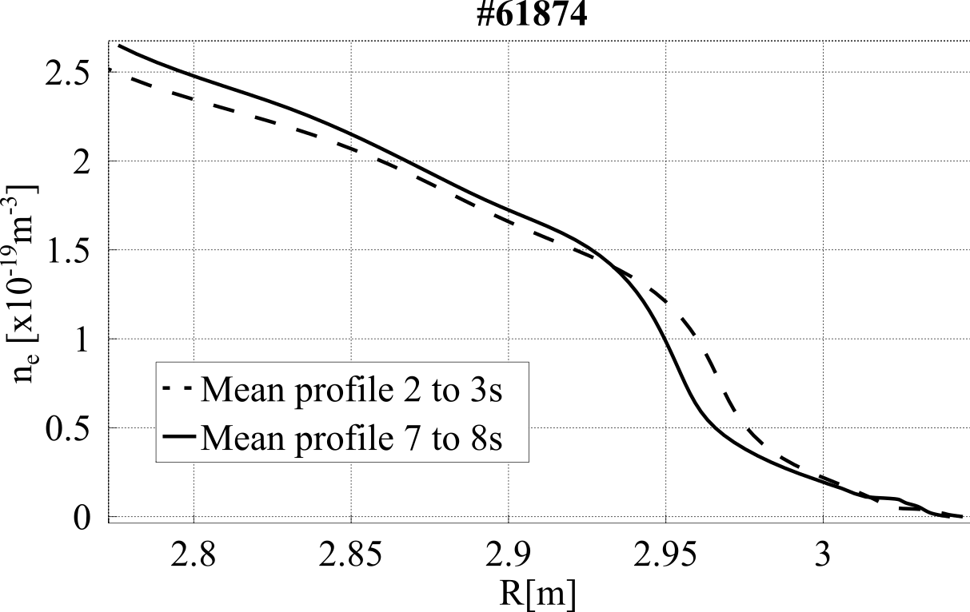
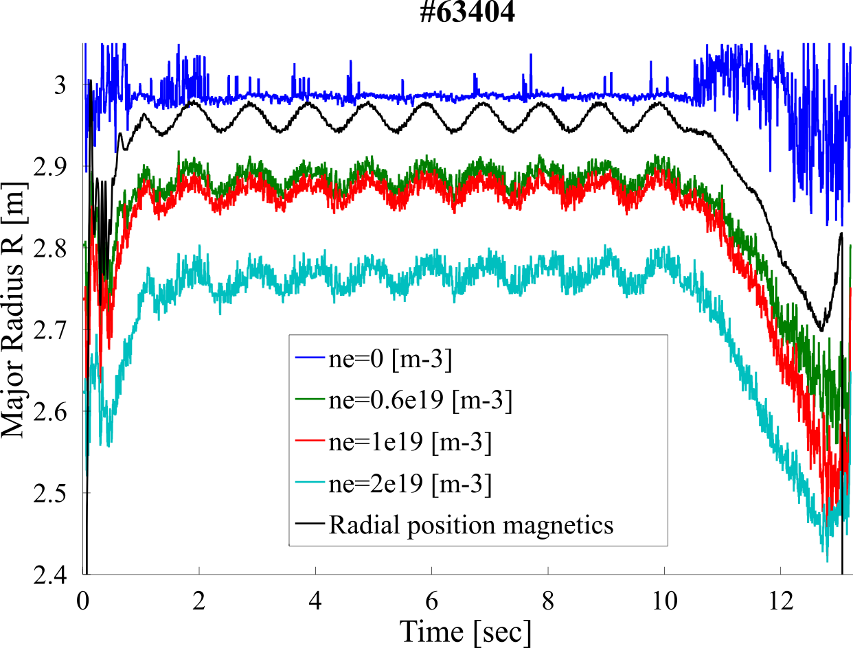

Steepening of the profile under edge density control
With edge density control
Standard interferometry control
Increase of the core density
$n_{e}\left(R=2.93m\right)=cte$
Plasma translation of 1 cm
Sinusoidal modulation of the radial position at 1Hz with a 4 cm amplitude
Quasi-rigid displacement at the time step of the diagnostics
Steepening of the profile under plasma translation and absolute density control

Slide 9
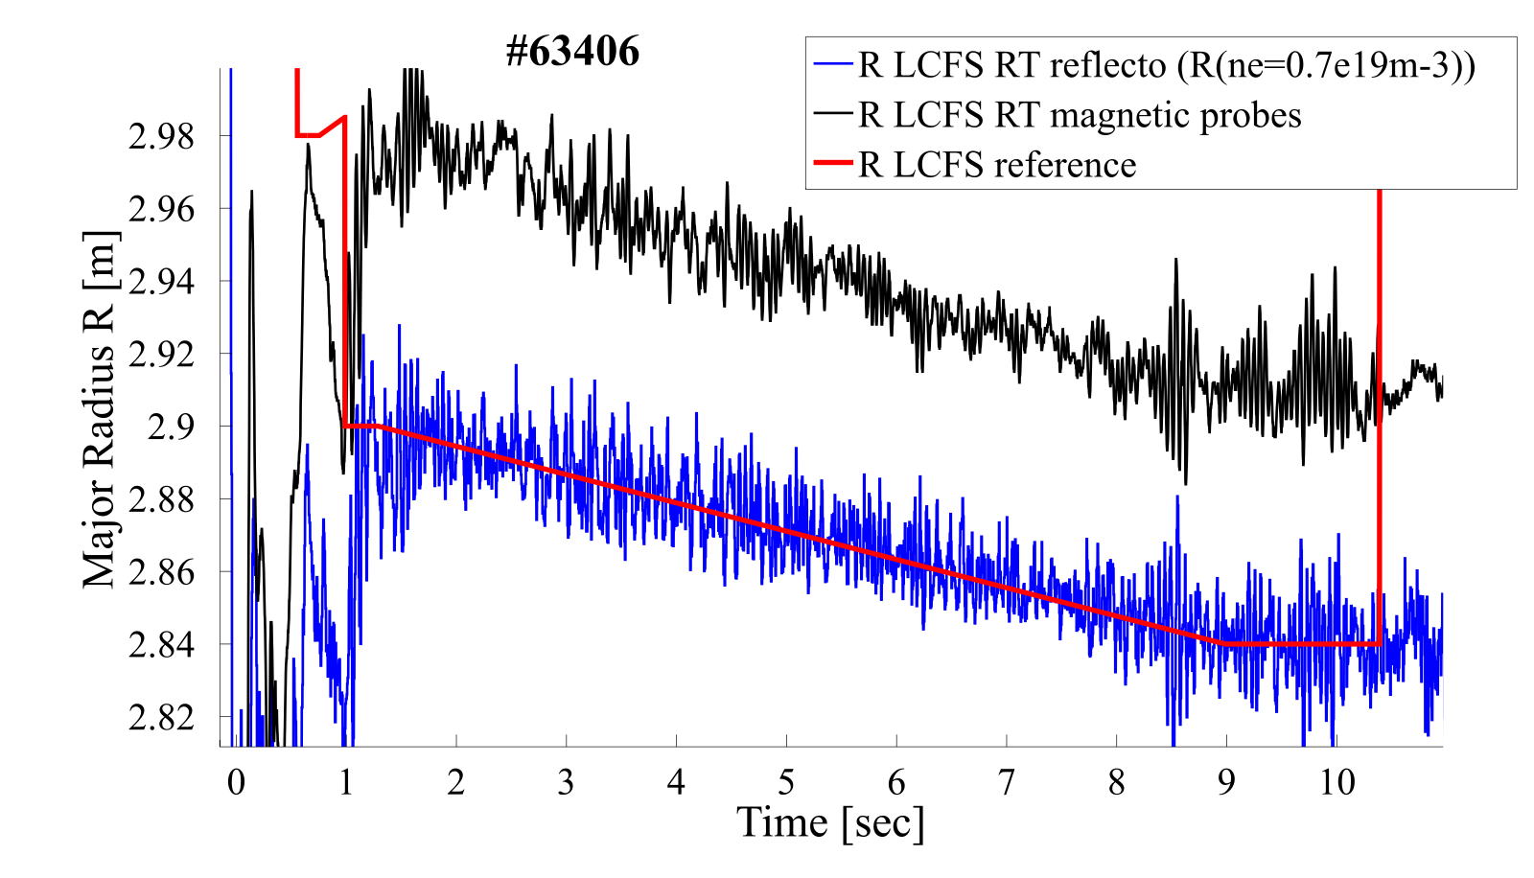
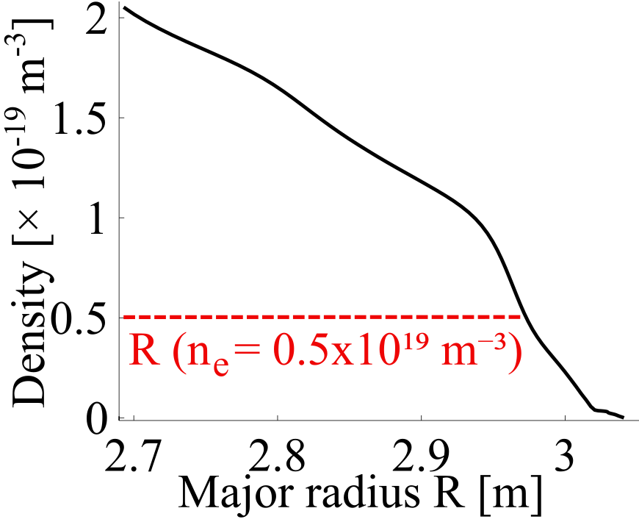

Plasma position control
$R_{ext}$ control at $n_{e}=0.5e19 m^{−3}$
First experiment:
Unstable position control (huge oscillation on the measurements)
Issue: 50 ms delay between magnetic and reflectometry measurement
Solution: Reach the standard magnetics measurement delay of 3 ms (optimize data processing/transfer and reduce delay induced by the averaging)
Second experiment:
Stable control (more noise because reduction of the averaging number)
Validation of plasma position control with X-mode reflectometry

Slide 10
Outline
Real-time X-mode reflectometry measurements for control
Density and position control experiments
Application to ICRH coupling optimization
Perspectives

Slide 11
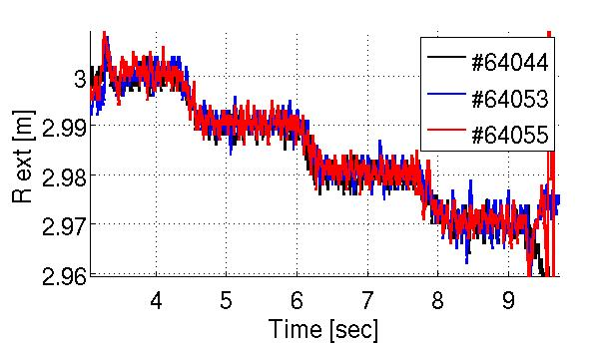
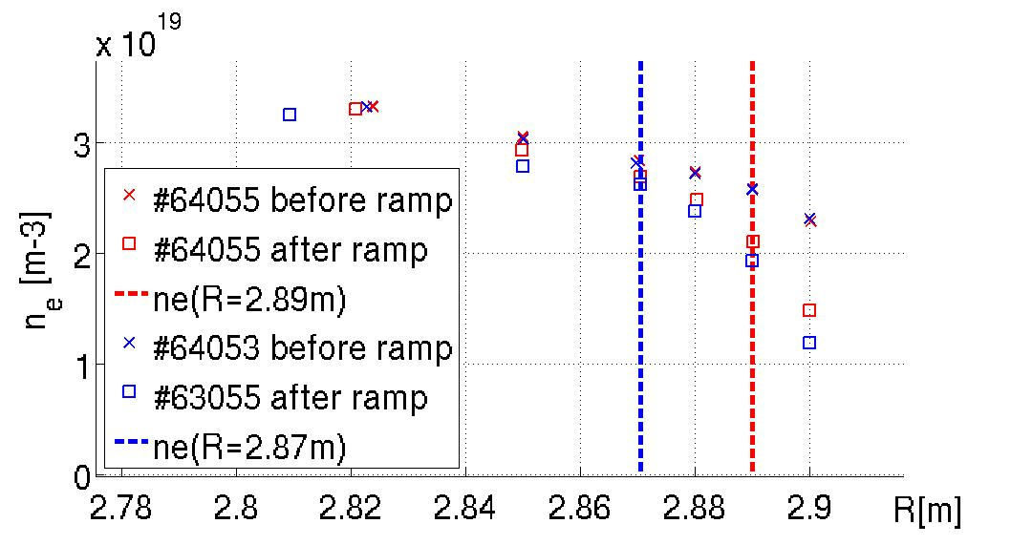
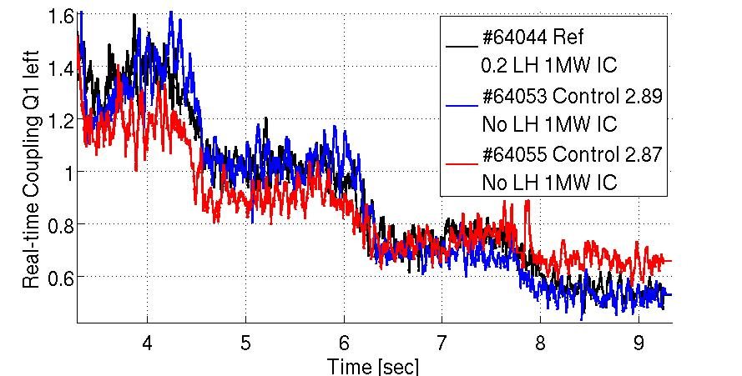

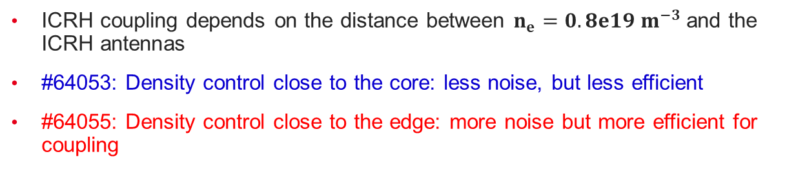
ICRH coupling optimization via the cutoff density
ICRH coupling depends on the distance between $n_{e}=0.8e19 m^{−3}$and the ICRH antennas
#64053: Density control close to the core: less noise, but less efficient
#64055: Density control close to the edge: more noise but more efficient for coupling
$$n_{e}=0.8e19 m^{−3}$$
Preliminary results: Positive effect on the ICRH coupling.
Hence, improvement of plasma response and control strategy:
Adjust the plasma scenario to increase the sensitivity of the coupling to the edge density – Local valve instead of top valve
Improve signal properties and tune the controller

Slide 12
Outline
Real-time X-mode reflectometry measurements for control
Density and position control experiments
Application to ICRH coupling optimization
Perspectives

Slide 13
Conclusions and perspectives
Conclusions:
Development of real-time X-mode reflectometry measurements
Validation of density and position control with X-mode
Encouraging results on ICRH coupling control
Upcoming experiments:
ICRH/LH coupling optimization (experiment in progress)
Density control with pellets (strong gradient; profile reliability )
Density gradient control with pellets for the core and the gas puff for the edge
Further development:
Interferometry fringe jump correction
Control with multi-diagnostics profile reconstruction
Use in multi-diagnostics fast events detection: LH transition, MHD mode, ELMs…
Control the density gradient to optimize edge transport

Slide 14
Thank you
Maylis Carrard, 3rd year PhD student
R. Sabot, Y. Moudden, R. Nouailletas, E. Lerche, and the WEST team
EPS Plasma Physics, June 29th – July 3rd of 2026

Slide 15
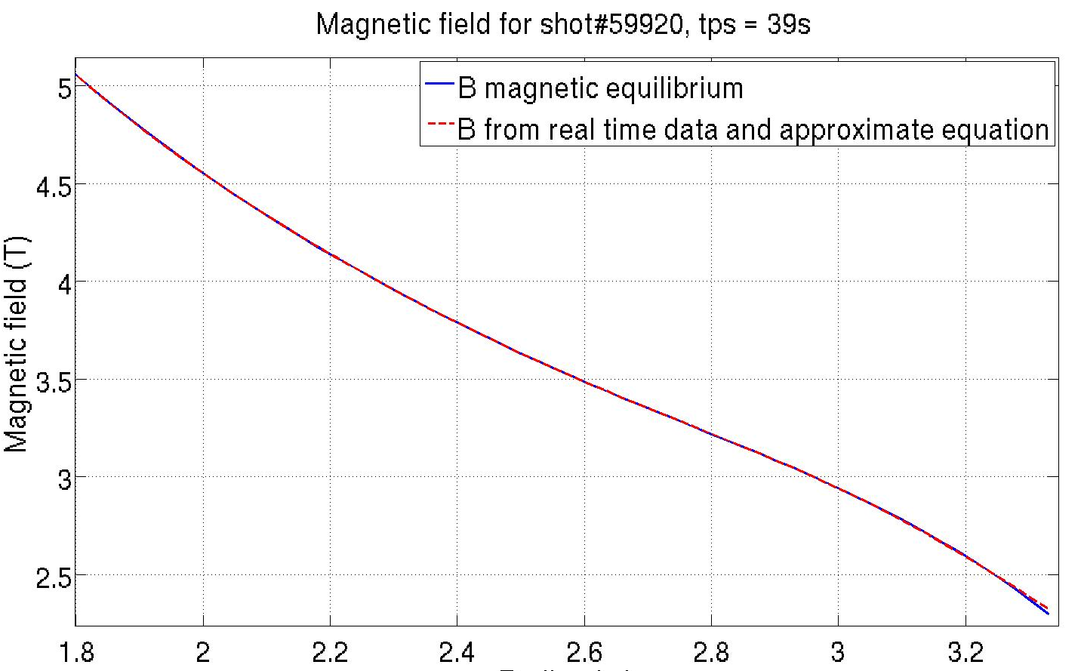
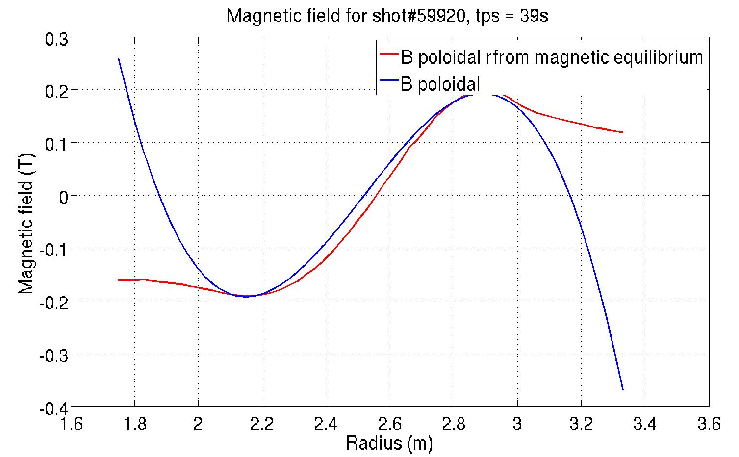
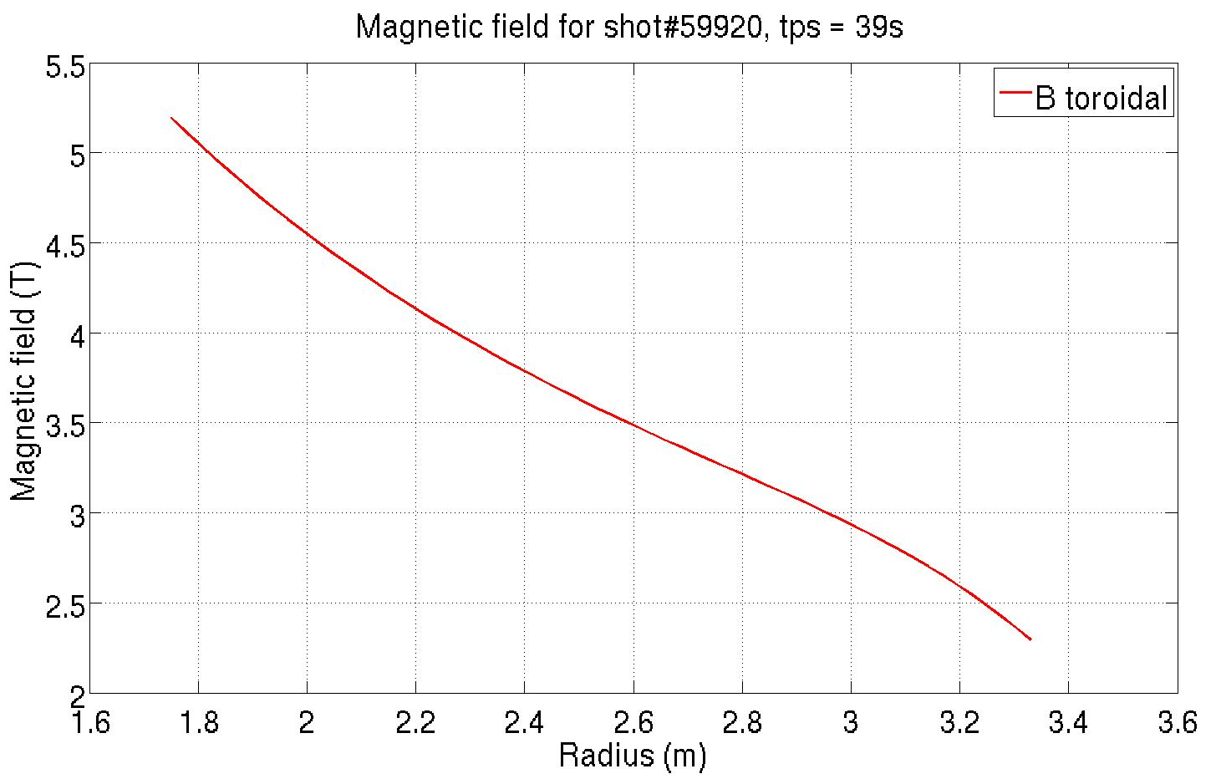



Real-time magnetic field
Toroidal field:
Normalized reference $B_{ref}$, real-time data $I_{tor}$
$$B_{tor}=B_{ref}∗I_{tor}$$
Poloidal field:
Real-time data $I_{p }$, $R_{tr}$ , a and approximated equation
$$B_{pol}= \frac{μ_{0 }∗I_{p }}{2 π}∗\frac{{\left(1 − \frac{{{(R}_{tr}−R_{0})}^{2}}{a^{2}}\right)}^{1+ ν}}{{(R}_{tr}−R_{0})}$$
$B_{tot}^{2}=B_{tor}^{2}+B_{pol}^{2}$
Total magnetic field, shot 59920, tps=39s
5
4
3
2
Poloidal magnetic field, shot 59920, tps=39s
Magnetic field(T)
Toroidal magnetic field, shot 59920, tps=39s
5
4
3
2
0.2
0.1
0
-0.1
-0.2
Magnetic field(T)
Magnetic field(T)
Radius (m)
Radius (m)
Radius (m)

Slide 17
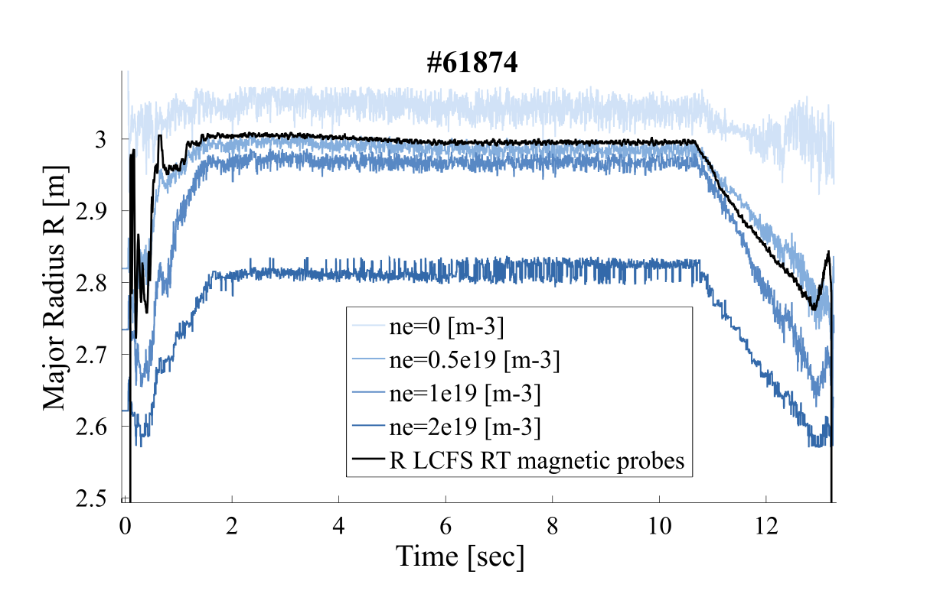
Choice of the sensors
ne
R

Slide 18
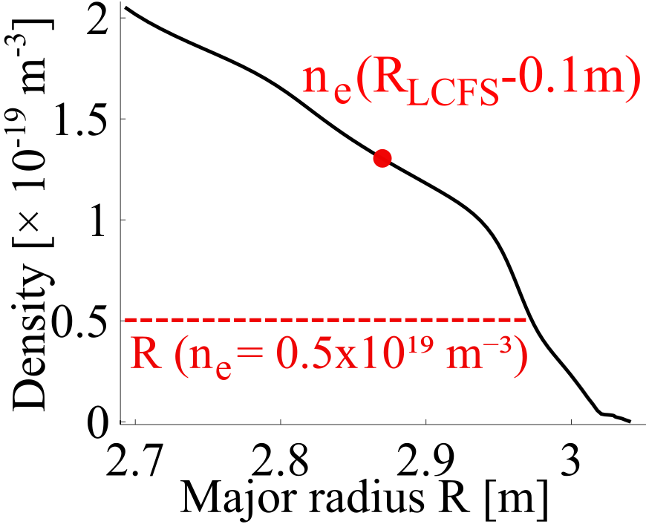
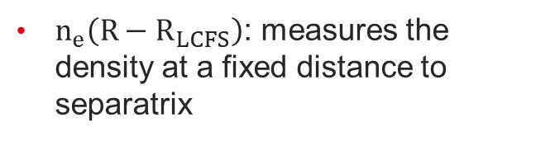
Choice of the sensors
$n_{e}\left(R−R_{LCFS}\right)$: measures the density at a fixed distance to separatrix

Slide 19
Density vs position control stability
Interferometry
Line integrated density
WEST Plasma Control System
~40 ms
Gas injection
Density control
35 ms
Local density
Reflectometer
Plasma position
>50ms →3ms
Position control
PF coils
3 ms
Magnetic reconstruction
Plasma position

Slide 20
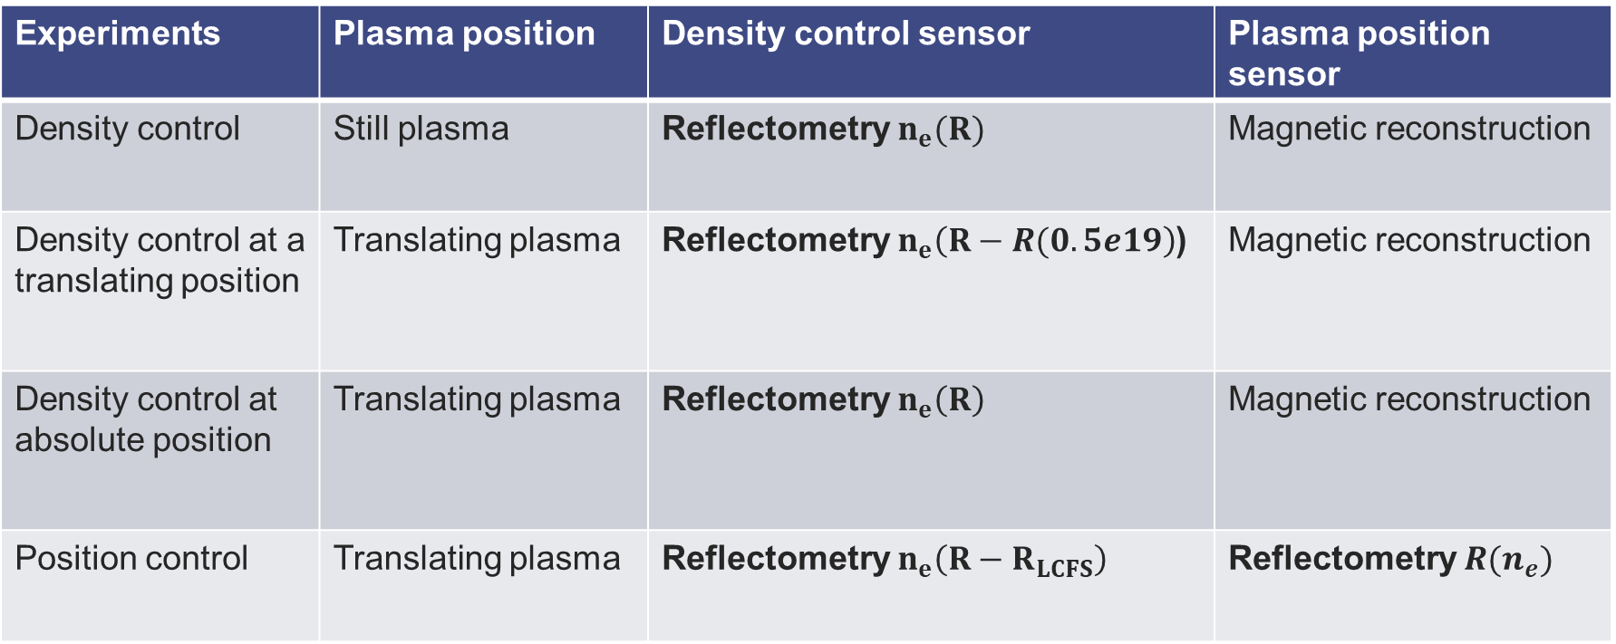
Control validation experiments
Experiments | Plasma position | Density control sensor | Plasma position sensor
Density control | Still plasma | Reflectometry $n_{e}(R)$ | Magnetic reconstruction
Density control at a translating position | Translating plasma | Reflectometry $n_{e}\left(R−R(0.5e19\right)$) | Magnetic reconstruction
Density control at absolute position | Translating plasma | Reflectometry $n_{e}\left(R\right)$ | Magnetic reconstruction
Position control | Translating plasma | Reflectometry $n_{e}\left(R−R_{LCFS}\right)$ | Reflectometry $R(n_{e})$
Specific to X-mode reflectometry

Slide 21
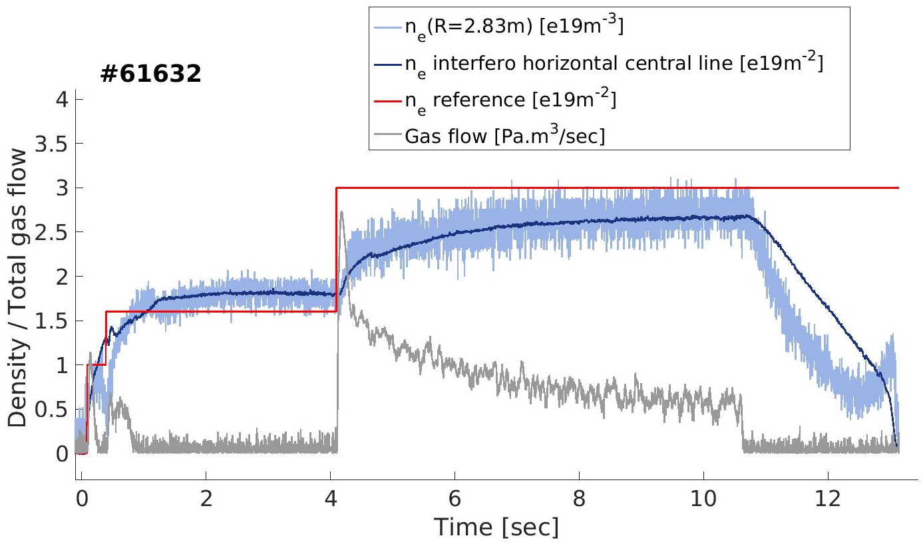
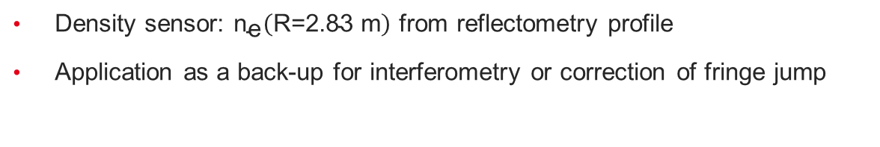
Validation of density control
Density sensor: ${\text{n}}_{\text{e}}\left(\text{R}\text{=2.83 }\text{m}\right)$ from reflectometry profile
Application as a back-up for interferometry or correction of fringe jump
Density control with reflectometry

Slide 22
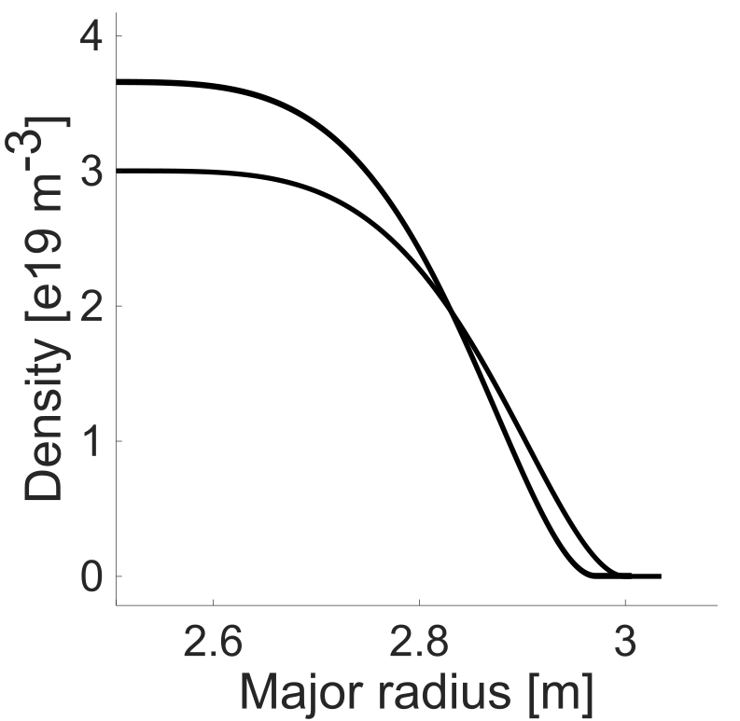
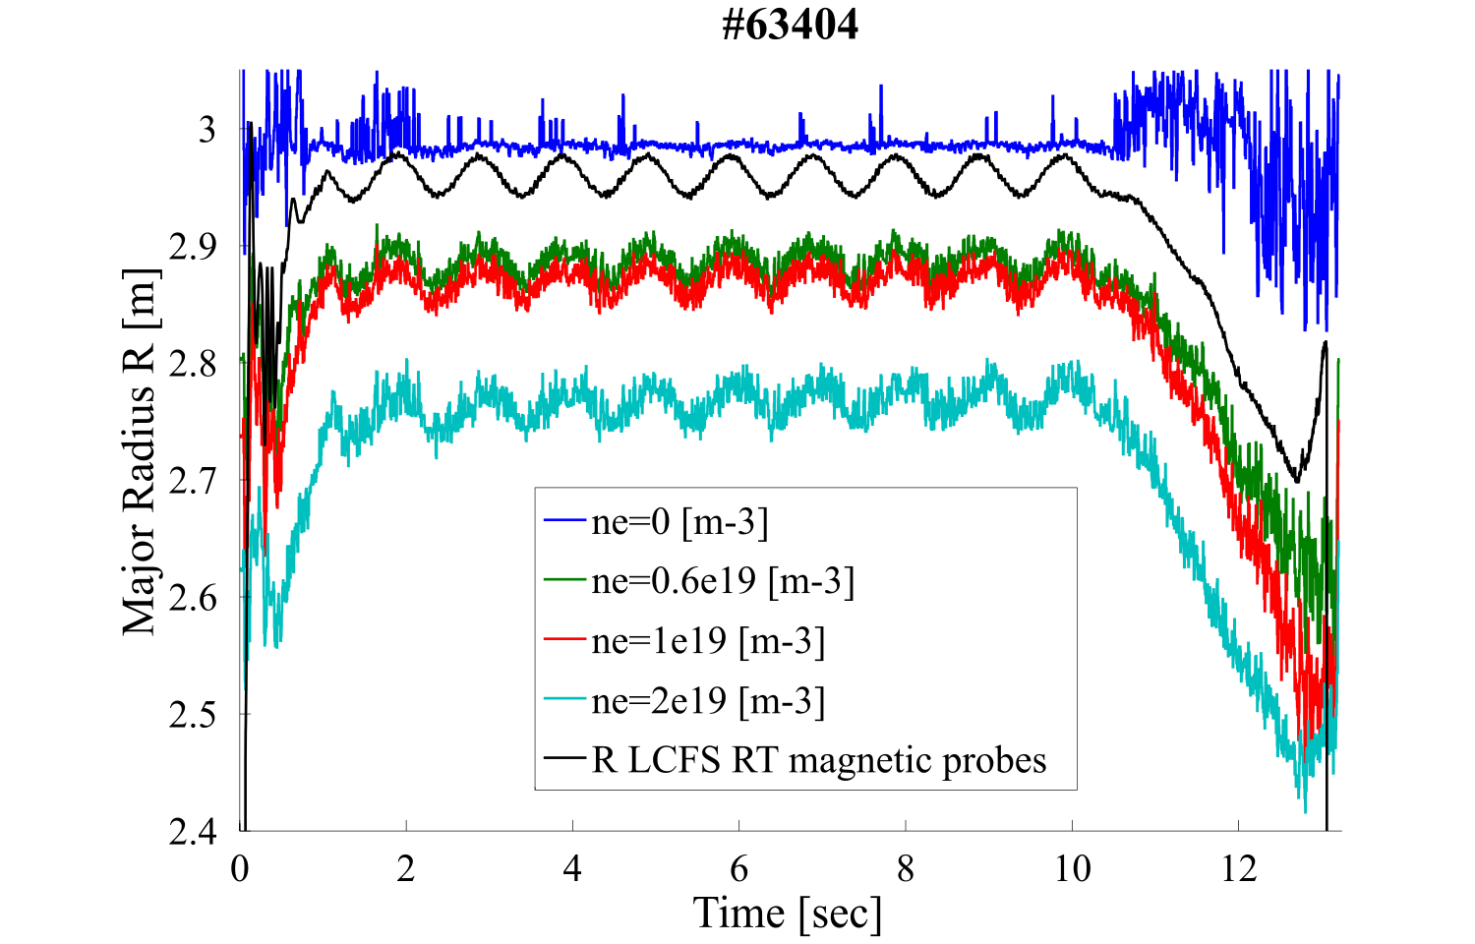


Steepening of the profile with the plasma translation
Increase in the profile gradient
$n_{e}\left(R=2.83m\right)=cte$
Plasma translation of 1 cm
Hypothesis of quasi-rigid plasma displacement
Sinusoidal modulation of the LCFS position at 1Hz with a 4 cm amplitude
Quasi-rigid displacement at the time step of the diagnostics (1ms)
Steepening under plasma translation and absolute density control

Slide 23
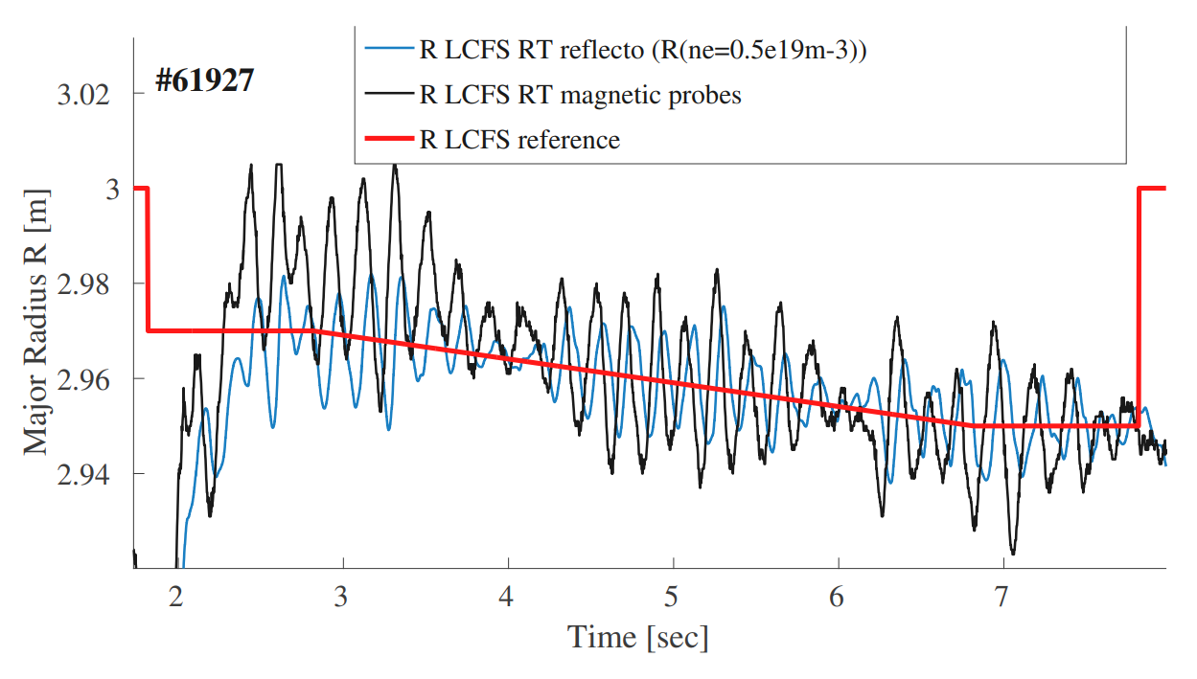
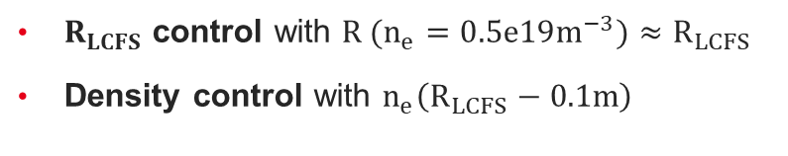
Plasma position control
Oscillations in the plasma position: control unstable
Delay of 50 ms between magnetic and reflectometry measurement
Reference delay of a few ms for magnetic measurements
$R_{LCFS}$ control with ${R (n}_{e}=0.5e19m^{−3})≈R_{LCFS}$
Density control with $n_{e}\left(R_{LCFS}−0.1m\right)$
Position reference
Reflectometry position
> 50 ms
WEST PCS
PF coils

Slide 24
Validation of plasma position control
Work on the data processing. Find a balance between:
Delay reduction (less data filtering, less delay induced by the filters)
Measurement reliability (More noise)
Reach the standard magnetics measurement delay of a few ms
Validation of plasma position control with X-mode reflectometry

Slide 25
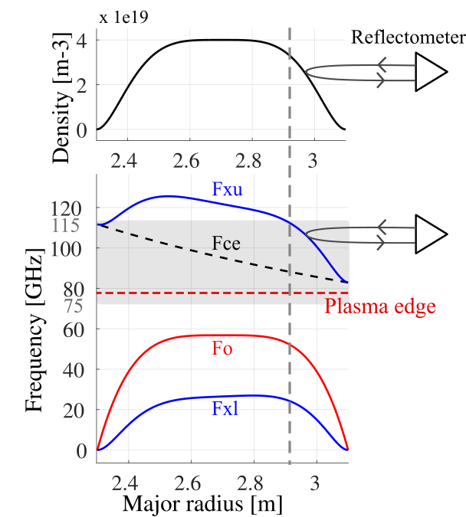
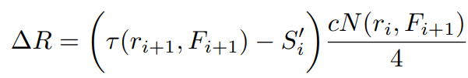
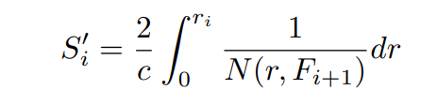
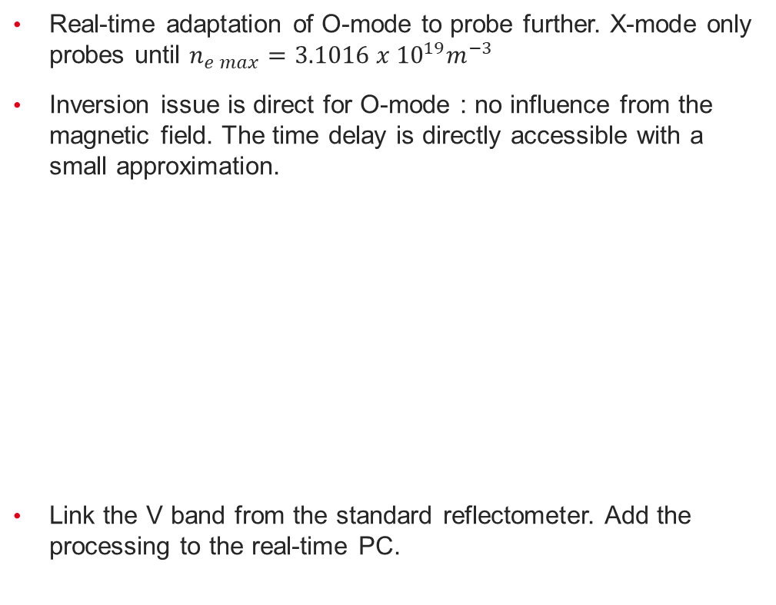

Implementation of the O-mode
$$n_{e max}$$
Real-time adaptation of O-mode to probe further. X-mode only probes until $n_{e max}=3.1016 x {10}^{19}m^{−3}$
Inversion issue is direct for O-mode : no influence from the magnetic field. The time delay is directly accessible with a small approximation.
Link the V band from the standard reflectometer. Add the processing to the real-time PC.

Slide 26
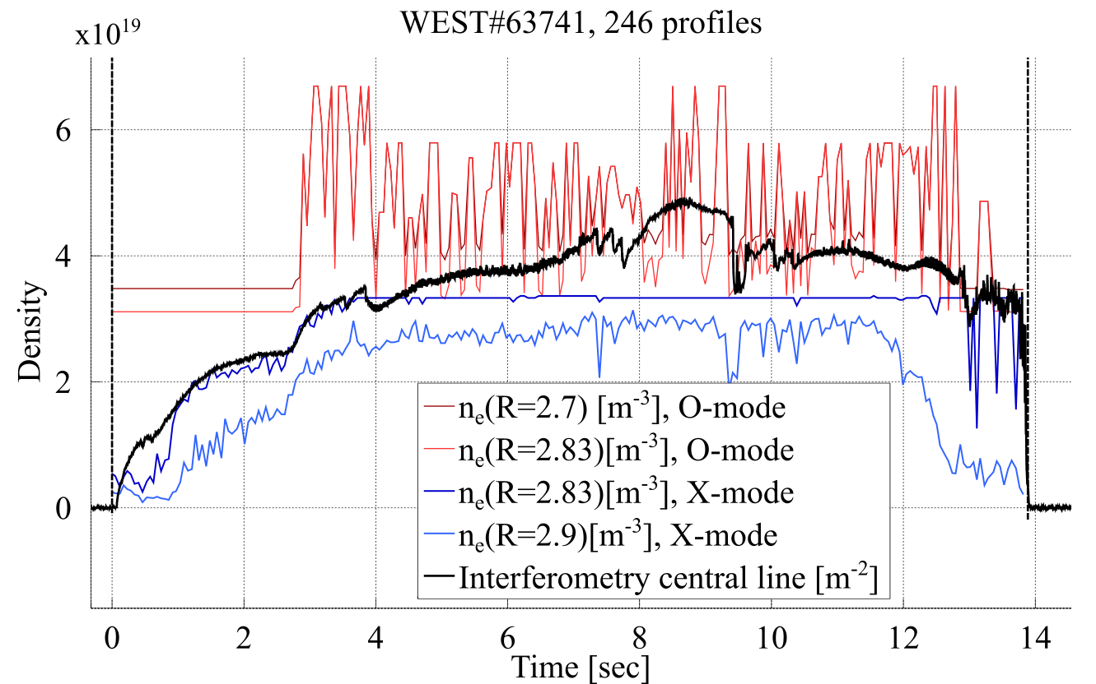
O-mode noisy signals
However, signal noise is very important (maybe due to low gradient ?)
Signal processing (filters) VS processed measurements latency
Part of the process was parallelized to satisfy a 1 ms update time
How to process the signal without increasing the latency?
So signal processing needs to be adapted. Eventually, put safety conditions, interpolation, and weight on the O or X modes.

Slide 27
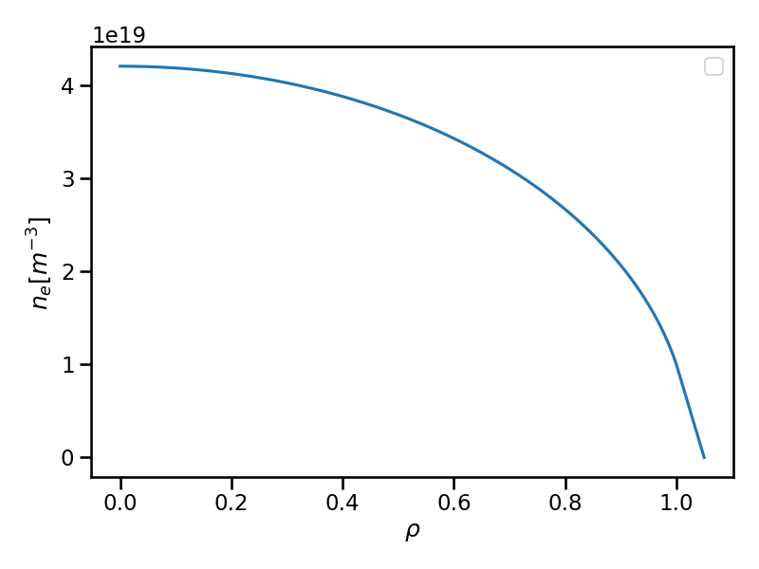
Dependance between RF coupling and critical density position
ICRH coupling varies as the inverse of $d_{crit−strap}$
Reflectometry provides the radial position of a fixed density -> can control $d_{crit−strap}$
Sensors of reflectometry :
  $n_{e}\left(R fixed\right)$
  $R \left(n_{e} fixed\right)$
Reflectometry
measurements
ICRH
antennas
$$d_{strap−antenna}$$
$d_{crit−strap}$ varies with $n_{e core}$, $I_{p}$ and Erog.
Objectives: Control the coupling by controlling $d_{crit−strap}$ during variations of these three parameters.

Slide 28
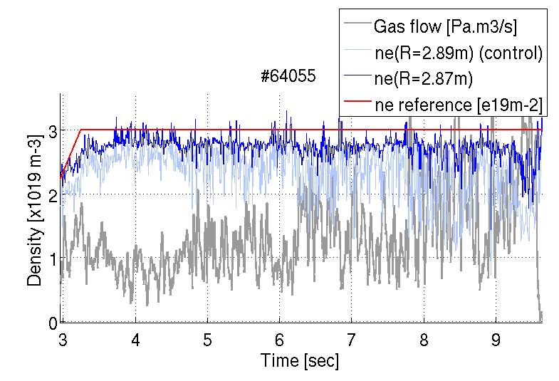
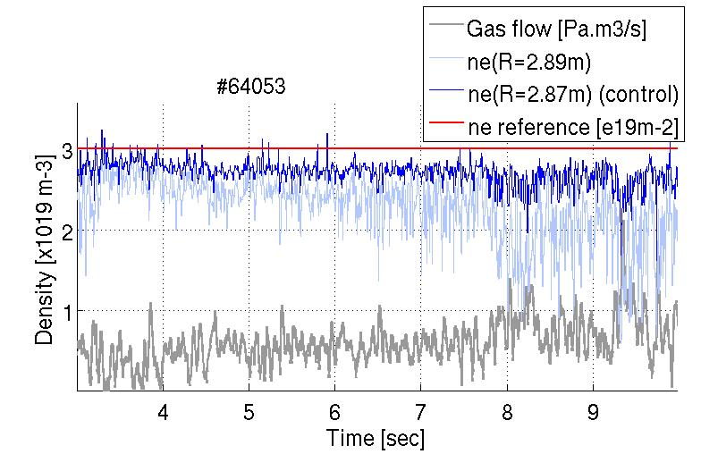
Edge density control for ICRH coupling optimization

Slide 29
Gradient density control
Pellet injection
RT Gradient measurement:
Measurement of edge density profile by reflectometry
Measurement of integrated density by interferometry
Leads to a measurement of the centrale density and the averaged core gradient: real-time value to exploit for gradient control
Gradient control:
Gas injection to control total density
Pellet injection to control central density
Gas puff
Edge reflectometry $n_{e}(r)$
Dentral density $n_{e0}$
Density gradient
Central interferometry line
$ne3=\int_{0}^{a}{n_{e}\left(r\right)dr}$

