Slide 1

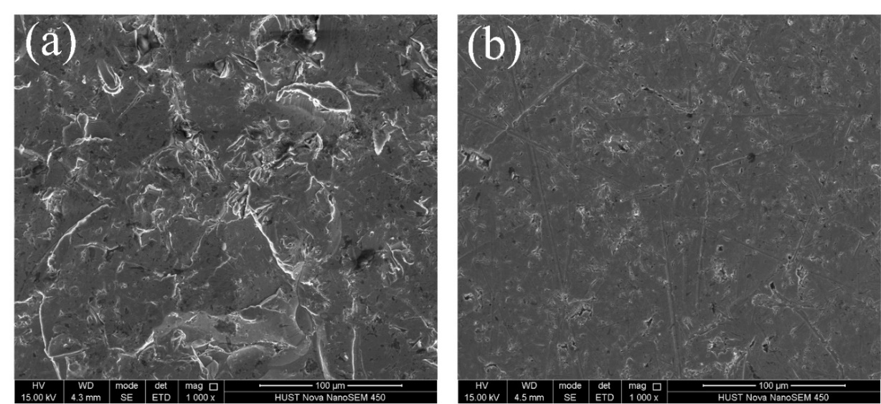
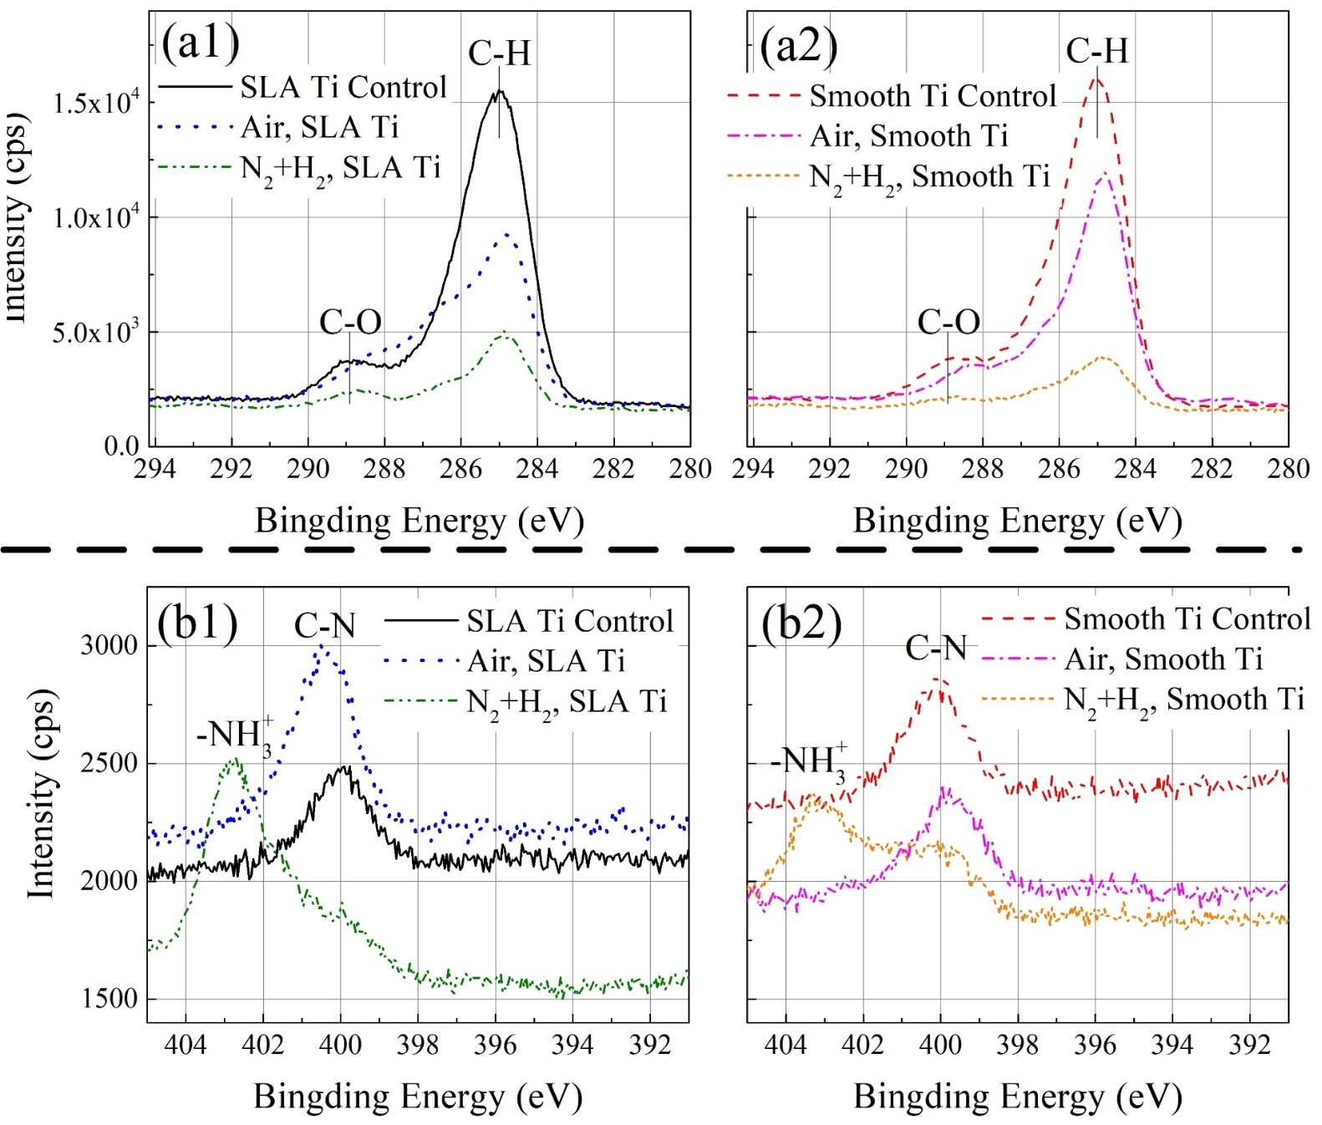
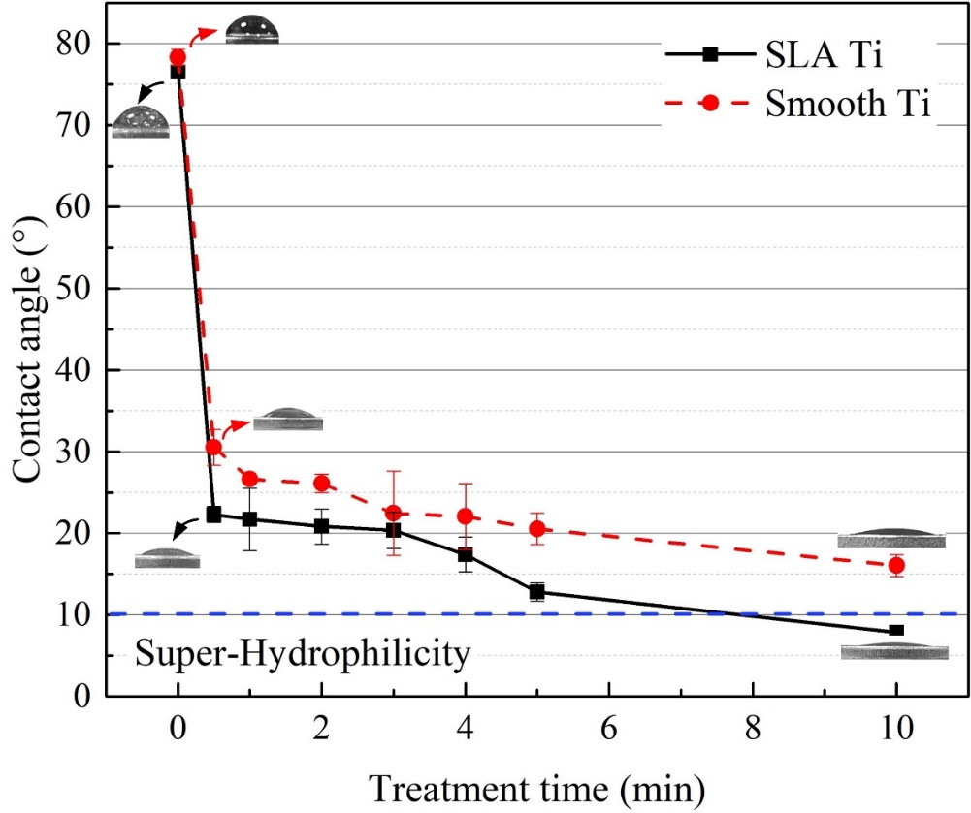
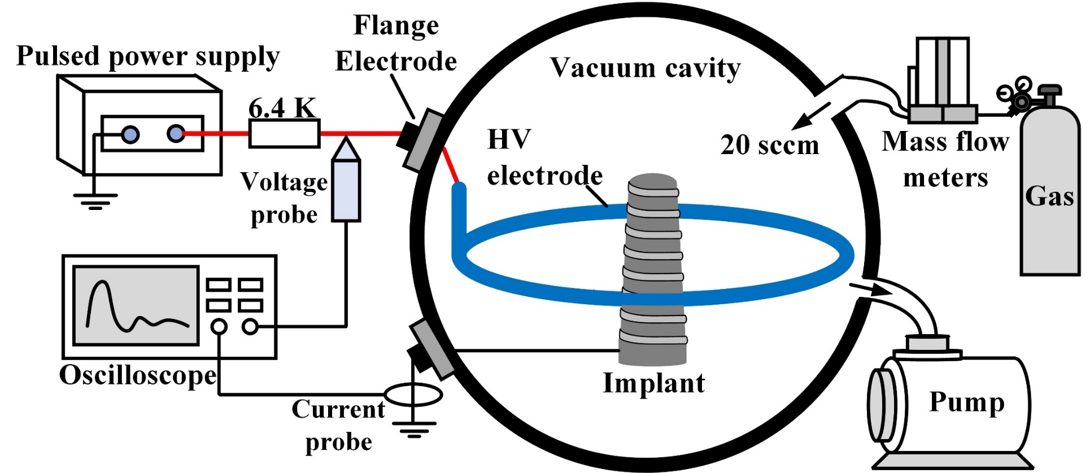
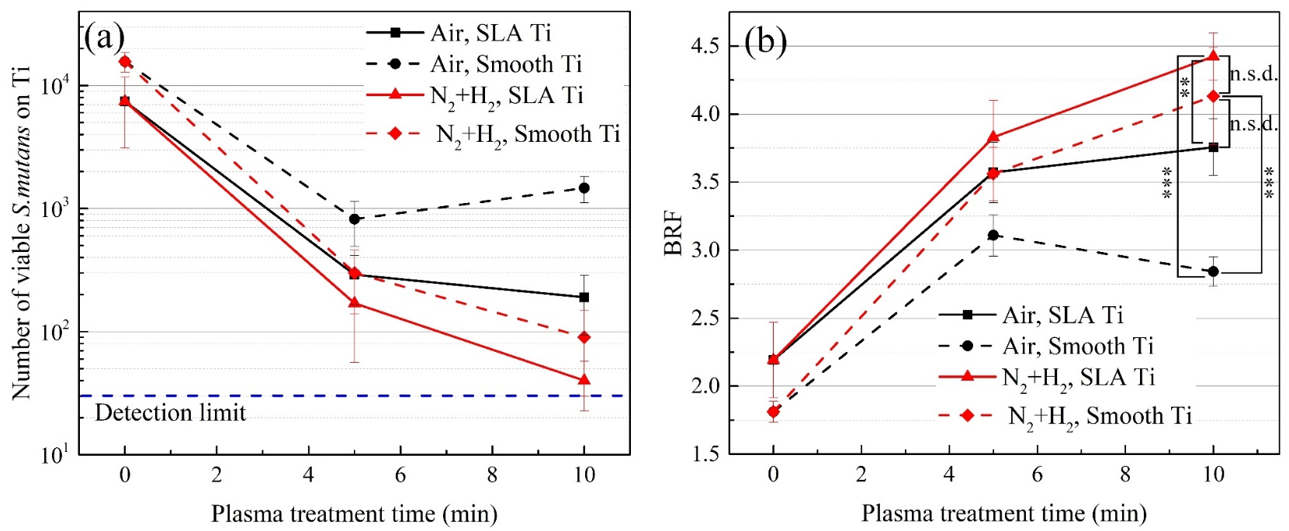
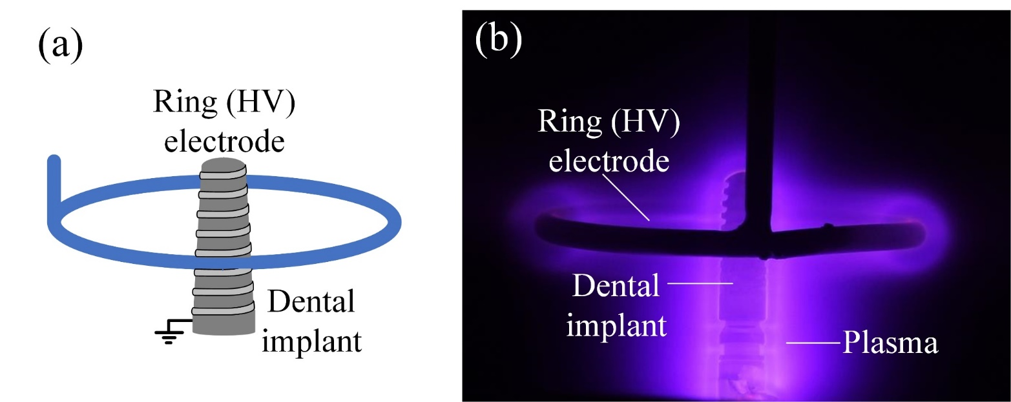
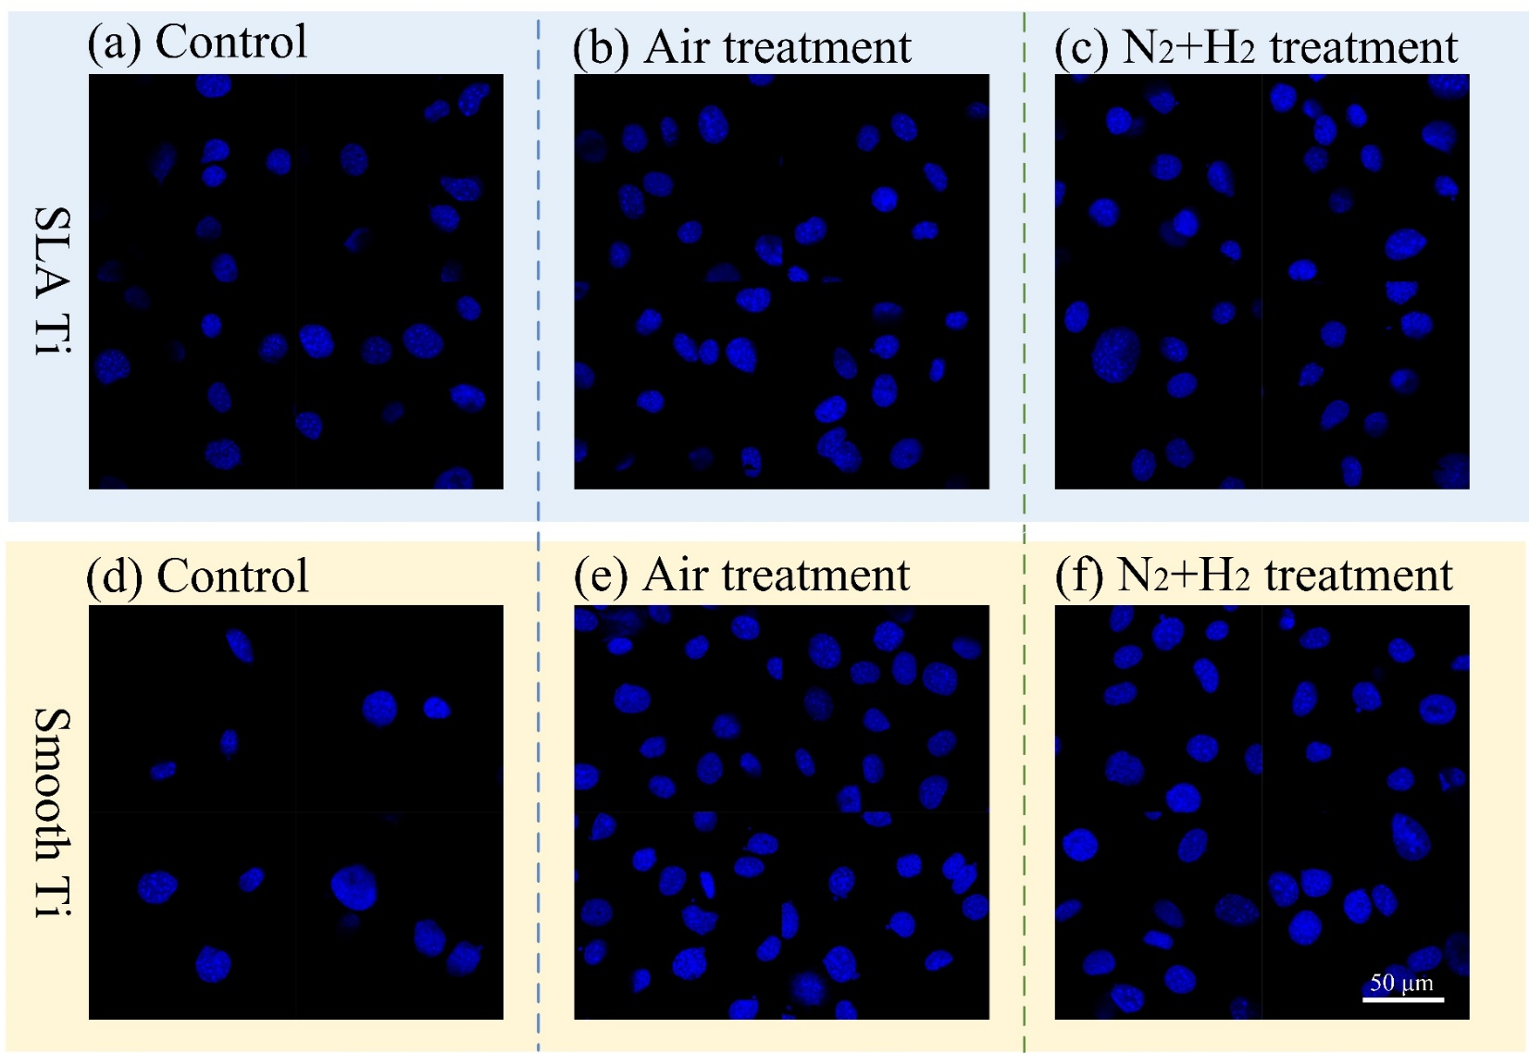
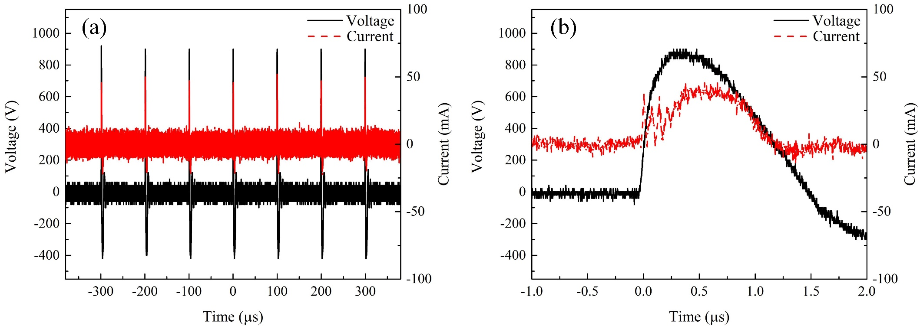
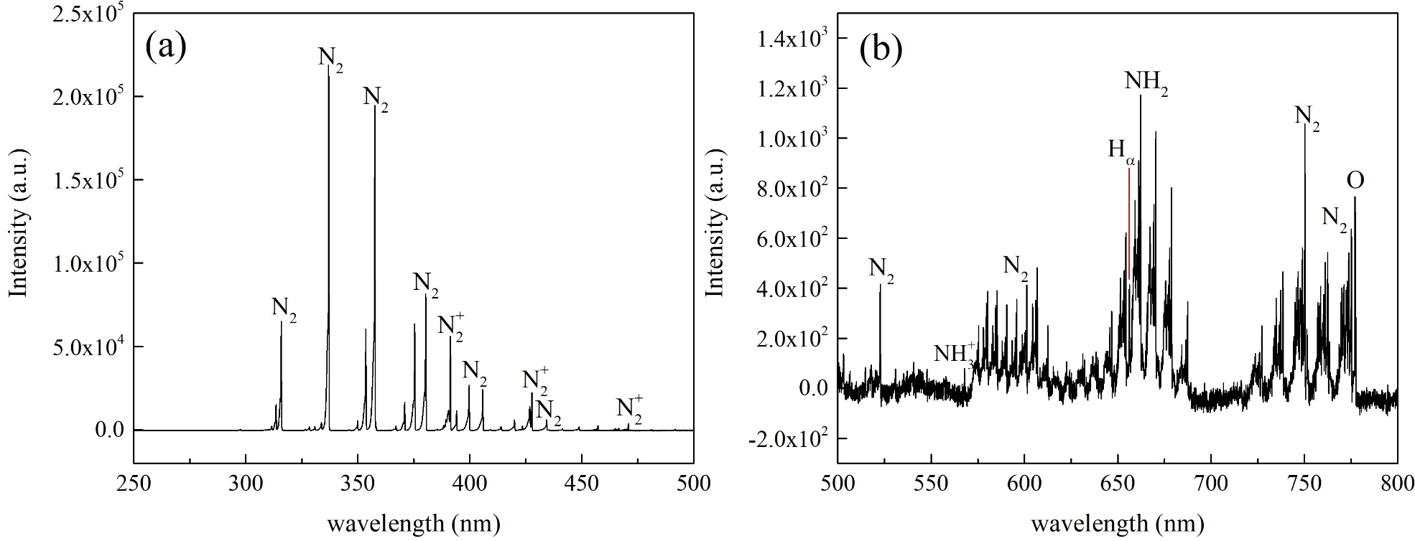
Surface modification of titanium by nanosecond pulsed low-pressure nitrogen-hydrogen plasma for enhanced antibacterial and osteogenic performance
Yiqian Li*, Yuexi Liu, Xinlei Zhang, Lanlan Nie, and Xinpei Lu
School of Electrical and Electronic Engineering, Huazhong University of Science and Technology, Wuhan, HuBei, 430074, People’s Republic of China
Abstract
Results
The success of dental implants depends strongly on osseointegration, which is closely related to the surface properties of titanium.
In this study, plasma treatment was used to modify titanium surfaces for dental applications. Surface morphology and chemistry were characterized by scanning electron microscopy and X-ray photoelectron spectroscopy, while biological performance was evaluated by antibacterial assays against Streptococcus mutans, MC3T3-E1 pre-osteoblastic cell adhesion tests, and cytotoxicity assays.
The results showed that plasma treatment removed surface carbon contaminants and introduced nitrogen-containing functional groups, especially –NH₃⁺, thereby converting titanium surfaces from hydrophobic to hydrophilic without altering surface topography. The modified surfaces exhibited strong antibacterial activity, with bacterial adhesion reduced by more than 4 orders of magnitude. Meanwhile, cell adhesion increased to approximately 70%, with no observed cytotoxicity.
These findings demonstrate that N₂+H₂ plasma treatment is an efficient and low-cost strategy for producing hydrophilic, antibacterial, and biocompatible surfaces.
titanium implant surfaces.
Surface morphology and chemistry
SEM was used to observe the surface morphology of titanium .
No obvious changes in surface morphology were detected after plasma treatment.
Figure 5. SEM images of (a) SLA Ti and (b) Smooth Ti surfaces after N₂+H₂ plasma treatment for 10 mins at 1000× magnification (scale bar = 100 μm).
The chemical composition and elemental states of the sample surfaces were analyzed using XPS.
XPS analysis provides a chemical explanation for the effects of N₂+H₂ plasma modification: (1) effective surface cleaning and (2) successful introduction of nitrogen-containing functional groups (-NH₃⁺).
Background
Osseointegration is defined as the direct, structured, functional connection between living bone tissue and the surface of a load-bearing implant, without intervening fibrous connective tissue. A dental implant is an artificial tooth root used to replace a missing natural tooth. It provides support and retention for a prosthetic tooth when placed into the bone. Currently, clinical implants are primarily fabricated from titanium or titanium alloys due to their excellent corrosion resistance and biocompatibility.
Surface modification is therefore essential for improving the clinical performance of titanium implants. Among various surface modification techniques, plasma treatment is an emerging and highly promising technology. Plasma, a collection of charged and neutral particles, can increase the surface energy of materials. Its modification effect on implants is typically achieved by removing adsorbed organic pollutants and introducing specific functional groups onto the surface.
Figure 6. Chemical composition of titanium samples measured by high-resolution XPS. (a) C 1s spectra. (b) N 1s spectra. (x1) for SLA Ti. (x2) for Smooth Ti.
Hydrophilicity
For SLA titanium, as the treatment time increased from 30 s to 10 min, the contact angle decreased from 22.3° to 7.9°, which indicating a super-hydrophilic surface.
Smooth titanium consistently exhibited higher contact angles than SLA titanium. After a 5-minute treatment, its contact angle was about 20.6°, and after 10 minutes, it was about 16°.
Experiment setup
Figure 7. Influence of plasma treatment time on the contact angle of titanium discs (Pressure: 200 Pa, Working gas: 95% N₂+ 5% H₂).
In this work, a nanosecond-pulsed low-pressure N₂+H₂ plasma was used to modify titanium.
Antibacterial and cellular assay
The antibacterial results are shown in Fig. 8. Compared to the untreated control titanium, all plasma-treated surfaces exhibited antibacterial effects.
Notably, the titanium modified by the N₂+H₂ plasma demonstrated better antibacterial performance compared to the air plasma group.
Figure 1. Nanosecond-pulse driven low-pressure plasma modification system for implants.
Figure 8. Antibacterial properties of plasma-modified titanium discs (Pressure: 200 Pa). (a) Bacterial attachment on each Ti surface. (b) Quantitative assessment of antibacterial performance by the BRF.
Cells adhered to the titanium surfaces after 2 hours of culture were labeled using DAPI fluorescence staining and observed. The results are shown in Fig. 9. All plasma-treated titanium surfaces exhibited significantly more adherent cells than the untreated control group, indicating that plasma treatment effectively promotes cell adhesion.
Figure 2. Photograph of discharge
Figure 3. Typical current and voltage waveforms of the plasma (Pressure: 200 Pa, Working gas: 95% N₂+ 5% H₂).
Figure 9. Fluorescence microscopy images of cell adhesion on plasma-modified titanium disc surfaces (DAPI staining) (Pressure: 200 Pa, Treatment time: 10 min).
Conclusions
This study demonstrates that nanosecond-pulsed low-pressure N₂+H₂ plasma is an effective strategy for titanium surface modification in dental implant applications.
The treatment didn’t alter the surface morphology, but it efficiently removed carbon contaminants and introduced nitrogen-containing functional groups, thereby markedly improving hydrophilicity and biocompatibility.
Figure 4. Optical emission spectra of the plasma (Pressure: 200 Pa, Working gas: 95% N₂+5% H₂). (a) 250 nm-500 nm. (b) 500 nm-800 nm.
Contact
References
[name] Yiqian Li
[organization] Huazhong University of Science and Technology
[email] d202380814@hust.edu.cn
[phone] +86 15927269162
[1] R. Brånemark, et al., J. Rehabil. Res. Dev. 38 (2001) 175–181.
[2] H. Schliephake, et al., J. Mater. Chem. 18 (2008) 2404–2414.
[3] M.P. Neupane, et al., Int. J. Electrochem. Sci. 4 (2009) 197–207.
[4] L. Wang, et al., ACS Omega 5 (2020) 3996–4003.
[5] C. Karthik, et al., Int. J. Mol. Sci. 25 (2024) 524.
[6] J.H. Lee, et al., Jpn. J. Appl. Phys. 53 (2014) 086202.

