Slide 1
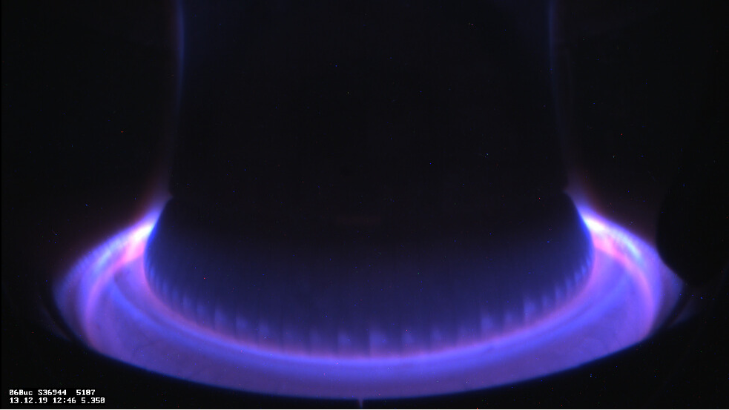
Theory-based integrated modelling of impurity transport in tokamaks
PhD research award – 52nd EPS Conference on Plasma Physics
Daniel Fajardo
Supervised by Clemente Angioni and Hartmut Zohm
Max Planck Institute for Plasma Physics, Garching, Germany

Slide 2

Impurities are critical in the operation of a fusion reactor
Core performance
Radiative losses
Impurity accumulation
Fuel dilution
Impurity seeding
Plasma-wall interaction
Power exhaust

Slide 3
Impurities are critical in the operation of a fusion reactor
During my PhD:
Develop a theory-based modelling workflow with impurities
Core performance
Plasma-wall interaction
Power exhaust

Slide 4
Impurities are critical in the operation of a fusion reactor
During my PhD:
Develop a theory-based modelling workflow with impurities
Validation in ASDEX Upgrade, a tokamak with full-W walls
Core performance
Plasma-wall interaction
Power exhaust

Slide 5
Impurities are critical in the operation of a fusion reactor
During my PhD:
Develop a theory-based modelling workflow with impurities
Validation in ASDEX Upgrade, a tokamak with full-W walls
Predictions of ITER plasmas
Core performance
Power exhaust
Confidence on extrapolation
Plasma-wall interaction

Slide 6
Impurities are critical in the operation of a fusion reactor
During my PhD:
Develop a theory-based modelling workflow with impurities
Validation in ASDEX Upgrade, a tokamak with full-W walls
Predictions of ITER plasmas
Core performance
Transport regime might not be the same
Plasma-wall interaction
Power exhaust

Slide 7
A happy coincidence for my PhD
Start: Oct. 2021
Finish: Oct. 2024
Develop workflow
Validation in AUG
Applications to ITER

Slide 8
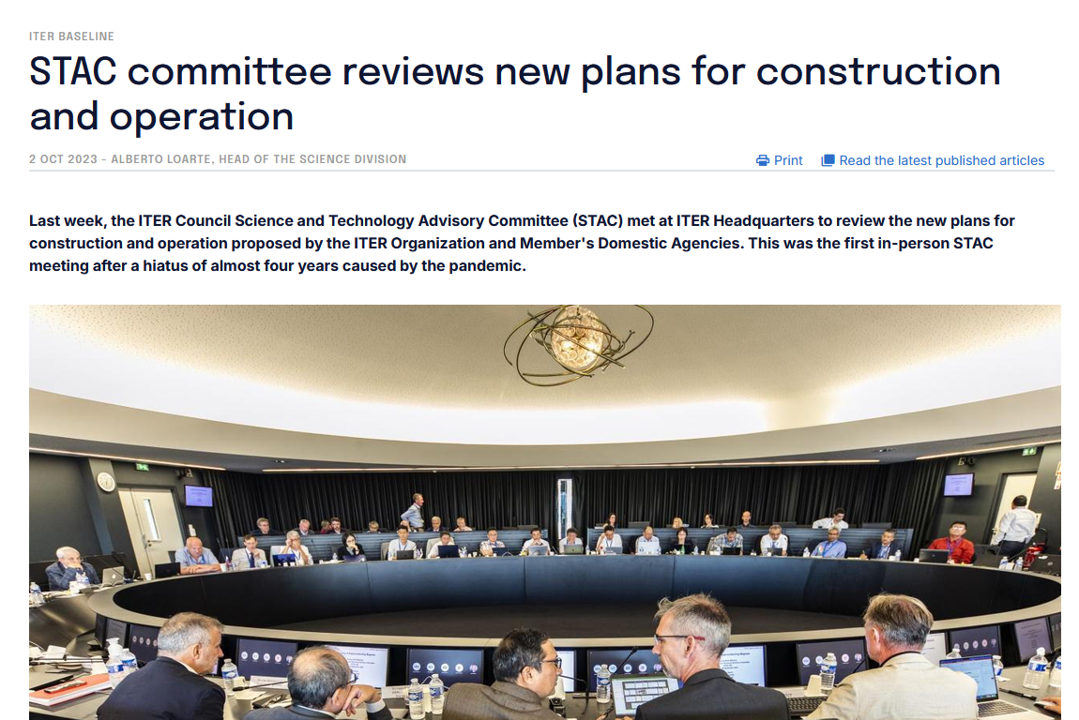
A happy coincidence for my PhD
Start: Oct. 2021
Finish: Oct. 2024
Develop workflow
Validation in AUG
Applications to ITER
Oct. 2023
ITER announces transition to full-W walls
A. Loarte 2023 ITER press release
2024 EPS conference
2025 PPCF 67 065023

Slide 9
Theory-based modelling workflow

Slide 10
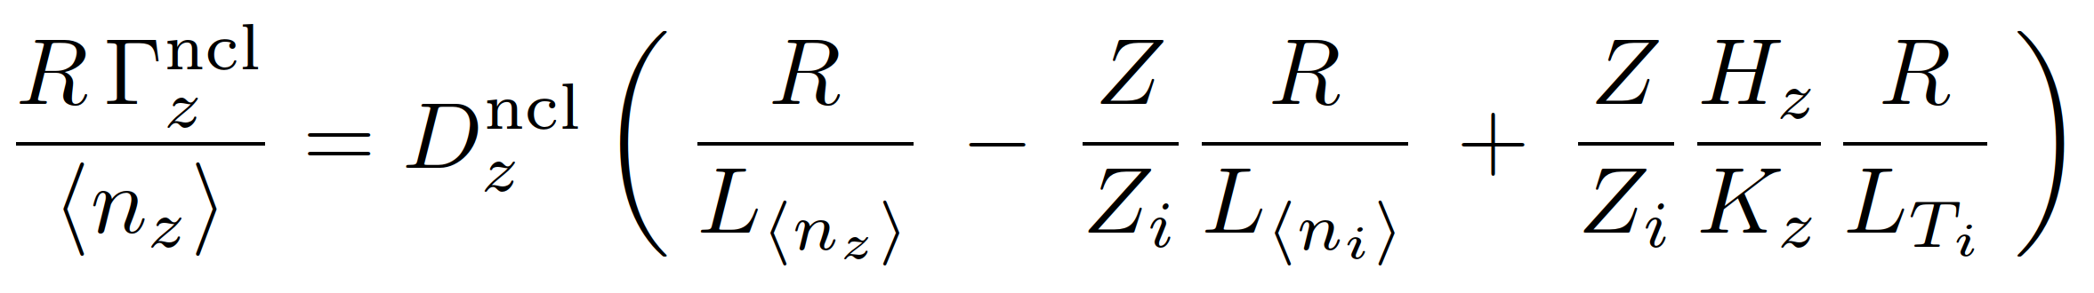
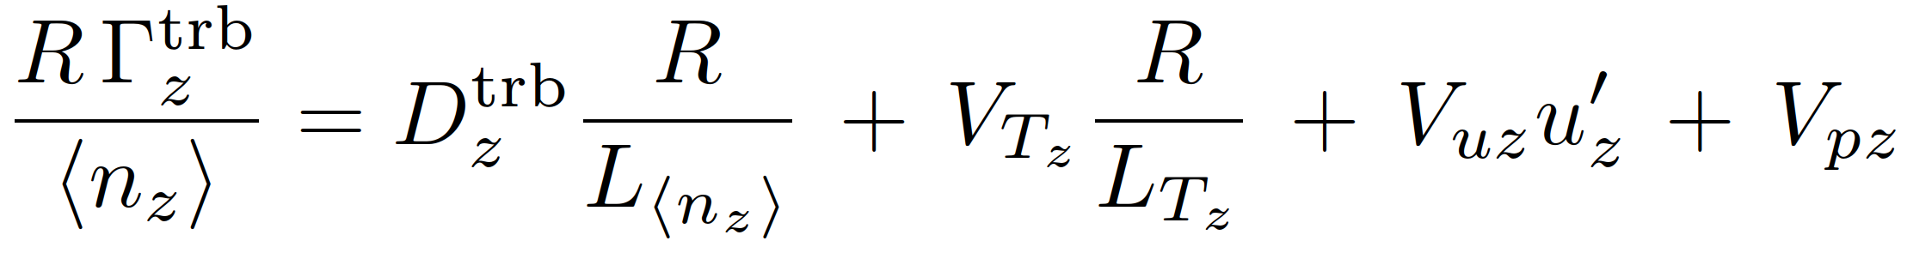
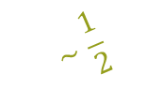
A little impurity transport theory
Neoclassical flux components strongly depend on charge, collisionality and rotation
diffusion
convection
$$∼\frac{1}{2}$$
can lead to central accumulation
inward pinch
temperature screening
Turbulent flux components do not scale strongly with charge or mass
diffusion
convection
does not cause strong peaking
thermo-diffusion
pure pinch
roto-diffusion

Slide 11
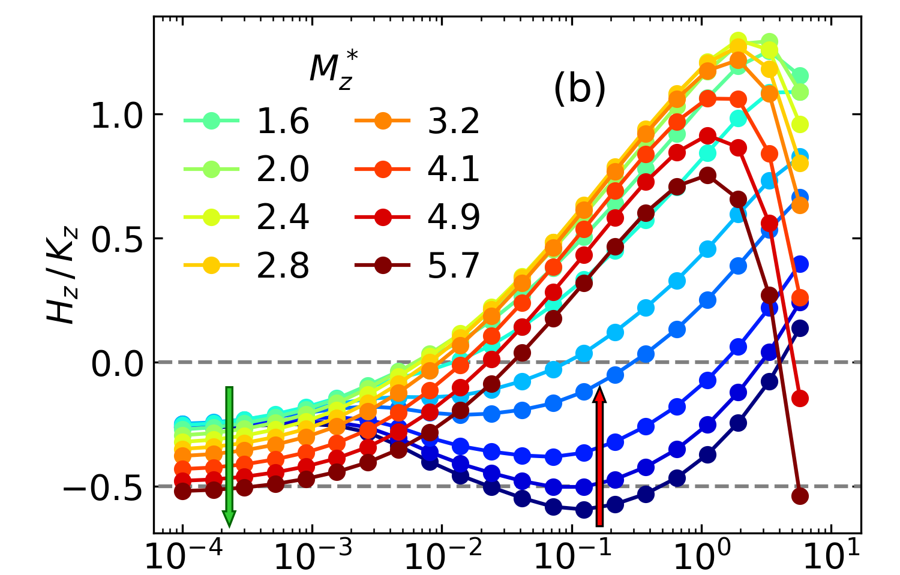
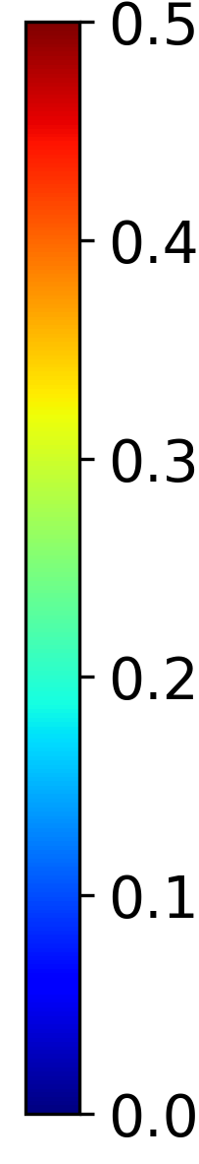
Extended neoclassical model for rotation effects at all collisionalities
Rotation can increase high-Z neoclassical transport by more than an order of magnitude
It can also modify or even reverse the screening coefficient
H_{w} / K_{w} from NEO
no temperature screening
Mach number (rotation)
less TS
more TS
collisionality

Slide 12
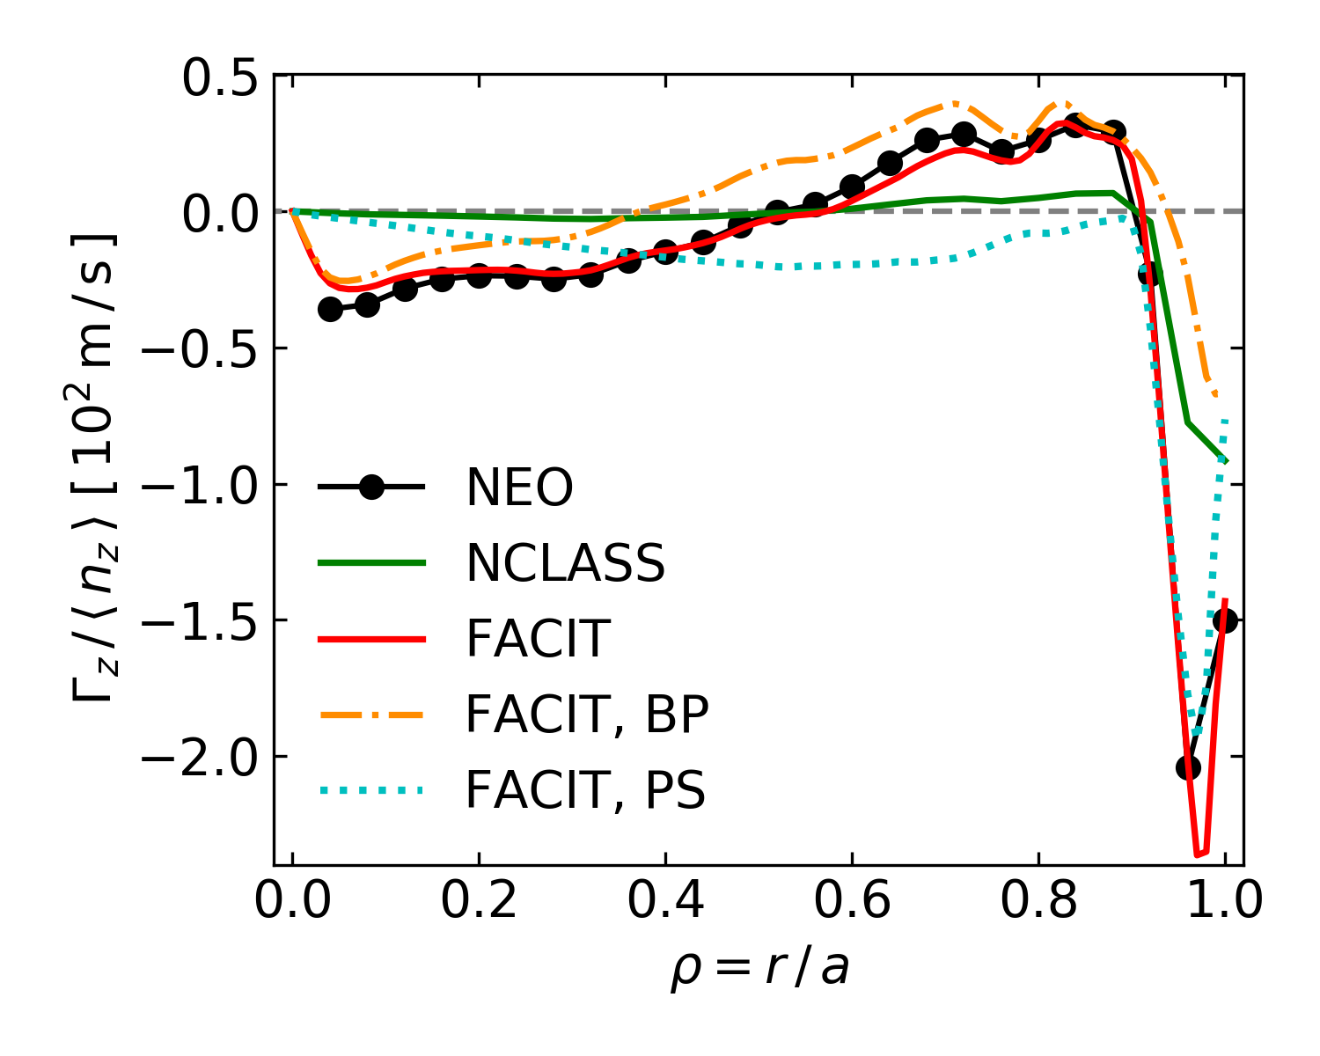
Extended neoclassical model for rotation effects at all collisionalities
Rotation can increase high-Z neoclassical transport by more than an order of magnitude
It can also modify or even reverse the screening coefficient
The FACIT model¹ was extended² to include rotation effects at all collisionalities, matching NEO³ drift-kinetic results
¹ Maget 2020 PPCF 62 105001
² Fajardo 2023 PPCF 65 035021
³ Belli 2009 PPCF 51075081
AUG #38910
H_{w} / K_{w} from NEO
no temperature screening
Mach number (rotation)
less TS
more TS
collisionality

Slide 13


Modelling workflow with impurities
¹ Maget 2020 PPCF 62 105001
² Fajardo 2023 PPCF 65 035021
³ Dux 2006 IPP report
⁴ Staebler 2022 NF 61 116007
ASTRA
Profile evolution
$$T$$
$$n$$
core
edge
FACIT^{1,2}
STRAHL³
TGLF-SAT2⁴
Neoclassical transport
Impurity densities & radiation
Turbulent transport

Slide 14
Modelling workflow with impurities
scenario to be modelled is summarized in this box
¹ Maget 2020 PPCF 62 105001
² Fajardo 2023 PPCF 65 035021
³ Dux 2006 IPP report
⁴ Staebler 2022 NF 61 116007
⁵ Fajardo 2024 NF 64 046021
⁶ Fajardo 2024 NF 64 104001
⁷ Fajardo 2026 NF 66 046005
Validated on
AUG L-modes⁵
AUG H-modes^{6,7}
JET-ILW and Alcator C-Mod⁷
ASTRA
Profile evolution
$$T$$
$$n$$
core
edge
FACIT^{1,2}
STRAHL³
TGLF-SAT2⁴
Neoclassical transport
Impurity densities & radiation
Turbulent transport

Slide 15
Full-radius modelling of AUG L-mode plasmas

Slide 16
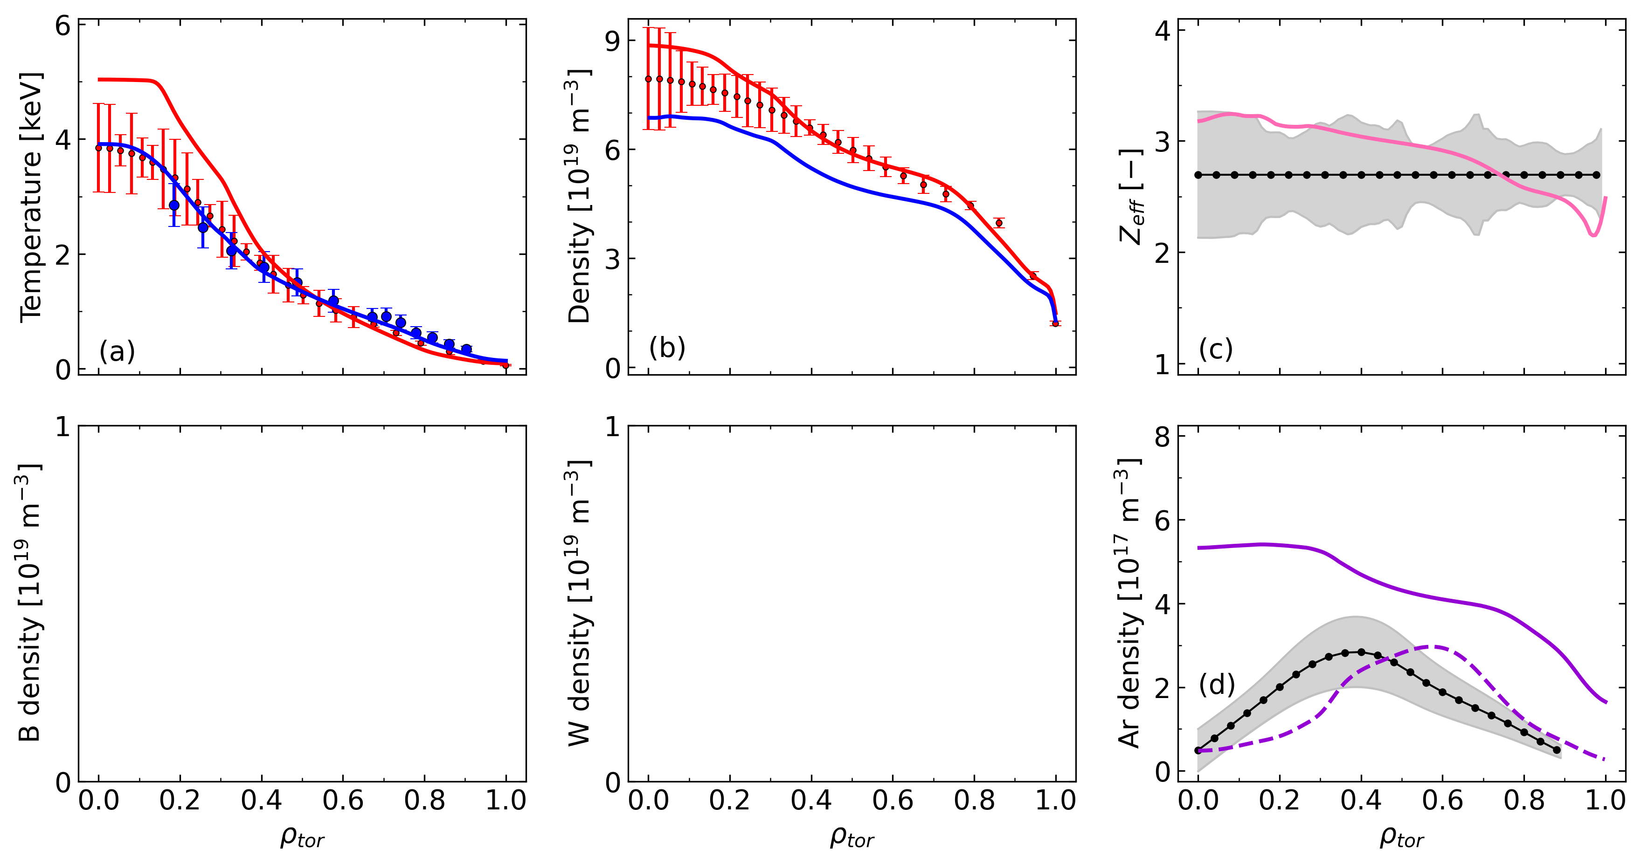
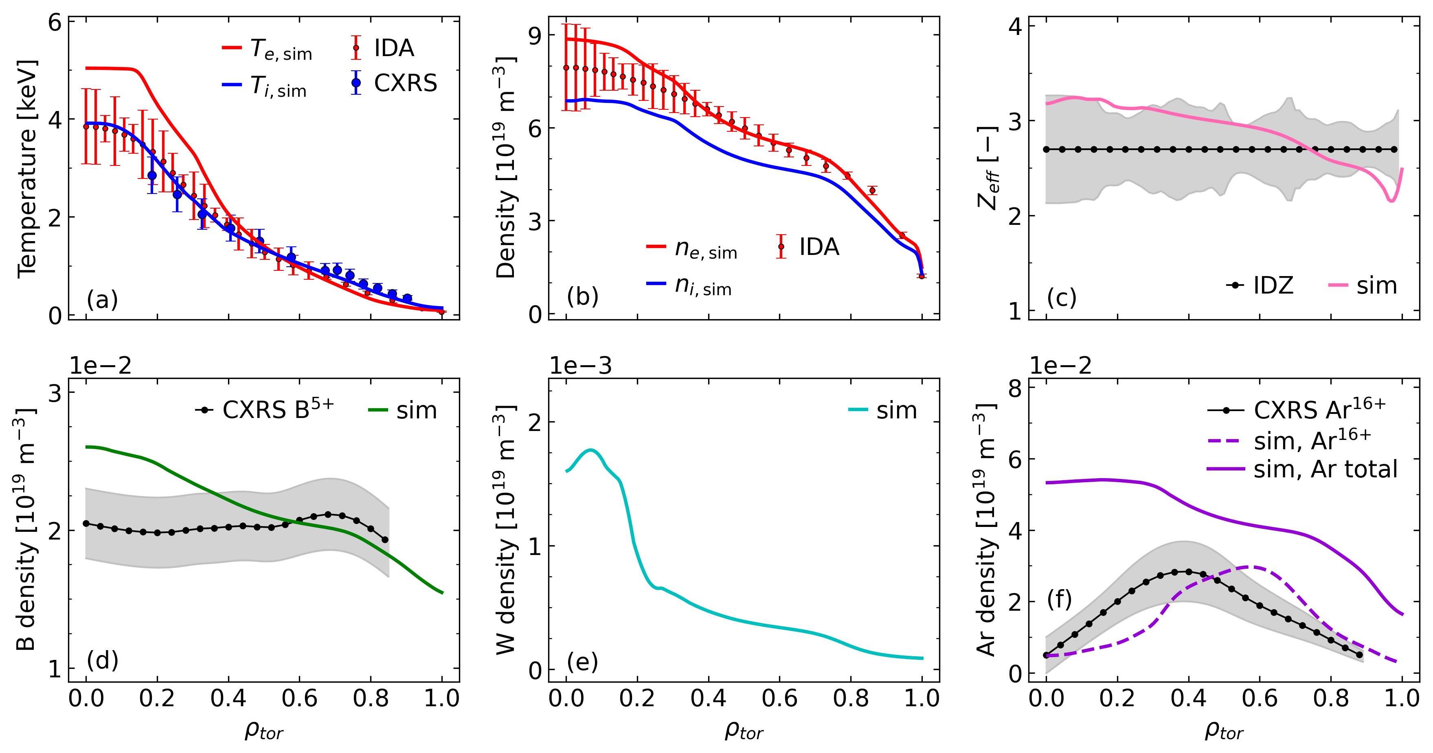
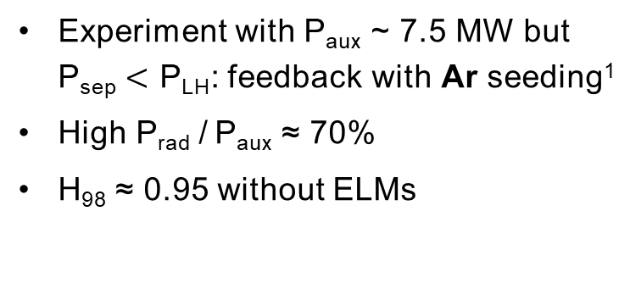
Full-radius modelling of AUG Ar seeded radiative L-mode
AUG 0.8 MA with Ar
Experiment with P_{aux} ~ 7.5 MW but P_{sep} $<$ P_{LH}: feedback with Ar seeding¹
High P_{rad} / P_{aux} ≈ 70%
H₉₈ ≈ 0.95 without ELMs
AUG #37041 at 5.0-5.5 s
Simulation of main plasma with three impurities²: Ar, W and B
High confinement is reproduced
Simple model for X-point radiation was included; total radiation matched
Removing argon from the simulation leads to 33% lower confinement
¹ Fable 2022 NF 62 024001
² Fajardo 2024 NF 64 046021

Slide 17
Modelling the control of W accumulation with central ECRH

Slide 18
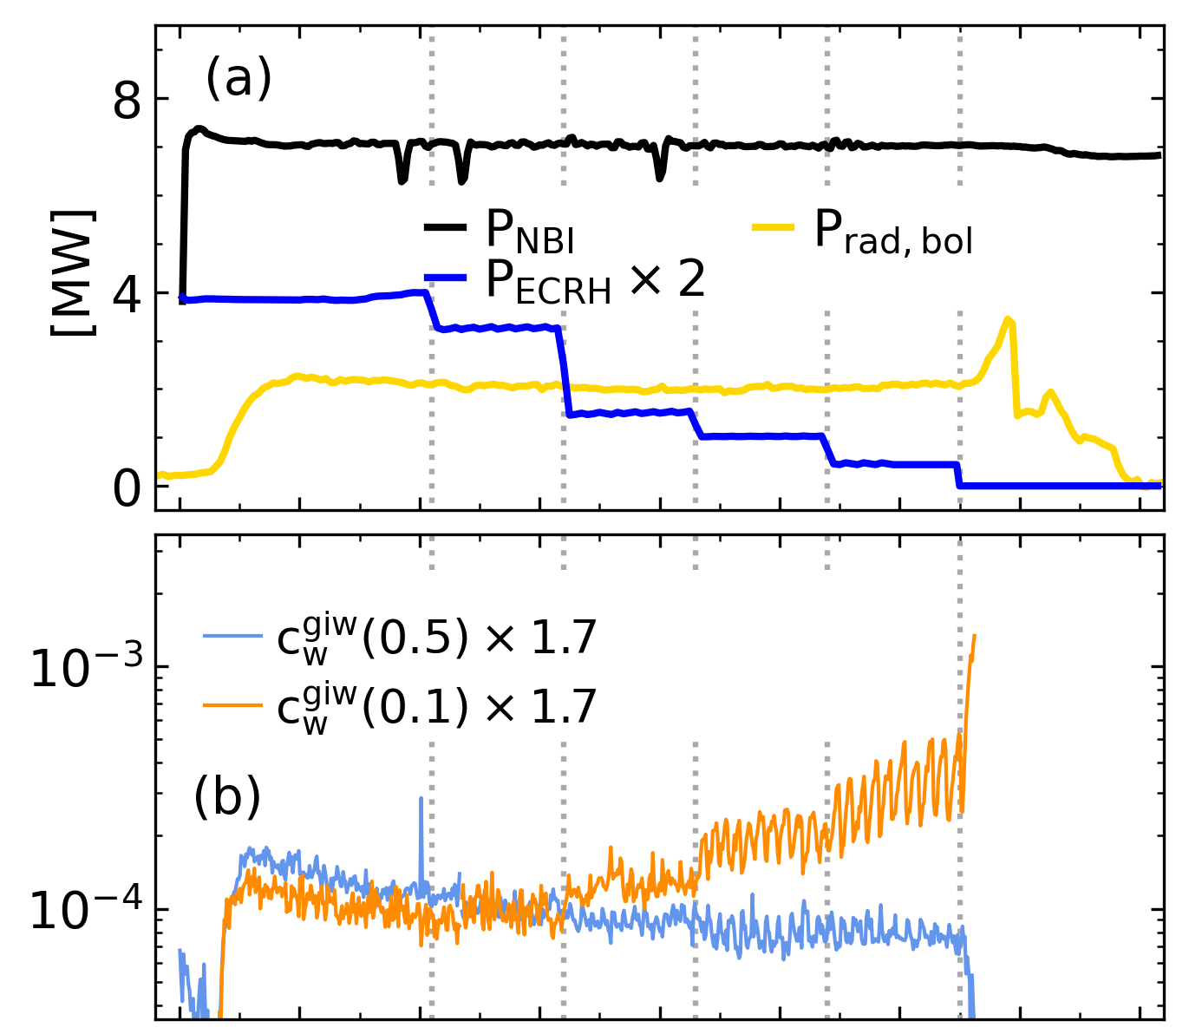
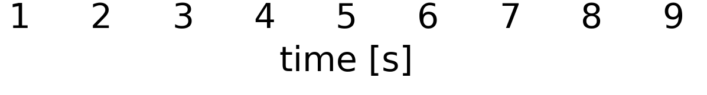
Dynamical modelling of AUG H-mode with NBI + ECRH steps
AUG 1.0 MA H-mode
AUG #32408
W accumulation as central ECRH is decreased¹
Central wave heating controls W accumulation because it increases W diffusivity and decreases W pinch
¹ Angioni 2017 NF 57 056015

Slide 19
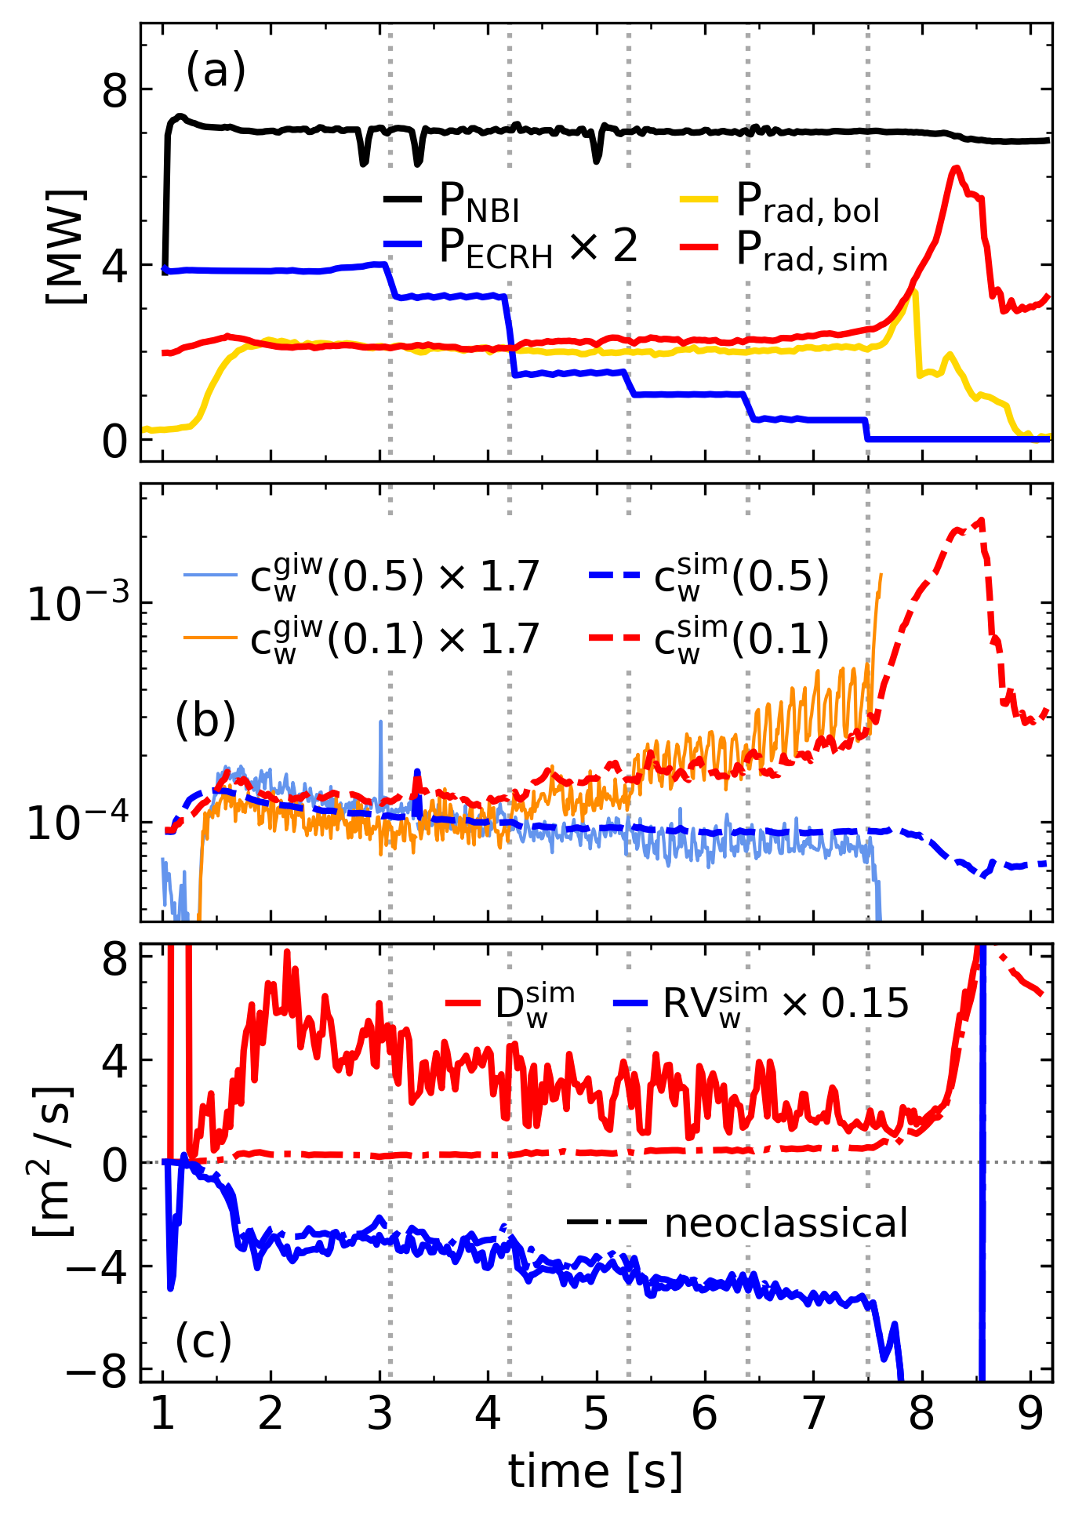
Dynamical modelling of AUG H-mode with NBI + ECRH steps
AUG 1.0 MA H-mode
AUG #32408
W accumulation as central ECRH is decreased¹
Central wave heating controls W accumulation because it increases W diffusivity and decreases W pinch
ASTRA-TGLF-FACIT modelling of entire flattop quantitatively reproduces experimental W behavior²
Competition between neoclassical convection and turbulent diffusion
¹ Angioni 2017 NF 57 056015
² Fajardo 2024 NF 64 104001

Slide 20
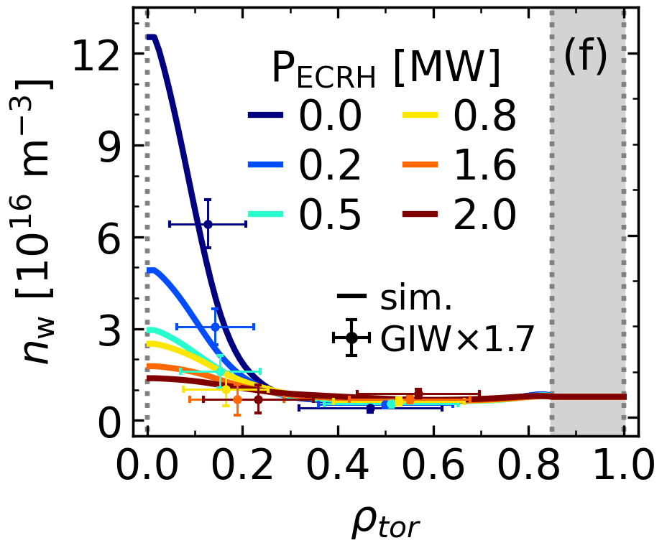
Dynamical modelling of AUG H-mode with NBI + ECRH steps
AUG 1.0 MA H-mode
W accumulation as central ECRH is decreased¹
AUG #32408
Central wave heating controls W accumulation because it increases W diffusivity and decreases W pinch
ASTRA-TGLF-FACIT modelling of entire flattop quantitatively reproduces experimental W behavior²
Competition between neoclassical convection and turbulent diffusion → different W profiles at different ECRH
¹ Angioni 2017 NF 57 056015
² Fajardo 2024 NF 64 104001

Slide 21
ITER 15 MA baseline scenario

Slide 22
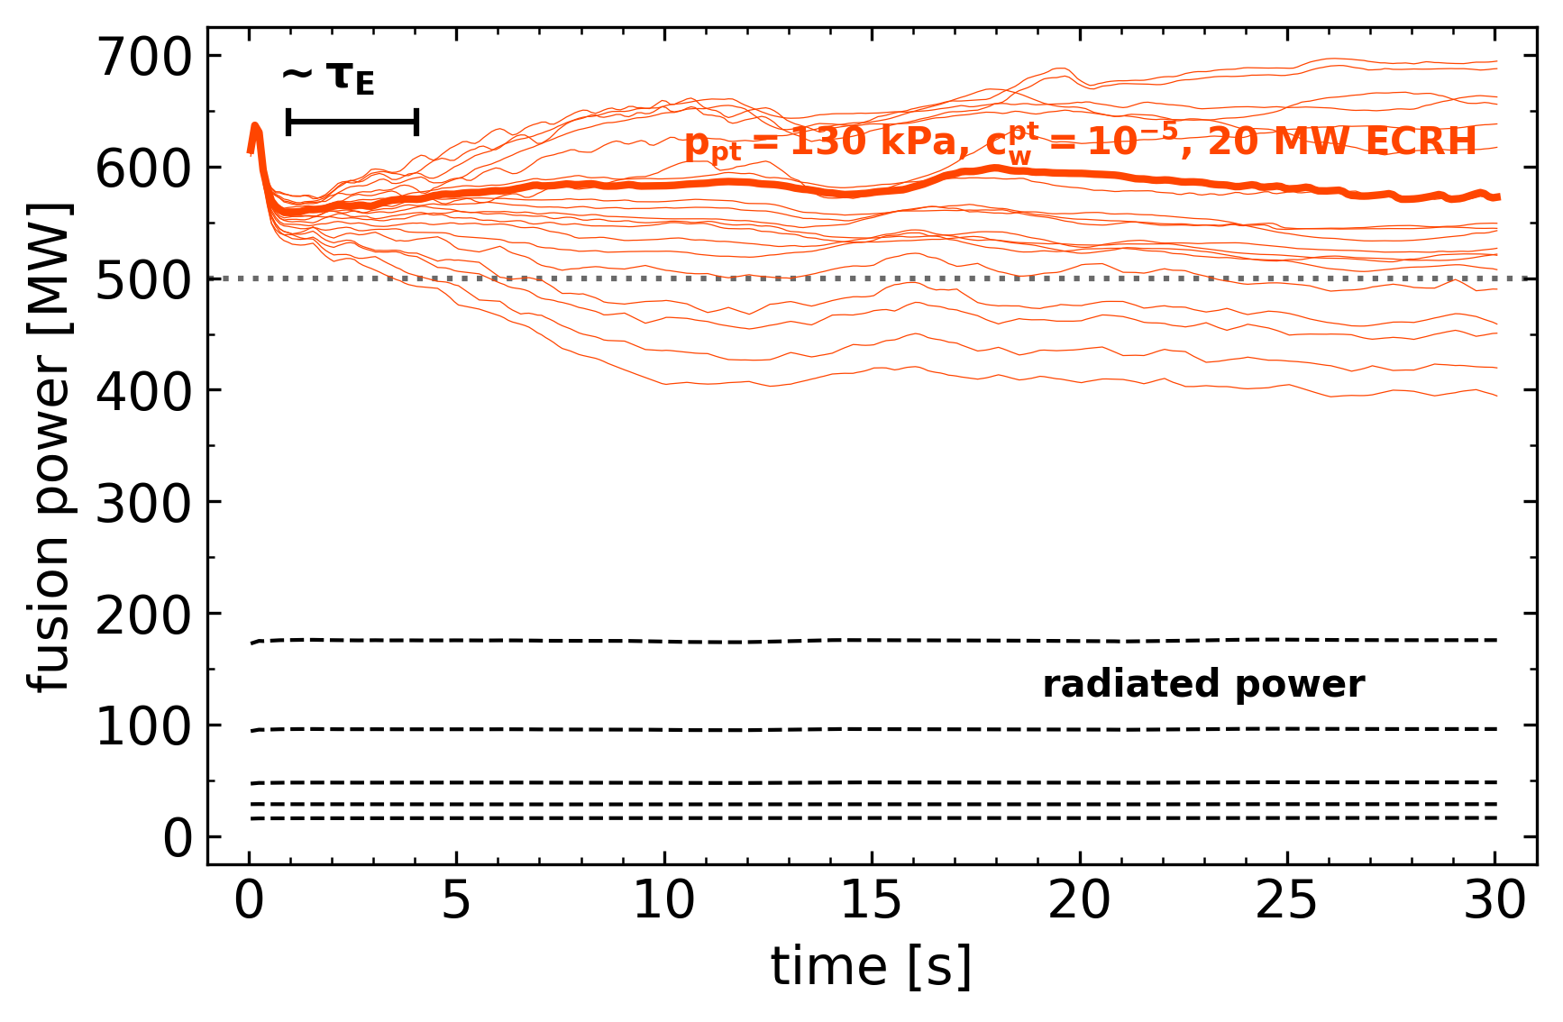
Modelling the 15 MA baseline scenario including tungsten
ITER 15 MA H-mode in DT
B_{t} = 5.3 T, 50/50 D-T mix
Boundary condition at pedestal top
Pedestal calculated with IMEP¹
30 MW of NBI
Scan in ECRH power: 0, 10, 20, 50, 70 MW
Scan in pedestal top W concentration: 10⁻⁵ to 10⁻⁴
¹ Luda 2025 NF 65 072001

Slide 23
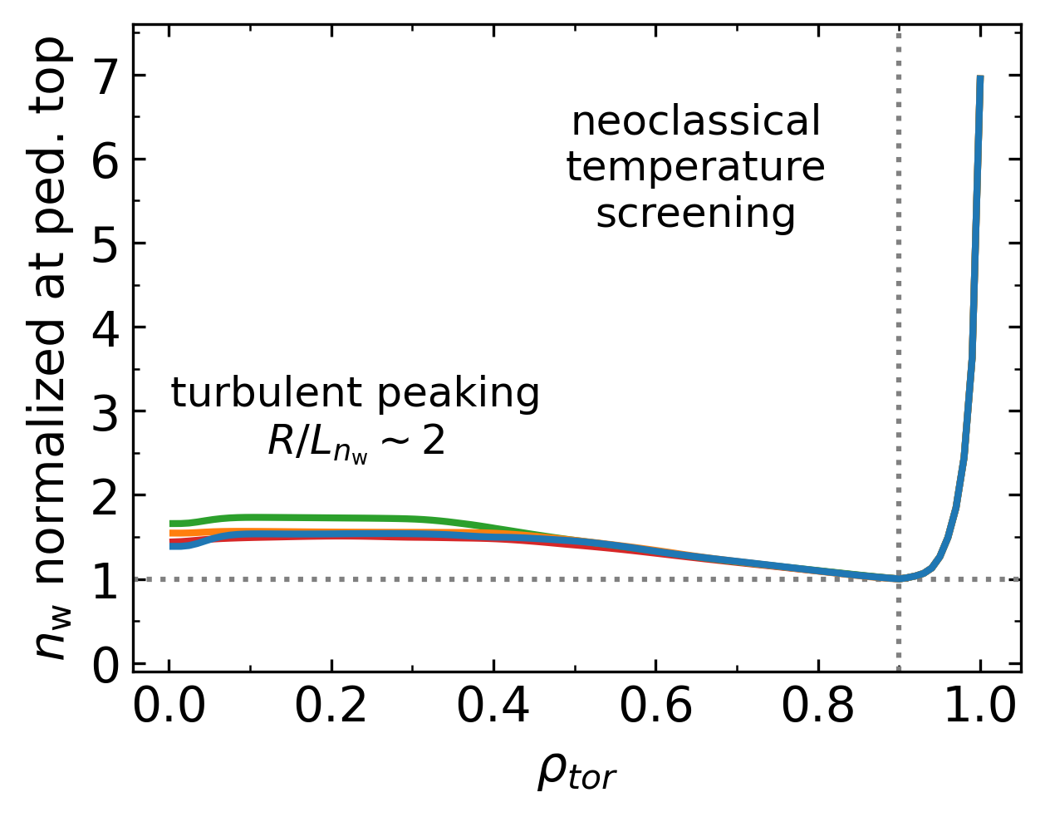
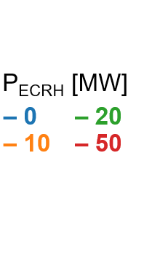
W profile shape & radiation are independent of ECRH power
ITER 15 MA H-mode in DT
ITER 15 MA
W density profile shape is practically not affected by ECRH¹
As a consequence, the radiated power losses are also independent of ECRH
¹ Fajardo 2024 NF 64 104001

Slide 24
W profile shape & radiation are independent of ECRH power
ITER 15 MA H-mode in DT
AUG #32408
ITER 15 MA
W density profile shape is practically not affected by ECRH¹
As a consequence, the radiated power losses are also independent of ECRH
¹ Fajardo 2024 NF 64 104001

Slide 25
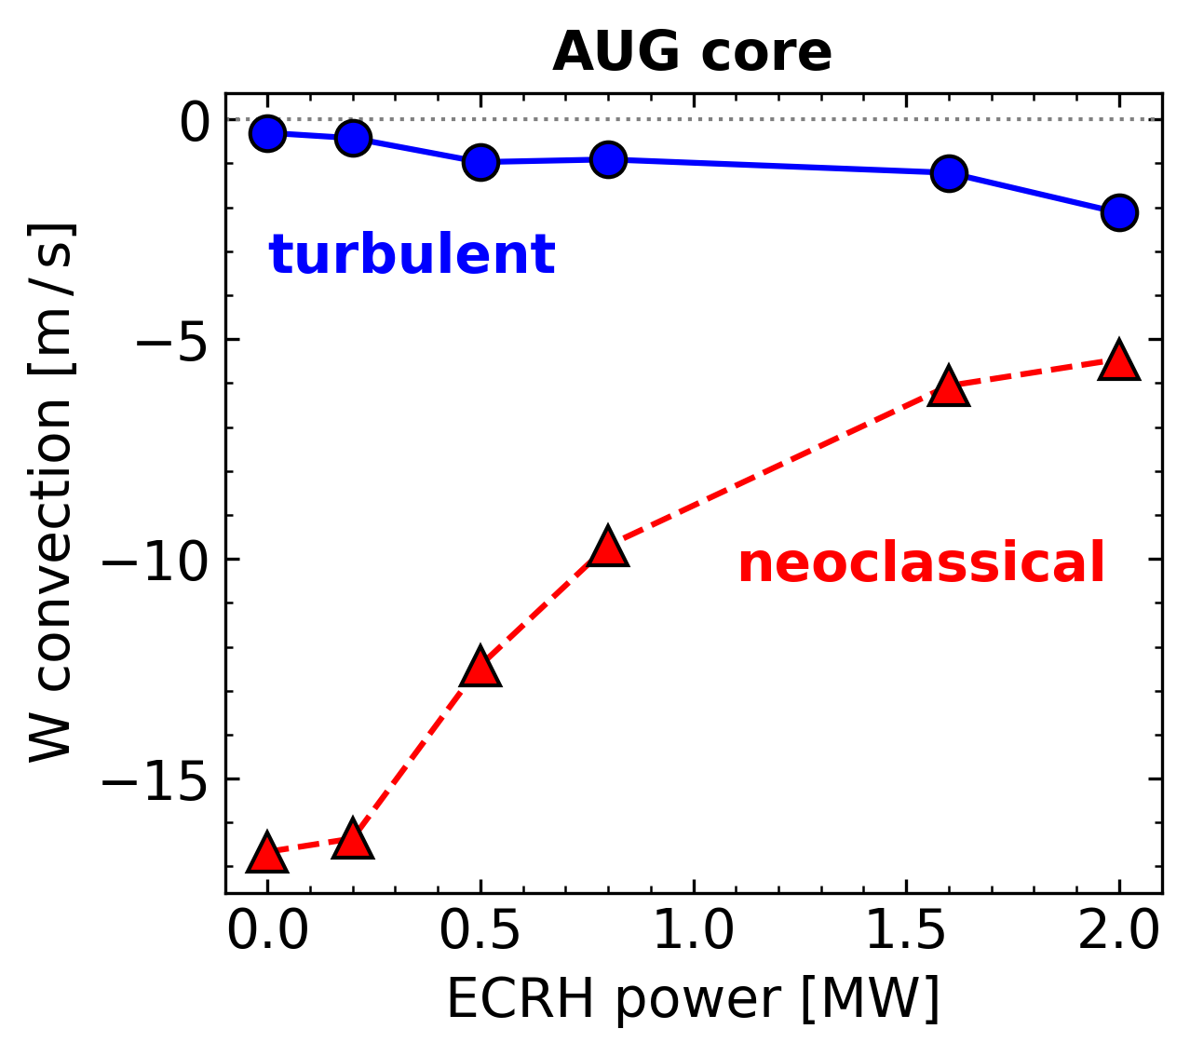
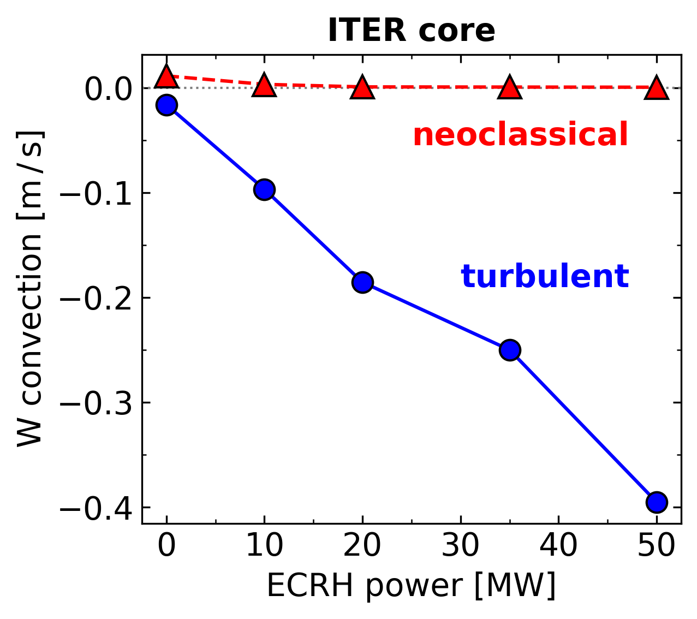
Turbulent transport is dominant for W in ITER core
In the core of ITER, the much lower collisionality and lower rotation (compared to present-day devices) cause the neoclassical transport to be almost negligible compared to turbulent transport
Turbulent transport does not lead to strong accumulation¹
Core W densities are flat regardless of ECRH power²
AUG 1.0 MA H-mode
ITER 15 MA H-mode
(+ 8 MW of NBI)
(+ 30 MW of NBI)
¹ Angioni 2021 PPCF 63 073001
² Fajardo 2024 NF 64 104001

Slide 26
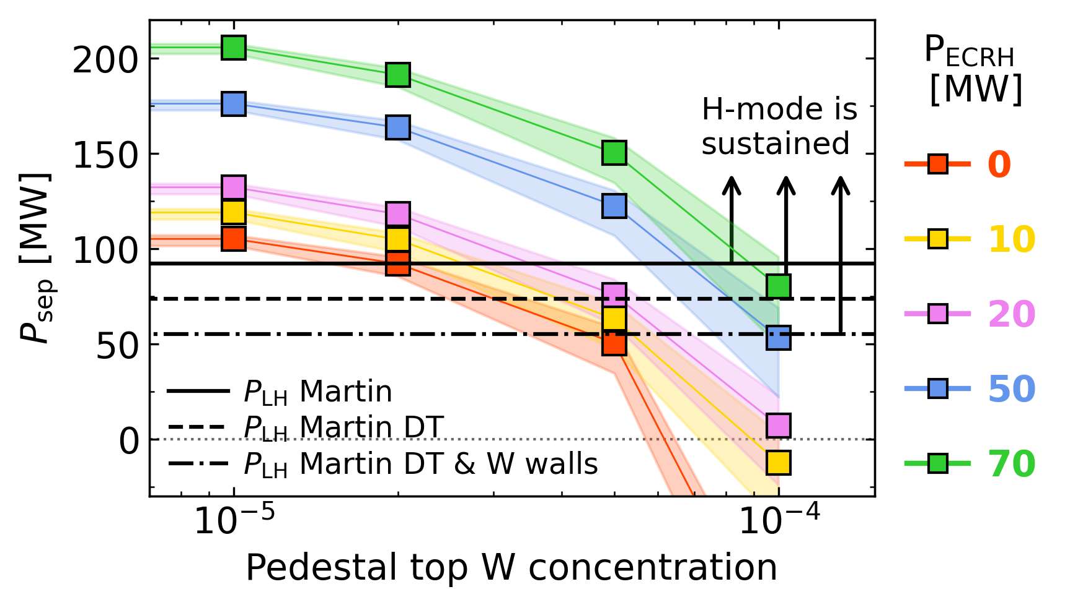
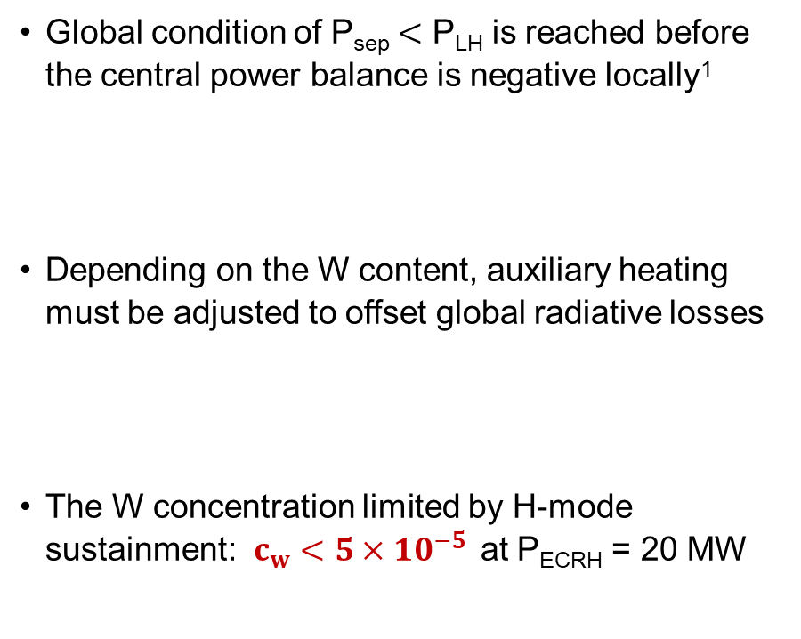
Operational limits by W are given by H-mode sustainment
ITER 15 MA H-mode in DT
Global condition of P_{sep} $<$ P_{LH} is reached before the central power balance is negative locally¹
Depending on the W content, auxiliary heating must be adjusted to offset global radiative losses
The W concentration limited by H-mode sustainment: $c_{w}<5×{10}^{−5 }$ at P_{ECRH} = 20 MW
¹ Fajardo 2024 NF 64 104001

Slide 27
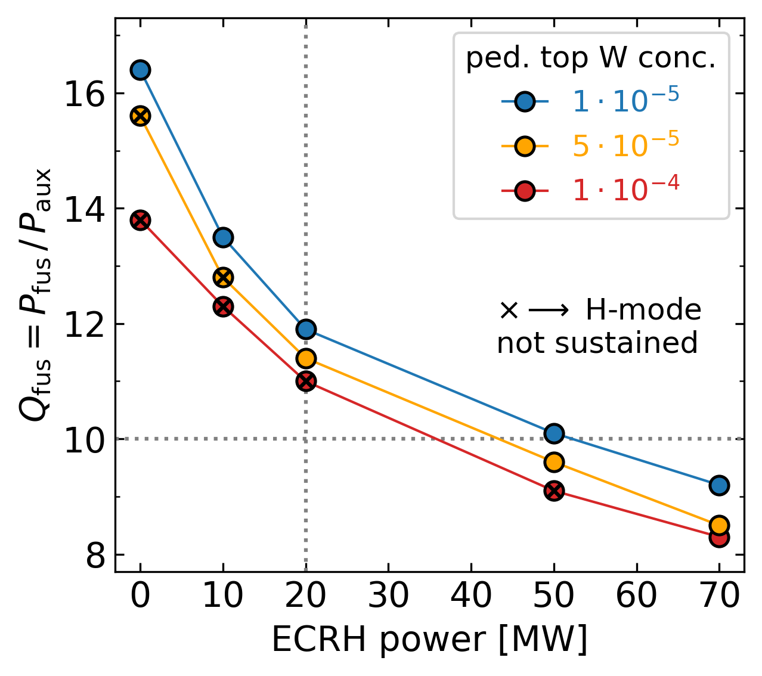
Interplay between plasma performance, heating and W content
ITER 15 MA H-mode in DT
Auxiliary heating can be raised to tolerate more W (lower Q) or lowered to reach higher Q
Little sensitivity of pedestal pressure to ECRH power in ITER¹ and stiff core profiles
ITER targets are satisfied, as long as $c_{w}$is low enough²
(+ 30 MW of NBI)
¹ Luda 2025 NF 65 072001
² Fajardo 2025 PPCF 67 015020

Slide 28
Full-radius modelling of the current ramp-up in ITER

Slide 29
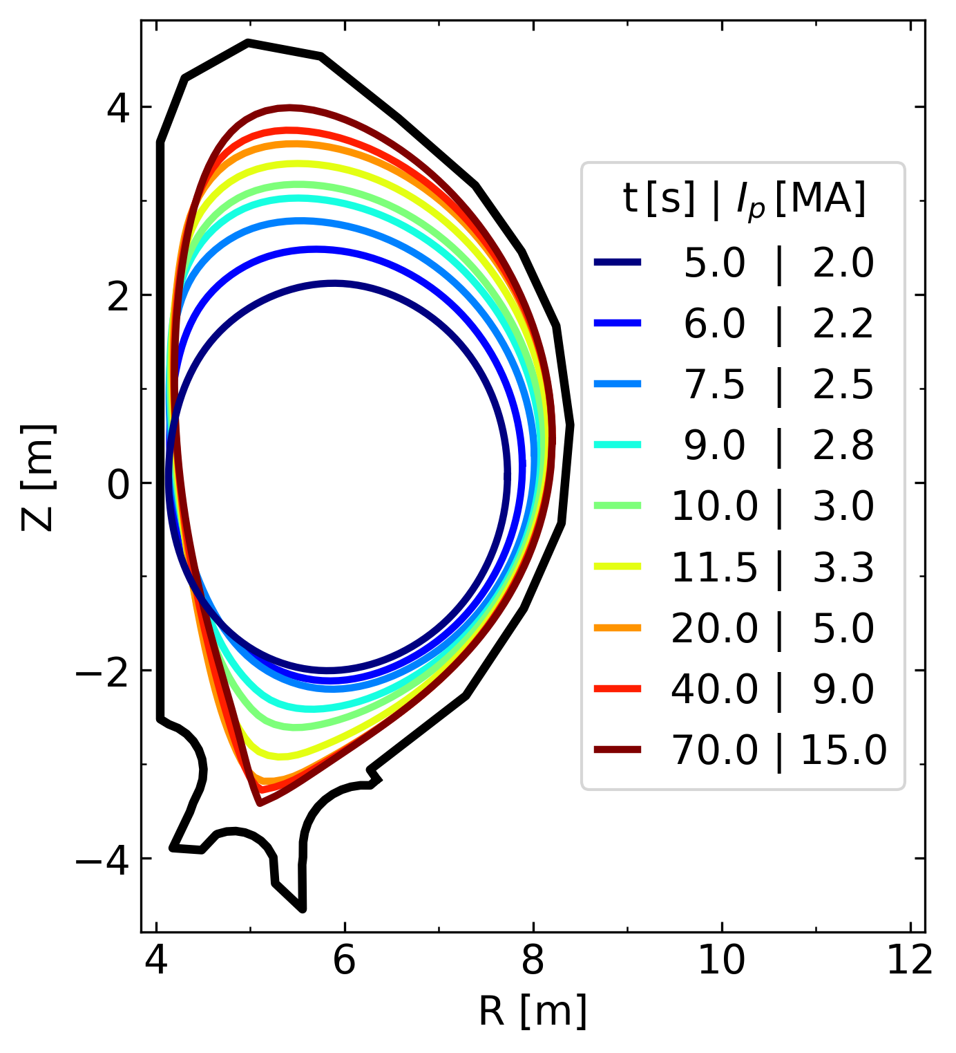
ITER current ramp-up simulations
ITER L-mode ramp-up in D
New ITER full-W wall brings particular interest to limiter phase¹
Dynamical modelling of limiter to diverted plasmas during I_{p} ramp over 65 seconds
Full-radius L-mode simulations, motivated by previous modelling of ITER electron-heated L-modes²
Scan W source to assess limits on W concentration
5.0
6.0
7.5
9.0
10.0
11.5
20.0
40.0
70.0
2.0
2.2
2.5
2.8
3.0
3.3
5.0
9.0
15.0
¹ Loarte 2025 PPCF 67 065023
² Fajardo 2025 PPCF 67 015020

Slide 30
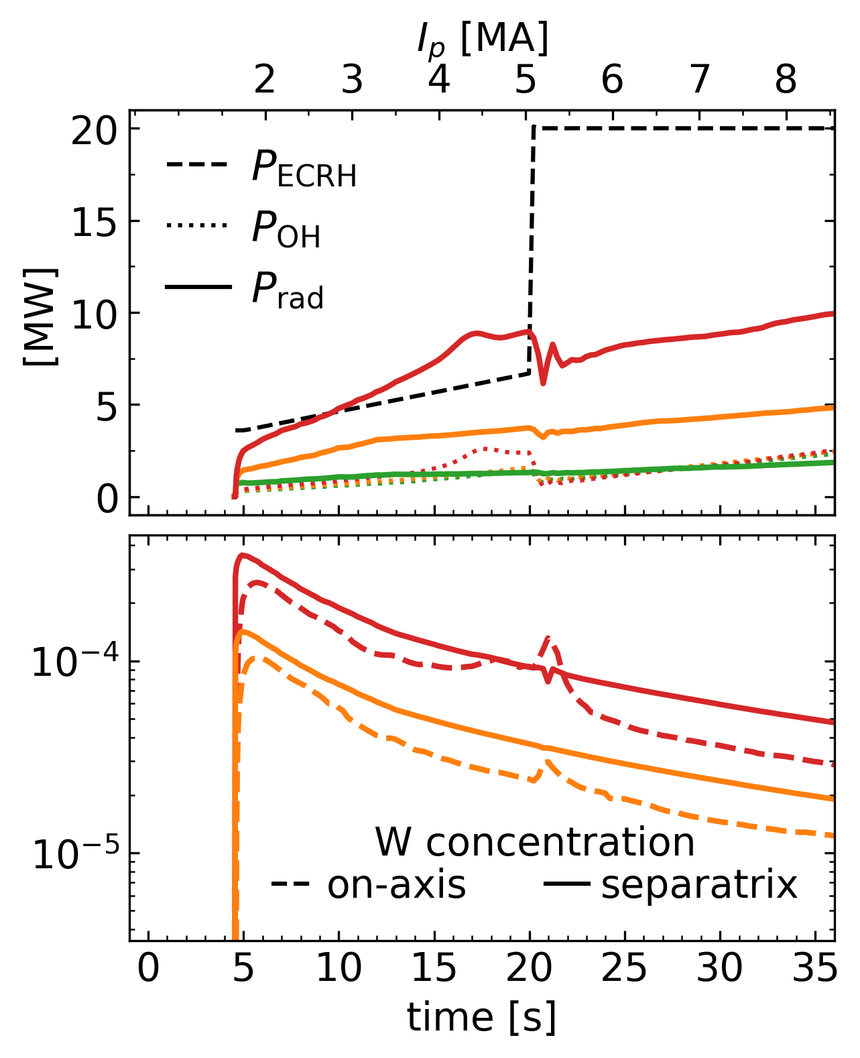
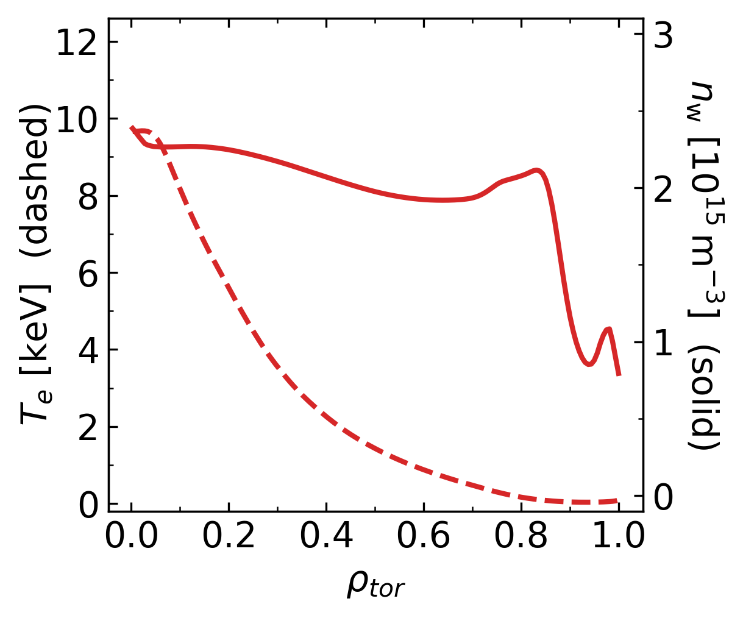
Limits of W content for plasma survival
ITER L-mode ramp-up in D
maximum W source, profiles before EC step
without W
intermediate W
maximum W
W concentration during limiter phase of 10⁻⁴ is tolerable, 3×10⁻⁴ is problematic¹
Plasma marginally survives at highest W source, but edge T_{e} collapses and W pedestal develops
¹ Fajardo 2025 PPCF 67 015020

Slide 31
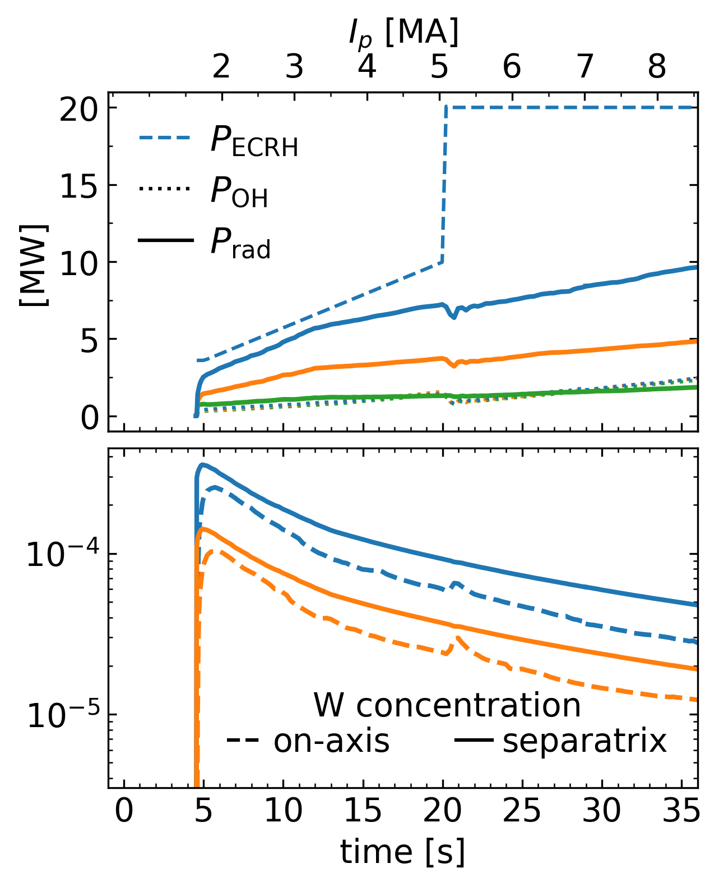
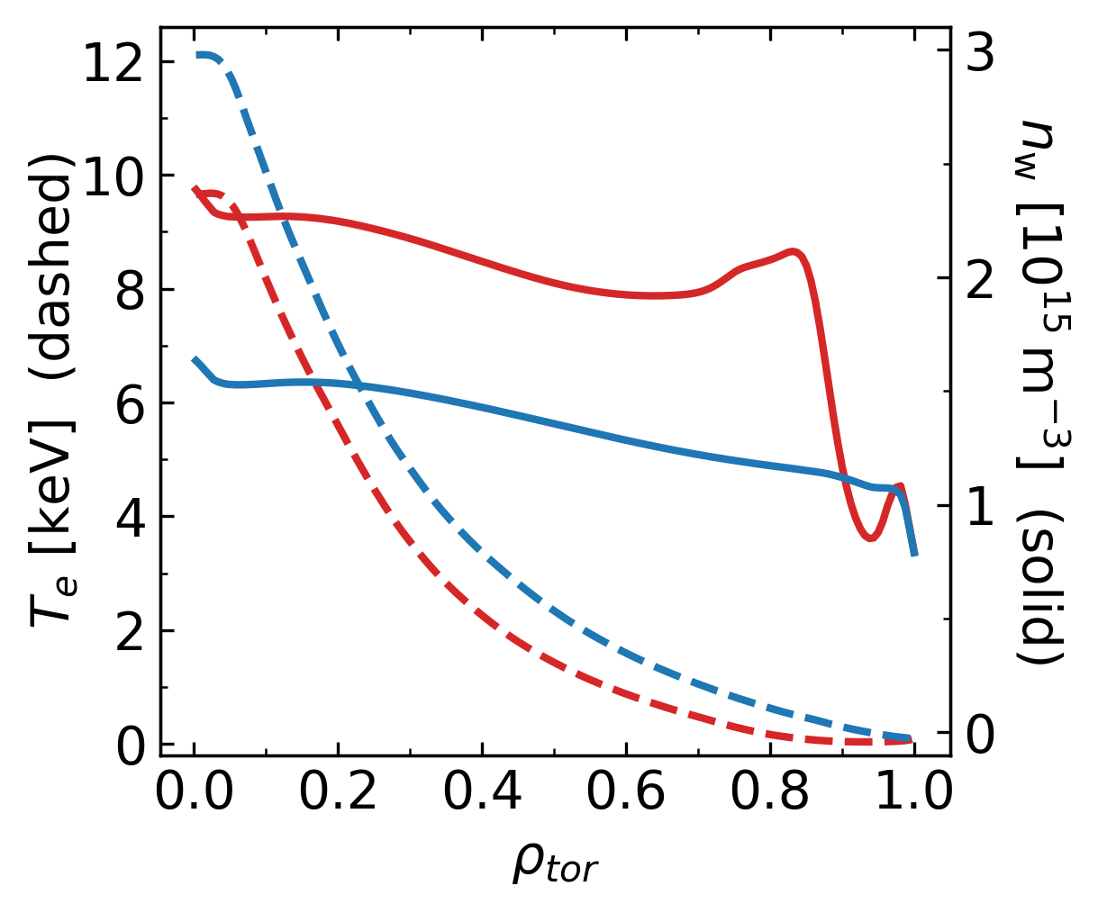
Slightly modified ECRH ramp alleviates problems at high W
ITER L-mode ramp-up in D
maximum W source, profiles before EC step
without W
intermediate W
maximum W with faster ECRH ramp
Optimized heating trajectory avoids transient increase of W radiation at high W source
Higher W concentrations can be tolerated by slightly modifying the ECRH ramp¹
¹ Fajardo 2025 PPCF 67 015020

Slide 32
Summary and conclusions

Slide 33
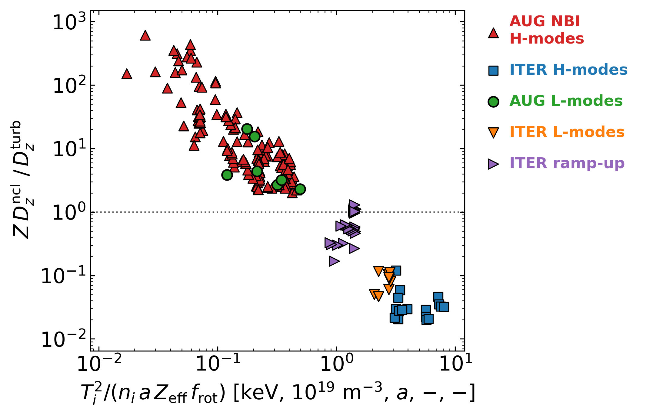

Key takeaway points
Theory-based integrated modelling with impurity transport → validated on present experiments → allows quantitative predictions
Transition from dominant neoclassical to turbulent W transport towards reactors
In ITER, auxiliary heating power is required to keep the plasma in H-mode, not to control central W accumulation
Predictive modelling allows optimization of heating trajectories in transient phases like current ramps
More neoclassical: potential for accumulation
More turbulent: flat core high-Z densities
for W: f_{rot} ≈
(1 + (8 M_{i})² )²
1 + (8 M_{i})⁴ / 50
$\frac{D_{gB}}{D_{ncl}}∼ \frac{{(v}_{ti}^{2}/Ω_{ci})(ρ_{i}/a)}{Z_{eff} ν_{z} ρ_{z}^{2} f_{rot}}\sim \frac{T_{i}^{2}}{n_{i} a Z_{eff} f_{rot}}$
Notes:
Integration challenge of radiated power-dilution-confinement
Future simulation of rotation

Slide 34
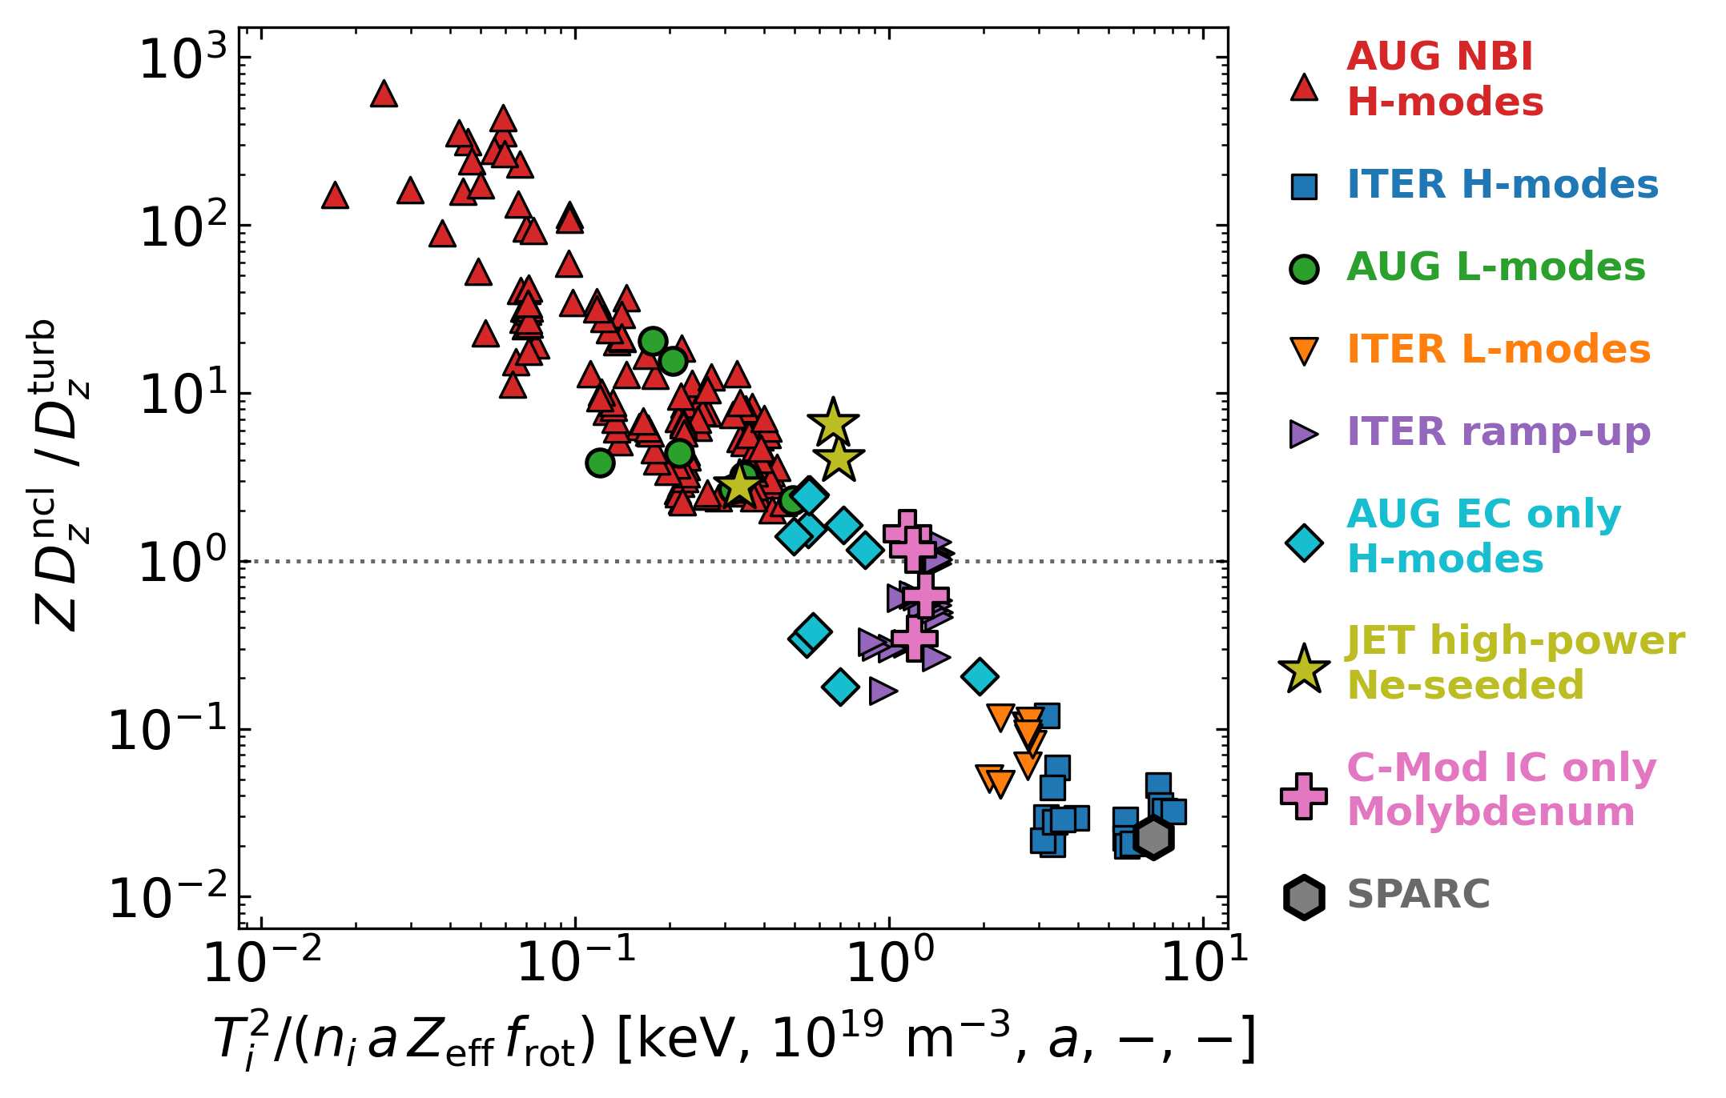


Key takeaway points
Theory-based integrated modelling with impurity transport → validated on present experiments → allows quantitative predictions
Transition from dominant neoclassical to turbulent W transport towards reactors
In ITER, auxiliary heating power is required to keep the plasma in H-mode, not to control central W accumulation
Predictive modelling allows optimization of heating trajectories in transient phases like current ramps
More neoclassical: potential for accumulation
More turbulent: flat core high-Z densities
¹
¹
for W: f_{rot} ≈
(1 + (8 M_{i})² )²
^{1,2}
1 + (8 M_{i})⁴ / 50
³
$\frac{D_{gB}}{D_{ncl}}∼ \frac{{(v}_{ti}^{2}/Ω_{ci})(ρ_{i}/a)}{Z_{eff} ν_{z} ρ_{z}^{2} f_{rot}}\sim \frac{T_{i}^{2}}{n_{i} a Z_{eff} f_{rot}}$
¹ Fajardo 2026 NF
² Perks 2025 PoP
³ Muraca 2026 PPCF
¡Vamos Colombia!
Notes:
Integration challenge of radiated power-dilution-confinement
Future simulation of rotation

Slide 35
Additional material

Slide 36
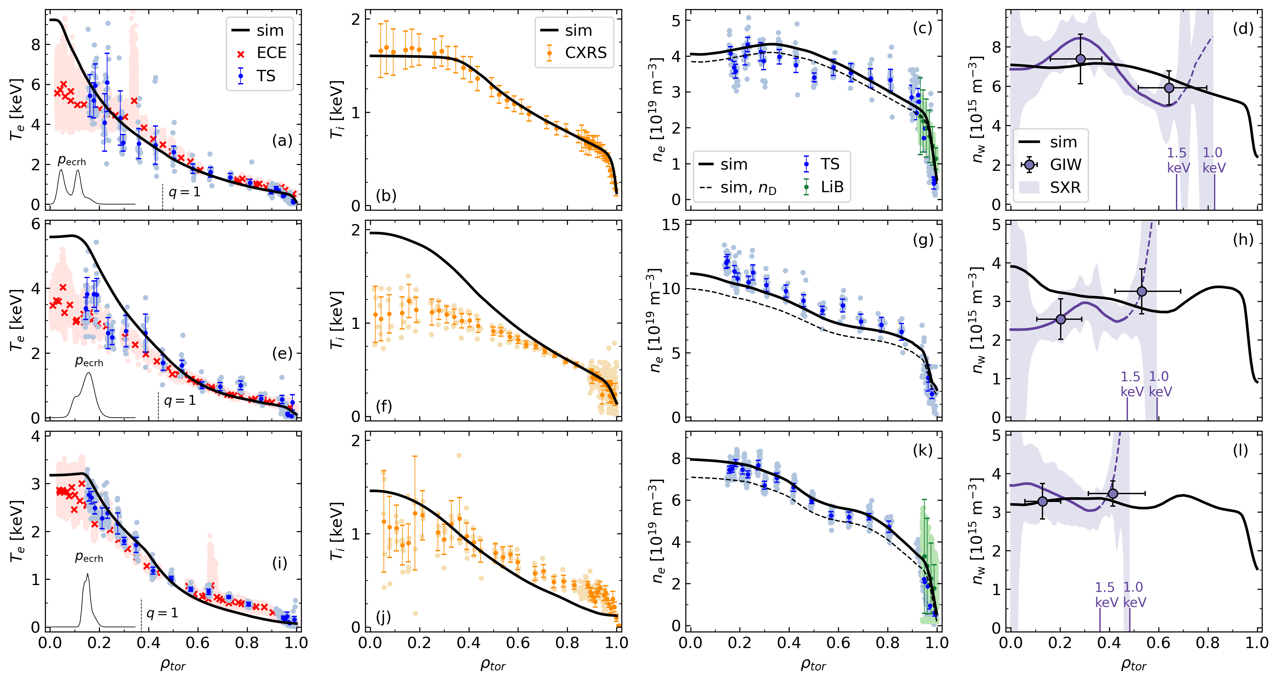
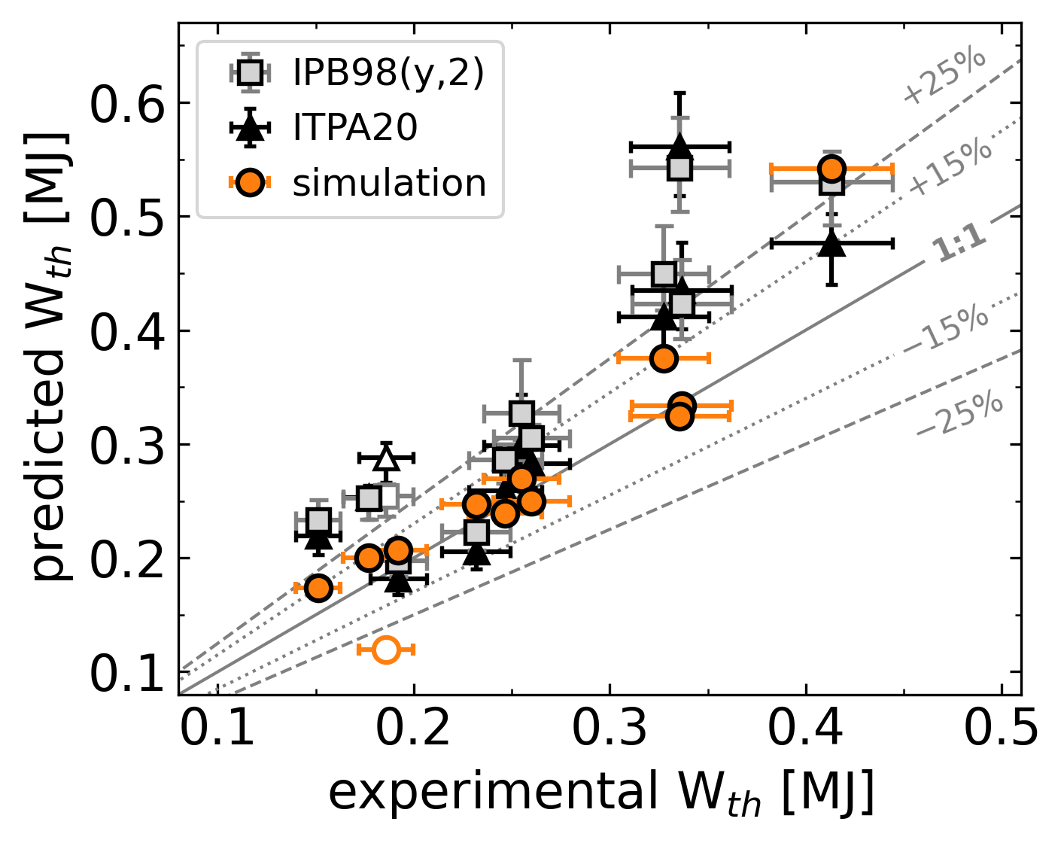
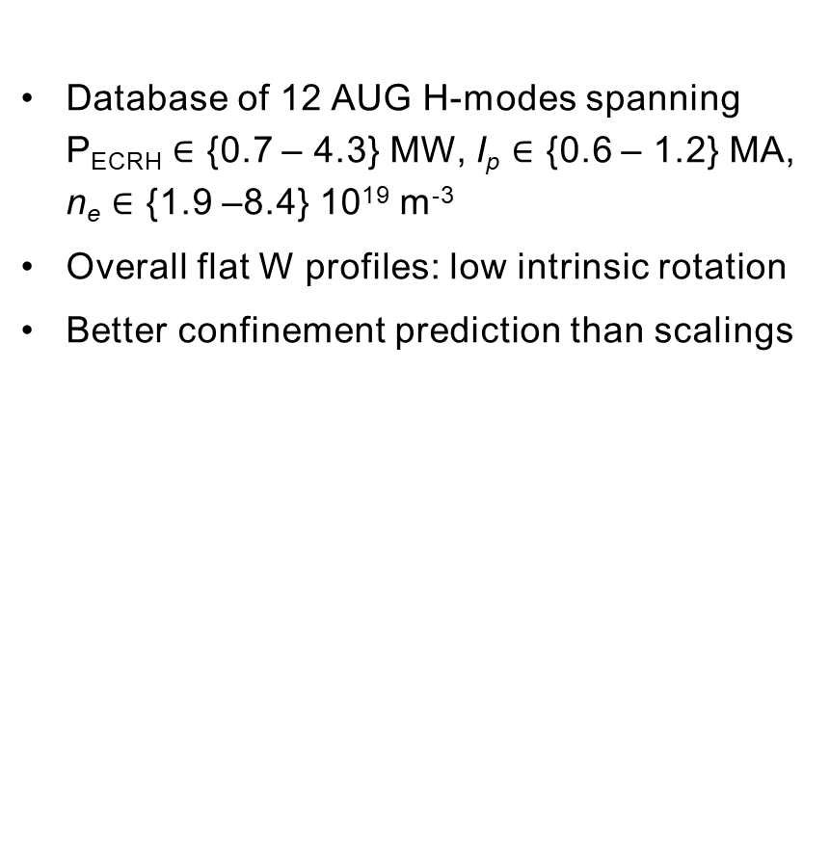
Simulations of ECRH-only AUG H-modes
AUG H-modes with only ECRH
Database of 12 AUG H-modes spanning P_{ECRH} $∈$ {0.7 – 4.3} MW, I_{p} $∈$ {0.6 – 1.2} MA, n_{e} $∈$ {1.9 –8.4} 10¹⁹ m⁻³
Overall flat W profiles: low intrinsic rotation
Better confinement prediction than scalings
AUG #37909
[Fajardo 2026 NF 66 046005]

Slide 37
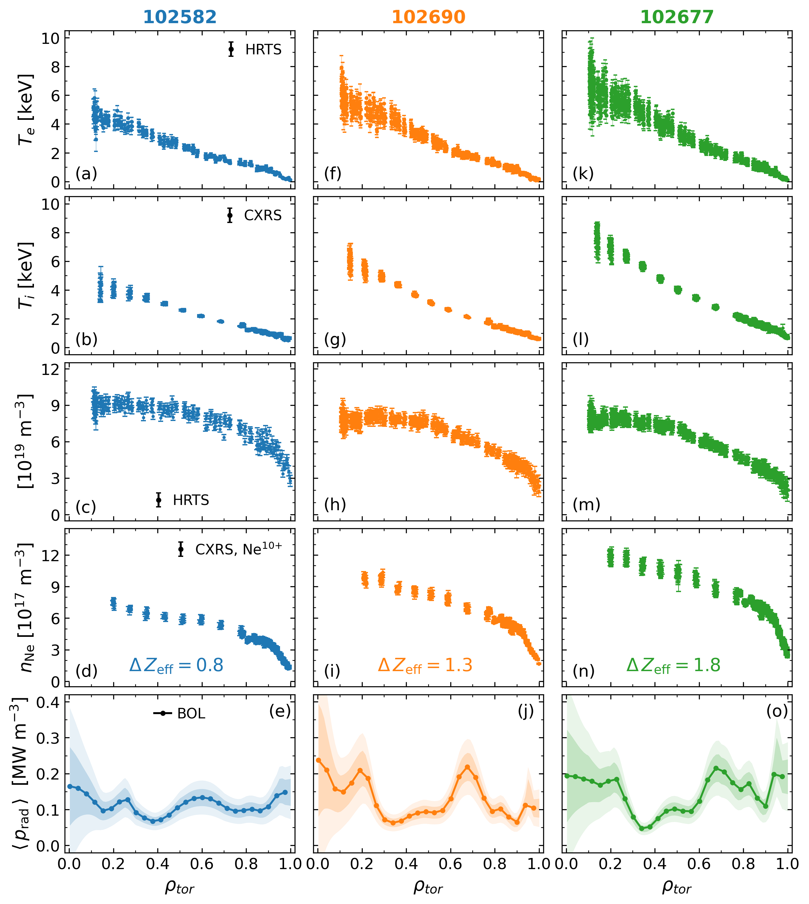
Full-radius modelling of JET high power Ne seeded plasmas
JET-ILW 3.2 MA 32 MW with Ne
High current I_{p} = 3.2 MA at B_{t} = 3.45 T (q₉₅ ~ 3.3) in deuterium
28 MW of NBI, 4 MW of ICRH
Neon seeding: low, intermediate, high
[Giroud 2025 IAEA FEC]

Slide 38
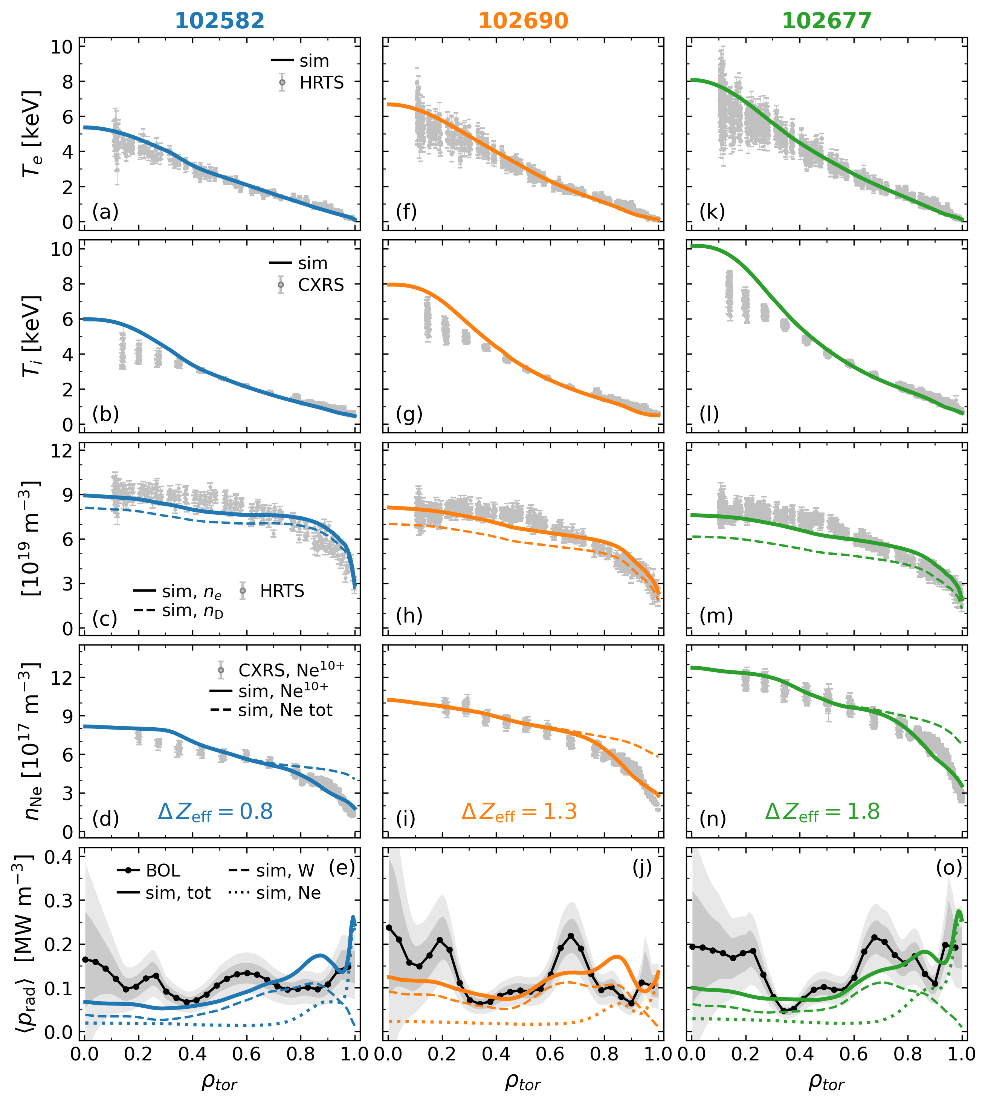
Full-radius modelling of JET high power Ne seeded plasmas
JET-ILW 3.2 MA 32 MW with Ne
High current I_{p} = 3.2 MA at B_{t} = 3.45 T (q₉₅ ~ 3.3) in deuterium
28 MW of NBI, 4 MW of ICRH
Neon seeding: low, intermediate, high
[Giroud 2025 IAEA FEC]
Excellent agreement with experiment across all transport channels¹
Including neon is necessary to reproduce the main profiles and global confinement in the simulations
Flat radiation profiles by W and Ne
¹ Fajardo 2026 NF 66 046005

Slide 39
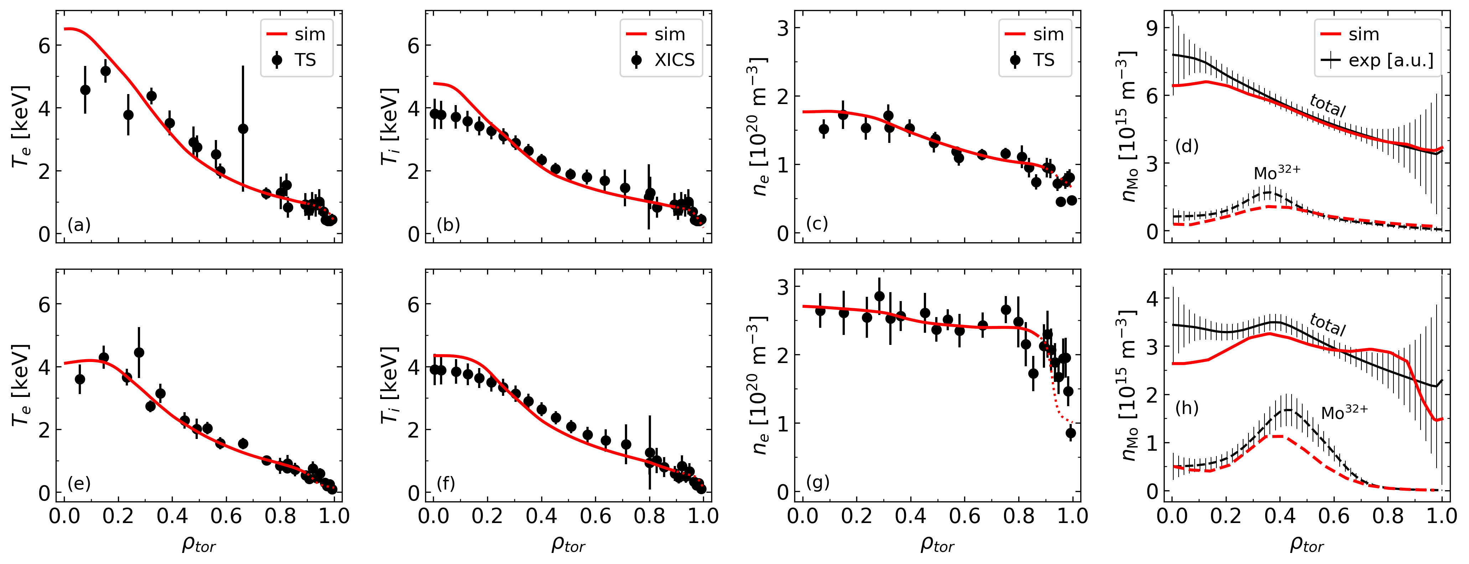
Simulations of Alcator C-Mod plasmas with Molybdenum
C-Mod H-,I- & L-modes in D
I-mode
H-mode
[Fajardo 2026 NF 66 046005]

Slide 40
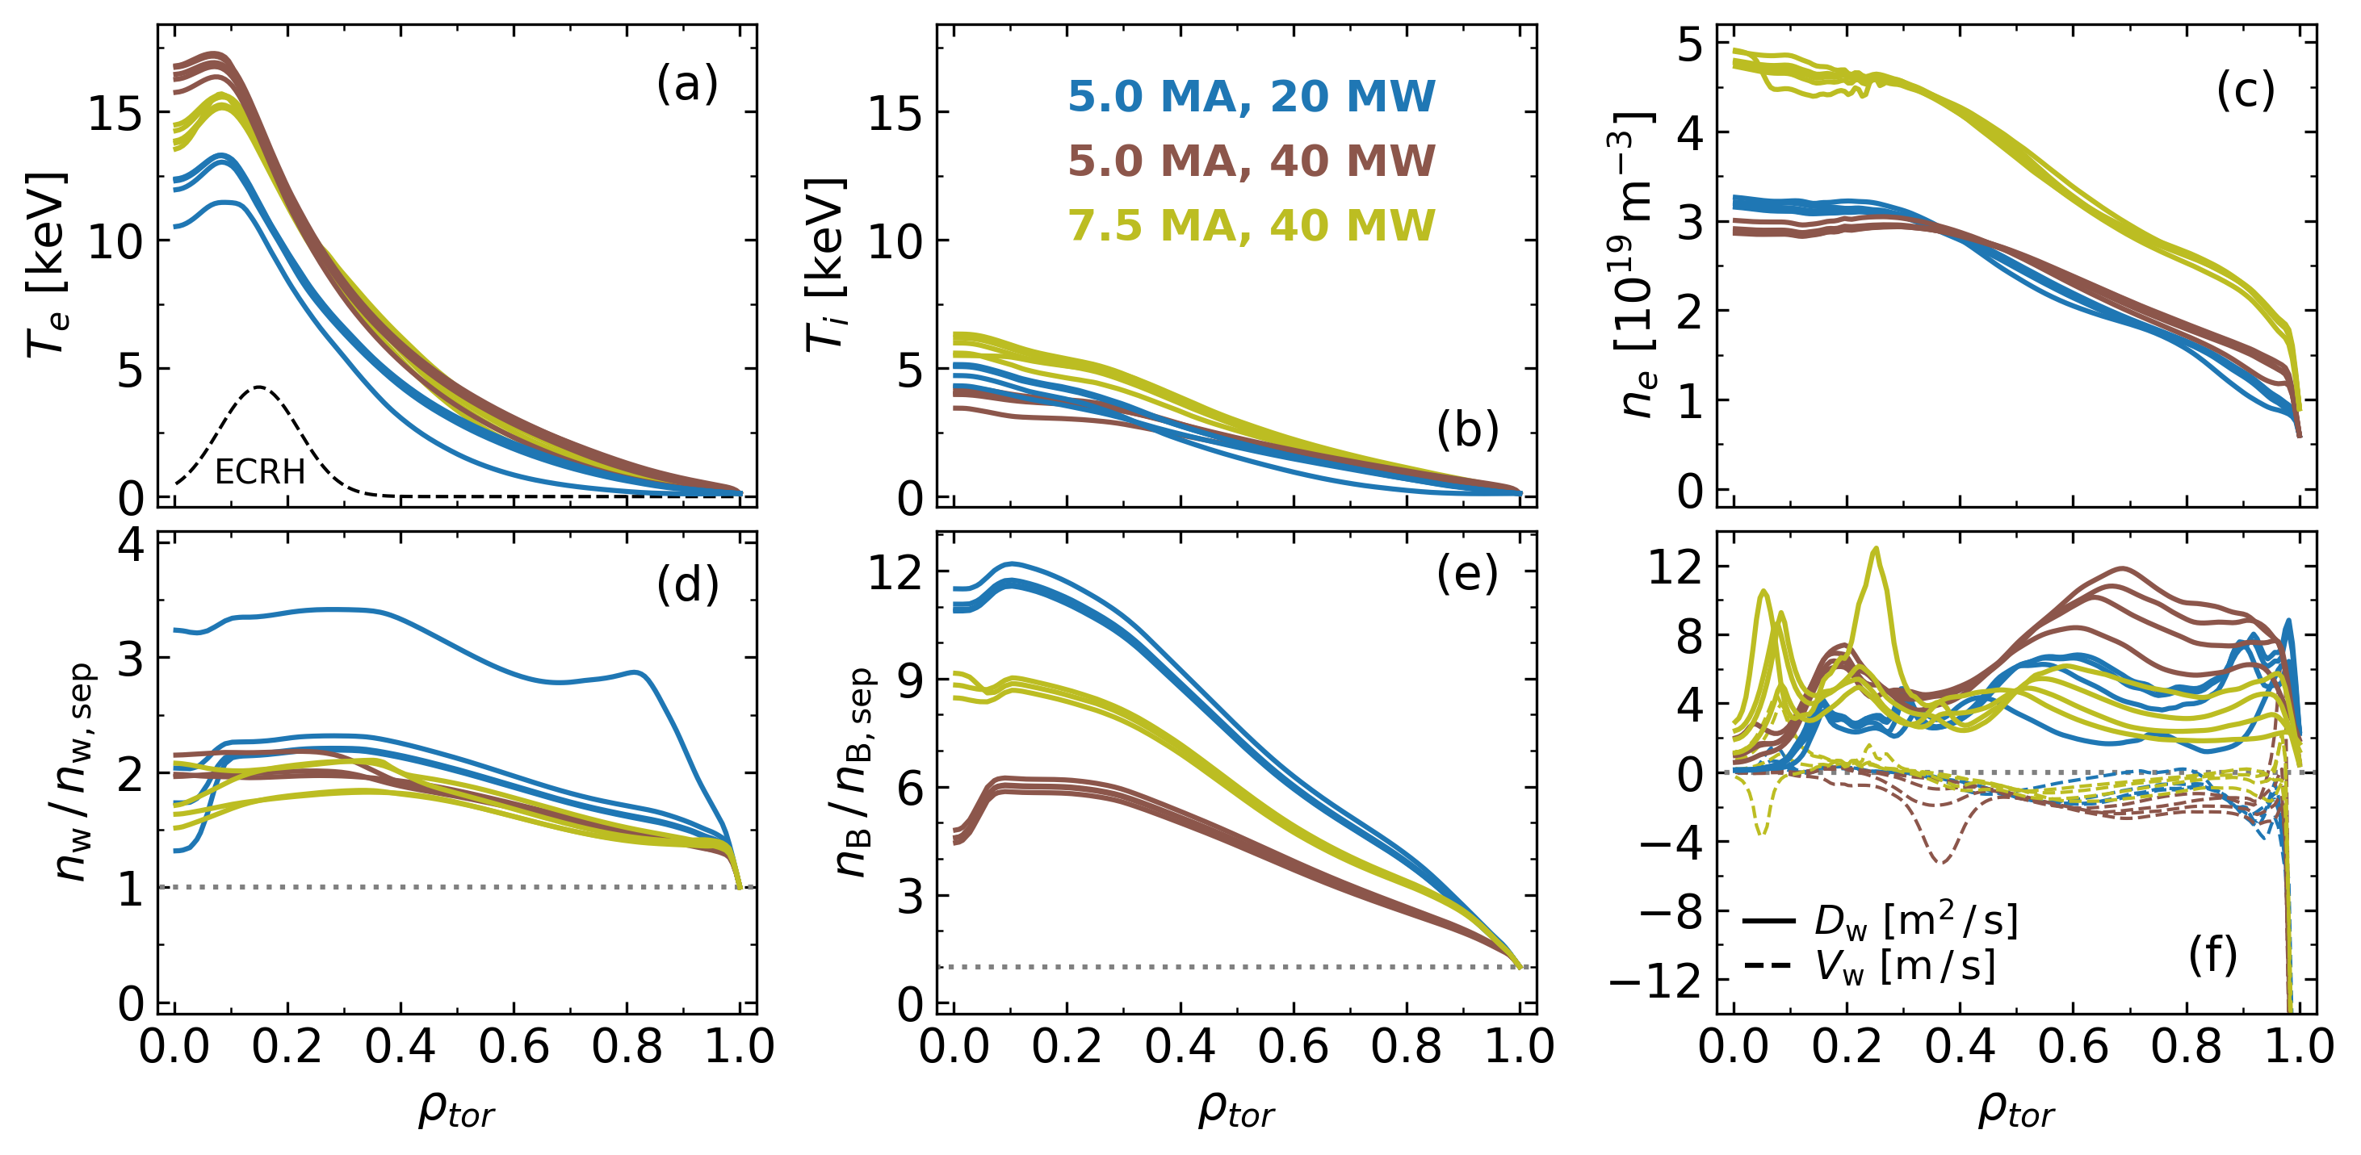
Full-radius simulations of electron-heated ITER L-modes
ITER 5 & 7.5 MA L-modes in D
5.0 MA with 20 MW and 40 MW of ECRH
7.5 MA with 40 MW of ECRH
B_{t} = 2.65 T, D plasmas, constant GW fraction
[Fajardo 2025 PPCF 67 015020]

Slide 41
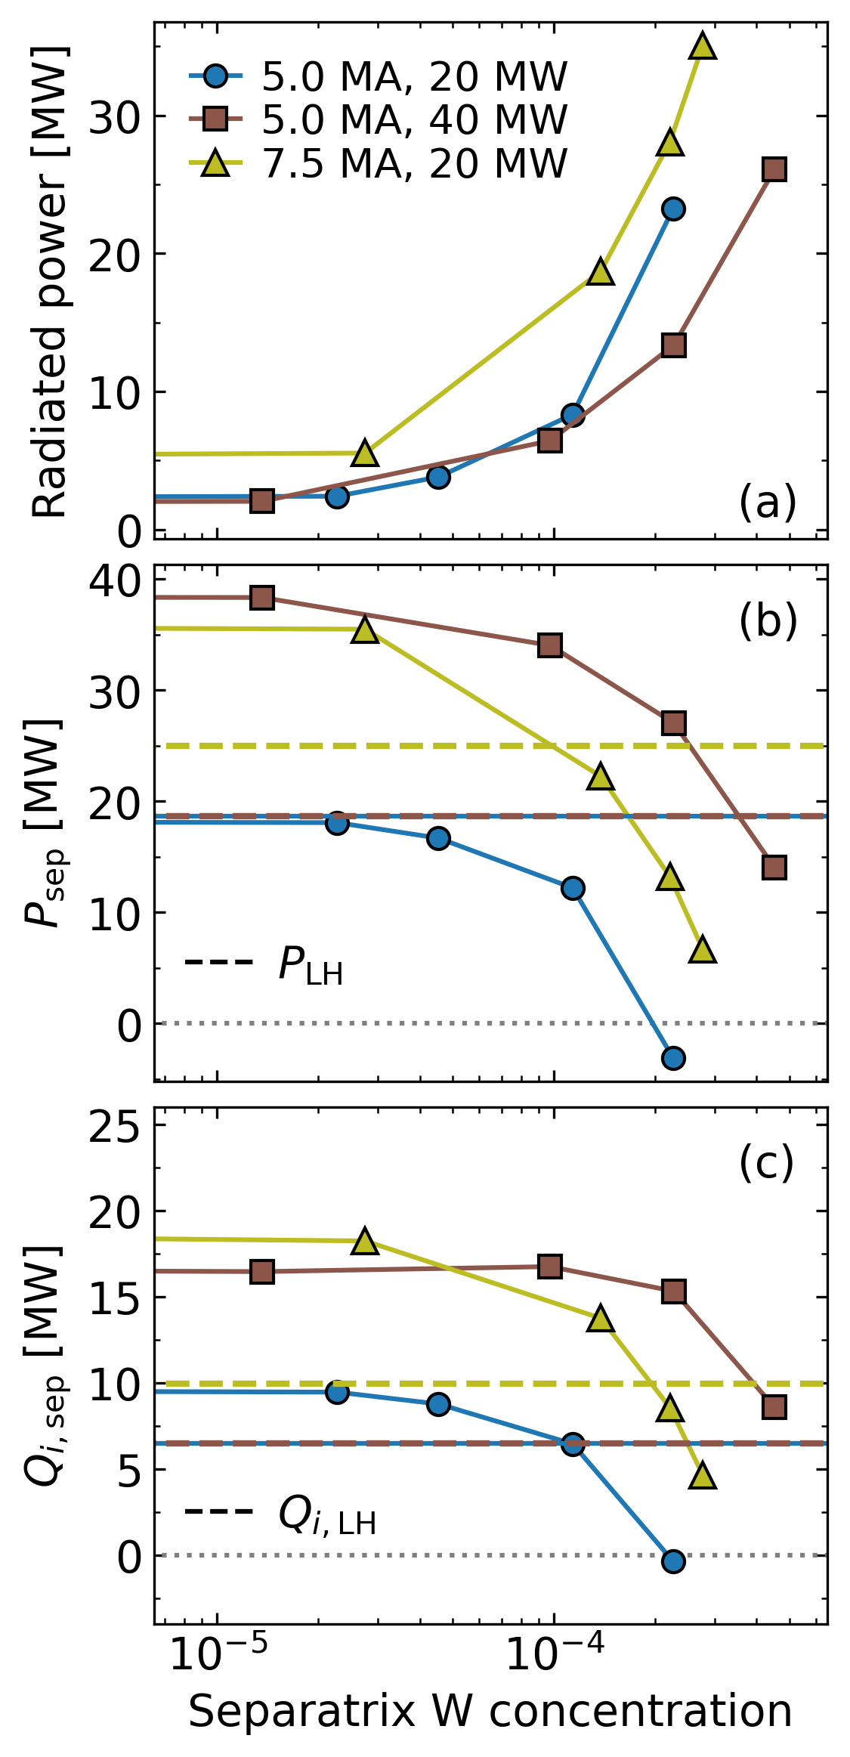
Radiation and access to H-mode
ITER 5 & 7.5 MA L-modes in D
5.0 MA, 20 MW
5.0 MA, 40 MW
7.5 MA, 40 MW
With our modelling assumptions, 20 MW of ECRH do not allow access to H-mode
40 MW of ECRH enables H-mode operation in D provided the separatrix W concentration remains below: 3×10⁻⁴ at 5MA, 1.5×10⁻⁴ at 7.5MA
[Fajardo 2025 PPCF 67 015020]

Slide 42
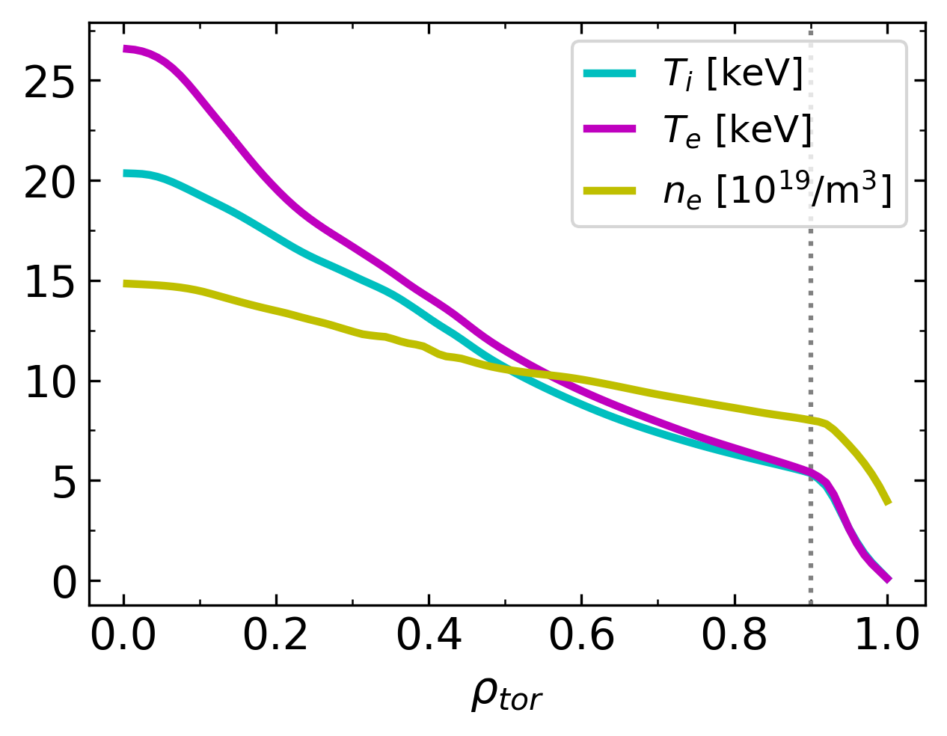
Main plasma profiles
ITER 15 MA H-mode in DT
Pedestal calculated with IMEP¹, kept fixed across the scans in ECRH power and W concentration
Core profiles evolved using TGLF-SAT2
Rotation profile from previous predictions^{2,3} was kept fixed, fusion power might be sensitive to it¹
TGLF-SAT2 + IMEP
¹ Luda 2025 NF 65 072001
² Singh 2017 NJP 19 055004
³ Chrystal 2020 NF 60 036003

Slide 43
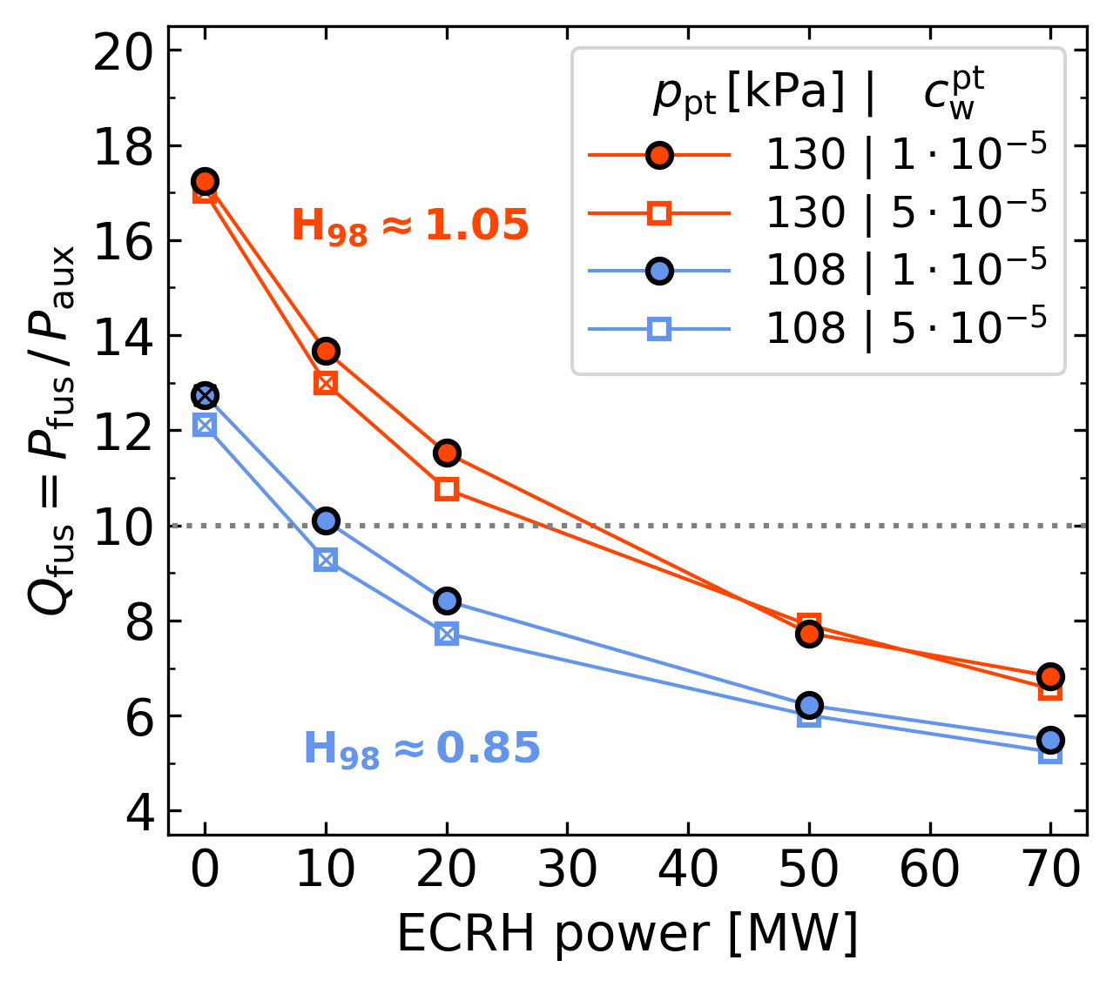
Interplay between plasma performance, heating and W content
ITER 15 MA H-mode in DT
Auxiliary heating can be raised to tolerate more W (lower Q) or lowered to reach higher Q
Little sensitivity of pedestal pressure to ECRH power in ITER²
x → H-mode not sustained
Pedestal top pressure at IMEP (& EPED) value of 130 kPa gives:
        better performance in Q (+1-5 w.r.t. 108 kPa)¹
        Higher margin for H-mode sustainment due to higher alpha heating (+20-30MW w.r.t. 108 kPa)¹
(+ 30 MW of NBI)
¹ Fajardo 2025 PPCF 67 015020
² Luda 2025 NF 65 072001
ITER targets are satisfied, as long as $c_{w}$and P_{LH} are low enough

Slide 44
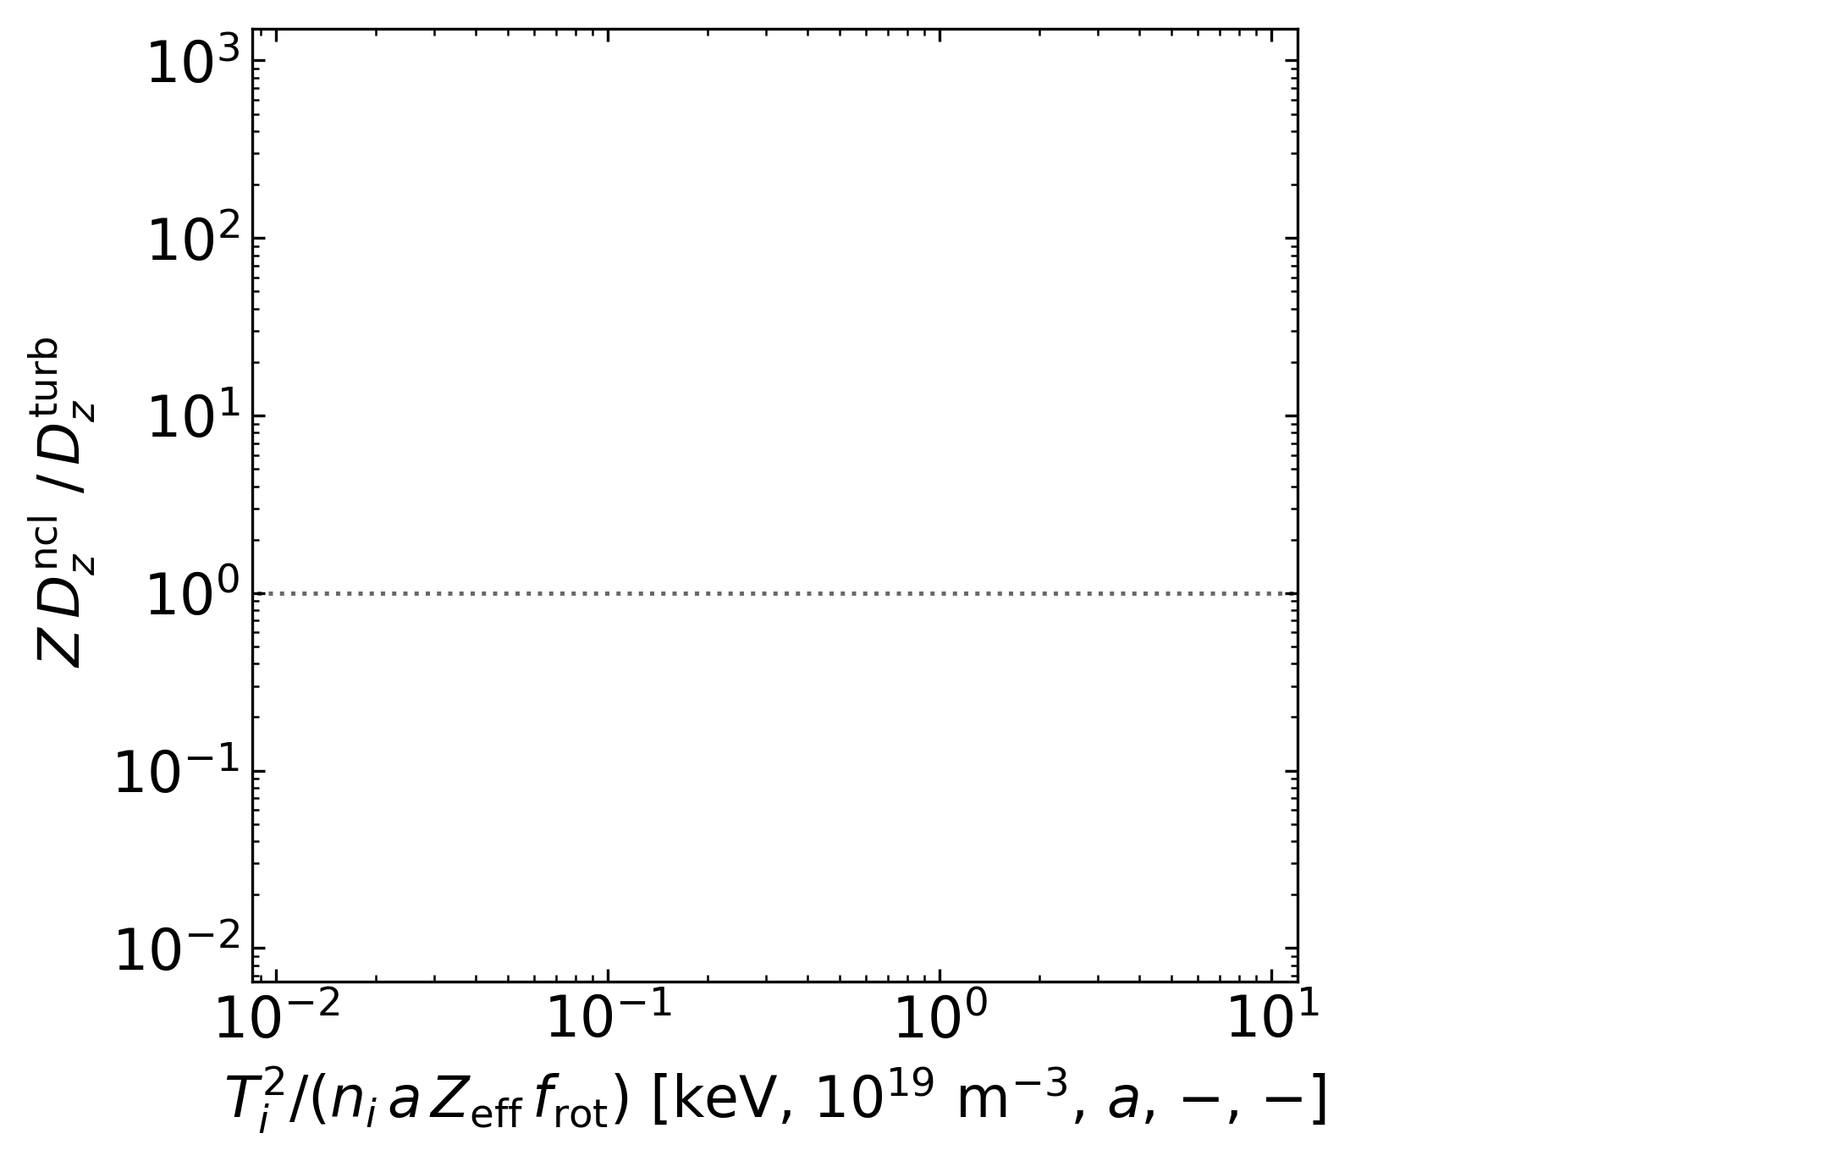
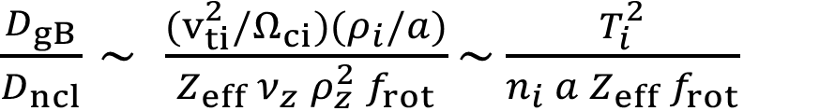
Transition from dominant neoclassical to turbulent W transport
In present-day devices, core W convection is mostly neoclassical and diffusion is mostly turbulent
In reactor core, much lower collisionality (and rotation) → convection is also mostly turbulent
calculated with transport codes
Simple rule-of-thumb with known/expected plasma parameters
$\frac{D_{gB}}{D_{ncl}}∼ \frac{{(v}_{ti}^{2}/Ω_{ci})(ρ_{i}/a)}{Z_{eff} ν_{z} ρ_{z}^{2} f_{rot}}\sim \frac{T_{i}^{2}}{n_{i} a Z_{eff} f_{rot}}$
(1 + (8 M_{i})² )²
for tungsten: f_{rot} ≈
1 + (8 M_{i})⁴ / 50

Slide 45
Transition from dominant neoclassical to turbulent W transport
In present-day devices, core W convection is mostly neoclassical and diffusion is mostly turbulent
In reactor core, much lower collisionality (and rotation) → convection is also mostly turbulent
More neoclassical: potential for accumulation
More turbulent: flat core high-Z densities
$\frac{D_{gB}}{D_{ncl}}∼ \frac{{(v}_{ti}^{2}/Ω_{ci})(ρ_{i}/a)}{Z_{eff} ν_{z} ρ_{z}^{2} f_{rot}}\sim \frac{T_{i}^{2}}{n_{i} a Z_{eff} f_{rot}}$
(1 + (8 M_{i})² )²
for tungsten: f_{rot} ≈
1 + (8 M_{i})⁴ / 50

Slide 46
Transition from dominant neoclassical to turbulent W transport
In present-day devices, core W convection is mostly neoclassical and diffusion is mostly turbulent
In reactor core, much lower collisionality (and rotation) → convection is also mostly turbulent
¹
¹
^{1,2}
³
$\frac{D_{gB}}{D_{ncl}}∼ \frac{{(v}_{ti}^{2}/Ω_{ci})(ρ_{i}/a)}{Z_{eff} ν_{z} ρ_{z}^{2} f_{rot}}\sim \frac{T_{i}^{2}}{n_{i} a Z_{eff} f_{rot}}$
¹ Fajardo subm. to NF
² Perks subm. to NF
³ Muraca 2025 EU-US TTF
for W: f_{rot} ≈
(1 + (8 M_{i})² )²
1 + (8 M_{i})⁴ / 50

