Slide 1


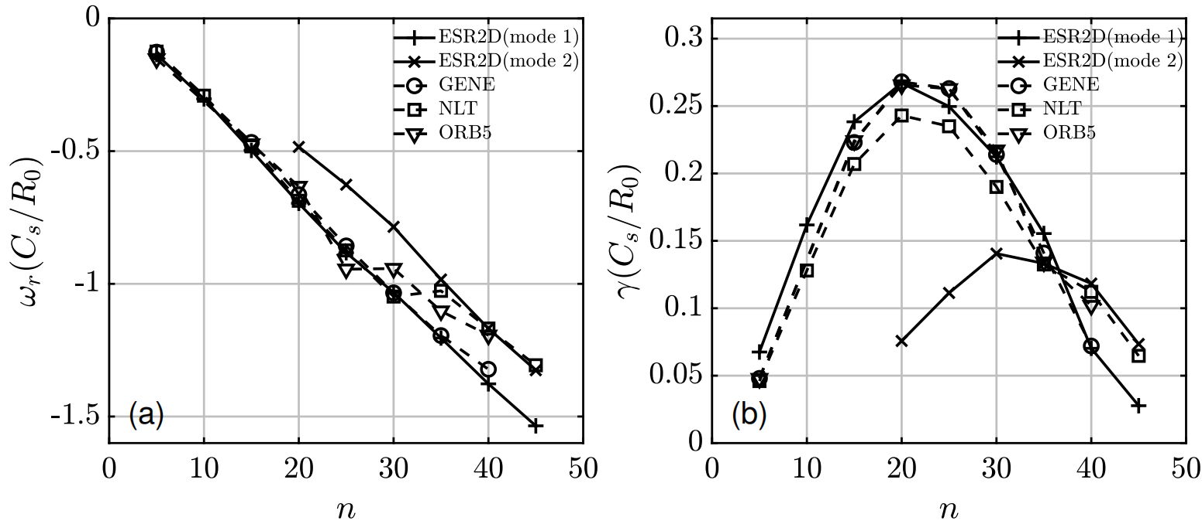
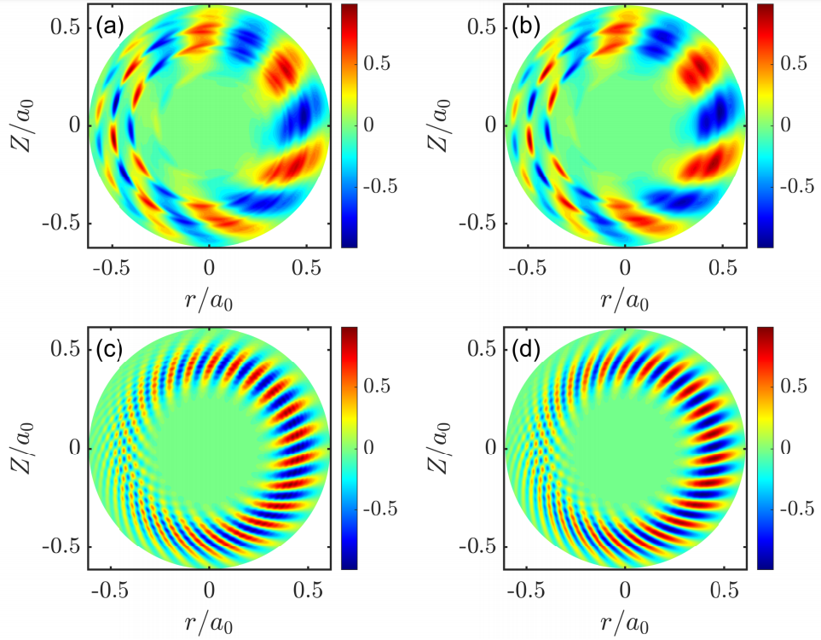
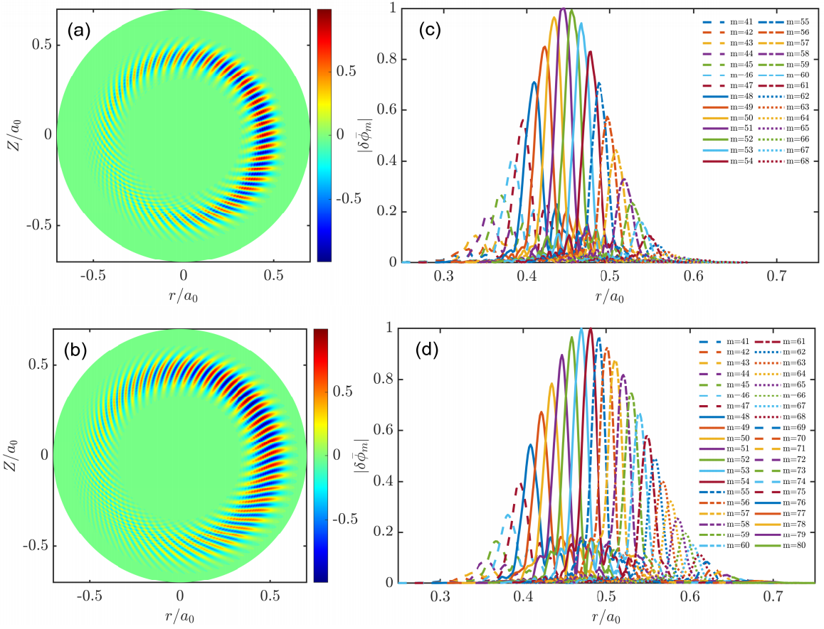
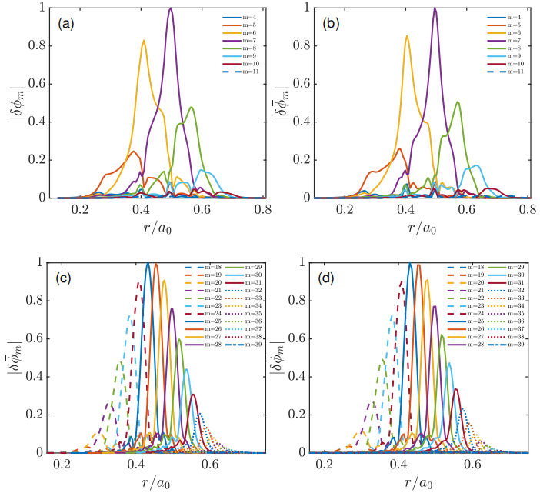
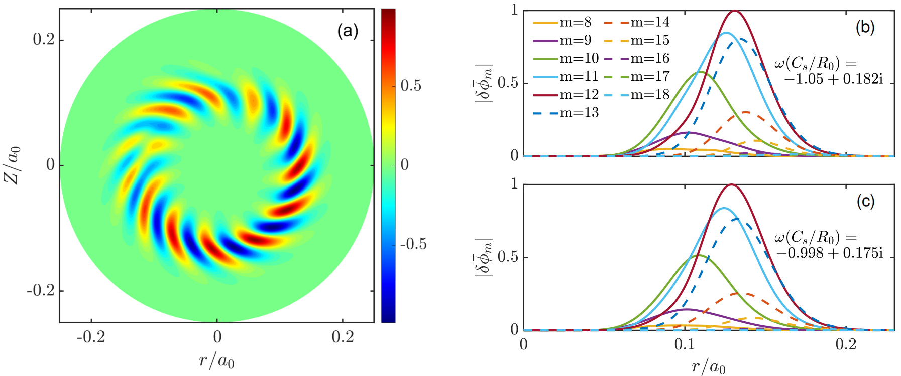
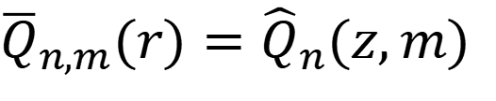
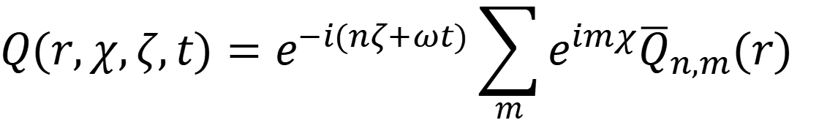
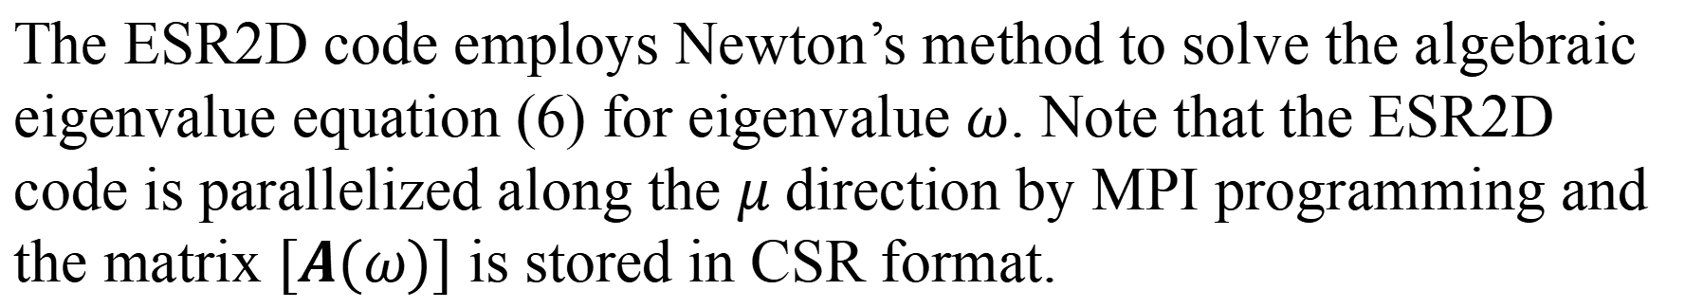
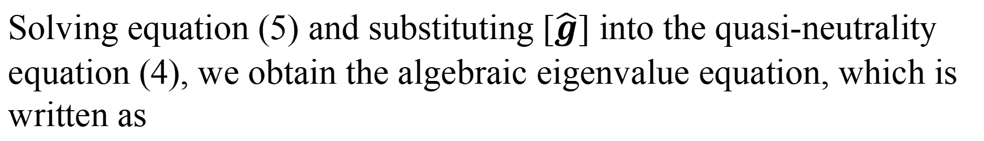


52nd EPS Plasma Physics Conference 2026
ESR2D: a two-dimensional Fourier-space global gyrokinetic eigenvalue code for the ion-temperature-gradient modes in tokamaks
Haochuan Wang¹, Jie Wang¹, Yuefeng Qiu¹, Shaojie Wang¹, Zihao Wang¹, Tiannan Wu¹, Yuesong Li¹, Yicheng Cai¹ and Shiqi Xiao¹
¹ Department of Engineering and Applied Physics, University of Science and Technology of China, Hefei 230026, China
Introduction
Simulation Results
The ion-temperature-gradient (ITG) mode is one of the most extensively studied drift-wave instabilities [1].
Eigenvalue codes efficiently compute eigenvalues and eigenmode structures, which are useful for analyzing experimental observations [2].
Existing solvers rely on high-n or simplifying assumptions (e.g., well-circulating particles).
This work:
(1) Develops ESR2D – a 2D gyrokinetic eigenvalue code in poloidal
Fourier space which treats passing and trapped ions in a unified way
without simplifications, and applies to arbitrary wavelengths.
(2) The code benchmarks well against GENE, NLT, and ORB5 and
identifies two coexisting toroidal ITG branches.
(3) Applies to weak magnetic shear near the magnetic axis.
1. CBC test
Basic Equations in ESR2D Code
Laplace transformation and Fourier transformations
$$Q(r,χ,ζ,t)=e^{−i(nζ+ωt)}\sum_{m}{e^{imχ}{\overline{Q}}_{n,m}(r)}$$
(1)
$${\overline{Q}}_{n,m}(r)={\hat{Q}}_{n}(z,m)$$
(2)
Here, $z∶=nq(r)−m$. Gyrokinetic Vlasov equation is written as
good agreement between ESR2D and inital-value codes is observed.
two toroidal branches coexist in the system and exhibit different radial locations.
$$\sum_{p}{(ω_{p}^{0}+ω_{p}^{z}∂_{z}+a_{p}∂_{v_{||}}){\hat{g}}_{i}(z−p,m+p,v_{||},μ)}$$
2. ITG modes in a weak magnetic shear configuration near the magnetic axis
$$=−\frac{e_{i}F_{Mi}^{(0)}}{T_{i}}\sum_{p}{ω_{p}^{t}}{〈δφ〉}_{gy}(z−p,m+p)$$
(3)
The quasi-neutrality equation is written as
$$−(\frac{e_{i}^{2}n_{i}}{T_{i}}+\frac{e_{e}^{2}n_{e}}{T_{e}})δ\hat{φ}(z,m)+e_{i}\frac{2πB^{(0)}}{m_{i}}\int{dv_{||}dμ}$$
(4)
the equilibrium configuration is the same as that in reference [4].
good agreement between ESR2D and NLT is observed.
$$\sum_{p}{σ_{p}{〈{\hat{g}}_{i}〉}_{gy}}(z−p,m+p,v_{||},μ)=0$$
After discretization, the Vlasov equation becomes
$$[A(ω)][\hat{g}]=[B(ω)][δφ]$$
(5)
Conclusion
Solving equation (5) and substituting $[\hat{g}]$ into the quasi-neutrality equation (4), we obtain the algebraic eigenvalue equation, which is written as
$$[M(ω)][δφ]=0$$
(6)
ESR2D is a new 2D gyrokinetic eigenvalue code for ITG modes in tokamaks.
It treats passing and trapped ions in a unified way, without simplifying assumptions, and applies to arbitrary wavelengths.
Benchmark results against GENE, NLT, and ORB5 show good agreement for Cyclone parameters.
It is found that two toroidal branches of ITG modes coexist in the system.
ESR2D is also capable of solving for ITG modes in weak magnetic shear configurations near the magnetic axis, and the results agree well with those obtained by NLT.
The ESR2D code employs Newton’s method to solve the algebraic eigenvalue equation (6) for eigenvalue $ω$. Note that the ESR2D code is parallelized along the $μ$ direction by MPI programming and the matrix $[A(ω)]$ is stored in CSR format.
Brief Introduction to NLT Code
NLT: Gyrokinetic Global Initial-value $δf$ code, gyrokinetic Vlasov equation is solved by using the numerical Lie-transform method [3].
$$\frac{dF_{s}}{dt}=\frac{∂F_{s}}{∂t}+\dot{\vec{X}}∙∇F_{s}+{\dot{v}}_{∥}\frac{∂F_{s}}{∂v_{∥}}=0$$
Reference
[1] W. Horton, Rev. Mod. Phys. 71, 735-778 (1999).
[2] J. Dong, G. Jian, A. Wang, H. Sanuki and K. Itoh, Nucl. Fusion 43, 1183 (2003).
[3] L. Ye, Y. Xu, X. Xiao, Z. Dai, and S. Wang, J. Comput. Phys. 316, 180 (2016).
[4] T. Wu and S. Wang, Phys. Rev. Lett. 136, 015102 (2026).
$$\dot{\vec{X}}=\left\{\vec{X},H_{0,s}+H_{1,s}\right\}, {\dot{v}}_{∥}=\left\{v_{∥},H_{0,s}+H_{1,s}\right\}$$
$$−\frac{{n_{i}e}_{i}^{2}}{T_{i}}δφ+\int{J_{v}dv_{||}dμ\frac{e_{i}^{2}}{T_{i}}F_{Mi}{〈〈δφ〉〉}_{gy}}+e_{i}δn_{i,gy}−\frac{n_{e}e_{e}^{2}}{T_{e}}\left(δφ−{\left\langle δφ\right\rangle }_{FA}\right)=0$$

