Slide 1


A fluid model for the deuterium molecules in the plasma edge based on the AMJUEL database and benchmark with EIRENE
TSVV-K
W. Van Uytven, N. Horsten, H. Mertens, W. Dekeyser
UKAEA Exhaust Code Workshop 2026
Notes:
Today I will present our work on a fluid model for molecules in solps, and a first benchmark with EIRENE

Slide 2
How to simulate neutrals?
Kinetic – Monte Carlo*
+ kinetic effects
+ elaborate physics description
(atoms, molecules, molecular ions,
neutral-neutral collisions)
− high CPU cost
− statistical noise
Fluid – Finite volume/elements
− no kinetic effects
− reduced physics
(only atoms)
+ low CPU cost
+ deterministic
RESEARCH GOAL
→
Major bottleneck for e.g. gradient-based optimization and coupling to plasma turbulence codes
Notes:
The choice between fluid or kinetic neutral model remains difficult. Kinetic models include kinetic effects, but in practise they are often also ahead in terms of physics. While most –not all- fluid neutral models conisder only atoms.
The kinetic models have higher computational cost however, and in case of monte carlo methods you have statistical noise. This is a major bottleneck for for example gradient-based optimization and coupling to plasma turbulence codes.
What I want to do is to get all the physics from eirene into the fluid models;

Slide 3
Scope
Derive, implement and benchmark a fluid model for the neutral molecules based on the physics described in [V. Kotov, 2007]*
Step-wise approach; initially
  frozen plasma background
  no neutral-neutral collisions
  only deuterium
Note: increasing the ‘resolution’ of the molecular physics
is an active topic, but not the focus of this work
Nr. | Reaction | Type
Atom-plasma
1 | D + e → D⁺ + 2 e | Ionization
2 | D + D⁺ → D⁺ + D | Charge-exchange
3 | D⁺ + e → D | Ion recombination
Neutral-neutral
4 | D + D → D + D | Elastic collision
5 | D + D₂ → D + D₂ | Elastic collision
6 | D₂ + D₂ → D₂ + D₂ | Elastic collision
Molecule-plasma
7 | D₂ + e → D₂⁺ + 2 e | Non-dissociative ionization
8 | D₂ + e → D + D + e | Dissociation
9 | D₂ + e → D + D⁺ + 2 e | Dissociative ionization
10 | D₂ + D⁺ → D⁺ + D₂ | Elastic collision
11 | D₂ + D⁺ → D + D₂⁺ | Ion conversion
12 | D₂⁺ + e → e + D + D⁺ | Dissociative excitation
13 | D₂⁺ + e → 2 e + D⁺ + D⁺ | Dissociative ionization
14 | D₂⁺ + e → D + D | Dissociative recombination
*Kotov, Vladislav, Detlev Reiter, and Andrey S. Kukushkin. Numerical study of the ITER divertor plasma with the B2-EIRENE code package. No. Juel--4257. Bochum Univ.(Germany), 2007.
Notes:
The scope of this work was to derive, implement and benchmark ..for the default molecular physics model in EIRENE. I’m doing this in a very step-wise manner, considerint initially only a frozen background, no nncs yet, and only D.
…

Slide 4
Previous work
First fluid models for molecules in UEDGE by A. Holm et al.
  Holm, A., T. D. Rognlien, and W. H. Meyer. "Implementation and assessment of an extended hydrogenic molecular model in UEDGE." Contributions to Plasma Physics 60.5-6 (2020): e201900150.
  Holm, A., M. Groth, and T. D. Rognlien. "UEDGE-predicted impact of molecules on low-field side target detachment in DIII–D." Nuclear Materials and Energy 19 (2019): 143-148.
  …
Notes:
This is not the first work on fluid molecular models. There are several papers on FM models in UEDGE. In those papers, the focus was on the details of the physics and the impact for DIII-D. I take a complementary angle, by sticking to the simplest physics model but doing a very careful benchmark with EIRENE.

Slide 5
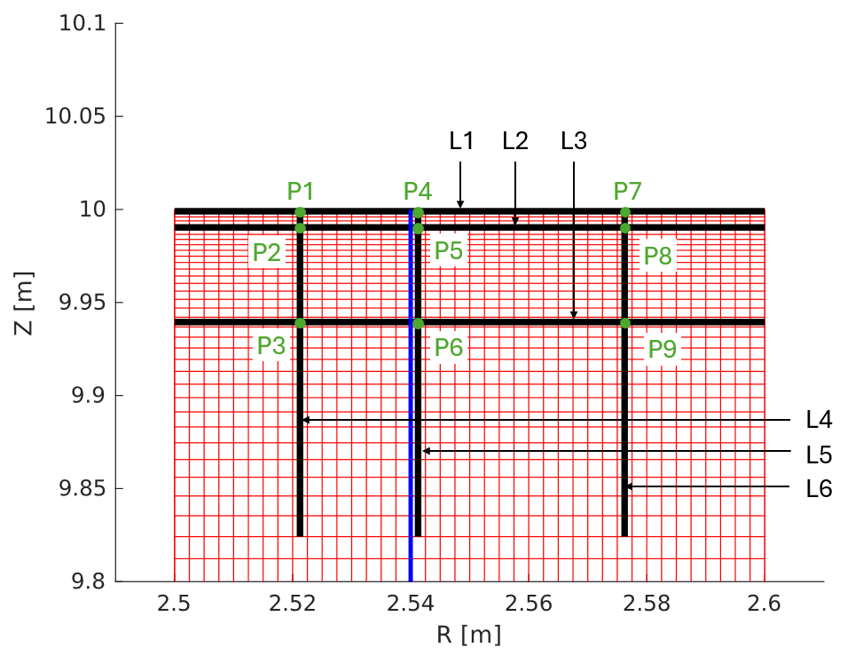
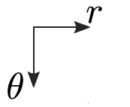
Slab case
Top target
Separatrix
Upstream
Notes:
The results I will show today are on an orthogonal slab case. The molecular solution is computed on a detached plasma background that I show here on the right. The lines and points on this slab case will be used to plot results later on.

Slide 6
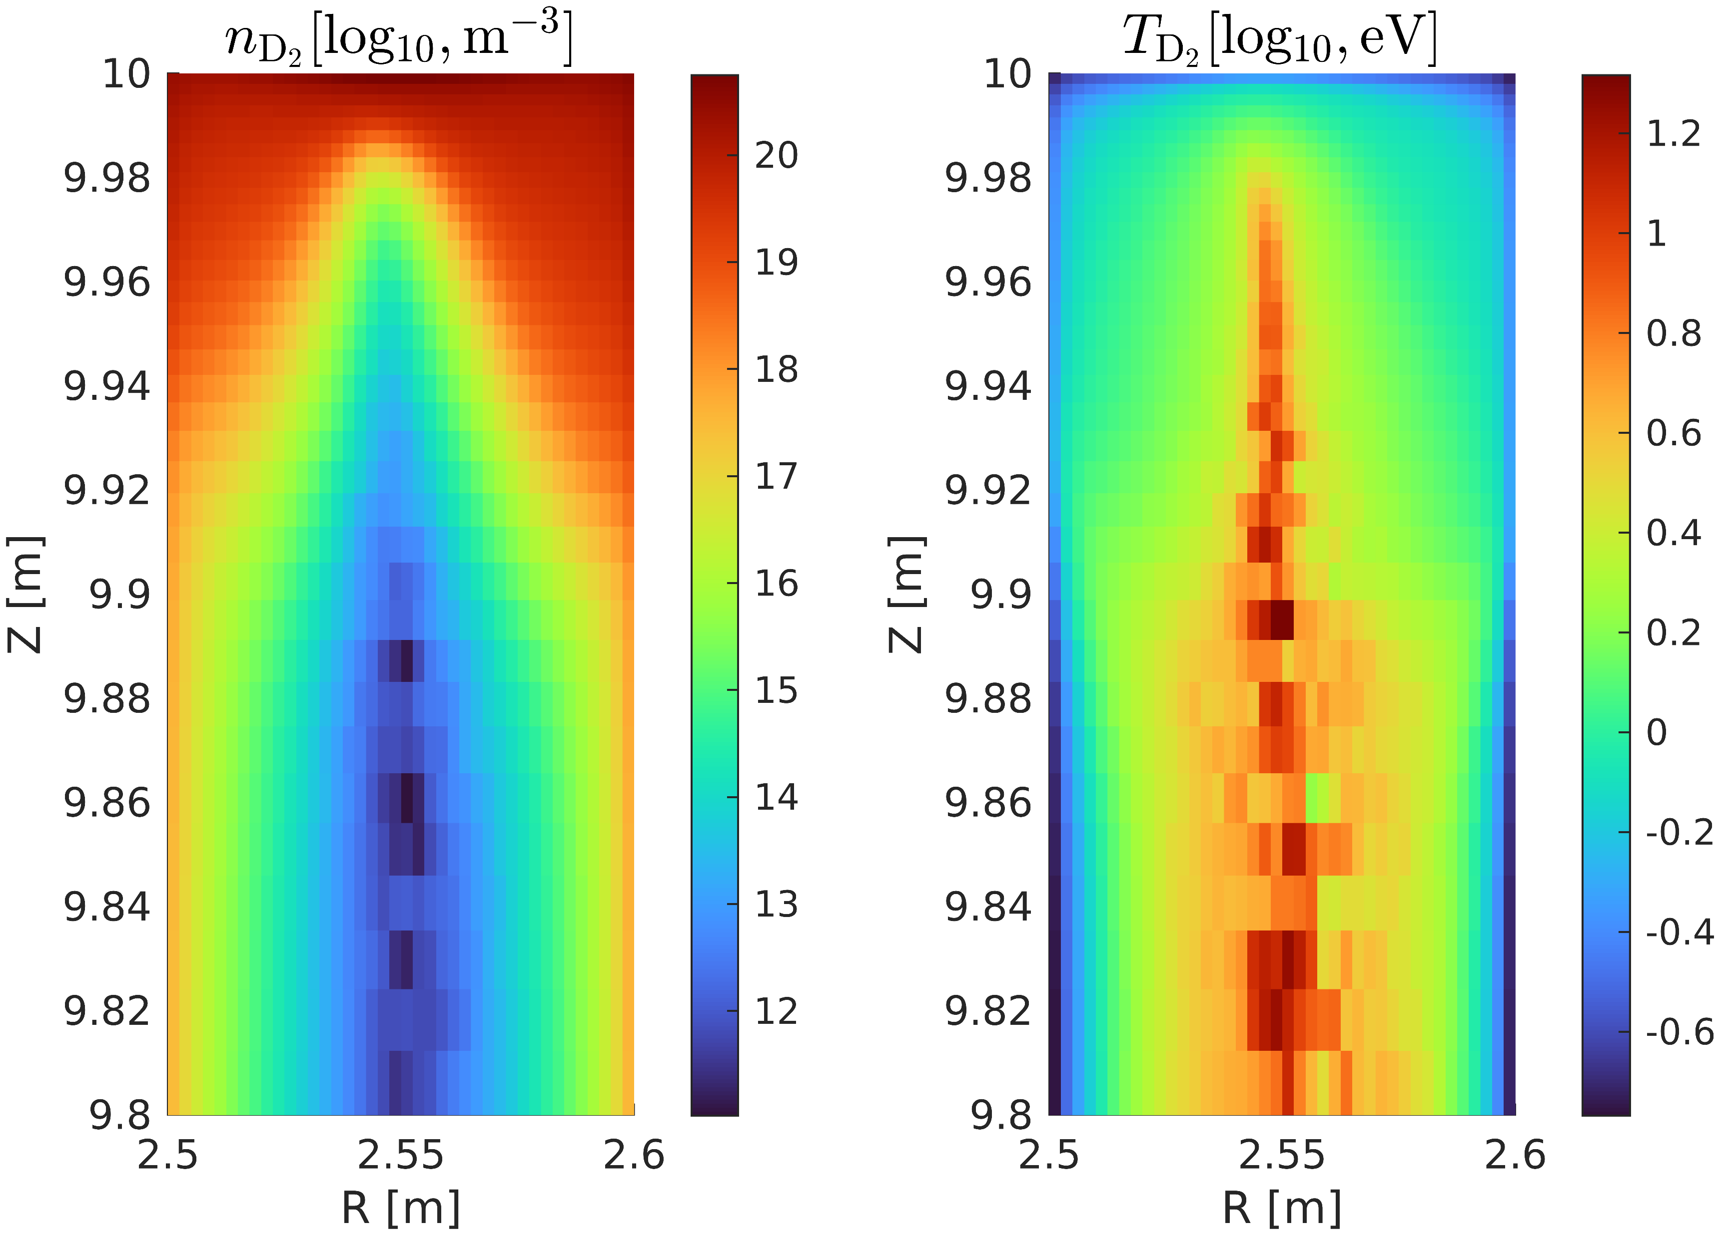
Kinetic solution
Notes:
Explain kinetic solution

Slide 7
Kinetic solution
Notes:
In a kinetic code like EIRENE, we can also look at the actual particle velocity distribution. In red, a perfect maxwellian based on the macroscopic eirene quantities, and in blue the acteual pvd.
The location of the points is shown on the right. …
Upstream, the pvd gets close to the maxwellian. Right at the wall, we see a significant deviaton due to the BCs. Fluid model could be reasonable, but kinetic effects important.

Slide 8
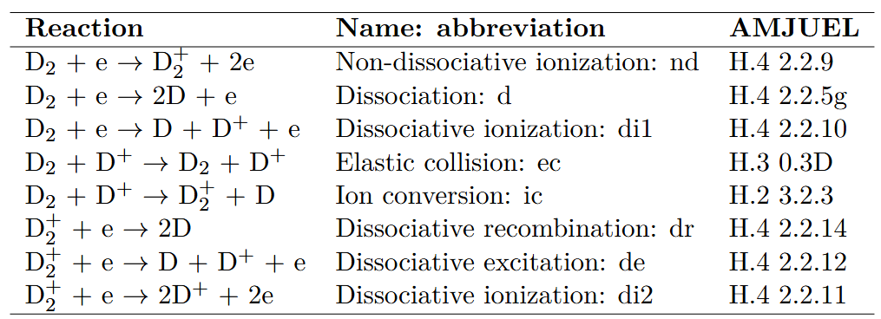
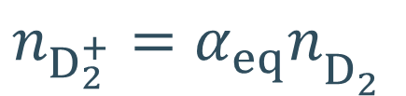

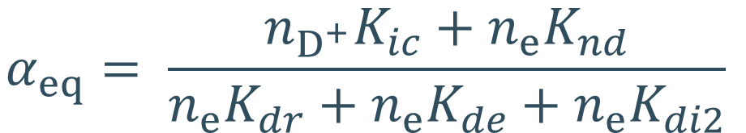
Molecular ions $D_{2}^{+}$
Reactions >> transport → local equilibrium concentration
$$n_{D_{2}^{+}}=α_{eq}n_{D_{2}^{}}$$
$$α_{eq}= \frac{n_{D^{+}}K_{ic}+n_{e}K_{nd}}{n_{e}K_{dr}+n_{e}K_{de}+n_{e}K_{di2}}$$
From momentum and energy conservation: $T_{D_{2}^{+}}=T_{D_{2}^{}}$and $V_{D_{2}^{+}}^{}=V_{D_{2}^{} }^{}$

Slide 9
Fluid model components
Source and sink terms
Boundary conditions
Transport model
Notes:
Fluid model

Slide 10
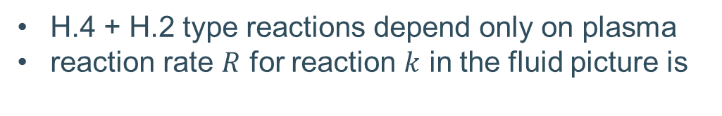
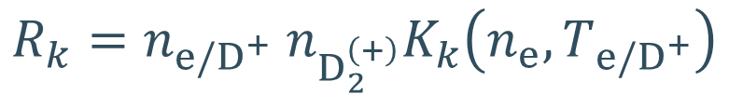
Reaction dependencies
H.4 + H.2 type reactions depend only on plasma
reaction rate $R$ for reaction $k$ in the fluid picture is
$$R_{k}=n_{e/D^{+}} n_{D_{2}^{\left(+\right)}}K_{k}\left(n_{e},T_{e/D^{+}}\right)$$

Slide 11
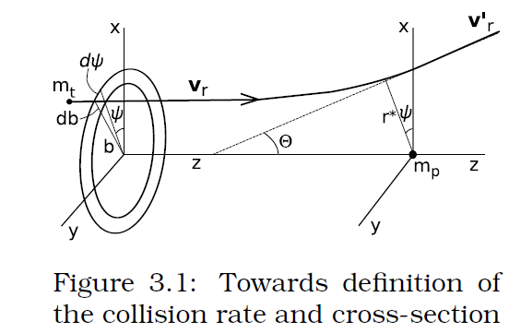
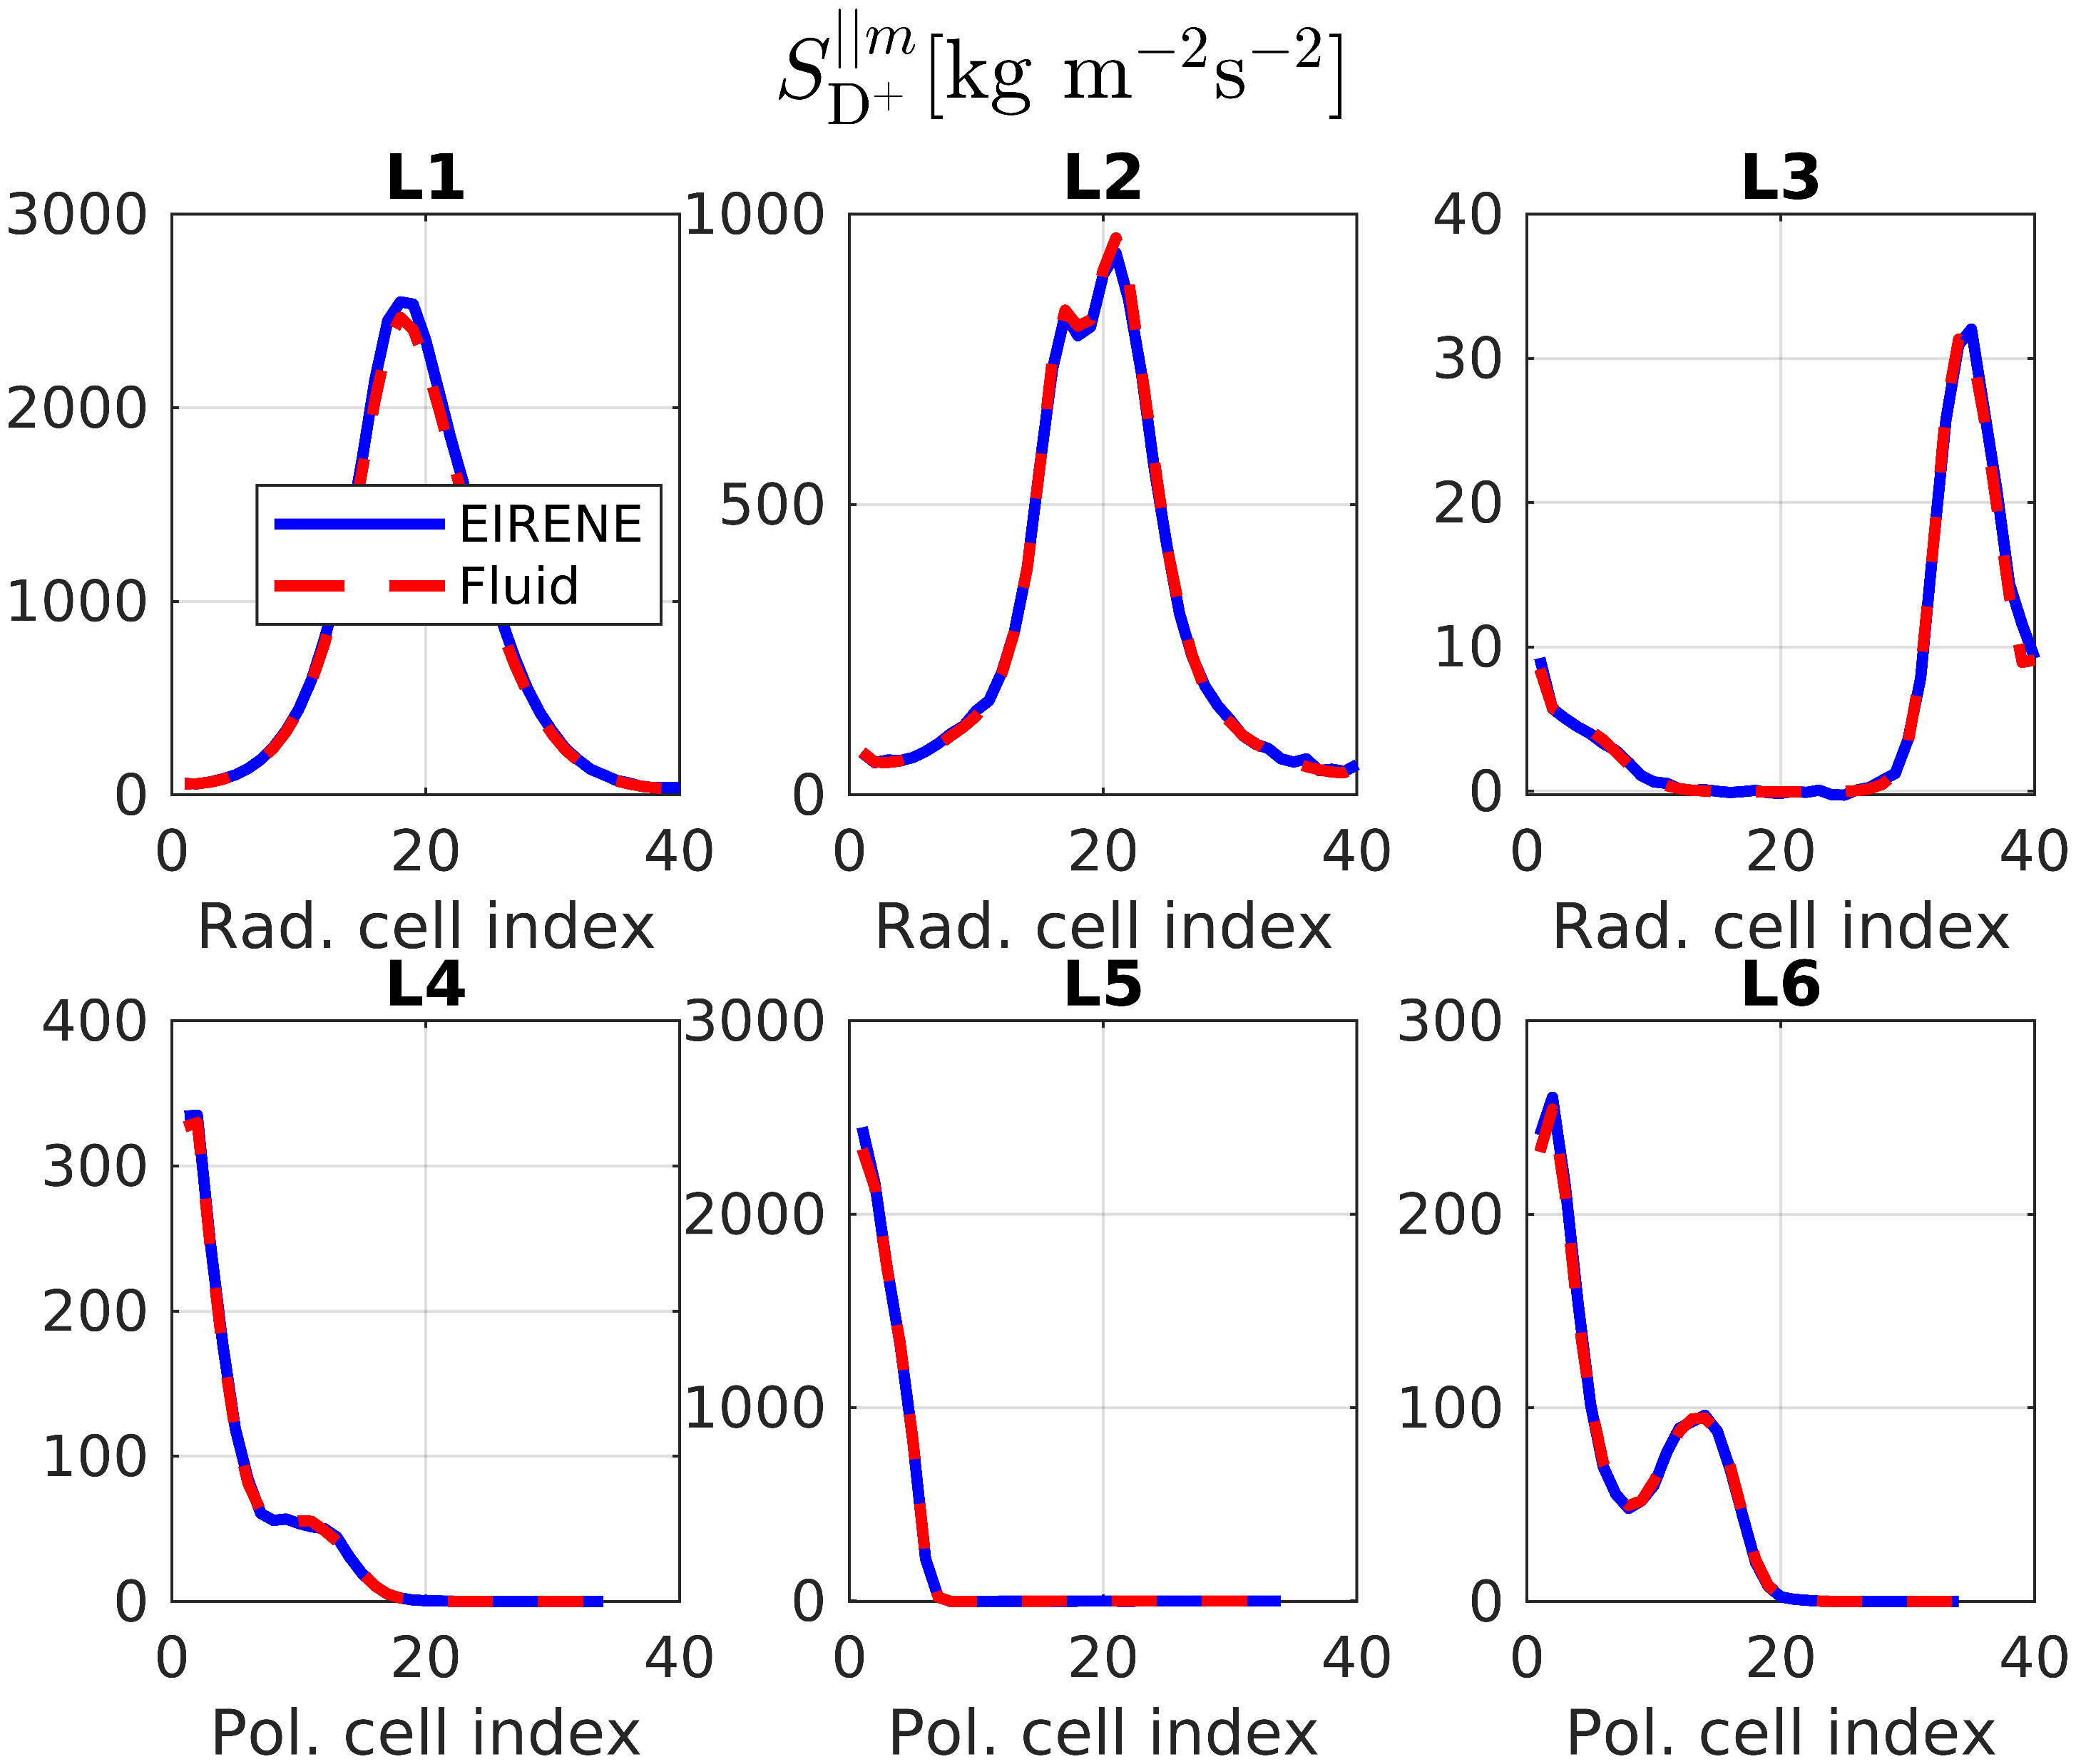
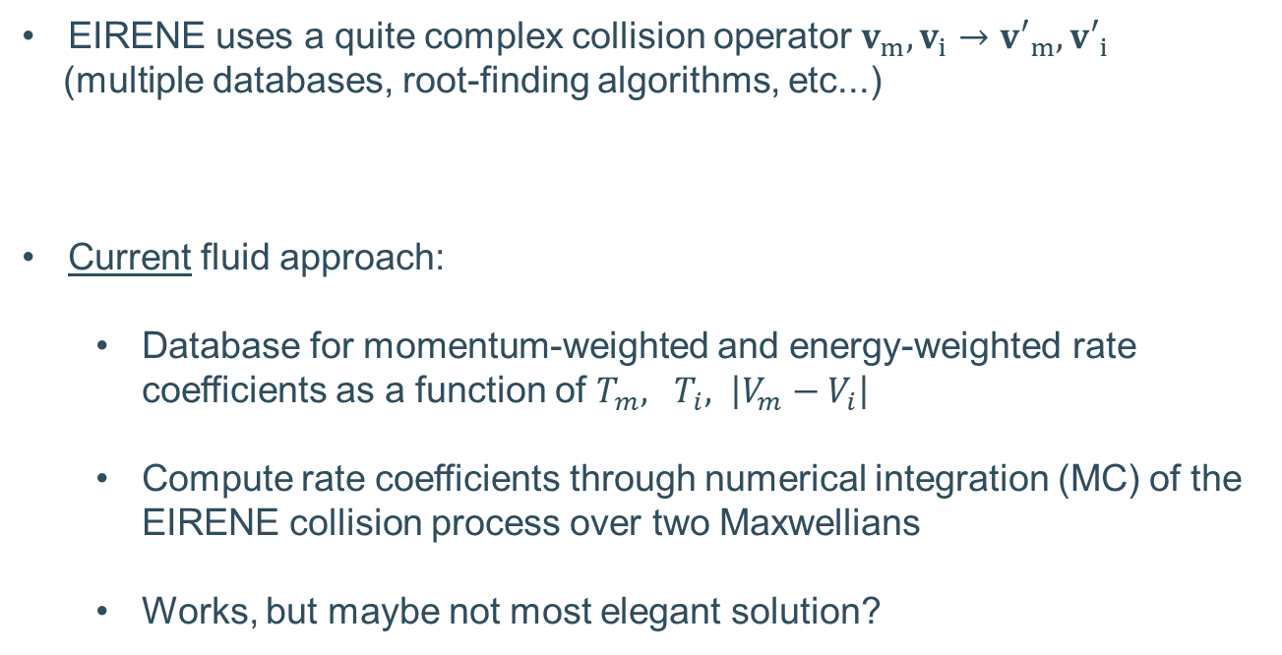
Elastic collisions
EIRENE uses a quite complex collision operator $v_{m},v_{i}→{v′}_{m}, {v′}_{i}$
(multiple databases, root-finding algorithms, etc...)
Current fluid approach:
  Database for momentum-weighted and energy-weighted rate coefficients as a function of $T_{m}, T_{i}, \left|V_{m}−V_{i}\right|$
  Compute rate coefficients through numerical integration (MC) of the EIRENE collision process over two Maxwellians
  Works, but maybe not most elegant solution?

Slide 12
Fluid model components
Source and sink terms
Boundary conditions
Transport model

Slide 13
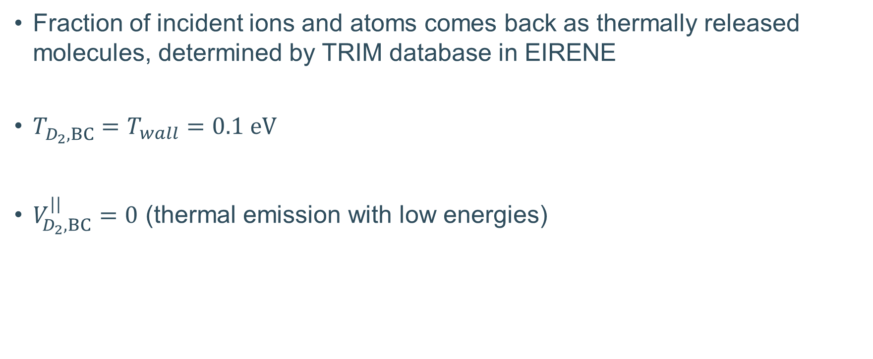
Boundary conditions
Fraction of incident ions and atoms comes back as thermally released molecules, determined by TRIM database in EIRENE
$T_{D_{2},BC}^{}=T_{wall}=0.1 eV$
$V_{D_{2},BC}^{||}=0$ (thermal emission with low energies)

Slide 14
Fluid model components
Source and sink terms
Boundary conditions
Transport model

Slide 15
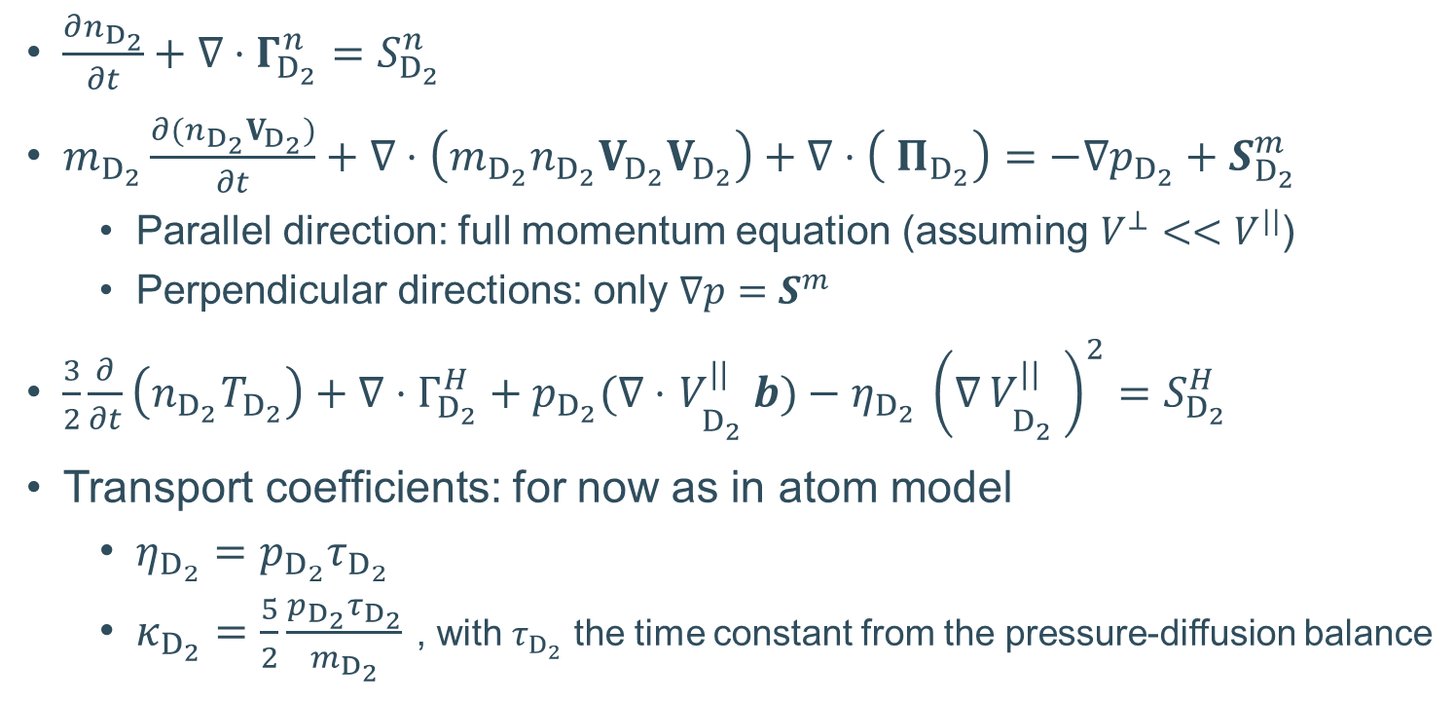
Transport model
$\frac{∂n_{D_{2}}}{∂t}+∇⋅Γ_{D_{2}}^{n}=S_{D_{2}}^{n}$
$m_{D_{2}}\frac{∂(n_{D_{2}}V_{D_{2}})}{∂t}+∇⋅\left(m_{D_{2}}n_{D_{2}}V_{D_{2}}V_{D_{2}}\right)+∇⋅\left( Π_{D_{2}}\right)=−∇p_{D_{2}}+S_{D_{2}}^{m}$
  Parallel direction: full momentum equation (assuming $V^{⊥}<<V^{||}$)
  Perpendicular directions: only $∇p=S^{m}$
$\frac{3}{2}\frac{∂}{∂t}\left(n_{D_{2}}T_{D_{2}}\right)+∇⋅Γ_{D_{2}}^{H}+p_{D_{2}}(∇⋅$ $V_{D_{2}^{}}^{||}b)−η_{D_{2} }{\left(∇_{ }V_{D_{2}^{}}^{||}\right)}^{2}=S_{D_{2}}^{H}$
Transport coefficients: for now as in atom model
  $η_{D_{2}}=p_{D_{2}}τ_{D_{2}}$
  $κ_{D_{2}}=\frac{5}{2}\frac{p_{D_{2}}τ_{D_{2}}}{m_{D_{2}}}$ , with $τ_{D_{2}}$ the time constant from the pressure-diffusion balance

Slide 16
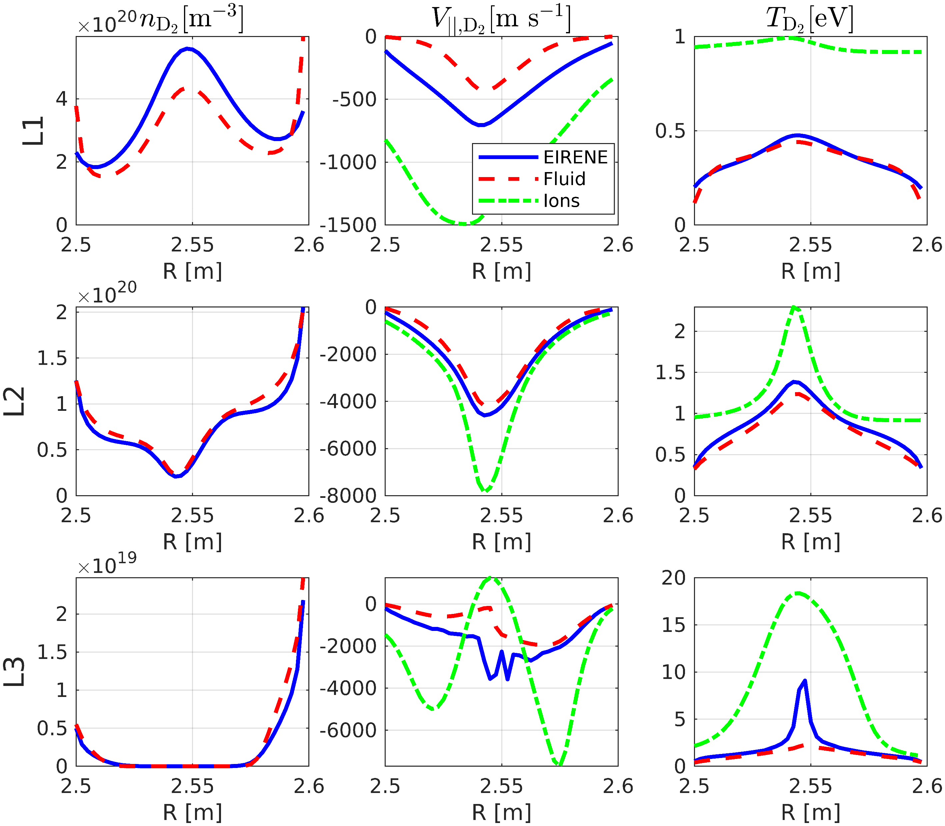
Results

Slide 17
Conclusion
Kinetic effects not fully negligible
Bulk of molecular physics is captured with fluid model
(detached slab case)

Slide 18
Future work
Short-medium term:
  Coupling to plasma and atom models, full convergence
  Further improve fluid model
    3D momentum equation?
    Derivation transport coefficients?
    Boundary conditions?
  Realistic geometries
  Neutral-neutral collisions
  Multi-species (mainly DT)
Long-term:
  Base the fluid model on a more advanced kinetic molecular model
  (explicit resolution of intermediate molecular states; rotationally, vibrationally, and electronically excited states)
ongoing
2027 (?)
Requires consensus in community

Slide 19
Back-up slides

Slide 20
Results: sources

Slide 21
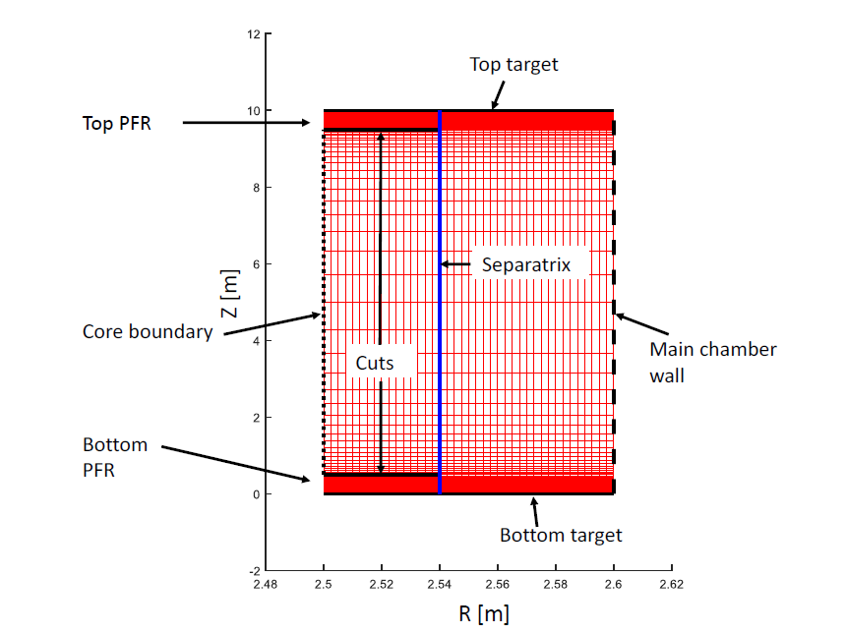
Slab case

Slide 22
Treatment of elastic collisions

Slide 23
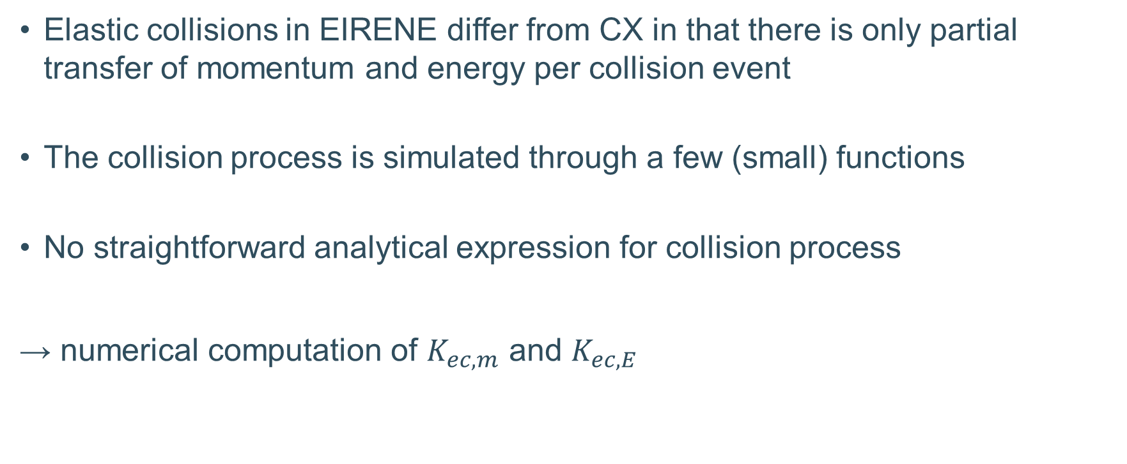
Treatment of elastic collisions
Elastic collisions in EIRENE differ from CX in that there is only partial transfer of momentum and energy per collision event
The collision process is simulated through a few (small) functions
No straightforward analytical expression for collision process
→ numerical computation of $K_{ec,m}$ and $K_{ec,E}$

Slide 24
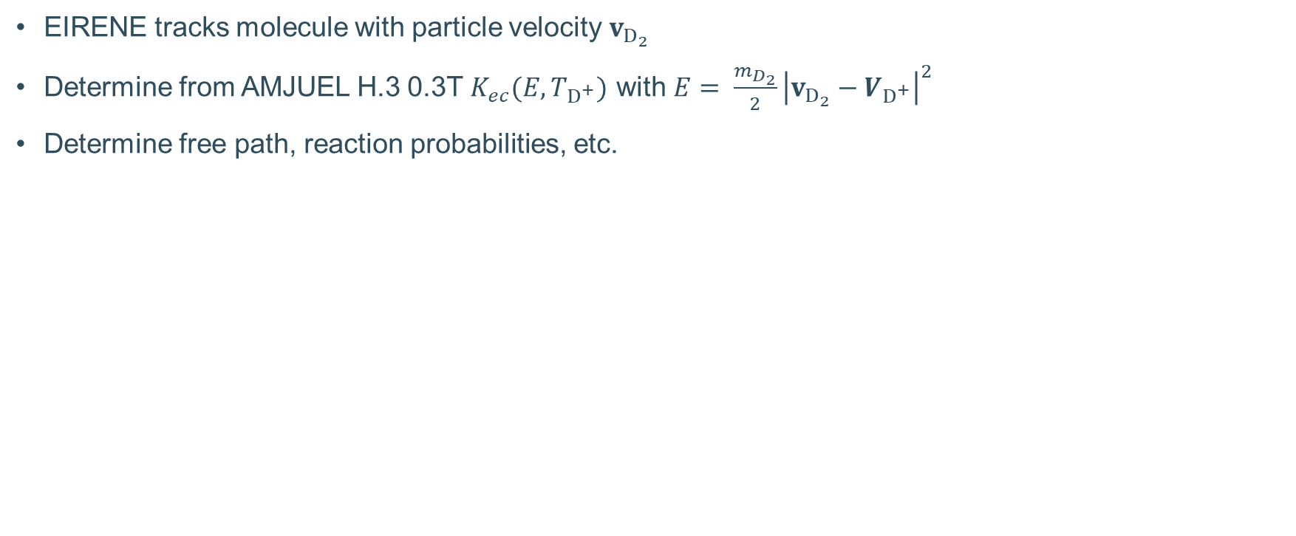
Kinetic treatment elastic collisions
EIRENE tracks molecule with particle velocity $v_{D_{2}}$
Determine from AMJUEL H.3 0.3T $K_{ec}(E,T_{D^{+}})$ with $E= \frac{m_{D_{2}}}{2}{\left|v_{D_{2}}−V_{D^{+}}\right|}^{2}$
Determine free path, reaction probabilities, etc.

Slide 25


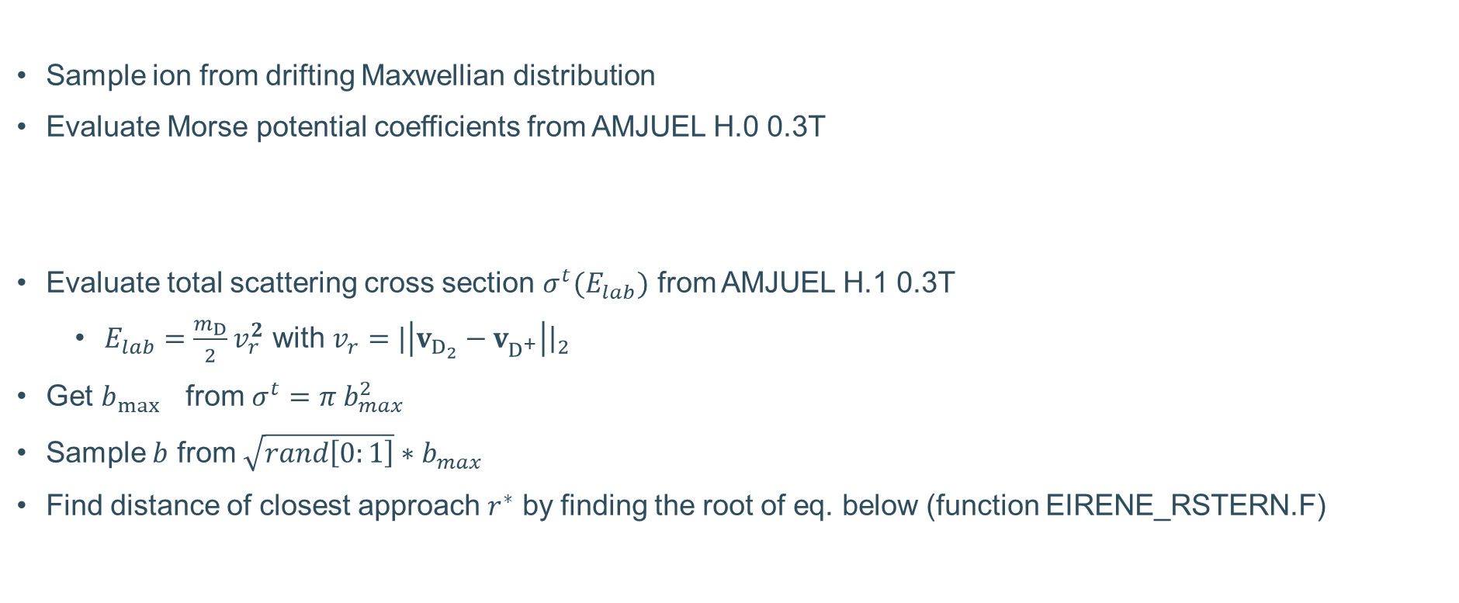
Kinetic treatment elastic collisions
Sample ion from drifting Maxwellian distribution
Evaluate Morse potential coefficients from AMJUEL H.0 0.3T
Evaluate total scattering cross section $σ^{t}(E_{lab})$ from AMJUEL H.1 0.3T
  $E_{lab}=\frac{m_{D}}{2}v_{r}^{2}$ with $v_{r}=|{\left|v_{D_{2}}−v_{D^{+}}^{}\right|{\left.​\right|}_{2}}^{}$
Get $b_{\max{}}$from ${σ^{t}=π b}_{max}^{2}$
Sample $b$ from $\sqrt{rand\left[0:1\right]}∗b_{max}$
Find distance of closest approach $r^{∗}$ by finding the root of eq. below (function EIRENE_RSTERN.F)

Slide 26

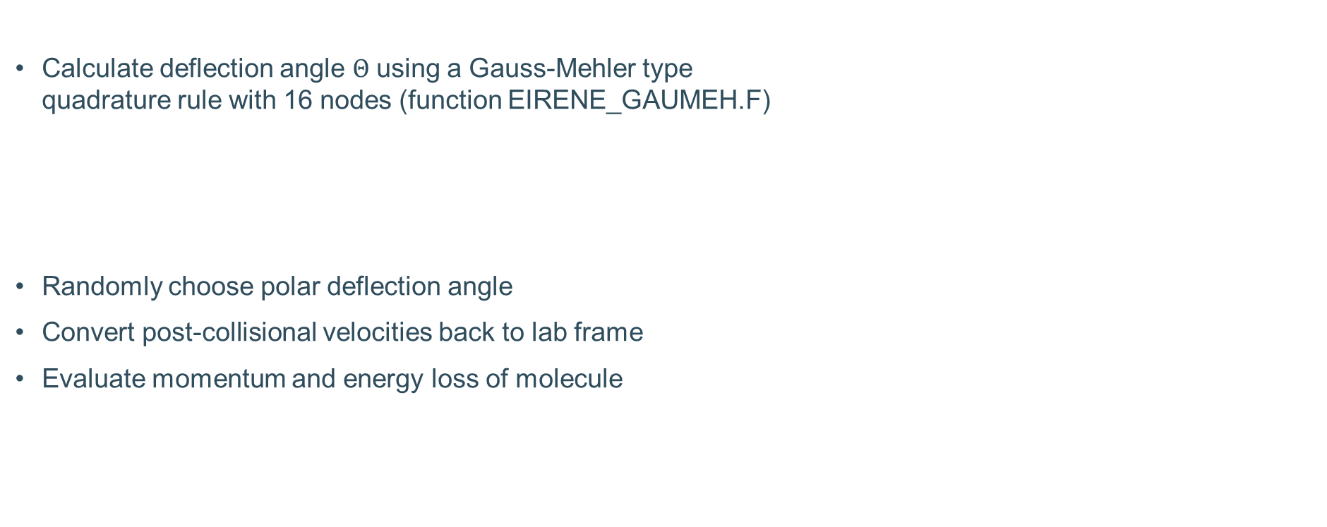
Kinetic treatment elastic collisions
Calculate deflection angle $Θ$ using a Gauss-Mehler type
quadrature rule with 16 nodes (function EIRENE_GAUMEH.F)
Randomly choose polar deflection angle
Convert post-collisional velocities back to lab frame
Evaluate momentum and energy loss of molecule

Slide 27
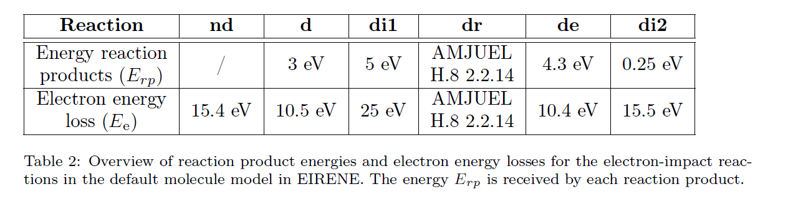
Reaction energies

Slide 28
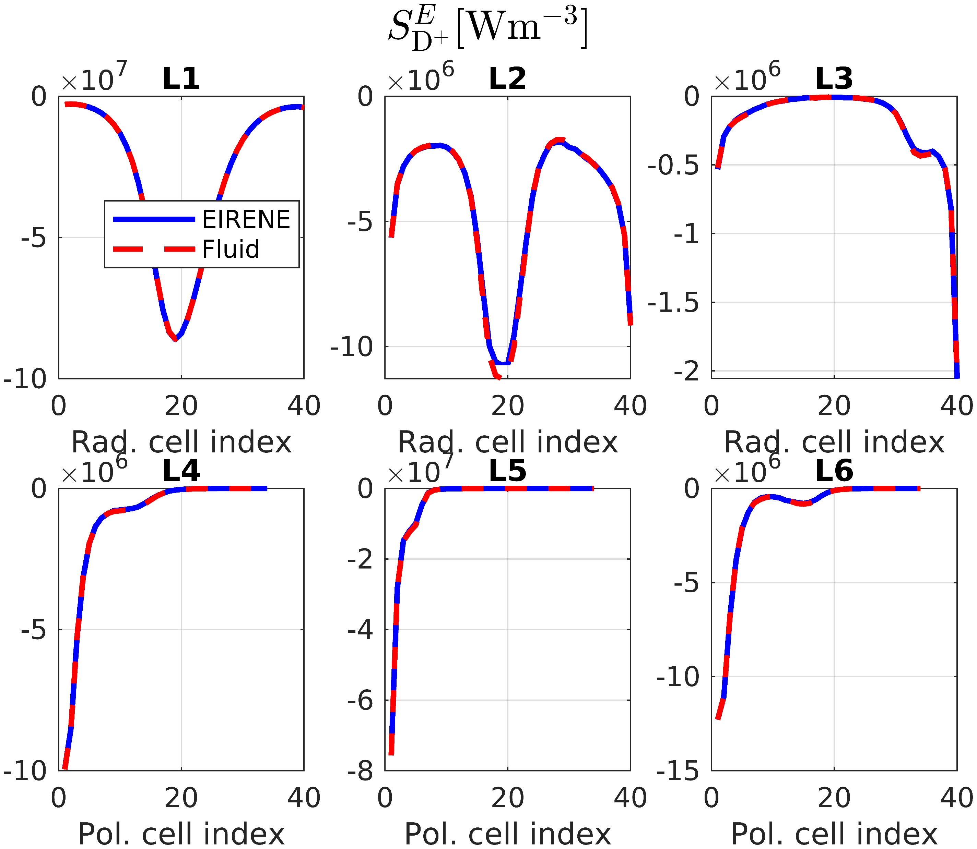
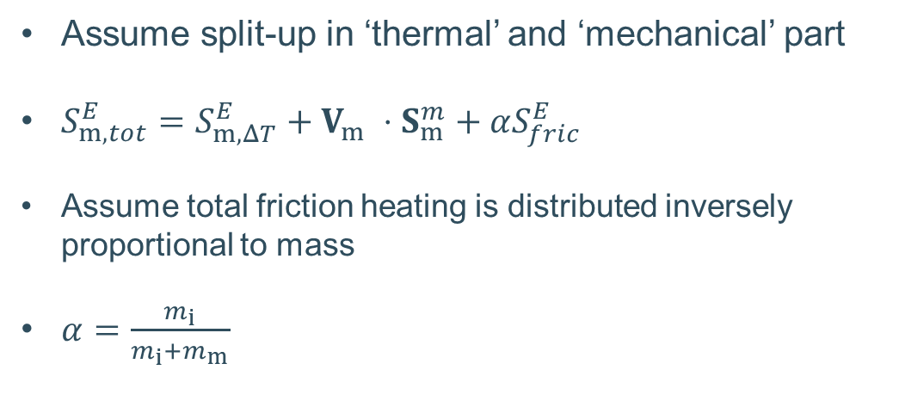
Elastic collisions
Energy exchange term in the fluid model
Assume split-up in ‘thermal’ and ‘mechanical’ part
$S_{m,tot}^{E}=S_{m,ΔT}^{E}+V_{m} ⋅S_{m}^{m}+αS_{fric}^{E}$
Assume total friction heating is distributed inversely proportional to mass
$α=\frac{m_{i}}{m_{i}+m_{m}}$

Slide 29
Scope
Nr. | Reaction | Type
Atom-plasma
1 | D + e → D⁺ + 2 e | Ionization
2 | D + D⁺ → D⁺ + D | Charge-exchange
3 | D⁺ + e → D | Ion recombination
Neutral-neutral
4 | D + D → D + D | Elastic collision
5 | D + D₂ → D + D₂ | Elastic collision
6 | D₂ + D₂ → D₂ + D₂ | Elastic collision
Molecule-plasma
7 | D₂ + e → D₂⁺ + 2 e | Non-dissociative ionization
8 | D₂ + e → D + D + e | Dissociation
9 | D₂ + e → D + D⁺ + 2 e | Dissociative ionization
10 | D₂ + D⁺ → D⁺ + D₂ | Elastic collision
11 | D₂ + D⁺ → D + D₂⁺ | Ion conversion
12 | D₂⁺ + e → e + D + D⁺ | Dissociative excitation
13 | D₂⁺ + e → 2 e + D⁺ + D⁺ | Dissociative ionization
14 | D₂⁺ + e → D + D | Dissociative recombination
Existing fluid
neutral models
Future work
This presentation

