Slide 1
PENKNIFE
Plasma Edge Numerics using
Kinetic Neutrals Integrated in Finite Elements
James Edgeley and UKAEA edge code team

Slide 2
PENKNIFE
Nektar++ meshing support
Working towards full performance portability
2D, Axisymmetric or full 3D geometry
Kinetic neutral reactions
VANTAGE coupled
Flexible B field configuration
Implicit, non-linear solver
Sheath boundary conditions
Mean Field Transport
Closure options
Reduced Braginskii equations
Multiple species
Anomalous diffusion
Electrostatic turbulence

Slide 3


NESO
VANTAGE
NESO Library
Reactions
PENKNIFE
Boundary Conditions
PlasmaSystem
ReactionSystem
Closures
Evaluation
Anistropic diffusion
Sources/sinks
Ionisation
Projection
Riemann Solvers
Integrators
CX
Reduced Braginskii
Source deposition
Recombination
Magnetic field control
Electrostatic Turbulence
Merge/removal
Surface Reactions

Slide 4
Drifts and spurious currents

Slide 5
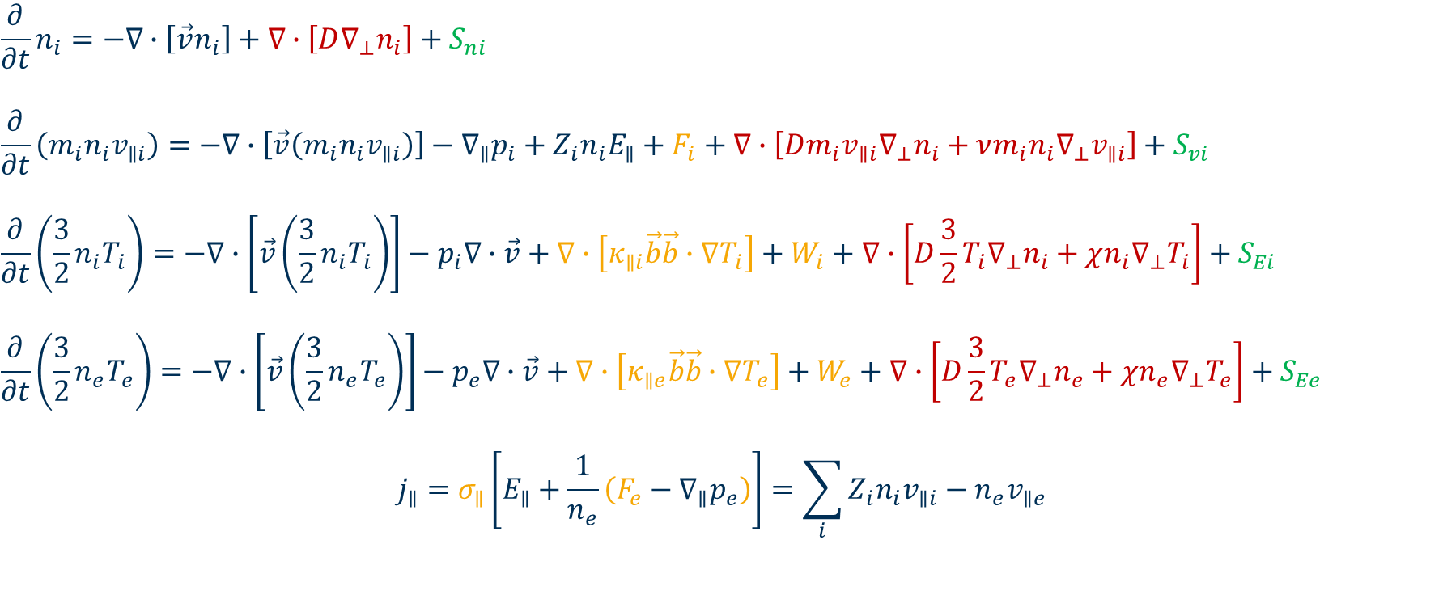
Reduced Equations
$$\frac{∂}{∂t}n_{i}=−∇∙\left[\vec{v}n_{i}\right]+∇∙\left[D∇_{⊥}n_{i}\right]+S_{ni}$$
$$\frac{∂}{∂t}\left(m_{i}n_{i}v_{∥i}\right)=−∇∙\left[\vec{v}\left(m_{i}n_{i}v_{∥i}\right)\right]−∇_{∥}p_{i}+Z_{i}n_{i}E_{∥}+F_{i}+∇∙\left[Dm_{i}v_{∥i}∇_{⊥}n_{i}+νm_{i}n_{i}∇_{⊥}v_{∥i}\right]+S_{vi}$$
$$\frac{∂}{∂t}\left(\frac{3}{2}n_{i}T_{i}\right)=−∇∙\left[\vec{v}\left(\frac{3}{2}n_{i}T_{i}\right)\right]−p_{i}∇∙\vec{v}+∇∙\left[κ_{∥i}\vec{b}\vec{b}∙∇T_{i}\right]+W_{i}+∇∙\left[D\frac{3}{2}T_{i}∇_{⊥}n_{i}+χn_{i}∇_{⊥}T_{i}\right]+S_{Ei}$$
$$\frac{∂}{∂t}\left(\frac{3}{2}n_{e}T_{e}\right)=−∇∙\left[\vec{v}\left(\frac{3}{2}n_{e}T_{e}\right)\right]−p_{e}∇∙\vec{v}+∇∙\left[κ_{∥e}\vec{b}\vec{b}∙∇T_{e}\right]+W_{e}+∇∙\left[D\frac{3}{2}T_{e}∇_{⊥}n_{e}+χn_{e}∇_{⊥}T_{e}\right]+S_{Ee}$$
$$j_{∥}=σ_{∥}\left[E_{∥}+\frac{1}{n_{e}}\left(F_{e}−∇_{∥}p_{e}\right)\right]=\sum_{i}{Z_{i}n_{i}v_{∥i}}−n_{e}v_{∥e}$$

Slide 6
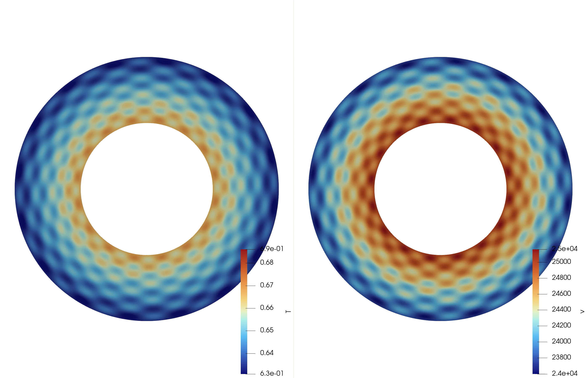
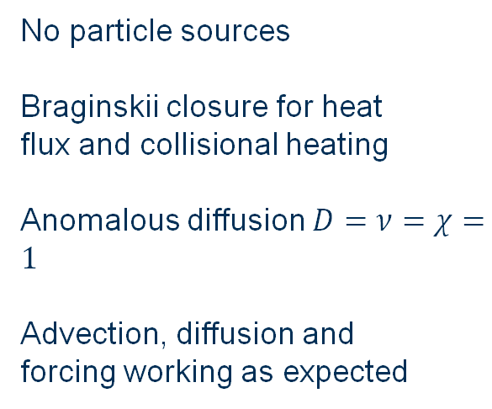
Reduced Braginskii equations
No particle sources
Braginskii closure for heat flux and collisional heating
Anomalous diffusion $D=ν=χ=1$
Advection, diffusion and forcing working as expected

Slide 7
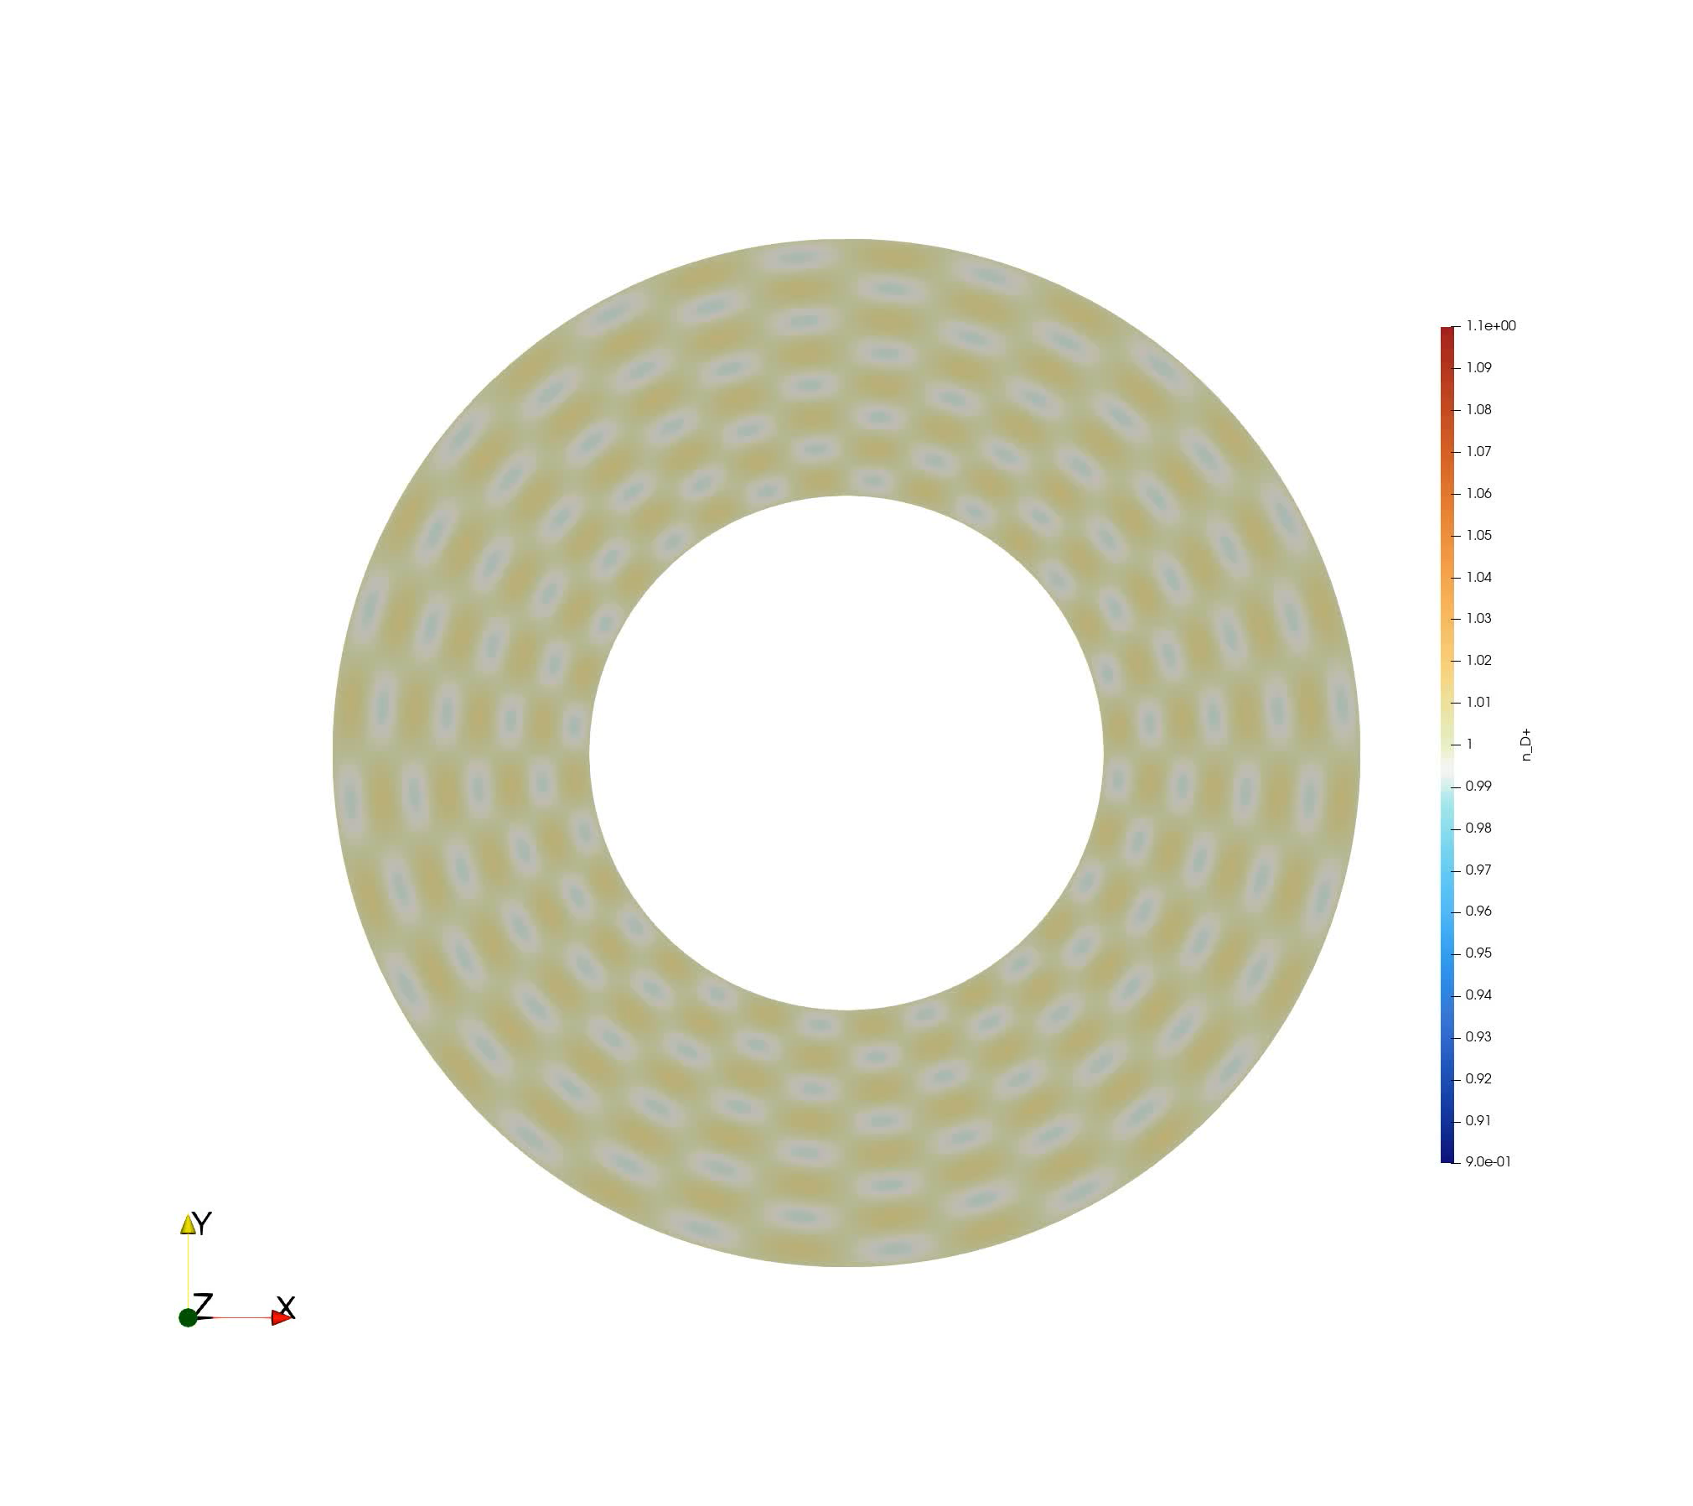
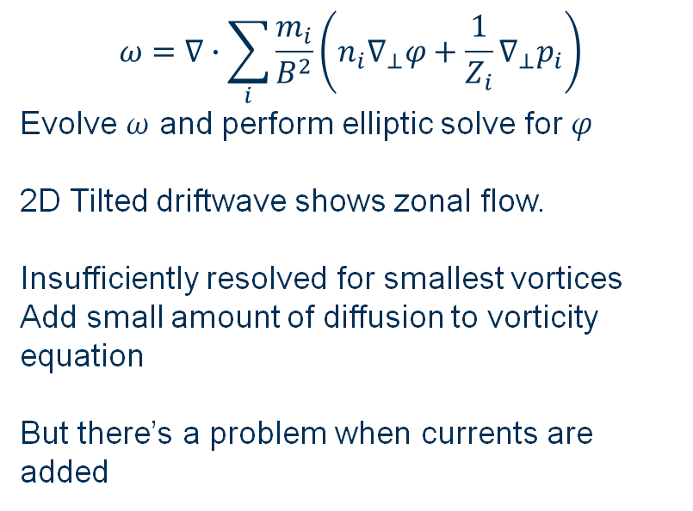
$$ω=∇∙\sum_{i}{\frac{m_{i}}{B^{2}}\left(n_{i}∇_{⊥}φ+\frac{1}{Z_{i}}∇_{⊥}p_{i}\right)}$$
Evolve $ω$ and perform elliptic solve for $φ$
2D Tilted driftwave shows zonal flow.
Insufficiently resolved for smallest vortices
Add small amount of diffusion to vorticity equation
But there’s a problem when currents are added

Slide 8


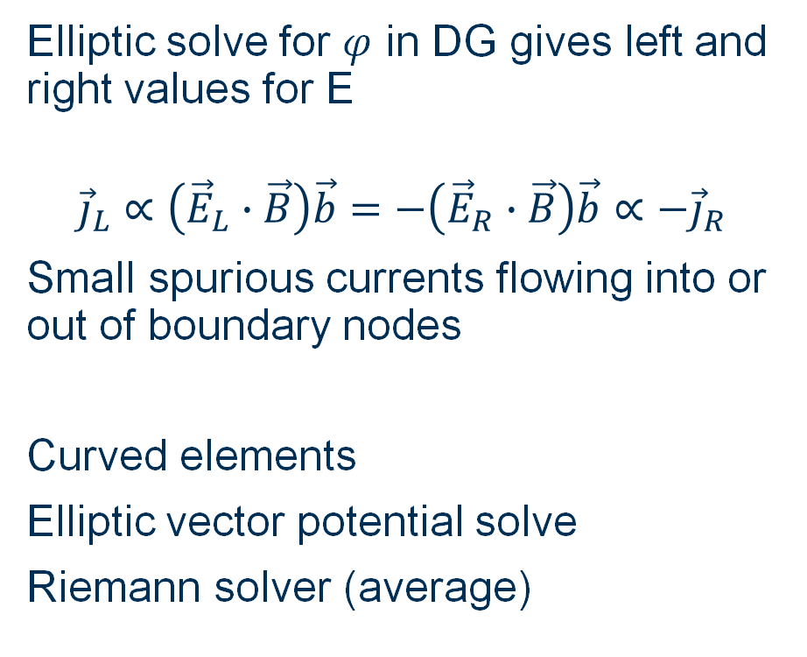



Spurious currents
$${\vec{E}}_{L}$$
$${\vec{E}}_{R}$$
Elliptic solve for $φ$ in DG gives left and right values for E
$${\vec{j}}_{L}∝\left({\vec{E}}_{L}∙\vec{B}\right)\vec{b}=−\left({\vec{E}}_{R}∙\vec{B}\right)\vec{b}∝−{\vec{j}}_{R}$$
Small spurious currents flowing into or out of boundary nodes
Curved elements
Elliptic vector potential solve
Riemann solver (average)
$$\vec{B}$$
$${\vec{j}}_{L}$$
$${\vec{j}}_{R}$$

Slide 9
Axisymmetry and code comparison

Slide 10
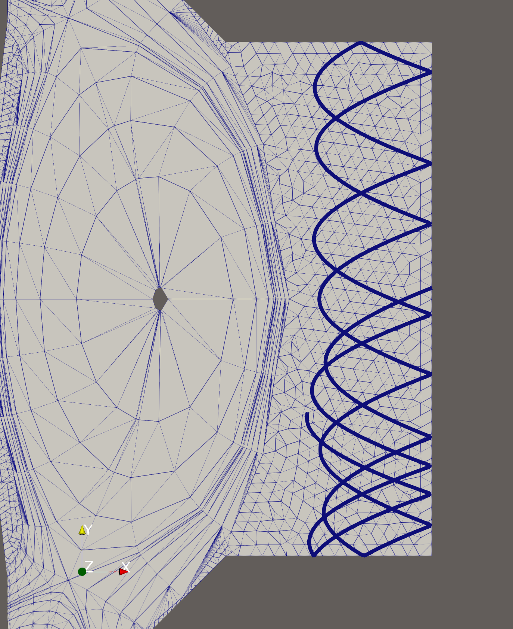
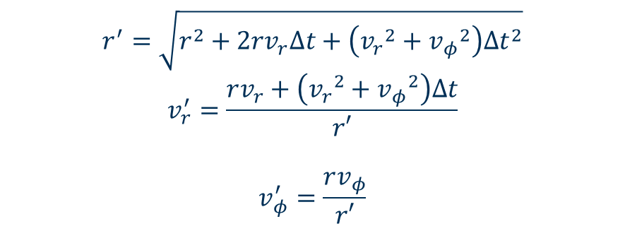
Neutral movement in axisymmetric geometry
Neutrals move in straight lines in 3D, but particles are constrained to 2D mesh
How to represent 3D neutral paths without introducing extra dimension.
Include fictitious force in particle pusher.
Verlet/leapfrog integration leads to energy drift
Conservation requires different approach
$$r^{′}=\sqrt{r^{2}+2rv_{r}Δt+\left({v_{r}}^{2}+{v_{φ}}^{2}\right){Δt}^{2}}$$
$$v_{r}^{′}=\frac{rv_{r}+\left({v_{r}}^{2}+{v_{φ}}^{2}\right)Δt}{r′}$$
$$v_{φ}^{′}=\frac{rv_{φ}}{r′}$$

Slide 11
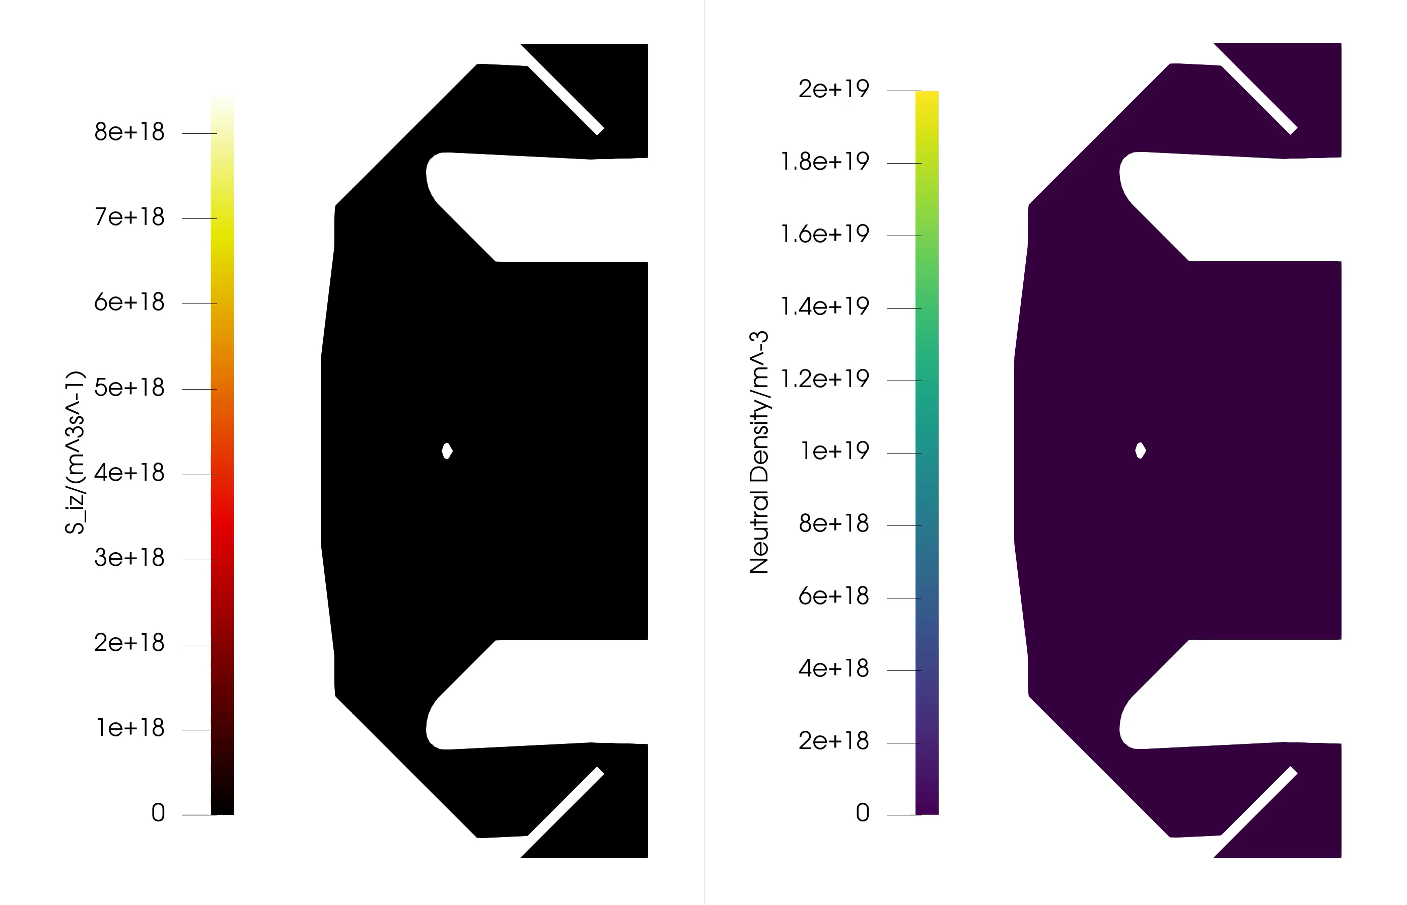
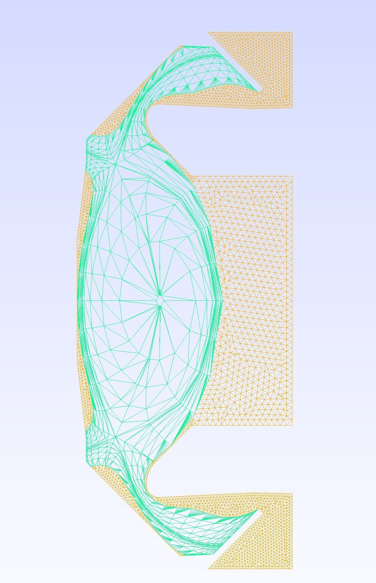
VANTAGE coupling
Thermal neutral source at outer midplane
Ionisation on fixed plasma background
Convergence to steady-state
Single mesh, multiple domains

Slide 12
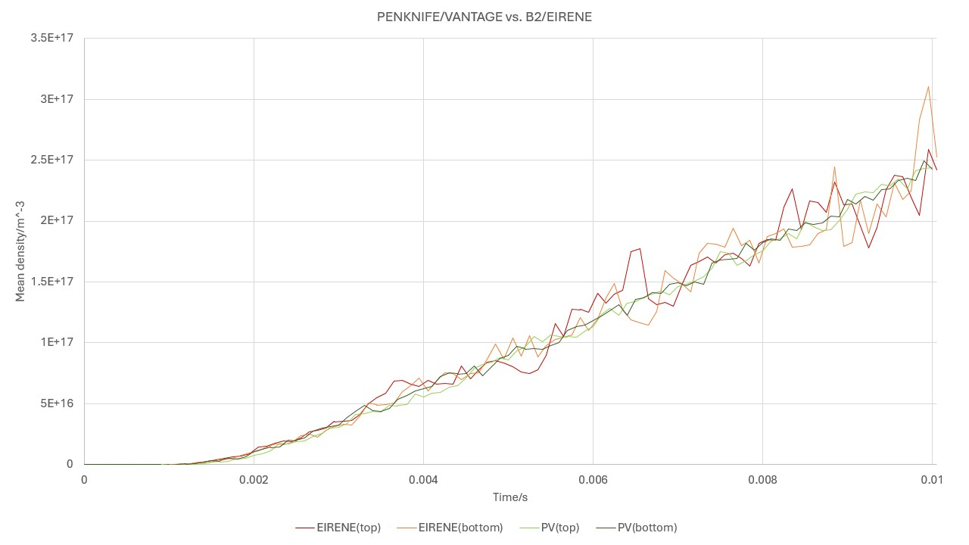
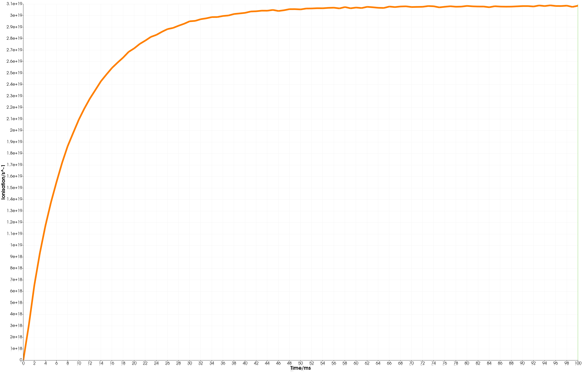
EIRENE comparison
Thermal source of neutrals at OMP
Neutral advection only – excellent agreement with EIRENE – with less noise
Ionisation and wall pumping
Steady state reached after around 50ms
Integral of ionisation source reaches to 3.08e19/s vs EIRENE 3.75e19/s
5e21/s source. Absorption at wall set too high (10%)

Slide 13
Marker particles and FEM reconstruction

Slide 14
Recombination and marker particles
VANTAGE requires marker particle sources for the recombination reaction.
Random distribution to avoid bias, but is not consistent with FEM integration
Marker particles’ weight must be adjusted according to their distribution in the cell before sampling FEM field
FEM field
Evaluation at particle positions
Multiplication by particle "mass"
Particle weight
FEM Projection

Slide 15
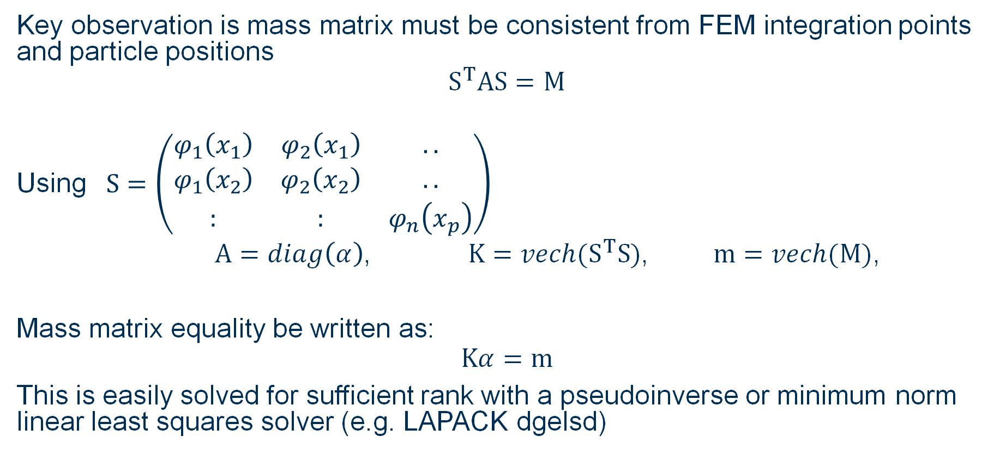
Consistent Marker Weights
Key observation is mass matrix must be consistent from FEM integration points and particle positions
$$S^{T}AS=M$$
Using $S=\left(\begin{matrix}φ_{1}\left(x_{1}\right) & φ_{2}\left(x_{1}\right) & .. \\ φ_{1}\left(x_{2}\right) & φ_{2}\left(x_{2}\right) & .. \\ : & : & φ_{n}\left(x_{p}\right)\end{matrix}\right)$
$A=diag\left(α\right)$, $K=vech(S^{T}S)$, $m=vech(M)$,
Mass matrix equality be written as:
$$Kα=m$$
This is easily solved for sufficient rank with a pseudoinverse or minimum norm linear least squares solver (e.g. LAPACK dgelsd)

Slide 16
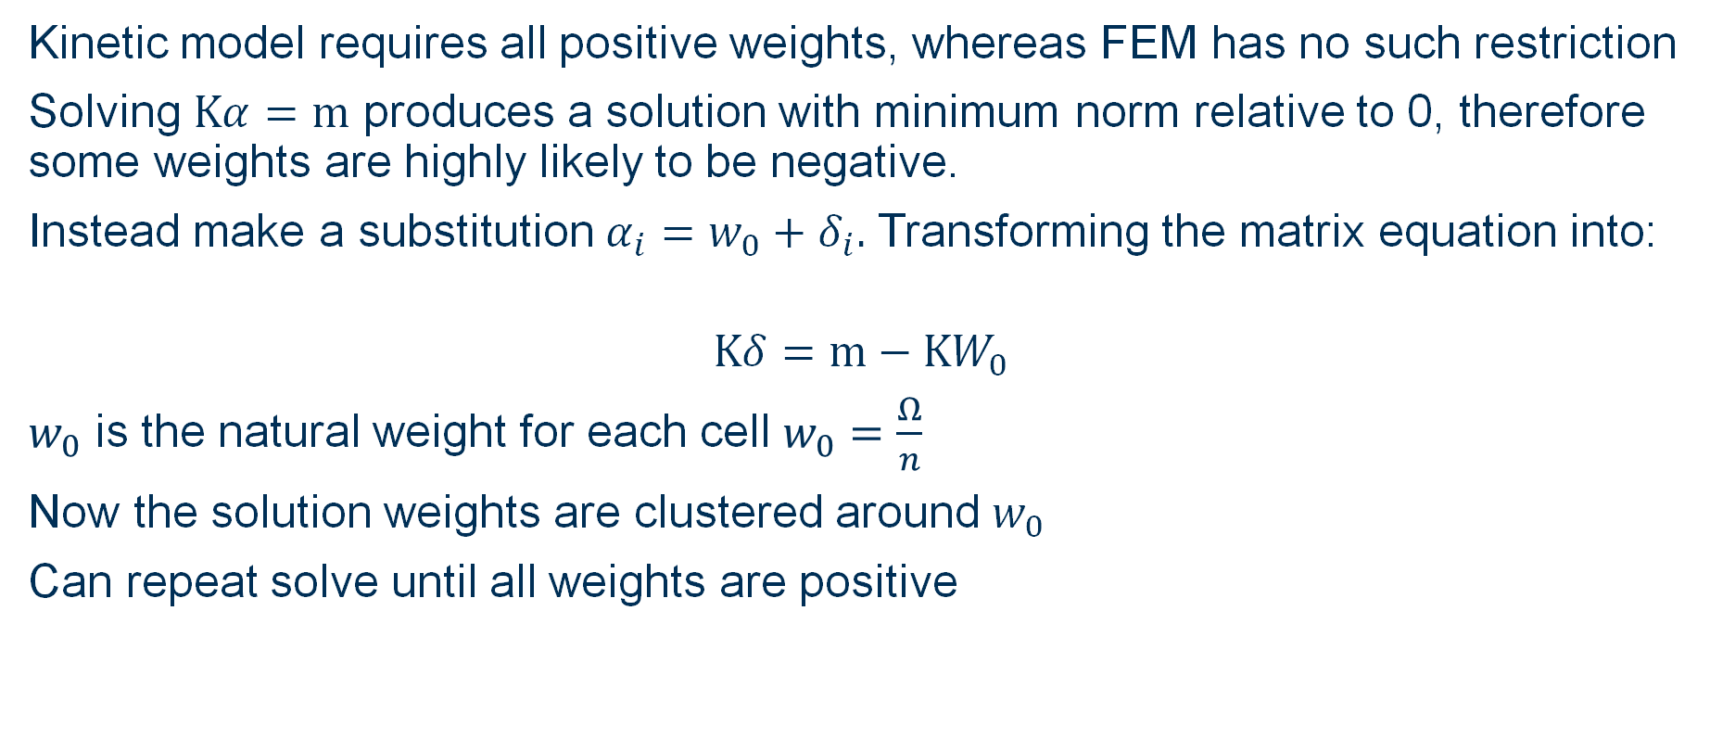
Avoiding negative weights
Kinetic model requires all positive weights, whereas FEM has no such restriction
Solving $Kα=m$ produces a solution with minimum norm relative to 0, therefore some weights are highly likely to be negative.
Instead make a substitution $α_{i}=w_{0}+δ_{i}.$ Transforming the matrix equation into:
$$Kδ=m−KW_{0}$$
$w_{0}$ is the natural weight for each cell $w_{0}=\frac{Ω}{n}$
Now the solution weights are clustered around $w_{0}$
Can repeat solve until all weights are positive

Slide 17
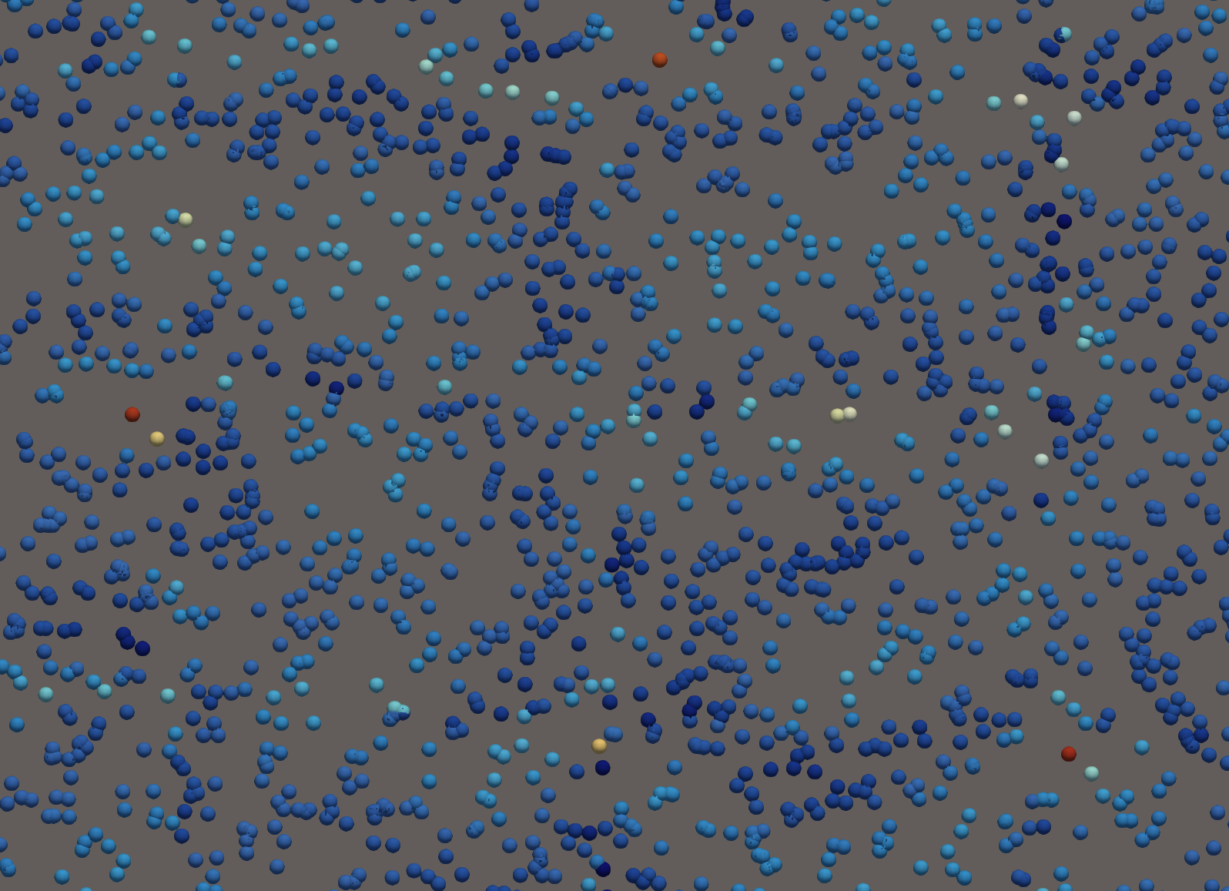
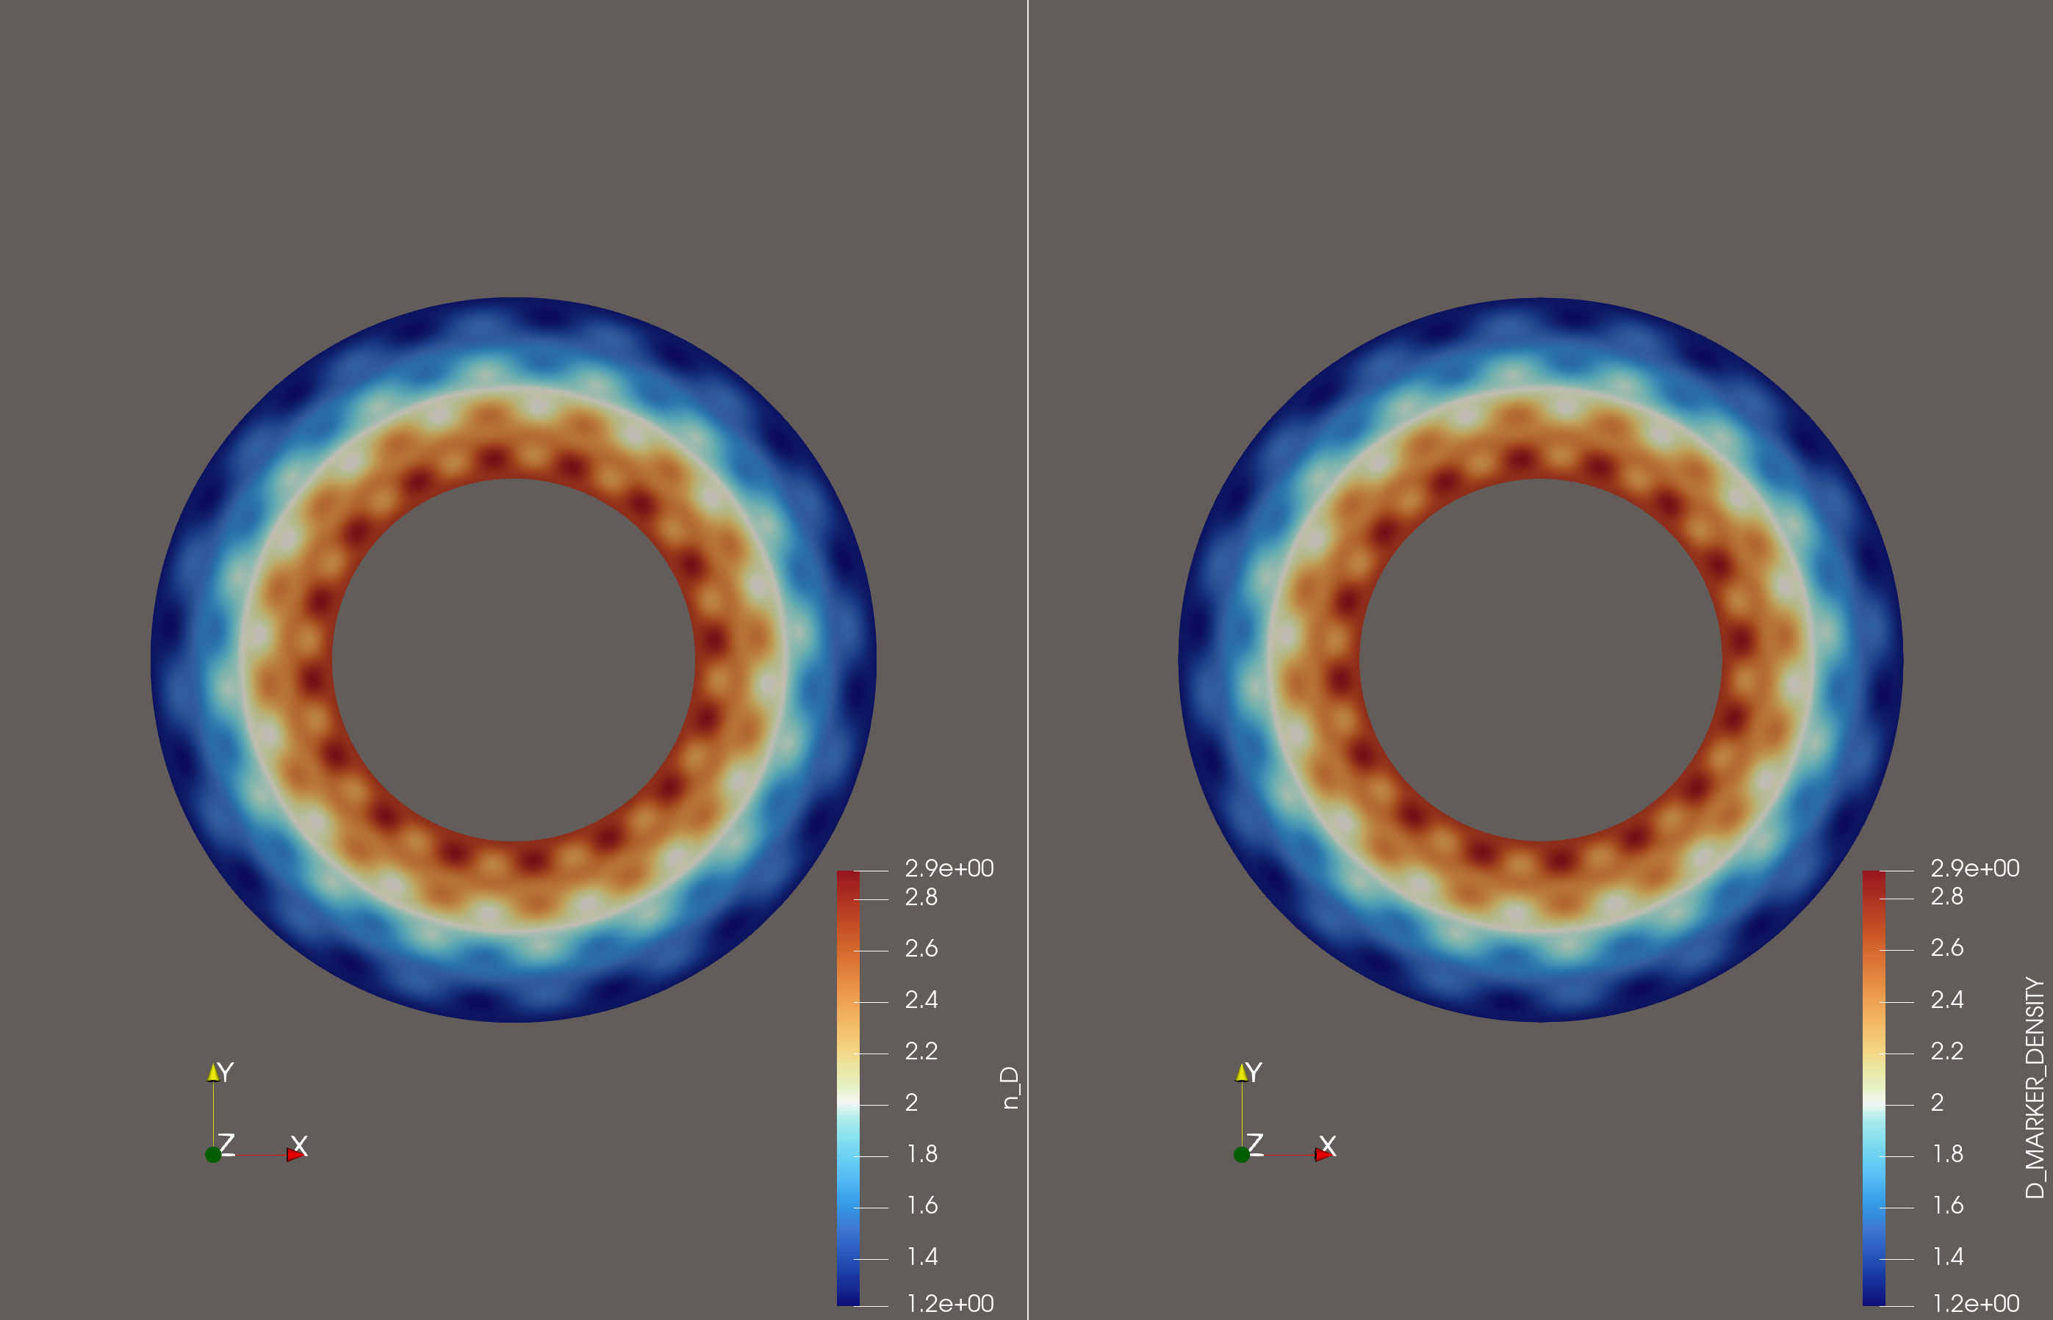
Marker weights
Uniform distribution of (static) marker particles.
Particles in voids are assigned higher masses
Particles in clusters are assigned lower masses
2D 200 markers/cell P=3 has ~0.01% error

Slide 18
Status and outlook

Slide 19
Status
PENKNIFE capability progressing in parallel and in conjunction with Nektar++ and VANTAGE development
FEM track
Basic advection-diffusion solver
Field aligned operators $∇_{∥}, ∇_{⊥}$
Field aligned operators ∇_∥, ∇_⊥
Kinetic track
Basic coupling to VANTAGE (ionisation/cx/recombination)
Merge, remove and project transformations
Physics track
Multispecies reduced equations
Braginskii closure
Basic surface reactions (absorption/reflection)
Advanced surface reactions (TRIM data/recycling)
Binary reactions and molecular processes
Zhdanov closure
EM turbulence
Electrostatic turbulence and drifts
Improved preconditioning, meshing and GPU execution
Implicit non-linear solver
Improving turbulence numerics

Slide 20
Future
Keep pace with VANTAGE development
Adopt numerical and meshing techniques from Nektar++ collaboration
Currently have only explored simple geometry for the complex models and simple models for the complex geometry.
SUNRISE will unlock the complex geometry, complex model capability

