Slide 1
NESO-Particles: A Performance Portable Particle Framework for Fusion Plasma Simulation
Will Saunders

Slide 2


NESO Solvers
PENKNIFE
NESO-Impurity-transport
BOUT++/Hermes-3
(in development)
Actual simulations
Other libraries
How to map particles into cells for a particular in-memory mesh format.
Trajectory-wall intersections.
Project (deposit) and evaluate.
NESO: Nektar++ interface
NP DMPlex interface
Particle data and looping.
Mesh abstraction base classes.
Common implementation patterns
Particle movement.
(Cartesian mesh included)

Slide 3
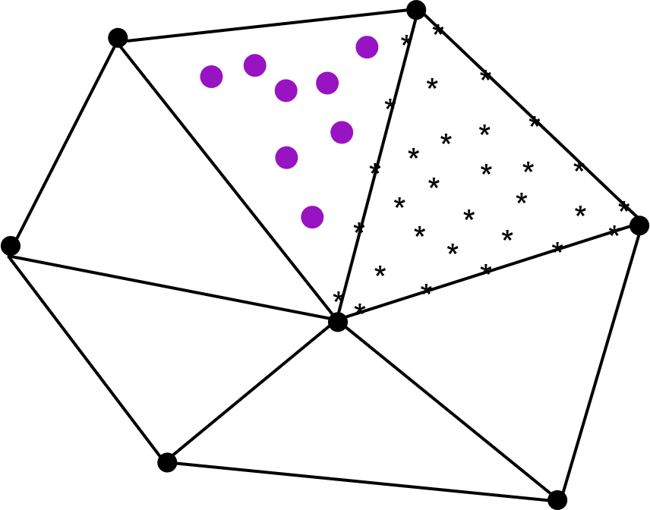
NESO-Particles: Core Components
MPI+SYCL Particle framework
Unstructured meshes
Particle data communication
  Highly directional plasma flow (along field lines)
  Fast neutral flow (typically global and omnidirectional)
  Unstructured high-order mesh
Particle Based Operations/Data structures
  Particle properties – position, velocity, charge, id...
  Loops over particles
  Degrees of Freedom (DOF) – Particle Loops
  Particle – Particle Loops
Retain cell based structure of DOFs and partices.

Slide 4
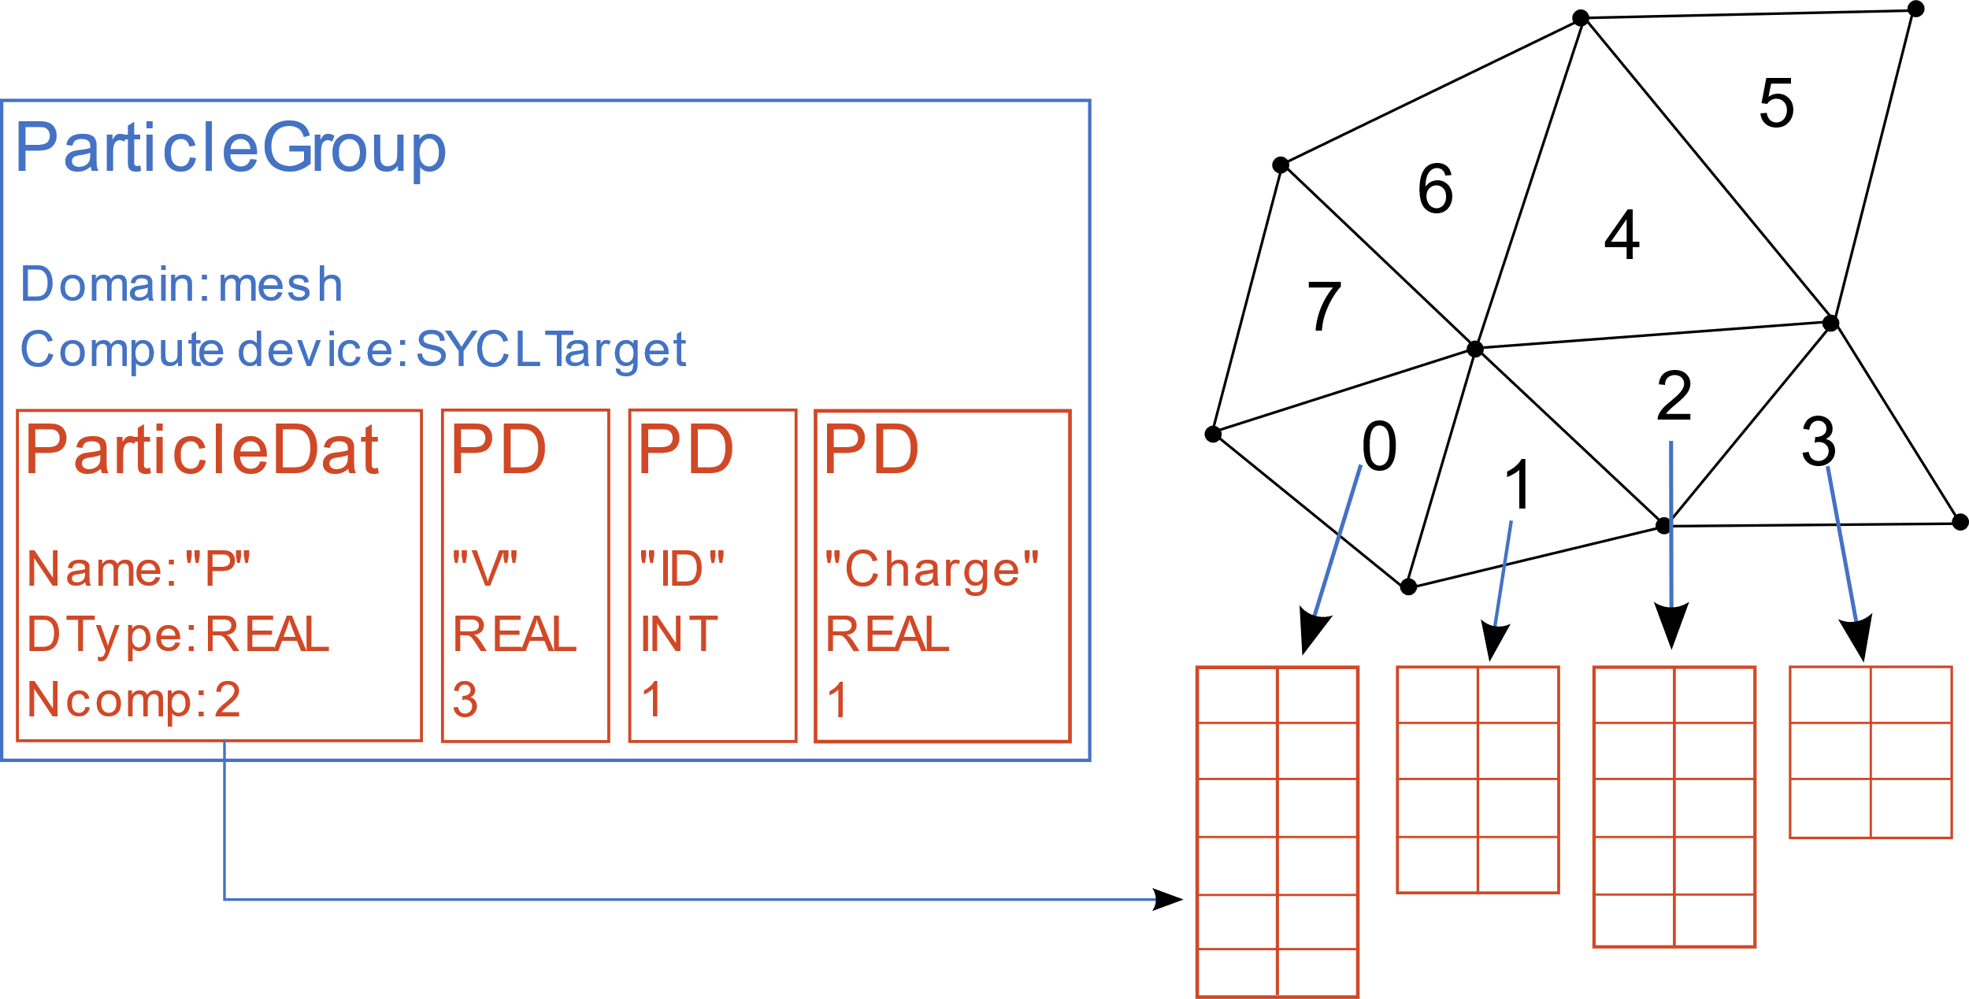
Particle Data
ParticleGroup, ParticleDat
Combines the: mesh, compute device and particle data.
Implements particle bookkeeping – cells and MPI ranks.
General particle properties, e.g. charge, mass, weight, velocity.
4

Slide 5
ParticleLoop
Abstraction [1]:
Have a collection of particles.
Each particle has the same property types, e.g. position (P), velocity (V)
Loop over all particles and apply the same kernel to all particles, e.g.
  For each particle i:
  Pi = Pi + dt * Vi
May also wish to access global data – not associated with a particular particle.
[1] A domain specific language for performance portable molecular dynamics algorithms, CPC, March 2018

Slide 6
Key:
NESO-Particles API
User Kernel
ParticleLoop
Implementation:
Is SYCL-free for the user
Significantly reduced boilerplate
Reduced room for error
Access descriptors allow implementation to infer when data is modified.
Templated C++
const int ndim = 2;
const REAL dt = 0.001;
auto loop = particle_loop(
particle_group,
[=](auto P, auto V){
for(int dimx=0 ; dimx<ndim ; dimx++){
P.at(dimx) += dt * V.at(dimx);
}
},
Access::write(Sym<REAL>("P")),
Access::read(Sym<REAL>("V"))
);
loop->execute();

Slide 7
ParticleSubGroup
auto sub_group = particle_sub_group(
particle_group,
[=](auto ID) {
return (ID.at(0) % 2 == 0);
},
Access::read(Sym<INT>("ID"))
);
auto loop = particle_loop(
sub_group,
[=](auto V, auto P){
P.at(0) += 0.001 * V.at(0);
P.at(1) += 0.001 * V.at(1);
},
Access::read(Sym<REAL>("V")),
Access::write(Sym<REAL>("P"))
);
Inspired by NumPy views
Lightweight selection of a subset of particles.
Valid iteration set for ParticleLoop
Either automatically update or are fixed.
Sub groups can be made from sub groups.
Are invalidated when:
  Particle layout is updated, e.g. adding/removing particles, moving between ranks/cells.
  Defining data, e.g. ID in example, is updated.

Slide 8
Particle Pair Loop
Abstraction [1]:
Have a collection of pairs of particles.
Each particle has the same property types, e.g. charge (Q)
Loop over all particle pairs and apply the same kernel to all pairs, e.g.
  For each pair (a, b):
  Q_tmp = Q_a
  Q_a = Q_b
  Q_b = Q_tmp
May also wish to access global data – not associated with a particular particle.

Slide 9
Pair-wise Looping
auto pair_list = …
Particle_pair_loop(
pair_list,
[=](auto P_a, auto P_b, ...){
REAL r2 = 0.0;
for(int dx=0 ; dx<3 ; dx++){
REAL r = P_a.at(dx) - P_b.at(dx);
r2 += r*r;
}
// use r2
},
Access::A(Access::read(Sym<REAL>("P"))),
Access::B(Access::read(Sym<REAL>("P"))),
...
)->execute();
Pair-wise implies a two-particle kernel.
We restrict which combination of pairs are permissible.
Initial implementation allows pairs where both particles reside in the same mesh cell.
Access descriptors denote which particle a parameter refers to.

Slide 10
Pair List
Exploiting the pair list structure is crucial for performance.
The structure determines parallelism at the mesh-cell level.
DSMC sub-divides mesh cells into collision cells and samples pairs per collision cell.
DSMC considers a (potentially) very small number of possible pairs (much less cache reuse* and parallelism in comparison to other pairwise methods, e.g. MD).
Pairs are chosen at random and the ordering of the pairs must be persevered
* Sampling without replacement implies no reuse of particle indices and hence no reuse of values. Best case scenario is reuse where data resides on a cacheline that is reused.

Slide 11
Partitioning and Masking
CollisionCellPartition: Map from collision cells to particles.
  construct: Create the map.
  get_max_num_pairs: Get the maximum number of pairs that can be sampled in each collision cell for a given pair of species. Uses particles masks.
  get_num_unmasked_particles: Number of particles of a given species in each collision cell.

Slide 12
Sampling
Have species and collision cells
Create map from (collision cell, species) to particles
Set all particle masks to "true"
Determine order of species pairs: (A,B), (B,D), (A,C)…
Pick species pair: (A, B)
Choose number of pairs to sample for each collision cell
Sample pairs from particles with mask "true"
Set particle masks for sampled pairs to "false"
Set pair masks to "true"
Perform pair looping

Slide 13
Overview
NESO-Particles is a MPI+SYCL particle framework
Single particle and two particle looping constructs
Initial support for DSMC use case
THE END

Slide 14
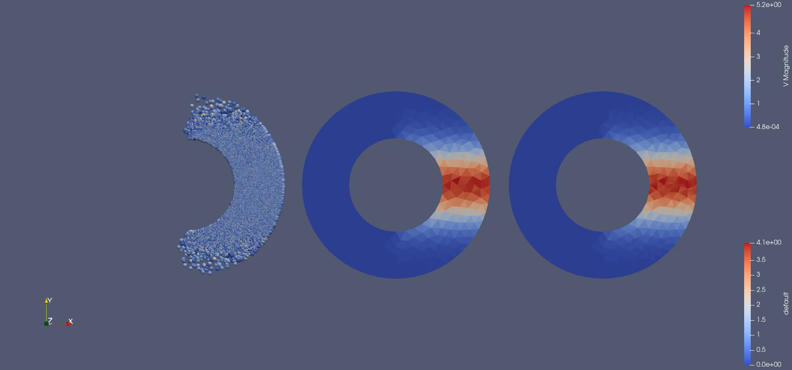

Slide 15
ParticleLoop
Additional Data Structures:
Are still SYCL-free for the user:
  LocalArray (Array on each rank)
  GlobalArray (Array with writes reduced over ranks)
  CellDatConst (Matrix per mesh cell)
  CellDat (Matrix per mesh cell – variable row count)
  SymVector (Runtime number of kernel arguments)
  ParticleLoopIndex (Index of particle in kernel)
  KernelRNG with GPU acceleration through NESO-RNG-Toolkit
Particle loops can create Products (new particles):
auto other = ...
auto loop = particle_loop(
particle_group,
[=](auto P, auto V, auto OTHER){
<use OTHER>
},
Access::write(Sym<REAL>("P")),
Access::read(Sym<REAL>("V")),
Access::write(other),
);
loop->execute();

