Slide 1
2D transport mechanisms near the X-points in snowflake divertors
UKAEA Exhaust Code Workshop 2026
Dominic Power
Acknowledgments: Vlad Soukhanovskii, Maxim Umansky, Dmitri Ryutov, Fabio Federici & the MAST-U Team
Prepared by LLNL under Contract DE-AC52-07NA27344.

Slide 2
Talk outline
The snowflake divertor background
Edge transport modelling of snowflake experiments at MAST-U
BOUT++ modelling of transport near the X-points
An electrostatic version of the churning mode?
Conclusions

Slide 3
Talk outline
The snowflake divertor background
Edge transport modelling of snowflake experiments at MAST-U
BOUT++ modelling of transport near the X-points
An electrostatic version of the churning mode?
Conclusions

Slide 4
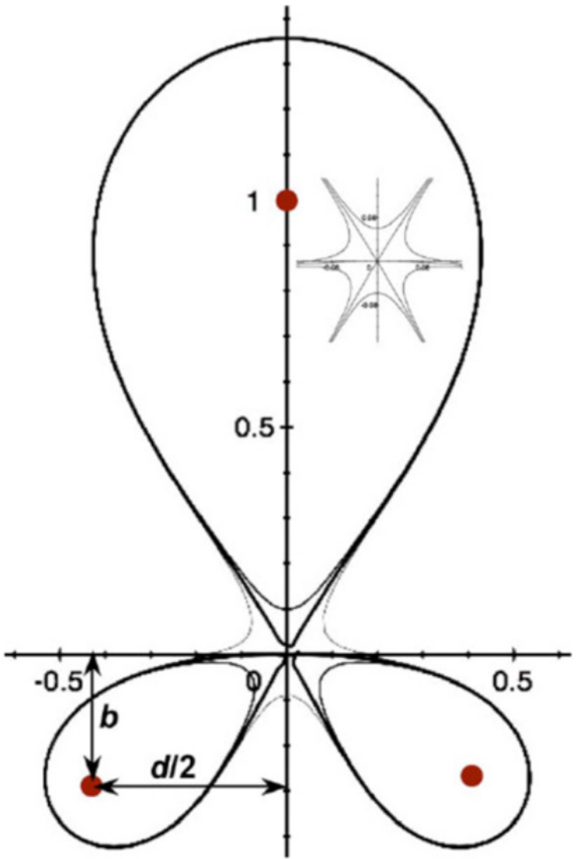
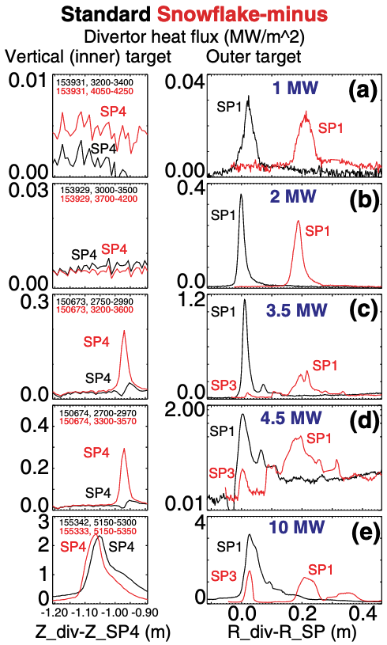
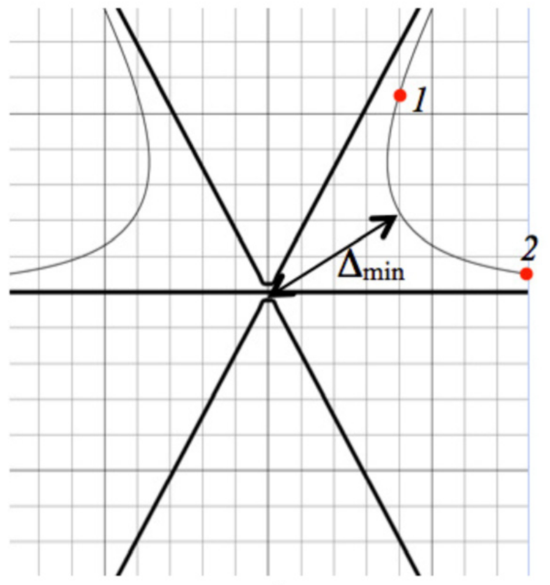
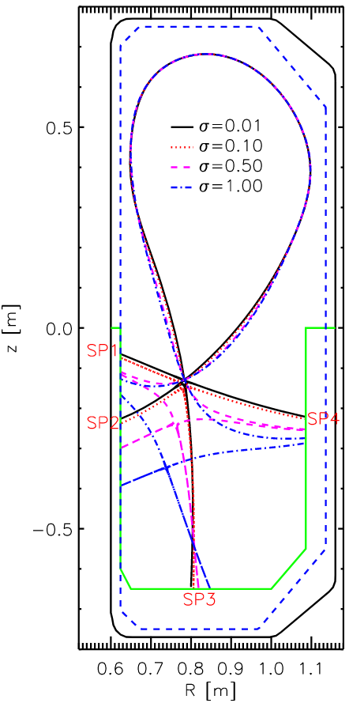
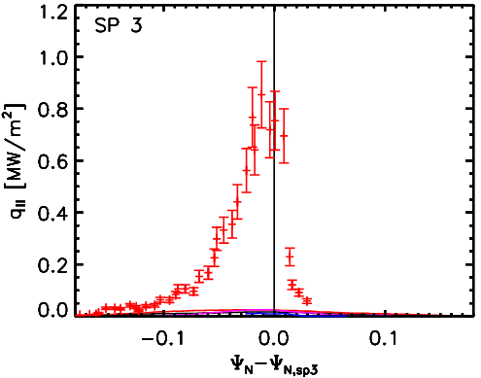
The snowflake divertor (SFD) - experiments show evidence of enhanced transport around the X-points
[1] Ryutov & Soukhanovskii, PoP (2015)
[2] Lunt et al., PPCF 56 (2014)
[3] Soukhanovskii et al., Nucl. Fusion 58 (2018)
Geometric + magnetic properties of the SFD indicate good exhaust performance
SFD realised at TCV, NSTX, DIII-D, MAST-U, ASDEX-Upgrade & planned for NSTX-U
From TCV: some transport mechanism is driving “activation” of secondary strike points, beyond that expected from standard edge transport modelling
From DIII-D: effect is sensitive to heating power → some dependence on pressure in X-point region?
LP measurements
Secondary SP increasingly activated at high heating power
EMC3-EIRENE simulations
[1]
[2]
[3]

Slide 5
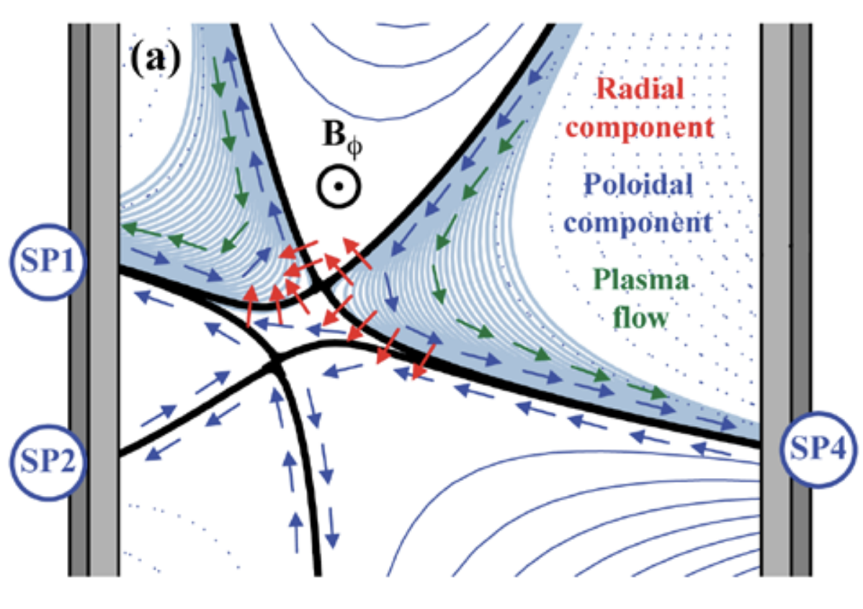
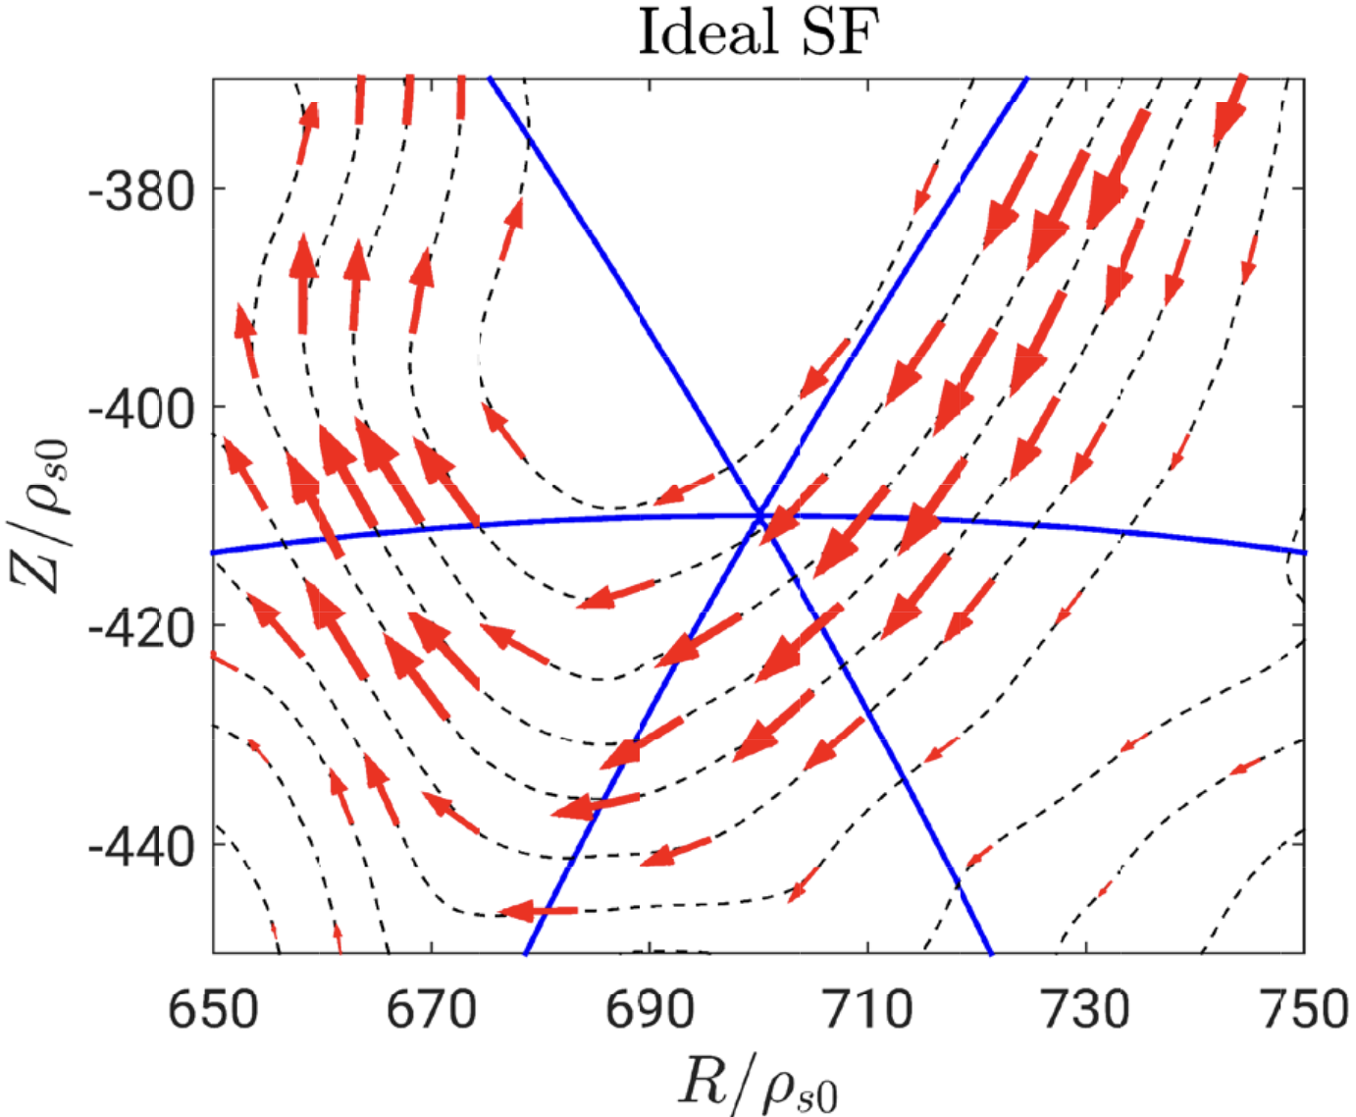

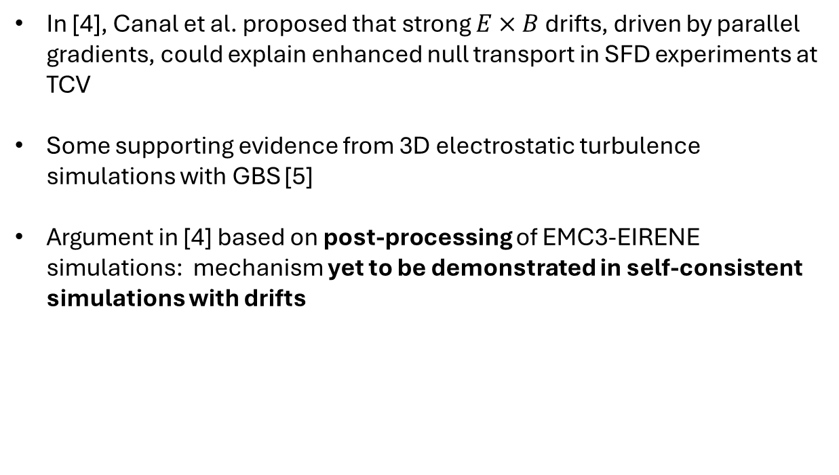
Candidate 1: Enhanced $E×B$ drifts driven by poloidal gradients near the X-points [Canal et al.]
In [4], Canal et al. proposed that strong $E×B$ drifts, driven by parallel gradients, could explain enhanced null transport in SFD experiments at TCV
Some supporting evidence from 3D electrostatic turbulence simulations with GBS [5]
Argument in [4] based on post-processing of EMC3-EIRENE simulations: mechanism yet to be demonstrated in self-consistent simulations with drifts
[4]
[5]
[4] Canal et al., Nucl. Fusion 55 (2015)
[5] Giacomin et al., Nucl. Fusion 60 (2020)

Slide 6
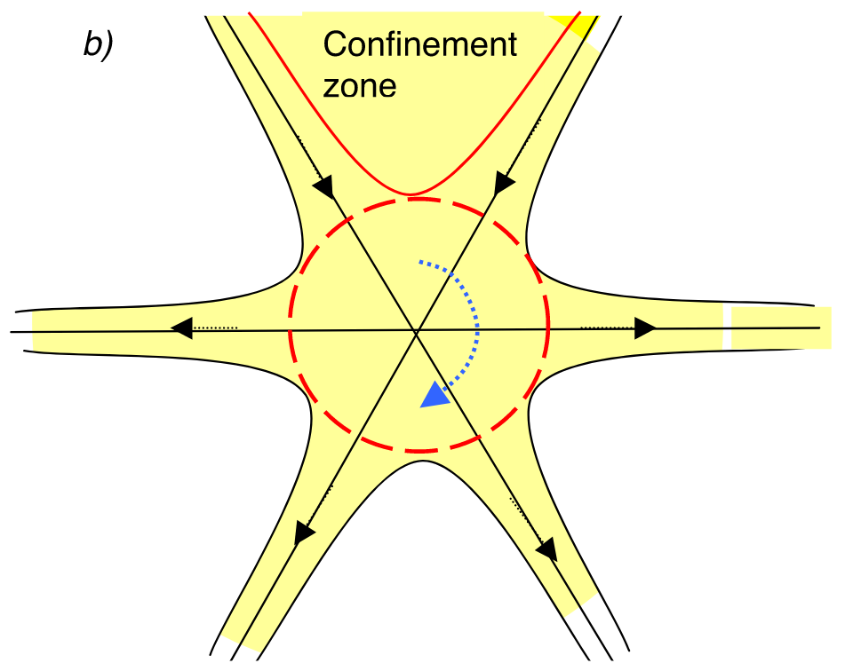
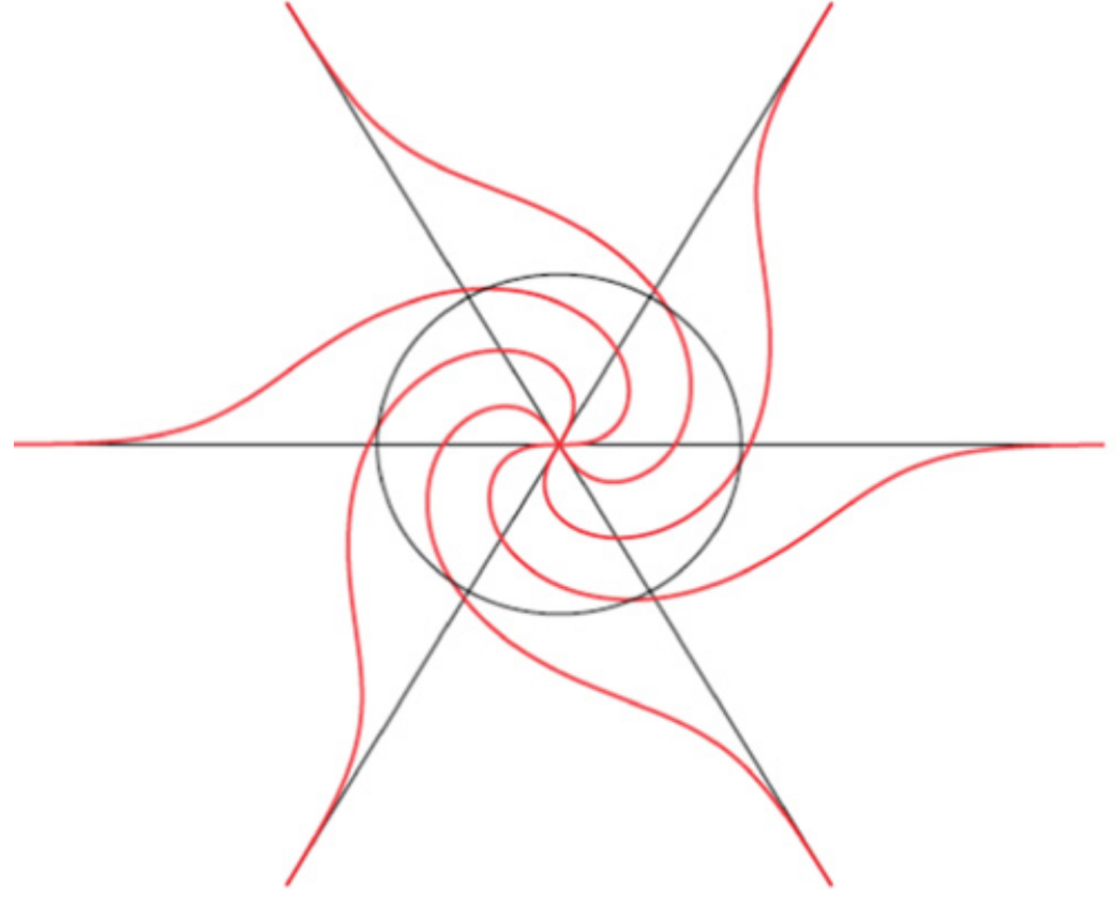
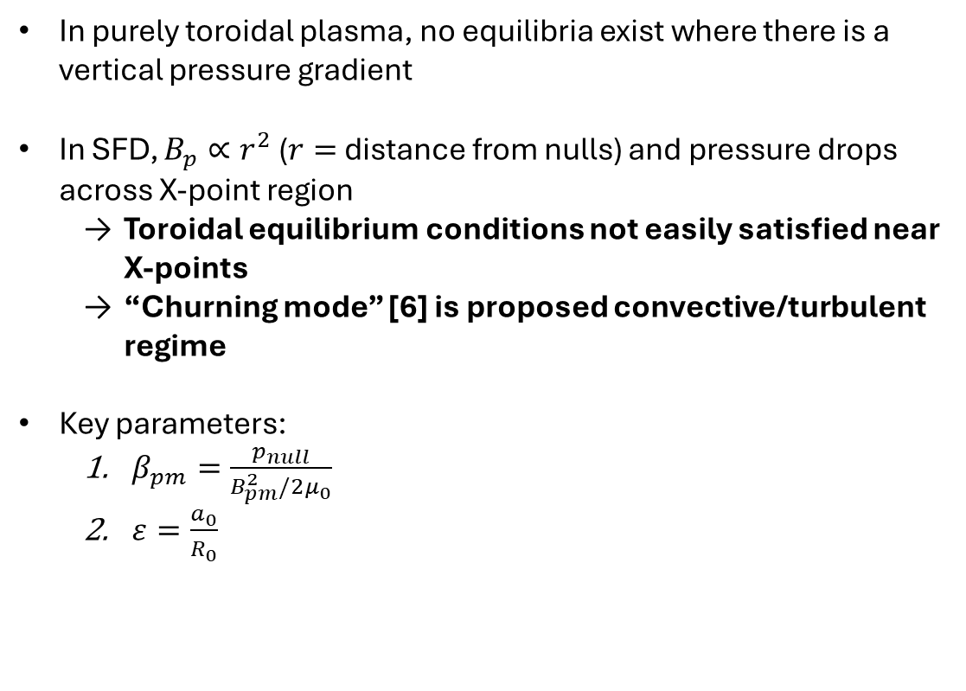
Candidate 2: The “churning mode” (CM), axisymmetric plasma convection in the null region [Ryutov et al.]
In purely toroidal plasma, no equilibria exist where there is a vertical pressure gradient
In SFD, $B_{p}∝r^{2}$ ($r=$distance from nulls) and pressure drops across X-point region
  Toroidal equilibrium conditions not easily satisfied near X-points
  “Churning mode” [6] is proposed convective/turbulent regime
Key parameters:
  $β_{pm}=\frac{p_{null}}{B_{pm}^{2}/2μ_{0}}$
  $ε=\frac{a_{0}}{R_{0}}$
Determine the size of the affected zone
[6]
[6] Ryutov et al., Phys. Scr. (2014)
[7] Umansky & Ryutov, PoP 23 (2016)
[8] Power et al., PoP 32 (2025)

Slide 7
Talk outline
The snowflake divertor background
Edge transport modelling of snowflake experiments at MAST-U
BOUT++ modelling of transport near the X-points
An electrostatic version of the churning mode?
Conclusions

Slide 8
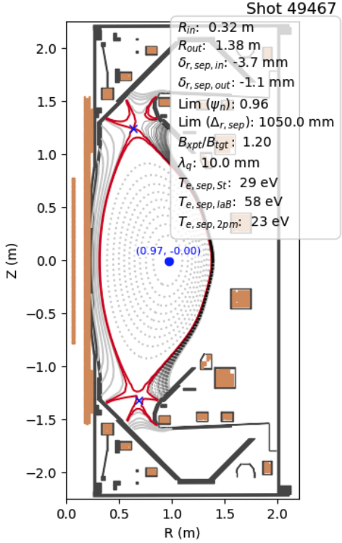
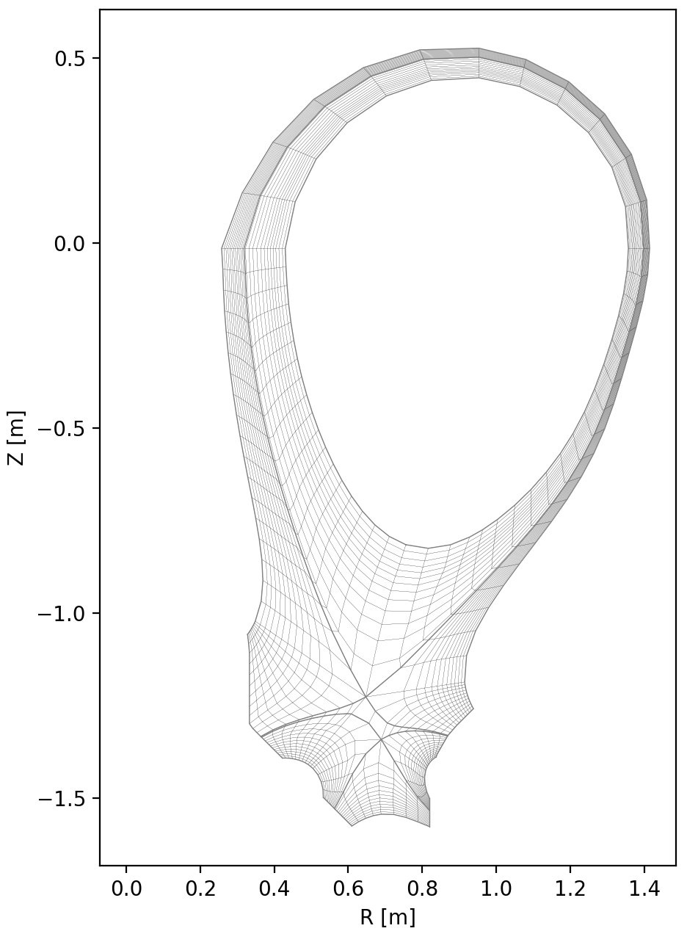
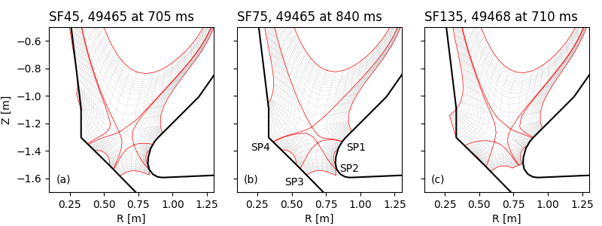
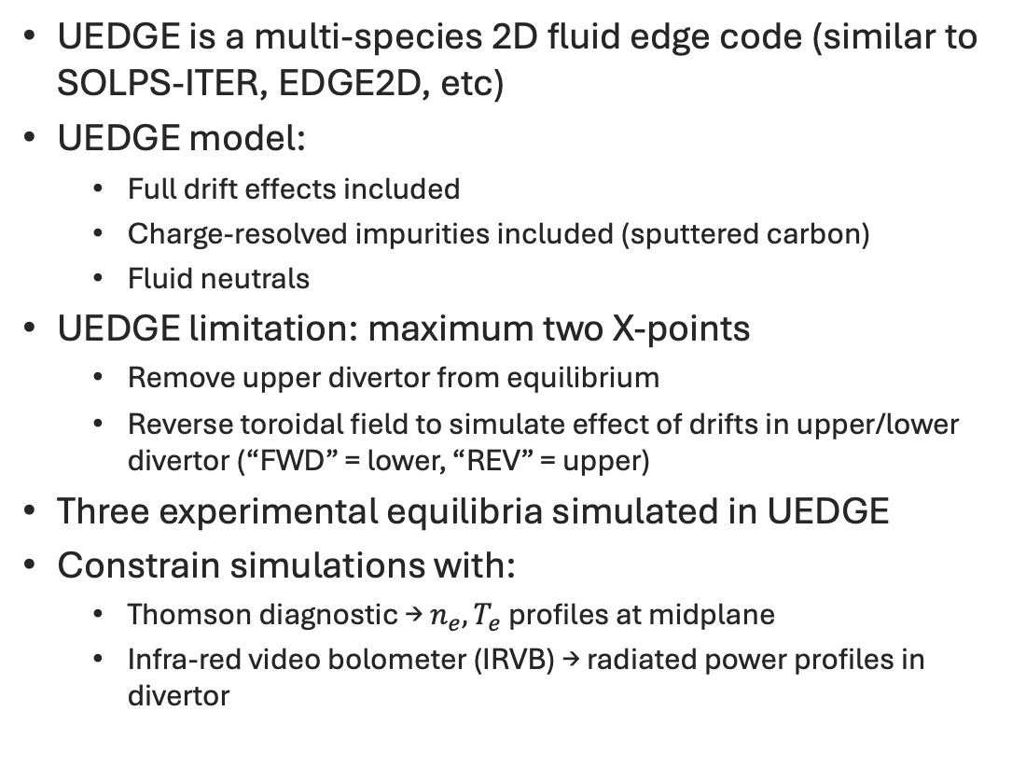
UEDGE modelling of SFD experiments at MAST-U
UEDGE is a multi-species 2D fluid edge code (similar to SOLPS-ITER, EDGE2D, etc)
UEDGE model:
  Full drift effects included
  Charge-resolved impurities included (sputtered carbon)
  Fluid neutrals
UEDGE limitation: maximum two X-points
  Remove upper divertor from equilibrium
  Reverse toroidal field to simulate effect of drifts in upper/lower divertor (“FWD” = lower, “REV” = upper)
Three experimental equilibria simulated in UEDGE
Constrain simulations with:
  Thomson diagnostic → $n_{e},T_{e}$ profiles at midplane
  Infra-red video bolometer (IRVB) → radiated power profiles in divertor
UEDGE grids

Slide 9
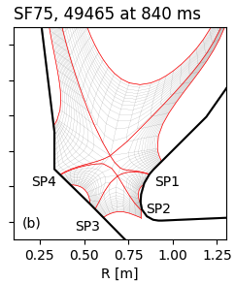
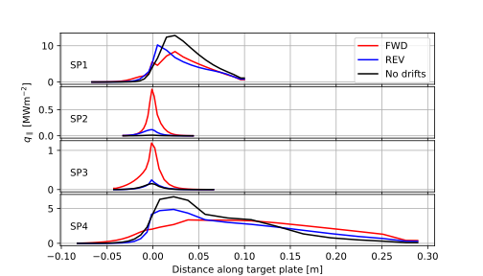
Simulations with drifts show redistribution of exhaust power from primary to secondary targets
Direct comparison of simulations with/without drifts show increased heat flux to secondary strike points (SPs), reduced heat flux to primary SPs
“Activation” of secondary SPs is beneficial for plasma exhaust
This indicates drifts are playing a role beyond the geometric properties of the SFD
Seen in all SFD geometries considered
Effect is more pronounced in lower divertor (FWD)
compared to upper divertor (REV)

Slide 10
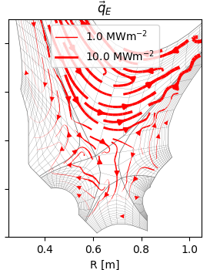
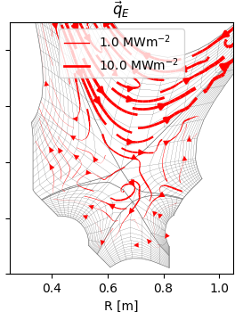
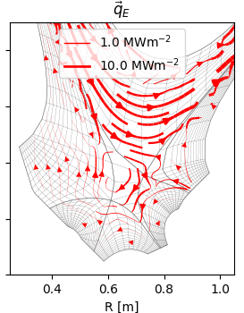
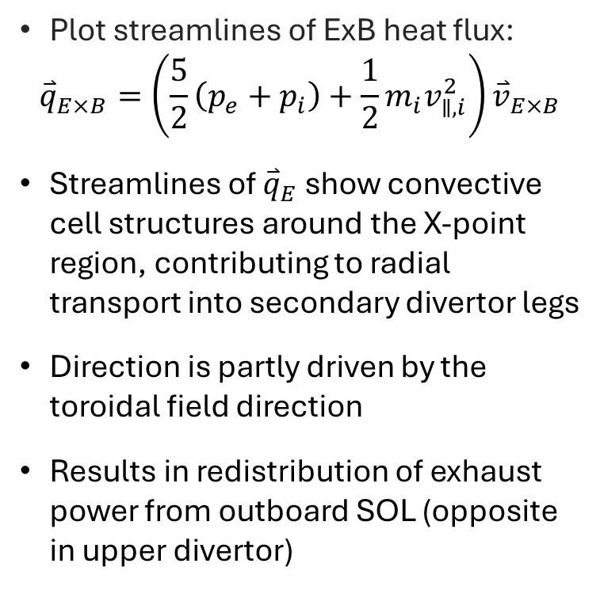
This additional transport comes from ExB flux near the X-points
Plot streamlines of ExB heat flux:
$${\overset{⃑}{q}}_{E×B}=\left(\frac{5}{2}\left(p_{e}+p_{i}\right)+\frac{1}{2}m_{i}v_{∥,i}^{2}\right){\overset{⃑}{v}}_{E×B}$$
Streamlines of ${\overset{⃑}{q}}_{E}$ show convective cell structures around the X-point region, contributing to radial transport into secondary divertor legs
Direction is partly driven by the toroidal field direction
Results in redistribution of exhaust power from outboard SOL (opposite in upper divertor)
SF45
SF75
SF135

Slide 11
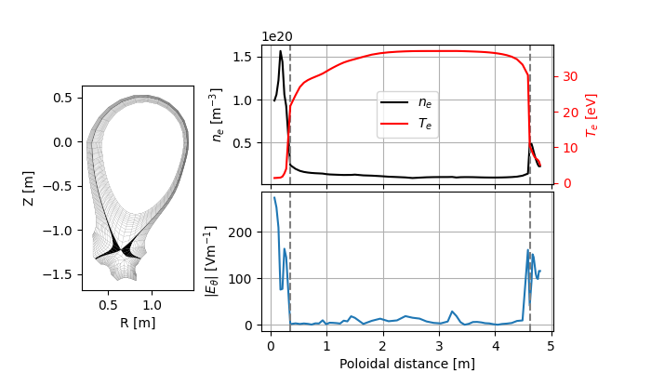

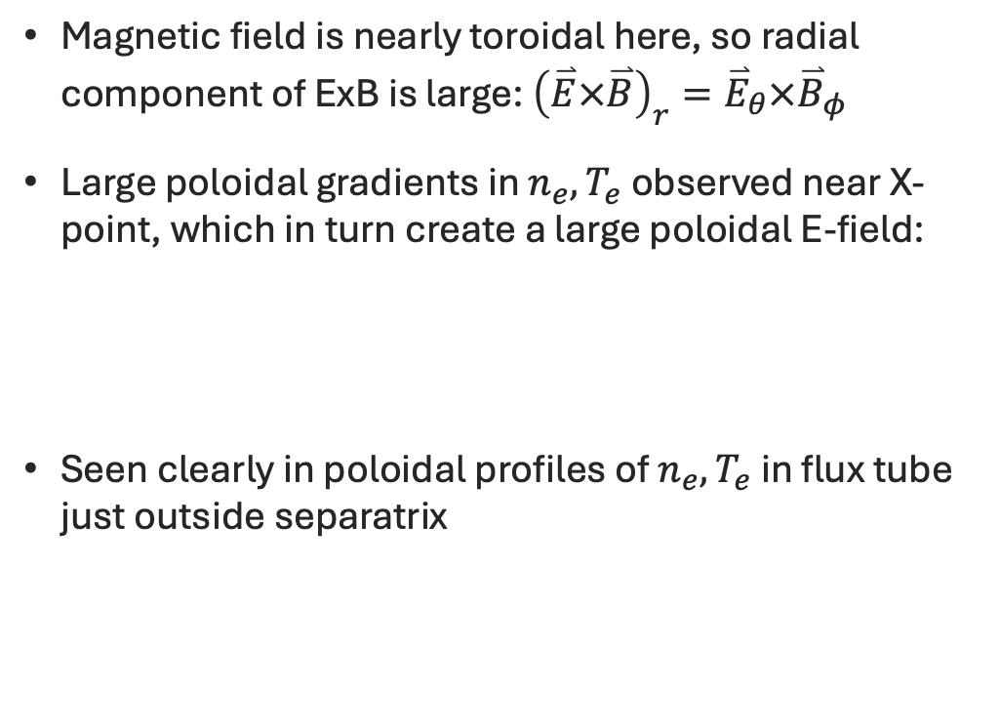
Strong ExB fluxes near the X-points arise from large poloidal gradients
Magnetic field is nearly toroidal here, so radial component of ExB is large: ${\left(\overset{⃑}{E}×\overset{⃑}{B}\right)}_{r}={\overset{⃑}{E}}_{θ}×{\overset{⃑}{B}}_{φ}$
Large poloidal gradients in $n_{e},T_{e}$ observed near X-point, which in turn create a large poloidal E-field:
Seen clearly in poloidal profiles of $n_{e},T_{e}$ in flux tube just outside separatrix
Primary X-point

Slide 12
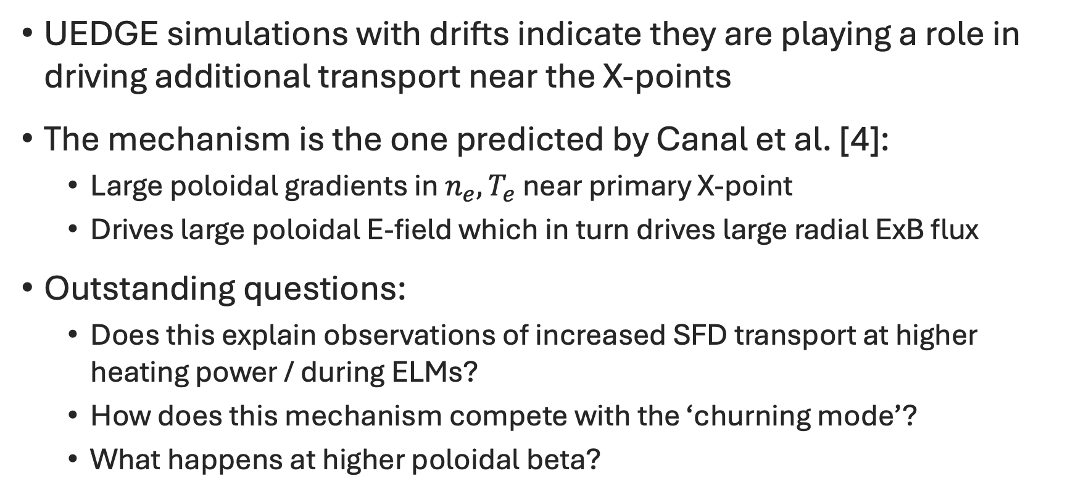
Conclusions from UEDGE modelling
UEDGE simulations with drifts indicate they are playing a role in driving additional transport near the X-points
The mechanism is the one predicted by Canal et al. [4]:
  Large poloidal gradients in ${n_{e},T}_{e}$ near primary X-point
  Drives large poloidal E-field which in turn drives large radial ExB flux
Outstanding questions:
  Does this explain observations of increased SFD transport at higher heating power / during ELMs?
  How does this mechanism compete with the ‘churning mode’?
  What happens at higher poloidal beta?
[4] Canal et al., Nucl. Fusion 55 (2015)

Slide 13
Talk outline
The snowflake divertor background
Edge transport modelling of snowflake experiments at MAST-U
BOUT++ modelling of transport near the X-points
An electrostatic version of the churning mode?
Conclusions

Slide 14
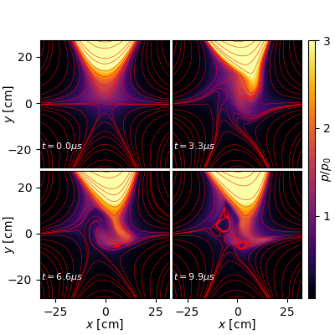
We seek a model that encompasses both the effect of equilibrium drifts and the churning mode (CM)
For direct comparison of the effect of ExB drifts and loss of magnetic equilibrium conditions we seek a model which includes both phenomena
Previous studies of the CM [7,8] used a model based on ideal MHD
Here we provide an extension:
  Include the effect of parallel gradients and thermal force in parallel Ohm’s law
  Finite resistivity
We will make some assumptions relevant to the region near the X-points, and simulate a 2D box around this location
  Constant density, lowest-order magnetic curvature vector, small parallel flows, etc
[8]
[7] Umansky & Ryutov, PoP 23 (2016)
[8] Power et al., PoP 32 (2025)

Slide 15




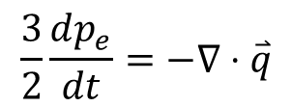
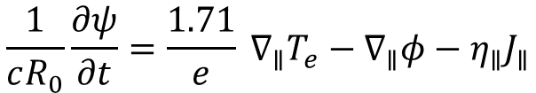

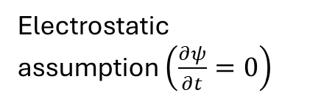
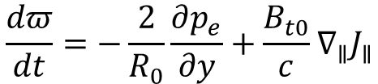
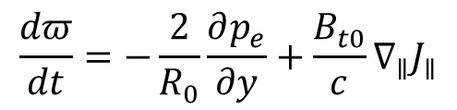
Extended model of the churning mode
Electromagnetic (EM) model
Electrostatic (ES) model
$$\frac{1}{cR_{0}}\frac{∂ψ}{∂t}=\frac{1.71}{e} ∇_{∥}T_{e}−∇_{∥}φ−η_{∥}J_{∥}$$
Electrostatic assumption $\left(\frac{∂ψ}{∂t}=0\right)$
$$\frac{3}{2}\frac{dp_{e}}{dt}=−∇⋅\overset{⃑}{q}$$
$$\frac{3}{2}\frac{dp_{e}}{dt}=−∇⋅\overset{⃑}{q}$$
$$\frac{dπ}{dt}=−\frac{2}{R_{0}}\frac{∂p_{e}}{∂y}+\frac{B_{t0}}{c}∇_{∥}J_{∥}$$
$$\frac{dπ}{dt}=−\frac{2}{R_{0}}\frac{∂p_{e}}{∂y}+\frac{B_{t0}}{c}∇_{∥}J_{∥}$$
where
Directly comparing ES vs. EM models allows us to compare magnitude of equilibrium ExB drifts vs. the CM

Slide 16
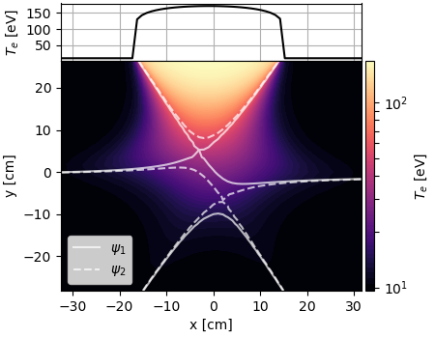
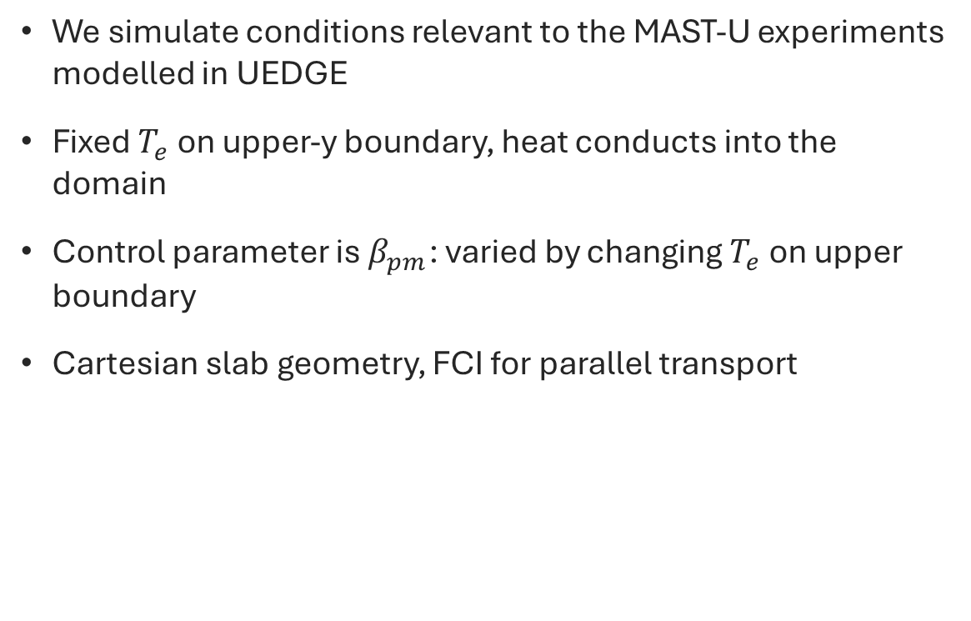
Both models have been implemented in BOUT++
We simulate conditions relevant to the MAST-U experiments modelled in UEDGE
Fixed $T_{e}$ on upper-y boundary, heat conducts into the domain
Control parameter is $β_{pm}$: varied by changing $T_{e}$ on upper boundary
Cartesian slab geometry, FCI for parallel transport

Slide 17
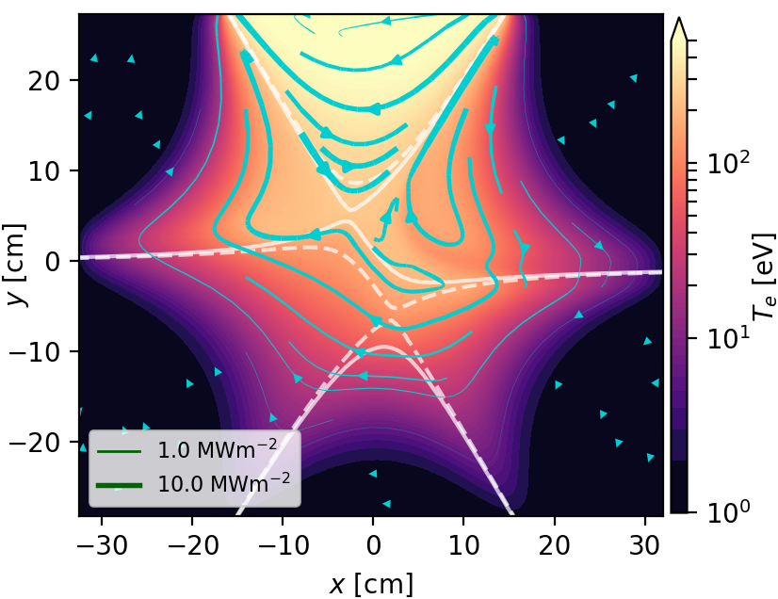
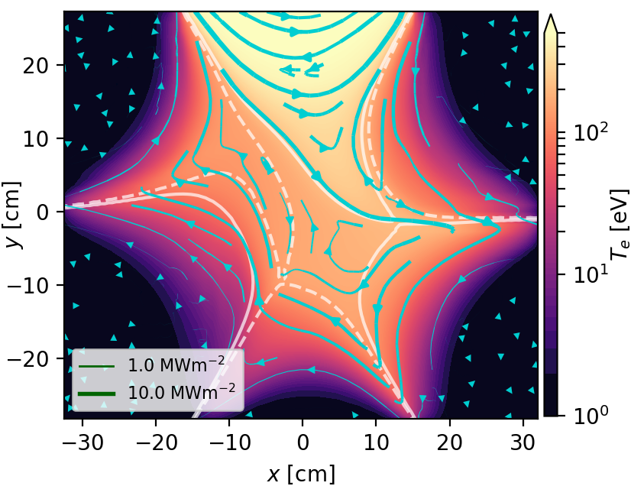
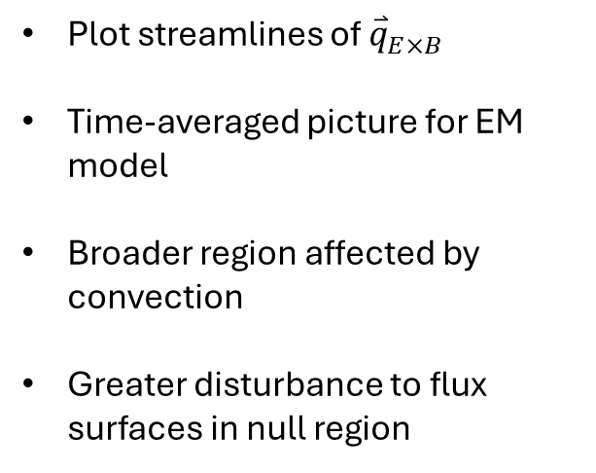

Quasi-steady state flow patterns show increasing differences between ES vs EM models at high $β_{pm}$
ES model
EM model
Plot streamlines of ${\overset{⃑}{q}}_{E×B}$
Time-averaged picture for EM model
Broader region affected by convection
Greater disturbance to flux surfaces in null region

Slide 18
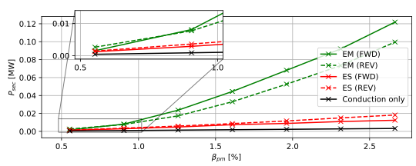
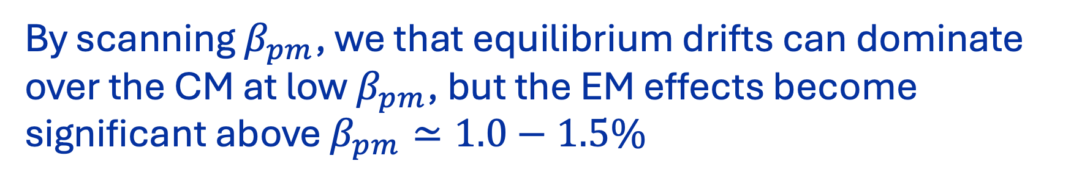
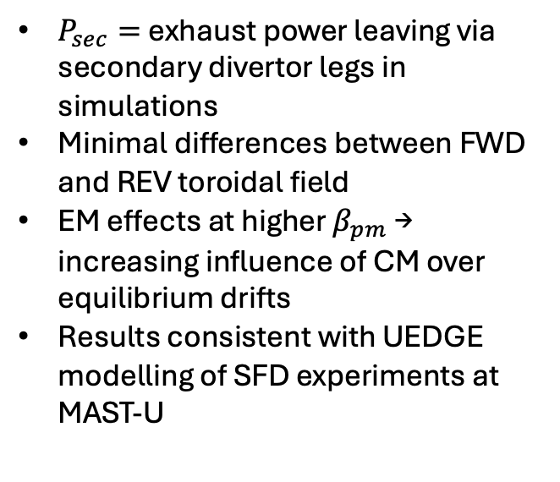
By scanning $β_{pm}$, we that equilibrium drifts can dominate over the CM at low $β_{pm}$, but the EM effects become significant above $β_{pm}≃1.0−1.5\%$
$P_{sec}=$exhaust power leaving via secondary divertor legs in simulations
Minimal differences between FWD and REV toroidal field
EM effects at higher $β_{pm}$ → increasing influence of CM over equilibrium drifts
Results consistent with UEDGE modelling of SFD experiments at MAST-U
P_sec vs. beta_pm
MAST-U experiments modelled in UEDGE

Slide 19
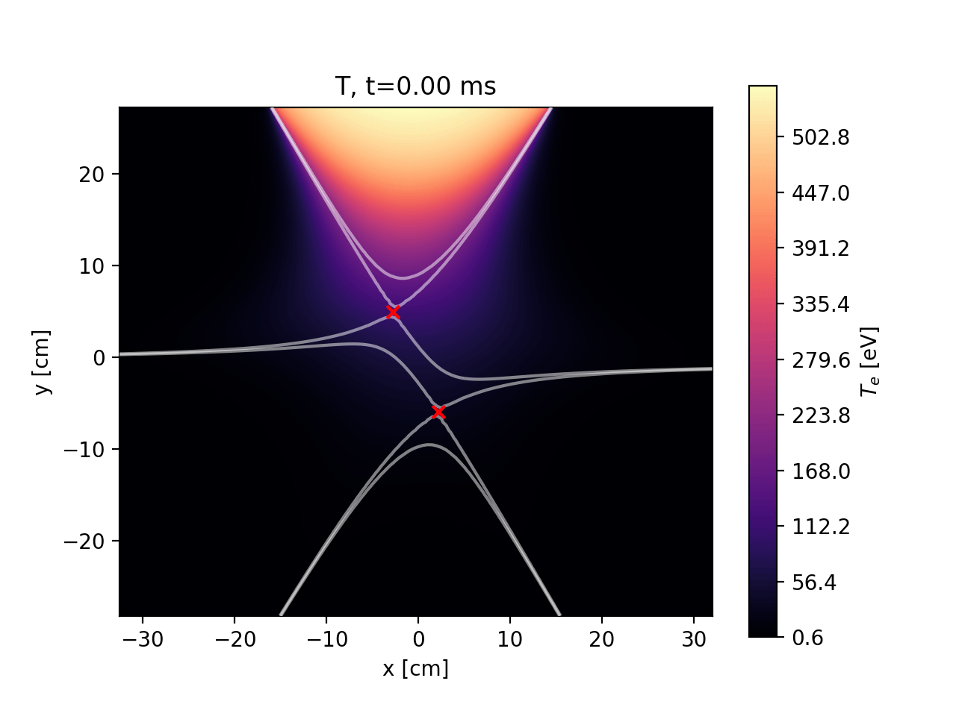

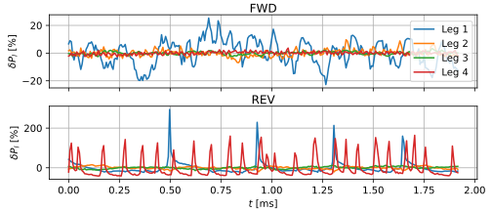
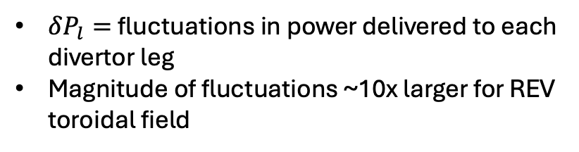
By reversing the toroidal field, we see that counter-propagating flows in EM model drives large fluctuations in exhaust power
FWD toroidal field
REV toroidal field
$δP_{l}=$fluctuations in power delivered to each divertor leg
Magnitude of fluctuations ~10x larger for REV toroidal field
Equilibrium drifts
CM

Slide 20
Talk outline
The snowflake divertor background
Edge transport modelling of snowflake experiments at MAST-U
BOUT++ modelling of transport near the X-points
An electrostatic version of the churning mode?
Conclusions

Slide 21
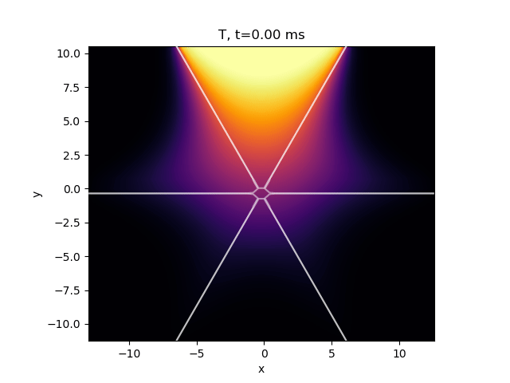
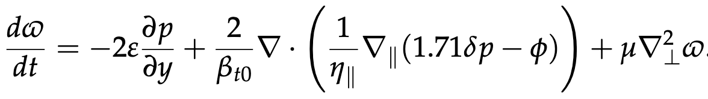

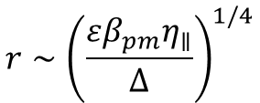

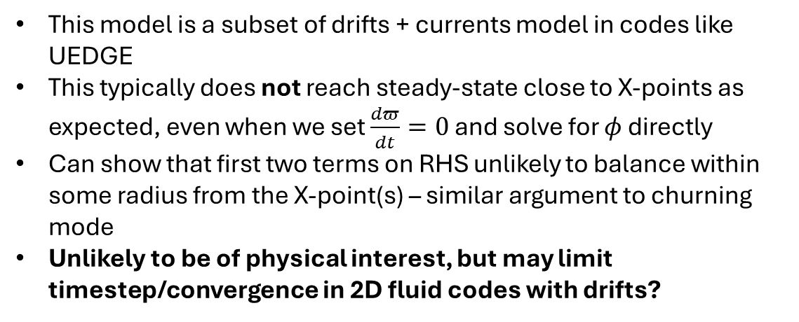
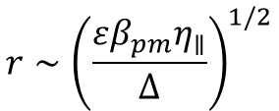

An electrostatic version of the churning mode?
Vorticity equation (normalised):
This model is a subset of drifts + currents model in codes like UEDGE
This typically does not reach steady-state close to X-points as expected, even when we set $\frac{dπ}{dt}=0$ and solve for $φ$ directly
Can show that first two terms on RHS unlikely to balance within some radius from the X-point(s) – similar argument to churning mode
Unlikely to be of physical interest, but may limit timestep/convergence in 2D fluid codes with drifts?
$$r∼{\left(\frac{εβ_{pm}η_{∥}}{Δ}\right)}^{1/4}$$
Snowflake:
$$r∼{\left(\frac{εβ_{pm}η_{∥}}{Δ}\right)}^{1/2}$$
Single null:
Where:
$Δ≃∇_{pol}p_{e}$ near X-point(s)
$$β_{pm}=\frac{8πp_{null}}{B_{pm}^{2}}$$
$$ε=\frac{a}{R_{0}}$$

Slide 22
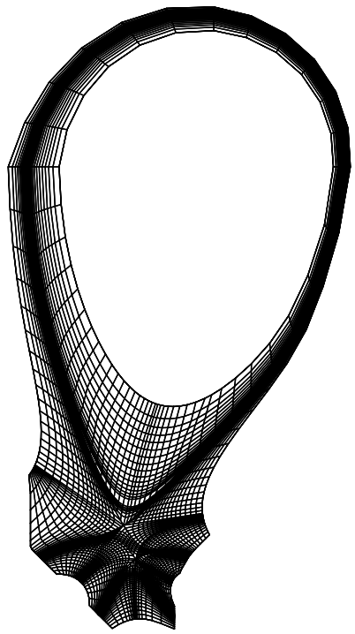
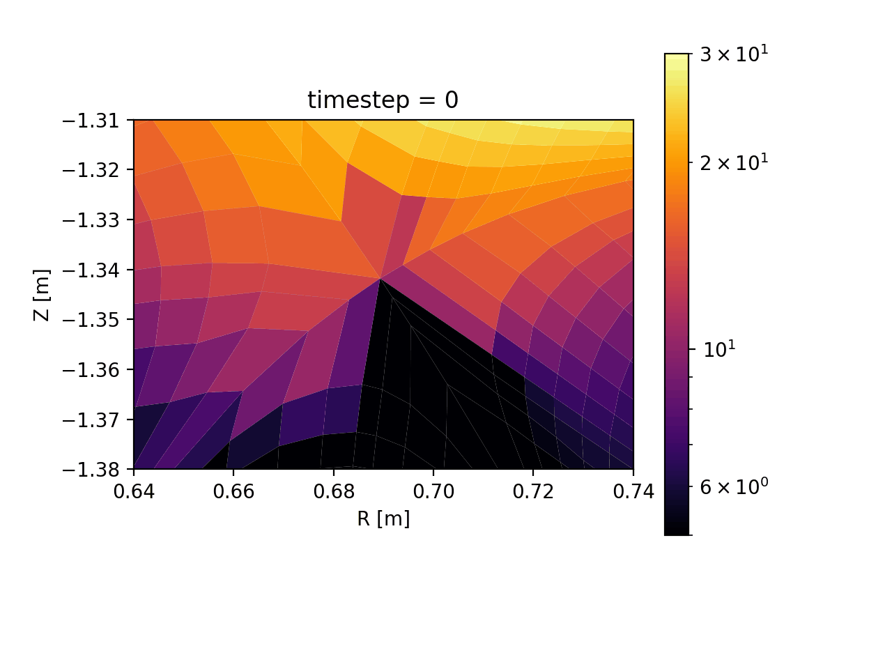
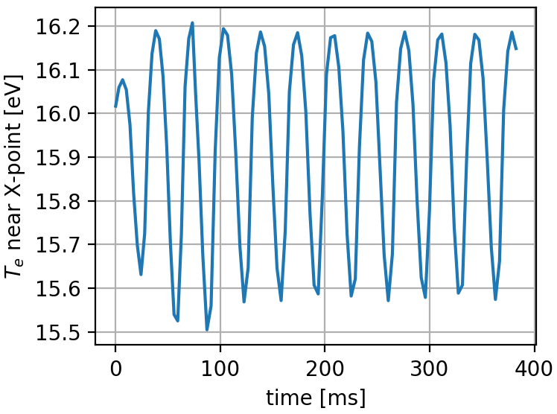
Have observed some similar behaviour in UEDGE
High-resolution SFD simulation in UEDGE with drifts
No radiation (i.e. cannot be a radiation-condensation instability)
We observe as an oscillatory solution at the secondary X-point
Triggered by increasing B-field strength (i.e. increasing strength of drift effects)

Slide 23
Talk outline
The snowflake divertor background
Edge transport modelling of snowflake experiments at MAST-U
BOUT++ modelling of transport near the X-points
An electrostatic version of the churning mode?
Conclusions

Slide 24
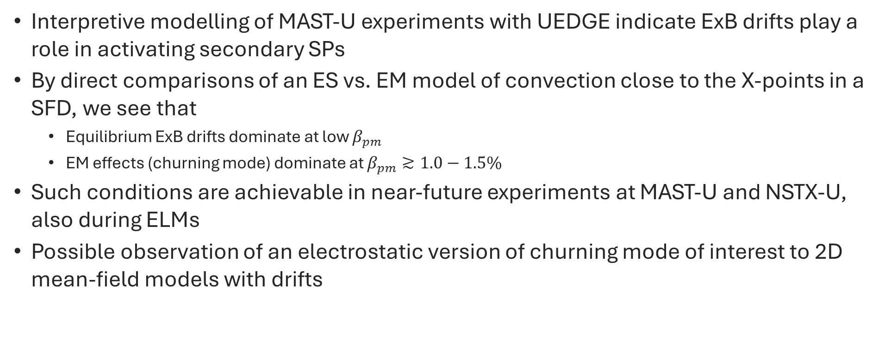
Conclusions
Interpretive modelling of MAST-U experiments with UEDGE indicate ExB drifts play a role in activating secondary SPs
By direct comparisons of an ES vs. EM model of convection close to the X-points in a SFD, we see that
  Equilibrium ExB drifts dominate at low $β_{pm}$
  EM effects (churning mode) dominate at $β_{pm}≳1.0−1.5\%$
Such conditions are achievable in near-future experiments at MAST-U and NSTX-U, also during ELMs
Possible observation of an electrostatic version of churning mode of interest to 2D mean-field models with drifts

Slide 25
EXTRAS

Slide 26





Quasi-steady state flow patterns show increasing differences between ES vs EM models at high $β_{pm}$
ES model
EM model
Plot streamlines of ${\overset{⃑}{q}}_{E}$
Time-averaged picture for EM model
Low $β_{pm}$:
  Similar flow patterns in EM & ES model, convection around X-points observed
High $β_{pm}$:
  Broader region affected by convection
  Greater disturbance to flux surfaces in null region
$$β_{pm}=0.6\%$$
$$β_{pm}=2.7\%$$

Slide 27


Extended model of the churning mode
Electromagnetic (EM) model
$$\frac{1}{cR_{0}}\frac{∂ψ}{∂t}=\frac{1.71}{e} ∇_{∥}T_{e}−∇_{∥}φ−η_{∥}J_{∥}$$
Evolve the poloidal flux $ψ$, electron pressure $p_{e}$, and vorticity $π$
Key features:
  Competition between curvature drive and magnetic restoring force in vorticity equation
  Field-aligned conduction maintains realistic pressure profile near X-points, sustains convection
  $∇_{∥}T_{e}$ term in parallel Ohm’s law drives parallel electric fields which contribute to $v_{E}$
  Resistive diffusion of poloidal field via $η_{∥}$
$$\frac{3}{2}\frac{dp_{e}}{dt}=−∇⋅\overset{⃑}{q}$$
$$\frac{dπ}{dt}=−\frac{2}{R_{0}}\frac{∂p_{e}}{∂y}+\frac{B_{t0}}{c}∇_{∥}J_{∥}$$
where
$$β_{pm}=\frac{8πp_{null}}{B_{pm}^{2}}$$
→ sets the size of the region affected by convection

Slide 28



Making the electrostatic assumption in this model results in a simplified version of the model of drifts in UEDGE
Electrostatic (ES) model
Make electrostatic (ES) assumption, i.e. $\frac{∂ψ}{∂t}=0$, then a closed set of equations can be recovered by rearranging parallel Ohm’s law giving
$$J_{∥}=\frac{1}{η_{∥}}\left(\frac{1.71}{e}∇_{∥}T_{e}−∇_{∥}φ\right)$$
$$\frac{3}{2}\frac{dp_{e}}{dt}=−∇⋅\overset{⃑}{q}$$
$$\frac{dπ}{dt}=−\frac{2}{R_{0}}\frac{∂p_{e}}{∂y}+\frac{B_{t0}}{c}∇_{∥}J_{∥}$$
This model can be recovered from standard 2D drifts models (e.g. UEDGE) under additional assumptions relevant to the X-point region
Directly comparing ES vs. EM models allows us to compare magnitude of equilibrium drifts vs. the CM

Slide 29


The snowflake divertor (SFD)
Second-order null in poloidal field
Key properties [1]:
  Four divertor legs instead of two
  Increased connection length, divertor volume and flux expansion
  Large region of low $B_{p}$ close to X-points
Exact SFD (shown left) is topologically unstable $→$ experimentally two X-points are placed “close enough”
In this case, SFD parameter space defined by ${(d}_{xx}, θ)$
Geometric + magnetic properties indicate good exhaust performance
May facilitate additional radial transport?
[1]
[1] Ryutov & Soukhanovskii, PoP (2015)

Slide 30
SFD experiments show evidence of enhanced transport around the X-points
LP measurements
EMC3-EIRENE simulations
Secondary SP increasingly activated at high heating power
[2]
SFD realised at TCV, NSTX, DIII-D, MAST-U, ASDEX-Upgrade & planned for NSTX-U
Some transport mechanism is driving “activation” of secondary strike points, beyond that expected from magnetic geometry and standard edge transport models
Sensitive to heating power → some dependence on pressure in null region?
[3]
[2] Lunt et al., PPCF 56 (2014)
[3] Soukhanovskii et al., Nucl. Fusion 58 (2018)

Slide 31

Research aims
Investigate the role of equilibrium drifts in edge transport in SFD experiments
Directly compare the effect of equilibrium drifts with electromagnetic effects in the region of high $β_{p}$ (i.e. the CM)
Focus on spherical tokamaks: MAST-U primarily, with relevance to future experiments on NSTX-U
Two-pronged approach:
Interpretive modelling of recent SFD experiments at MAST-U with code UEDGE (multi-fluid edge transport with drifts)
Model development and implementation in BOUT++ for 2D convective transport in the X-point region

Slide 32




Experimental measurements of midplane $n_{e},T_{e}$ profiles help to constrain the UEDGE model
Anomalous diffusion coefficients are guided by past modelling on UEDGE and measurements of $n_{e},T_{e}$ at midplane from Thomson scattering diagnostic
Particle and thermal diffusivities, $D_{n}$ and ${ χ}_{i,e}$, are allowed to vary with radial coordinate

Slide 33



Synthetic IRVB indicates that including drifts in UEDGE improves agreement with experiment
SF45
No direct heat flux measurements on these experiments, but we can compare radiated power profiles in divertor region to IRVB diagnostic
Synthetic IRVB profiles generated by solving for bolometer foil temperature due to heating from plasma radiated power profiles from UEDGE (see [9])
In all geometries, UEDGE without drifts fails to capture key features of radiated power profiles from experiment
SF75
SF135
[9] Federici et al., Rev. Sci. Instrum. 94 (2023)

Slide 34


At high $β_{pm}$, the EM model exhibits significant additional transport near the X-points
ES model
EM model
Separatrices

