Slide 1


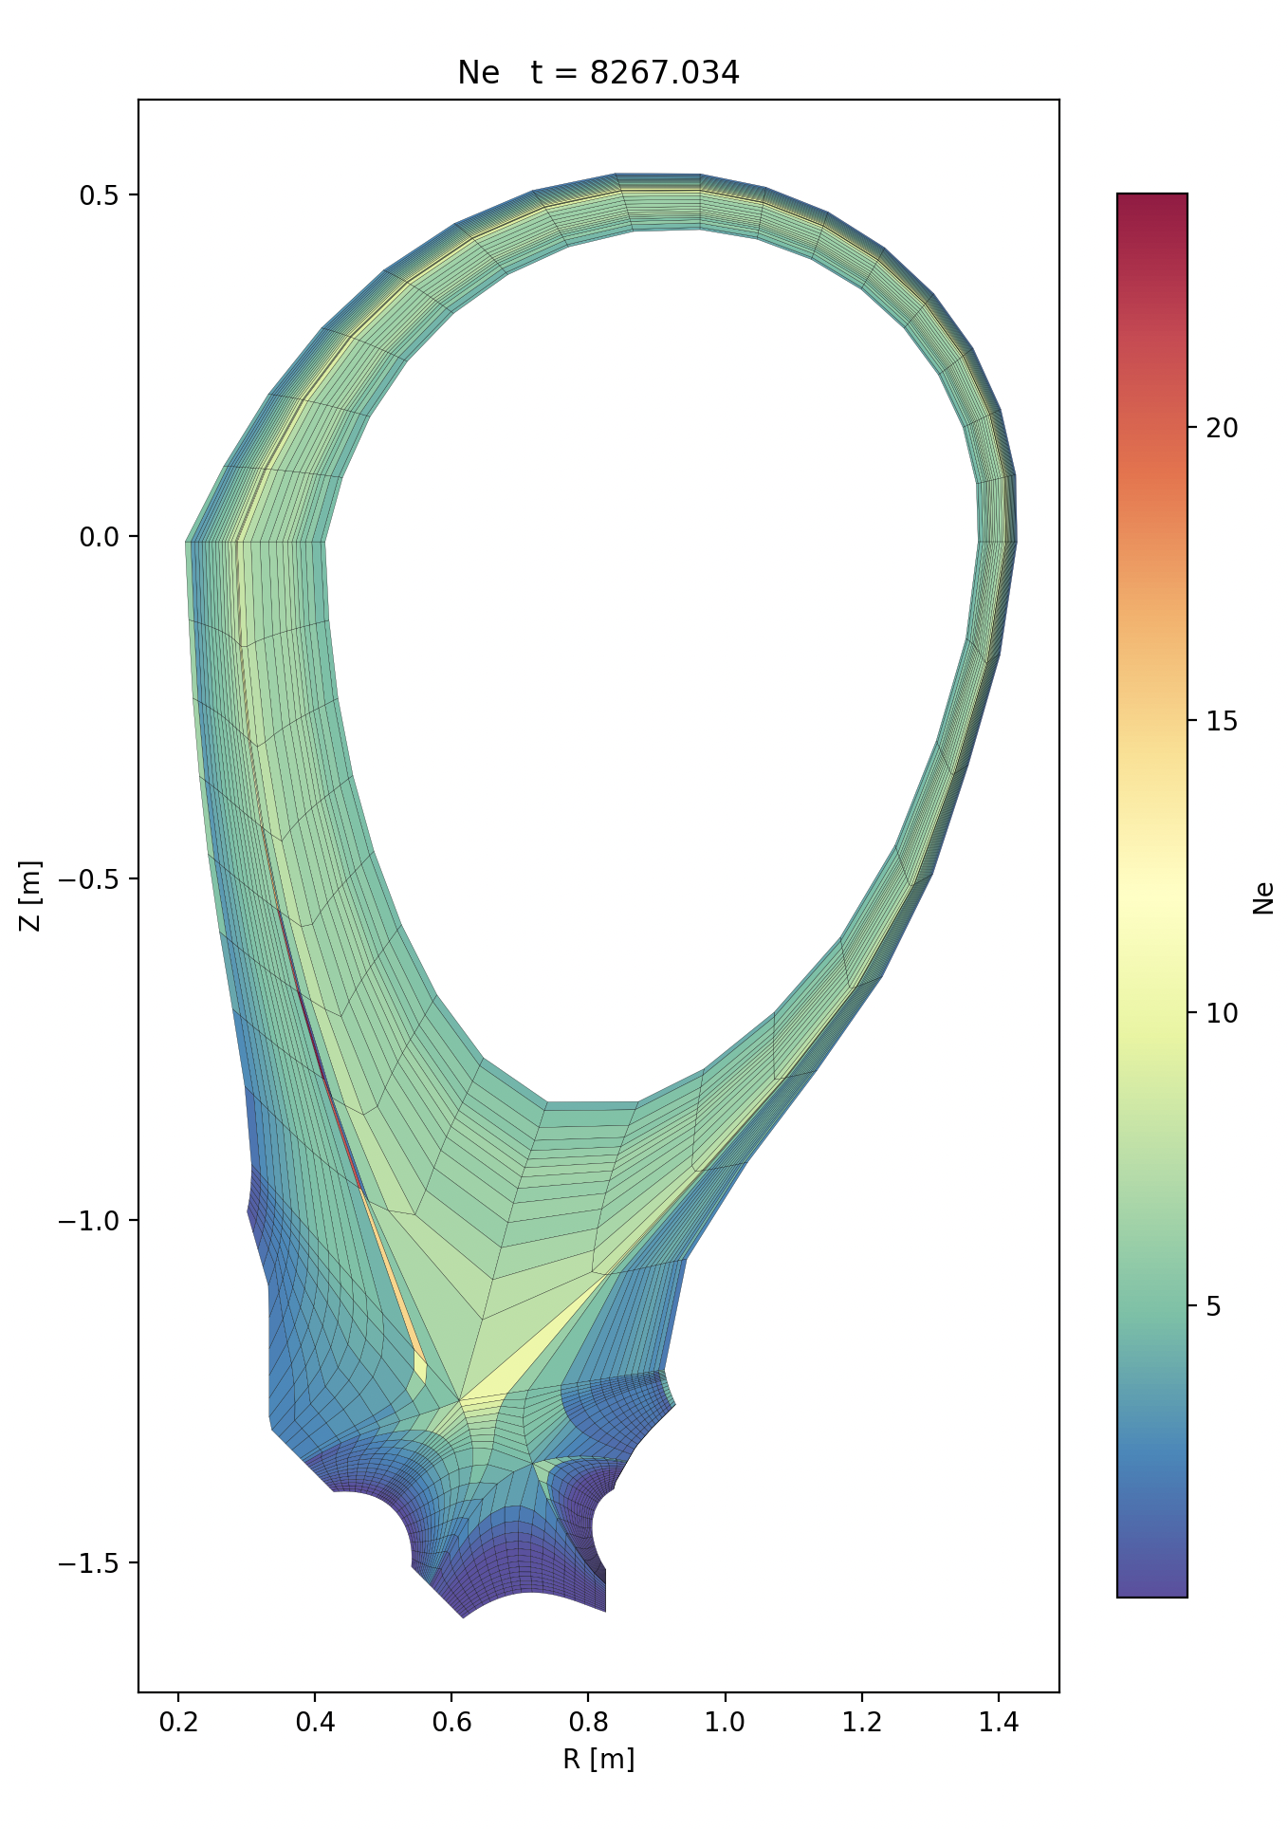
First Hermes-3 Simulations with a Snowflake Divertor
Sebastian Ruiz Gonzalez, Peter Hill, Ben Dudson

Slide 2
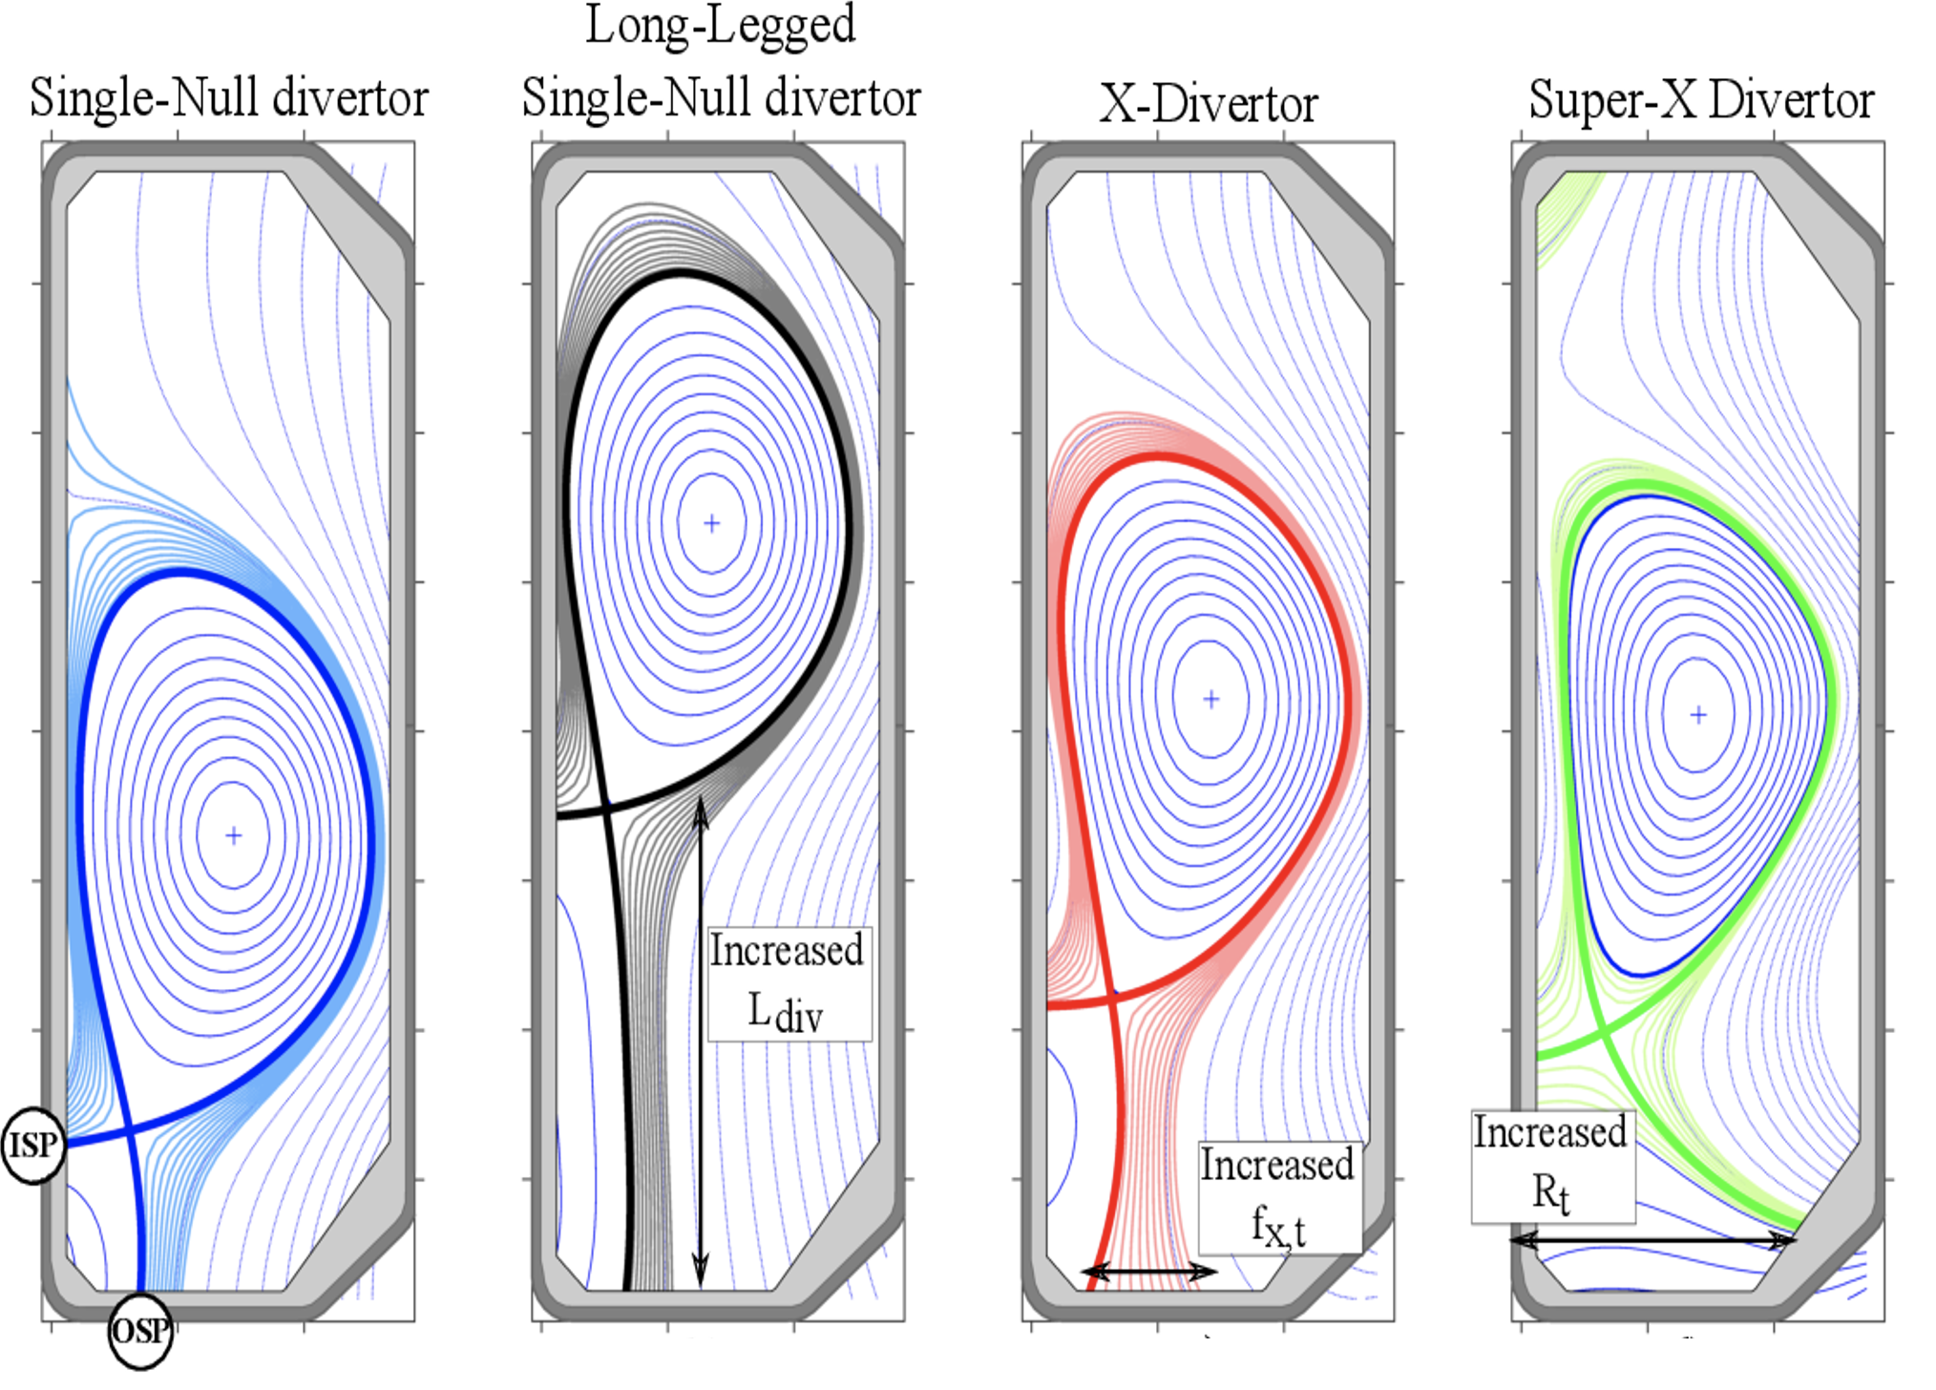
Motivation
[2] A. Loarte, “Effects of divertor geometry on tokamak plasmas,” Plasma Phys. Control. Fusion, vol. 43, no. 6, p. R183, Jun. 2001, doi: 10.1088/0741-3335/43/6/201.
Notes:
Current divertor heat loads, and the predicted ones for steady-state operation exceed material limits by at least an order of magnitude.
The divertor’s behaviour can be modified by changing the magnetic field’s topology and/or geometry.
Here you can see the usual divertor configurations where only the geometry is changed. The main modified parameter is the leg length (distance from X-Point to the separatrix).

Slide 3
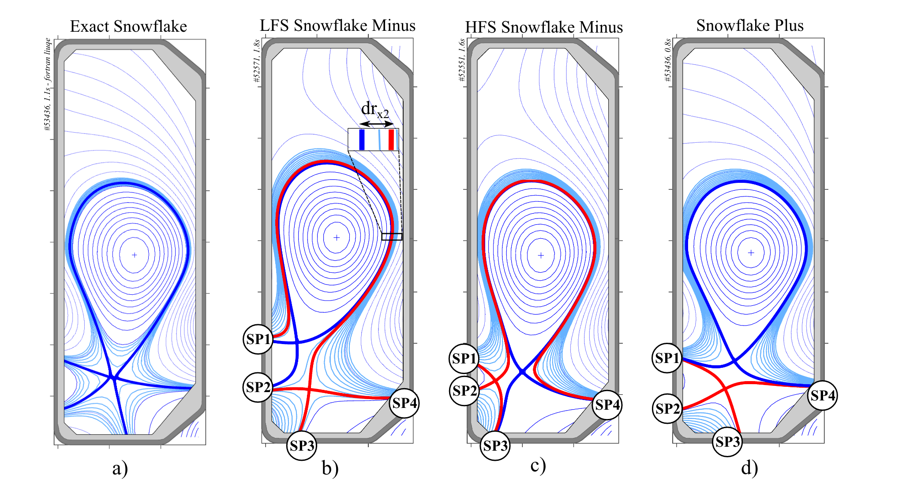
Motivation
[2] A. Loarte, “Effects of divertor geometry on tokamak plasmas,” Plasma Phys. Control. Fusion, vol. 43, no. 6, p. R183, Jun. 2001, doi: 10.1088/0741-3335/43/6/201.
Notes:
My research focuses on changing the magnetic topology by adding a second X-Point. Setting this X-pt close to the primary one creates The snowflake divertor family which branches the sepatrix into 4 branches instead of two. This relaxes the constraints on the plasma facing materials.
The divertor’s magnetic tolopotical features make it more challenging to simulate:

Slide 4
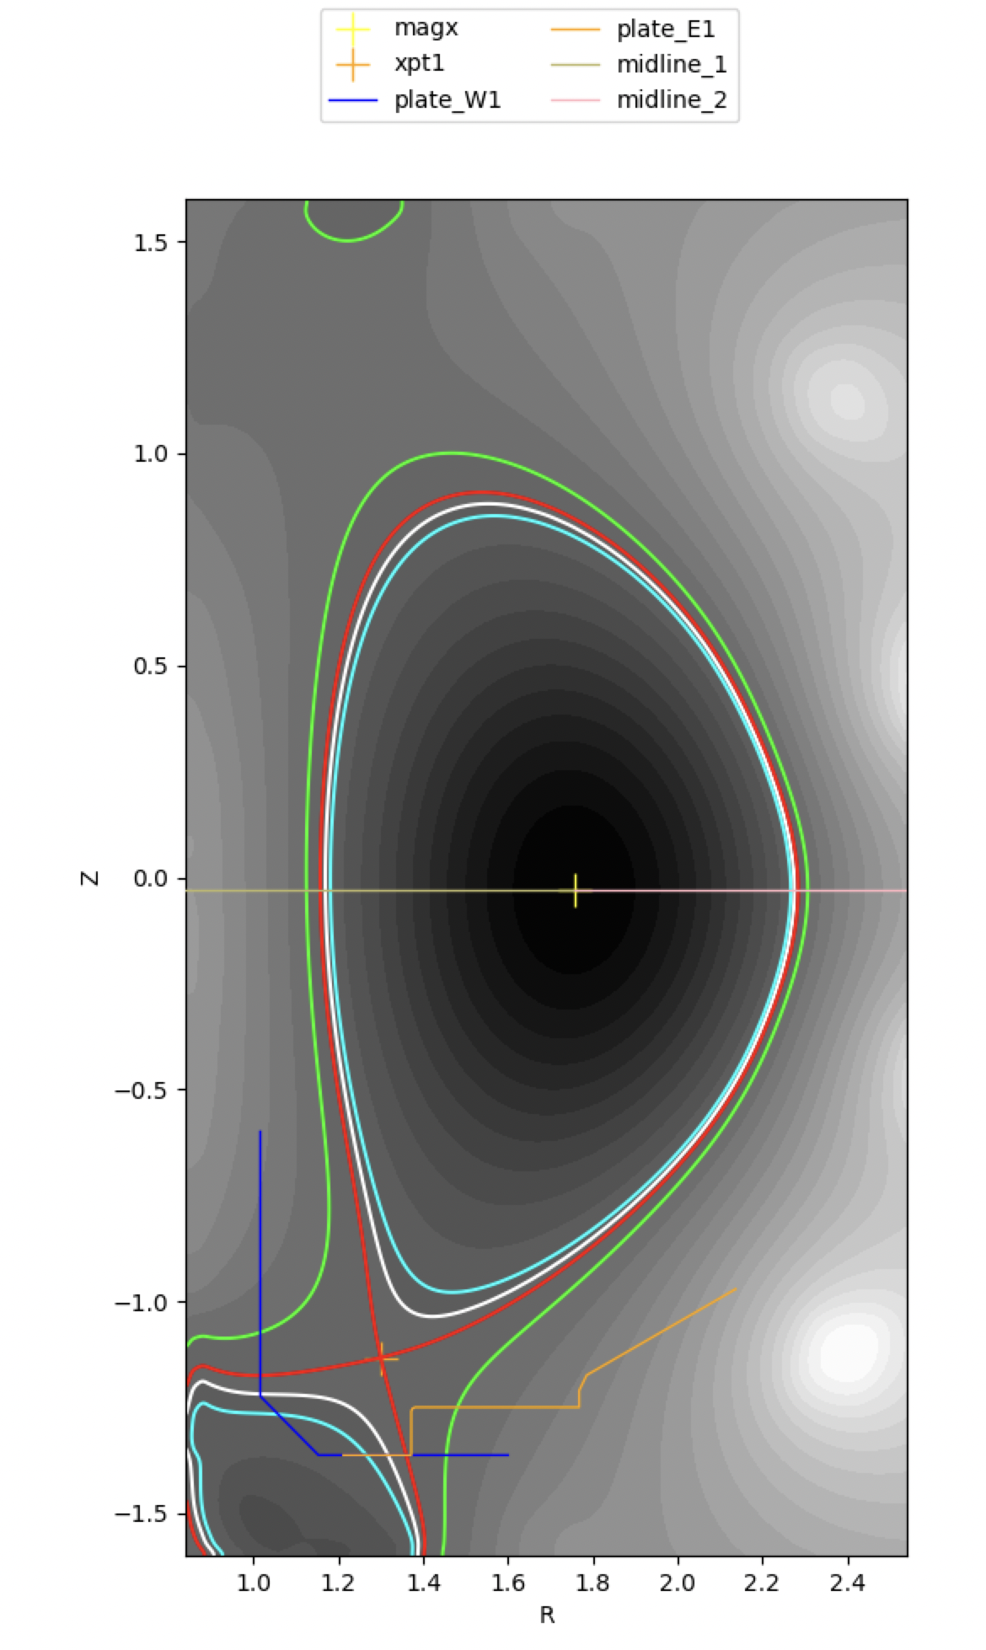
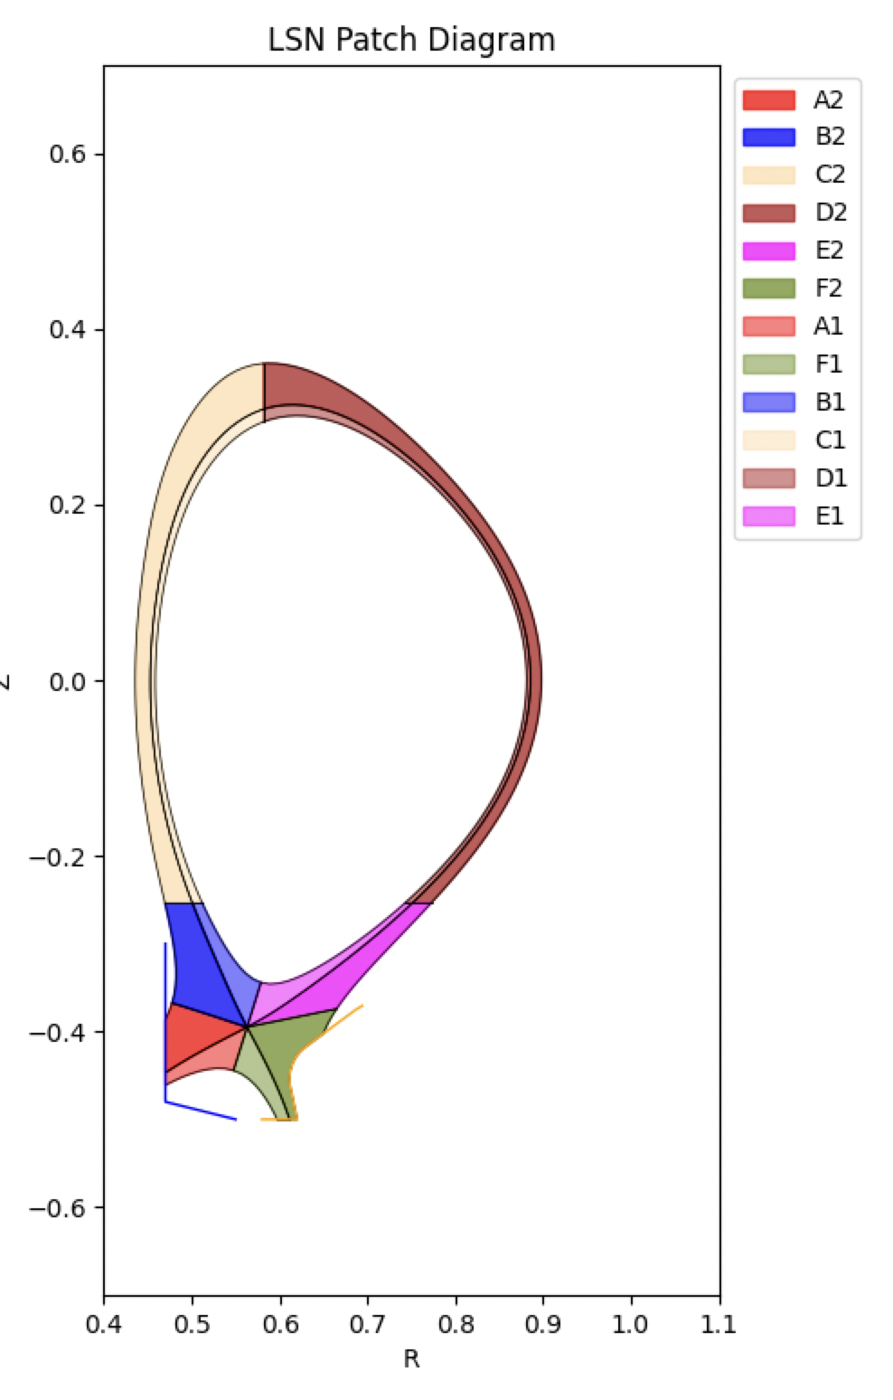
Notes:
This is a SN configuration, the simplest diverted configuration we have with just one X-Point and short legs.

Slide 5
Division of domain into processors in Index Space
Single Null (SN)
A3
B3
C3
D3
E3
F3
Ixseps1 = Ixseps2
A2
B2
C2
D2
E2
F2
nx
Jyeseps1_1
Jyeseps2_1
ny
Notes:
This is how the physical subregions of the SN look in index space, and the dotted lines are what we call branch cuts which are basically discontinuities in index space that make the connections in physical space possible.

Slide 6
Division of domain into regions in Index Space
Single Null (SN)
SOL
A3
B3
C3
D3
E3
F3
Ixseps1 = Ixseps2
A2
B2
C2
D2
E2
F2
PFR
Core
PFR
nx
Jyeseps1_1
Jyeseps2_1
ny
Notes:
This is what BOUT and Hermes see, the physical regions of the SN which are then sent to different processors to be solved independently.

Slide 7

Outer SOL
A2
B2
C2
D2
E2
F2
A1
B1
C1
D1
E1
F1
R
Core Region
φ
Notes:
This is how those regions then communicate the boundary conditions, enabling the parallelization of the simulations.

Slide 8
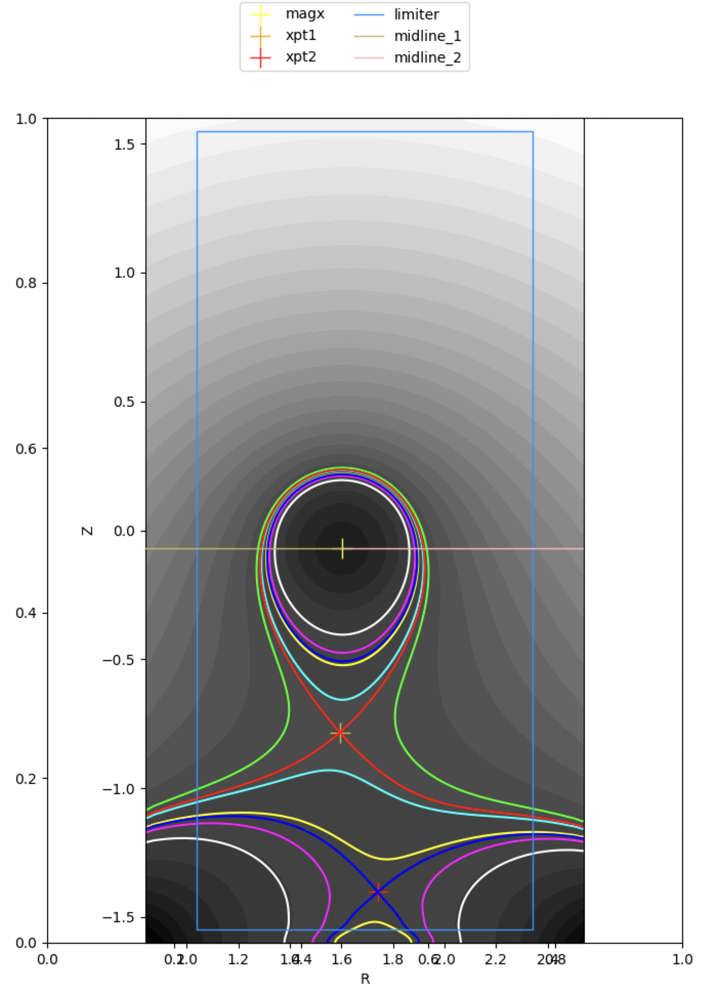
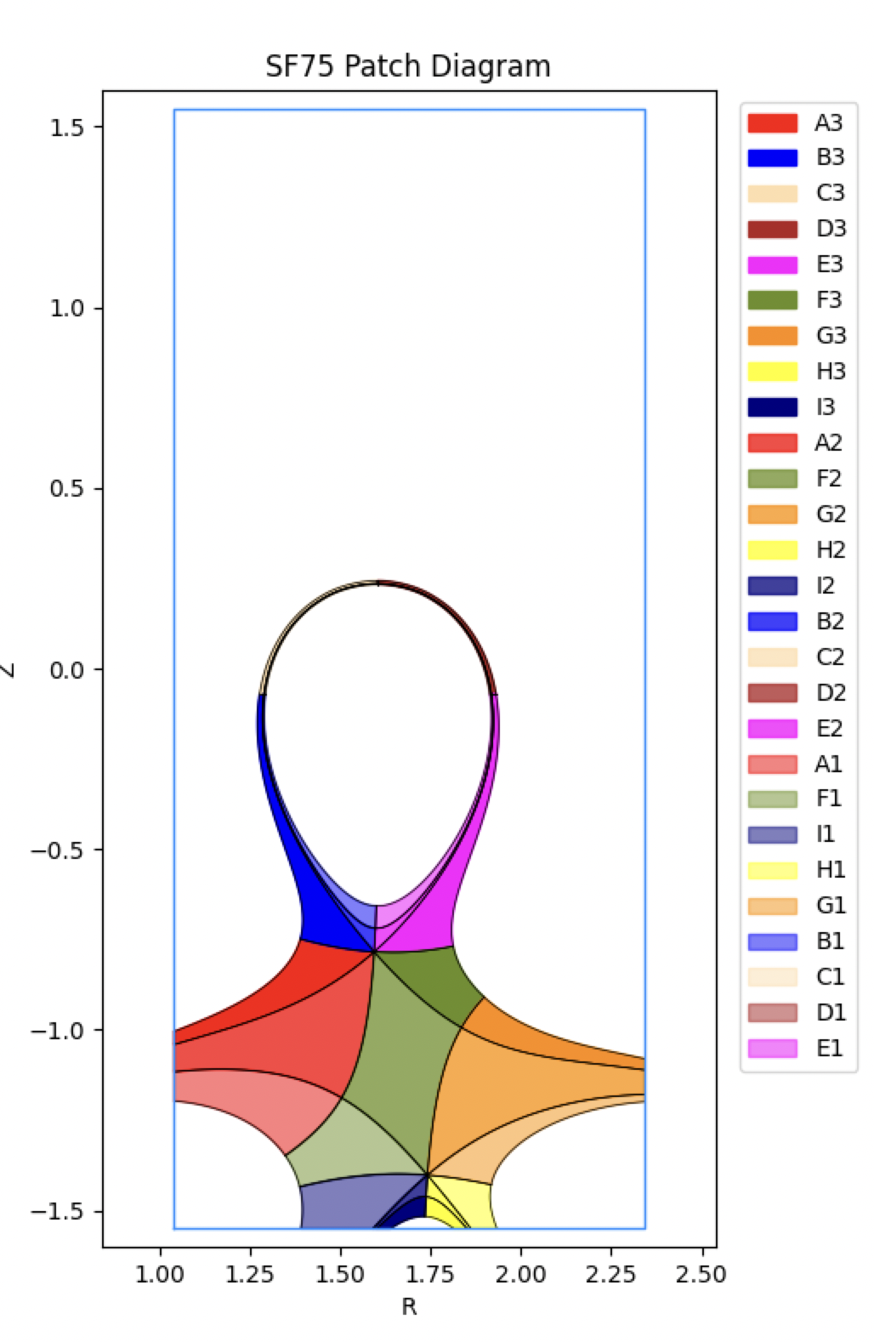
Notes:
For a SF configuration, we have something more complex, the number of regions increses, hence the minimun number of processors does too.

Slide 9
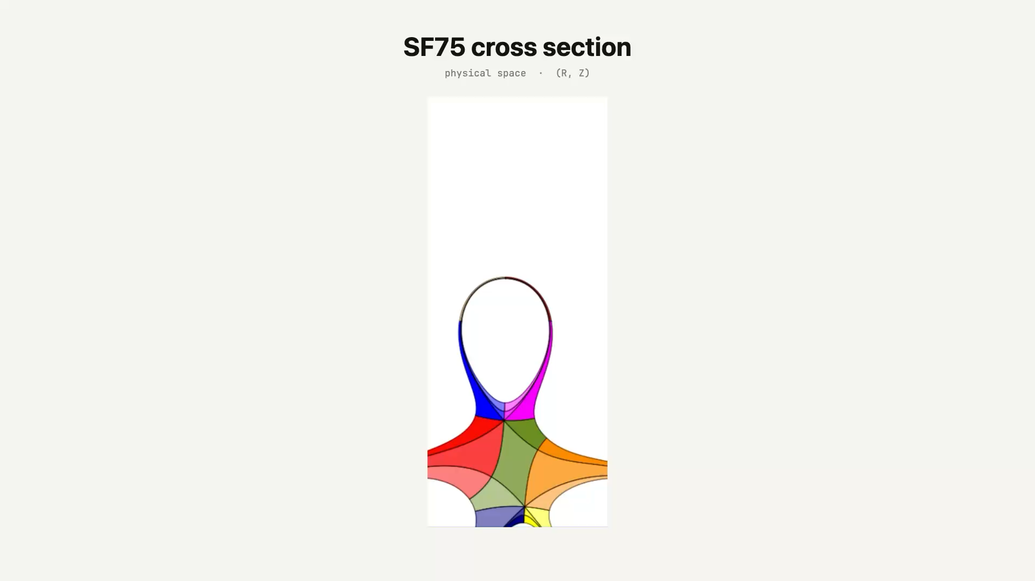
Notes:
Here you can see how the physical sub regions are transported to index space, where bout then defines the regions with the branch cuts

Slide 10
ny_inner
x = nx - 1
SOL
PF_South
A3
B3
C3
D3
E3
F3
G3
H3
I3
Ixseps2 = ixseps_upper
B2
C2
PF_NC
PF_NE
I2
A2
D2
E2
F2
G2
H2
I2
PF_NW
Core
Ixseps1 = iseps_lower
A1
B1
C1
D1
E1
PF_W
PF_E
PF_E
PF_W
PF_W
F1
G1
H1
I1
nx
x = 0
y = ny - 1
y = 0
Jyeseps1_1
Jyeseps2_1
Jyeseps1_2
ny_inner + 1
Jyeseps2_2
ny_inner - 1
ny
Notes:
We now have extra regions. The SF features two extra private flux regions which are in part responsible for the heat redistribution .

Slide 11

Outer SOL
A3
B3
C3
D3
E3
F3
G3
H3
I3
Inner SOL
A2
B2
C2
D2
E2
F2
G2
H2
I2
R
A1
B1
C1
D1
E1
F1
G1
H1
I1
Core
φ
Notes:
And the communication becomes harder. Most of my phd has focused on painfully coding this diagram.

Slide 12
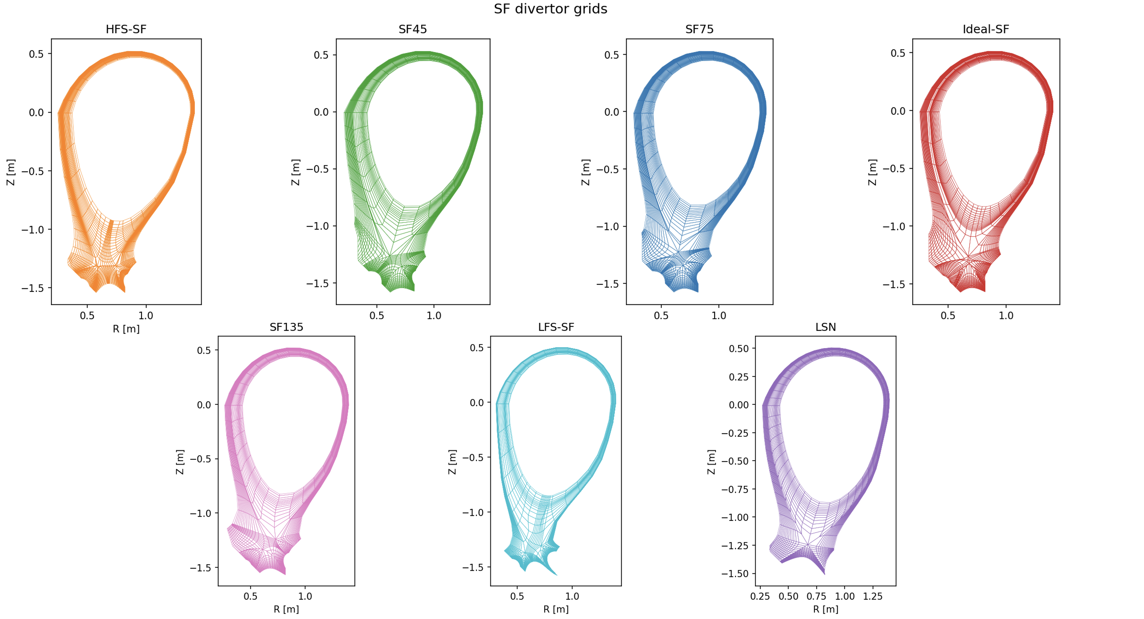
Notes:
And let’s not forget that there are several types of SFs , usually they aren’t stable, so they fluctuate in between them, and as real snowflakes, they are all unique and require a specific tunning of the diagram you saw before.

Slide 13
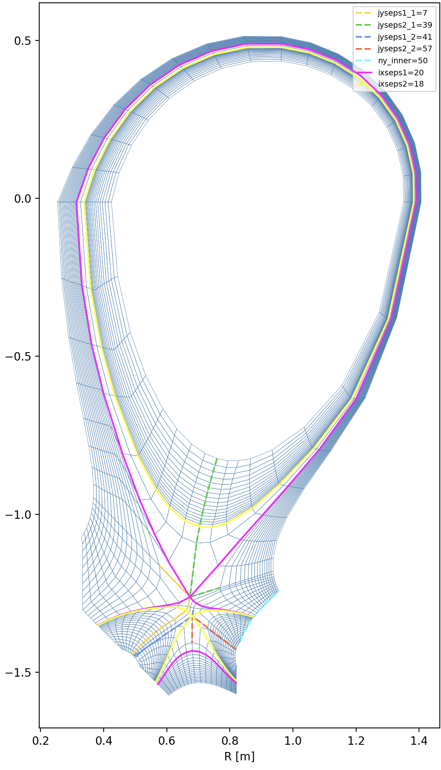
Next steps
Snowflake (SF) topologies sweep to figure out stability.
Run model with drifts and compare to topology sweep.
Hopefully create / run some turbulence simulations with the new SF topologies.
Notes:
an

Slide 14
Thanks!

Slide 15
Bibliography
[1]B. Dudson et al., BOUT++. (Oct. 10, 2025). Zenodo. doi: 10.5281/zenodo.17313945.
[2] A. Loarte, “Effects of divertor geometry on tokamak plasmas,” Plasma Phys. Control. Fusion, vol. 43, no. 6, p. R183, Jun. 2001, doi: 10.1088/0741-3335/43/6/201.
[3] M. Giacomin, L. Stenger, and P. Ricci, “Turbulence and flows in the plasma boundary of snowflake magnetic configurations,” vol. 60, no. 2, Jan. 2020, doi: 10.1088/1741-4326/ab6435.
[4] D. Power, M. V. Umansky, and V. A. Soukhanovskii, “Simulations of the churning mode: toroidally symmetric plasma convection and turbulence around the X-points in a snowflake divertor,” May 27, 2025, arXiv: arXiv:2505.21223. doi: 10.48550/arXiv.2505.21223.

