Slide 1
Using SPARTA as a standalone DSMC test bed for divertor neutral transport and exhaust boundary conditions
M. Moscheni, D. Douqa, S. Lazerson
07/10/2026 – UKAEA Exhaust Code Workshop

Slide 2



Introduction of lesser-known important aspects: particles and not power
Plasma – tritium fuel cycle interface [IAEA]:
Is critical, but
Under-explored and
Doesn’t care about power :’)
Uncle Ben’s renewed emphasis on:
Particle injection [Meschini26, Moscheni26]
Particle balance [work in progress]
Particle exhaust (pumping) [Moscheni26’]
Why improving particle exhaust? See Ryoko Sama’s talk!
It is inefficient because pseudo-random poloidal motion
= many pump ducts
= bad [PitcherStangeby97]
= improve that!
… by capturing toroidal neutral flows?
and particles!

Slide 3
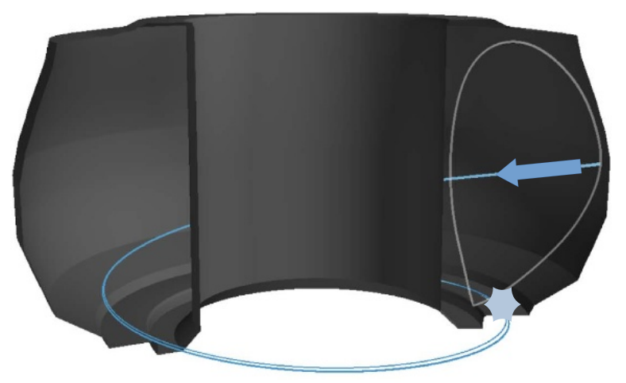
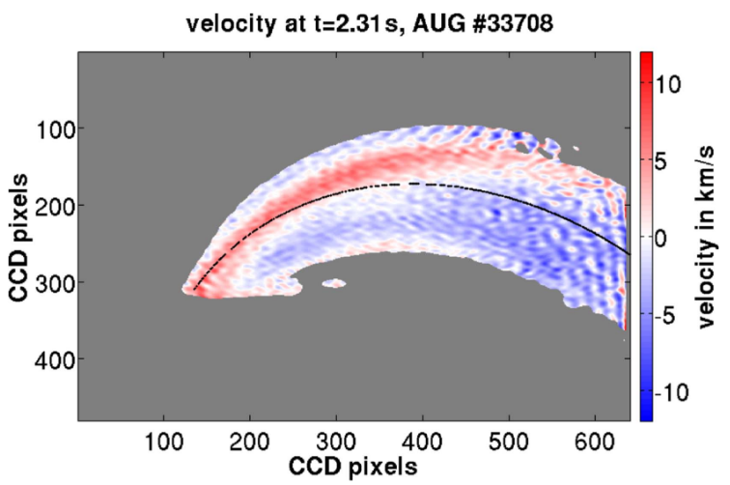
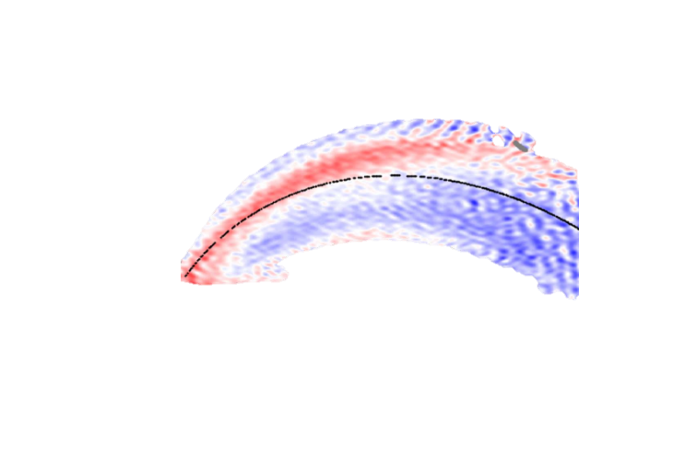


Ordered toroidal plasma flow generates ordered toroidal neutral flow
Parallel flow of D atoms in AUG divertor (attached) [Gradic18]
Toroidal neutral “wind” [Brunner13] introduced in [PitcherStangeby97, Pitcher99, Goetz99, Welch01]
+ Mike’s disco ball
Can we reproduce it with SPARTA?
plasma
$$φ$$
$$R$$
neutral wind (+)
plasma
Ion-neutral interactions:
RC + CX + EL

Slide 4
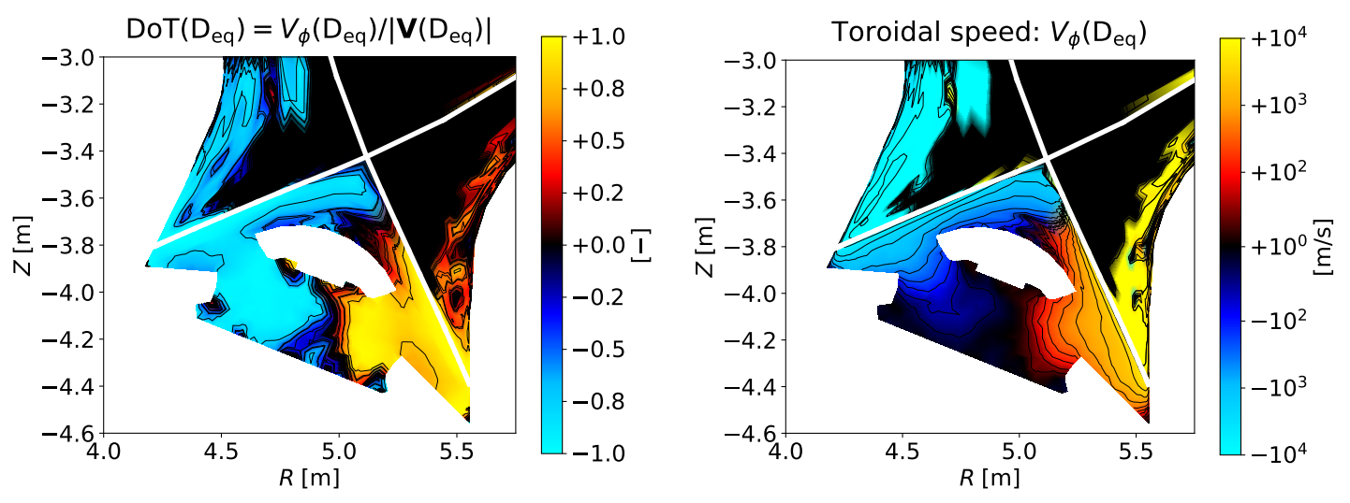
Jeremy’s SOLPS-ITER simulations reproduce the wind for every species
SOLPS-ITER simulations of ITER from [Lore22]
Toroidal neutral wind is reproduced qualitatively and quantitatively
It persists across species D, D2, Ne, He
Non-linear trend with increasing detachment… but favourable over realistic detachment window
Can we replicate it with SPARTA + plasma-like boundary conditions?

Slide 5
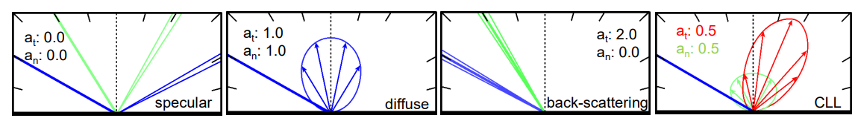
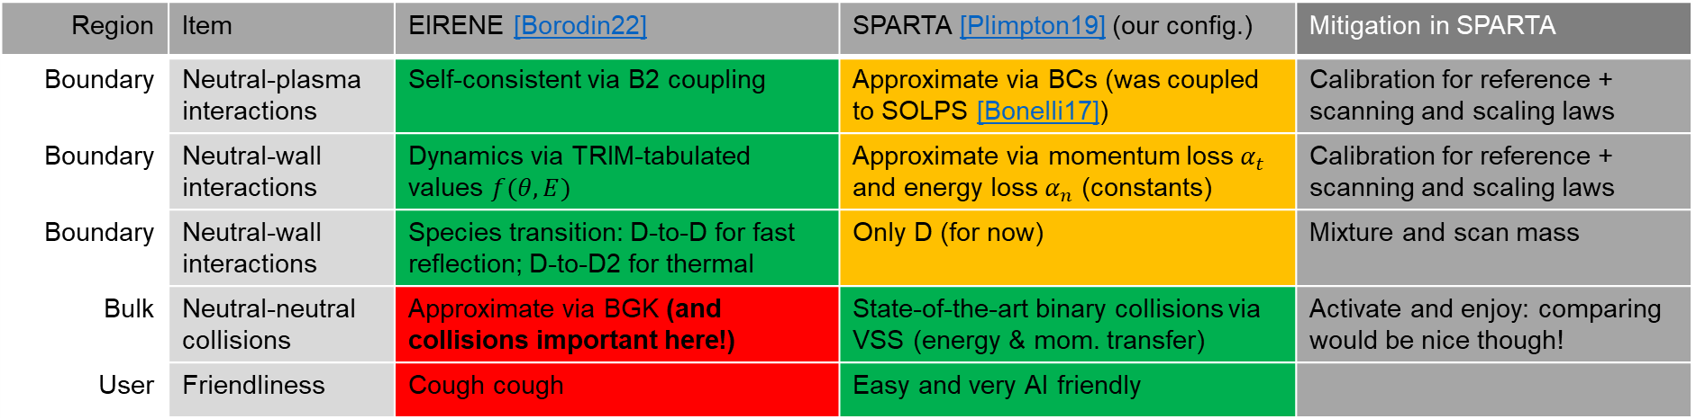

EIRENE vs. SPARTA: models differs and SPARTA shines in the volume
Can we re-create toroidal winds?
Region | Item | EIRENE [Borodin22] | SPARTA [Plimpton19] (our config.) | Mitigation in SPARTA
Boundary | Neutral-plasma interactions | Self-consistent via B2 coupling | Approximate via BCs (was coupled to SOLPS [Bonelli17]) | Calibration for reference + scanning and scaling laws
Boundary | Neutral-wall interactions | Dynamics via TRIM-tabulated values $f(θ,E)$ | Approximate via momentum loss $α_{t}$ and energy loss $α_{n}$ (constants) | Calibration for reference + scanning and scaling laws
Boundary | Neutral-wall interactions | Species transition: D-to-D for fast reflection; D-to-D2 for thermal | Only D (for now) | Mixture and scan mass
Bulk | Neutral-neutral collisions | Approximate via BGK (and collisions important here!) | State-of-the-art binary collisions via VSS (energy & mom. transfer) | Activate and enjoy: comparing would be nice though!
User | Friendliness | Cough cough | Easy and very AI friendly
EIRENE > TRIM: fast and thermal reflection
SPARTA: $≃$average
No one??
[Varoutis23]
Retro-scattering? [Toussaint24]
Can be important for rough surfaces!

Slide 6
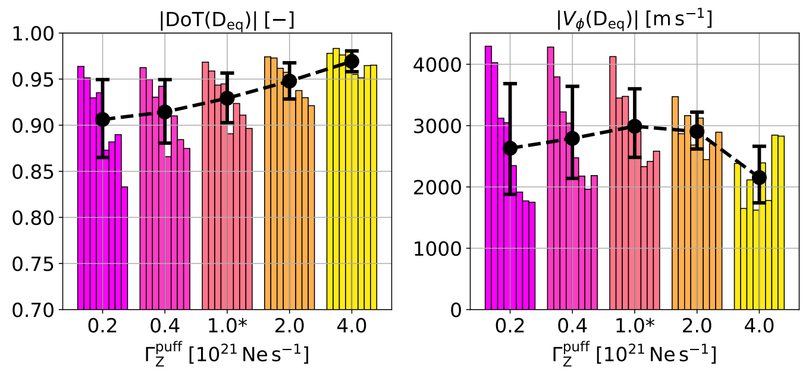
SOLPS-ITER reproduces toroidal neutral flows
Holds across species (Ne, He)
Non-linear trend with increasing detachment:
  = increasing cohesion
  = increasing ion-neutral coupling
  = decreasing ion speed available
Can we replicate it with SPARTA + plasma-like boundary conditions?

Slide 7
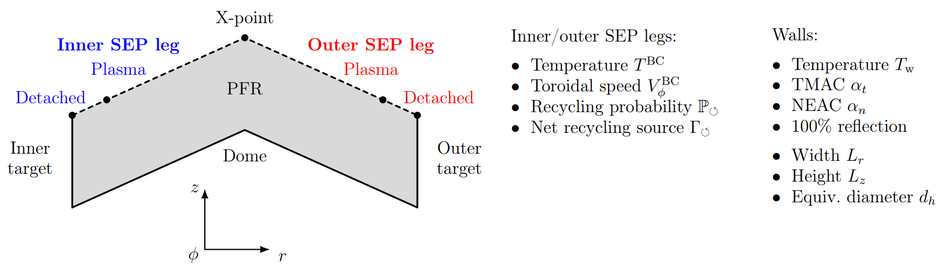
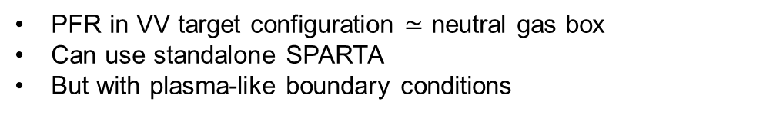
SPARTA domain: PFR + plasma-like boundary conditions
PFR in VV target configuration $≃$ neutral gas box
Can use standalone SPARTA
But with plasma-like boundary conditions

Slide 8

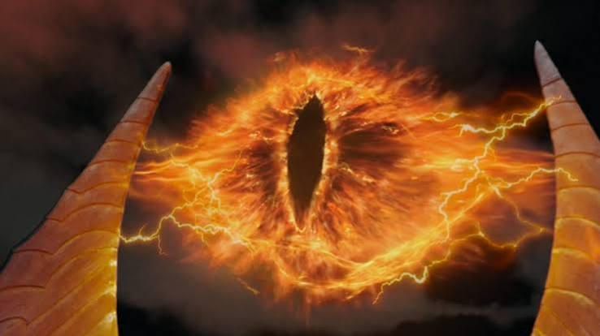
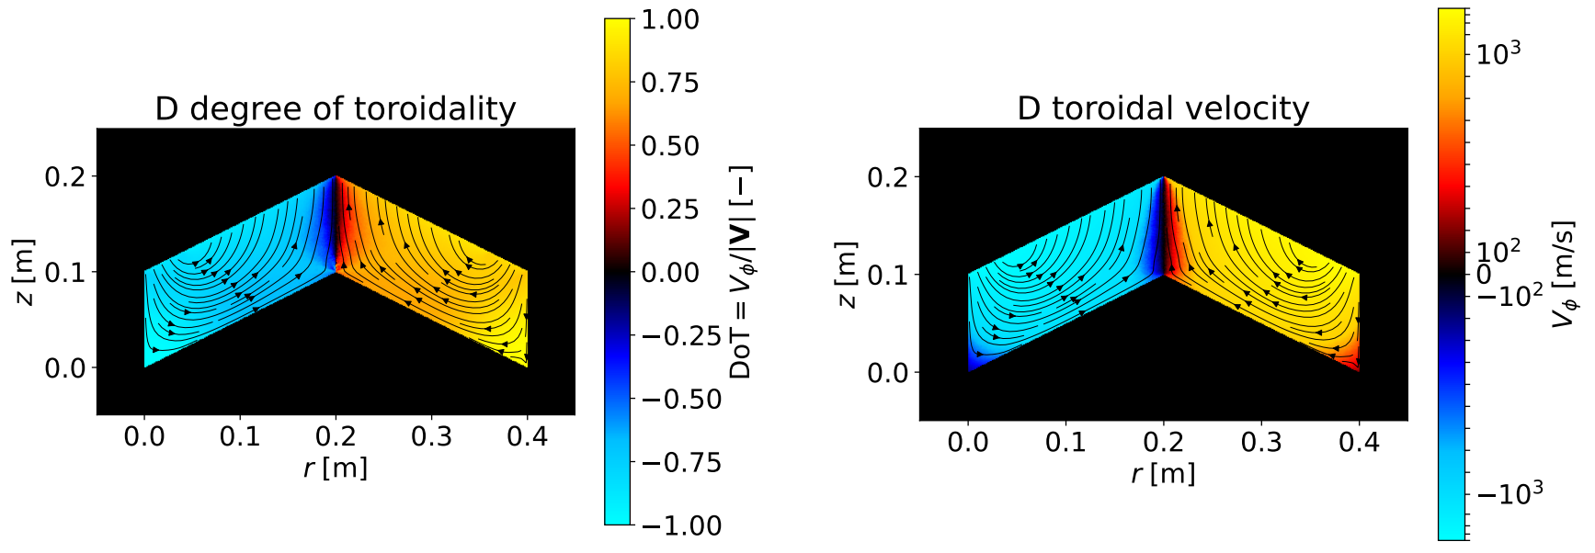
SPARTA vs. SOLPS-ITER: satisfactory agreement
One plasma-like BC enough to drive macroscopic toroidal neutral flow
[Roohi25]
Couette flow: >0 boundary velocity
Forced convection: recycling-ionisation
Fourier heat transfer: unfavourable temperature gradient(no buoyancy)
Unknown superposition of known neutral-gas scenarios: synergistic / agnostic / antagonistic?
Great test case
40 CPUh (up to 1.2 kCPUh) = build database [Zenodo26]: conclusion = these conditions are robust
SOLPS-ITER simulations of ITER from dear Jeremy [Lore22]
[Gradic18]
One boundary condition to drive them all toroidally
SPARTA
SPARTA

Slide 9
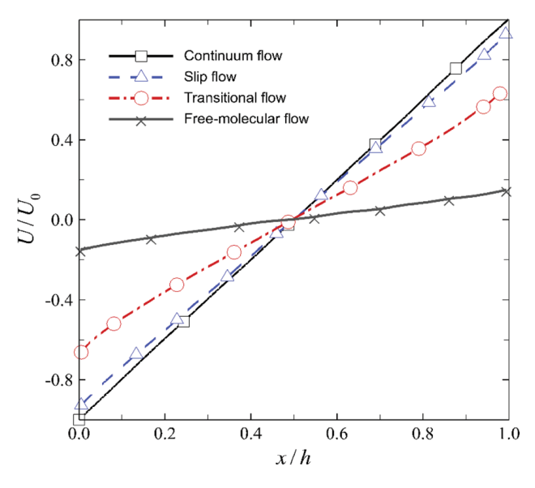

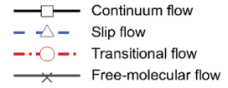
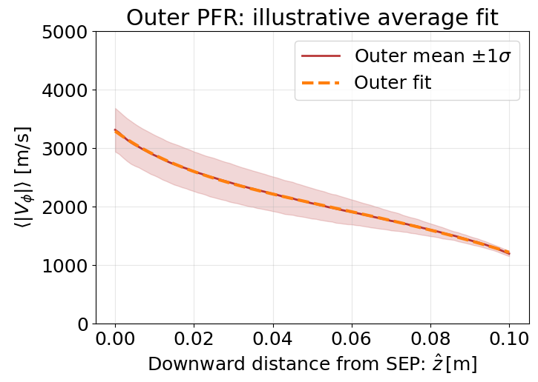
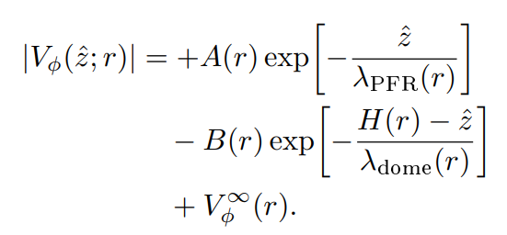
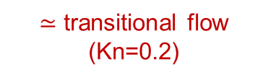

Analysis of vertical velocity slices: bi-exponential relaxation pattern orderr
Vertical slice
Close agreement with [Roohi25]
Literature uses cumbersome functions…
… we fit with beloved exponentials!
$≃$ transitional flow (Kn=0.2)
$$λ_{PFR}=2.4 cm$$
[Roohi25]
Toroidal wind speed decays over $≳2.0 cm>$ flux-expanded plasma decay lengths in PFR bridaaa = GOOD! Wind exists where plasma does not

Slide 10
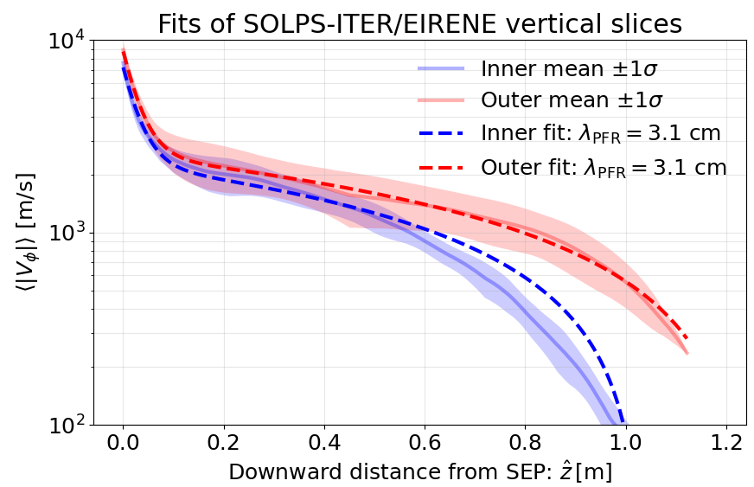
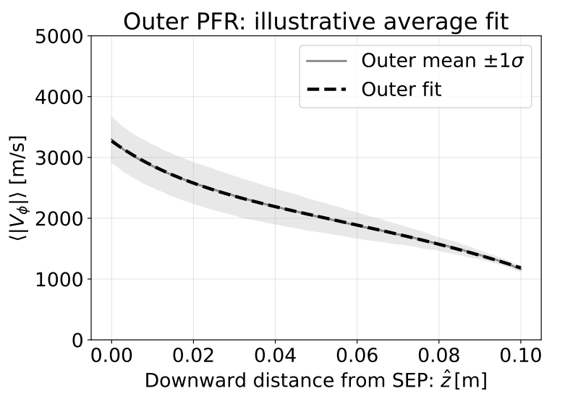
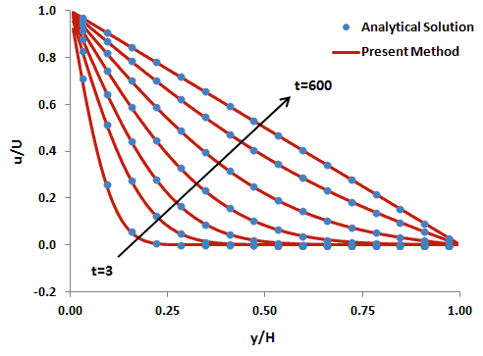
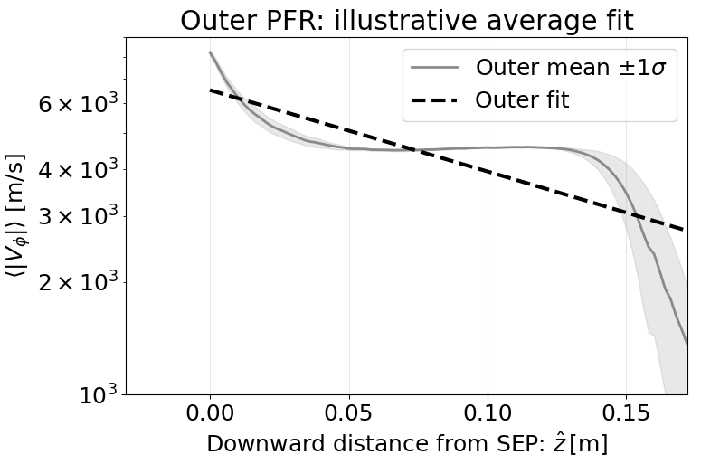



Zoomming in: good qualitative agreement with EIRENE but differences remain
Big drop
No big drop
Vertical slice
SPARTA
Great agreement with textbooks: Fig. 7.4 of [Roohi25]
Good qualitative agreement with EIRENE
But big wiggle at plasma and wall boundaries in EIRENE
Seems not wall friction nor size
Relaxation time? Increases time to convergence… O(100ms) (Ryoko Sama’s talk!)
Too many/efficient n-n collisions in BGK?
To be explored… a lot to cross-compare beyond pressure!
SOLPS-ITER:
EU-DEMO from [Subba21]
Bi-exponential fit:
$$λ_{PFR}=2.4 cm$$
Big drop
Half-domain [Guzel15]
$≃$SPARTA
n-n collision diameter x10
SPARTA
$≃$EIRENE

Slide 11
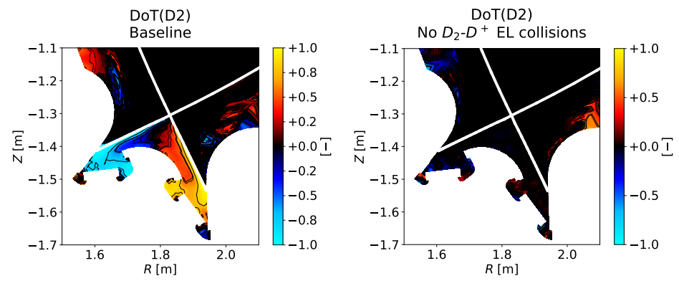
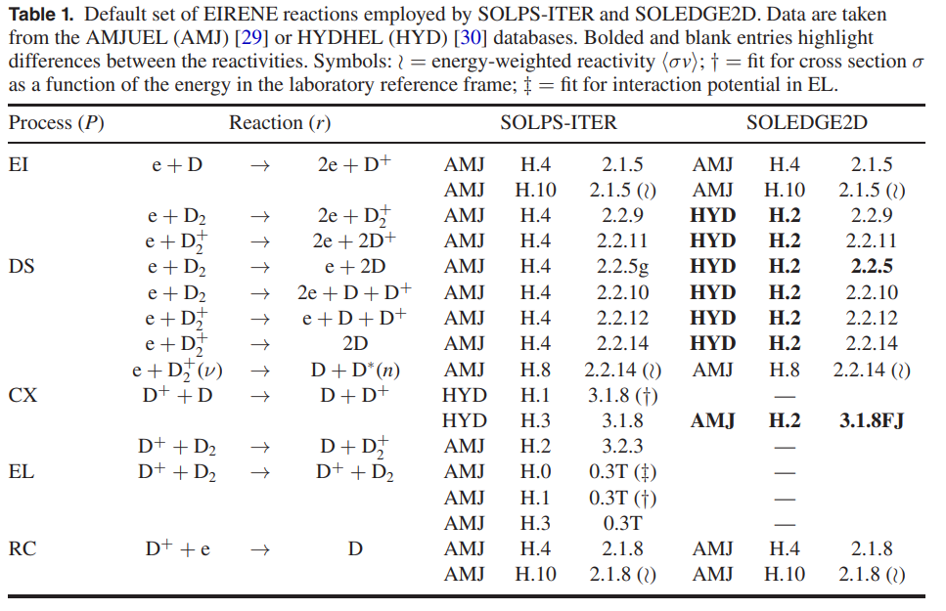
Toroidal wind dynamics depends heavily on reactions implemented
Windy wind :)
Reduced SOLEDGE2D reaction set (complete in SOLEGE3X) [Moscheni22]
No wind :(
SOLPS-ITER simulations in DTT from [Moscheni25]

Slide 12
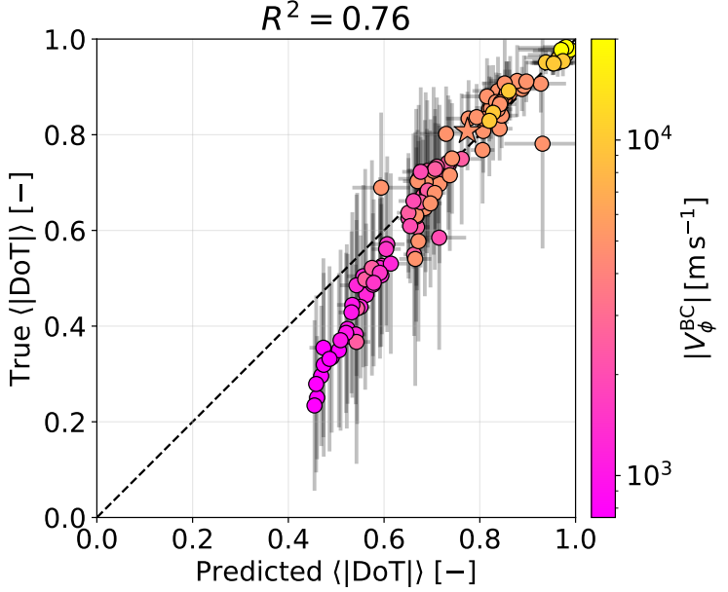

Slide 13
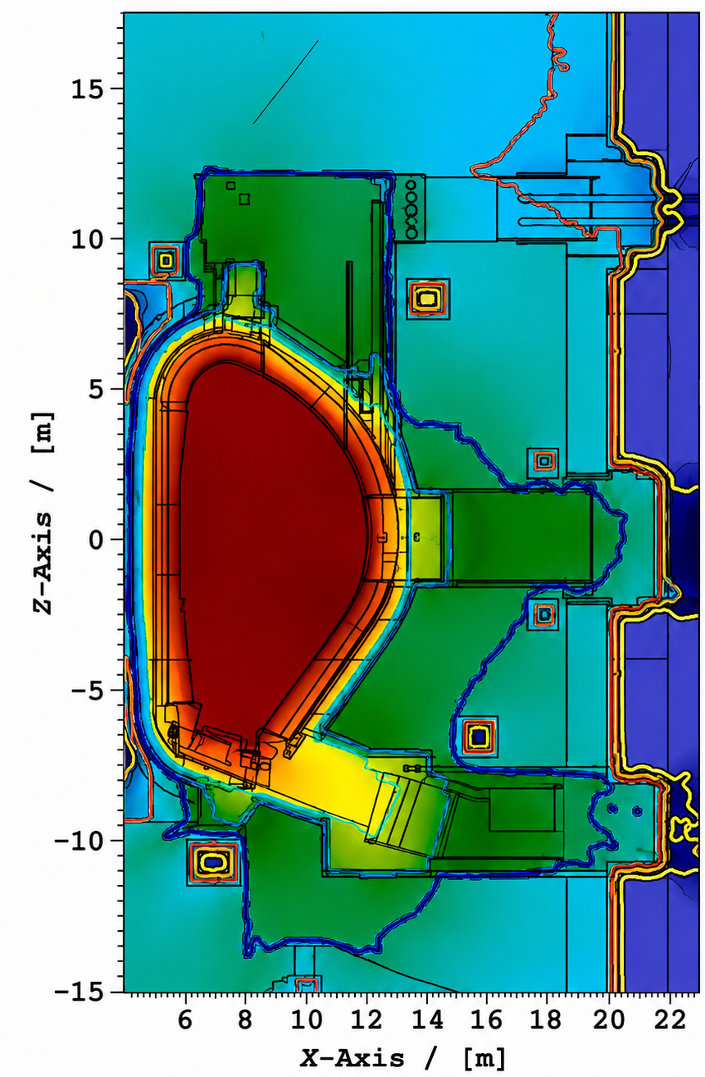
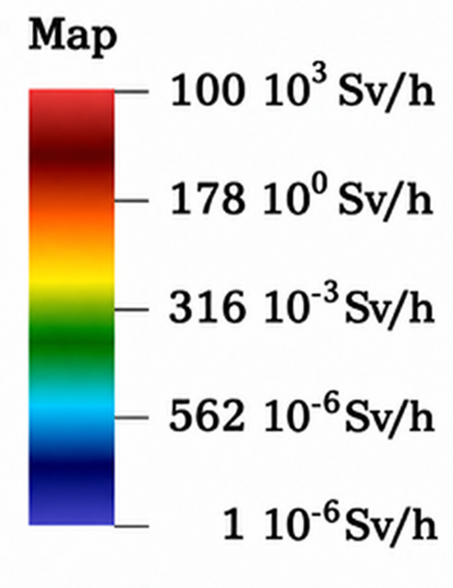
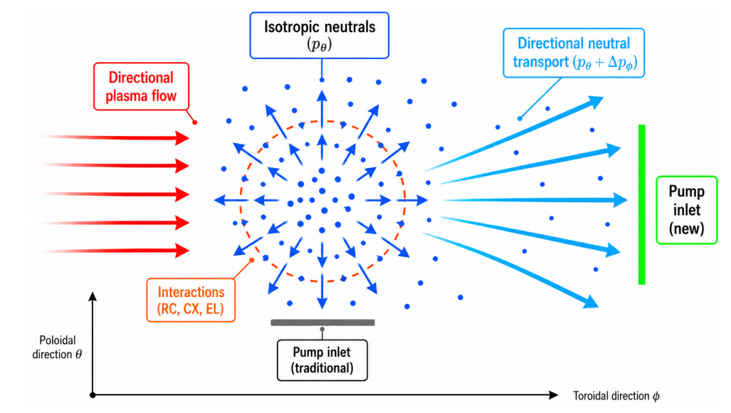
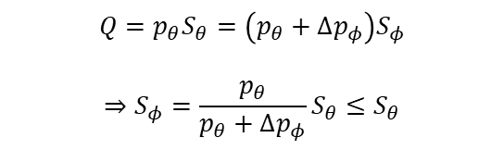
Why and how do we exploit toroidal neutral flows?
Why
Each vacuum duct = hole in neutron shielding = bad = x200 neutron dose :(
Complexity, limited space especially in compact reactors [Meschini-Moscheni]
Incentive at minimising pumps [PitcherStangeby1997]
How
60-70% backflow = 30-40% efficiency = bad = many ducts (not a stellarator thingy, 60% in DTT) = improve that!
Capture the toroidal flow with a toroidally-oriented pump inlet
$$Q=p_{θ}S_{θ}=\left(p_{θ}+Δp_{φ}\right)S_{φ}$$
$$⇒S_{φ}=\frac{p_{θ}}{p_{θ}+Δp_{φ}}S_{θ}≤S_{θ}$$
x 200

Slide 14
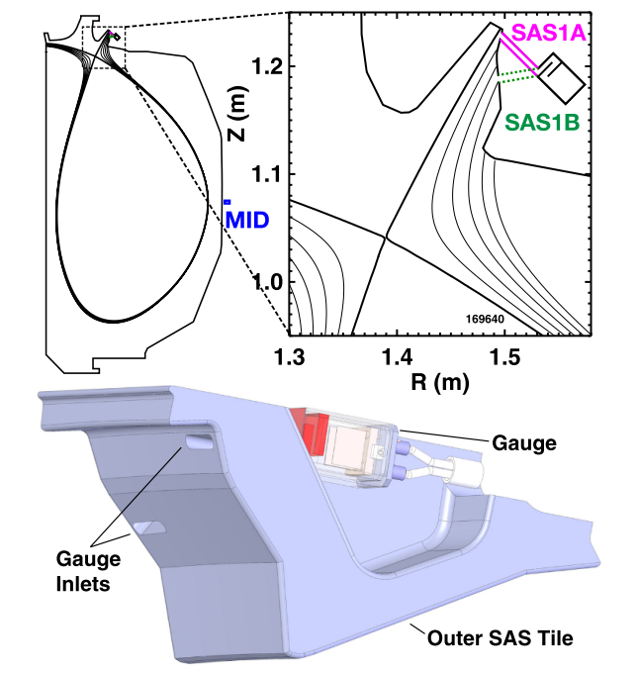
Practical implication
The presence of toroidal neutral wind can bias measurements in location of high wind speed
Pressure-hole error

Slide 15
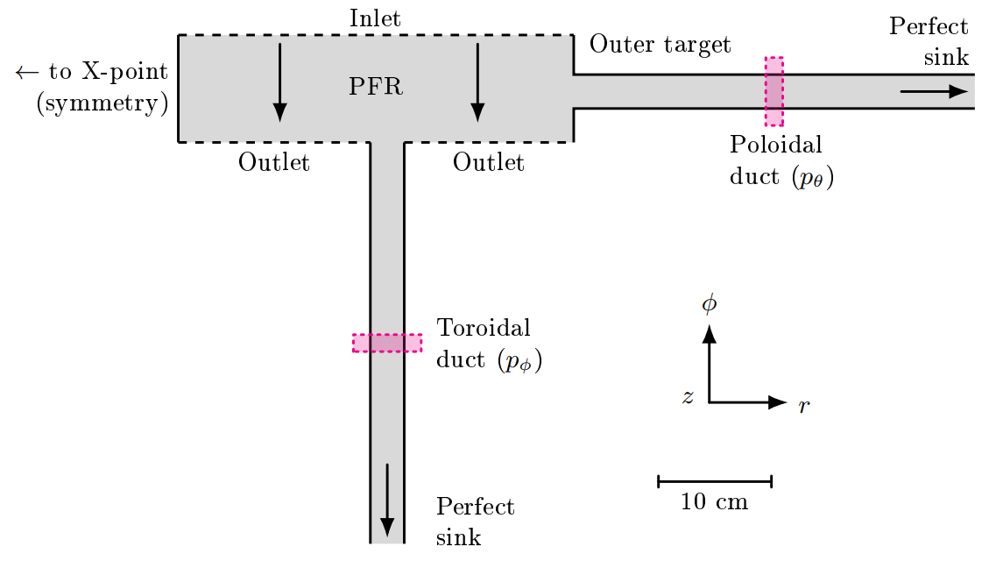
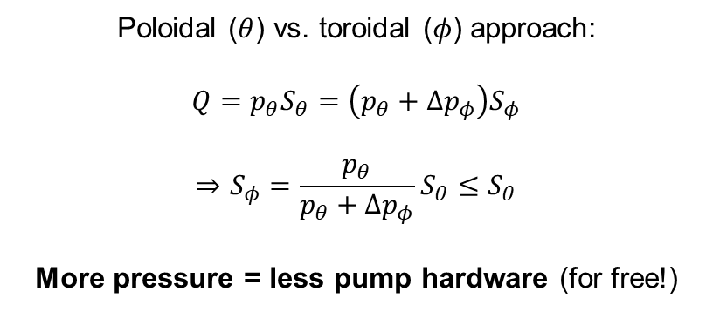
Practical application and simplified SPARTA domain: capturing the wind
SPARTA domain for proof-of-principle simulations
Poloidal ($θ$) vs. toroidal ($φ$) approach:
$$Q=p_{θ}S_{θ}=\left(p_{θ}+Δp_{φ}\right)S_{φ}$$
$$⇒S_{φ}=\frac{p_{θ}}{p_{θ}+Δp_{φ}}S_{θ}≤S_{θ}$$
More pressure = less pump hardware (for free!)

Slide 16
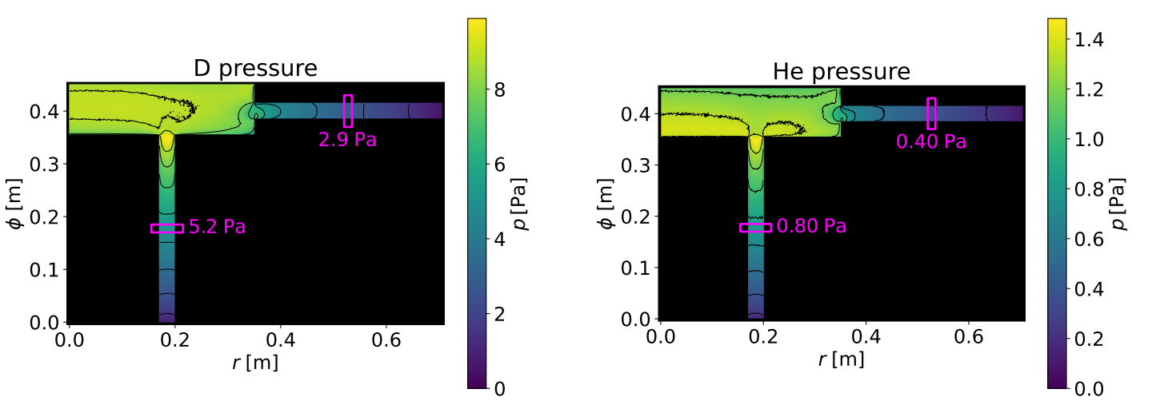
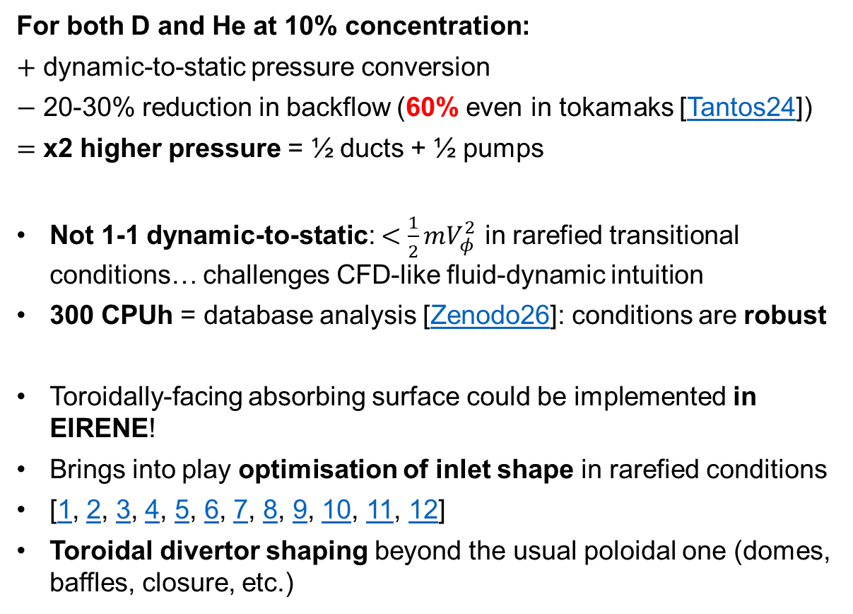
Pressure gain is tangible but much more still to investigate
For both D and He at 10% concentration:
$+$ dynamic-to-static pressure conversion
$−$ 20-30% reduction in backflow (60% even in tokamaks [Tantos24])
$=$ x2 higher pressure = ½ ducts + ½ pumps
Not 1-1 dynamic-to-static: $<\frac{1}{2}mV_{φ}^{2}$ in rarefied transitional conditions… challenges CFD-like fluid-dynamic intuition
300 CPUh = database analysis [Zenodo26]: conditions are robust
Toroidally-facing absorbing surface could be implemented in EIRENE!
Brings into play optimisation of inlet shape in rarefied conditions
[1, 2, 3, 4, 5, 6, 7, 8, 9, 10, 11, 12]
Toroidal divertor shaping beyond the usual poloidal one (domes, baffles, closure, etc.)
Wind direction
Wind direction

Slide 17
Any input is most welcome!
Reach out to us: matteo.moscheni@gauss-fusion.com
Cross-compare to our cases: Zenodo26?
Provide further numerical evidence of toroidal winds from other codes?
And thanks for the attention :)
Spoiler: partnership with IPP to test toroidal-neutral-flow capture in ASDEX Upgrade 2027 [link] !

Slide 19
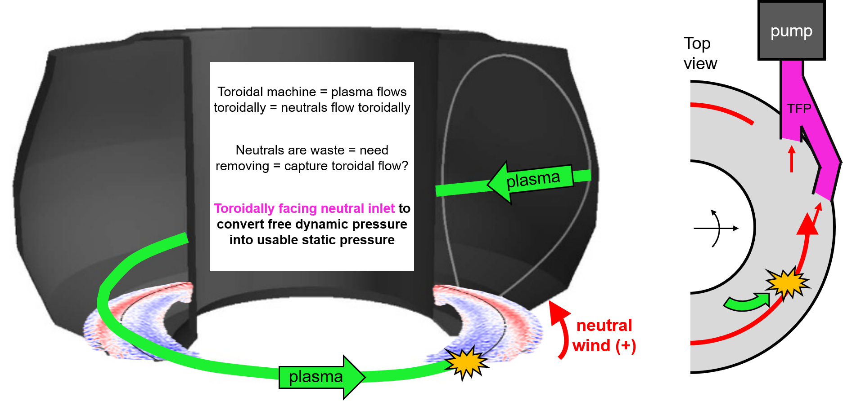
Summary
TFP PROOF OF CONCEPT IN AUG

