Slide 1

The effect of fluid neutrals on 1D detachment burn-through for STEP
J. L. Baker^{1,2}, C. P. Ridgers¹, M. Kryjak^{1,2}, D. Moulton², S. S. Henderson² and I. Cziegler¹
¹York Plasma Institute, Department of Physics, University of York, York, United Kingdom
²UKAEA, Culham Science Centre, Abingdon, OX14 3DB, United Kingdom
J. L. Baker -3rd UKAEA Edge Code Workshop, 07/10/2026, Culham

Slide 2
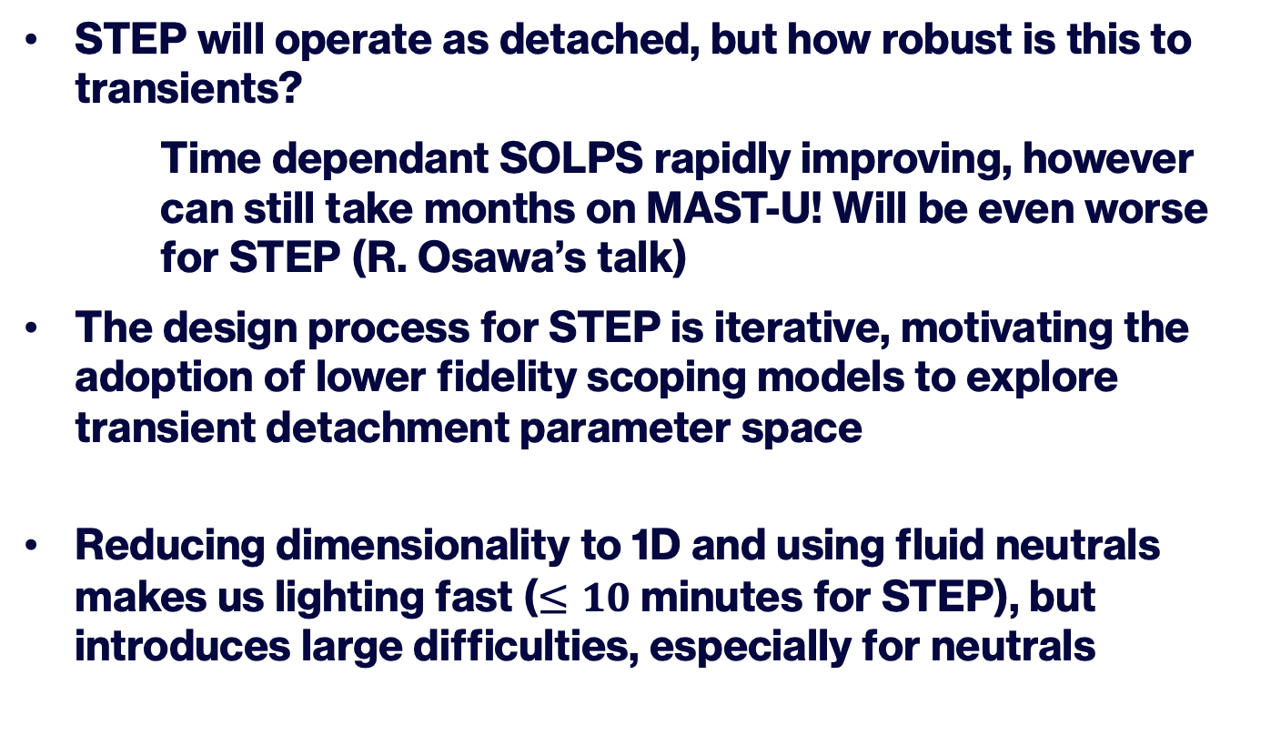
The case for 1D transient modelling
STEP will operate as detached, but how robust is this to transients?
Time dependant SOLPS rapidly improving, however can still take months on MAST-U! Will be even worse for STEP (R. Osawa’s talk)
The design process for STEP is iterative, motivating the adoption of lower fidelity scoping models to explore transient detachment parameter space
Reducing dimensionality to 1D and using fluid neutrals makes us lighting fast ($≤10$ minutes for STEP), but introduces large difficulties, especially for neutrals
Notes:
This is the structure of the talk

Slide 3
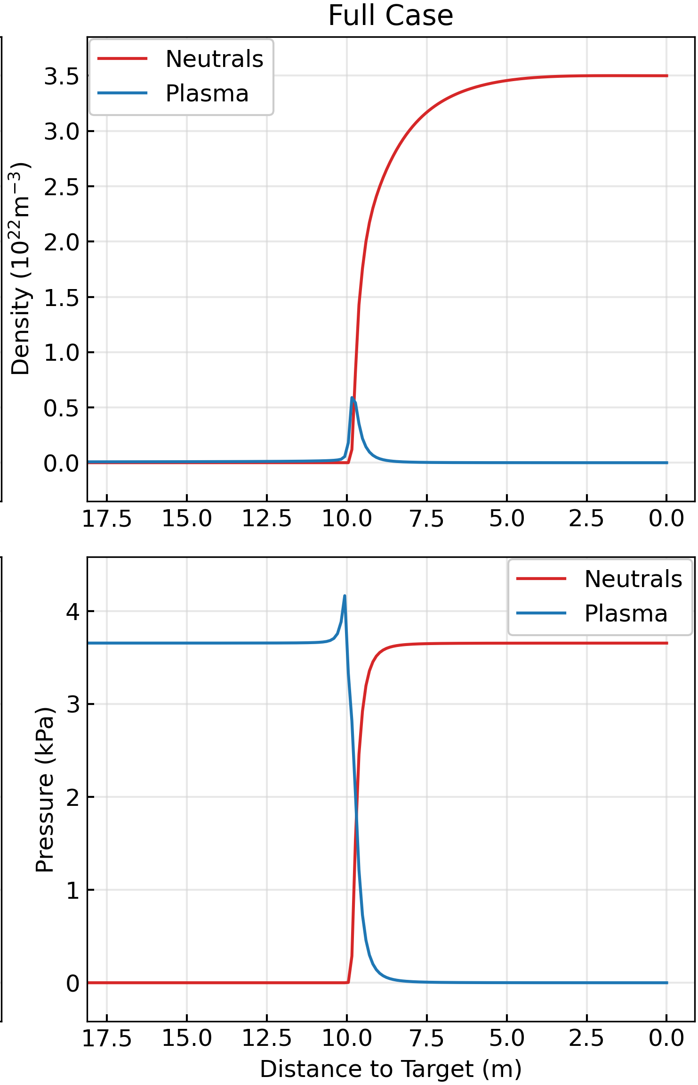
The neutral piston effect
Lack of cross field neutral transport combined with charge exchange compression due to charge exchange with fluid neutrals
1D Flux tube
Neutrals
pressure
Plasma ->
pressure
[1]
[1] M. Khan et al., Nucl. Fusion 66(9), 096032 (2026). https://doi.org/10.1088/1741-4326/ae91f8
Notes:
This is the structure of the talk

Slide 4
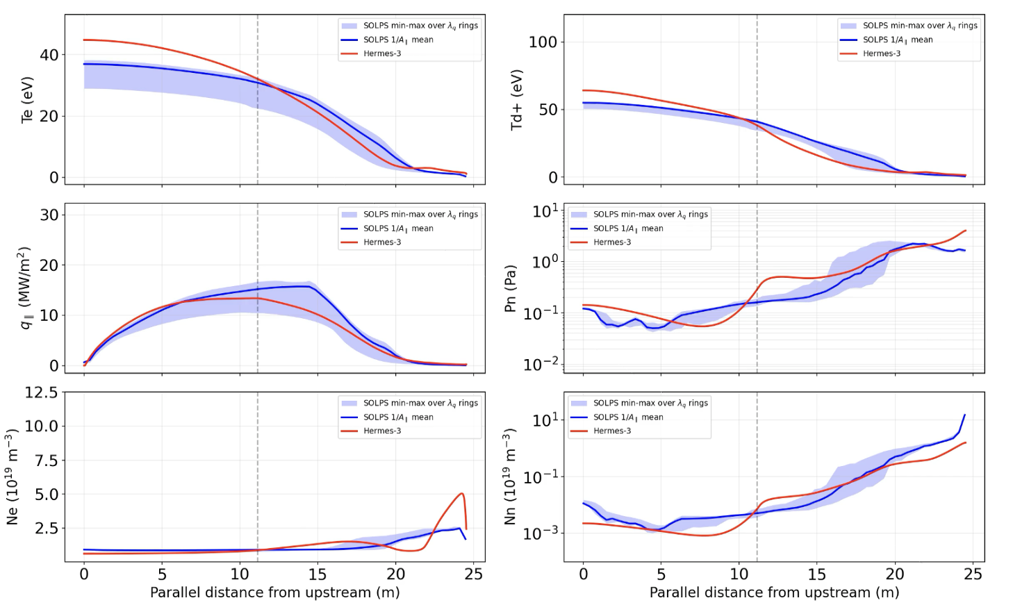
Reservoir models
Neutrals
Baffle
Neutrals
DIFFER group has pioneered reservoir models [1] in DIV1D [2], now implemented in Hermes-3… How does it perform with fast power transients
1D Flux tube
Neutrals
Neutrals
pressure
Plasma ->
Plasma ->
pressure
1D Flux tube
Hermes-3 comparison to SOLPS MAST-U
Simulations in steady state
[1] G. L. Derks et al., Plasma Phys. Control. Fusion 66(5), 055004 (2024). https://doi.org/10.1088/1361-6587/ad2e37
[2] G. L. Derks et al., Plasma Phys. Control. Fusion 67(10), 105003 (2025). https://doi.org/10.1088/1361-6587/adfe18
Notes:
This is the structure of the talk

Slide 5
Steady state profiles
Notes:
This is the structure of the talk

Slide 6
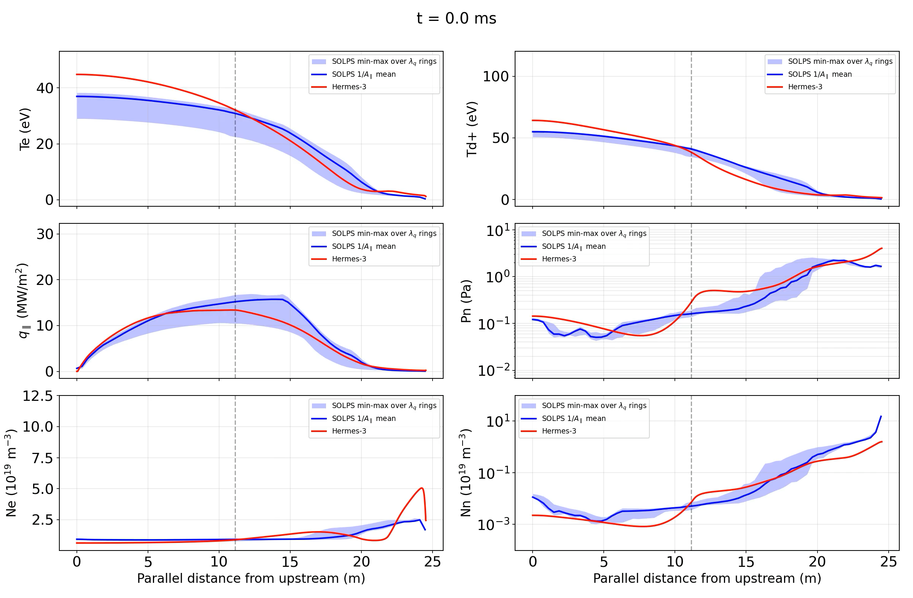
Transient (profiles)
Notes:
This is the structure of the talk

Slide 7
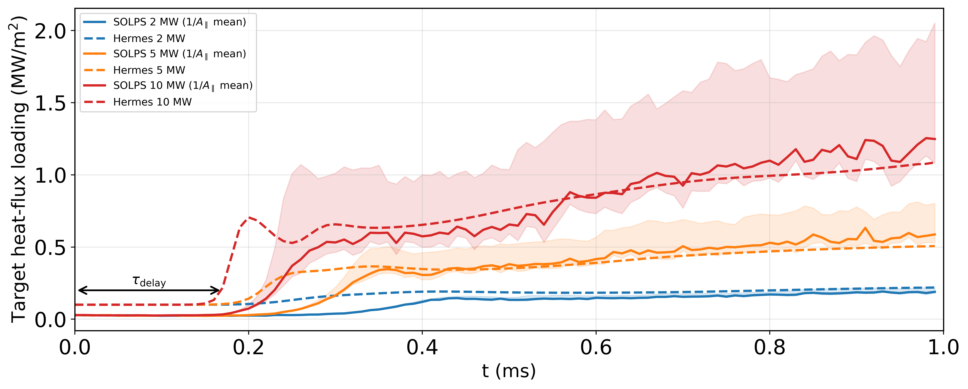
Transient results (target heat loads)
Notes:
This is the structure of the talk

Slide 8
Look forward to speaking to you
Notes:
This is the structure of the talk

