Slide 1
GUERNICA:
Overcoming Challenges Associated With 2X3V Kinetic Neutrals
Jack Gabriel and Saskia Mordijck
William & Mary
UKAEA Exhaust Code Workshop

Slide 2
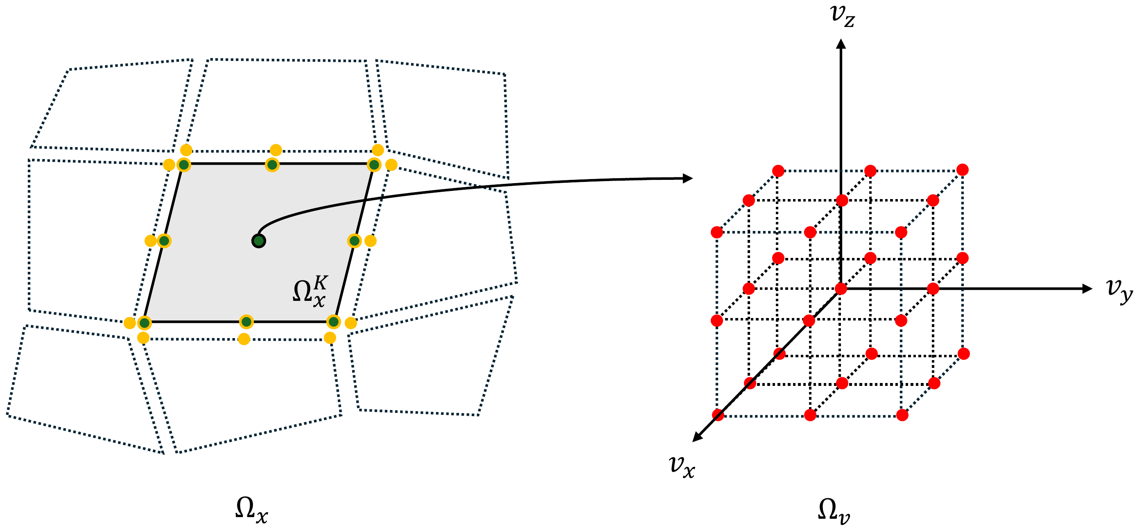
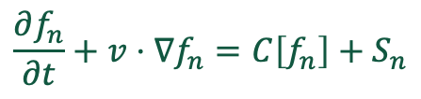
GUERNICA: 2X3V Kinetic Neutral Solver
Transient
Steady-state
$$\frac{∂f_{n}}{∂t}+v⋅∇f_{n}=C\left[f_{n}\right]+S_{n}$$
Equation: Boltzmann for atomic hydrogen on a static background plasma
Configuration space: DG on unstructured quadrilaterals, nodal Gauss–Lobatto basis, upwind flux, matrix-free, built on MFEM
Velocity space: discrete velocity method on a uniform Cartesian grid
Collision operators: Charge exchange, ionization, radiative recombination, conservative BGK neutral-neutral*

Slide 3
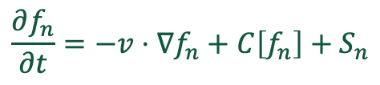
How Long Does A Code Take To Run?
$$\frac{∂f_{n}}{∂t}=−v⋅∇f_{n}+C\left[f_{n}\right]+S_{n}$$
Wall Clock Time = # of iterations x time per iteration
Part 1: Speeding up charge exchange
Part 2: The negative consequences of the choices made to speed up charge exchange
Part 3: Fixing the negative consequences of the choices made to speed up charge exchange
Part 4: The serendipitous potentially positive consequences of fixing the negative consequences of the choices made to speed up charge exchange

Slide 4
Cost Per Iteration
Part 1

Slide 5
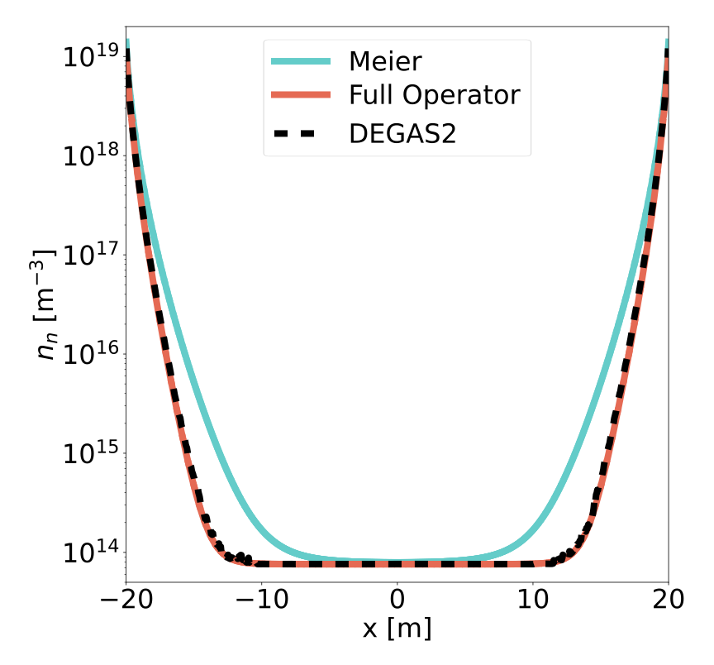
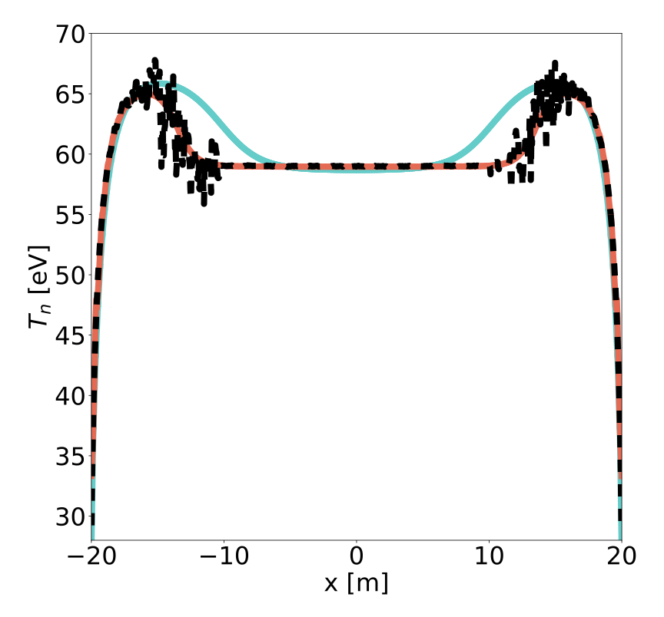



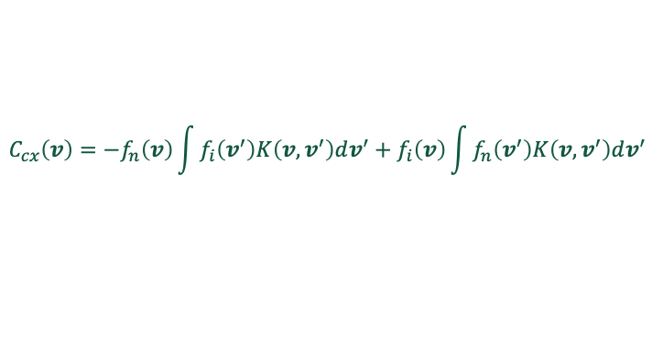
Full CX Matches DEGAS2; Meier CX Does Not
Full CX: a convolution in velocity
Meier approximation: eliminating velocity dependence
$$C_{cx}\left(v\right)=−f_{n}\left(v\right)\int{f_{i}\left(v^{′}\right)K\left(v,v^{′}\right)dv^{′}}+f_{i}\left(v\right)\int{f_{n}\left(v^{′}\right)K\left(v,v^{′}\right)dv^{′}}$$
$$C_{cx}\left(v\right)=−σ\left(V_{cx}\right)V_{cx}(n_{i}f_{n}−n_{n}f_{i})$$
$$K\left(v,v^{′}\right)=σ(\left|v−v^{′}\right|)\left|v−v^{′}\right|$$
$$V_{cx}^{2}=\frac{4}{π}\left(v_{ti}^{2}+v_{tn}^{2}\right)+{\left|u_{i}−u_{n}\right|}^{2}$$
Velocity-dependent loss, gain from the full integral
Velocity-independent loss rate; new neutrals get the ion Maxwellian
Full CX reproduces DEGAS2 results to within its noise
Meier over-penetrates: Increased temperature profile leads to increased penetration, 31% too many neutrals overall
One code, mesh and velocity grid; only the CX operator swapped
Low-density Bernard benchmark: T_{i} = 60 eV, n = 5×10¹⁸ m⁻³, L = 40 m, recycling walls (R = 1)

Slide 6
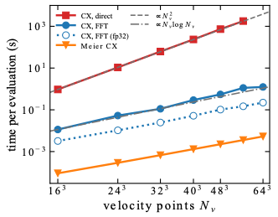
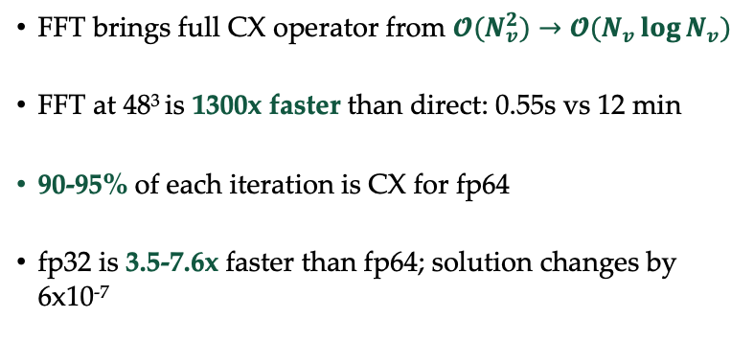
CX Is Slow; FFT Makes It Fast(er)
FFT brings full CX operator from $𝓞(N_{v}^{2})→𝓞(N_{v}\log{N_{v}})$
FFT at 48³ is 1300x faster than direct: 0.55s vs 12 min
90-95% of each iteration is CX for fp64
fp32 is 3.5-7.6x faster than fp64; solution changes by 6x10⁻⁷
Low-density benchmark | Full CX fp64 | Full CX fp32 | Meier (Gkeyll)
CX operator per iteration | 695.6 ms | 103.7 ms | 3.1 ms
Wall time to a 10⁻⁵ residual | 75.9 min | 18.4 min | 8.3 min

Slide 7
The Issue With Uniform Cartesian Grids
Part 2

Slide 8
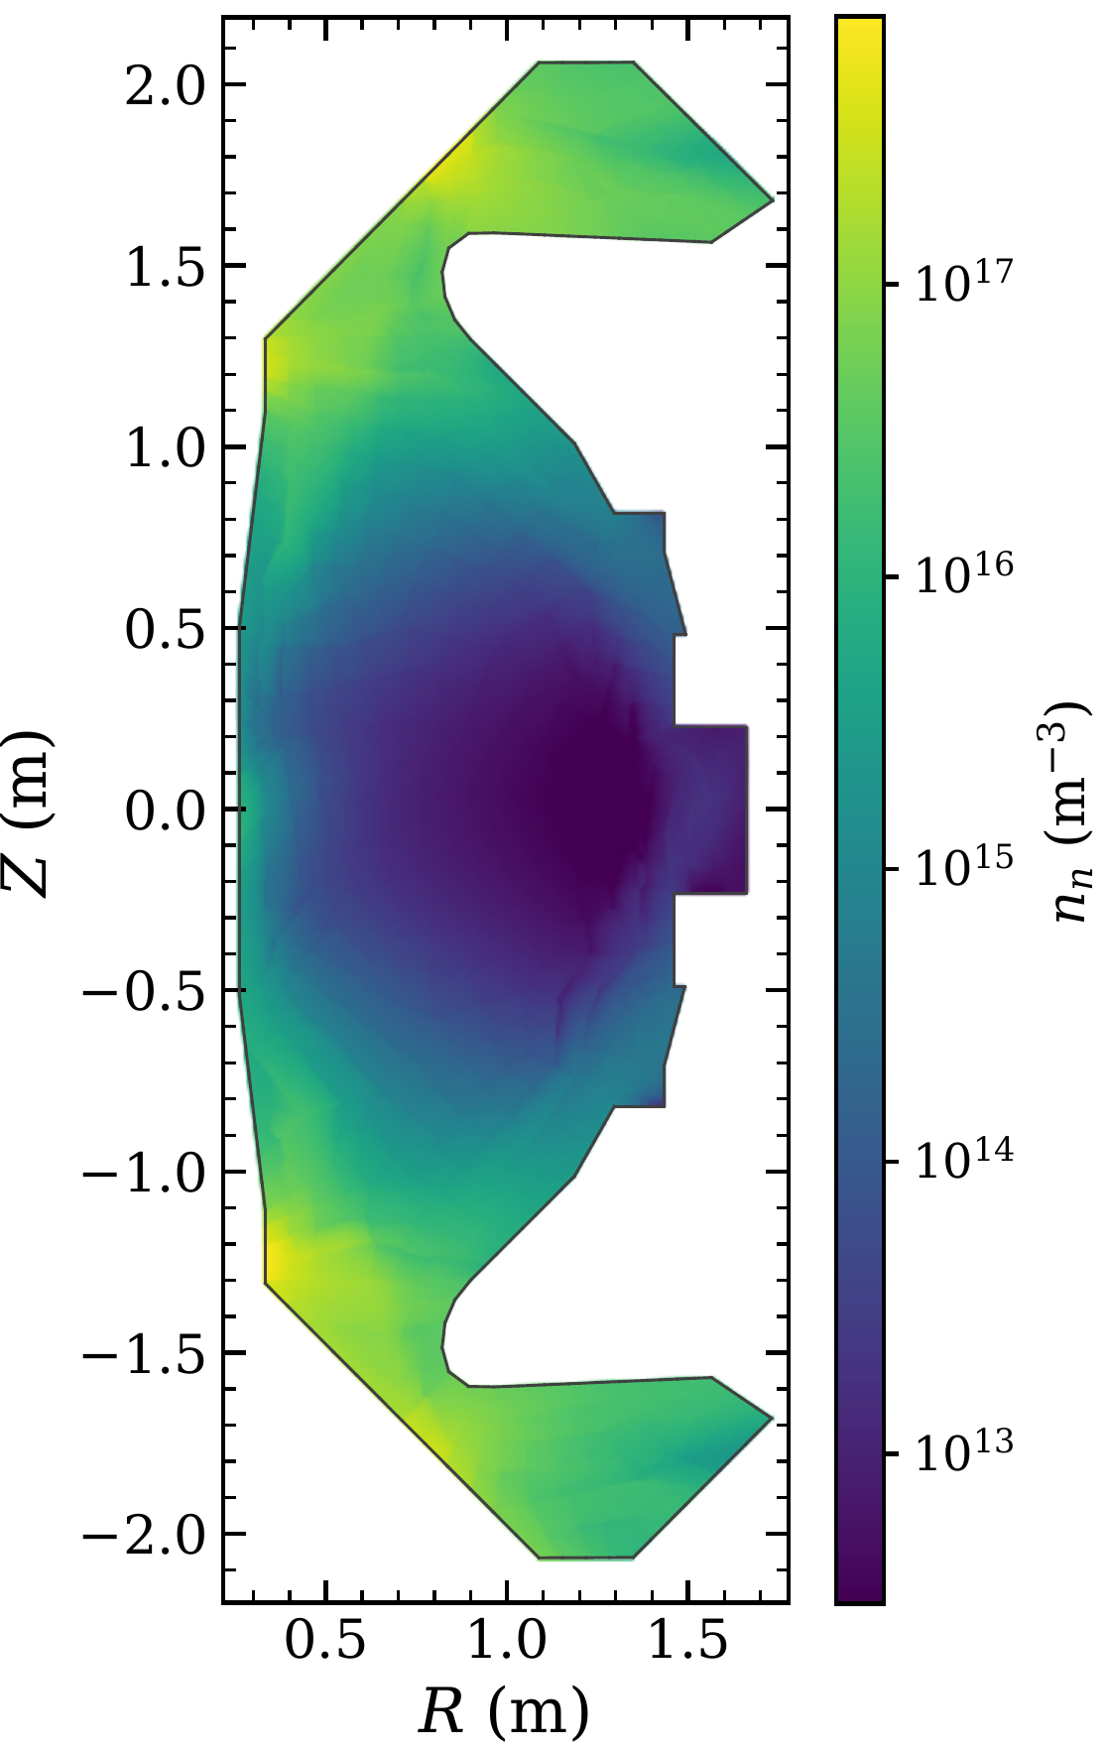
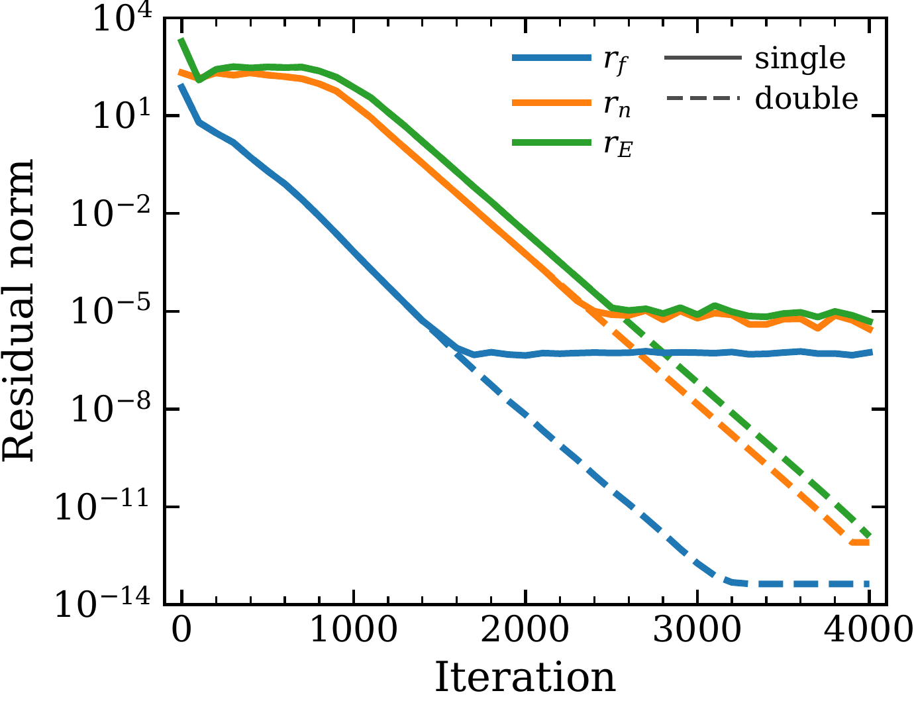
Preliminary MAST-U Demonstration
Setup
SOLPS-ITER background, shot 45470 at 0.42 s; ions = electrons
Planar 2D, 709 quads to the first wall, p = 1
108 × 108 × 26 velocities over ±4.7×10⁵ m/s
Recycling walls at 2 eV
Ionization + CX + recombination
Results
4,000 iterations in 86 min on one A5000 with fp32 CX (6.0 h in fp64): 8.6×10⁸ phase-space DOFs, 18.8 of 24 GiB
Particle and energy balance to 3×10⁻⁹
Peak n_{n} = 8×10¹⁷ m⁻³ at the lower inner strike point; T_{n} from a few eV to > 100 eV

Slide 9
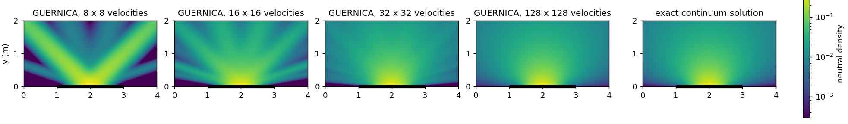
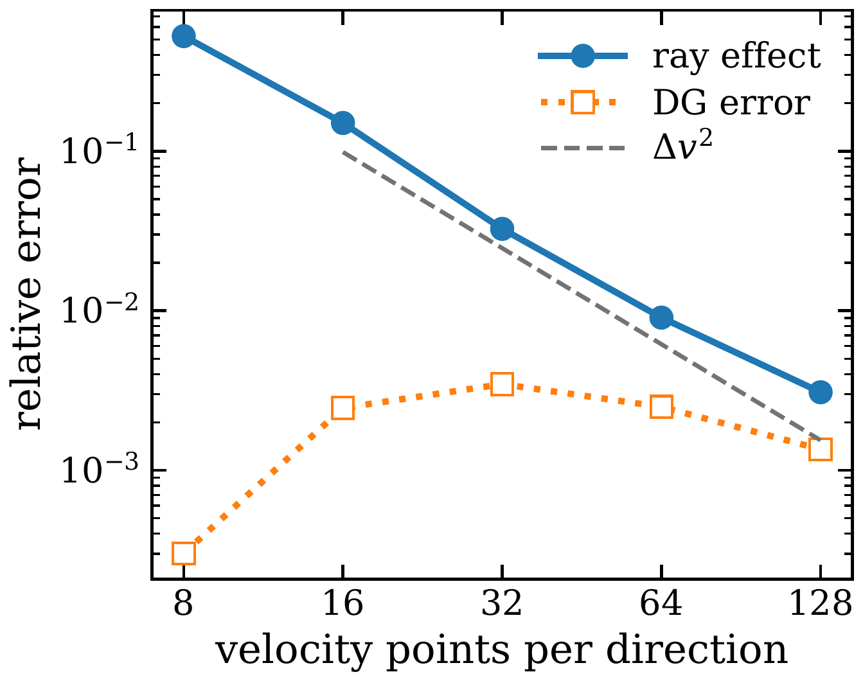
Consequences Of Under-Resolved Velocity Space
Converged ≠ Correct
MAST-U: ≈ 1.6 points per thermal speed of the 2 eV neutrals, between 16² and 32²
Looks like under-sampled EIRENE, but the cause is discretization, not statistics
Uniform Cartesian grid has major drawbacks
Allows for fast CX evaluation BUT,
One grid for 2 eV wall neutrals and > 100 eV CX neutrals
≈ 128³ points needed: does not fit in GPU memory

Slide 10
Moving To A Spherical Grid
Part 3 (and some of 4)

Slide 11
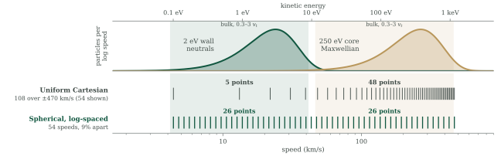
From Uniform Cartesian To Spherical Velocity Space
~7× fewer velocity points: 54 speeds × 12 × 64 directions = 41,472 against ≈ 300,000
CX without the FFT: Legendre expansion of the kernel (L = 8), ~10⁻⁴ accuracy to Mach 6, ~20× fewer operations

Slide 12
Conclusions
GUERNICA: a 2X3V continuum kinetic neutral solver that keeps the full charge-exchange operator
Reducing cost of charge exchange
  Full CX reproduces DEGAS2; the Meier approximation over-penetrates
  The FFT makes full CX 1300× faster than direct evaluation, and an fp32 convolution a further 3.5–7.6×
  A uniform Cartesian grid allows the FFT but under-resolves the cold wall neutrals: ray effects
Plans to take advantage of a spherical velocity grid
  A log-spaced spherical grid covers 2 eV wall neutrals to the hot core with ~7× fewer points with better accuracy (in development)
  Explicit pseudo-time stepping is limited by stability, so convergence can still be slow
  Advection sweeps invert transport and loss exactly: no stability limit (in development)

Slide 13
Backup

Slide 14
Number Of Iterations
Part 3

Slide 15
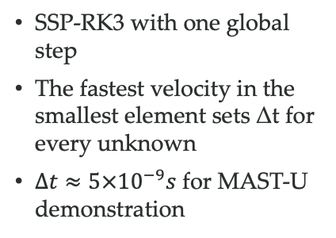

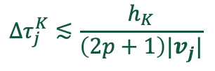
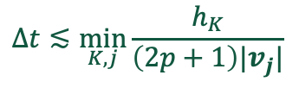
From Time Stepping To Advection Sweeps
1. Transient
The origin story
2. Pseudo-time
Today’s steady solver
3. Advection sweep
Moving forward
$$Δt≲\min_{K,j}{\frac{h_{K}}{\left(2p+1\right)|v_{j}|}}$$
$$Δτ_{j}^{K}≲\frac{h_{K}}{\left(2p+1\right)|v_{j}|}$$
$$v_{j}⋅{∇f}_{j}^{k+1}+ν_{j}f_{j}^{k+1}=G_{cx}{\left[f^{k}\right]}_{j}+S_{j}$$
SSP-RK3 with one global step
The fastest velocity in the smallest element sets Δt for every unknown
$Δt≈5×{10}^{−9}s$ for MAST-U demonstration
Forward Euler, local step per element–velocity pair
Still explicit: a transport limit and a collisional limit (νΔτ < 2)
Convergence can still be slow
Per direction, solve elements in downwind order (4 × 4 local system at p = 1)
Transport and loss inverted exactly: no stability limit
Basic idea can be applied for both steady state and transient
Why not fully implicit? Memory constraints!

Slide 16
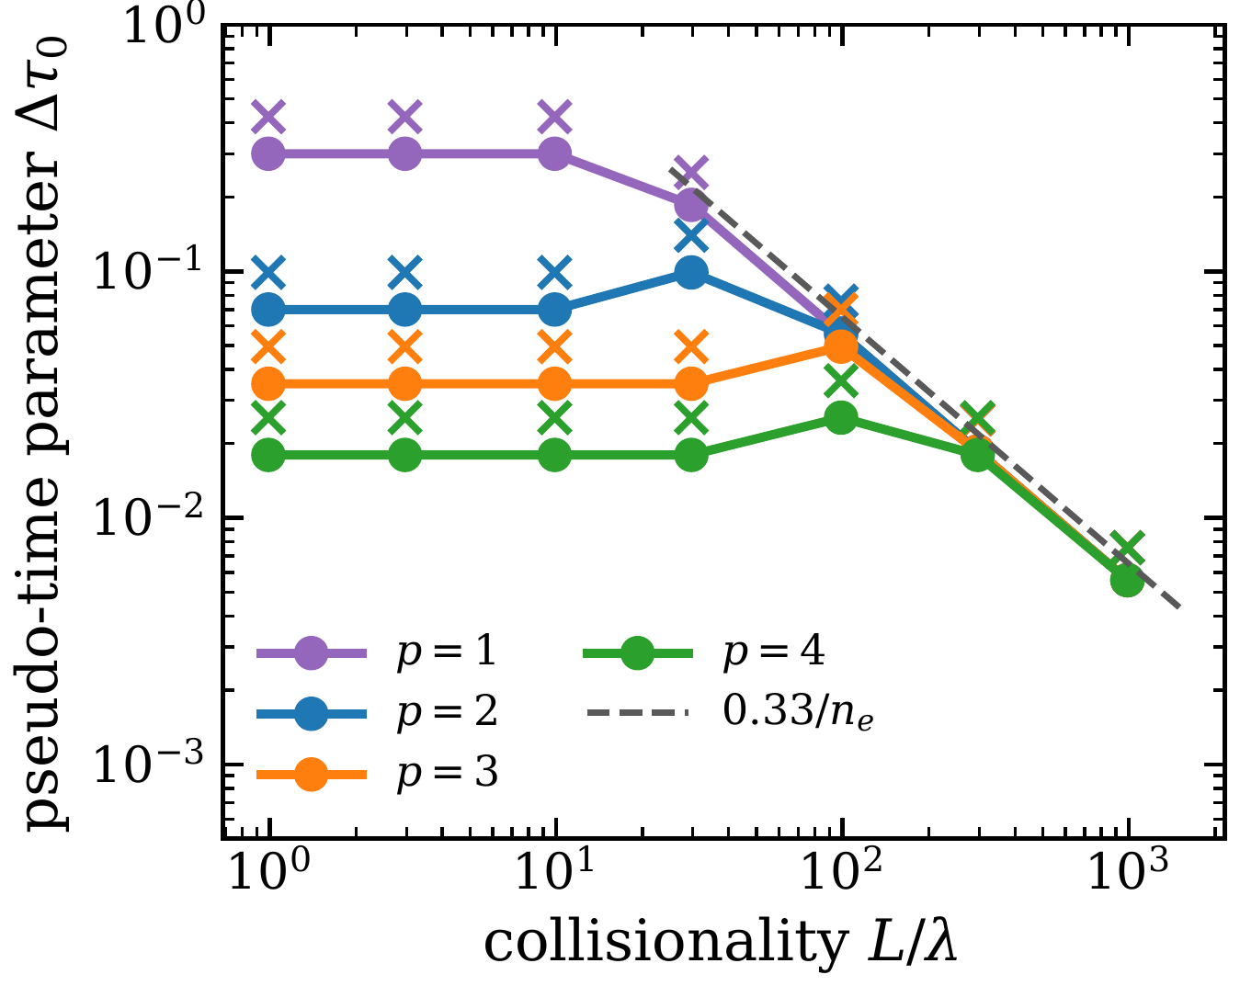
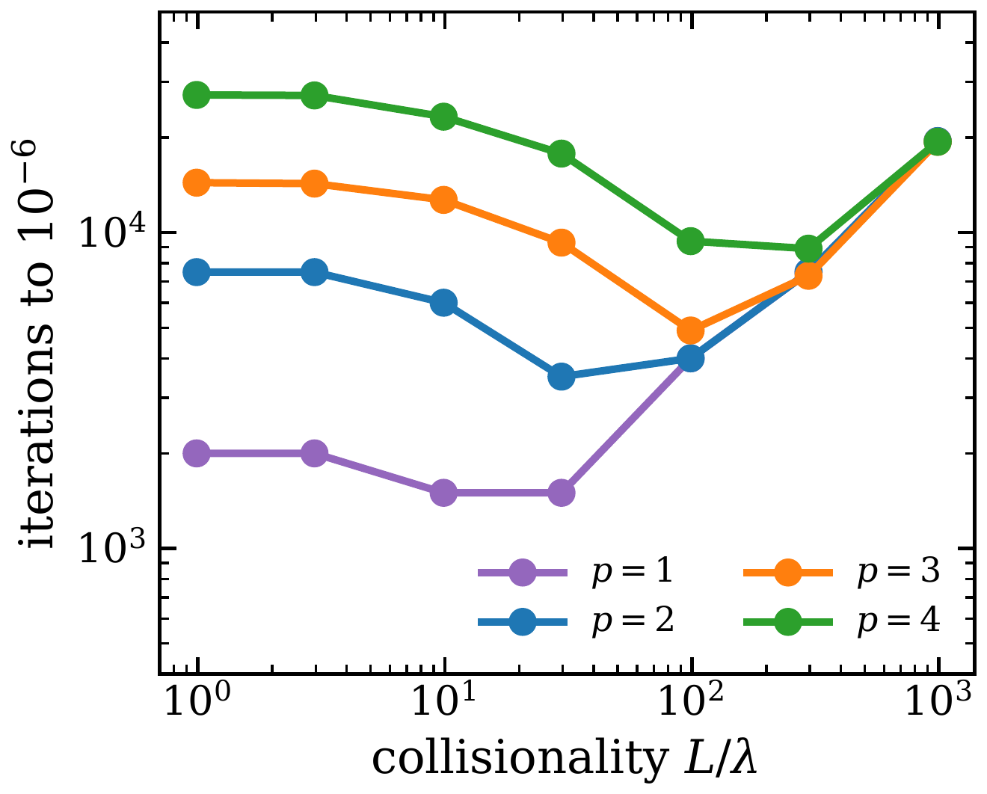
Stability And Convergence Of Pseudo-Time Stepping
Two stability limits
Transport: Δτ₀ ≤ 0.36, 0.08, 0.035, 0.018 for p = 1–4
Collisional: νΔτ < 2, so Δτ₀ < 0.33/n_{e} for every p
Largest stable pseudo-time parameter
Iterations to a 10⁻⁶ residual
Cost of one iteration is independent of collisionality; the number of iterations is not.
Notes:
Forward Euler in pseudo-time with a local step per element-velocity pair. Scan in collisionality L/lambda ~ 20 n_e / 1e18 m^-3 from 1 to 1000.
Two stability limits:
- Transport limit (low collisionality): largest stable dtau0 is 0.36, 0.08, 0.035, 0.018 for p = 1, 2, 3, 4. It roughly halves with each order above p = 2.
- Collisional limit (high collisionality): forward Euler needs nu*dtau < 2, giving dtau0 < 0.33/n_e, the same for every p.
Iterations to bring all residuals below 1e-6: about 2,000 / 7,500 / 14,000 / 27,000 for p = 1-4 at low collisionality; the same for every p at high collisionality, growing with density to about 19,500 at L/lambda = 1000.
Consequences: the cost of one iteration does not depend on collisionality, but the number of iterations does. Higher order is more accurate per node but costs more iterations.

Slide 17
Conclusions
GUERNICA: a 2X3V continuum kinetic neutral solver that keeps the full charge-exchange operator
Reducing cost of charge exchange
  Full CX reproduces DEGAS2; the Meier approximation over-penetrates
  The FFT makes full CX 1300× faster than direct evaluation, and an fp32 convolution a further 3.5–7.6×
  A uniform Cartesian grid allows the FFT but under-resolves the cold wall neutrals: ray effects
Plans to take advantage of a spherical velocity grid
  A log-spaced spherical grid covers 2 eV wall neutrals to the hot core with ~7× fewer points with better accuracy (in development)
  Explicit pseudo-time stepping is limited by stability, so convergence can still be slow
  Advection sweeps invert transport and loss exactly: no stability limit (in development)

Slide 18
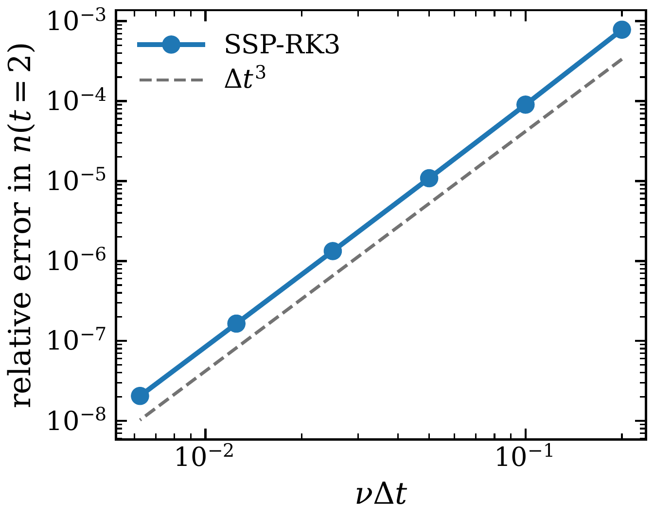
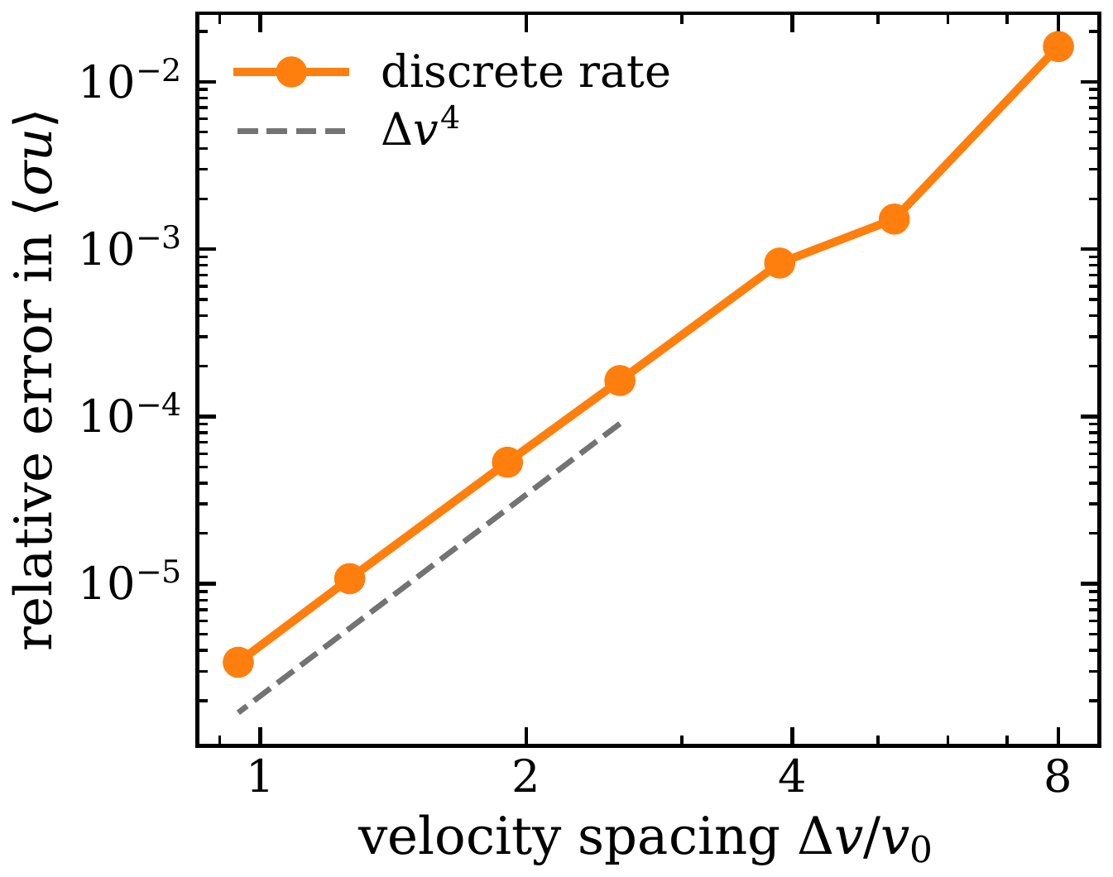
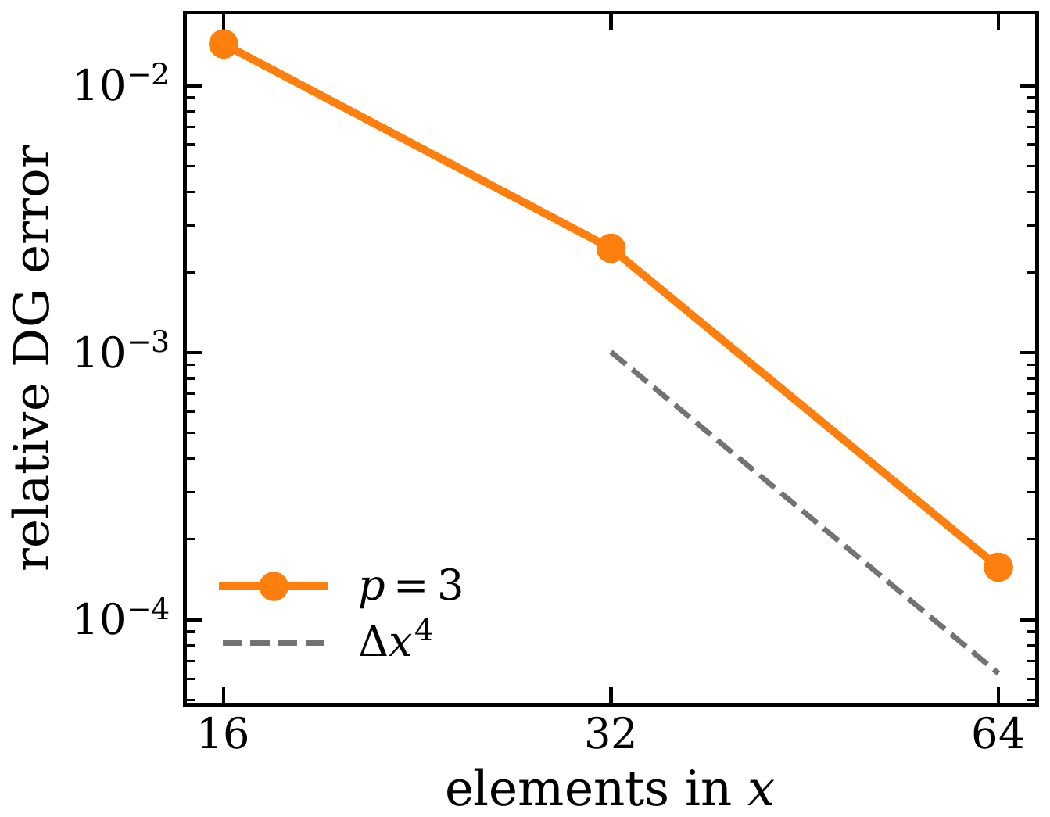
Operator Tests
Ionization decay
SSP-RK3 converges at 3rd order in νΔt
CX rate between two Maxwellians
4th order in Δv (lattice rule, conical kernel singularity)
Wall boundary condition
4th order in the mesh at p = 3
Notes:
Verification of the individual pieces.
- Ionization: exponential decay advanced with SSP-RK3; the error in n(t = 2) falls at third order in nu*dt.
- Charge exchange: the discrete CX rate between two Maxwellians converges at 4th order in the velocity spacing, the expected rate for a lattice rule with a conical singularity in the kernel.
- Wall boundary condition: emitting-wall test converges at 4th order in the mesh at p = 3.

Slide 19
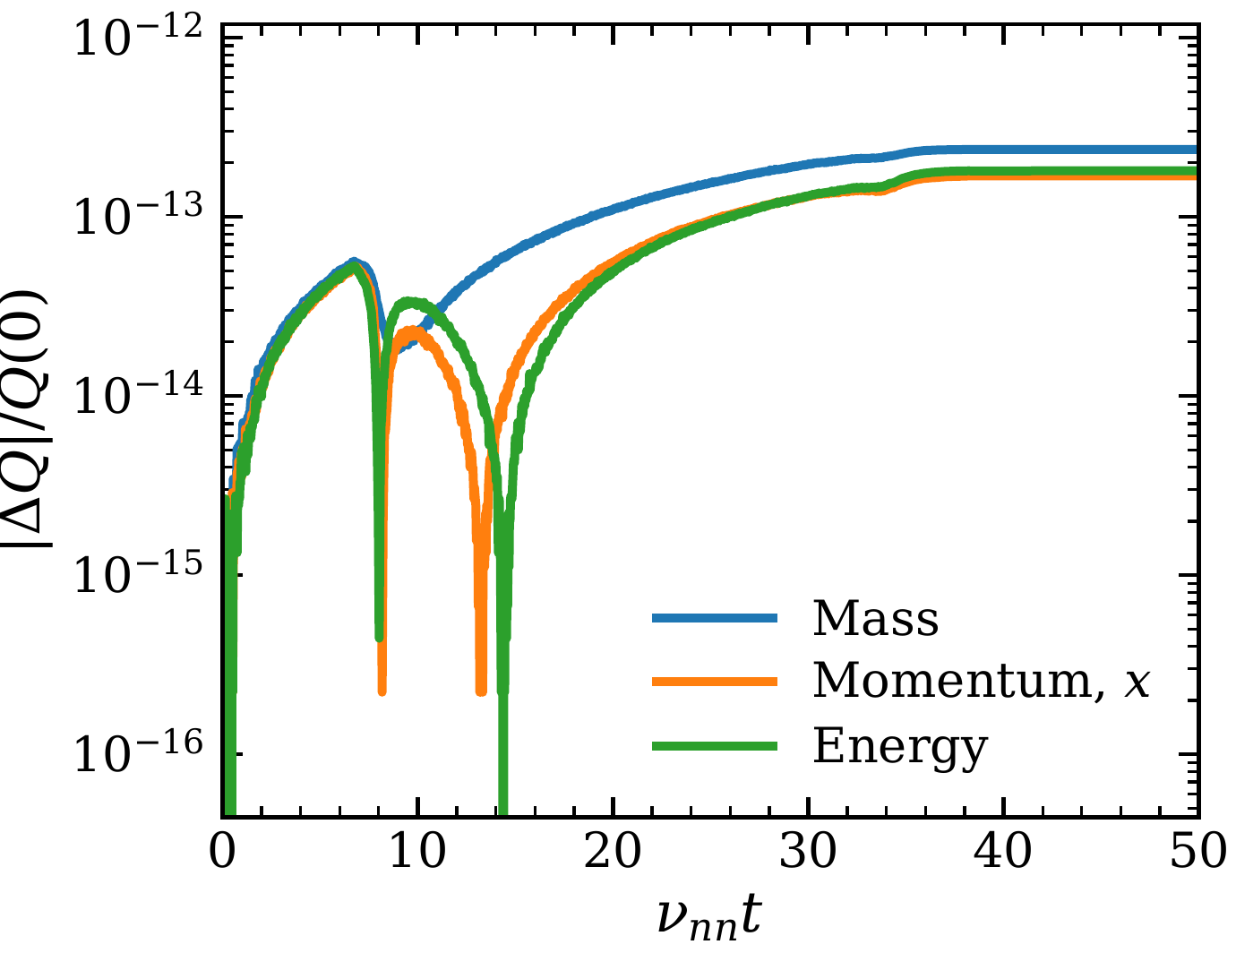
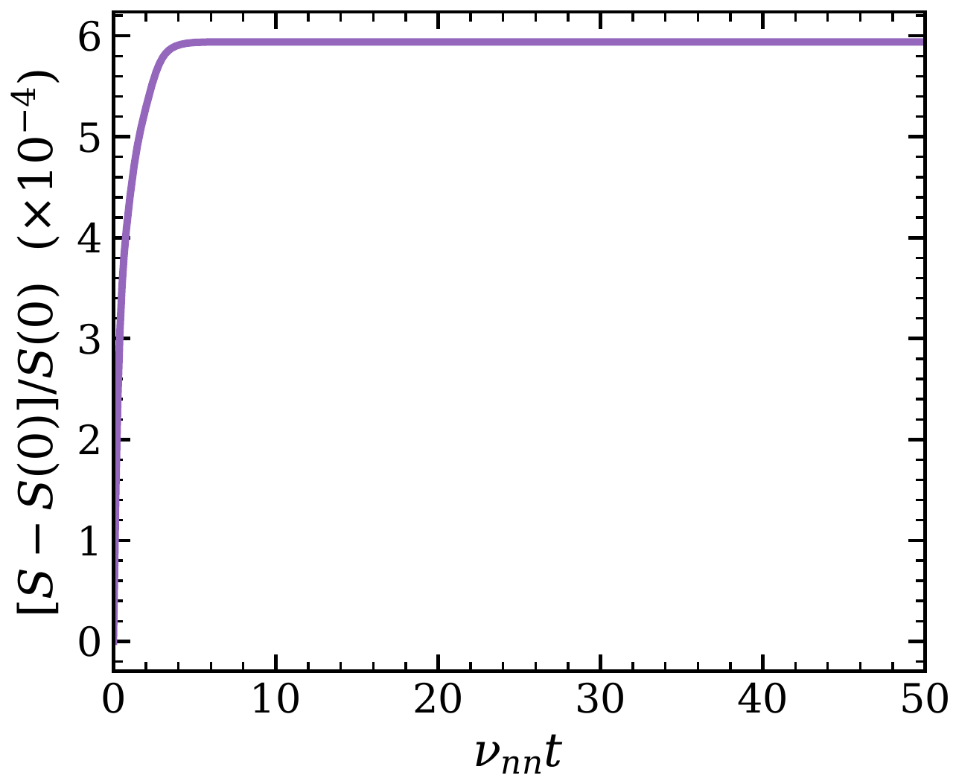
BGK Validation
Conservative: Mieussens discrete equilibrium holds mass, momentum and energy to round-off (2.4×10⁻¹³)
Entropy increases monotonically
Newton solve: O(N_{vx} + N_{vy} + N_{vz}), at most 3 iterations
Cost: about 2% of CX
Transient mode only for now
Relative change in mass, momentum and energy
Kinetic entropy
Notes:
Neutral-neutral collisions use a BGK operator with the Mieussens discrete equilibrium, so mass, momentum and energy are conserved at the discrete level.
- Periodic relaxation test with an anisotropic perturbation: conserved quantities stay constant to round-off (2.4e-13), and the kinetic entropy increases monotonically.
- The Newton Jacobian for the equilibrium factorises on the tensor velocity grid, so it costs O(N_vx + N_vy + N_vz) and converges in at most 3 iterations.
- BGK costs about 2% of CX.
- A different pseudo-time step for each velocity breaks this discrete conservation, so BGK currently runs only in transient mode; a moment-preserving pseudo-time update is in progress.

Slide 20
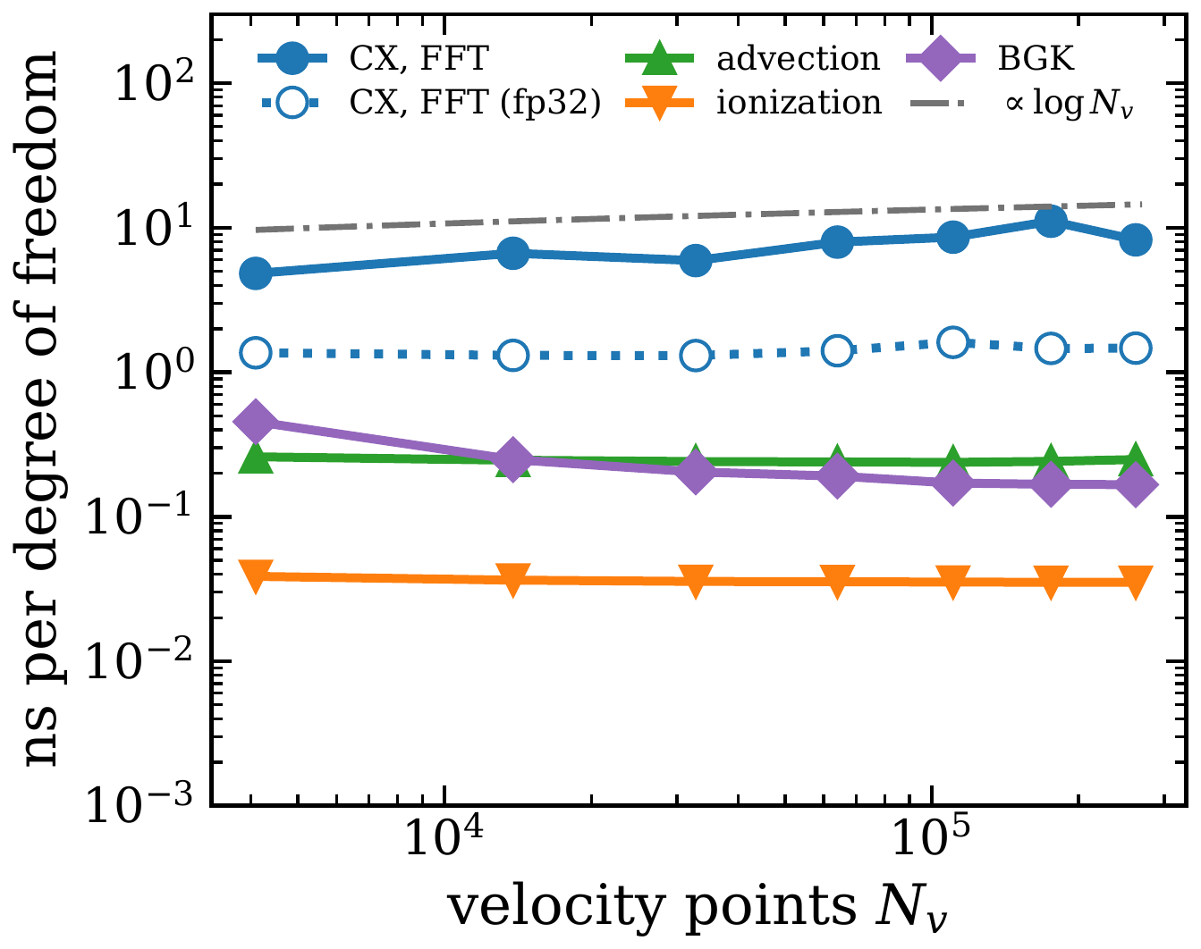
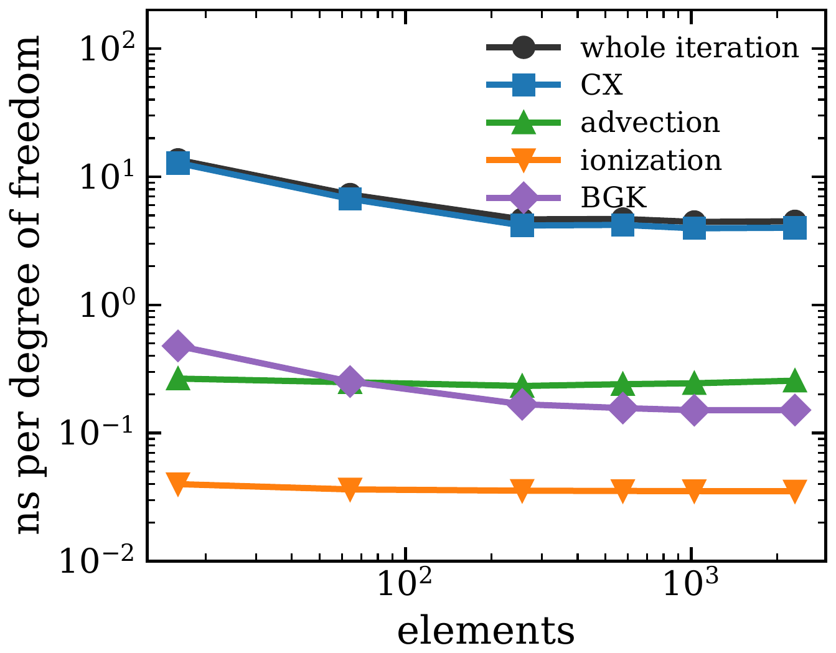
Computational Cost
CX is 90–95% of each iteration in fp64
FFT: scales as N_{v}^{1.13}; direct as N_{v}^{2.02}
fp32 convolution: 3.5–7.6× faster
≈ 4.5 ns per phase-space DOF per iteration once the GPU is saturated
Linear in elements, roughly independent of p
Cost vs velocity points
Cost vs number of elements
Notes:
Cost per phase-space degree of freedom per iteration, on one RTX A5000.
- CX is 90-95% of each iteration in double precision; nothing else is worth optimising. BGK costs about 2% of CX.
- The FFT convolution takes 11.5 ms at 16^3 velocities and 1.25 s at 64^3, scaling as N_v^1.13; direct evaluation scales as N_v^2.02.
- Running only the convolution in fp32 is 3.5-7.6x faster and changes the high-density DEGAS2 benchmark solution by 6e-7.
- Once the GPU is saturated the cost is about 4.5 ns per phase-space DOF per iteration in double precision. It is linear in the number of elements and roughly independent of polynomial order.

Slide 21
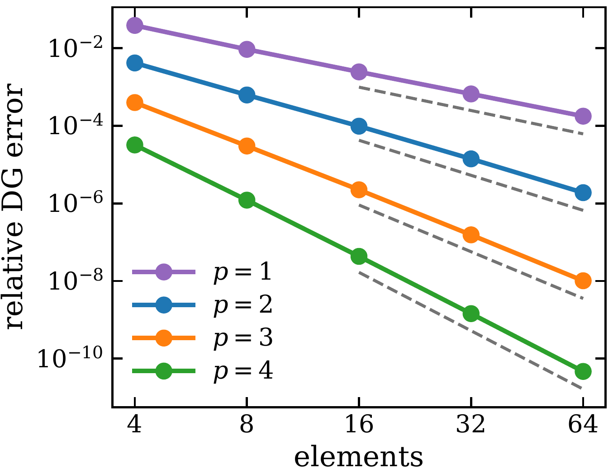
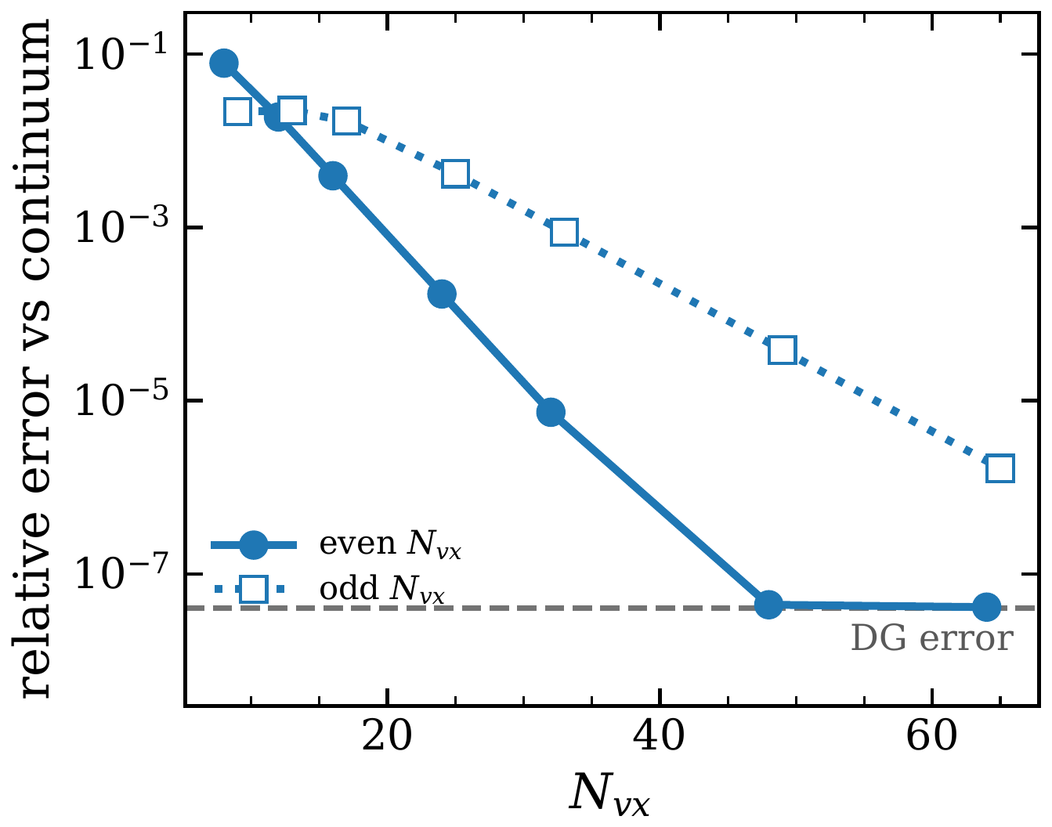
Spatial And Velocity Convergence
Space: O(Δx^{p+1}) for p = 1–4, also on randomly perturbed meshes
Velocity, even N: exponential convergence down to the DG error
Velocity, odd N: composite Simpson weights converge at half the rate
DG error vs number of elements
Error vs velocity points, even and odd N
Notes:
Spatial: the DG discretisation converges at the expected O(dx^(p+1)) for p = 1-4, including on randomly perturbed meshes.
Velocity: the even-N rule is the "alternative extended Simpson" rule (trapezoid rule with fourth-order end corrections) and converges exponentially once the distribution has decayed at the grid edges. Odd N uses composite Simpson weights, which alternate and converge at half the exponential rate. Both level off at the DG error.
History: the code only accepted odd N until late August, which is why earlier MAST-U runs used N_vz = 25. An even-vs-odd comparison at N_vz ~ 25 changed energy quantities by about 14%, because neither resolves the 2 eV Maxwellian.

Slide 22
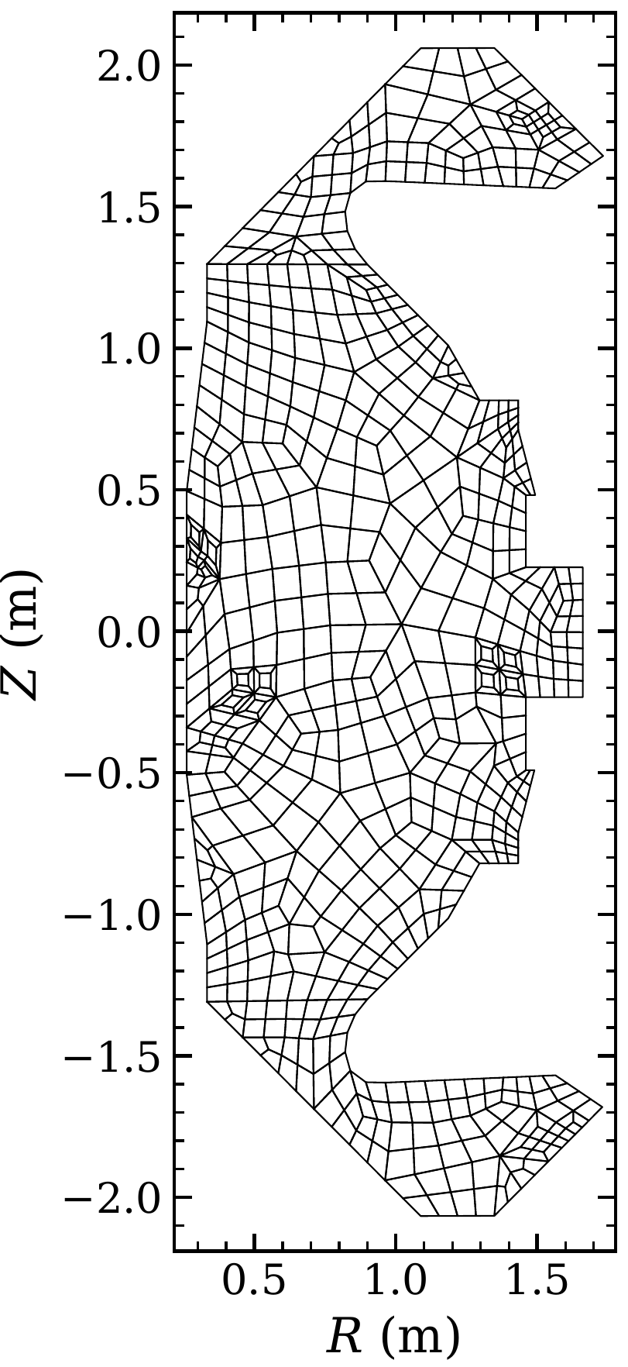
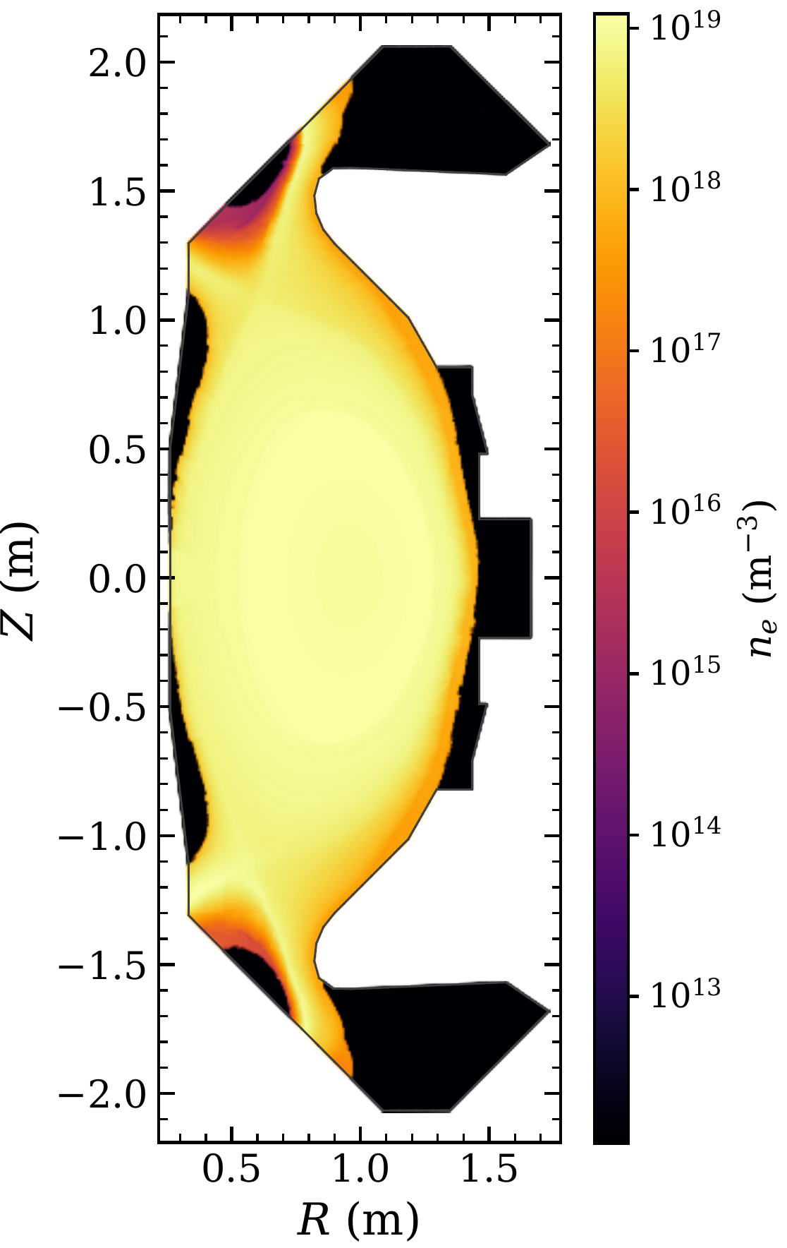
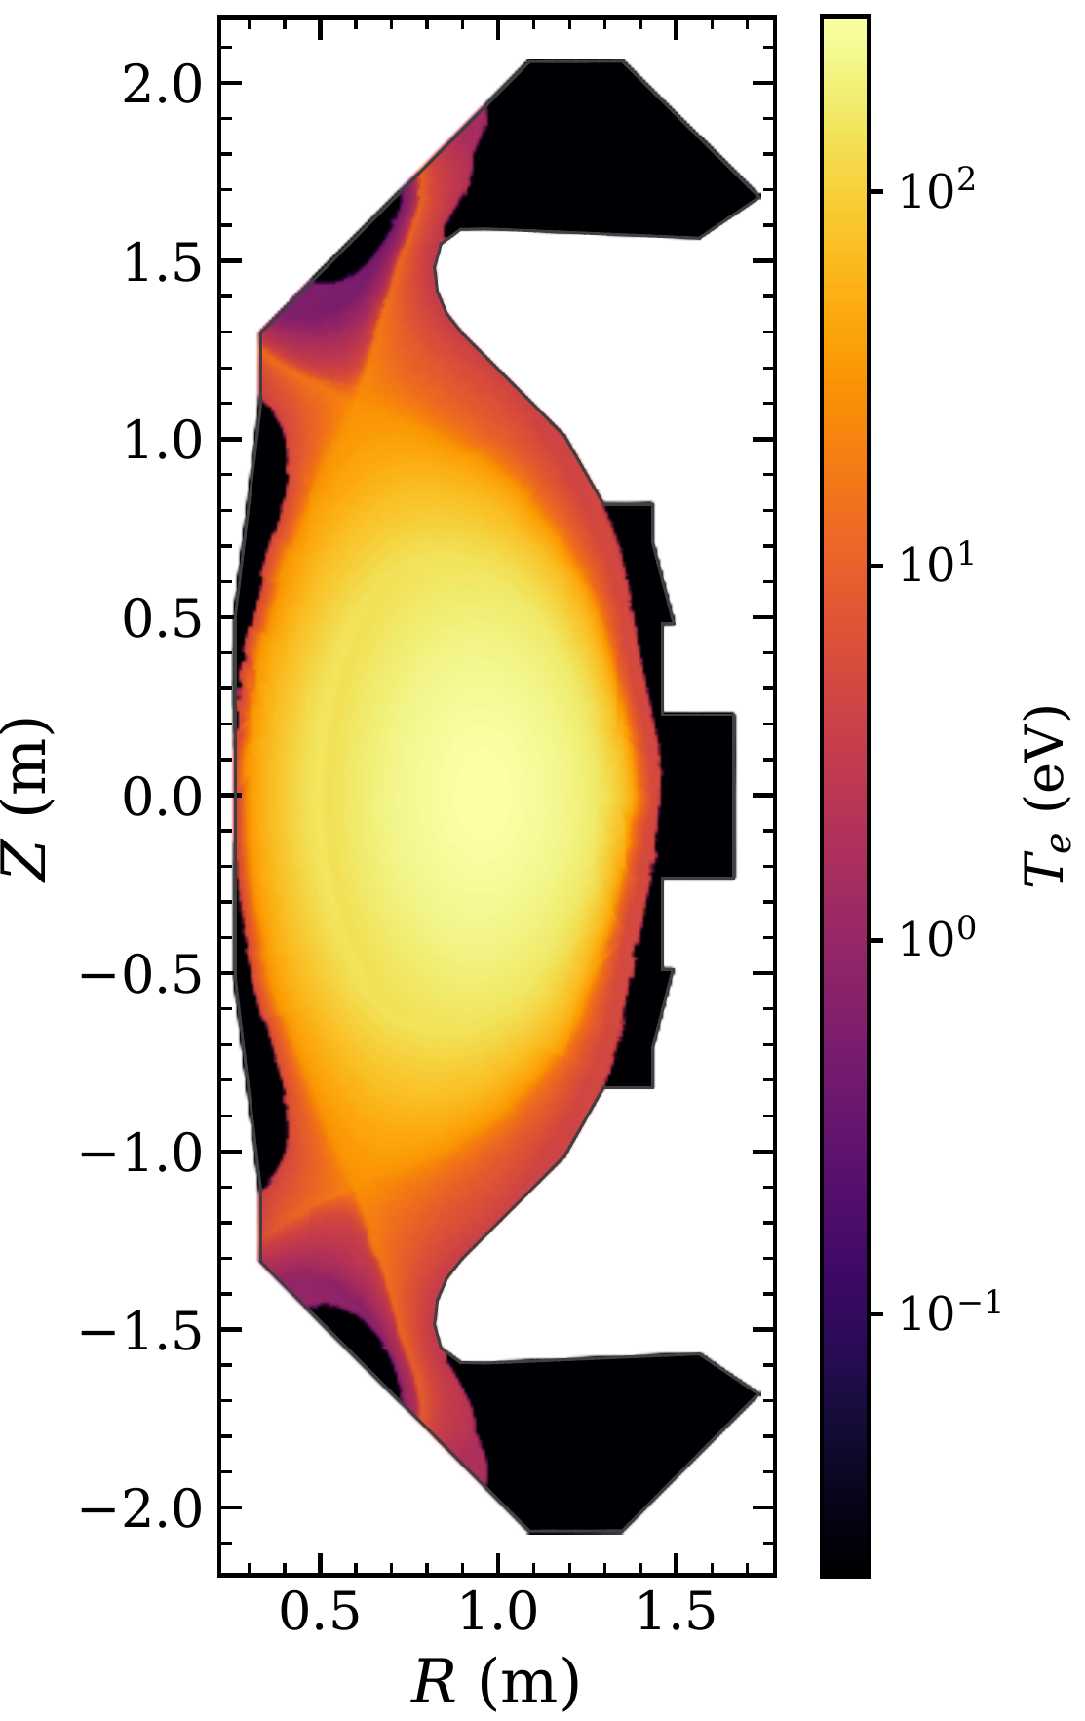
MAST-U Demonstration: Background And Mesh
SOLPS-ITER background, shot 45470 at 0.42 s: ohmic L-mode, double null, conventional divertor
Ion fields set equal to the electron fields
Planar 2D, uniform toroidally
709 quadrilaterals out to the first wall, p = 1
108 × 108 × 26 velocities over ±4.7×10⁵ m/s
Recycling walls at 2 eV; ionization + CX + recombination
Plasma density
Plasma temperature
GUERNICA mesh
Notes:
Background plasma from a SOLPS-ITER simulation of MAST-U shot 45470 at 0.42 s: ohmic L-mode, double null, conventional divertor (Moulton et al., Nucl. Fusion 64, 076049, 2024). Ion fields are set equal to the electron fields.
Planar 2D cross-section, uniform toroidally (no cylindrical geometry terms). 709 quadrilaterals from Gmsh extending to the first wall, p = 1.
Velocity grid 108 x 108 x 26 over +/-4.7e5 m/s. Recycling walls at 2 eV. Ionization, CX and recombination on. fp32 CX.

Slide 23
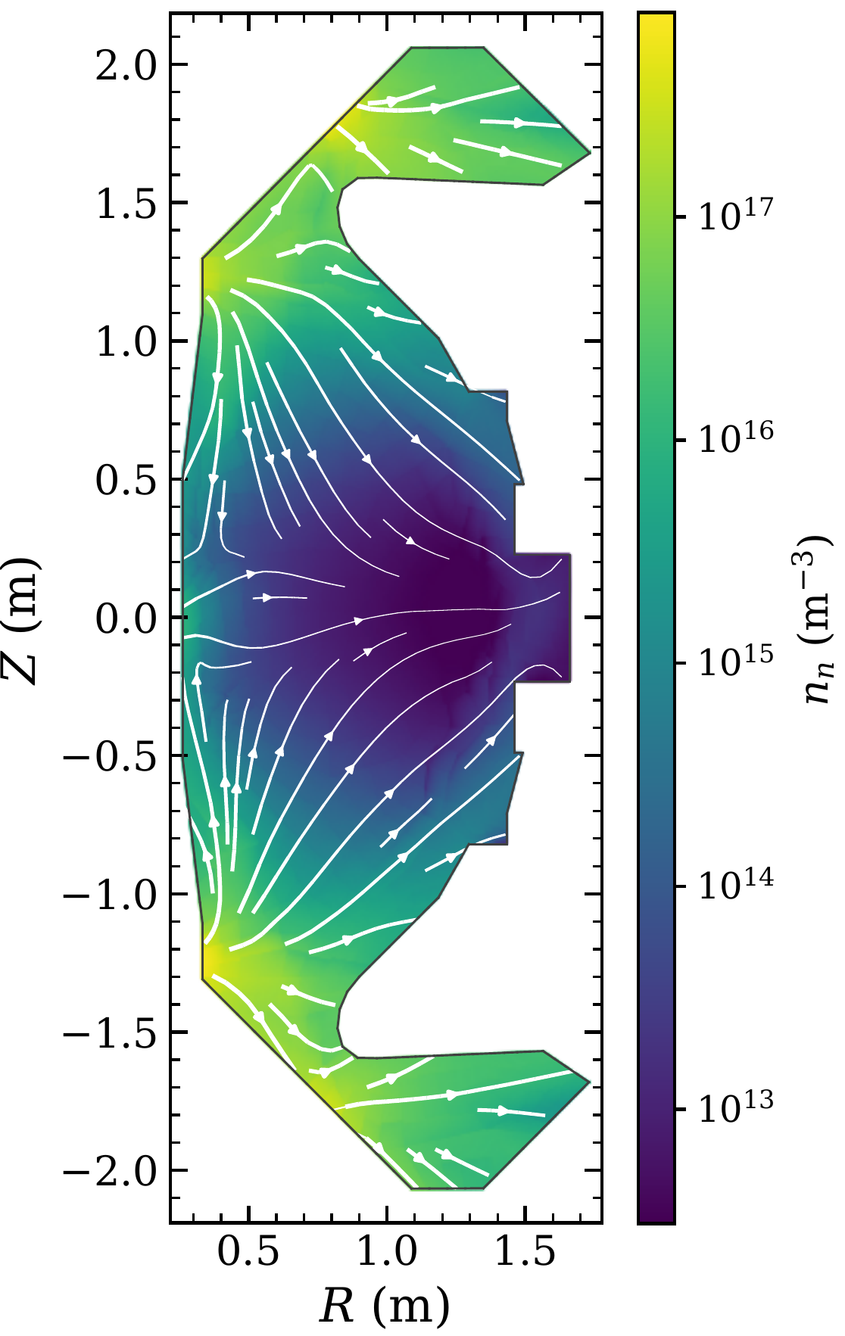
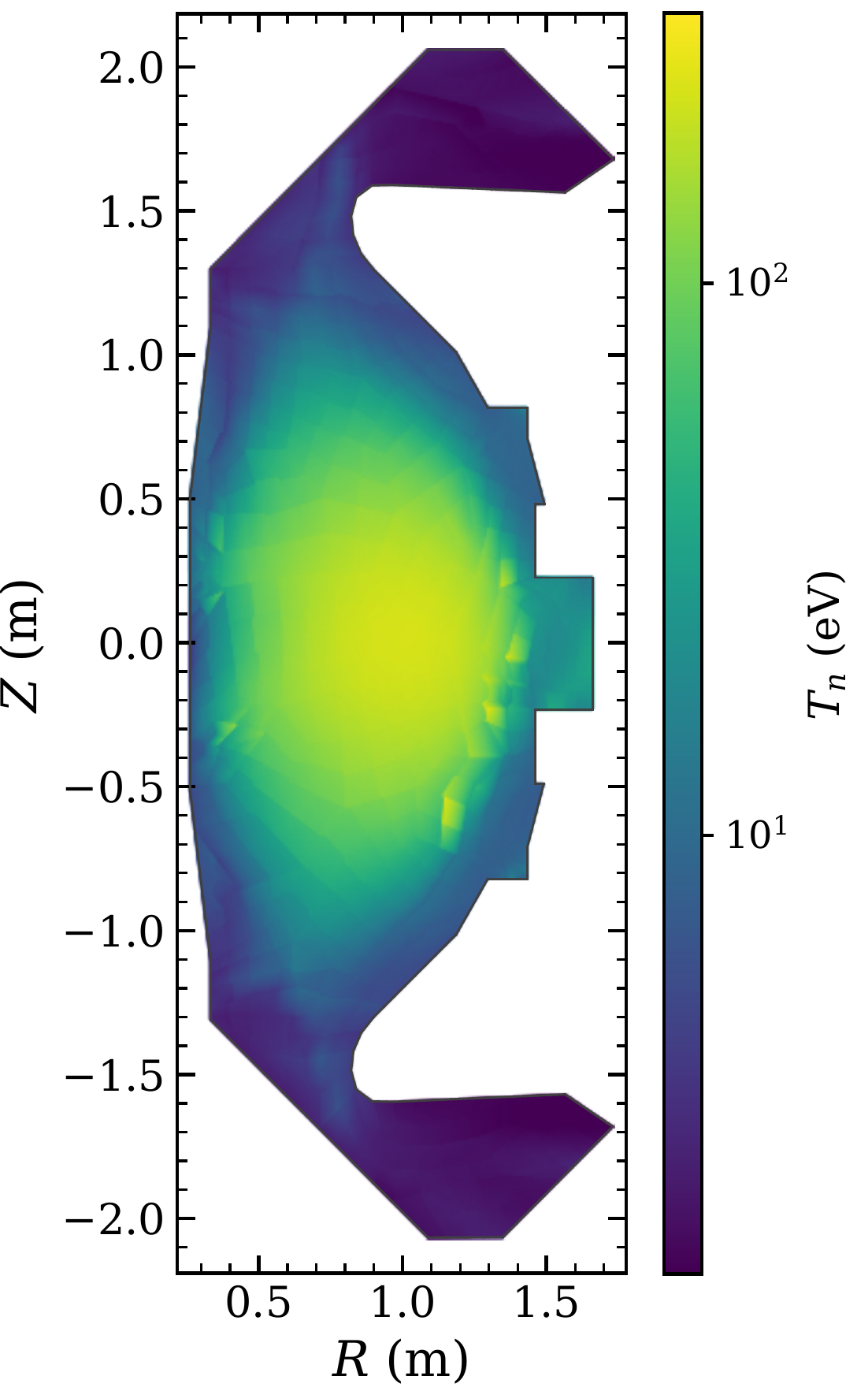
MAST-U Demonstration: Neutral Solution
Peak n_{n} = 8×10¹⁷ m⁻³ at the lower inner strike point
T_{n} from a few eV in the divertor chambers to > 100 eV in the core
Flux streamlines run from the strike points to the walls
Faint streaks from the strike points are ray effects
Neutral density
Neutral flux
Neutral temperature
Notes:
Steady-state neutral solution.
- Peak neutral density 8e17 m^-3 at the lower inner strike point.
- Neutral temperature goes from a few eV in the divertor chambers to above 100 eV in the core.
- Streamlines of the neutral flux run from the strike points through the domain to the walls.
- Faint streaks from the strike points follow the velocity-grid directions: ray effects, with about 1.6 velocity points per thermal speed of the 2 eV recycled neutrals.

Slide 24
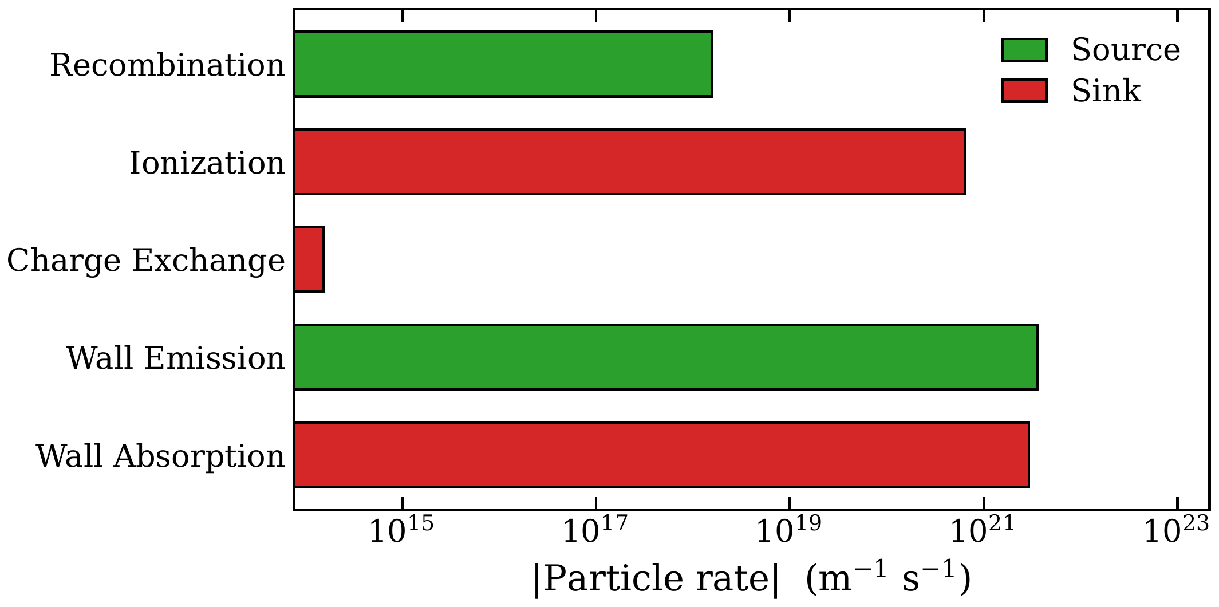
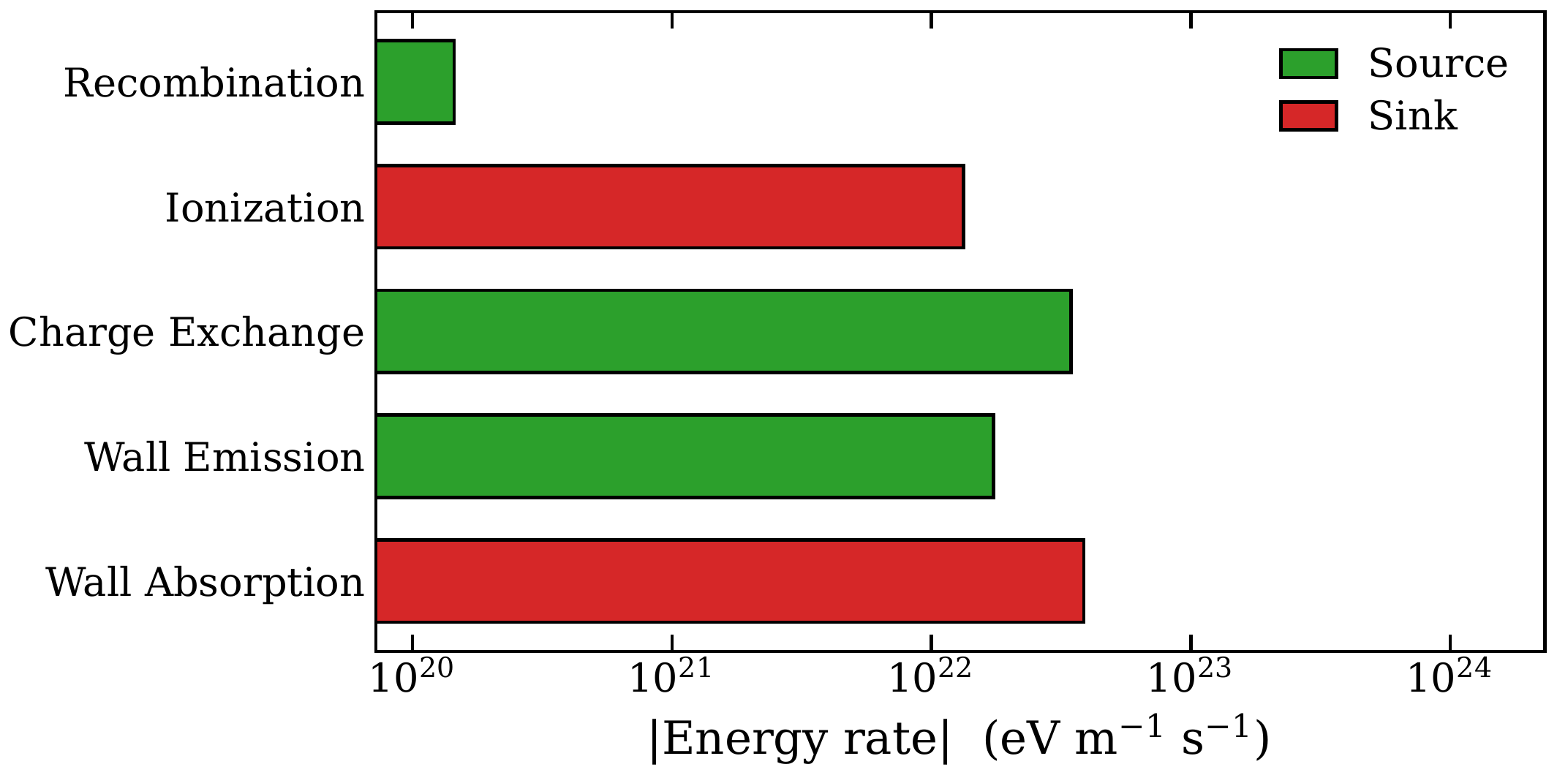
MAST-U Demonstration: Balance And Convergence
Ionization removes 18% of emitted neutrals; 82% are absorbed at the walls
Balances close to 3×10⁻⁹ relative
fp32: residual floor 5×10⁻⁷ to 8×10⁻⁶
fp64: residuals reach 4×10⁻¹⁴ – 10⁻¹²; density changes by 2×10⁻⁷
Residuals, fp32 (solid) and fp64 (dashed)
4,000 iterations: 86 min in fp32, 6.0 h in fp64
Notes:
Global particle and energy balance, and residual convergence.
- Ionization removes 18% of the emitted neutrals; the other 82% are absorbed at the walls.
- Particle and energy balances close to 3e-9 relative.
- 4,000 iterations: 86 min with the fp32 convolution, 6.0 h in double precision, for 8.6e8 phase-space DOFs and 18.8 of 24 GiB.
- Residuals drop about 8 orders of magnitude, then level off at the fp32 floor (5e-7 to 8e-6). In fp64 they continue to 4e-14 to 1e-12, and the density changes by only 2e-7.
- CX particle non-conservation is 4e-8 of the wall emission in fp32 against 3e-16 in fp64.

Slide 25
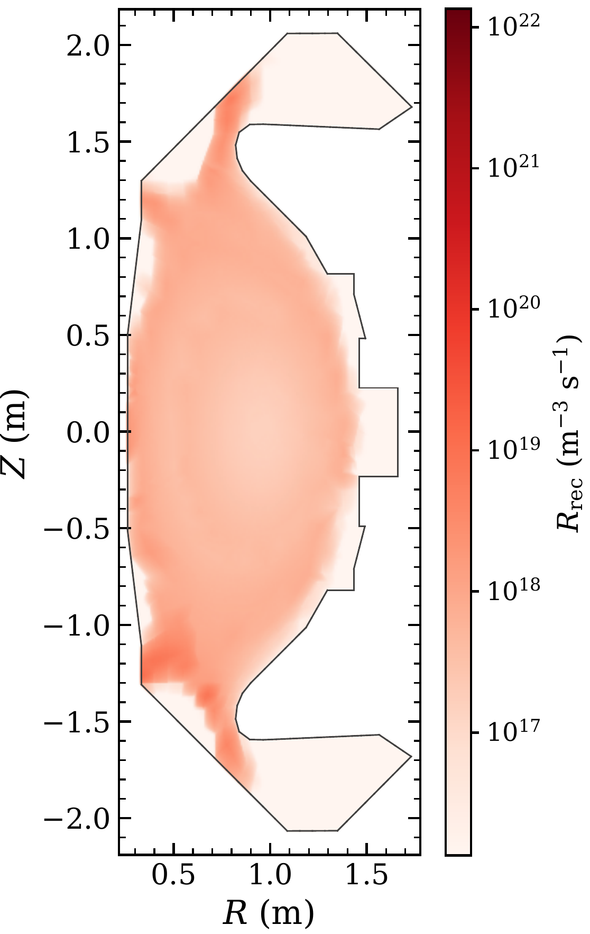
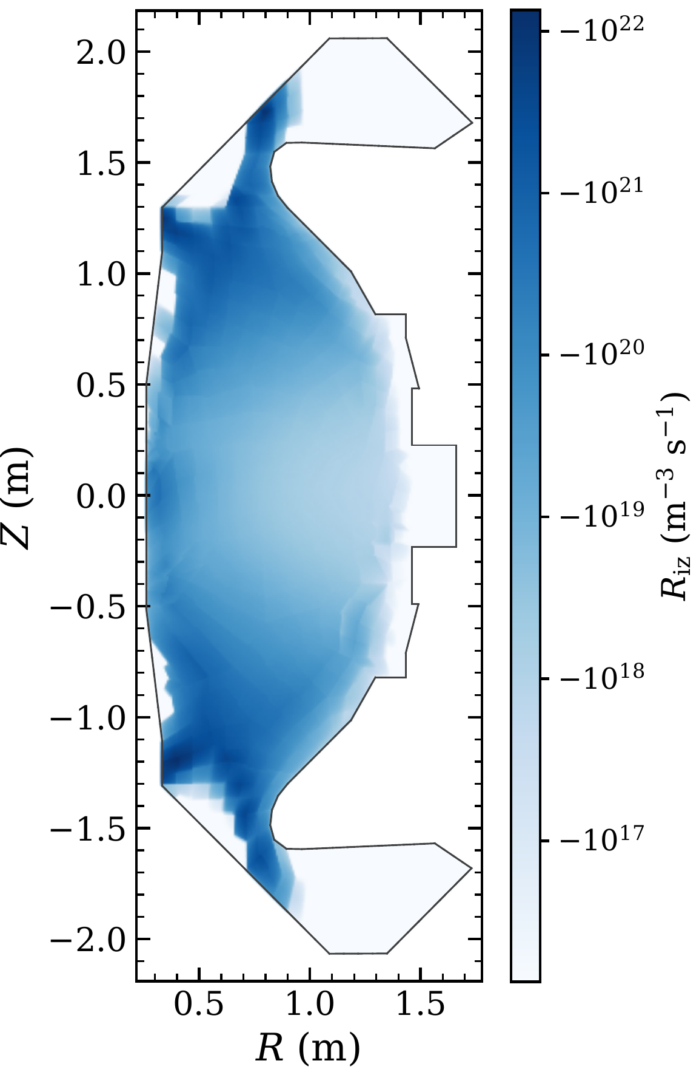
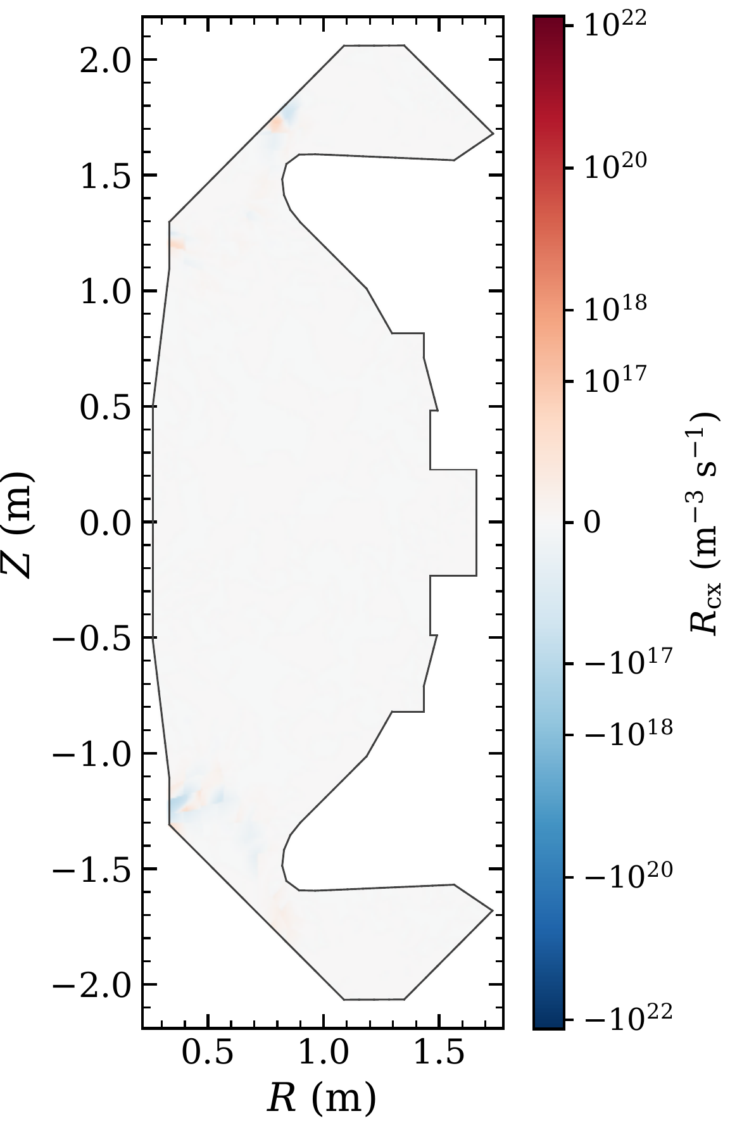
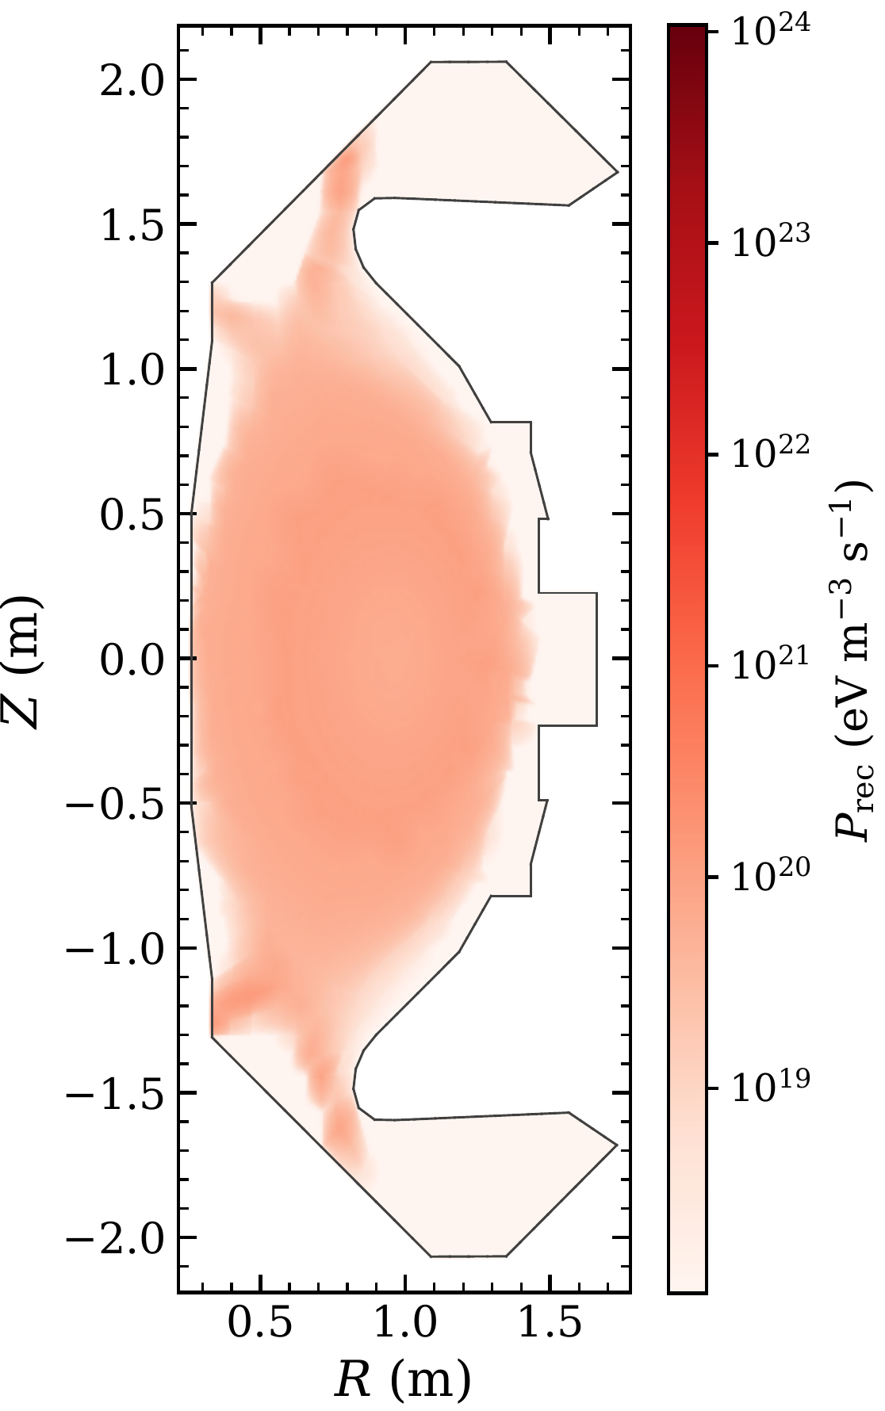
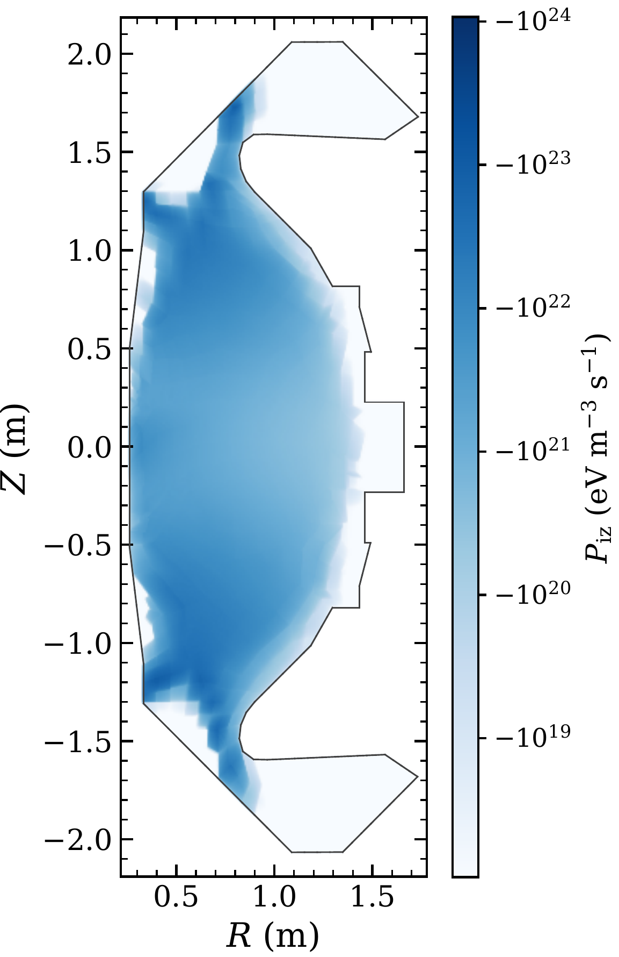
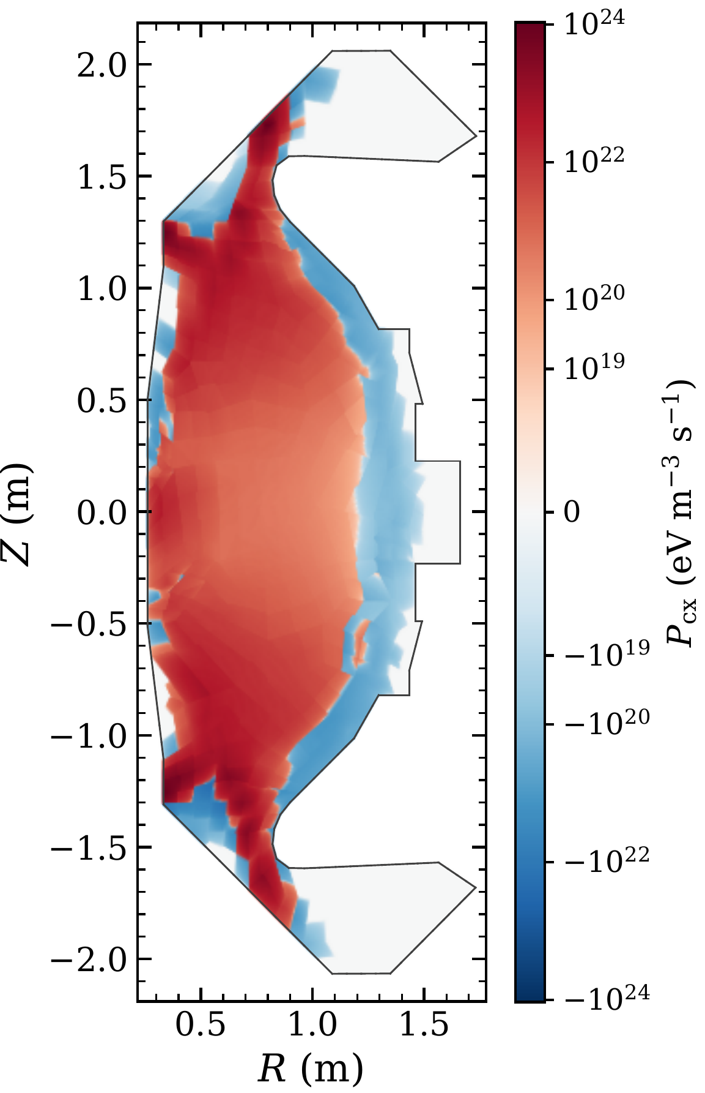
MAST-U Demonstration: Reaction Rates
Particle rates: recombination, ionization, charge exchange
Energy rates: recombination, ionization, charge exchange
Ionization is the main volumetric sink of neutral particles and energy
Charge exchange conserves particles (R_{cx} at round-off); in energy it is a source inside the plasma and a sink near the walls
Recombination is a small source; radiative only, three-body still to be added
Notes:
Steady-state particle (R) and energy (P) exchange rates for recombination, ionization and charge exchange. Red is a source for the neutrals, blue a sink.
- Ionization is the main volumetric sink of neutral particles and energy.
- Charge exchange conserves particles, so R_cx is at round-off (non-conservation is 4e-8 of the wall emission with the fp32 convolution). In energy it is a source for neutrals inside the plasma and a sink near the walls.
- Recombination is a small source. Only radiative recombination is included; three-body recombination is still to be added.

Slide 26
Fundamental Tradeoff Of Modeling
Speed
vs.
Accuracy
How can we get 2X3V kinetic neutrals fast without compromising accuracy?

