Slide 1
Progress of the drift and turbulence capabilities of Hermes-3 for non-axisymmetric geometries
T. Tork, D. Bold, B. Shanahan, D. Dudson, P. Hill, F. Reimold and the BOUT++/Hermes-Teams

Slide 2
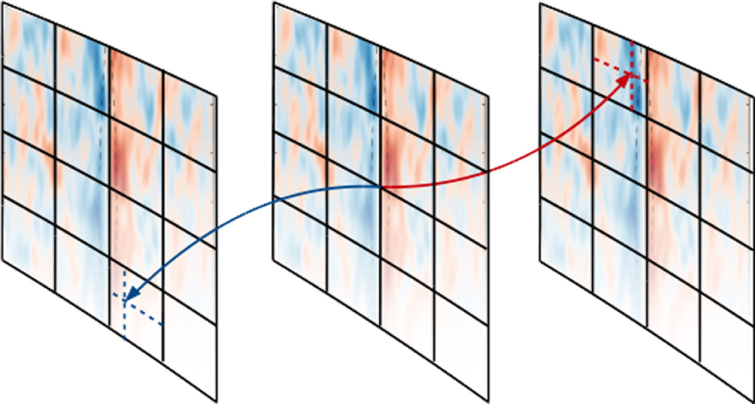
Flux-Coordinate Independent approach (FCI)
Decoupling of directions
      Poloidal (X-Z)
      Parallel (Y)
High poloidal but sparse parallel resolution
Cross sections are not connected in the y-direction (!)
      Different to FA
Parallel derivatives are done using interpolation and slices
Restriction on resolution
Field line tracing (maps)
P. Hill et al, CPP Volume 213, April 2017, Pages 9-18

Slide 3
Can it run turbulence?

Slide 4
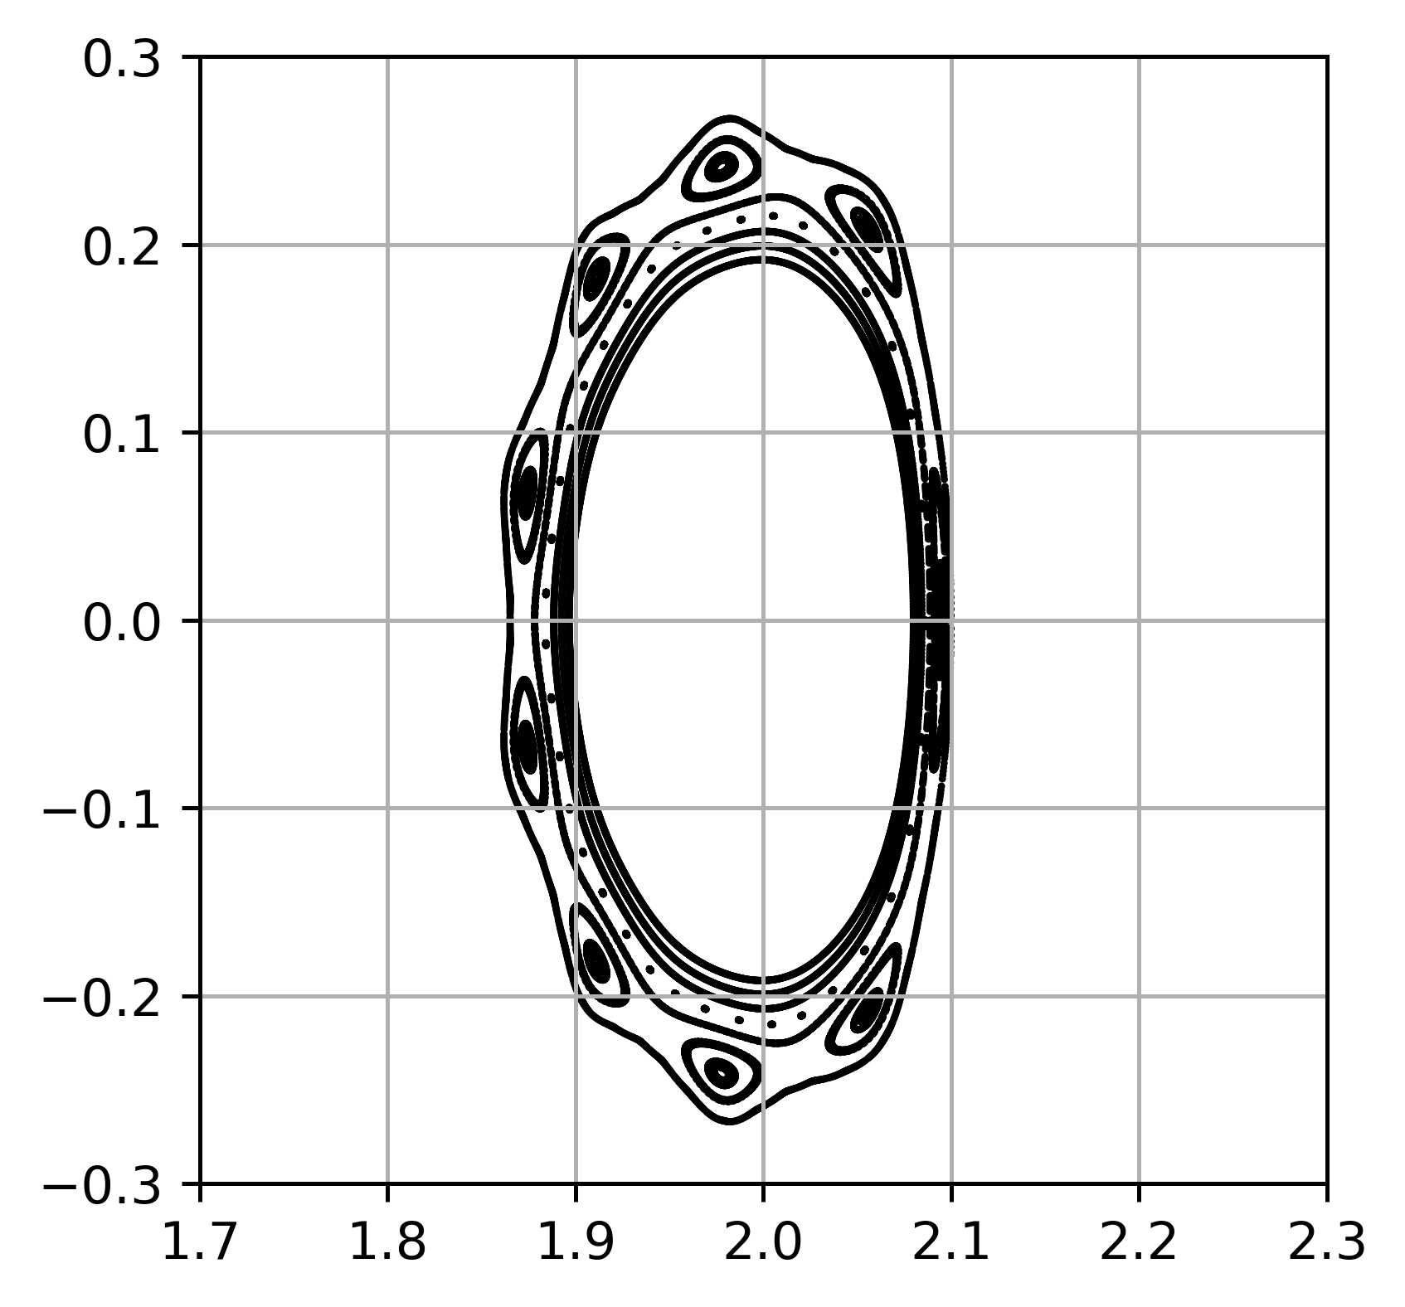
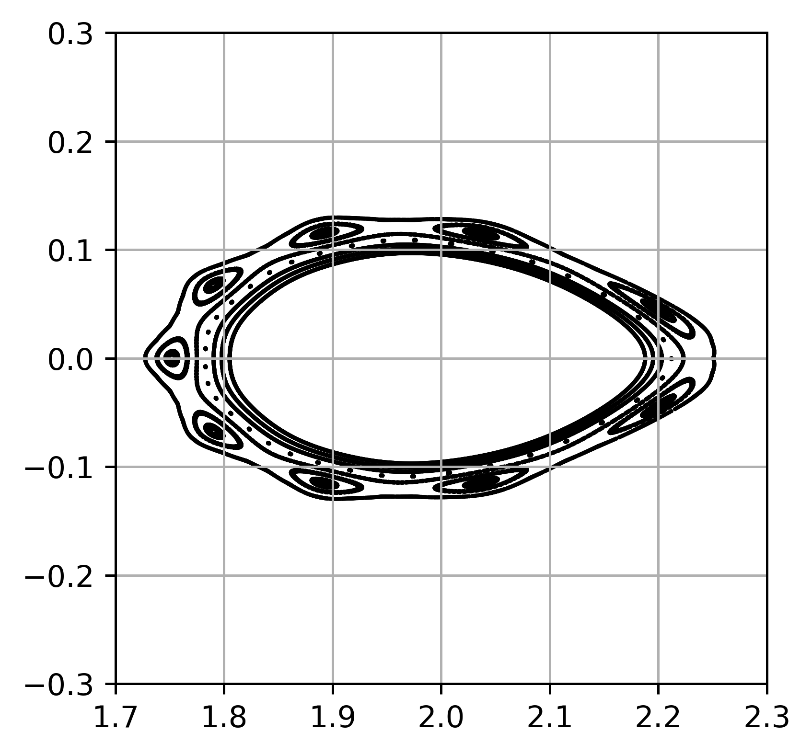
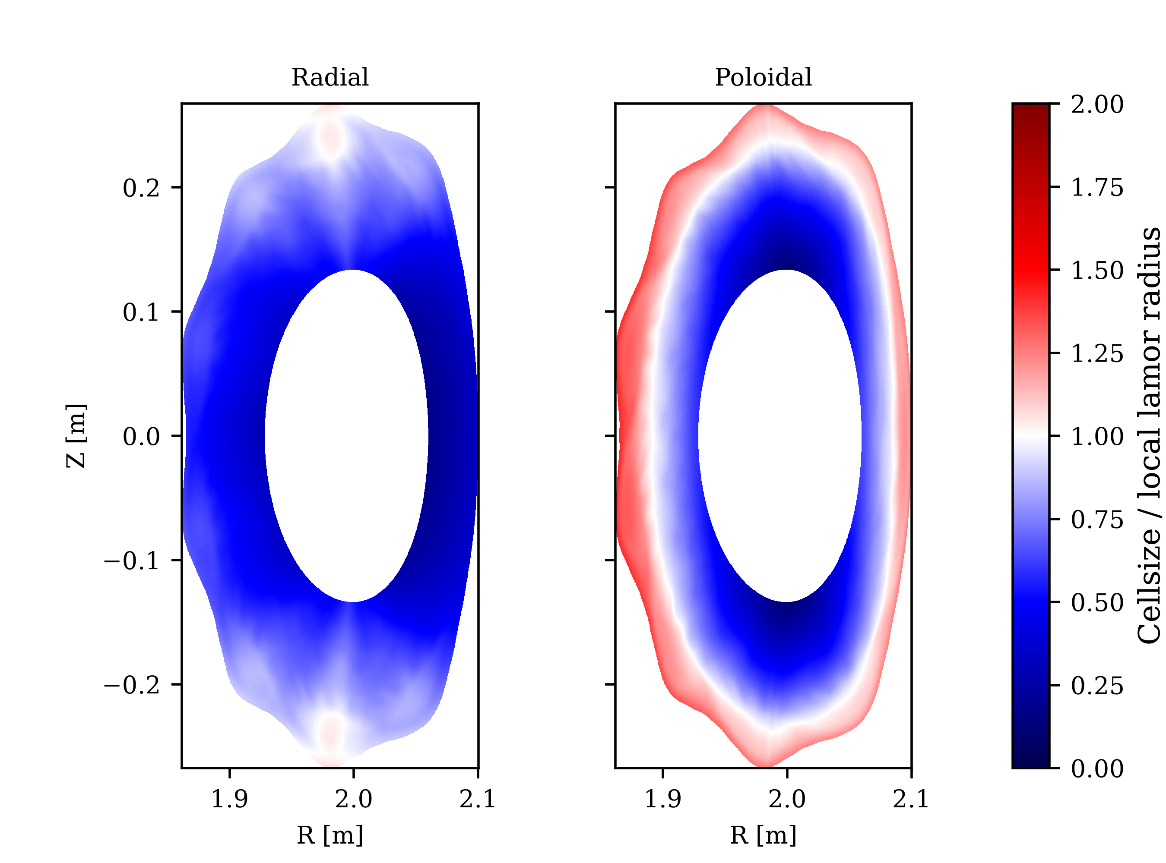


Turbulence in FCI
$$φ=0°$$
$$φ=36°$$
Magnetic field generated using Dommaschk potentials
9 magnetic islands
R = 2.0 m, B = 1.5 T
No divertor targets / sheath physics
Inner/Outer boundaries aligned with flux surfaces
Starting background taken from transport simulation
Zonal Neumann for BC of potential on the inner flux surface
Grid
128 x 8 x 1024
2 Nodes (256 cores total)
One module
Radial Cross sections Poloidal

Slide 5
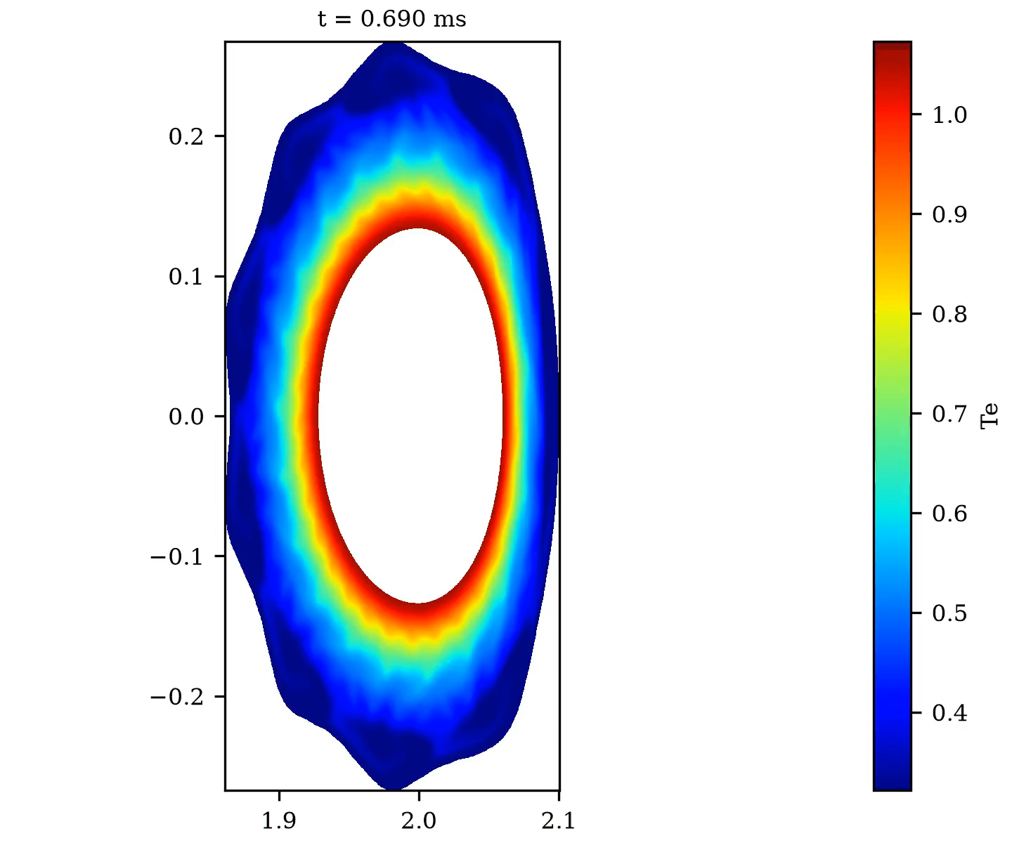
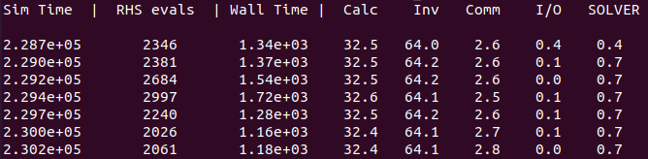
Turbulence in FCI
Magnetic field generated using Dommaschk potentials
9 magnetic islands
R = 0.2 m, r = 0.1 (half of W7-AS)
No divertor targets / sheath physics
Inner/Outer boundaries aligned with flux surfaces
Starting background taken from transport simulation
Zonal Neumann for BC of potential on the inner flux surface
Two inversions
Local Neumann
Zonal

Slide 6
Turbulence in FCI
Magnetic field generated using Dommaschk potentials
9 magnetic islands
R = 0.2 m, r = 0.1 (half of W7-AS)
No divertor targets / sheath physics
Inner/Outer boundaries aligned with flux surfaces
Starting background taken from transport simulation
Zonal Neumann for BC of potential on the inner flux surface
Takeaways
Turbulence is in a testable state
Why not apply it to a real W7-X geometry?
Efficiency has to be improved
Parallelization in Z
Preconditioning (e conduction)
Making the life of the solver easier
Two inversions
Local Neumann
Zonal

Slide 7
Grid generation and flexiblity

Slide 8
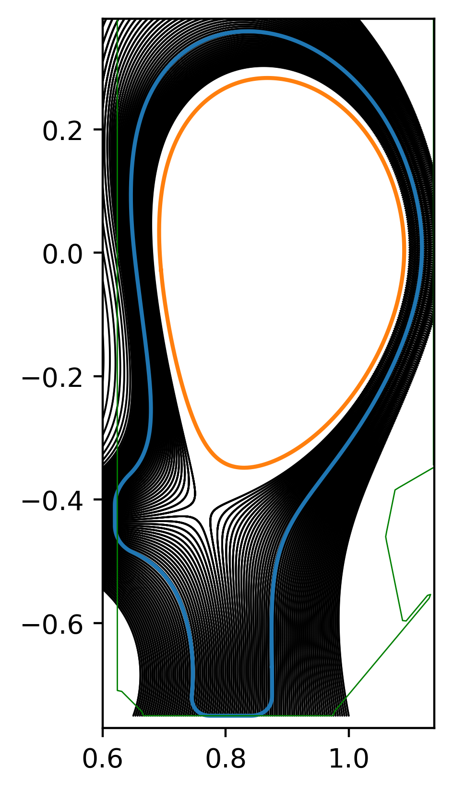
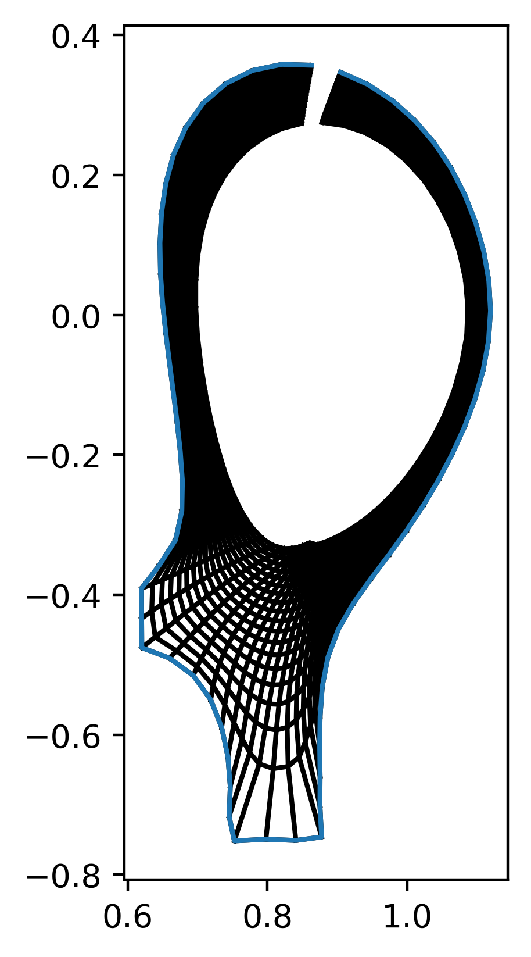
Toy problem: TCV X-21
Curvilinear grids
Solve elliptic equation between inner and outer line
Problems when normal of the core is tangential to the outer line when projected
Works for open divertors (like current W7-X) but not for closed divertors or long divertor legs in tokamaks
Can be addressed with altering the elliptic grid solver
“Radial” number of cells the same for each poloidal angle

Slide 9
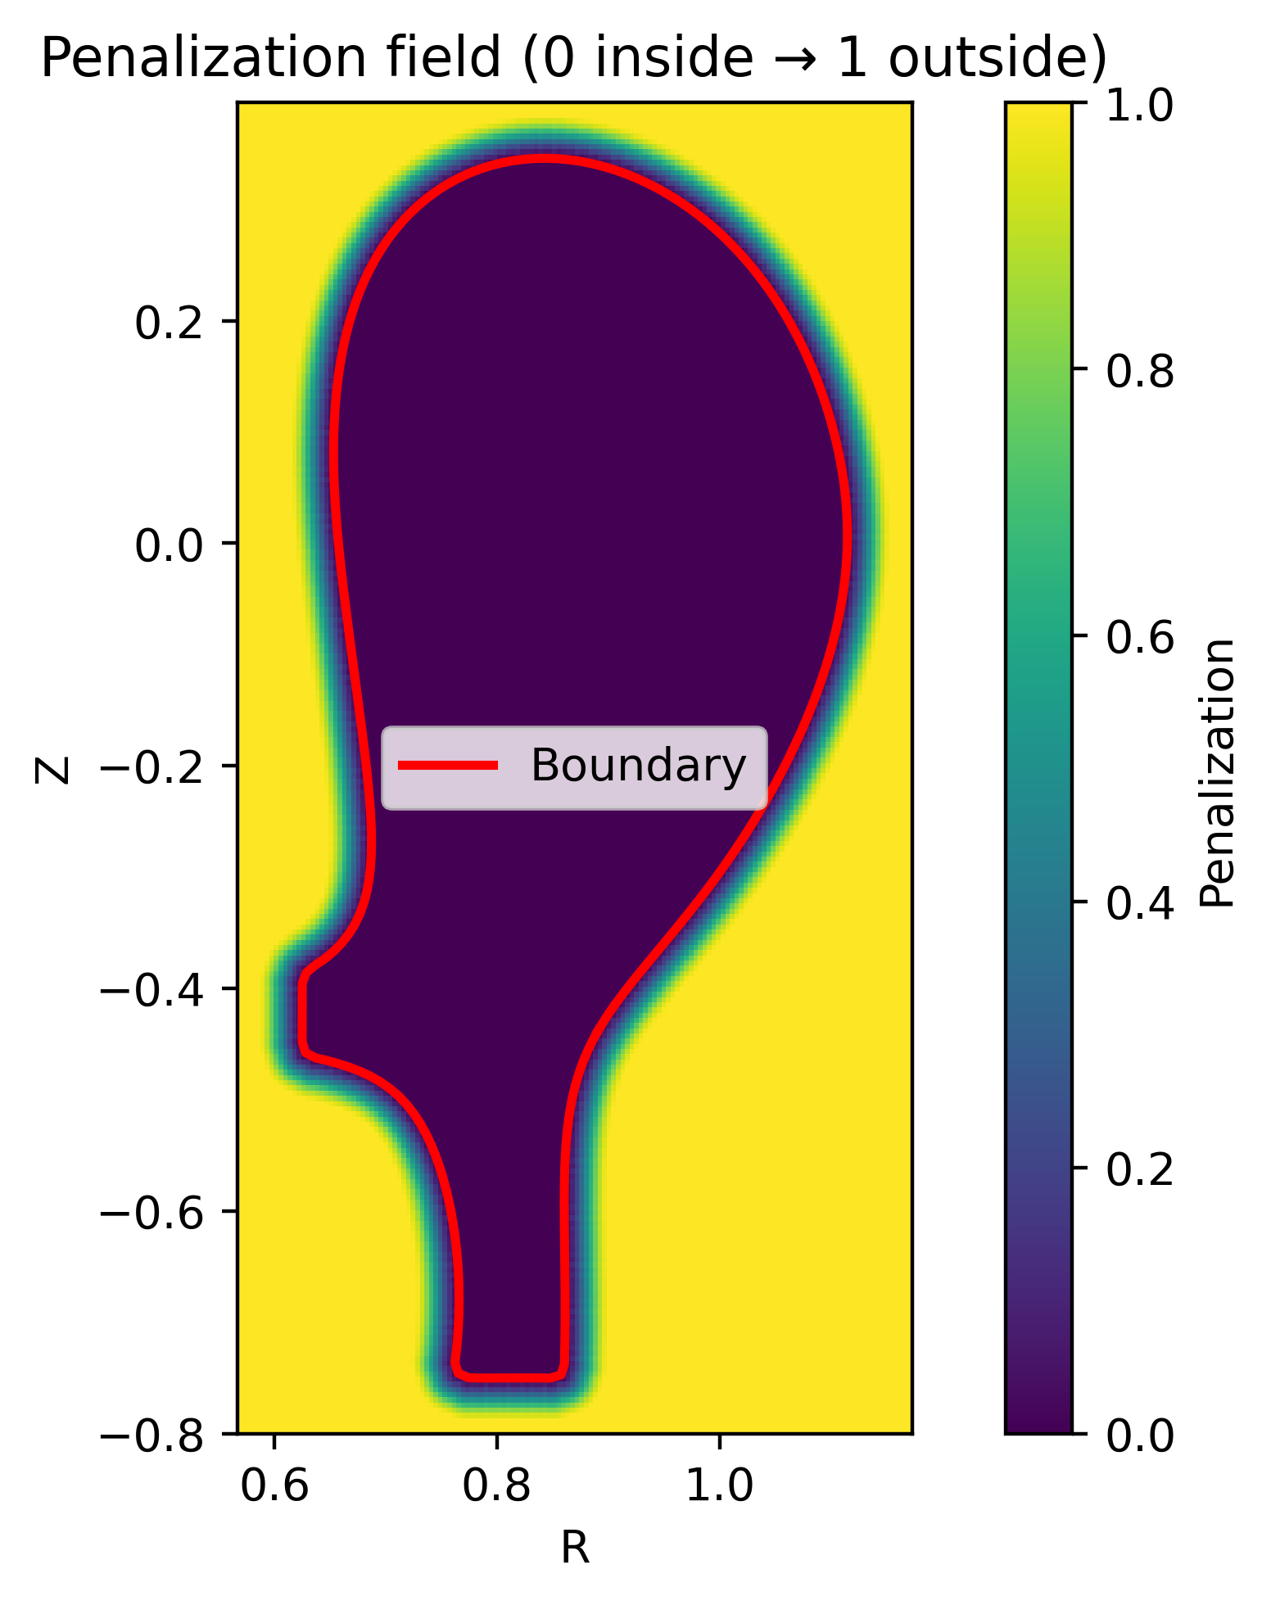
Toy problem: TCV X-21
Penalization
Impose boundaries by altering your equations
Smooth penalization function
Outer boundary is not exactly localized anymore
Create arbitrary shapes

Slide 10
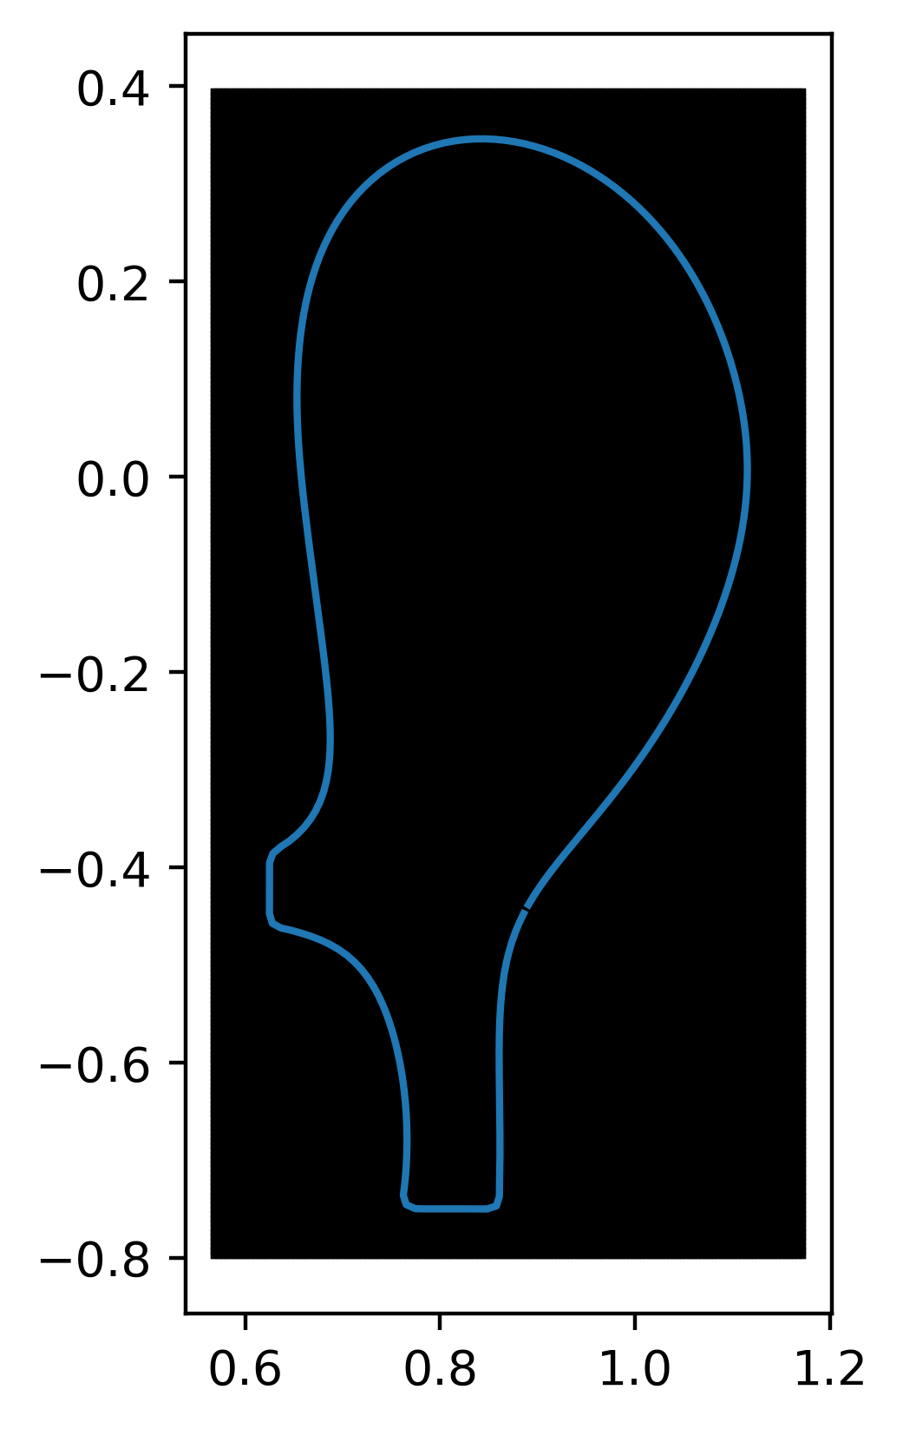
Toy problem: TCV X-21
Create rectangular grid with penalization
Parallel derivatives still work because of Fci
Simulating “dead” area, should not govern the time step but increases number of CPUs needed
Slab grids are numerically easier (no derivatives in metric coefficients)
We simulate the core
  No core boundary conditions required ☺

Slide 11
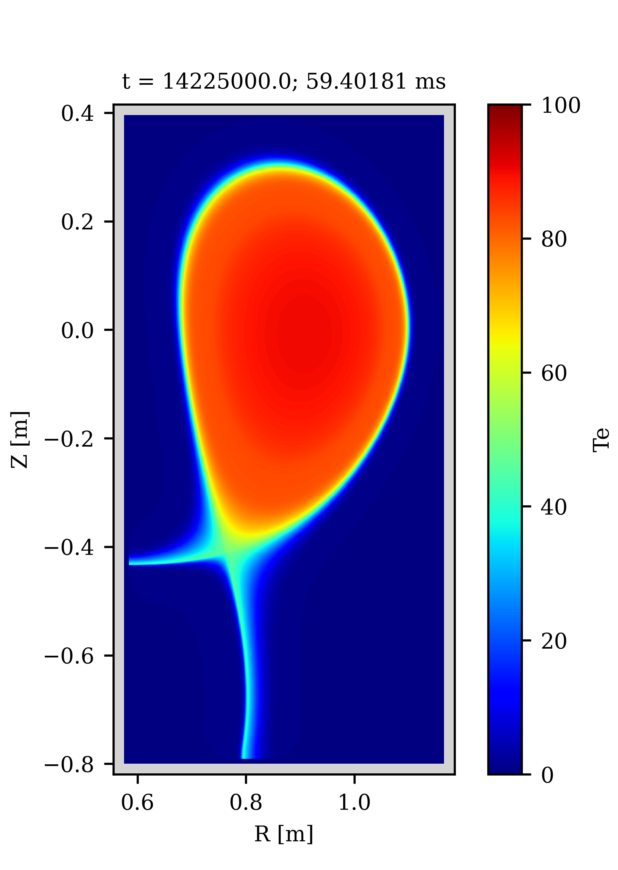
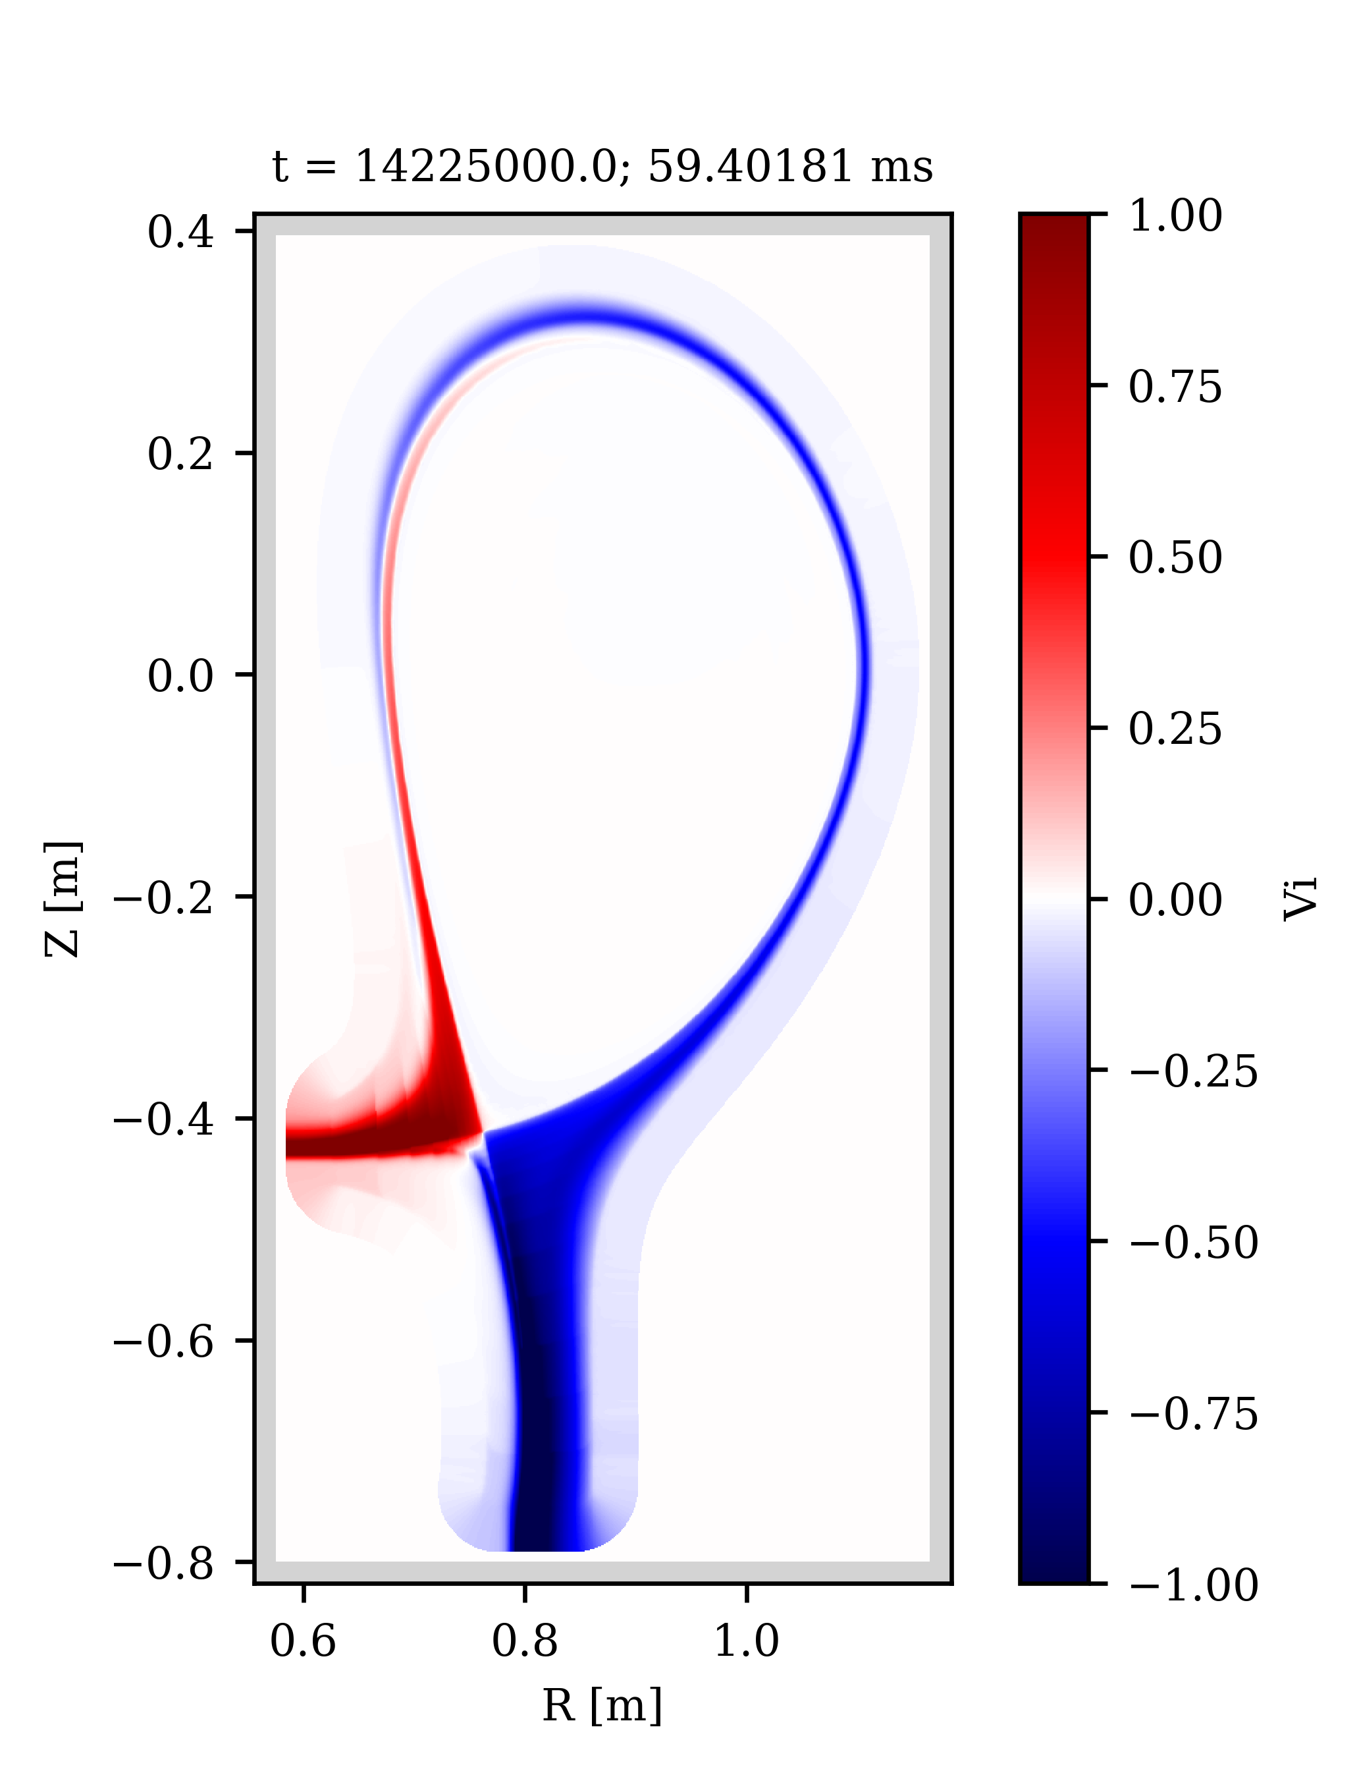
Toy problem: TCV X-21
But can it actually run?
Without drifts

Slide 12
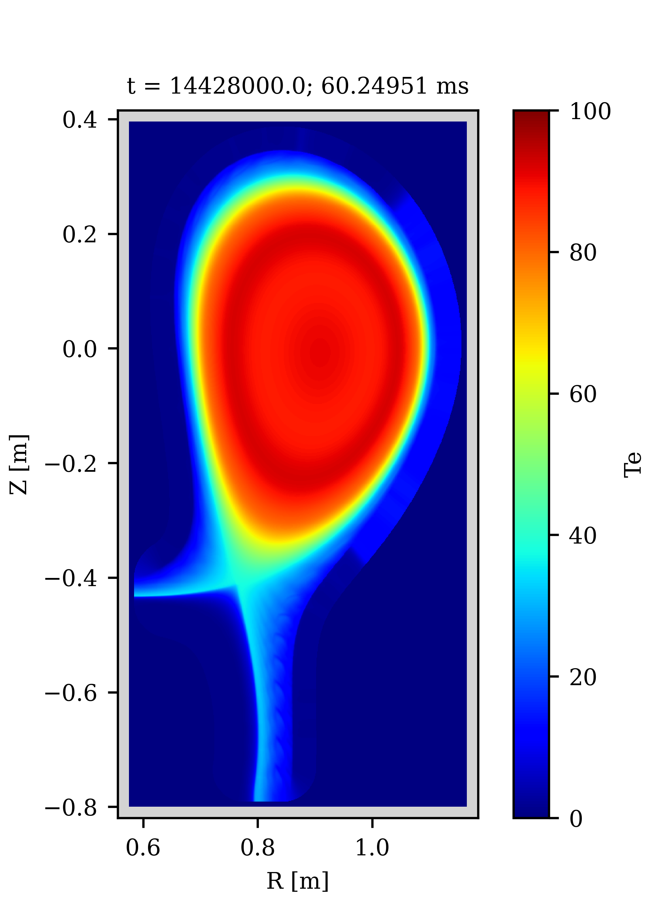
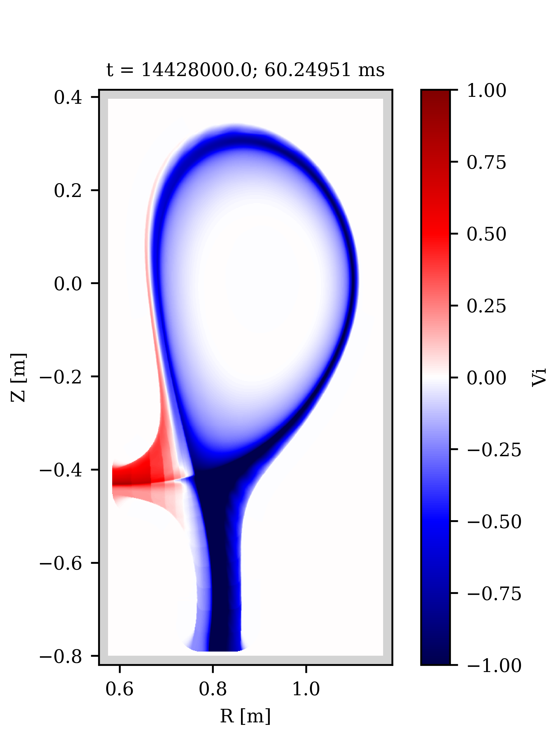
Toy problem: TCV X-21
But can it actually run?
Alternative: Unstructured grids
See D. Bold’s poster
Without drifts
With drifts

Slide 13
The drift model

Slide 14
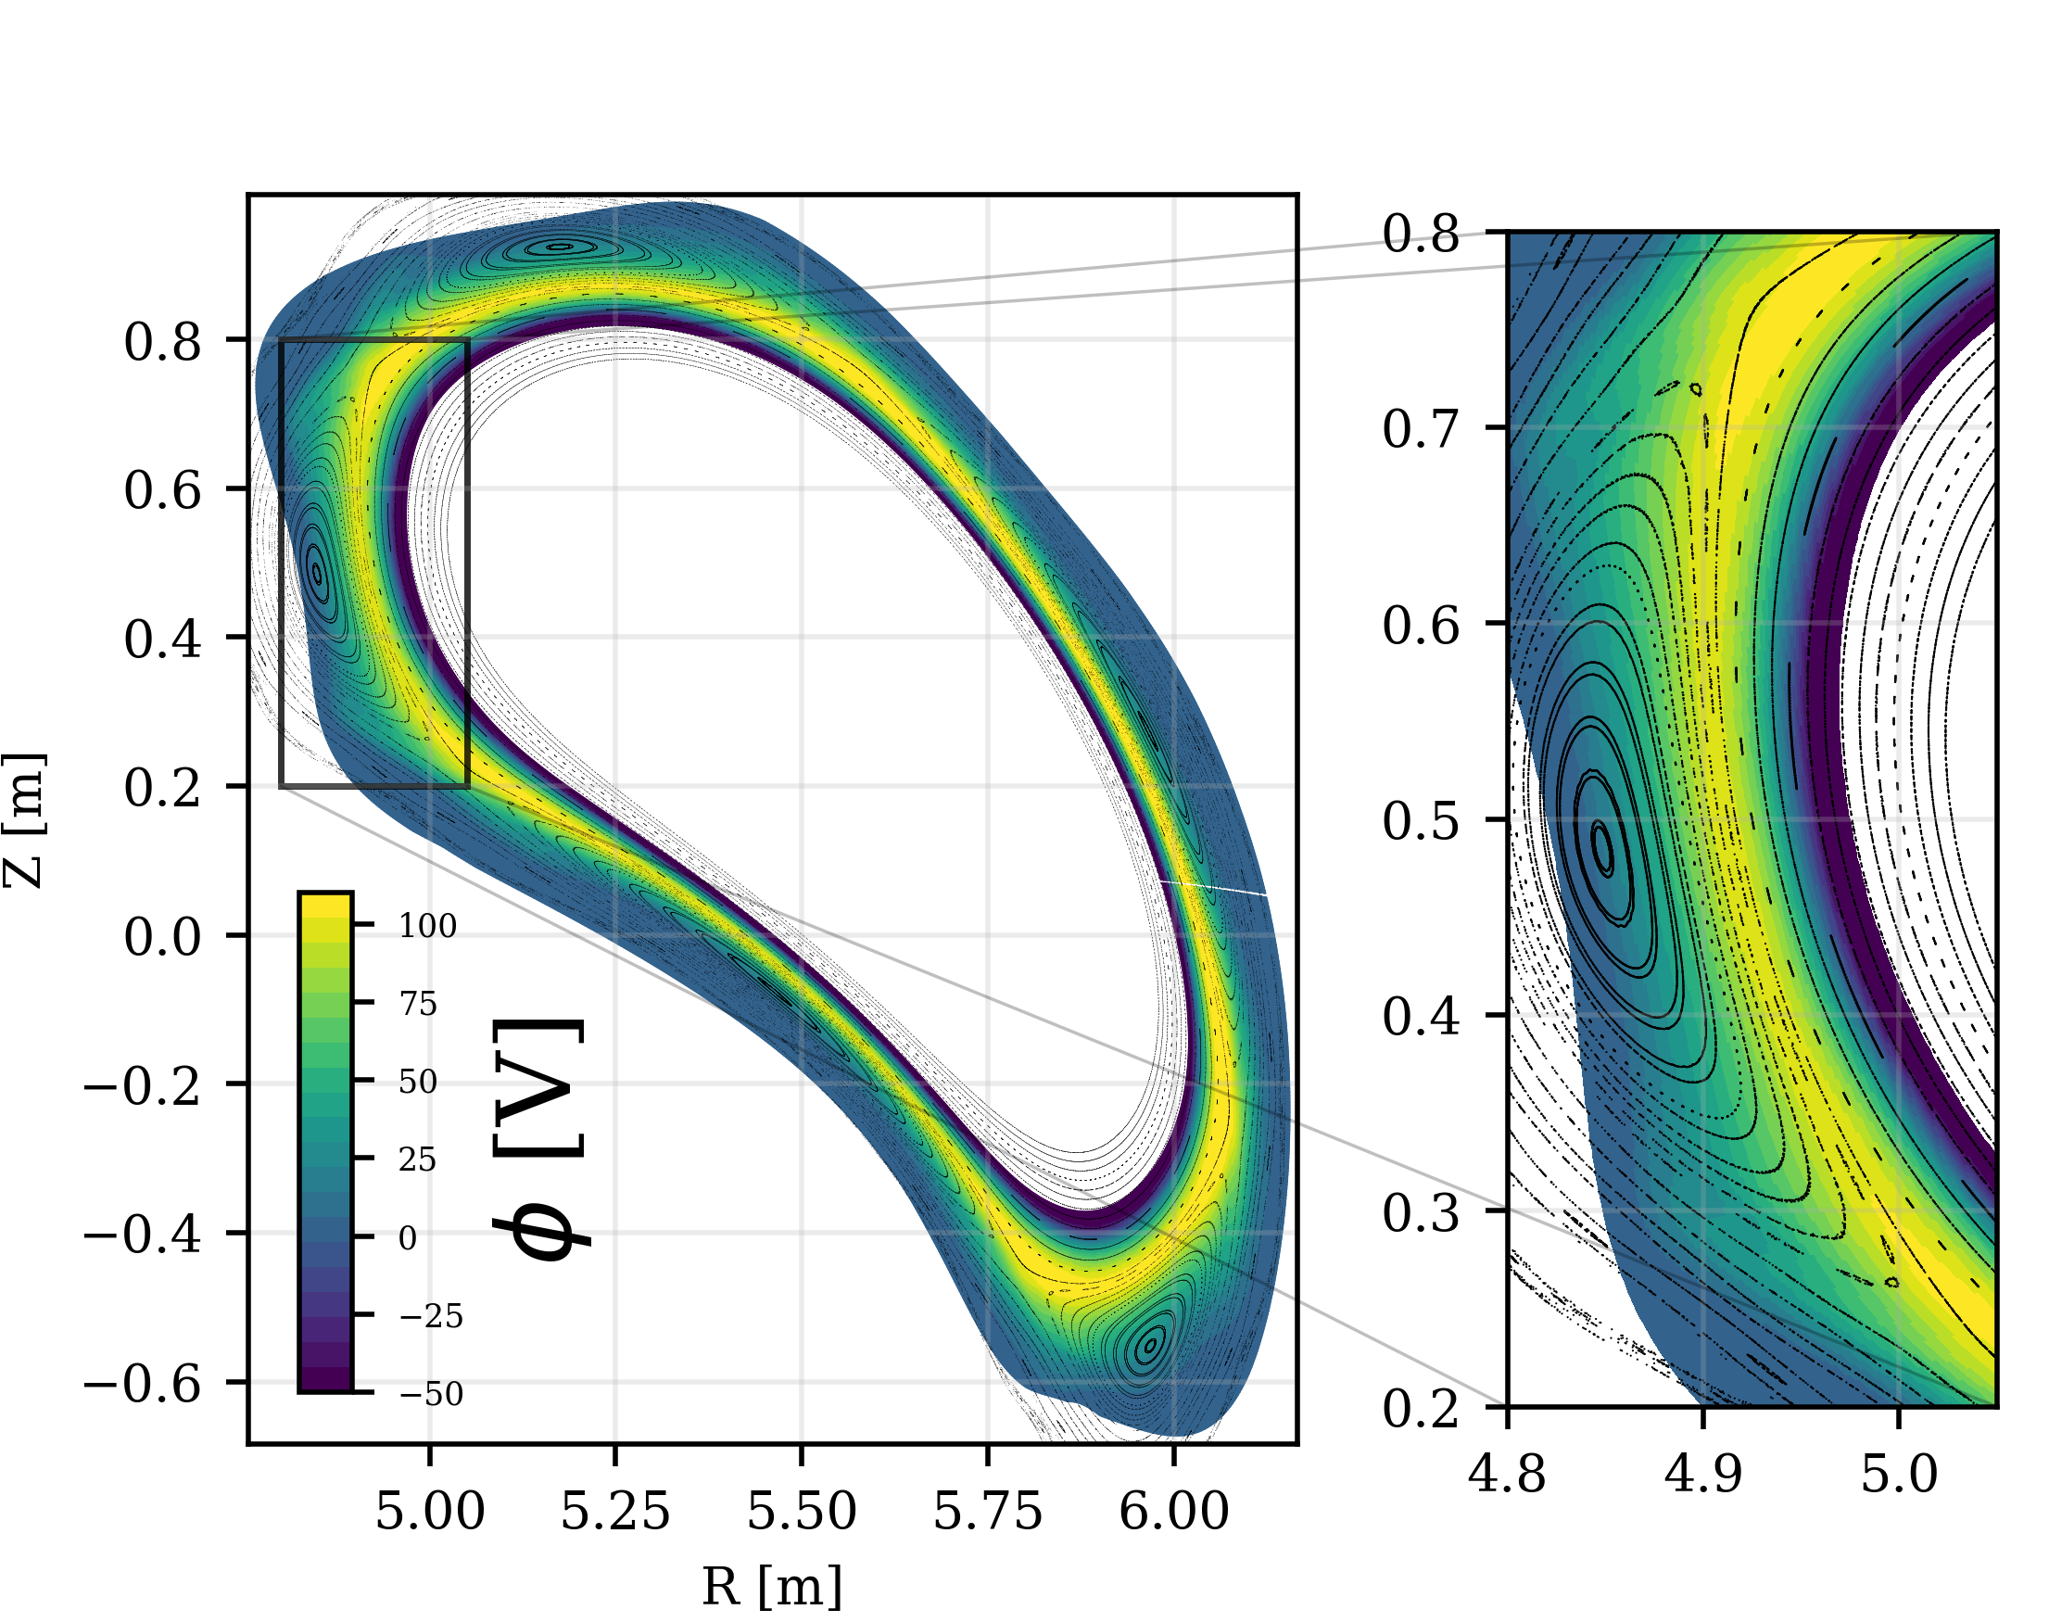
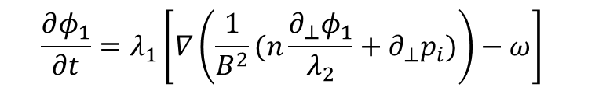
The drift model
More details on the model at B. Dudson’s talk
      $$\frac{∂φ_{1}}{∂t}=λ_{1}\left[∇\left(\frac{1}{B^{2}}(n\frac{∂_{⊥}φ_{1}}{λ_{2}}+∂_{⊥}p_{i})\right)−ω\right]$$
Calculate potential profile on constant plasma background
Effect on background still missing
[T. Tork et al., 2026 CPP, https://doi.org/10.1002/ctpp.70157]

Slide 15
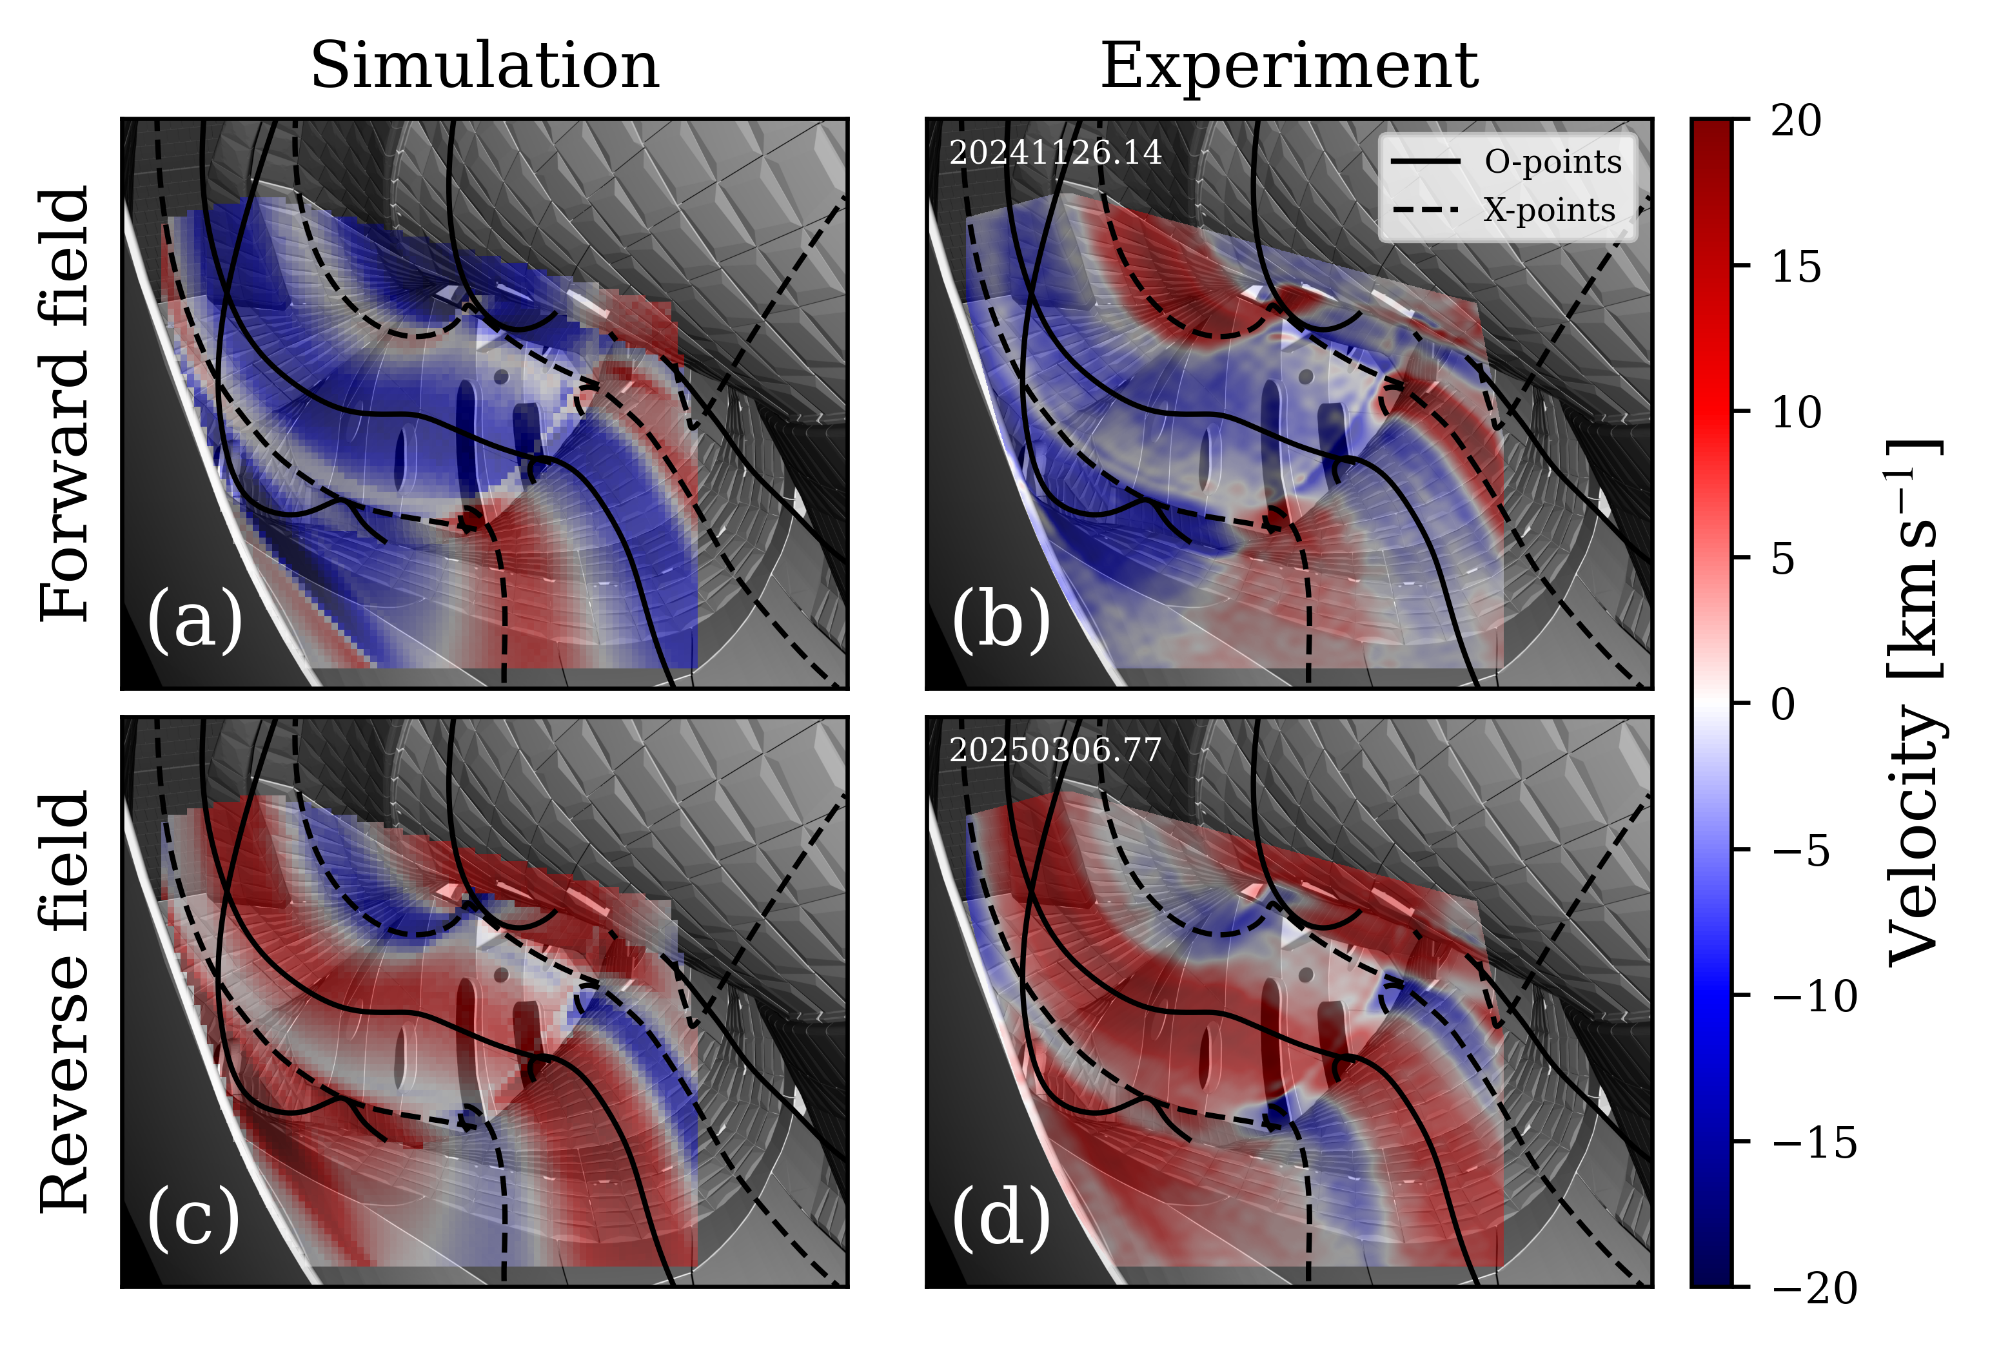
The drift model
More details on the model at B. Dudson’s talk
      $$\frac{∂φ_{1}}{∂t}=λ_{1}\left[∇\left(\frac{1}{B^{2}}(n\frac{∂_{⊥}φ_{1}}{λ_{2}}+∂_{⊥}p_{i})\right)−ω\right]$$
Calculate potential profile on constant plasma background
Effect on background still missing
Include effect of ExB & dia. Drifts on plasma profiles
Dampening of linear growth rates [Estevao Gomez, Master’s thesis, IPP Garching]
[T. Tork et al., 2026 CPP, https://doi.org/10.1002/ctpp.70157]
[T. Tork et al., 2026 submitted]

Slide 16
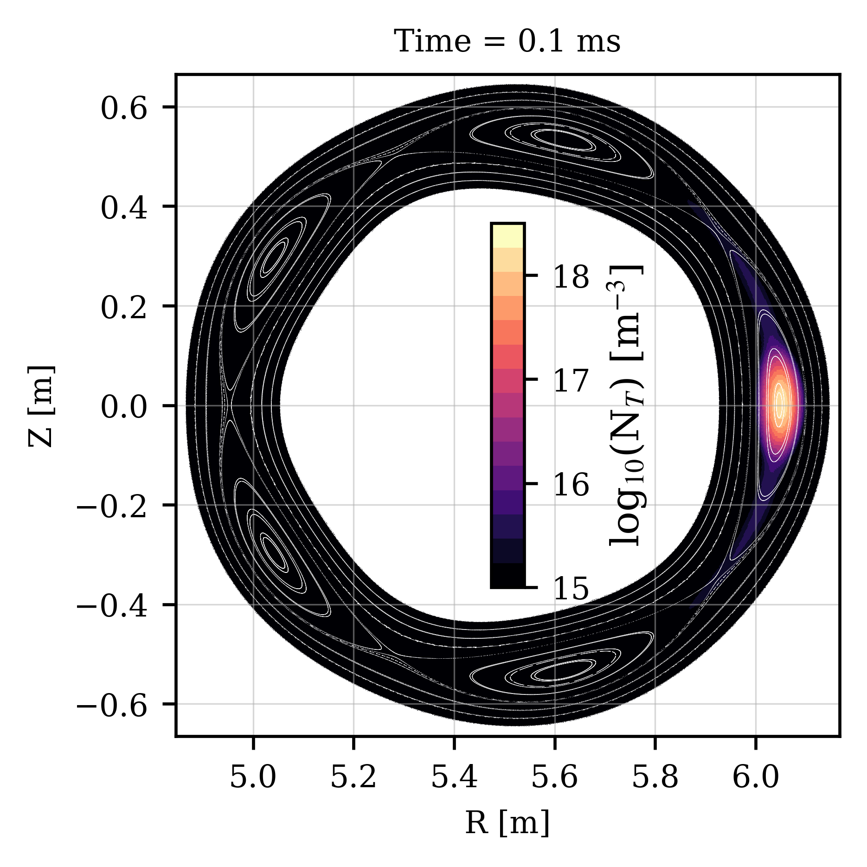
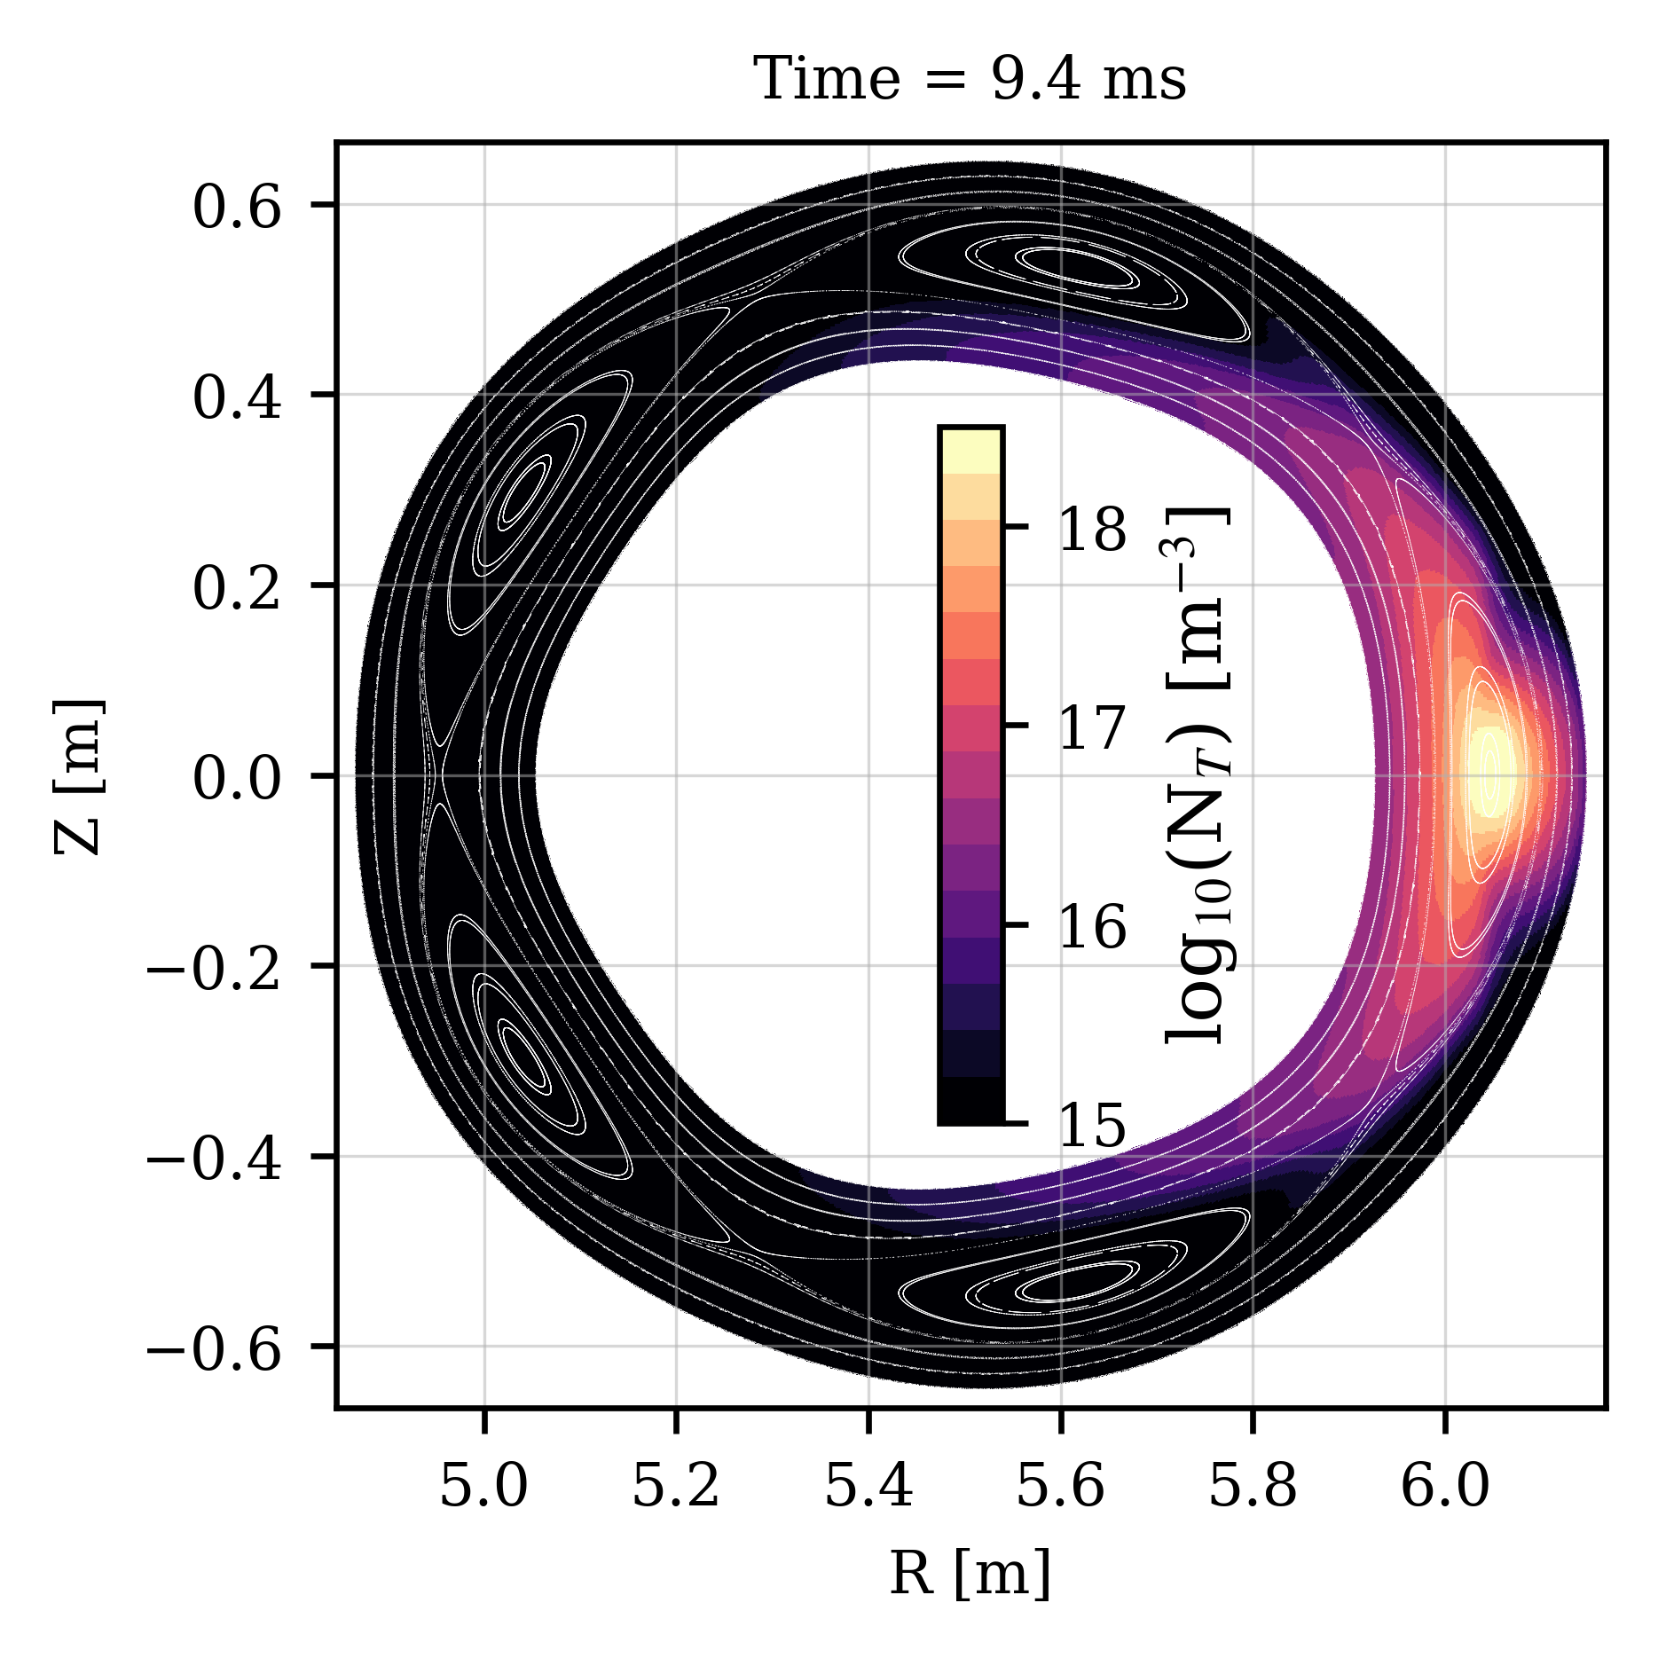

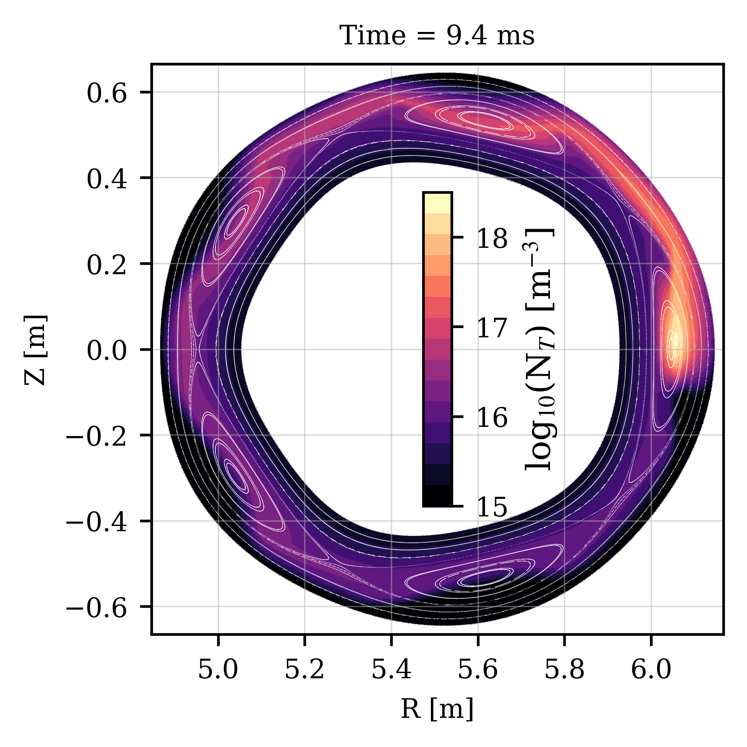
The drift model
More details on the model at B. Dudson’s talk
      $$\frac{∂φ_{1}}{∂t}=λ_{1}\left[∇\left(\frac{1}{B^{2}}(n\frac{∂_{⊥}φ_{1}}{λ_{2}}+∂_{⊥}p_{i})\right)−ω\right]$$
Calculate potential profile on constant plasma background
Effect on background still missing
Include effect of ExB & dia. Drifts on plasma profiles
Dampening of linear growth rates [Estevao Gomez, Master’s thesis, IPP Garching]
Trace density transport in island diverted stellarators
Only trace diffusion
Diffusion and ExB drift
[T. Tork et al., 2026 CPP, https://doi.org/10.1002/ctpp.70157]
[T. Tork et al., 2026 submitted]
[T. Tork et al., 2026 submitted]

Slide 17
Current status of FCI in Hermes-3 Master

Slide 18
Current status of FCI in Hermes-3 Master
EEEvolve density / pressure / momentum
PR633 ✓
Braginskii conduction
PR644 ✓
Sheath boundaries
PR662 🔧
Transport w/ Drifts
Turbulence
PR643 ✓
Anomalous diffusion
Vorticity / Diamagnetic drift / ExB
PR664 🔧
PR???
Neutral model
Electromagnetic
PR???
PR???
Potential relaxation

