Slide 1
Old Solver, New Tricks
Modernizing and developing the UEDGE codebase in the age of AI
UKAEA Exhaust Code Workshop 2026
A. Holm on behalf of the UEDGE Team
October 9th, 2026

Slide 2
UEDGE is a 2D multi-fluid, edge-plasma code with a fully time-implicit solver, written in Fortran and ported to Python
2020-2025
Nonorthogonal grids (1996) [3]
2015-2020
Implicit coupling attempts to DEGAS2
(2015-2017) [12]
Multi-charge state impurity models (1996) [2,4]
Cross-field drift implementation (1999) [5]
2000-2005
Explicit coupling to DEGAS2 (2000) [7]
2005-2015
Initial Python interface (2007) [10]
Snowflake capabilities introduced (2007) [11]
Attempts at core-edge coupling for whole-device modeling FACETS project (2008) [10]
UEDGE made publicly available on GitHub with Python interface [13]
Fluid molecular model (2021) [14, 15]
Neutral temperature equations (2021) [16]
Ion anisotropy model (2021) [16]
Python interfacing using UETOOLS (2023) [19]
1992-2000
Solver and preconditioner improvements [2]
2025-
Teletransport model [20]
OpenMP parallelization of preconditioner and RHS (2025) [21]
Advanced fluid neutral boundary condition implementation
Grid extensions to device walls
Code modernization and agentic workflows
Double null capabilities (1999) [6]
First UEDGE user manual revision published (2000) [8]
MPI parallelization using Fortran-C interface and KINSOL package (2002) [9]
Increased use training surrogate models [17, 18]
Branched off Braams’ B2 in 1992 [1], developed over 35 years
[1] T.D. Rognlien, et al., J. Nucl. Mater. 196 (1992) 347
[2] G.R. Smith, et al., J. Nucl. Mater. 220 (1995) 1024
[3] M.E. Rensink, T.D. Rognlien, LLNL report doi.org/10.2172/371415
[4] T.D. Rognlien, et al., Contrib. Plasma Phys. 34 (1994) 362
[5] T.D. Rognlien, et al., Phys. Plasmas 6 (1999) 1851
[6] M.E. Rensink, et al., Contrib. Plasma Phys. 40 (2000) 302
[7] D.P. Stotler et al., Contrib. Plasma Phys. 40 (2000) 221
[8] T.D. Rognlien, et al., LLNL Report, OSTI ID 15007243
[9] T.D. Rognlien, et al., J. Comp. Phys., 175 (2002) 249
[10] J.R. Cary, et al., J. Phys.: Conf. Ser. 125 (2008) 012040
[11] D.D. Ryutov, Phys. Plasmas, 14 (2007) 064502
[12] I. Joseph et al., Nucl. Mater. Energy, 12 (2017) 813
[13] T.D. Rognlien, et al., LLNL Software (LLNL-CODE-845914), github.com/LLNL/UEDGE
[14] A. Holm A, et al., Contrib. Plasma Phys., 60 (2020) e201900150
[15] A. Holm, et al., Nucl. Mater. Energy, 27 (2021) 100982
[16] M. Zhao, et al., Nucl Mater. Energy, 26 (2021) 100881
[17] B. Zhu, et al., J. Plasma Phys. 88 (2022) 905880504
[18] B. Zhu, et al., Phys. Plasmas, 32 (2024) 062508
[19] A. Holm, et al., LLNL Software (LLNL-CODE-846751), github.com/LLNL/UETOOLS
[20] M. Zhao, et al., Contrib. Plasma Phys., preprint (2026) e70093
[21] A. Holm, et al., Contrib. Plasma Phys., preprint (2026) e70135

Slide 3
Development driven by tight code-experiment validation loops and applications to various geometries and devices
Agile and adaptable code, responsive to experimental results
  Routine validation with DIII-D, C-mod, and NSTX
  Also used to model JET, JT60, KSTAR, ITER, K-DEMO, ARC, SPARC, FSNF, …
Experimental data
Code Validation
New capability
Code more adaptable
Complexity increases
Tech debt accumulates
Harder to extend
New capability
Virtuous
cycle
Vicious
cycle
Notes:
Unmanaged growth→ complexity → risk for tech-debt spiral
E-type software: Continuing change, increasing complexity, conservation of familiarity, continuing growth, declining quality

Slide 4
UEDGE has evolved into a tightly coupled end-to-end workflow tied together by common coupling
Organic growth concentrated in a few subroutines
  Convoluted coding with order-dependent execution
  No entry points for unit testing
NKSOL, VSODE, etc.
Preconditioner
ODE solver
UEDGE
UETOOLS
Human-readable input files
Automated provenance
Interfacing with Python packages
Grid generation
Grid from equilibria & setup
Stenciling
Metrics and geometric coefficients
Physics model
Plasma transport
Impurity model
Neutral model
Stored to common block
Optional grid file
Detects changes to grid and interpolates
Boundary conditions
Notes:
Big Ball of Mud
Physics routines – different parts called from physics within routines – no clear interface layer
UETOOLS

Slide 5

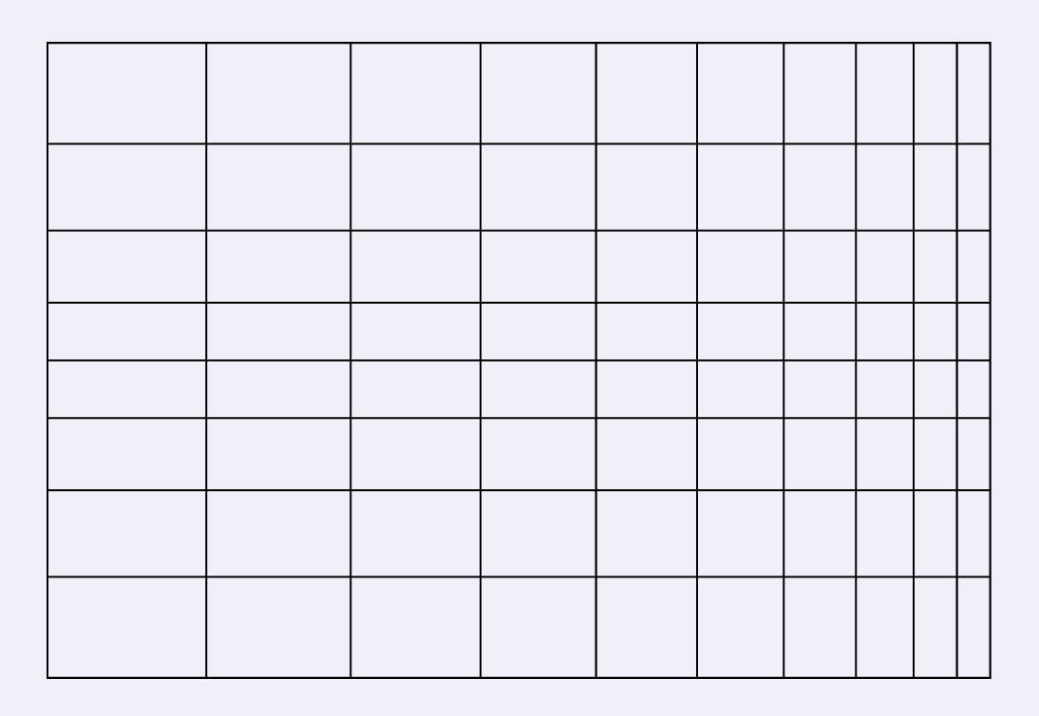

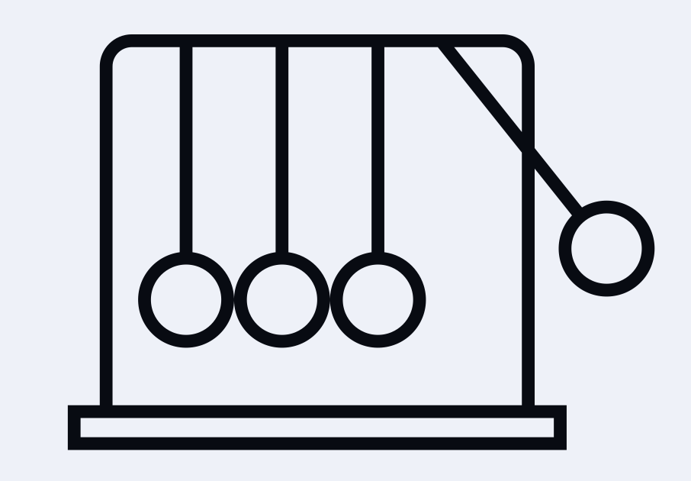
UEDGE has evolved into a tightly coupled end-to-end workflow tied together by common coupling
Organic growth concentrated in a few subroutines
  Convoluted coding with order-dependent execution
  No entry points for unit testing
_______________ VSODE, etc.
Preconditioner
ODE solver
UEDGE
UETOOLS
_uman-readable input files
Automated provenance
Interfacing with Python packages
Grid generation
Stenciling
______ geometric coefficients
Physics model
_____ transport
Impurity model
Neutral model
Boundary conditions
Detects changes to grid and interpolates
Notes:
Big Ball of Mud
Physics routines – different parts called from physics within routines – no clear interface layer
UETOOLS

Slide 6
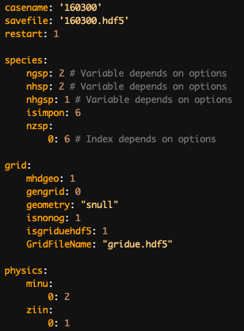
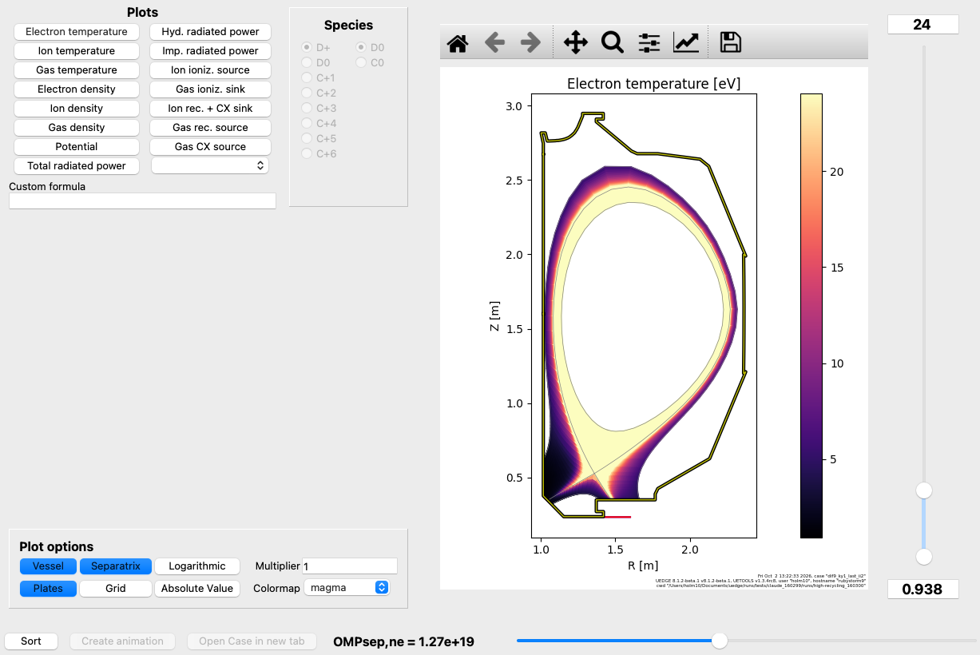
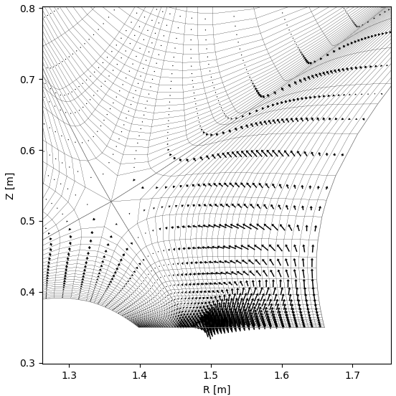
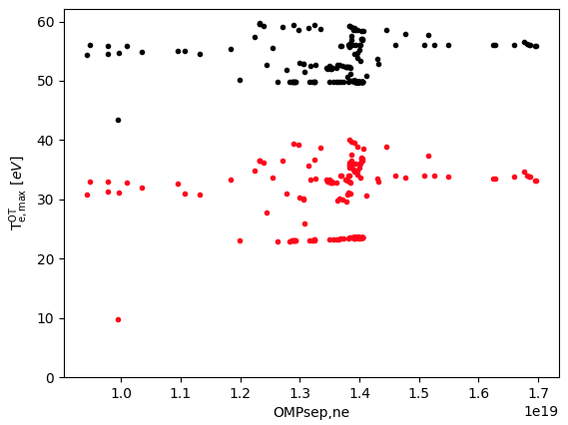
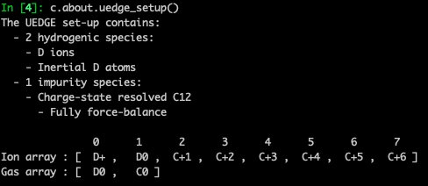
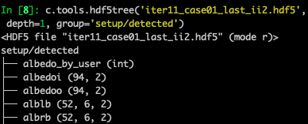
UETOOLS [19] provides a Python user interface that abstracts UEDGE-specific idiosyncrasies, lowering barriers to entry
A natural API-like layer between UEDGE and downstream workflows
  Bayesian optimization, multiprocessing, geometric packages, etc.
Plotting routines
Parameter scan/database support
Human-readable YAML input files
GUI dashboard
Setup diagnostics
Provenance-embedded and
self-describing save files
[19] A. Holm, et al., LLNL Software (LLNL-CODE-846751), github.com/LLNL/UETOOLS

Slide 7
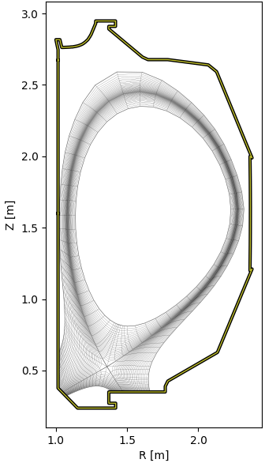
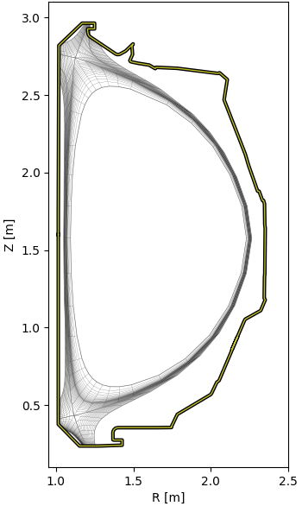
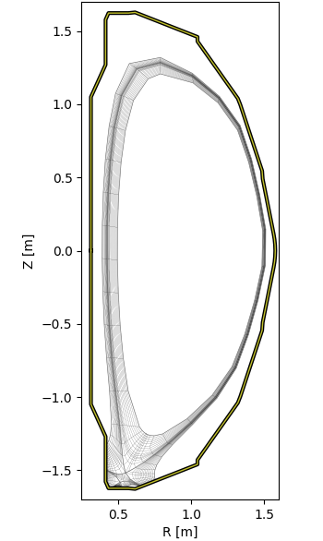
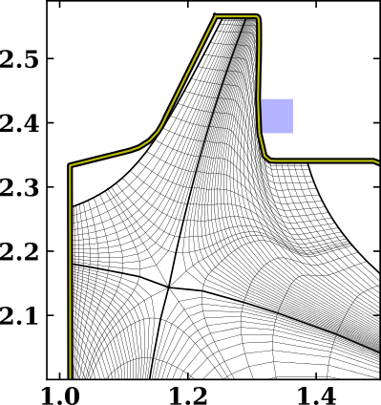
Envisioned refactoring applies separation of concerns, building on the natural interface grid files already provide
Separating the physics modules requires deconvolution of variables
Physics solver & stencil assume structured, flux-surface aligned grids
UEDGE DIII-D single-null
UEDGE DIII-D double-null
INGRID [22] NSTX-U snowflake
UEDGE DIII-D chimney divertor
Z [m]
R [m]
[22] B.M. Garcia, et al., Comp. Phys. Comm., 275 (2022) 108316
Notes:
Snull, chimney, dnull, snowflake, goat
Diverted, limited, double-null, simplified geometries

Slide 8
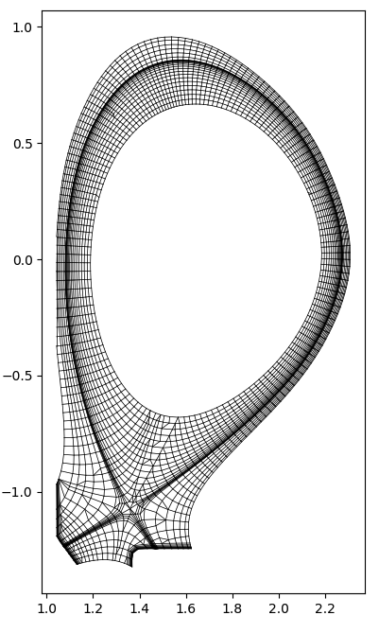
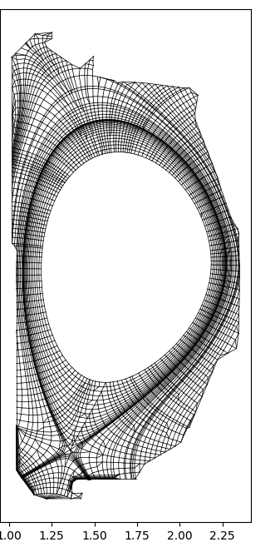
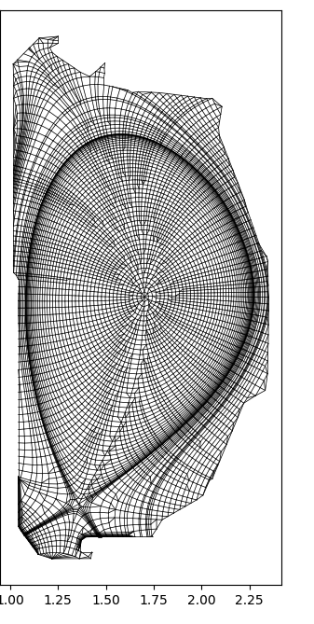
Potential for extended grids using GOAT [23] investigated as part of LDRD project: constrained by UEDGE architecture
Significant refactoring necessary for unstructured mesh capability
  B2-style distributed loops
  Staggered mesh
Boundary physics model need
to be implemented
Structured grids with cut-cell approaches?
  Limited by monolithic subroutine structure
Z [m]
R [m]
[23] S. Van den Kerkhof, et al., "Automated 2D plasma edge grid generation for arbitrary
magnetic topologies," Contrib. Plasma Phys., submitted (2026)
Notes:
SOLPS-ITER refactoring by KU Leuven group amounted to multi-year full-team effort
(cut-cell/immersed boundary approaches)

Slide 9
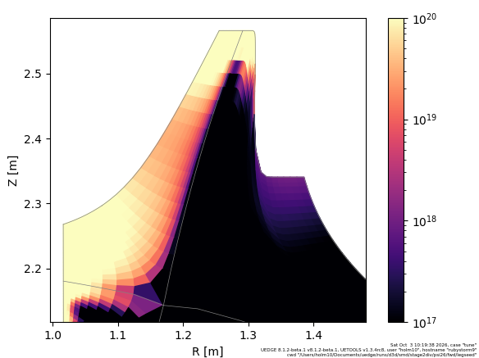
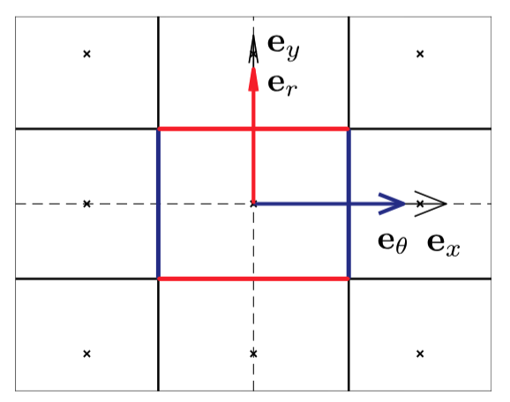
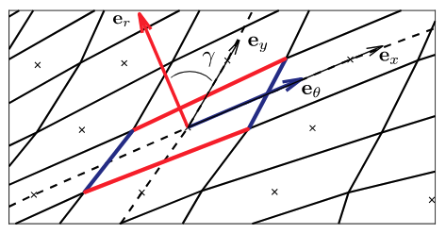
The fluid model of atoms solves a continuity, parallel momentum, and energy equation using a 9-point stencil
9-point stencil applied since its inception and alleviates discrepancies observed in early SOLPS simulations [24]
Neutral distribution in strongly shaped DIII-D chimney divertor
Orthogonal 5-point vs. nonorthogonal 9-point stenciling [26]
[24] W. Dekeyser, et al., Nucl. Mater. Energy, 18 (2019) 125

Slide 10
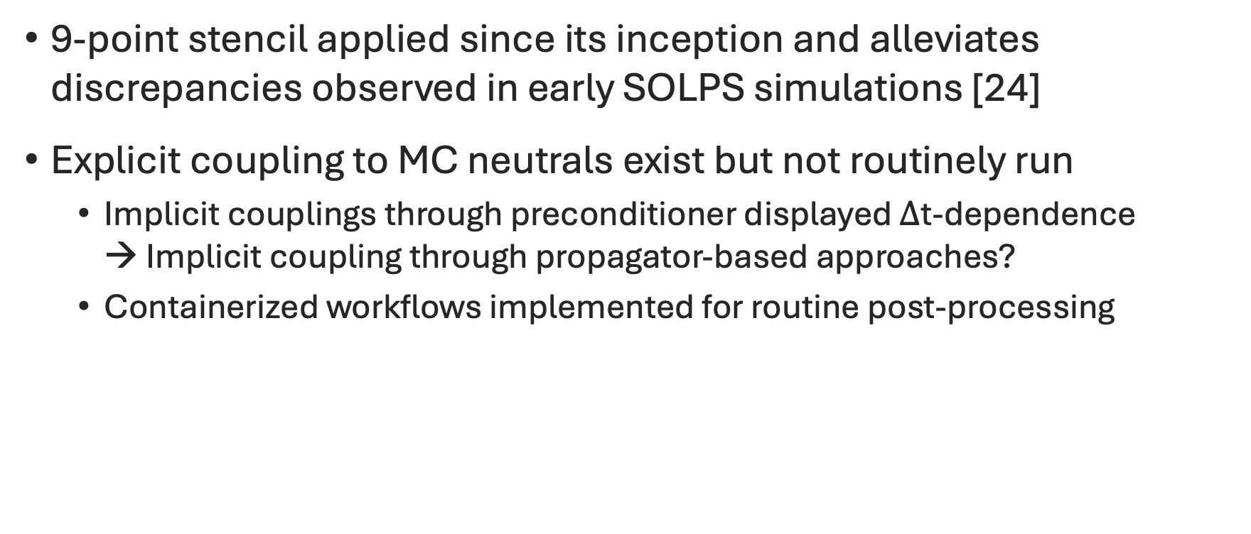
The fluid model of atoms solves a continuity, parallel momentum, and energy equation using a 9-point stencil
9-point stencil applied since its inception and alleviates discrepancies observed in early SOLPS simulations [24]
Explicit coupling to MC neutrals exist but not routinely run
  Implicit couplings through preconditioner displayed $Δ$t-dependence
  → Implicit coupling through propagator-based approaches?
  Containerized workflows implemented for routine post-processing
[24] W. Dekeyser, et al., Nucl. Mater. Energy, 18 (2019) 125

Slide 11
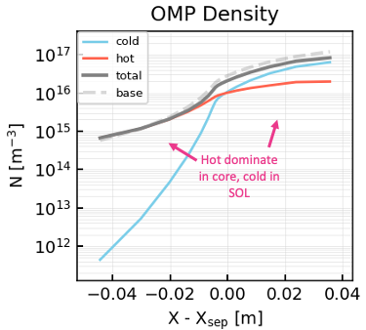
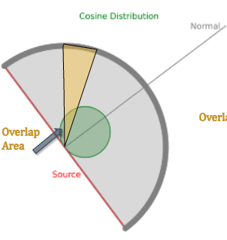
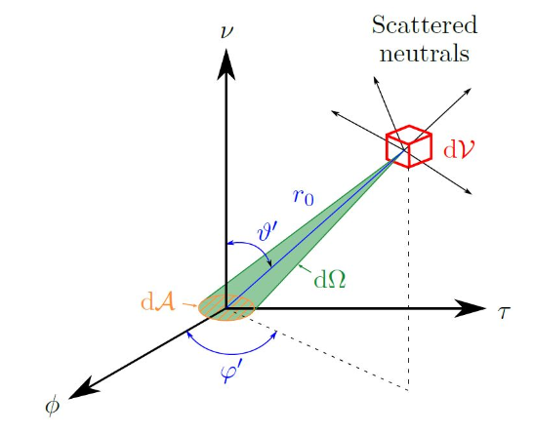
Internal LLNL development and research project for increasing neutral model fidelity funded 2025-2027
Implement Advanced Fluid Neutral BCs developed by KU Leuven [25,26]
Geometric, grid-free vacuum neutral model leveraging
transfer matrix methods
Potential two-temperature distribution models
Telematrix model implemented
for DIII-D [30]
Scattering of neutrals in control volume for AFN boundary model [25,26]
OMP effect of Hot-Neutral Model (HNM) with two-temperature atoms [27]
Schematic of angular coefficient method [28]
[25] N. Horsten, et al., Nucl. Fusion, 57 (2017), 116043
[26] W. Van Uytven et al., Nucl. Fusion, 62 (2022) 086023
[27] M. Kryjak, et al., EMU(S) Meeting (2024)
[28] J. Jaura, et al., 67th Annual Meeting of the APS Division of Plasma Physics (2025)
Notes:
W. Dekeyser, X. Bonnin, S.W. Lisgo, R.A. Pitts, B. LaBombard, "Implementation of a 9-point stencil in SOLPS-ITER and implications for Alcator C-Mod divertor plasma simulations," Nucl. Mater. Energy 18 (2019) 125–130. doi:10.1016/j.nme.2018.12.016
BCs (KU Leuven), Angular coefficient method (Hottel’s zone method/Gebhart absorption factors/S2S radiation models) and Green’s function methods
Solver stability negated by statistical noise → limited to small $Δ$t
Grid-free vacuum neutral model leveraging transfer matrix, angular coefficient, and Green’s function methods

Slide 12
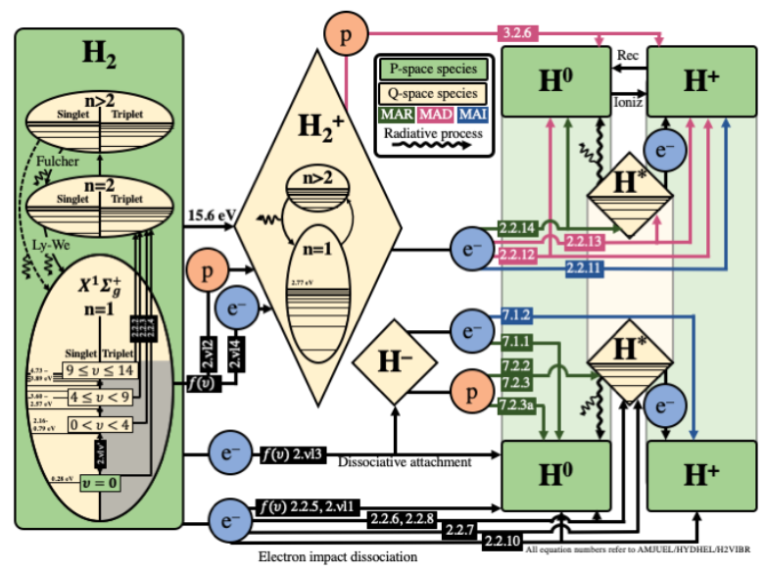
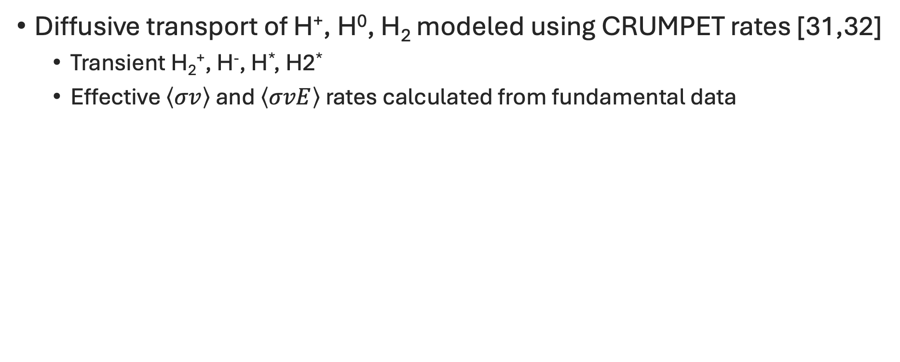
Effective Greenland collisional-radiative rates [29] are used in the UEDGE fluid molecular model [30,31]
Diffusive transport of H⁺, H⁰, H₂ modeled using CRUMPET rates [31,32]
  Transient H₂⁺, H⁻, H*, H2*
  Effective $\left\langle σv\right\rangle$ and $\left\langle σvE\right\rangle$ rates calculated from fundamental data
[29] P.T. Greenland, Proc. Royal Soc. London A 457 (2001) 1821
[30] A. Holm, et.al., Contrib. Plasma Phys, 60 (2020) e201900150
[31] A. Holm, et al., Nucl. Mater. Energy 27, (2021) 100982
[32] A. Holm, CRUMPET, Computer Sofrware, https://github.com/holm10/CRUMPET

Slide 13
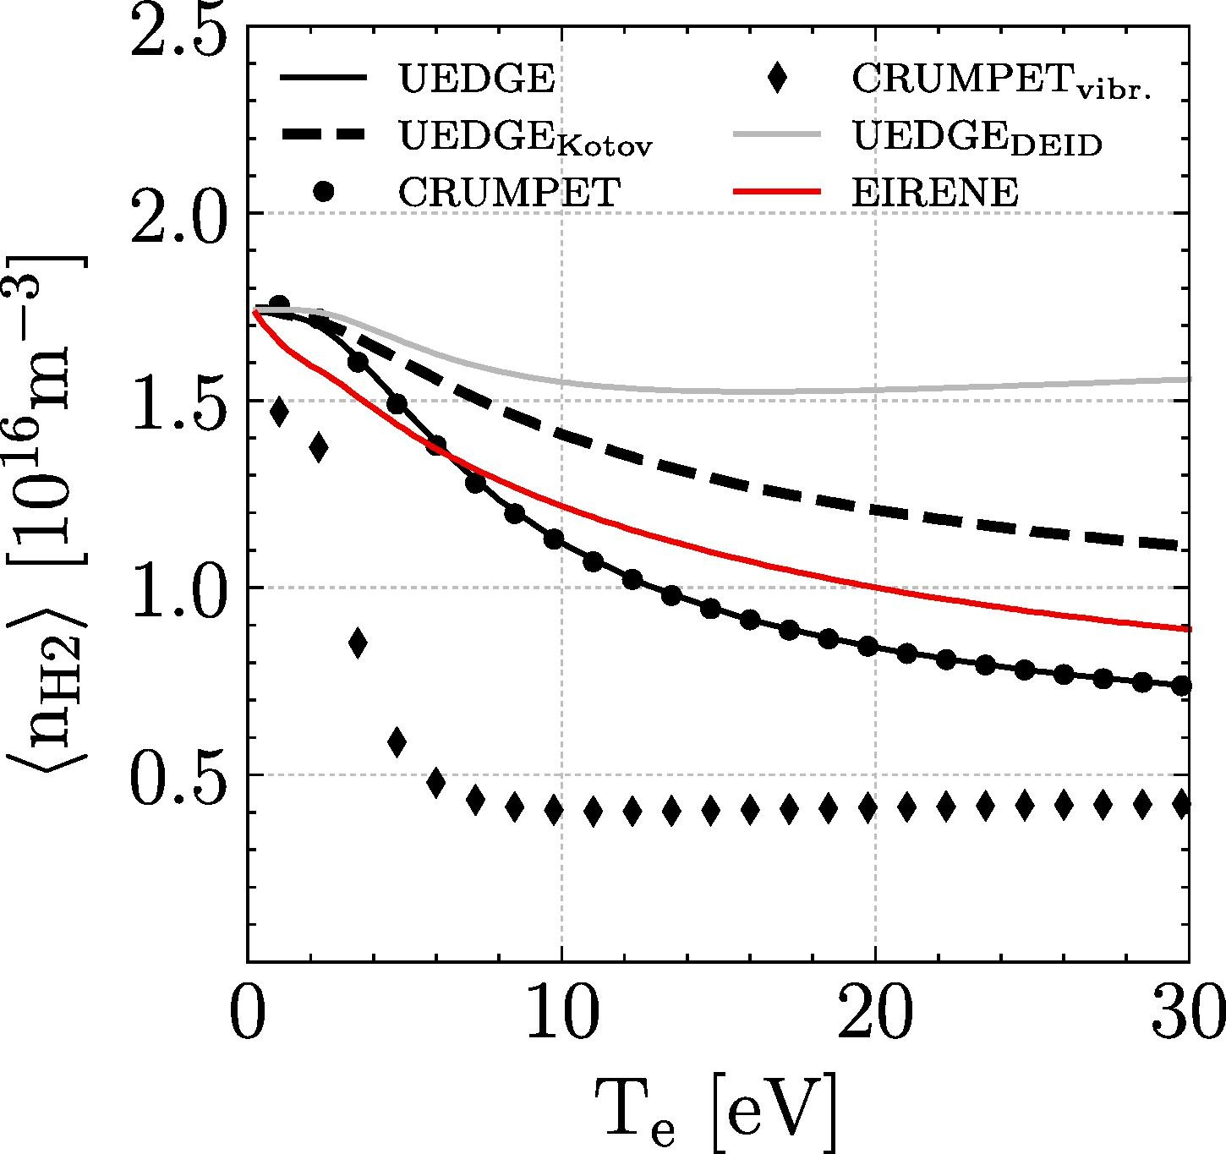
Effective Greenland collisional-radiative rates [29] are used in the UEDGE fluid molecular model [30,31]
Diffusive transport of H⁺, H⁰, H₂ modeled using CRUMPET rates [31,32]
Differences in rates dominant over transport in comparisons to EIRENE
[29] P.T. Greenland, Proc. Royal Soc. London A 457 (2001) 1821
[30] A. Holm, et.al., Contrib. Plasma Phys, 60 (2020) e201900150
[31] A. Holm, et al., Nucl. Mater. Energy 27, (2021) 100982
[32] A. Holm, CRUMPET, Computer Sofrware, https://github.com/holm10/CRUMPET

Slide 14
Effective Greenland collisional-radiative rates [29] are used in the UEDGE fluid molecular model [30,31]
Diffusive transport of H⁺, H⁰, H₂ modeled using CRUMPET rates [31,32]
Differences in rates dominant over transport in comparisons to EIRENE
Kinetic transport effects and boundary conditions need to be evaluated (see W. van Uytven, J. Bryant this workshop)
[29] P.T. Greenland, Proc. Royal Soc. London A 457 (2001) 1821
[30] A. Holm, et.al., Contrib. Plasma Phys, 60 (2020) e201900150
[31] A. Holm, et al., Nucl. Mater. Energy 27, (2021) 100982
[32] A. Holm, CRUMPET, Computer Sofrware, https://github.com/holm10/CRUMPET

Slide 15
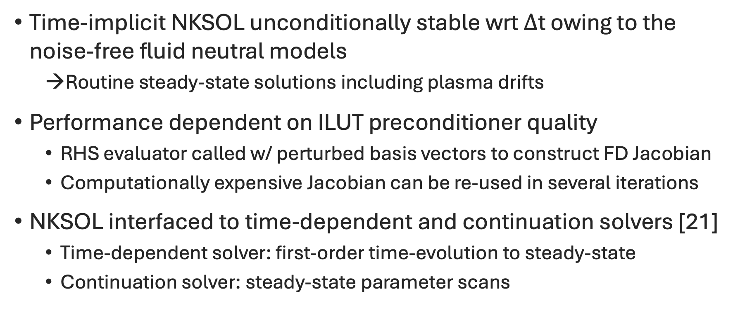
UEDGE uses the bespoke, internal JFNK solver, NKSOL: later developed into the KINSOL solver of SUNDIALS
Time-implicit NKSOL unconditionally stable wrt $Δ$t owing to the noise-free fluid neutral models
  Routine steady-state solutions including plasma drifts
Performance dependent on ILUT preconditioner quality
  RHS evaluator called w/ perturbed basis vectors to construct FD Jacobian
  Computationally expensive Jacobian can be re-used in several iterations
NKSOL interfaced to time-dependent and continuation solvers [21]
  Time-dependent solver: first-order time-evolution to steady-state
  Continuation solver: steady-state parameter scans
[21] A. Holm, et al., Contrib. Plasma Phys., preprint (2026) e70135
Notes:
Bespoke NKSOL version, later evolved into KINSOL of SUNDIALS
VG 9: Title may be misleading. While true, JFNK still needs incremental steps to follow the local linear response. Maybe rephrase to emphasize that large time steps are allowed as equilibrium is approached.
VG 9: The last bullet about ILUT/preconditioner: Not so much an ILUT issue (can also use a banded solve), but one of refreshing the Jacobian. Maybe say: Performance is a balance of reusing or refreshing the Jacobian

Slide 16
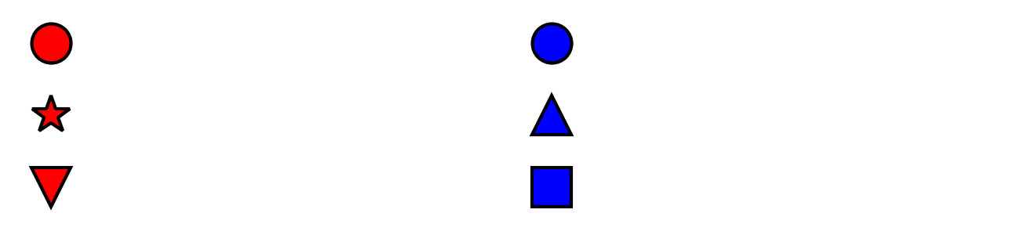
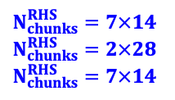
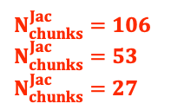
OpenMP parallelization of the preconditioner and RHS evaluation provides 80% speedup vs. serial version [21]
Preconditioner construction embarrassingly parallelizable
Shared memory parallelization complicated by common coupling and structured meshes
  MPI-like implementation for RHS physics routines
  Higher-order terms and staggered velocity mesh increases stencil size
Total time
Jacobian
NK RHS evaluations
Matrix solve
Set-up
Factorization
$N_{chunks}^{Jac}=106$
$N_{chunks}^{Jac}=53$
$N_{chunks}^{Jac}=27$
$N_{chunks}^{RHS}=7×14$
$N_{chunks}^{RHS}=2×28$
$N_{chunks}^{RHS}=7×14$
[21] A. Holm, et al., Contrib. Plasma Phys., preprint (2026) e70135
Notes:
22s average time per steady-state for benchmark parameter scan

Slide 17
Continuous development has long outpaced funded maintenance: refactoring needed to meet modern standards
Maintenance and modernization opportunities rarely funded:
  Perpetual competition with science output
Cumulative capabilities
Relative effort
Technical debt/
dev. cost
Funded maintenance
and modernization
Time

Slide 18
Continuous development has long outpaced funded maintenance: refactoring needed to meet modern standards
Maintenance and modernization opportunities rarely funded:
  Perpetual competition with science output
Google.org code modernization and agentic workflow award (2-year at ~50% coverage)
  Create API-like layers for JAXification of routines
  Automated test coverage and refactoring using AI/LLM-assisted tooling
  SOLPS-ITER refactoring by KU Leuven group amounted to multi-year full-team effort
Cumulative capabilities
Relative effort
Technical debt/
dev. cost
Funded maintenance
and modernization
Time

Slide 19



UEDGE is scientifically mature but technically strained following decades of validated development
Development remains active, continually extending physics models
UEDGE’s track record and a modernized codebase are not in tension
With the advent of AI/LLM tooling a practical path to addressing technological debt is available
Refactor
Test
Comprehend

Slide 20
Auspices and acknowledgements
This work was supported by US DOE under contract no. DE-AC52-07NA27344.
This report was prepared as an account of work sponsored by an agency of the United States Government. Neither the United States Government nor any agency thereof, nor any of their employees, makes any warranty, express or implied, or assumes any legal liability or responsibility for the accuracy, completeness, or usefulness of any information, apparatus, product, or process disclosed, or represents that its use would not infringe privately owned rights. Reference herein to any specific commercial product, process, or service by trade name, trademark, manufacturer, or otherwise, does not necessarily constitute or imply its endorsement, recommendation, or favoring by the United States Government or any agency thereof. The views and opinions of authors expressed herein do not necessarily state or reflect those of the United States Government or any agency thereof.

Slide 22
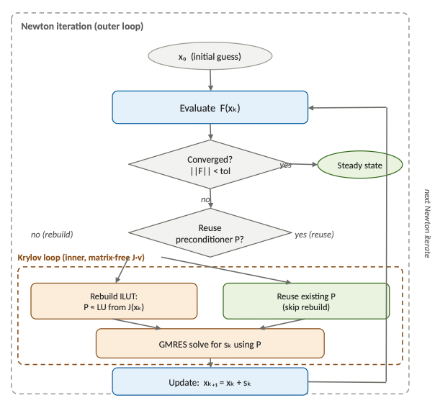
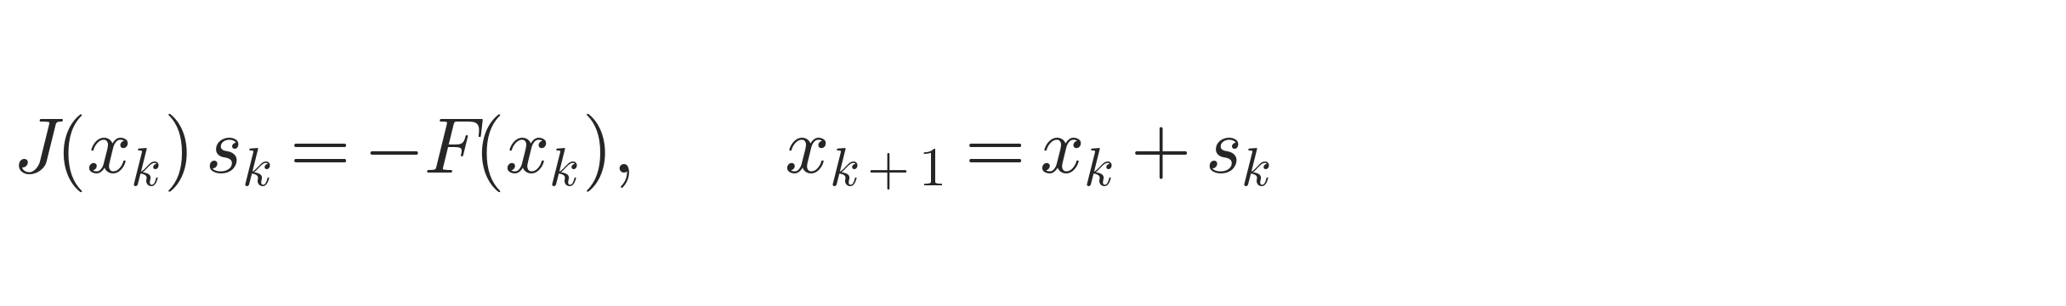
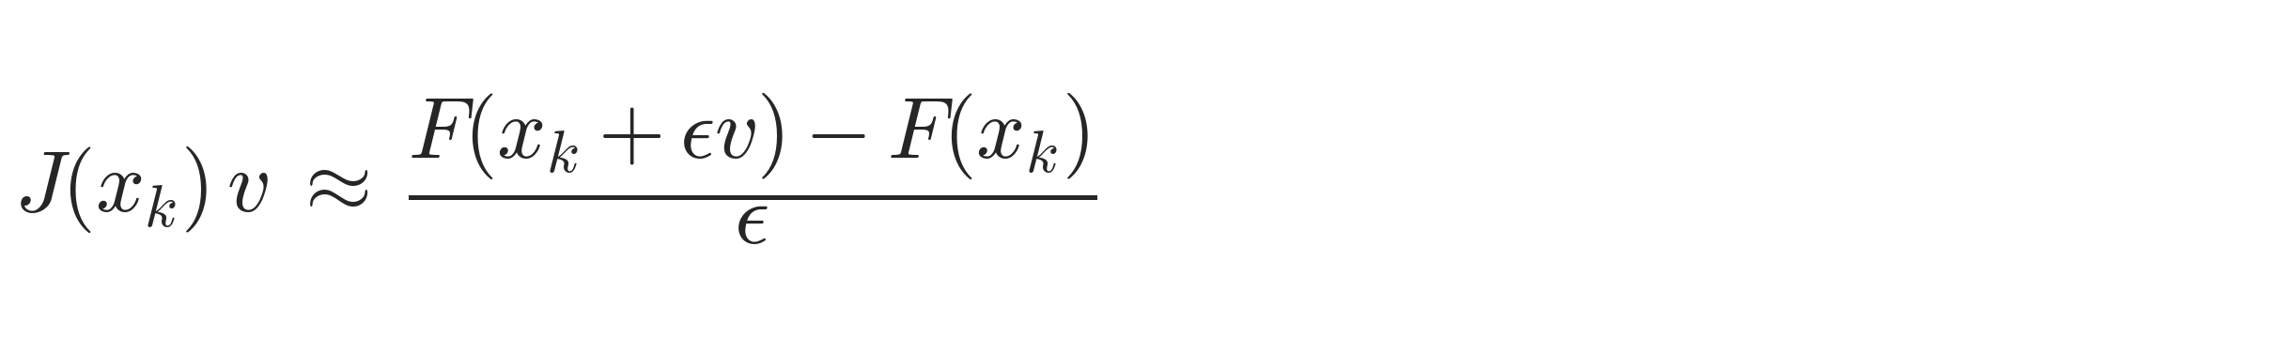
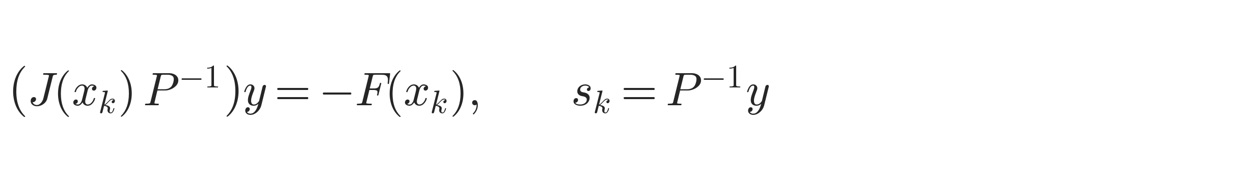
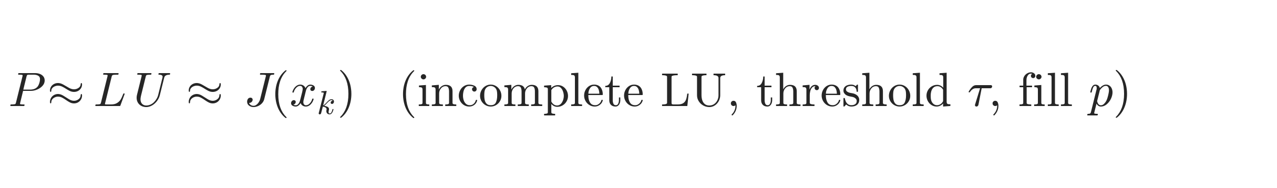
JFNK solver equations
Newton step
Jacobian-free directional derivative
Preconditioned Krylov (GMRES) solve
ILUT preconditioner

Slide 23
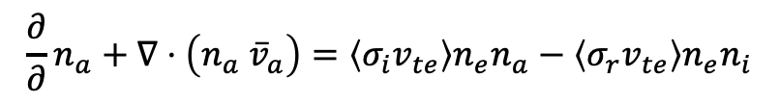
Atom model equations
$$\frac{∂}{∂}n_{a}+∇⋅\left(n_{a} {\overline{v}}_{a}\right)=\left\langle σ_{i}v_{te}\right\rangle n_{e}n_{a}−\left\langle σ_{r}v_{te}\right\rangle n_{e}n_{i}$$
$$\frac{∂}{∂t}{m_{a}n}_{a}v_{a,∥}+∇⋅\left(m_{a}n_{a} v_{a,∥}{\overline{v}}_{a}−η_{a}∇v_{a,∥}\right)=\frac{B_{θ}}{B}\left(−\frac{∂P_{a}}{∂θ}\right)+m_{i}n_{i}ν_{cx}\left(v_{i,∥}−v_{a,∥}\right)−m_{a}n_{a}ν_{i}v_{a,∥}+m_{i}n_{i}ν_{r}v_{i,∥}$$
$$\frac{∂}{∂t}\left(\frac{3}{2}n_{a}T_{a}\right)+∇⋅\left(\frac{5}{2}n_{a} T_{a}{\overline{v}}_{a}−κ_{a}∇T_{a}\right)+Π_{a}:∇{\overline{v}}_{a}={\overline{v}}_{a}⋅∇P_{a}+Q_{a}+S_{a}^{E}+S_{a}^{m}⋅{\overline{v}}_{a}+\frac{1}{2}m_{a}v_{a}^{2}S_{a}$$

Slide 24
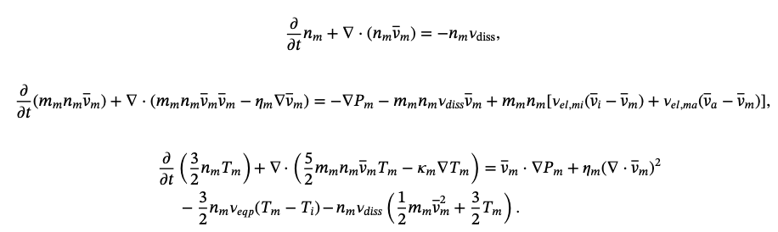
Molecular model equations

