Slide 1
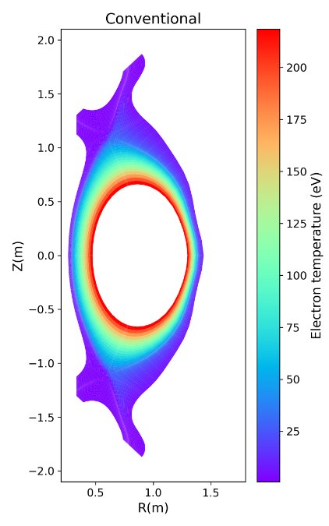
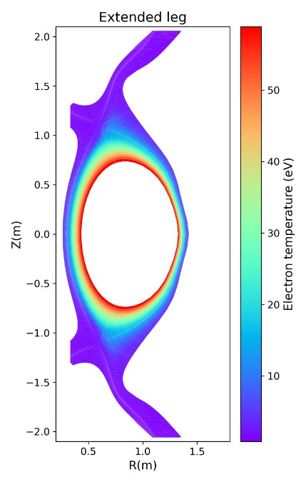
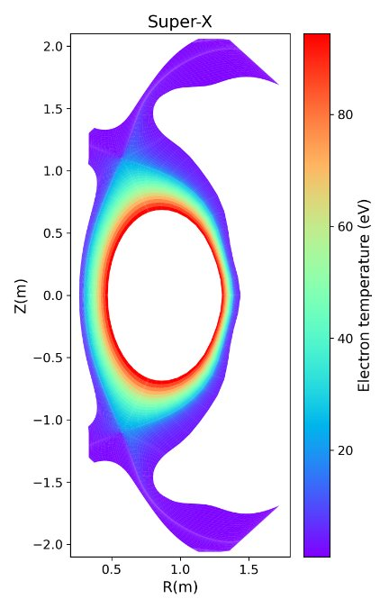
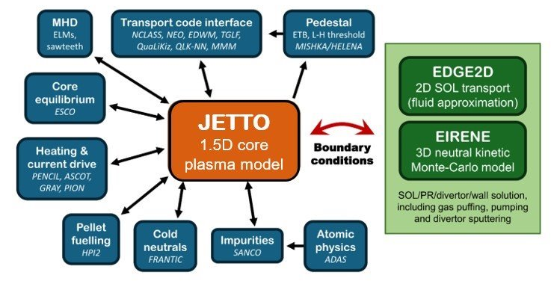
A deep-learning surrogate for EDGE2D-EIRENE
Problem
EDGE2D-EIRENE captures plasma + kinetic neutral physics
But simulations are computationally expensive and thus integrated modelling and divertor sign is slow
No existing surrogates for EDGE2D-EIRENE
Approach
~24,000 converged simulations, ~8500 with no impurity puff
Inputs: power, separatrix density, puff location
Model: transolver
Outputs: predicts 2D plasma & neutral fields
Example 2d outputs - different equilibria in the dataset
Image from F. Eriksson et al. 2024
Learning EDGE2D-EIRENE: Fast 2D Surrogate Models for Plasma-Edge Simulation, N. Carey et al., Culham Campus, Sep-2026
Notes:
The divertor is where we have to deal with the enormous heat and particle exhaust from a fusion plasma. In MAST-U, EDGE2D-EIRENE lets us study this region by modelling both the plasma and the kinetic neutral population.
The problem is that these simulations are computationally expensive. That makes them difficult to use when we want to scan a large operating space, or eventually include edge modelling inside whole-plasma simulations.
So, the aim of this work is to replace the expensive simulation with a fast deep-learning surrogate.
We use 8,457 converged EDGE2D-EIRENE simulations without nitrogen. The model takes a small set of inputs — including power, separatrix density, gas-puff location and divertor geometry — and predicts the full two-dimensional plasma and neutral fields. (on the "Approach" bit, I would say "~24,000 converged simulations, ~8500 with no impurity puff" and then say in words that Carbon impurity is sputtered. Then again in words say that use only the ones without impurity puff)
For the neural network, we use Transolver, a transformer-based architecture designed for spatial point data. So rather than predicting a single number, the model learns to reproduce the spatial structure of the entire simulated divertor state

Slide 2
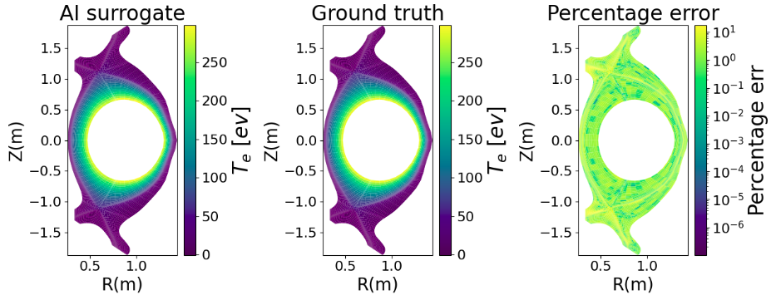
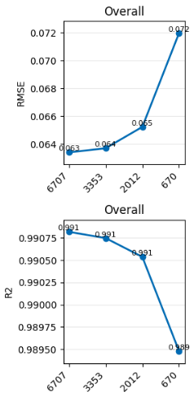
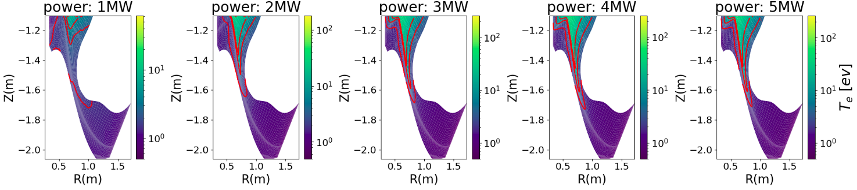
Fast prediction with good spatial agreement
RMSE (CD/SX/ED)​ | 0.065 (0.319/0.066/0.071)
R2​ (CD/SX/ED)​ | 0.991 (0.820/0.991/0.989
Error across entire point cloud and all samples in validation dataset​, averaged across all variables
Example output from model vs ground truth simulation (electron temperature)
Electron temperature
Increasing power
Out of distribution from the dataset
Model performance across different dataset sizes
Power parameter scan (electron temperature)
Learning EDGE2D-EIRENE: Fast 2D Surrogate Models for Plasma-Edge Simulation, N. Carey et al., Culham Campus, Sep-2026
Notes:
So, does it work?
Across the test set, we get an RMSE of about 0.091 and an R-squared of 0.985, and the model performs reasonably consistently across the three MAST-U divertor configurations.
But the important result isn't just the overall error. If we compare the predicted fields with the EDGE2D-EIRENE results, the surrogate also reproduces the main spatial structures of the plasma and neutral fields.
We can also vary the inputs after training. For example, when we scan the input power, the model captures changes in the plasma state and the movement of the detachment front. Changing the gas-puff location also produces the corresponding changes in the plasma and radiation fields.
However, there's an important limitation. The model performs well when we stay within the parameter range represented in the training data, but predictions become less reliable when we extrapolate beyond that range.
So the main takeaway is that a relatively small set of inputs can be used to reproduce the much more expensive two-dimensional EDGE2D-EIRENE solution.
The next step is to improve the model's generalisation — for example by using partially converged simulations and adding physics-informed inputs such as magnetic-field information and transport coefficients. Ultimately, we'd like to integrate the surrogate into JINTRAC so that edge and divertor predictions can be obtained much more rapidly during whole-plasma simulations.

