Slide 1
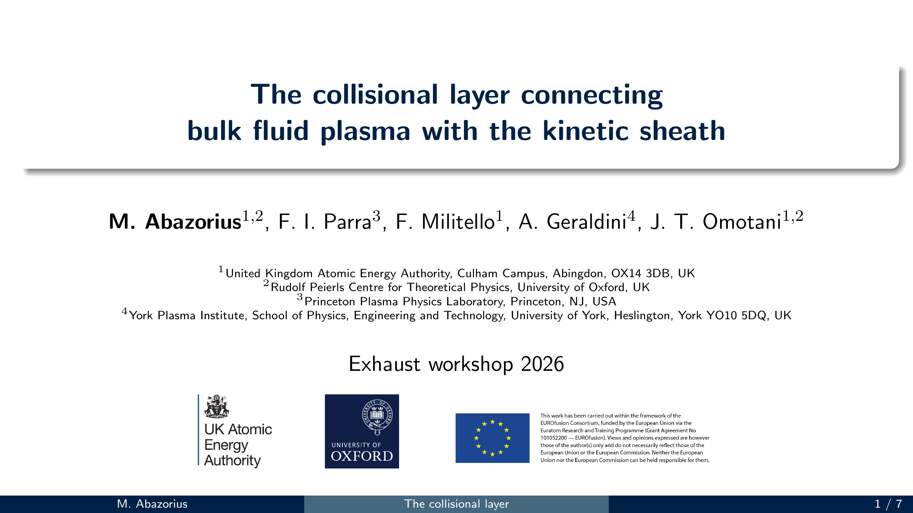
Notes:
SAY (~10 s): I'll talk about the plasma right next to the divertor target, and
how the fluid plasma in the scrape-off layer connects to the kinetic sheath at the wall.

Slide 2
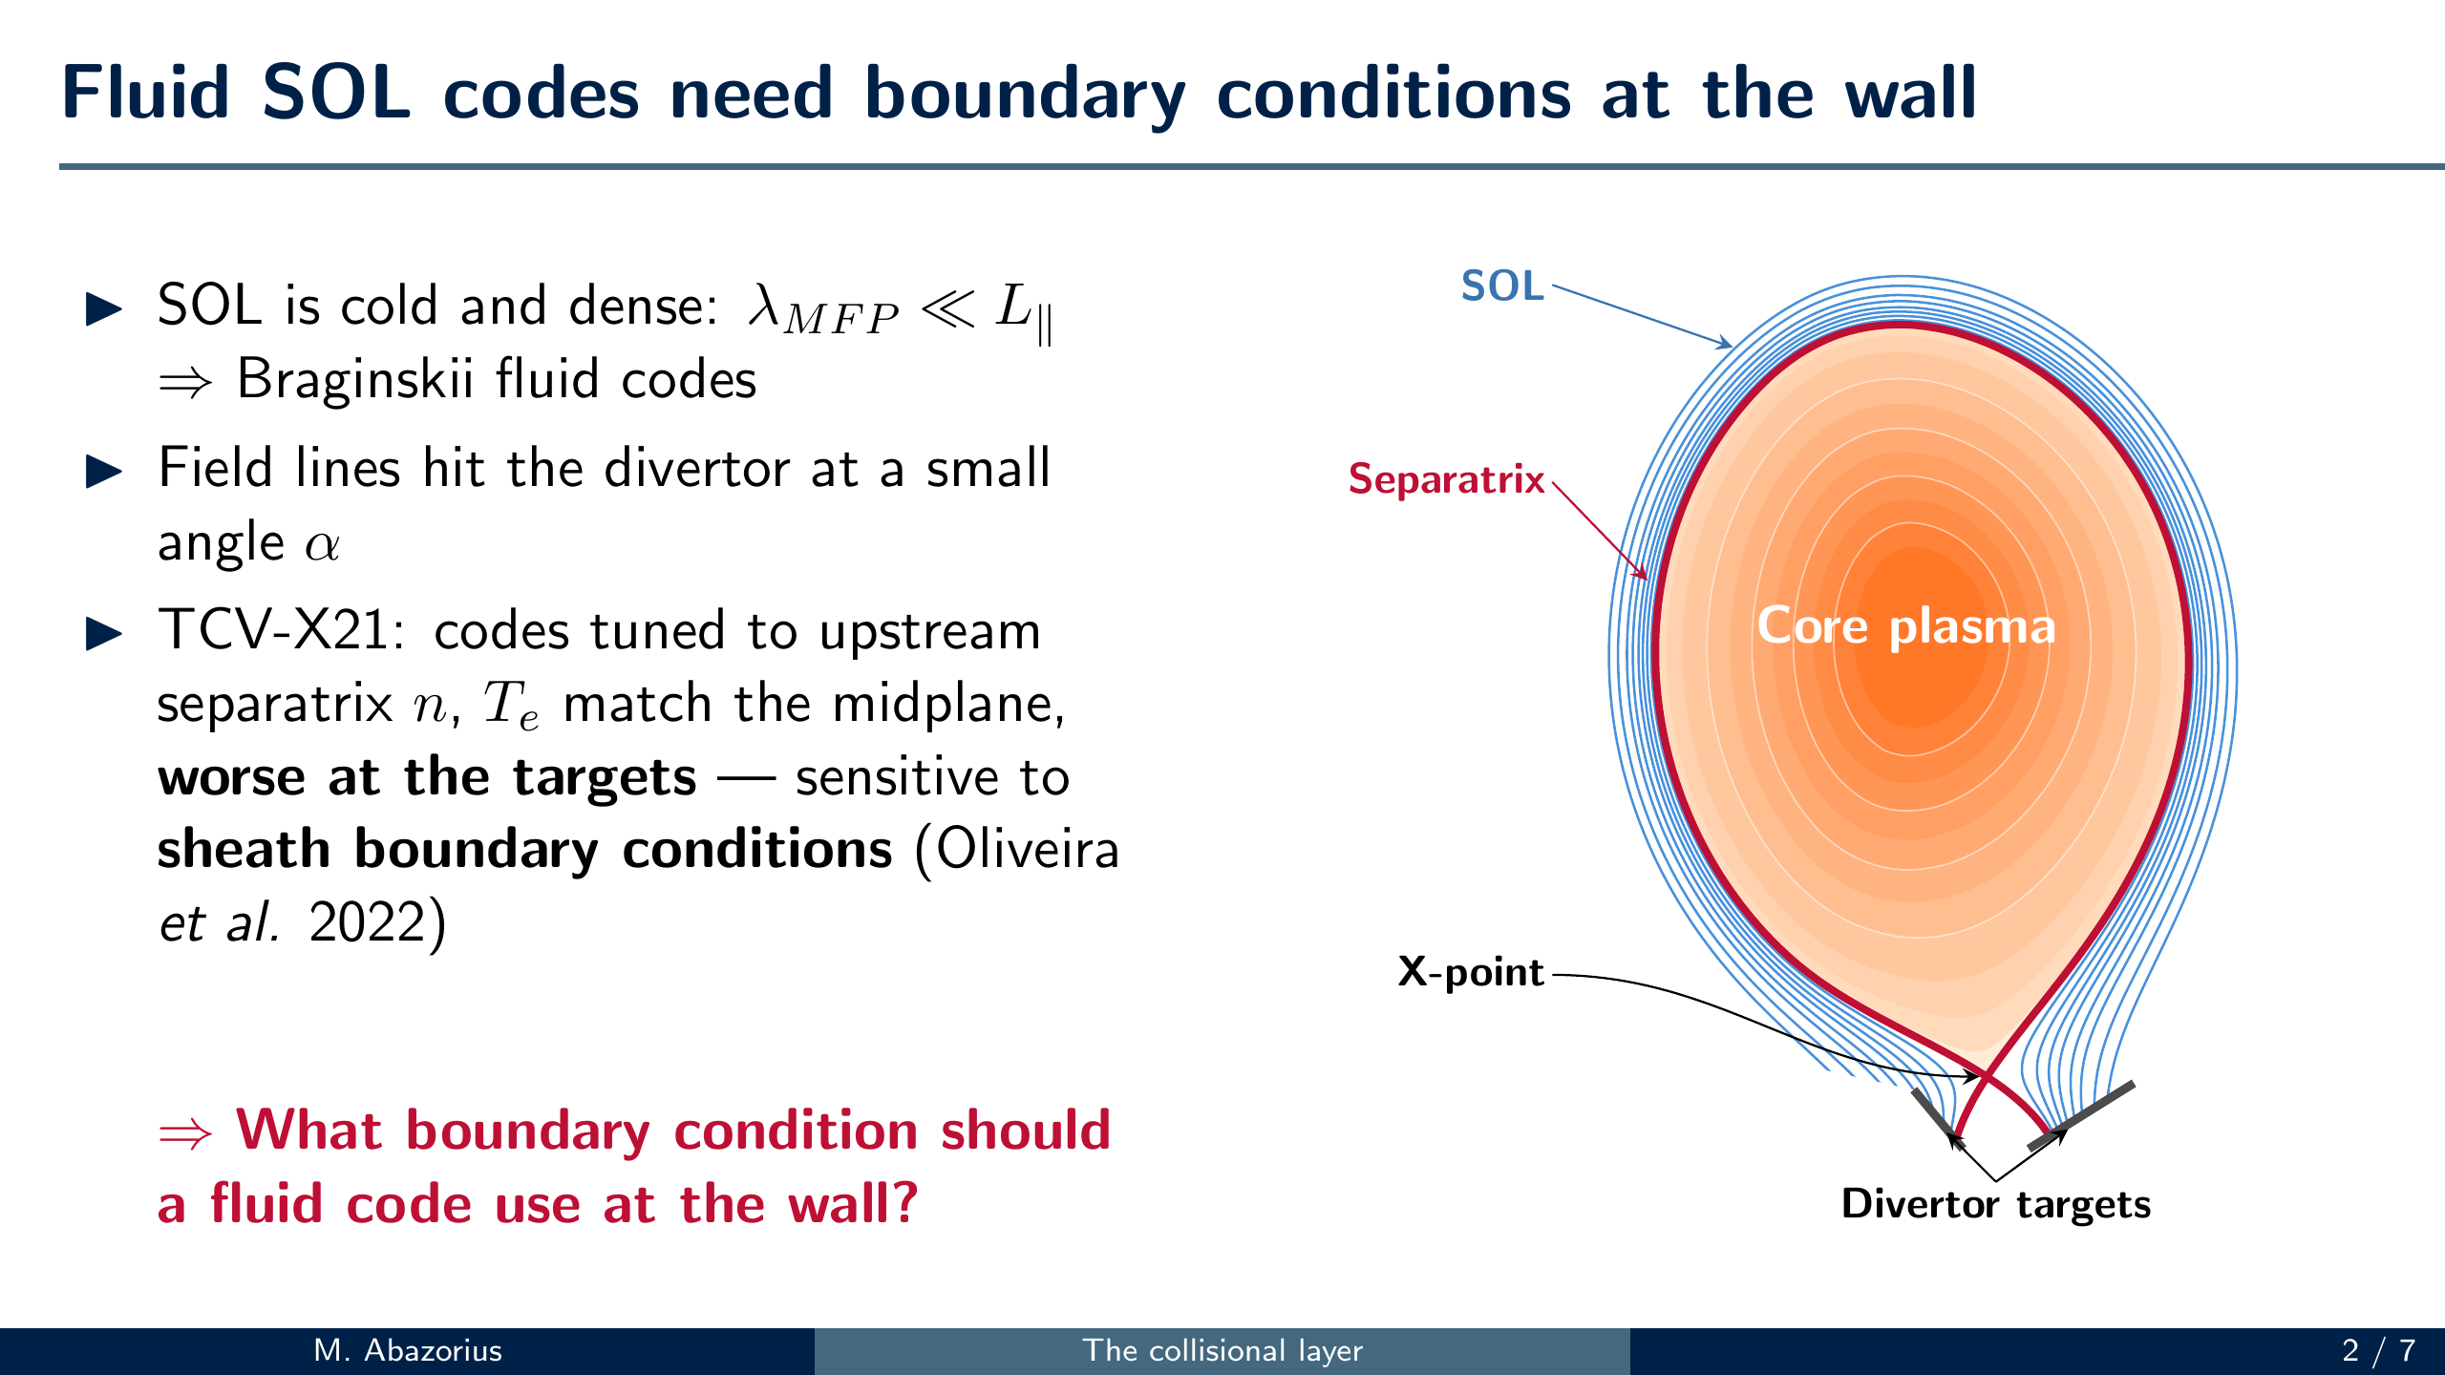
Notes:
SAY (~45 s): This is a tokamak cross section. Inside the red separatrix the field
lines are closed; outside it is the scrape-off layer, where open field lines carry
the plasma down to the divertor targets. The SOL is cold and dense - the mean free
path is much shorter than the connection length - so we model it with Braginskii
fluid codes. Those codes need boundary conditions where the field lines hit the
targets, at a shallow angle alpha.
In the TCV-X21 validation (Oliveira et al. 2022) the codes tuned their sources to
match the upstream separatrix density and temperature, so good upstream agreement
is partly by construction - but agreement got worse towards the targets, and the
target profiles were sensitive to the sheath boundary conditions (along with
resistivity, heat conductivities, input power and missing neutrals).
So: what boundary condition should a fluid code use at the wall?
IF ASKED: Hermes-3 (Dudson et al. 2025) used only total power and target particle
flux as inputs, no tuning, and got better target agreement; it attributes the
remaining divertor mismatch mainly to missing neutrals.

Slide 3

Notes:
SAY (~60 s): [PDF: hold the right-arrow key through the fade, zoom and movie
(~160 pages) until the bare slab settles; each later click also plays a short
animation (hold the key). PowerPoint: each click starts the next video.]
Let's zoom in where the SOL hits the outer target. Looking along the toroidal
direction, the field lines hit the target at a small angle alpha (exaggerated
here); locally the geometry is just a slab: wall at the bottom, B at angle alpha.
[click - the ion starts gyrating down the field line] Towards the wall the length
scales shrink, so the fluid SOL approximations break down one after another. First,
a few mean free paths times sin(alpha) from the wall, high collisionality breaks
down: the collisional layer - this is what I study, and fluid codes skip it. Here
the ion still follows the field line on a circular gyro-orbit.
[click - the orbit gets stretched towards the wall] Closer in, a few ion gyroradii
from the wall, the electric field is strong enough to distort the gyro-orbits: the
magnetic presheath, which is collisionless.
[click - the ion drops straight to the wall] Finally, a few Debye lengths from the
wall, quasineutrality breaks down: the Debye sheath, which shields the negatively
charged wall (electrons are lighter and reach the wall faster); the ions are
accelerated straight into the wall. (Numbers: JET-like divertor, B~2T, T~50eV, n~1e19.)
IF ASKED (is it all due to the wall charge?): the collisional layer and the
magnetic presheath come mainly from the wall absorbing the plasma - f(v_par<0)=0
at the wall - like a Knudsen layer in a neutral gas; only the Debye sheath needs
the wall charge. The charge does set the electric field and the Boltzmann
electrons in our model. The wall is negative for alpha >> sqrt(m_e/m_i).

Slide 4
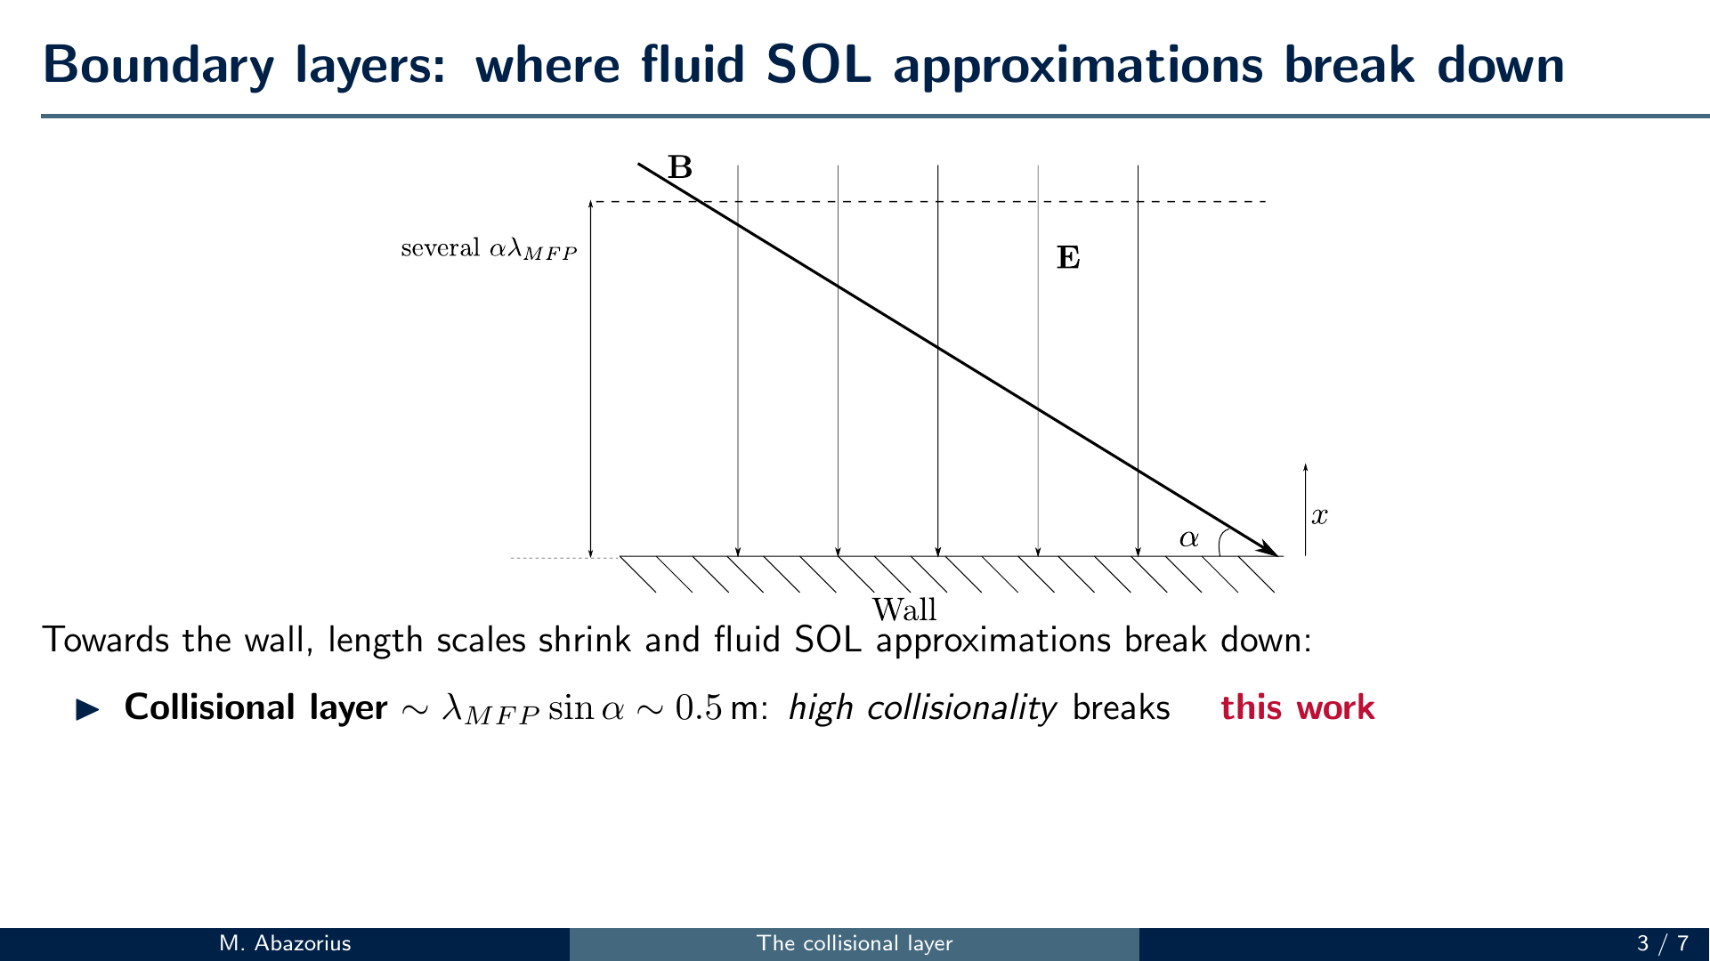

Slide 5
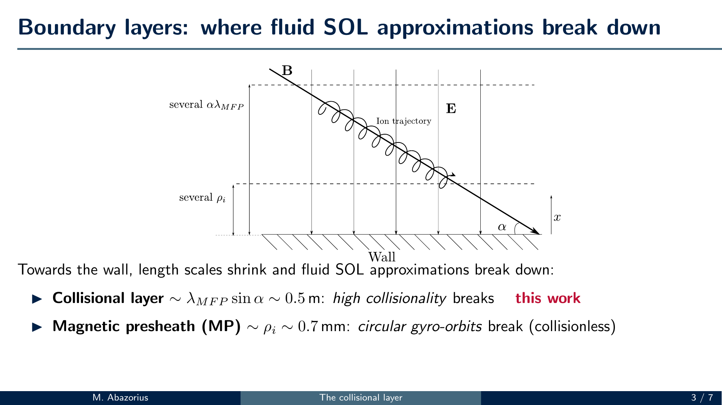

Slide 6
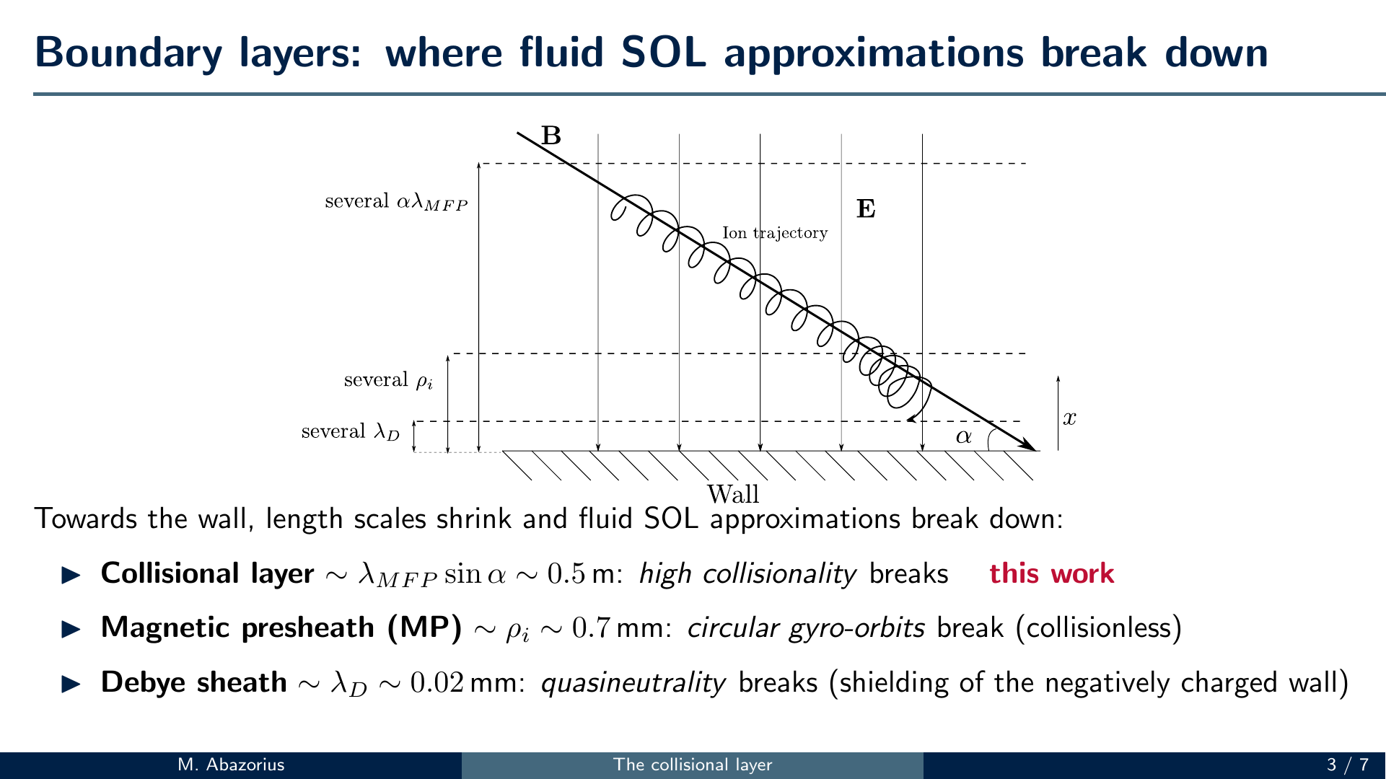

Slide 7
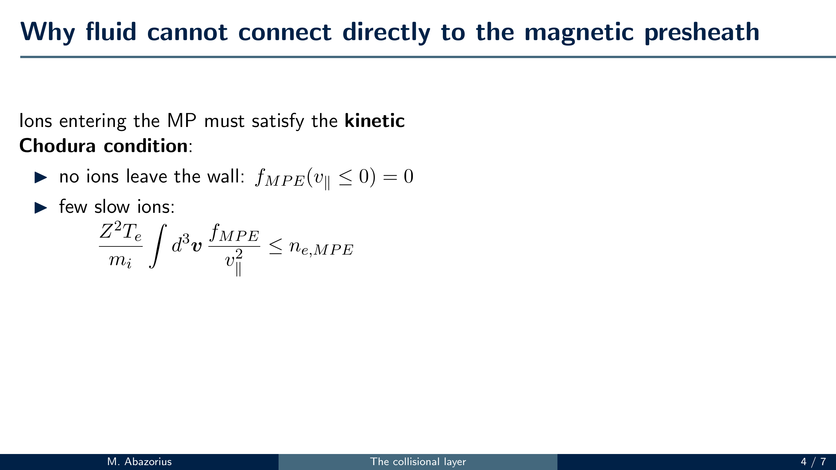
Notes:
SAY (~35 s): Ions entering the magnetic presheath must satisfy the kinetic
Chodura condition: no ions coming back from the wall, and very few slow ions -
the integral of f over v_par squared must be bounded.
[click] A Maxwellian always has ions at zero parallel velocity, so this integral
diverges and it can never satisfy the condition. So the fluid picture must break
down before the presheath, and something has to reshape the distribution - from
the Maxwellian far away to the f at the presheath entrance in the plot, which has
no slow ions. That is the collisional layer, and it needs the full Fokker-Planck
ion-ion operator because it is neither collisionless nor strongly collisional.

Slide 8
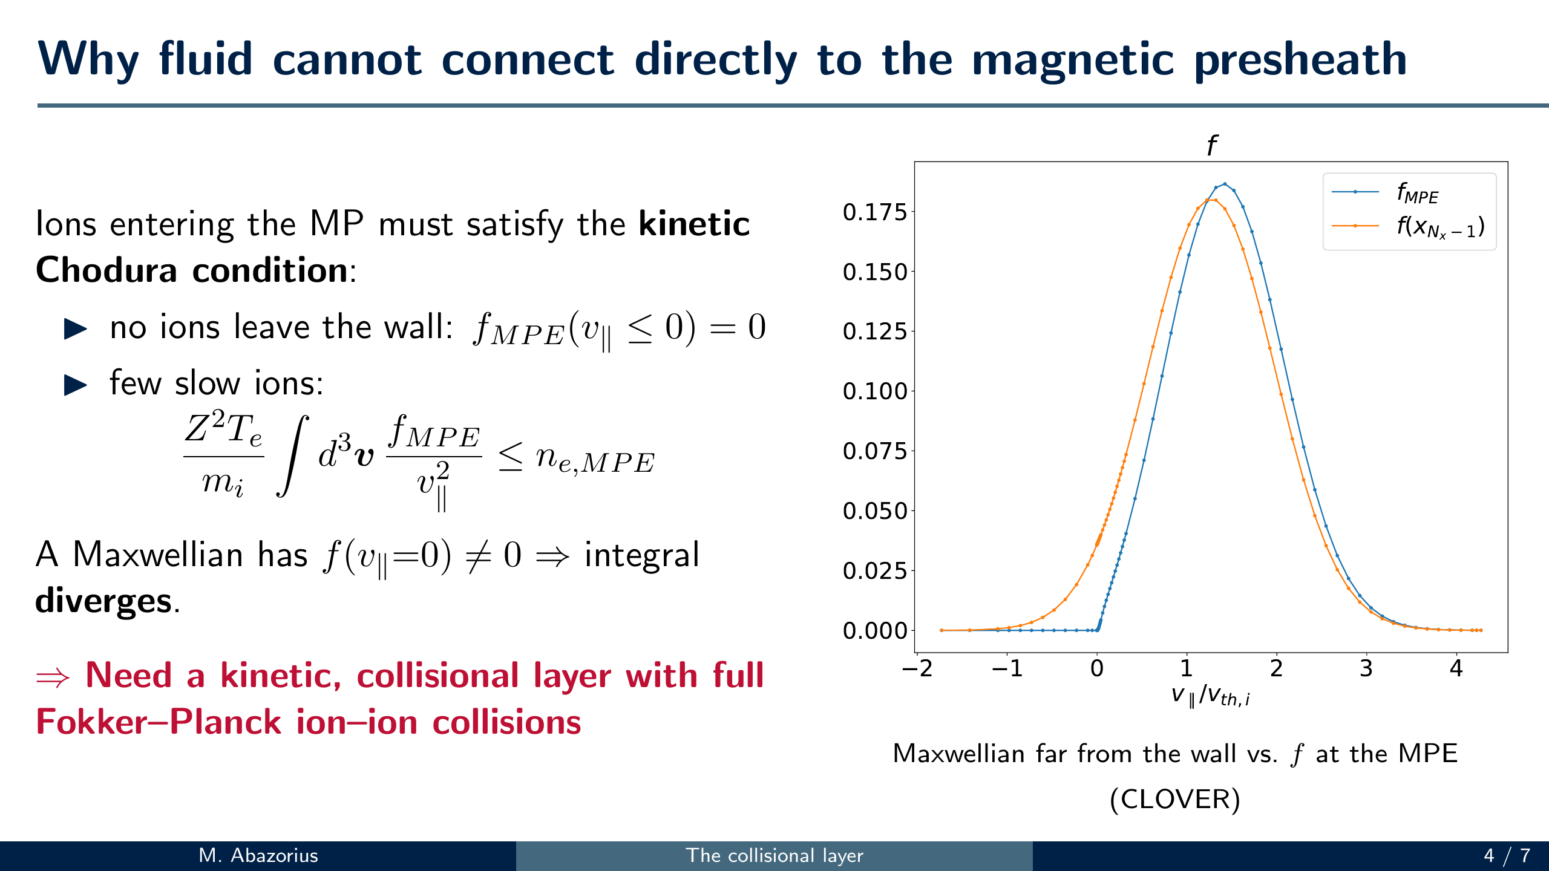

Slide 9
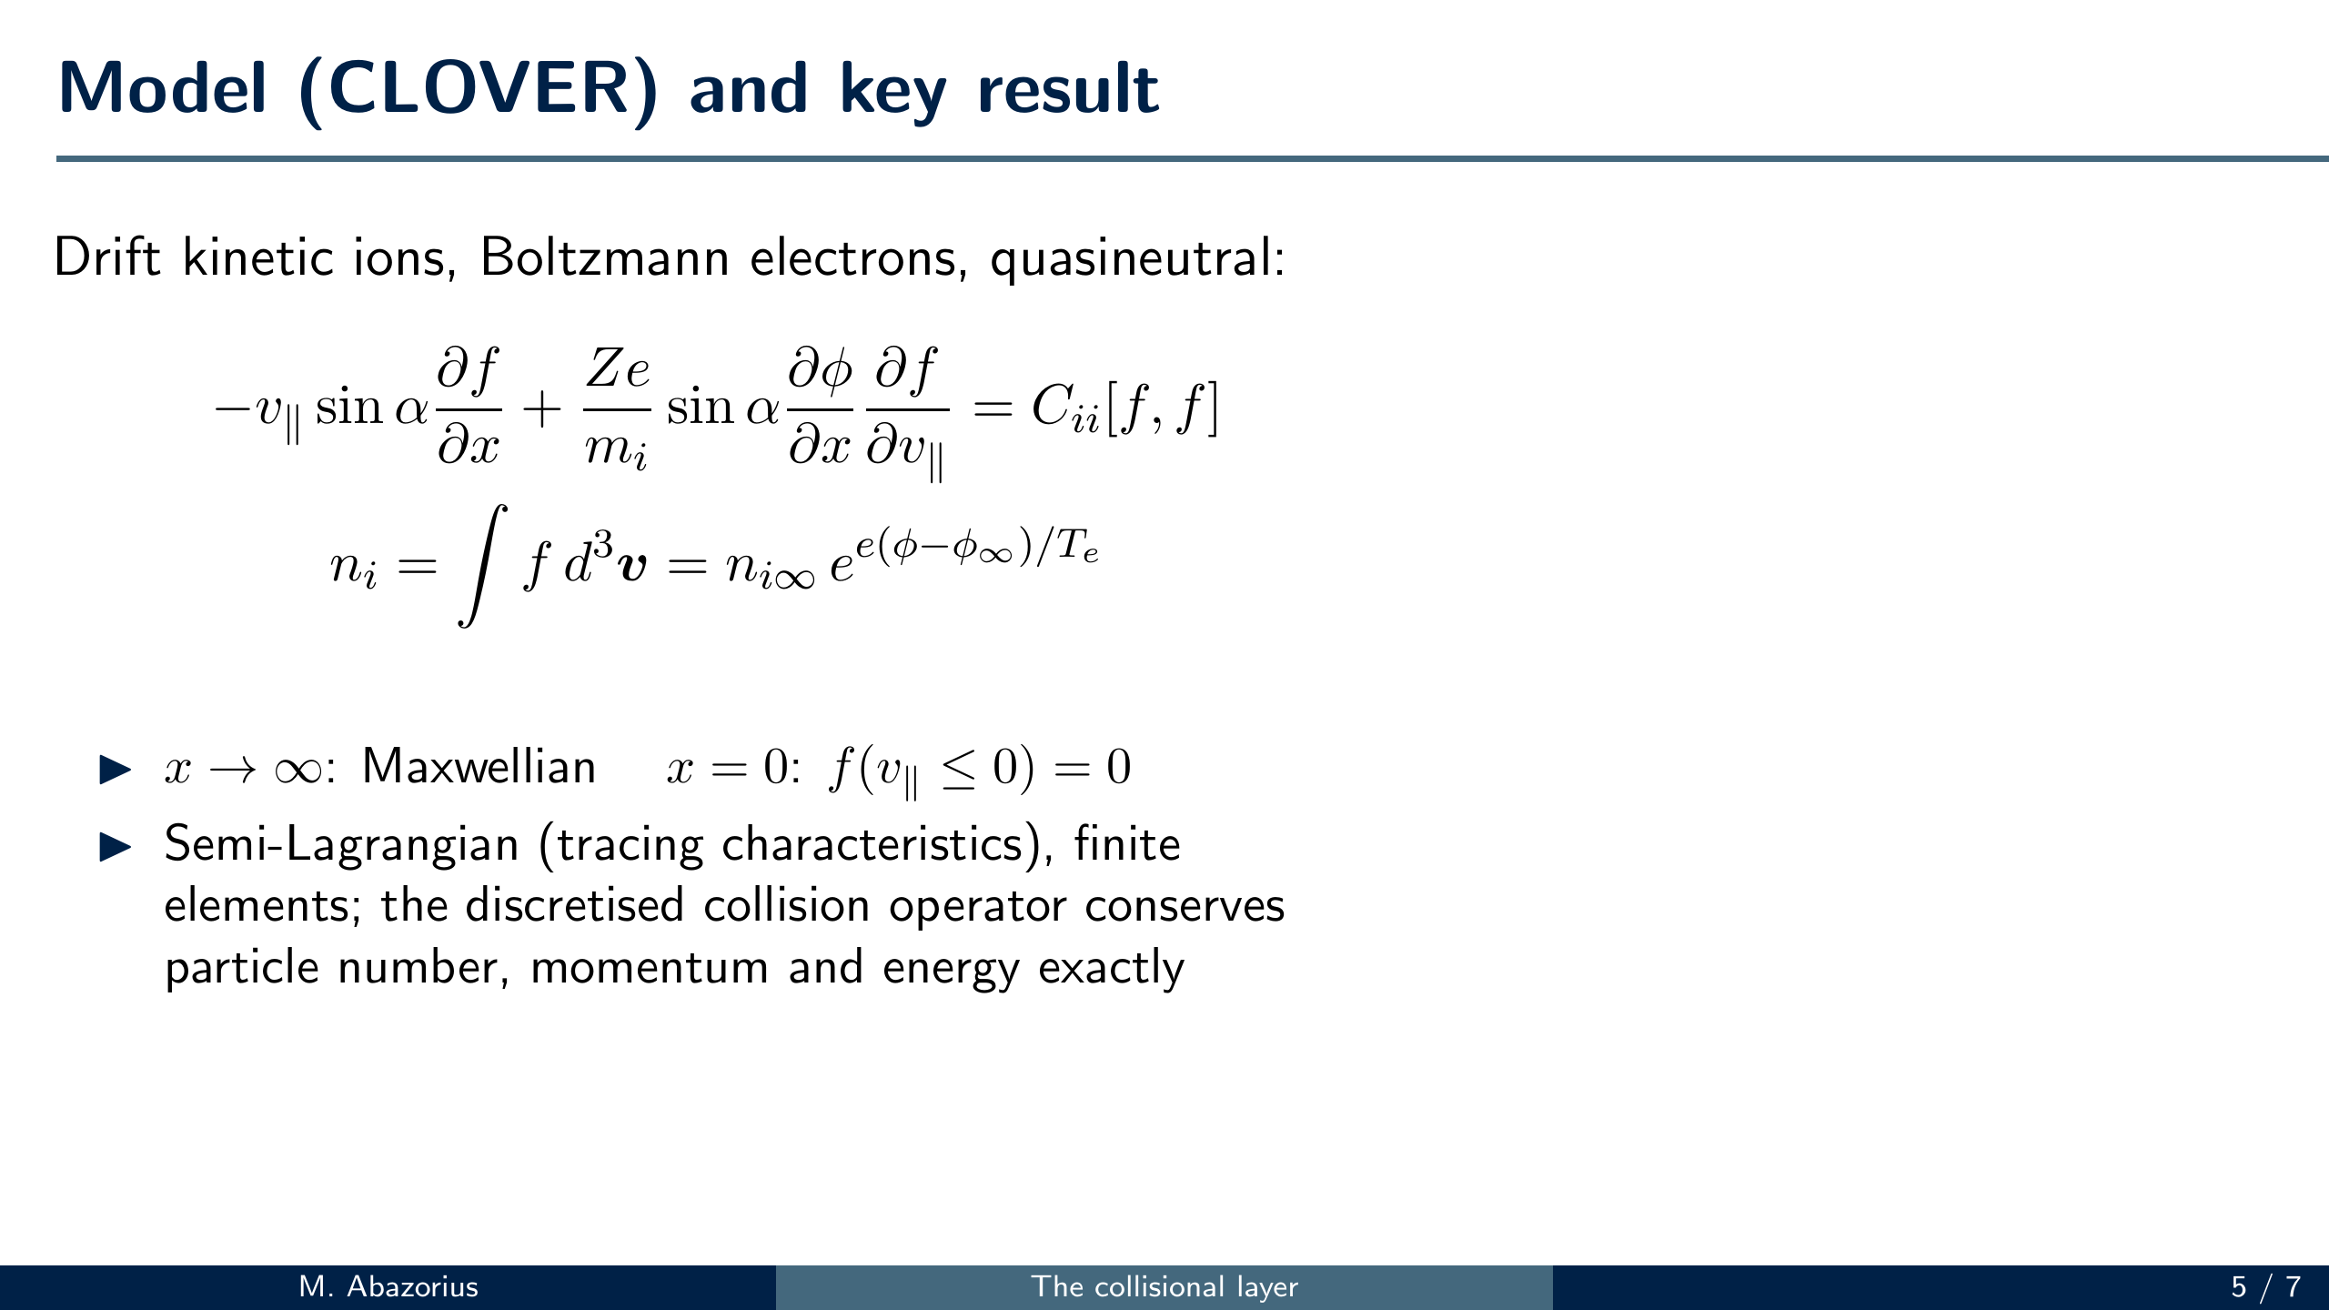
Notes:
SAY (~40 s): We solve the steady-state drift kinetic equation for the ions with the
full ion-ion collision operator, with Boltzmann electrons and quasineutrality:
the ion density, the integral of f, follows the Boltzmann factor. Far away the
ions are Maxwellian; at the presheath entrance no ions come back from the wall.
Our code, CLOVER, is semi-Lagrangian - it traces the characteristics, the ion
trajectories - with finite elements in velocity, and the discretised collision
operator conserves particle number, momentum and energy exactly.
[click] Near the presheath entrance we show analytically that the potential goes
like sqrt(x), so the electric field diverges - and that is what makes the
distribution satisfy the Chodura condition: the layer enforces it itself. The
simulations recover the sqrt(x) scaling for slow and fast incoming flow (plot).

Slide 10
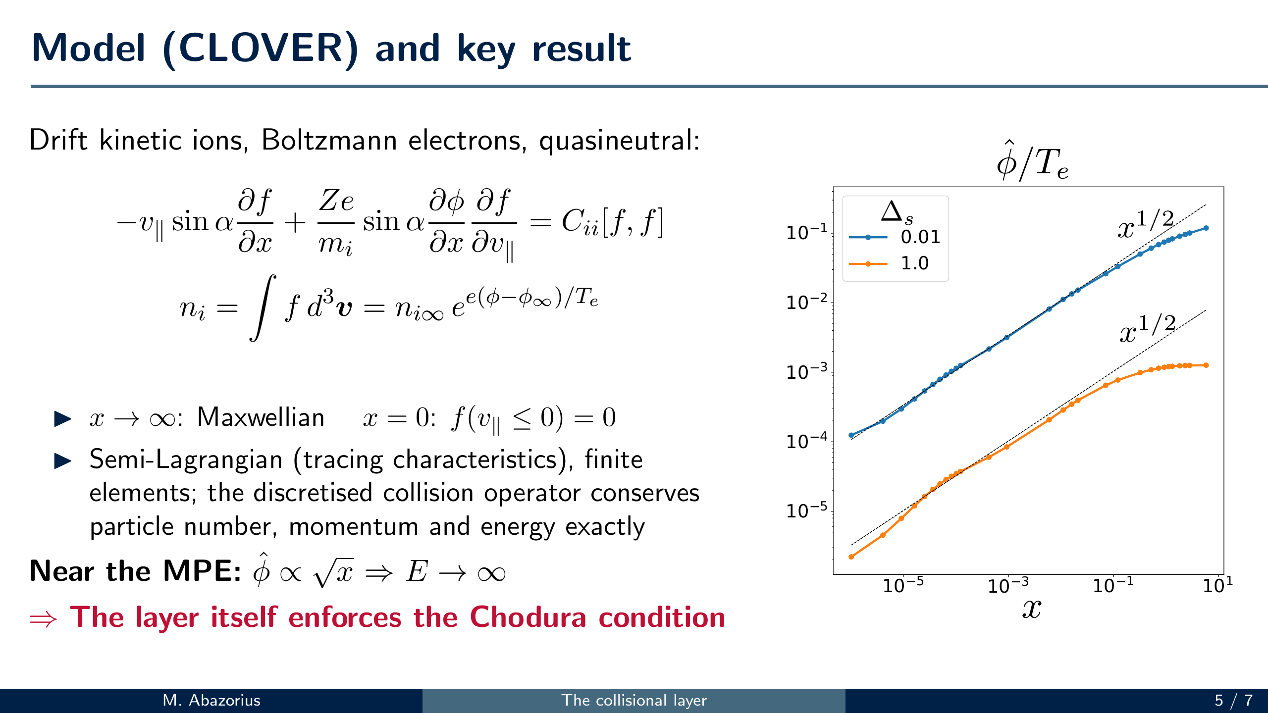

Slide 11
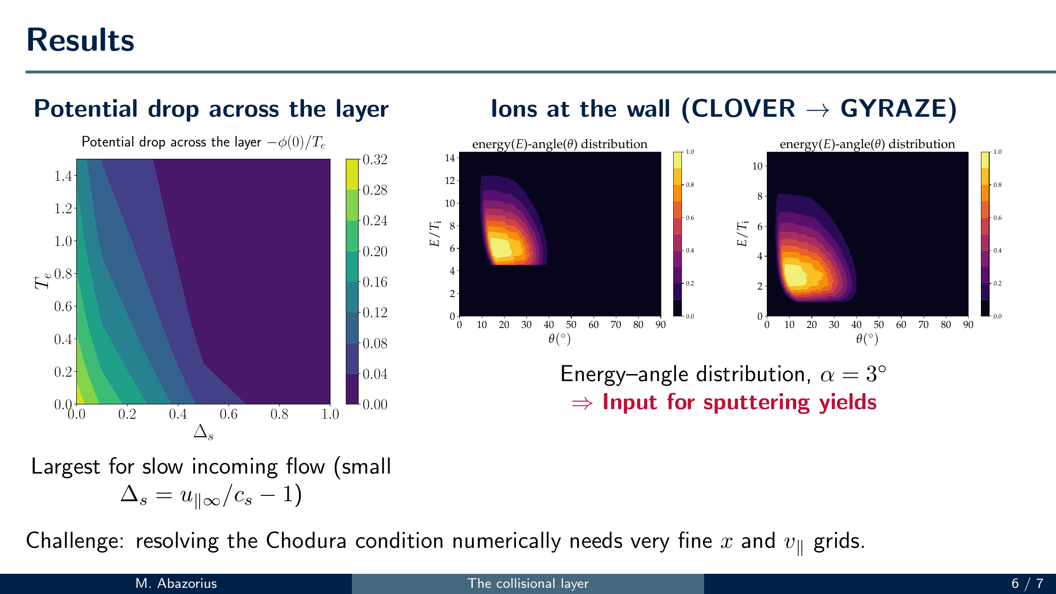
Notes:
SAY (~35 s): Two results. Left: the potential drop across the collisional layer as
a function of the electron temperature and the incoming flow Delta_s - it is
largest for slow flow. Right: we pass our distribution at the presheath entrance
to the magnetic presheath and Debye sheath solver GYRAZE and get the ion energy
and impact-angle distribution at the wall, here for alpha = 3 degrees and two
temperature ratios - what you need for sputtering yields. Numerically, resolving
the Chodura condition needs very fine grids near the wall - more on the poster.

Slide 12
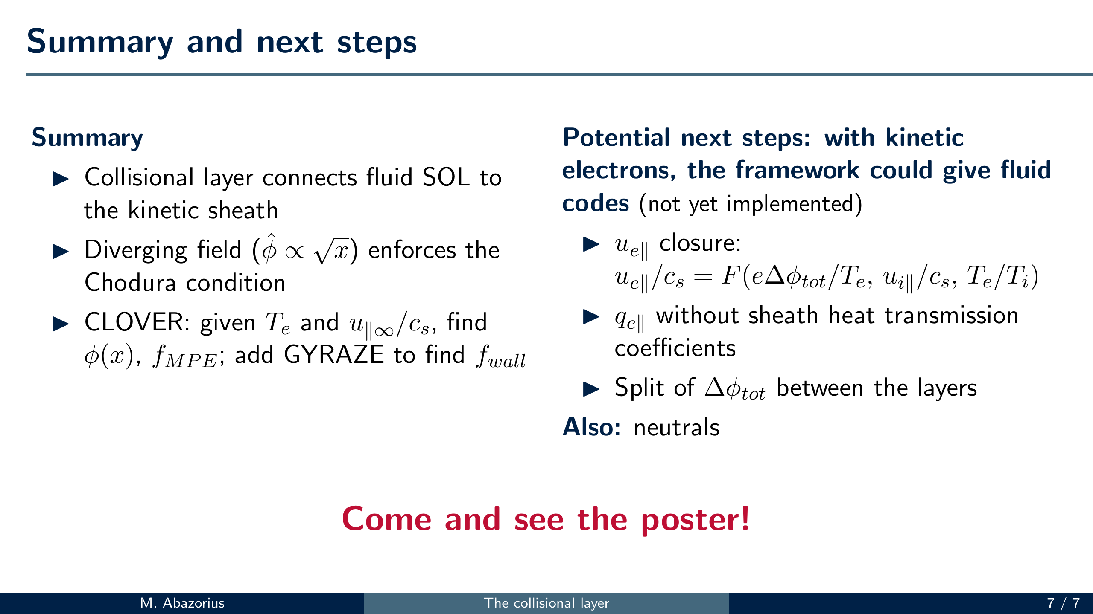
Notes:
SAY (~20 s): To summarise: the collisional layer connects the fluid SOL to the
kinetic sheath; the diverging field, phi_hat ~ sqrt(x), enforces the Chodura
condition; and given T_e and the incoming flow, CLOVER gives the potential and
the distribution at the presheath entrance, and with GYRAZE the distribution at
the wall. Potential next steps: with kinetic electrons the framework could give
fluid codes more than the ion flow condition - the electron flow, the electron
heat flux without transmission coefficients, and how the potential drop splits
between the layers. None of this is implemented yet. And neutrals.
Thanks - come and see the poster.
REFERENCE (for questions; from thesis sec. 1.4, 6.2, 6.3). Everything below
is what the framework COULD provide, not what has been done:
1. Electron parallel flow as a closure. With kinetic electrons, coupled to
the MP and Debye sheath (e.g. GYRAZE), the layer gives
u_e||/c_s = F(e dphi_tot/T_e, u_i||/c_s, T_e/T_i) (thesis eqs 1.35, 6.2).
Applying F at both ends of a field line gives the two missing conditions
for u_e|| and phi (thesis 1.4). Covers the grad_par u_e|| and grad_par j||
terms (j|| depends on u_e||, so the current condition comes from F too).
2. Electron heat flux without transmission coefficients. The electron
distribution at the collisional layer entrance gives q_e|| directly
(thesis 1.4): add the Braginskii heat-flux correction to incoming
electrons, solve the layer for the outgoing part (6.3). Covers the
grad_par(chi_e grad_par T_e) term. Hook: Hermes-3 TCV-X21 (Dudson 2025)
matches the target IR heat flux worst (d_j ~ 5, chi = 1.0) and its gamma_e
varies 3.5-9 - but they do NOT attribute that to gamma; don't claim it.
3. Split of the total potential drop between collisional layer, MP and
Debye sheath (6.3). Ion-only results already give the collisional layer
share; the split matters most once electrons are kinetic.
4. Ion flow condition u_i|| > c_s (thesis ch. 2). Fluid codes already use
it. Analytic decay length disagrees with numerics by ~10x in the thesis,
and the paper defers the proof - present as "consistent with what codes
assume", not as a new result.
5. Cannot provide: parallel viscosity and vorticity BCs - need higher-order
terms and gradients along the wall (thesis p. 35-36). Neutrals only help
fluid codes whose transport coefficients include neutral effects (6.2).
Not for fluid codes, but useful: ion energy-angle distribution at the wall
(sputtering); benchmarks for kinetic codes at the MPE (Chodura satisfied,
diverging E, phi_hat ~ sqrt(x)) (thesis 6.1).

