Slide 1
First time-dependent SOLPS-ITER simulations of detachment burn-through on MAST-U
UKAEA, Culham Campus, Abingdon OX14 3DB, UK
ªSee the author list of J. Harrison et al 2024 Nucl. Fusion (https://doi.org/10.1088/1741-4326/ad6011)
^{b}See the author list of N. Vianello et al 2026 Nucl. Fusion in press (https://doi.org/10.1088/1741-4326/ae71ec)
D Moulton, R Scannell, J Flanagan, S Leigh the MAST-U teamª and the EUROfusion Tokamak Exploitation team^{b}

Slide 2
Highlights and discussion points
Verification against the analytic solution for a 1D isothermal expansion of a gaussian density perturbation into vacuum
Wall clock per time step x5 and memory usage x38 in time-dependent Eirene case, for similar levels of noise
October 2026 ECW | D Moulton

Slide 3
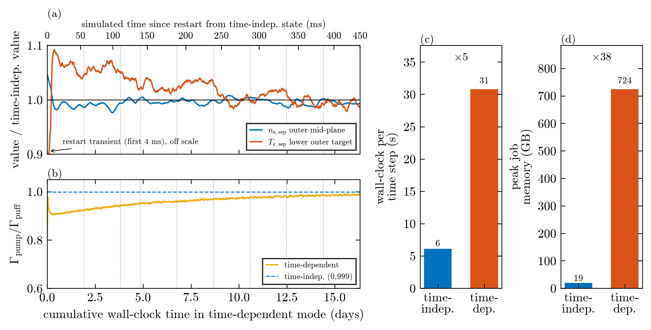
Highlights and discussion points
Verification against the analytic solution for a 1D isothermal expansion of a gaussian density perturbation into vacuum
Wall clock per time step x5 and memory usage x38 in time-dependent Eirene case, for similar levels of noise
October 2026 ECW | D Moulton

Slide 4
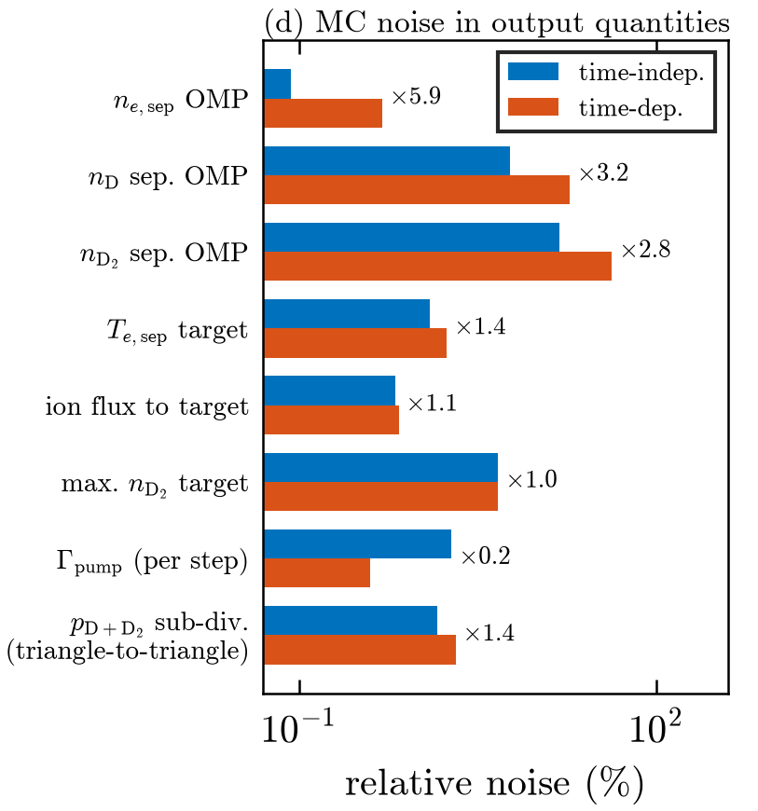
Highlights and discussion points
Verification against the analytic solution for a 1D isothermal expansion of a gaussian density perturbation into vacuum
Wall clock per time step x5 and memory usage x38 in time-dependent Eirene case, for similar levels of noise
What sets the noise level in time-dependent Eirene?
October 2026 ECW | D Moulton

Slide 5
Highlights and discussion points
Verification against the analytic solution for a 1D isothermal expansion of a gaussian density perturbation into vacuum
Wall clock per time step x5 and memory usage x38 in time-dependent Eirene case, for similar levels of noise
What sets the noise level in time-dependent Eirene?
When we run transient simulations of burnthrough, we see that the pre-existing neutral reservoir is far too small to buffer typical transients on MAST-U
Instead, recycling is a key driver of the degree of transient buffering. What sets the recycling timescale?
October 2026 ECW | D Moulton

