Slide 1

KN1DPy: A Python translation of KN1D
Jamie Dunsmore
UKAEA Exhaust Code Workshop 2026
MIT PSFC
Jerry Hughes
Aaron Ho
Brian LaBombard
Steven Thomas
William & Mary
Nicholas Brown
Saskia Mordijck
IPP CAS
Daniel Švorc

Slide 2
Outline
Introduction to KN1D
The Python translation and kn1d-lite
Recent applications of KN1D
Comparisons against 2D codes
Notes:
Regular validation just uses Thomson scattering
But internally the model has to have a neutral density profile and an estimate for the diffusion strength in the pedestal. Can we validate these. YES! Ly-alpha. Signpost really clearly here. Next slide
Inform improvements to the model. I’ll give some ideas.
Apply to SPARC

Slide 3
Outline
Introduction to KN1D
The Python translation and kn1d-lite
Recent applications of KN1D
Comparisons against 2D codes
Notes:
Regular validation just uses Thomson scattering
But internally the model has to have a neutral density profile and an estimate for the diffusion strength in the pedestal. Can we validate these. YES! Ly-alpha. Signpost really clearly here. Next slide
Inform improvements to the model. I’ll give some ideas.
Apply to SPARC

Slide 4
KN1D: Kinetic Neutrals in 1-Dimension
KN1D is a kinetic neutrals code with 1 spatial dimension and 2 velocity dimensions. It solves for the f_{H} and f_{H2} distribution functions on a plasma background.
Originally written (in IDL) by B. LaBombard in 2001 for fuelling studies on Alcator C-Mod
Scrape-off-Layer flows on Alcator C-Mod
Pedestal fuelling on C-Mod
Cross-field particle transport on TCV
IMEP modelling framework on AUG
Smick et al. Nuclear Fusion (2013)
Hughes et al. Physics of Plasmas (2006)
Han et al. Nuclear Fusion (2023)
Luda et al. Nuclear Fusion (2024)
KN1D is fast (~10s per run) and kinetic, but uses a simplified 1D slab geometry
Notes:
Regular validation just uses Thomson scattering
But internally the model has to have a neutral density profile and an estimate for the diffusion strength in the pedestal. Can we validate these. YES! Ly-alpha. Signpost really clearly here. Next slide
Inform improvements to the model. I’ll give some ideas.
Apply to SPARC

Slide 5
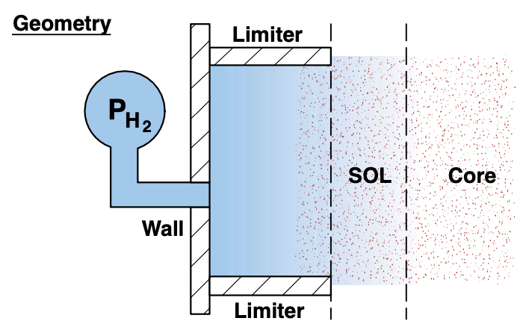
The code uses 1D slab geometry, with neutrals born from the limiter sides
Scalar Inputs
P_{H2}: molecular pressure at the gauge
Isotope mass
Profile Inputs (defined on x)
n_{e}
T_{e}
T_{i}
L_{c} (connection length)
v_{x} (plasma velocity profile)
Outputs
f_{H} (x, vx, vr)
f_{H2} (x, vx, vr)
Derived quantities
L_{c}
x=0
x_{lim}
x_{sep}
x
Notes:
Regular validation just uses Thomson scattering
But internally the model has to have a neutral density profile and an estimate for the diffusion strength in the pedestal. Can we validate these. YES! Ly-alpha. Signpost really clearly here. Next slide
Inform improvements to the model. I’ll give some ideas.
Apply to SPARC

Slide 6
The code uses 1D slab geometry, with neutrals born from the limiter sides
Scalar Inputs
P_{H2}: molecular pressure at the gauge
Isotope mass
Profile Inputs (defined on x)
n_{e}
T_{e}
T_{i}
L_{c} (connection length)
v_{x} (plasma velocity profile)
Outputs
f_{H} (x, vx, vr)
f_{H2} (x, vx, vr)
Derived quantities
H2
H
H+
x=0
x_{lim}
x_{sep}
x
Notes:
Regular validation just uses Thomson scattering
But internally the model has to have a neutral density profile and an estimate for the diffusion strength in the pedestal. Can we validate these. YES! Ly-alpha. Signpost really clearly here. Next slide
Inform improvements to the model. I’ll give some ideas.
Apply to SPARC

Slide 7


KN1D solves the Boltzmann equation for f_{H} and f_{H2} using the method of successive generations
0th generation
Molecules
Same procedure is used to solve for the atoms (although precise sources and sinks are slightly different)
Source from pressure gauge and limiter recycling of atoms and plasma
Sink from all collisional processes (dissociation, elastic scattering etc.)
j^{th} generation
Recycling source from previous generation
Charge-exchange source from previous generation
Sink from all collisional processes
Elastic scattering source from previous generation
Notes:
Regular validation just uses Thomson scattering
But internally the model has to have a neutral density profile and an estimate for the diffusion strength in the pedestal. Can we validate these. YES! Ly-alpha. Signpost really clearly here. Next slide
Inform improvements to the model. I’ll give some ideas.
Apply to SPARC

Slide 8
Outline
Introduction to KN1D
The Python translation and kn1d-lite
Recent applications of KN1D
Comparisons against 2D codes
Notes:
Regular validation just uses Thomson scattering
But internally the model has to have a neutral density profile and an estimate for the diffusion strength in the pedestal. Can we validate these. YES! Ly-alpha. Signpost really clearly here. Next slide
Inform improvements to the model. I’ll give some ideas.
Apply to SPARC

Slide 9
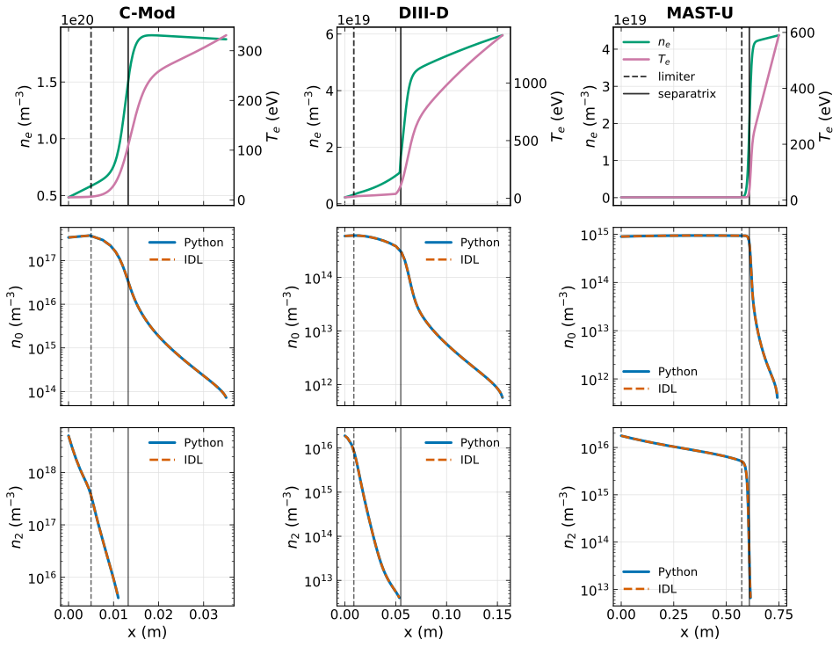
KN1DPy matches the IDL results for test cases on C-Mod, DIII-D and MAST-U (N. Brown)
Code improvements in Python version:
Important inputs like the velocity/spatial mesh resolution and different collision toggles can now be specified in a config file
Straightforward to add new rate coefficients into the code
Includes a reduced version of KN1D that runs from the separatrix inwards: kn1d-lite
https://github.com/W-M-plasma-group/KN1DPy
Max error between Python and IDL neutral profiles: <0.1%
Notes:
Regular validation just uses Thomson scattering
But internally the model has to have a neutral density profile and an estimate for the diffusion strength in the pedestal. Can we validate these. YES! Ly-alpha. Signpost really clearly here. Next slide
Inform improvements to the model. I’ll give some ideas.
Apply to SPARC

Slide 10
kn1d-lite solves for the atomic neutrals inside the separatrix
H2
H
H+
x=0
x_{lim}
x_{sep}
x
Notes:
Regular validation just uses Thomson scattering
But internally the model has to have a neutral density profile and an estimate for the diffusion strength in the pedestal. Can we validate these. YES! Ly-alpha. Signpost really clearly here. Next slide
Inform improvements to the model. I’ll give some ideas.
Apply to SPARC

Slide 11
kn1d-lite solves for the atomic neutrals inside the separatrix
H
H+
Idea
Specify plasma profiles inside the LCFS and the n0 distribution function at the LCFS
Removes complexity/uncertainty surrounding recycling model, treatment of molecules and plasma profiles in the SOL
Runs in a couple of seconds
x=0
x
Notes:
Regular validation just uses Thomson scattering
But internally the model has to have a neutral density profile and an estimate for the diffusion strength in the pedestal. Can we validate these. YES! Ly-alpha. Signpost really clearly here. Next slide
Inform improvements to the model. I’ll give some ideas.
Apply to SPARC

Slide 12
Outline
Introduction to KN1D
The Python translation and kn1d-lite
Recent applications of KN1D
Comparisons against 2D codes
Notes:
Regular validation just uses Thomson scattering
But internally the model has to have a neutral density profile and an estimate for the diffusion strength in the pedestal. Can we validate these. YES! Ly-alpha. Signpost really clearly here. Next slide
Inform improvements to the model. I’ll give some ideas.
Apply to SPARC

Slide 13
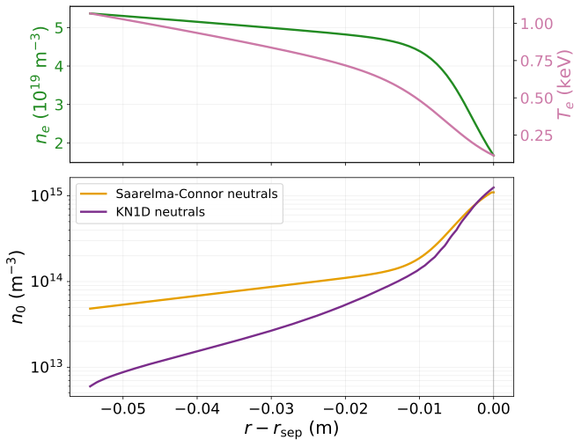
Application 1: kn1d-lite to supply S_{ion} in reduced models for the density pedestal
Saarelma-Connor model couples a reduced plasma transport model to a two-jet neutral model in the pedestal
Saarelma et al. Nuclear Fusion (2023)
Saarelma et al. Nuclear Fusion (2024)
Model assumes negligible edge ionisation source at 𝜓_{N} = 0.85, but validation on DIII-D shows that this is not the case with the two-jet model
Dunsmore et al. In preparation (2026)
Using KN1D as the neutrals model improves agreement with experimental n_{e} profiles
kn1d-lite
Notes:
Regular validation just uses Thomson scattering
But internally the model has to have a neutral density profile and an estimate for the diffusion strength in the pedestal. Can we validate these. YES! Ly-alpha. Signpost really clearly here. Next slide
Inform improvements to the model. I’ll give some ideas.
Apply to SPARC

Slide 14
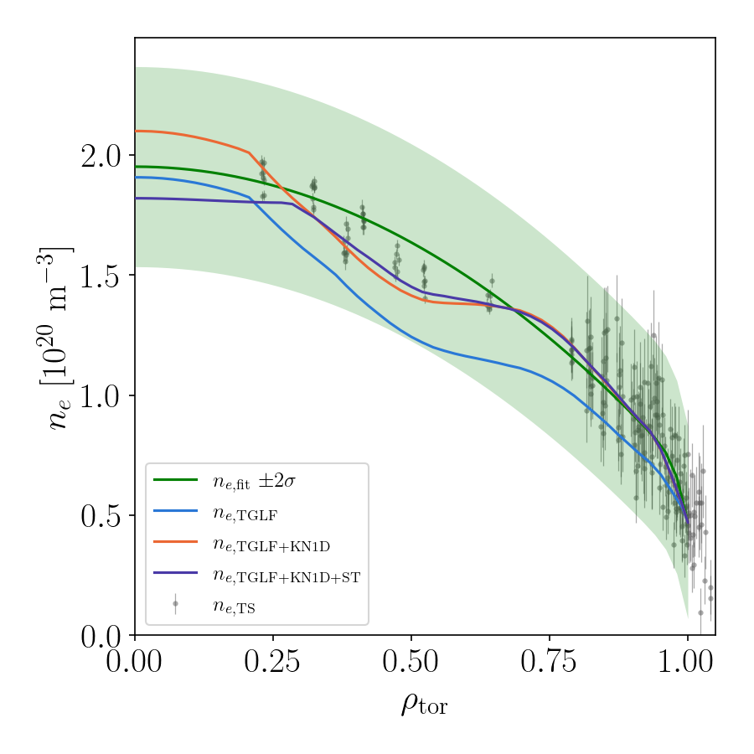
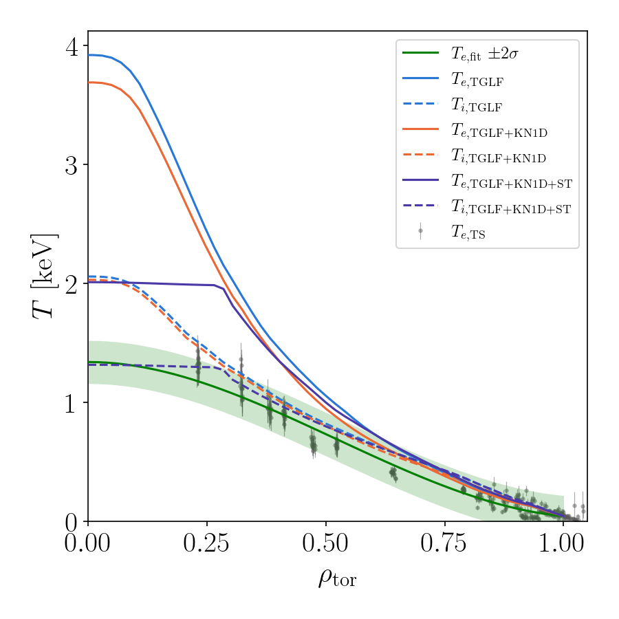
Application 2: kn1d-lite as the neutrals model in TORAX (A. Ho)
C-Mod Ohmic L-mode test case
Work still ongoing, but agreement has improved by including kn1d-lite and sawteeth (ST) in the model.
kn1d-lite
Notes:
Regular validation just uses Thomson scattering
But internally the model has to have a neutral density profile and an estimate for the diffusion strength in the pedestal. Can we validate these. YES! Ly-alpha. Signpost really clearly here. Next slide
Inform improvements to the model. I’ll give some ideas.
Apply to SPARC

Slide 15
Outline
Introduction to KN1D
The Python translation and kn1d-lite
Recent applications of KN1D
Comparisons against 2D codes
Notes:
Regular validation just uses Thomson scattering
But internally the model has to have a neutral density profile and an estimate for the diffusion strength in the pedestal. Can we validate these. YES! Ly-alpha. Signpost really clearly here. Next slide
Inform improvements to the model. I’ll give some ideas.
Apply to SPARC

Slide 16
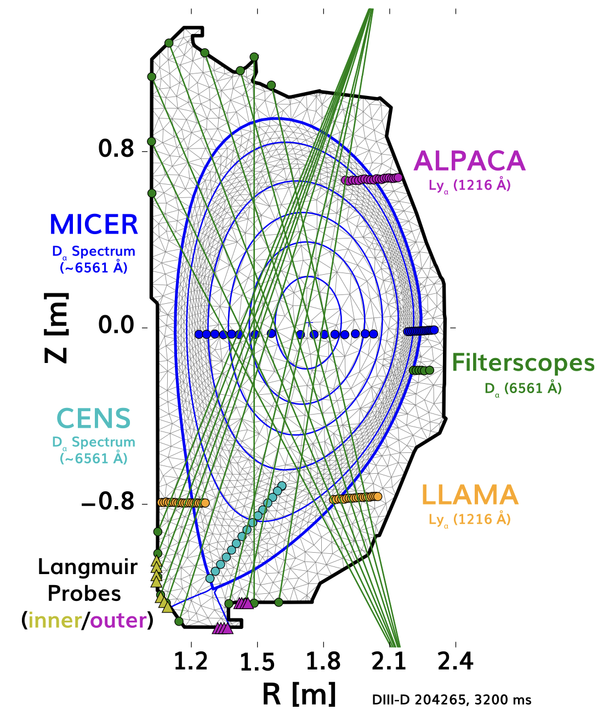
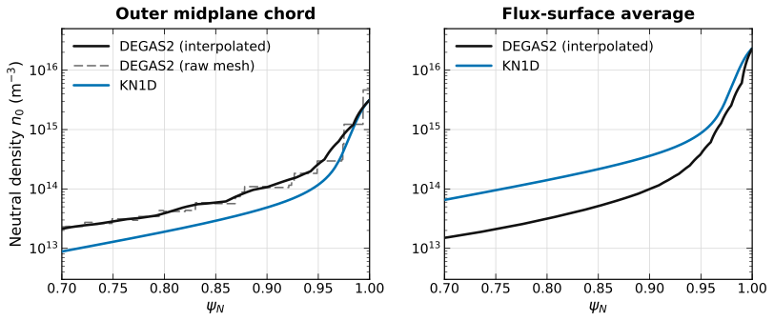
Currently trying to validate KN1D against 2D DEGAS2 simulations on DIII-D
New workflow uses experimental neutral measurements to constrain DEGAS2 simulations on DIII-D
KN1D
OMP: good agreement (factor of ~2). Would agreement be improved with higher DEGAS2 mesh resolution?
FSA: lots of neutrals coming from the X-point in the DEGAS2 simulations, not captured by KN1D outer midplane geometry
Pratt et al. Nuclear Fusion (2026)
Notes:
Regular validation just uses Thomson scattering
But internally the model has to have a neutral density profile and an estimate for the diffusion strength in the pedestal. Can we validate these. YES! Ly-alpha. Signpost really clearly here. Next slide
Inform improvements to the model. I’ll give some ideas.
Apply to SPARC

Slide 17
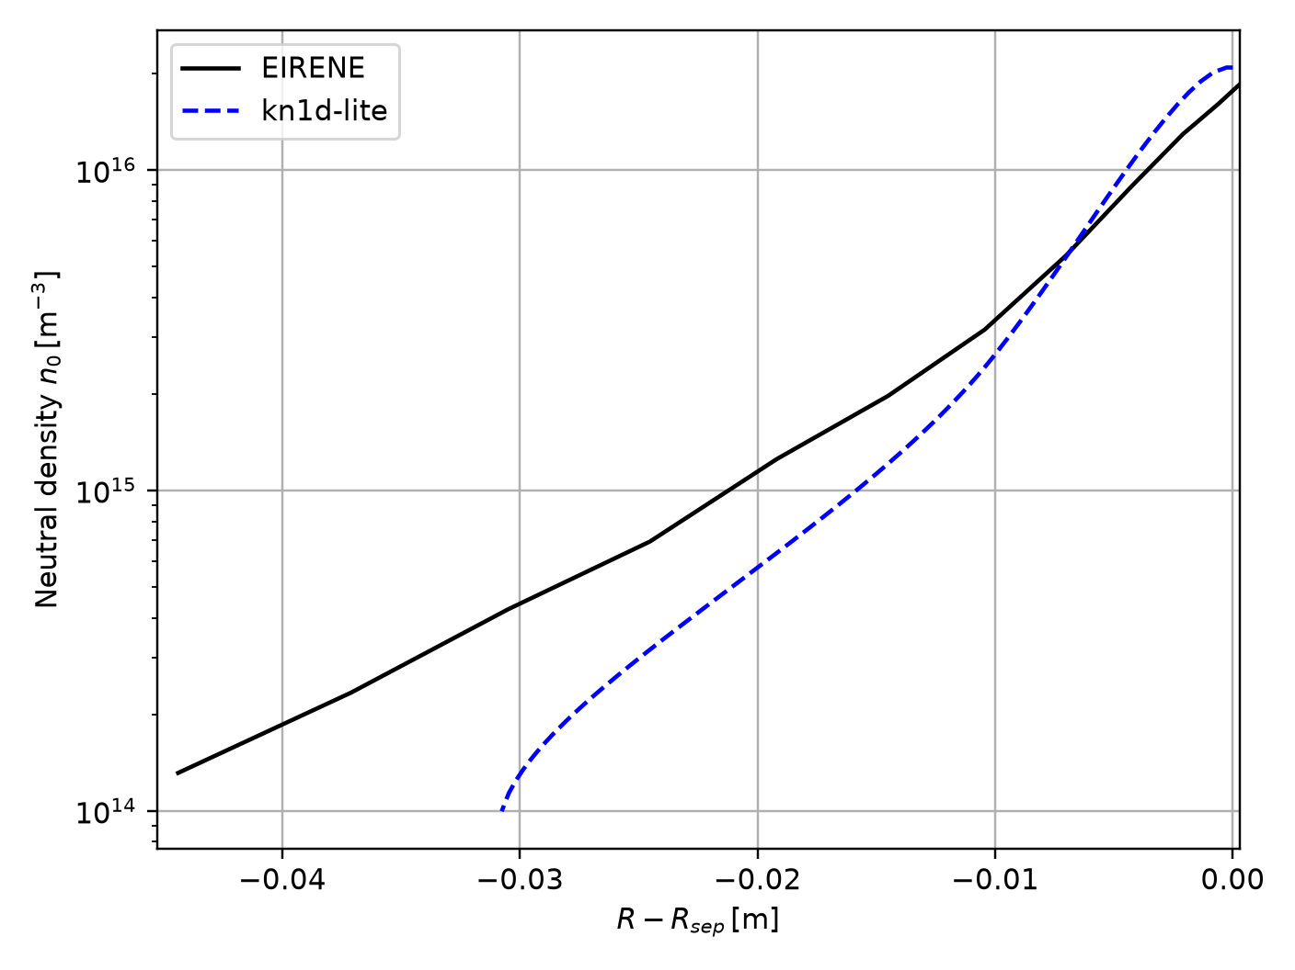
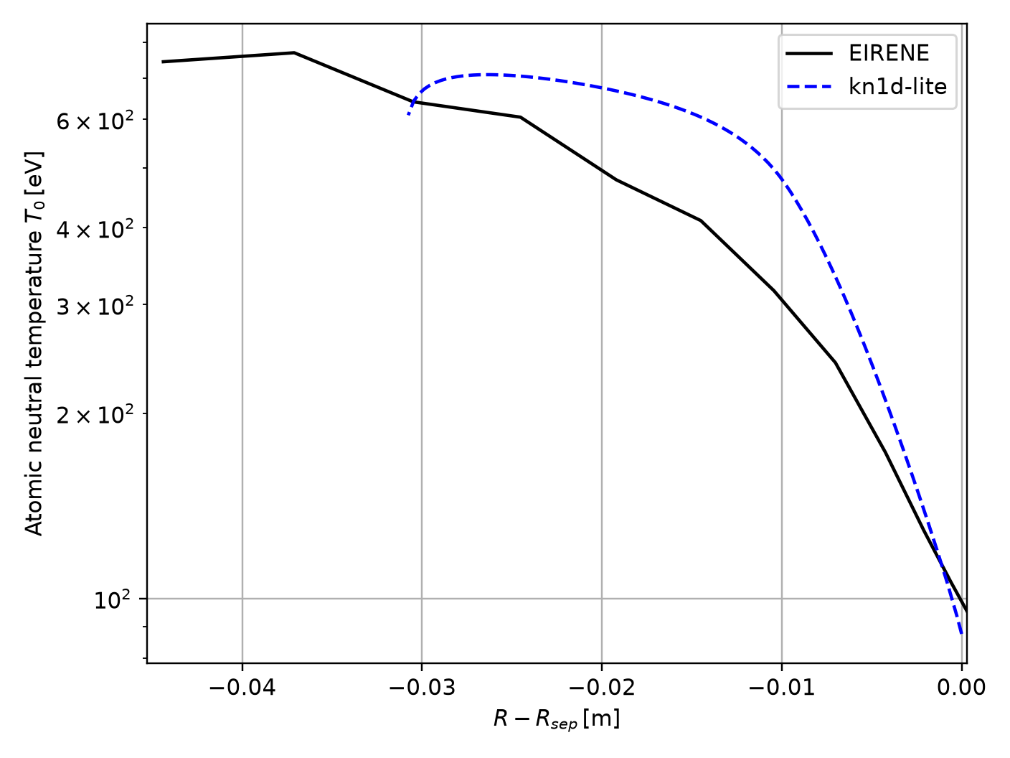
Work is also ongoing to validate KN1D against C-Mod SOLPS/EIRINE simulations (D. Švorc)
SOLPS simulations from:
M.A. Miller, PhD thesis (2025)
Preliminary results show faster decay of neutrals in kn1d-lite than in EIRENE
Still to check:
  Match rate coefficients + collisions
  Energy of the incident neutral beam in kn1d-lite
kn1d-lite
Notes:
Regular validation just uses Thomson scattering
But internally the model has to have a neutral density profile and an estimate for the diffusion strength in the pedestal. Can we validate these. YES! Ly-alpha. Signpost really clearly here. Next slide
Inform improvements to the model. I’ll give some ideas.
Apply to SPARC

Slide 18
Open Questions & Comments
Are there any standard test cases with fixed geometry, collisional processes and rate coefficients?
KN1D, SOLPS and DEGAS2 use three different sets of rate coefficients. Is there any consensus on what the most accurate rate coefficients are?
2D effects are clearly very important for the neutrals: is it possible to get away with a suitable 1D model for the purposes of reduced pedestal models?
Notes:
Regular validation just uses Thomson scattering
But internally the model has to have a neutral density profile and an estimate for the diffusion strength in the pedestal. Can we validate these. YES! Ly-alpha. Signpost really clearly here. Next slide
Inform improvements to the model. I’ll give some ideas.
Apply to SPARC

Slide 19
Thank you!
Notes:
Regular validation just uses Thomson scattering
But internally the model has to have a neutral density profile and an estimate for the diffusion strength in the pedestal. Can we validate these. YES! Ly-alpha. Signpost really clearly here. Next slide
Inform improvements to the model. I’ll give some ideas.
Apply to SPARC

Slide 20
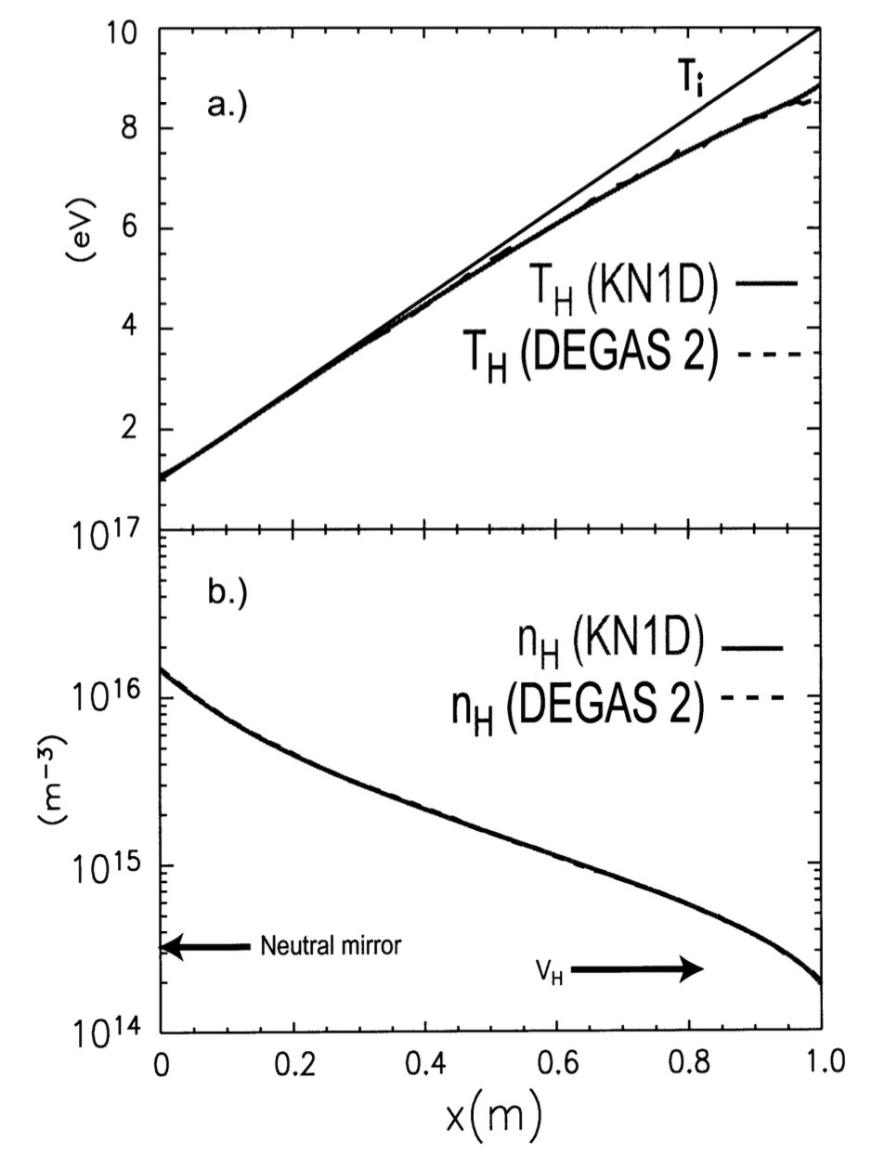
Benchmarking
Some benchmarking was done on the charge-exchange terms between the original IDL KN1D and DEGAS2 in a slab geometry.
J.W. Hughes, PhD thesis (2005)
Good agreement was obtained but only after matching the CX rate coefficients in DEGAS2
Are there any standard test cases that can be used to benchmark these codes in a more systematic way?
Notes:
Regular validation just uses Thomson scattering
But internally the model has to have a neutral density profile and an estimate for the diffusion strength in the pedestal. Can we validate these. YES! Ly-alpha. Signpost really clearly here. Next slide
Inform improvements to the model. I’ll give some ideas.
Apply to SPARC

Slide 21
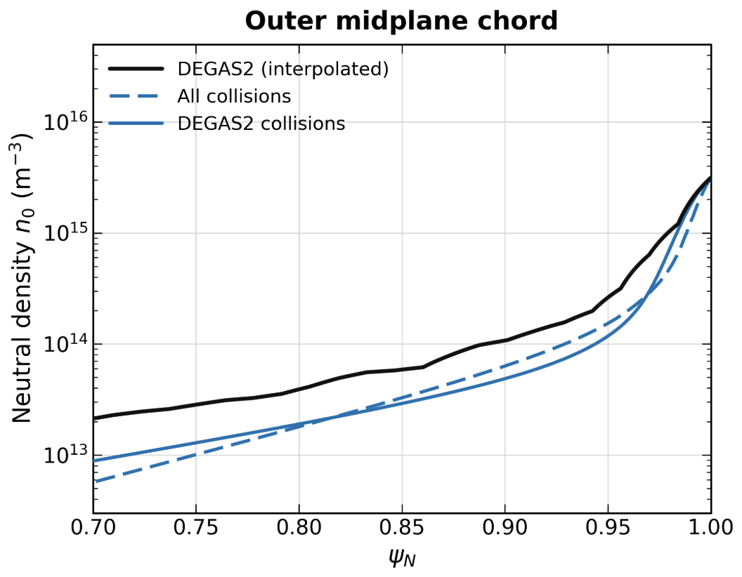
How do KN1D results change when you add in elastic collisions?
DEGAS2 is run without elastic collisions. Elastic collisions on vs off does have a small effect on the KN1D results
Notes:
Regular validation just uses Thomson scattering
But internally the model has to have a neutral density profile and an estimate for the diffusion strength in the pedestal. Can we validate these. YES! Ly-alpha. Signpost really clearly here. Next slide
Inform improvements to the model. I’ll give some ideas.
Apply to SPARC

Slide 22
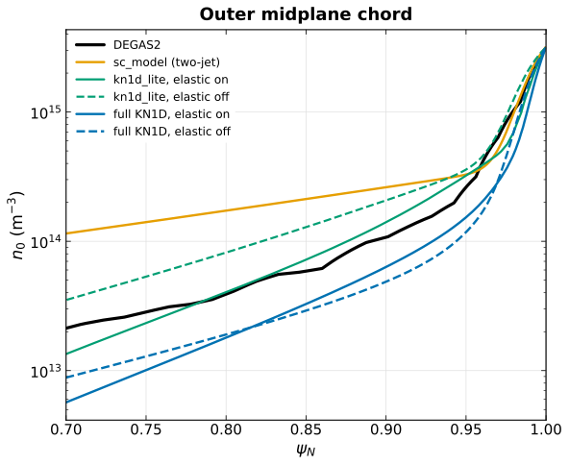
How do KN1D and kn1d-lite profiles compare to the Saarelma-Connor neutrals model?
kn1d-lite with elastic scattering actually overpredicts slightly the DEGAS2 result – still lower than the Saarelma-Connor profile
Notes:
Regular validation just uses Thomson scattering
But internally the model has to have a neutral density profile and an estimate for the diffusion strength in the pedestal. Can we validate these. YES! Ly-alpha. Signpost really clearly here. Next slide
Inform improvements to the model. I’ll give some ideas.
Apply to SPARC

Slide 23
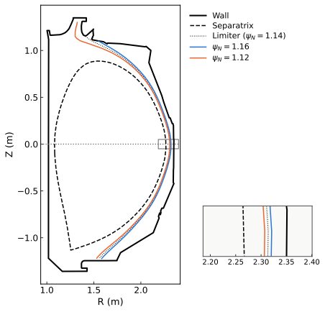
How is the KN1D geometry chosen for DIII-D?
X_wall: use limiter position at the outer midplane (black solid line)
X_lim: the innermost flux surface that intersects both the upper and lower baffle: ‘window-frame’ method
Whyte et. al., PPCF (2005)
Lc: trace the contour of this innermost flux surface between the upper and lower baffles (in reality, results are not sensitive to this input)
Notes:
Regular validation just uses Thomson scattering
But internally the model has to have a neutral density profile and an estimate for the diffusion strength in the pedestal. Can we validate these. YES! Ly-alpha. Signpost really clearly here. Next slide
Inform improvements to the model. I’ll give some ideas.
Apply to SPARC

Slide 24
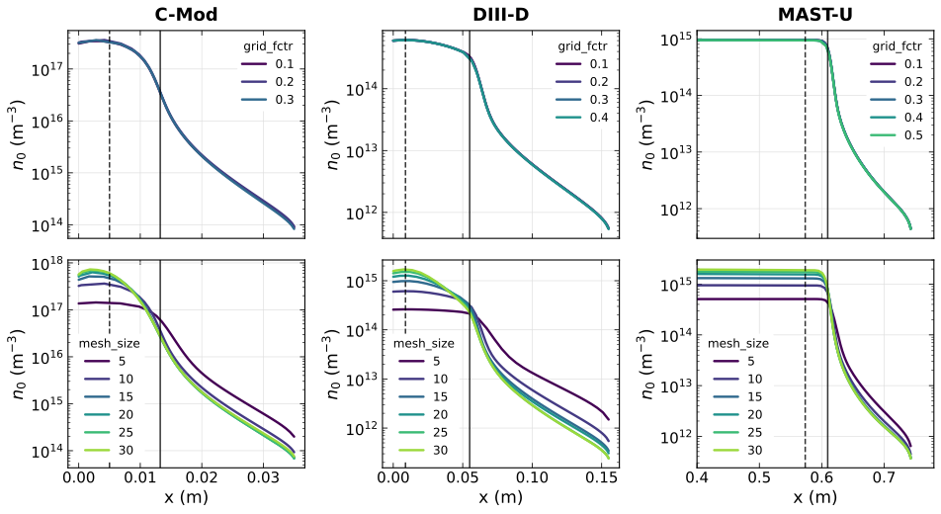
How sensitive are KN1D results to spatial mesh resolution and velocity mesh resolution?
Notes:
Regular validation just uses Thomson scattering
But internally the model has to have a neutral density profile and an estimate for the diffusion strength in the pedestal. Can we validate these. YES! Ly-alpha. Signpost really clearly here. Next slide
Inform improvements to the model. I’ll give some ideas.
Apply to SPARC

Slide 25
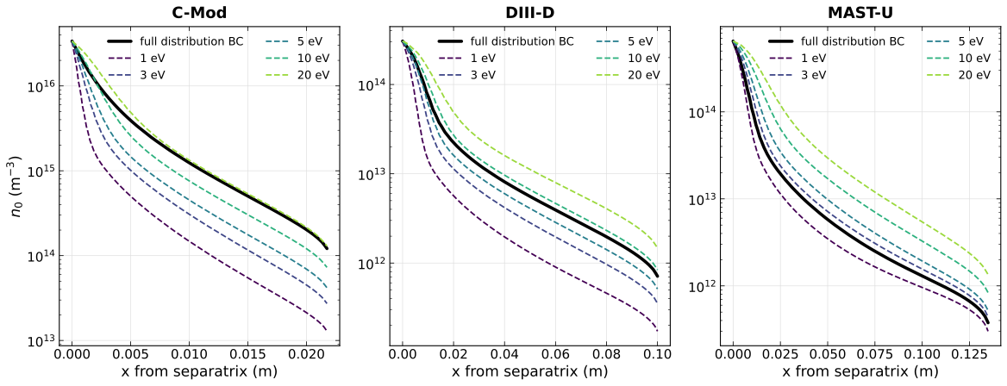
How do kn1d-lite results depend on the energy of the incident neutral beam at the separatrix?
Notes:
Regular validation just uses Thomson scattering
But internally the model has to have a neutral density profile and an estimate for the diffusion strength in the pedestal. Can we validate these. YES! Ly-alpha. Signpost really clearly here. Next slide
Inform improvements to the model. I’ll give some ideas.
Apply to SPARC

