Slide 1
Adding Molecules to Hermes-3
Owen Parry & The Hermes-3 Development Team
Reactions Framework
The Kotov Mechanism
Dissociation
Elastic collisions
Molecular CX
Hermes-3 configuration file
Stoichiometric matrix
Auto-generated source terms:
Molecule-activated chains

Slide 2
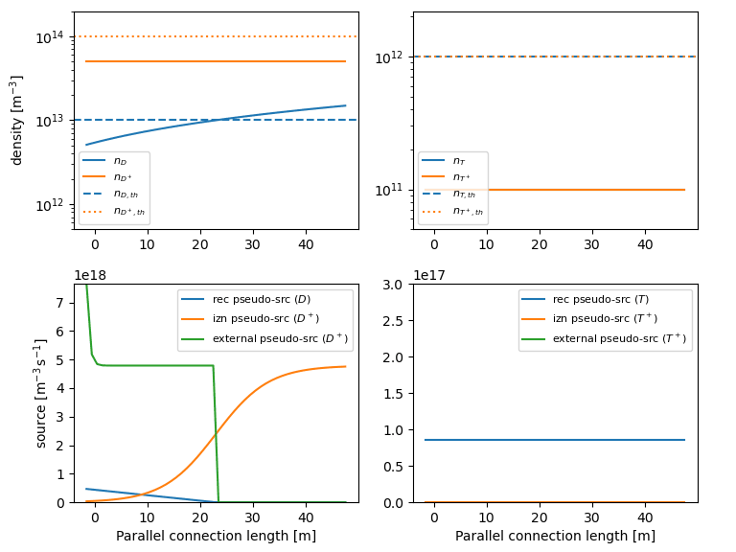
Adding Molecules to Hermes-3
Owen Parry & The Hermes-3 Development Team
Numerical challenges
Initial Testing in 1D
Extreme atomic, molecular density & pressure gradients near the target
Highly supersonic neutral velocities
Dissociation + elastic collisions only; No d₂⁺
Full Kotov mechanism
Strategies:
Neutral Parallel Diffusion (reaction/collision-driven)
Neutral velocity regularisation
Pseudo-reaction sources:
 | Enabled source(s)
Molecules depleted | Pseudo-association
Atoms depleted | Pseudo-recombination
Ions depleted | Pseudo-ionisation
Atoms and ions depleted | External ion source + pseudo-recombination
Rollover plot – sweep upstream density and record target ion flux
Timescale slow enough to avoid floor-like behaviour, but fast enough to compete with physical reactions in depleted conditions
Pseudo-reactions restore depleted species

