Slide 1
A One-Dimensional Integrated Workflow for Tungsten Sputtering, Transport, and Redeposition in the Divertor Region
Tengfei Tang，K. T. E. Chua¹ A. Geraldini² V. H. Hall-Chen¹ M. Abazorius³
¹ FEAT, A*STAR, ² University of York
³ CCFE, UKAEA
ECW 2026

Slide 2
OUTLINE
Tungsten impurity in Tokamak
1D Sheath model benchmark
Coupled model for the tungsten sputtering
Tungsten impurity under sheath
Summary

Slide 3
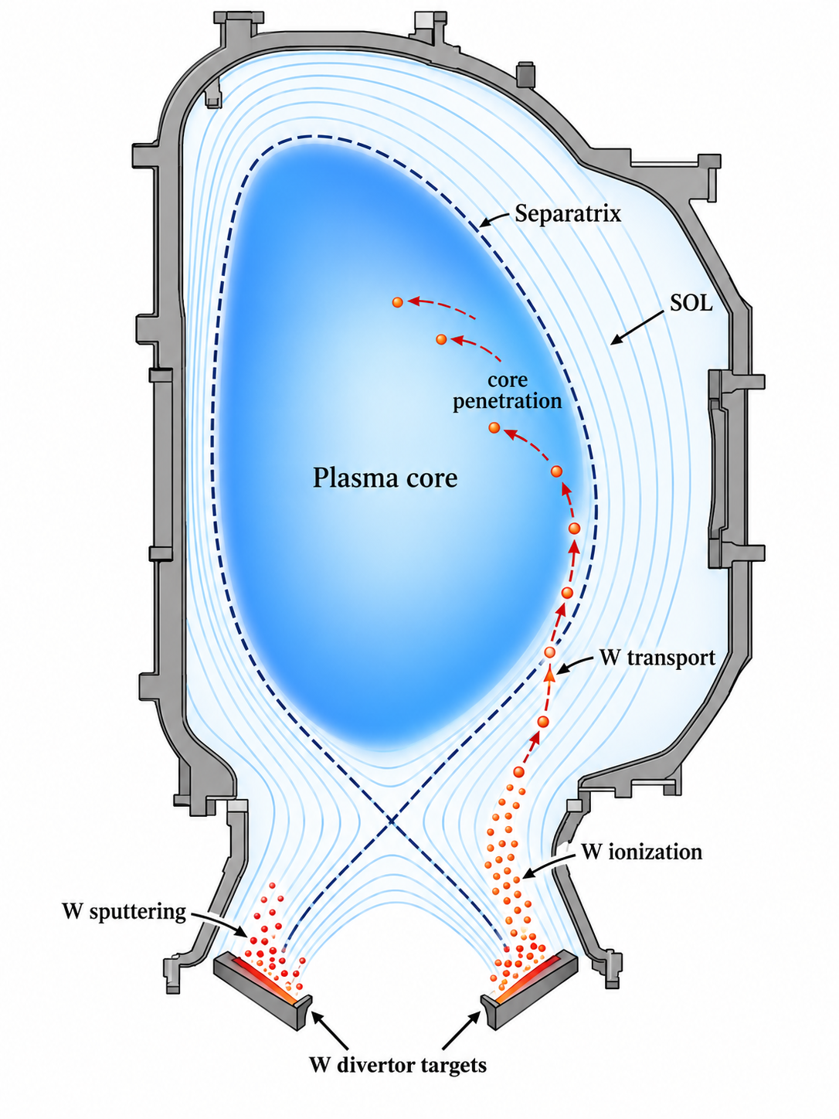
Tungsten impurity in Tokamak
Full poloidal cross-section: W source and transport path
Generation at tungsten plasma-facing components
Incident ions and charge-exchange neutrals strike W divertor targets.
1
Physical sputtering releases neutral tungsten W⁰ near the surface.
Edge plasma ionizes W⁰ to W⁺ and then higher charge states Wᶻ⁺.
Transport after ionization
SOL/divertor
Parallel flow and friction move W ions along open field lines; many particles redeposit.
Pedestal/core
Cross-field transport, neoclassical pinch and turbulence set the inward flux.
Radiation
High-Z W radiates efficiently; small core concentration can cool and dilute the plasma.
What the model chain must predict
ion impact
E, θ
sputtering
Y(E,θ)
ionization
W⁰→Wᶻ⁺
transport
SOL→core
Radiation
Core
Sheath

Slide 4
Simulation of tungsten generation and transport
Typical code workflow for W source generation, near-wall transport, redeposition, radiation and core penetration
1 Edge plasma state
2 Sheath + W source
3 MC impurity transport
4 Core / MHD response
• SOLPS-ITER / EDGE2D-EIRENE
• UEDGE / Hermes-3 / SOLEDGE
• Outputs: nₑ, Tₑ, Tᵢ, Γᵢ, B, α, neutrals
• Analytic sheath / PIC
• SDTrimSP / TRIM / yield database
• Maps target state → IED/IAD → S_W(E,θ)
• ERO2.0 / DIVIMP / ASCOT/OPENEDGE/VANTAGE
• Trace W⁰ and Wᶻ⁺: ionization, CX, drifts
• STRAHL / JOREK / integrated models
• Pedestal-core W accumulation
• Radiative cooling, ELM/RMP/disruption effects
Sheath physics:
Floating/sheath potential sets impact energy and ion acceleration (IED)
Magnetic presheath bends gyro-orbits and changes incidence angle θ (IAD)
Near-wall full-orbit treatment controls prompt redeposition
Divertor regime changes Tₑ, Tᵢ, nₜ, Γᵢ → different W source

Slide 5
Code workflow of the 1D model
Main coupling sequence
1. Fluid code
2. Sheath / MPS
3. MC tracing
4. DSMC
Hermes-3
Clover, GYRAZE *
sample ions in E and B
near-wall W / neutrals
Solve edge/divertor plasma and neutrals.
Output: n_e, T_e, T_i, Gamma_i, q_parallel, flow, B, alpha, recycling state.
Map fluid target state to near-wall fields.
Output: phi_s, E(x), sheath potential, magnetic-presheath bending.
Sample f_i(v) and integrate ion orbits.
Output: Gamma_i(E,theta), IED/IAD, flux-weighted impact distribution.
Track sputtered W, reflected particles and neutral collisions.
Output: redeposition, escape fraction, W source to plasma.
Wall time : minutes
What each coupling stage changes
Fluid -> sheath
Sheath -> MC
MC -> DSMC
Plasma background
IAE and IDE
Sputtering yield，redeposition
tungsten atom and ion distribution at the sheath
*Geraldini A et al., Monotonic sheaths near a wall with grazing magnetic incidence (2025)

Slide 6
OUTLINE
Tungsten sputtering in Tokamak
1D Sheath model benchmark
Coupled model for the tungsten sputtering
Tungsten impurity under sheath
Summary

Slide 7
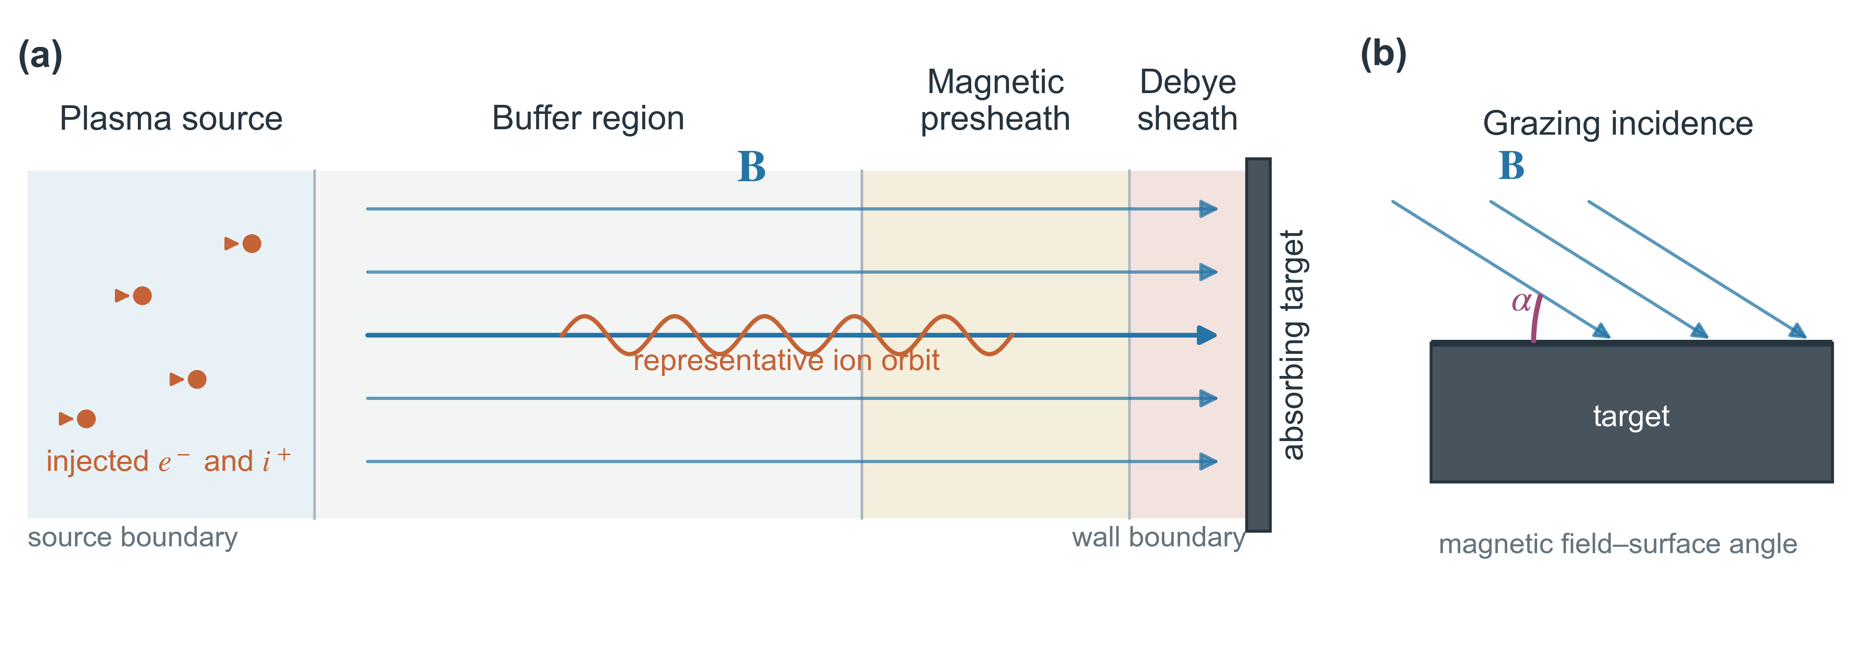
Particle-in-cell (PIC) sheath model: 1D3V with a plasma source
New features added:
Poisson solver: TDMA, SuperLU, MG
Code capability:
  Coloum collision; ionization; excitation; charge exchange collision; Recombination collision; sputtering yield; 2D3V; multi-species ion.
Code: lizCode (based on *Smilei)
  Smilei is an open-source PIC code
Model: 1D3V
  1D in space, 3D in velocity
*Derouillat J et al., Comput. Phys. Commun. 222 (2018) 351-373 (Smilei PIC)
Notes:
The parallel velocity of the ion is the sound speed.

Slide 8
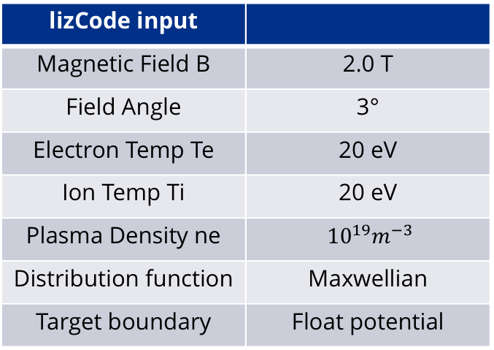
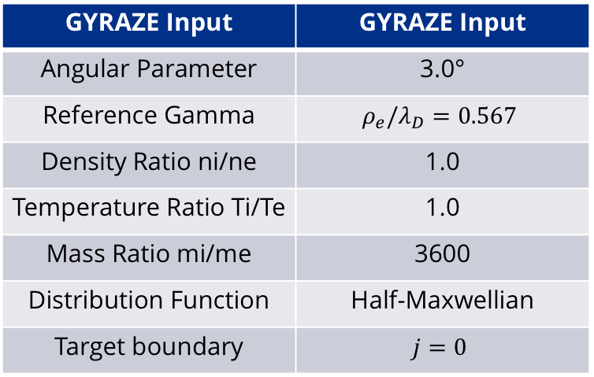
Calculate the GYRAZE input from the PIC input
lizCode input
Magnetic Field B | 2.0 T
Field Angle | 3°
Electron Temp Te | 20 eV
Ion Temp Ti | 20 eV
Plasma Density ne | ${10}^{19}m^{−3}$
Distribution function | Maxwellian
Target boundary | Float potential
GYRAZE Input | GYRAZE Input
Angular Parameter | 3.0°
Reference Gamma | $$ρ_{e}/λ_{D}=0.567$$
Density Ratio ni/ne | 1.0
Temperature Ratio Ti/Te | 1.0
Mass Ratio mi/me | 3600
Distribution Function | Half-Maxwellian
Target boundary | $$j=0$$
lizCode has the bulk plasma and sheath (5 mm), no collision is added.
A drift velocity of Cs along the magnetic field line is added.

Slide 9
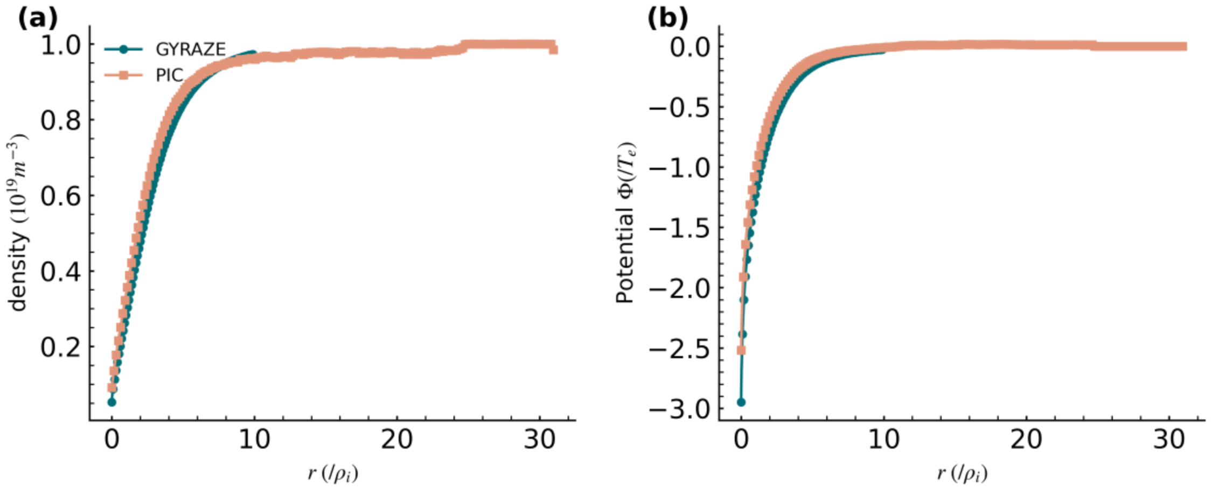
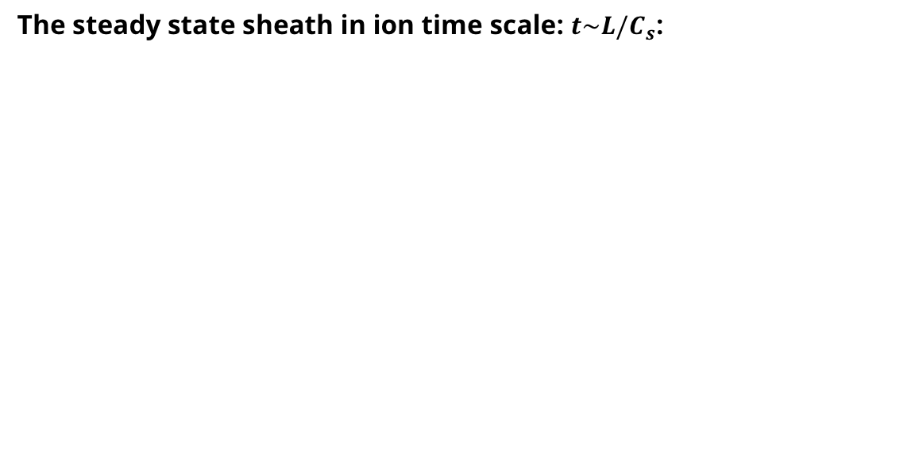
Kinetic drift velocity in the PIC code: ion scale
The steady state sheath in ion time scale: $t\sim L/C_{s}$:
Both the density and potential profile match the PIC result. (Clover provides a natural particle distribution at the presheath)

Slide 10
OUTLINE
Tungsten sputtering in Tokamak
1D Sheath model benchmark
Coupled model for the tungsten sputtering
Tungsten impurity under sheath
Summary

Slide 11
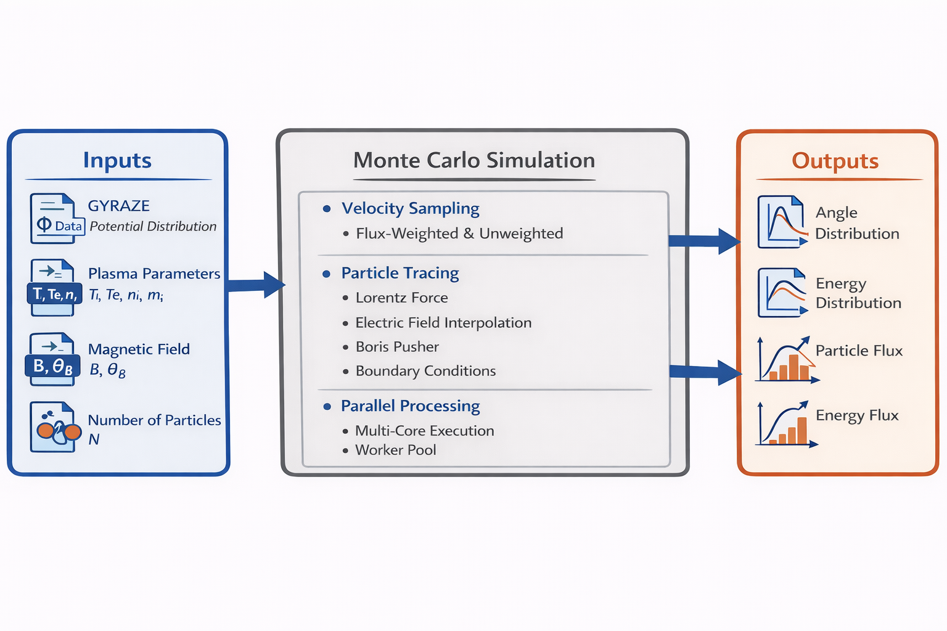
Monte-Carlo test particle code to get the IED and IAD: comparison
A new Monte-Carlo test particle code using the GYRAZE output as potential distribution to get the IED and IAD.

Slide 12
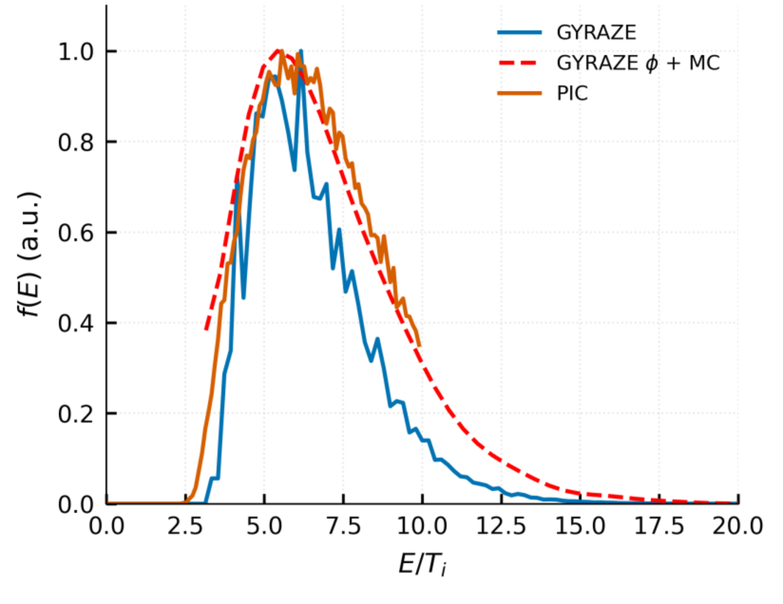
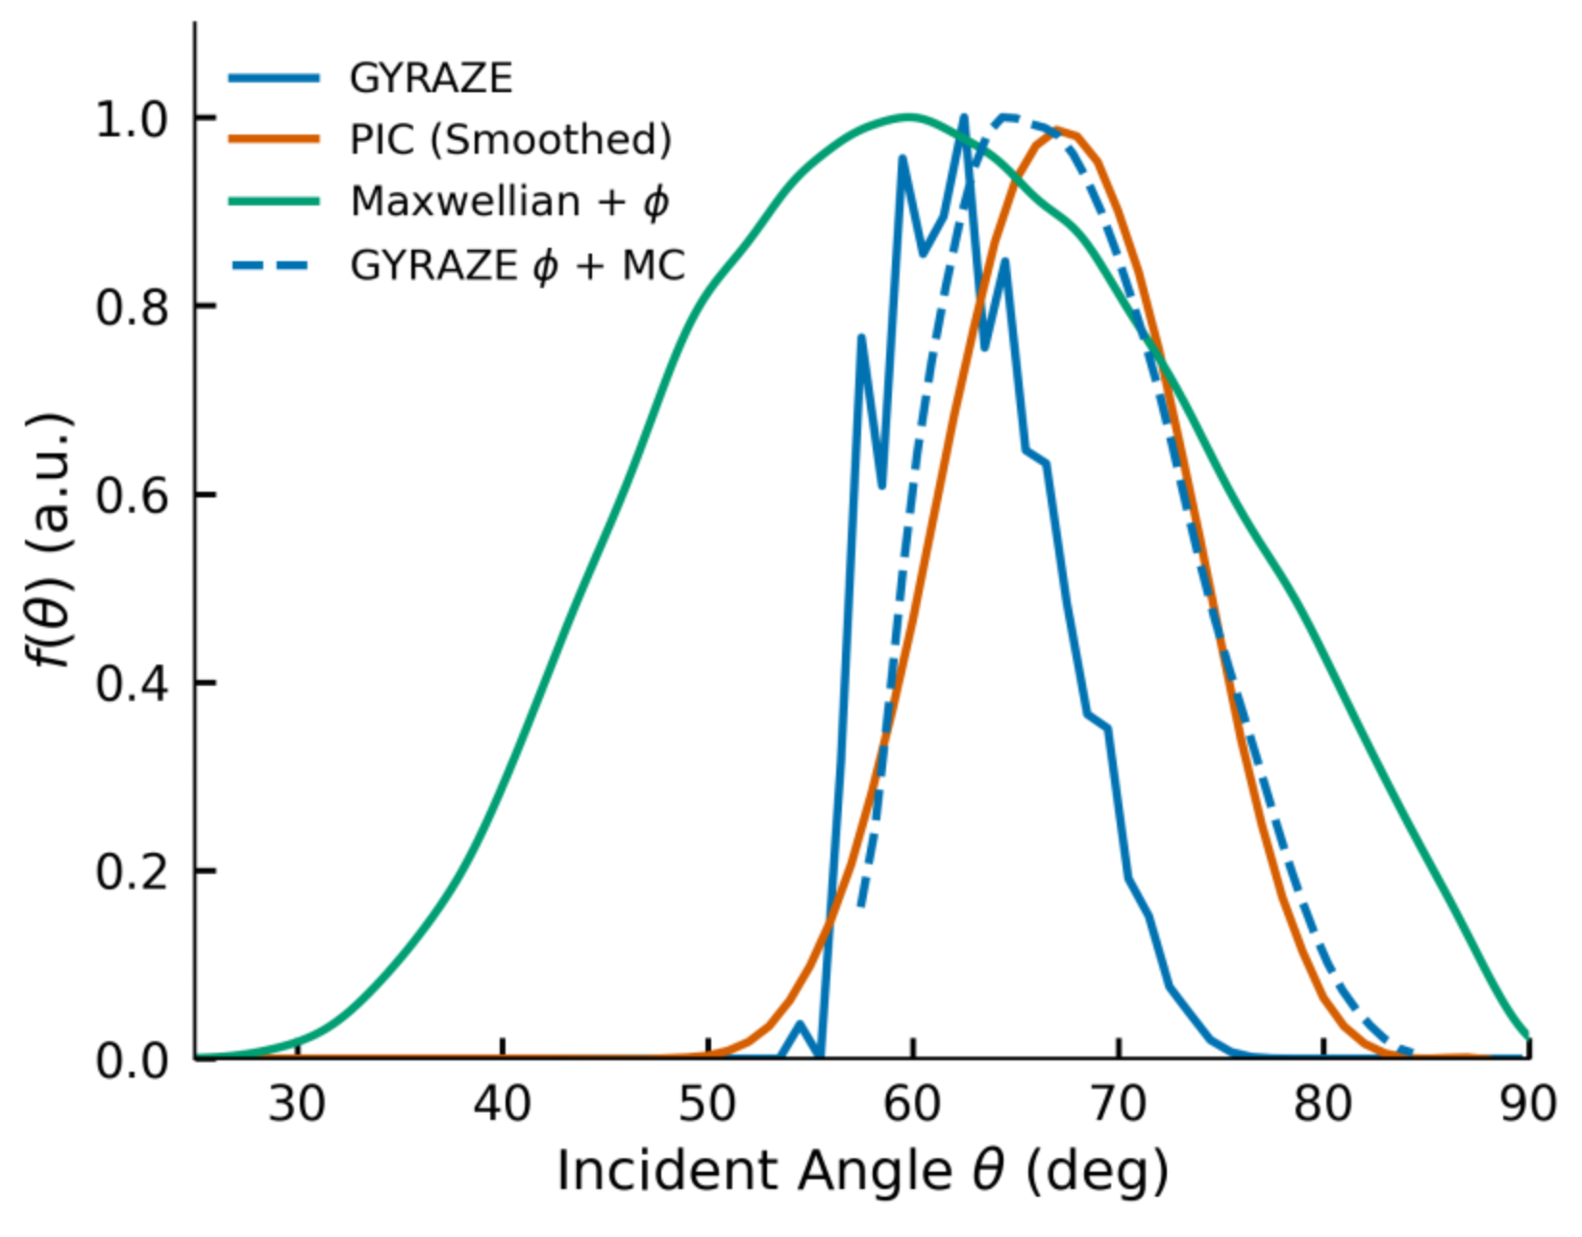
Angle and energy distribution
With the test particle module, the final IAD and IED match the PIC results.

Slide 13
OUTLINE
Tungsten sputtering in Tokamak
1D Sheath model benchmark
Coupled model for the tungsten sputtering
Tungsten impurity under sheath
Summary

Slide 14
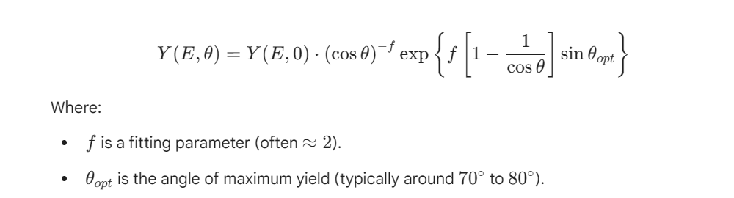
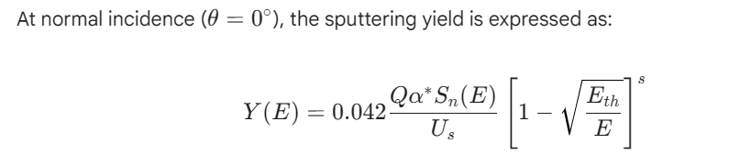
Tungsten sputtering model at the target
Eckstein formula
the code first uses Yamamura-Tawara to find the "base yield" at 0 degrees.

Slide 15
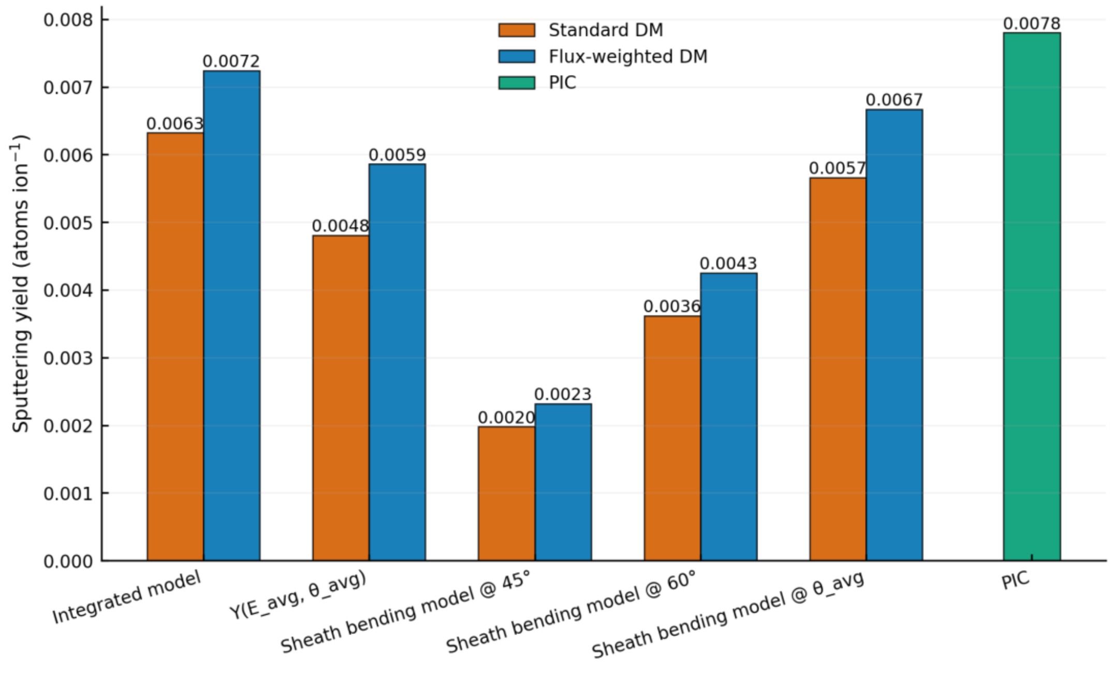
Different method of calculation of sputtering yield
Match the PIC result.
Sheath bending used in the fluid codes get a much smaller value.
The most closed bending model should use the averaged angle from calculation.
The sheath profile from the pre sheath profile and Debye sheath profile model to get the averaged angle without direction calculations.

Slide 16
OUTLINE
Tungsten sputtering in Tokamak
1D Sheath model benchmark
Coupled model for the tungsten sputtering
Tungsten impurity under sheath
Summary

Slide 17
Direct Simulation Monte Carlo (DSMC) method
DSMC computational domain
sample outcoming particles
move + collide in cells
target
cells Δx
1 Initialise
2 Move
3 Collide
4 Surface
Create simulation particles in each cell
from prescribed f(E,θ), density and temperature.
x(t+Δt)=x(t)+vΔt
P = 1 - exp(-ν Δt)
At the wall, sample reflection, sticking or sputtering from Y(E,θ).
Particles travel ballistically between collisions; external fields may be included when required.
Random numbers select whether a pair collides; velocities are updated from the chosen cross section.
Each computational particle represents many physical particles.
Returned particles or sputtered atoms are inserted with sampled energy and angle.
DSMC separates particle transport into repeated move–collide–sample steps; macroscopic distributions are obtained statistically from many particle histories
Notes:
DSMC method slide. This slide explains the method only: computational particles, cells, ballistic motion, stochastic collision selection, surface interactions, and tallied IED/IAD outputs. No Hermes-3, PIC, GYRAZE, or divertor-regime results are included.

Slide 18
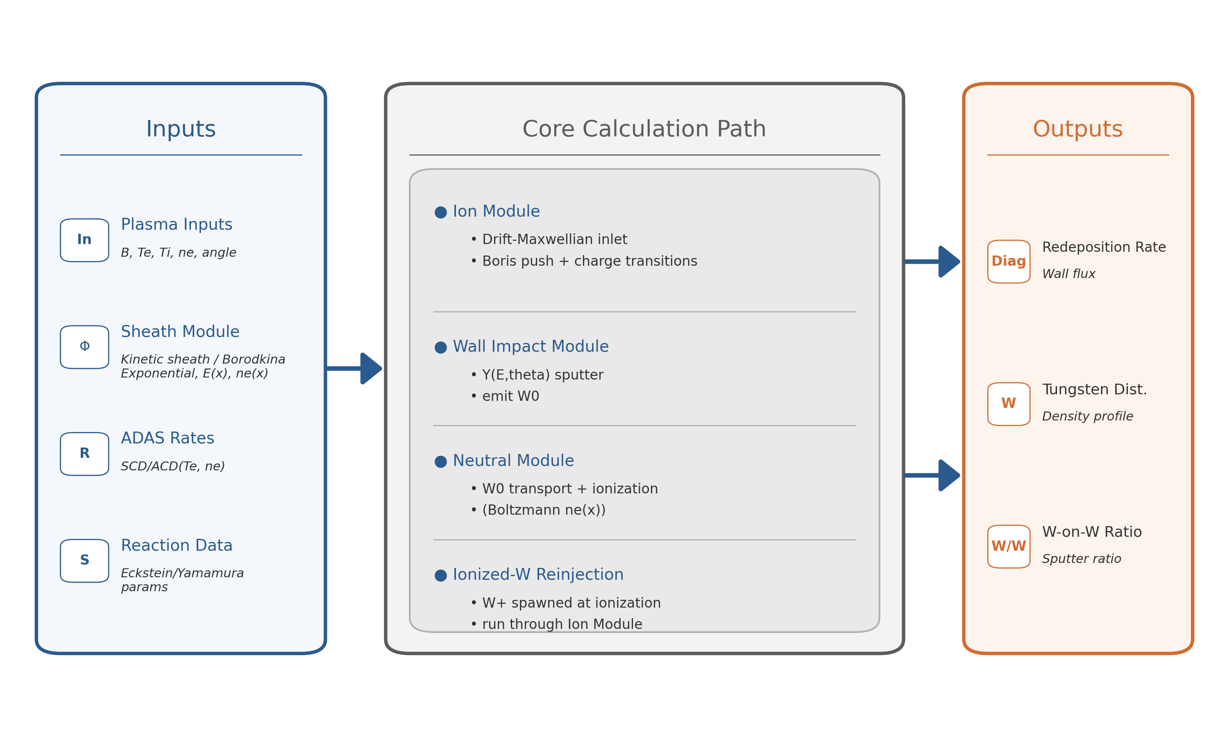
Tungsten generation and transport module
Monte-Carlo Ion,
DSMC neutral atom,
Kinetic sheath,
Multi-species ion source.

Slide 19
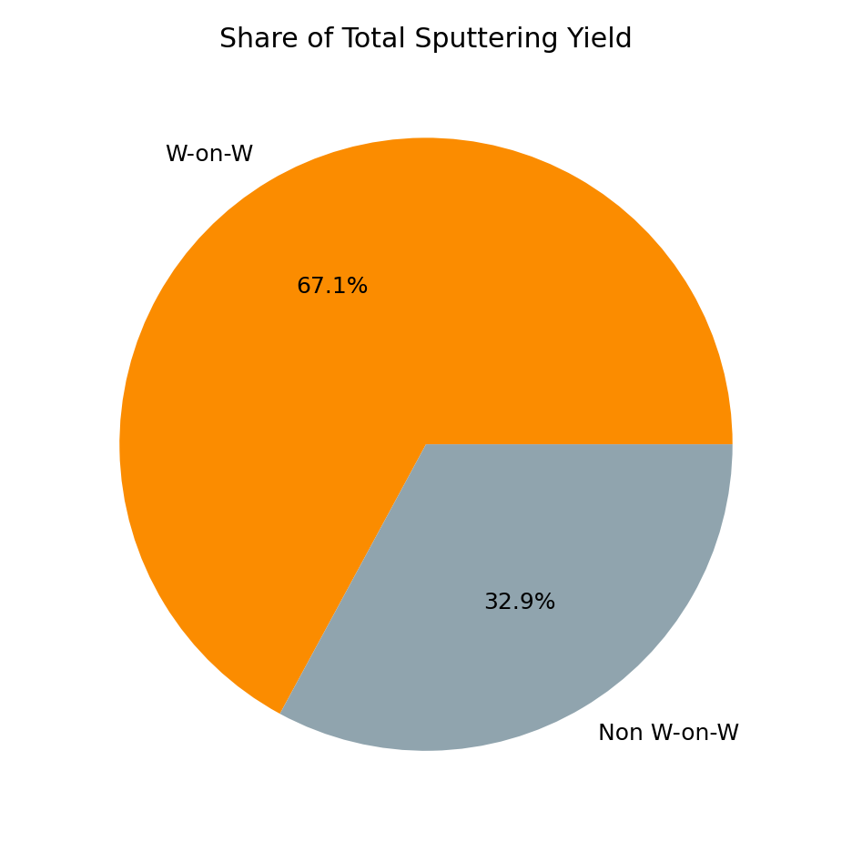
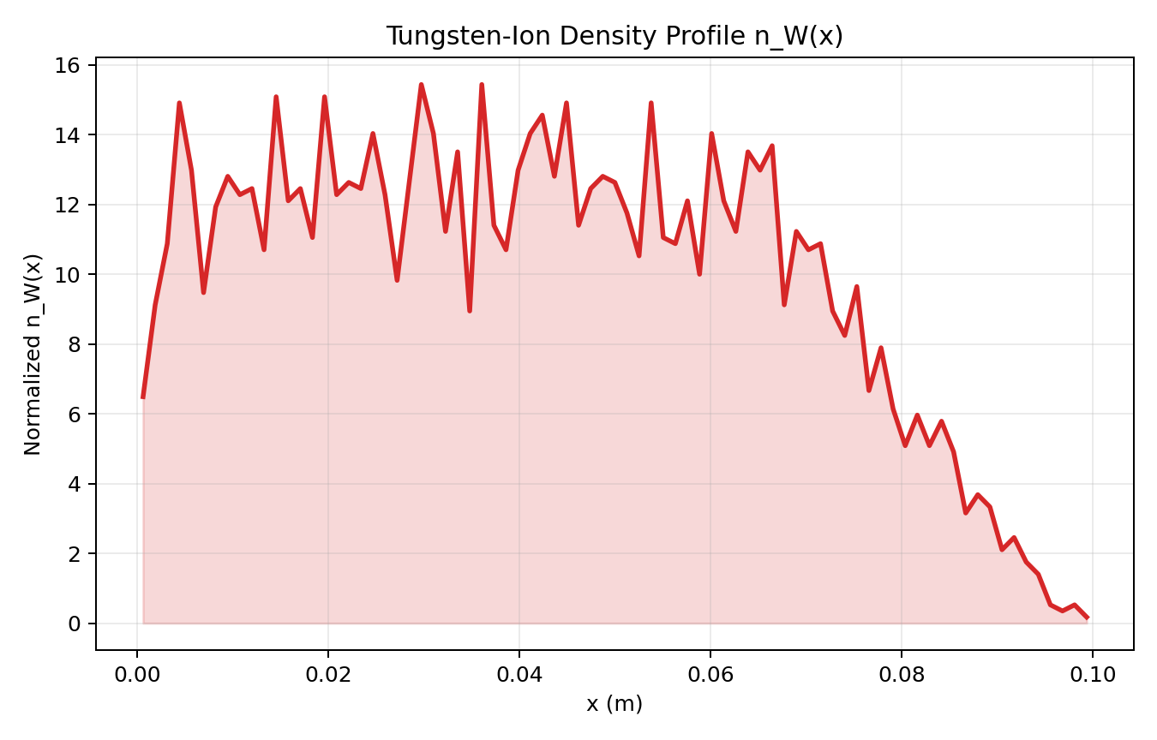
Sputtering yield calculation: self sputtering and distribution
Distribution of the ion-W along the perpendicular direction.
Include ion-W with different charge number.
Add impurity ion W to get the self-sputtering rate.
Support different impurity ions.

Slide 20
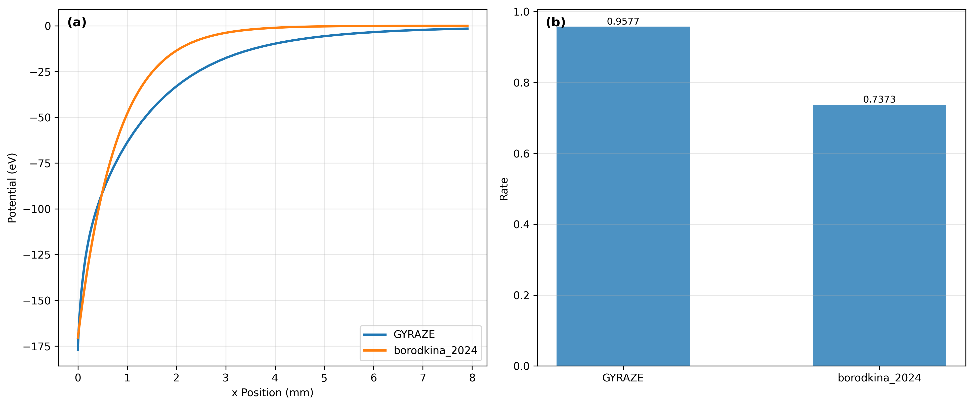
Redeposition rate calculation with the sheath profile
Compared to a similar analytical sheath model
Comparing to the sheath model with similar potential drop, the redeposition rate could be largely different.

Slide 21

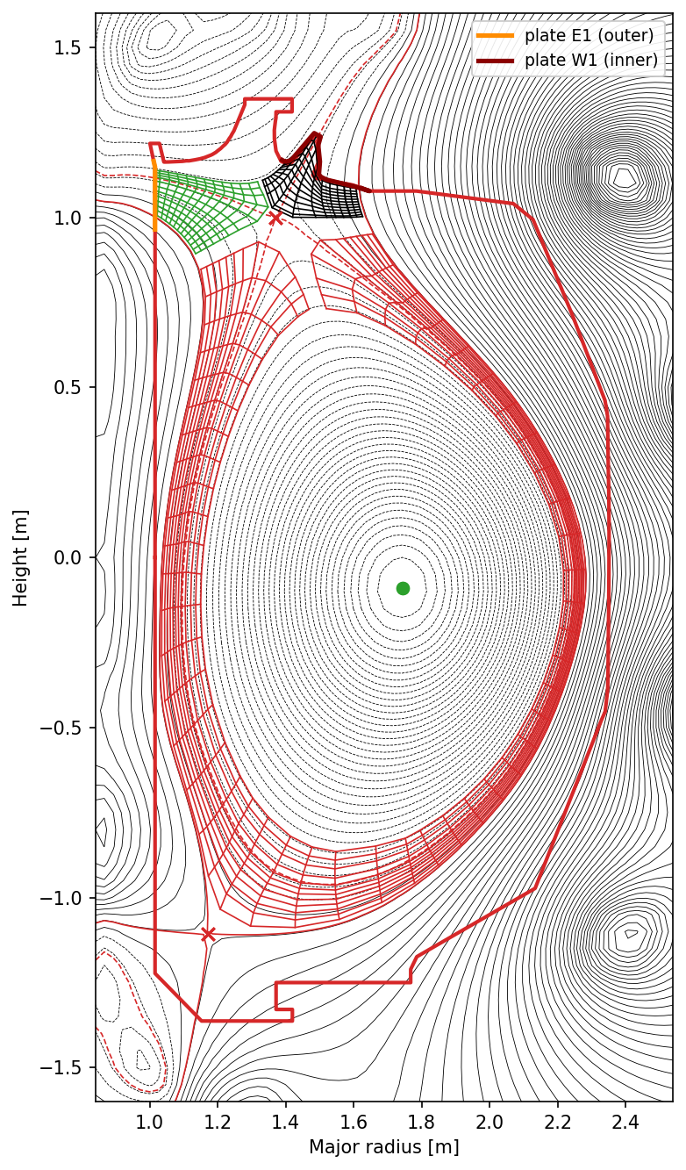
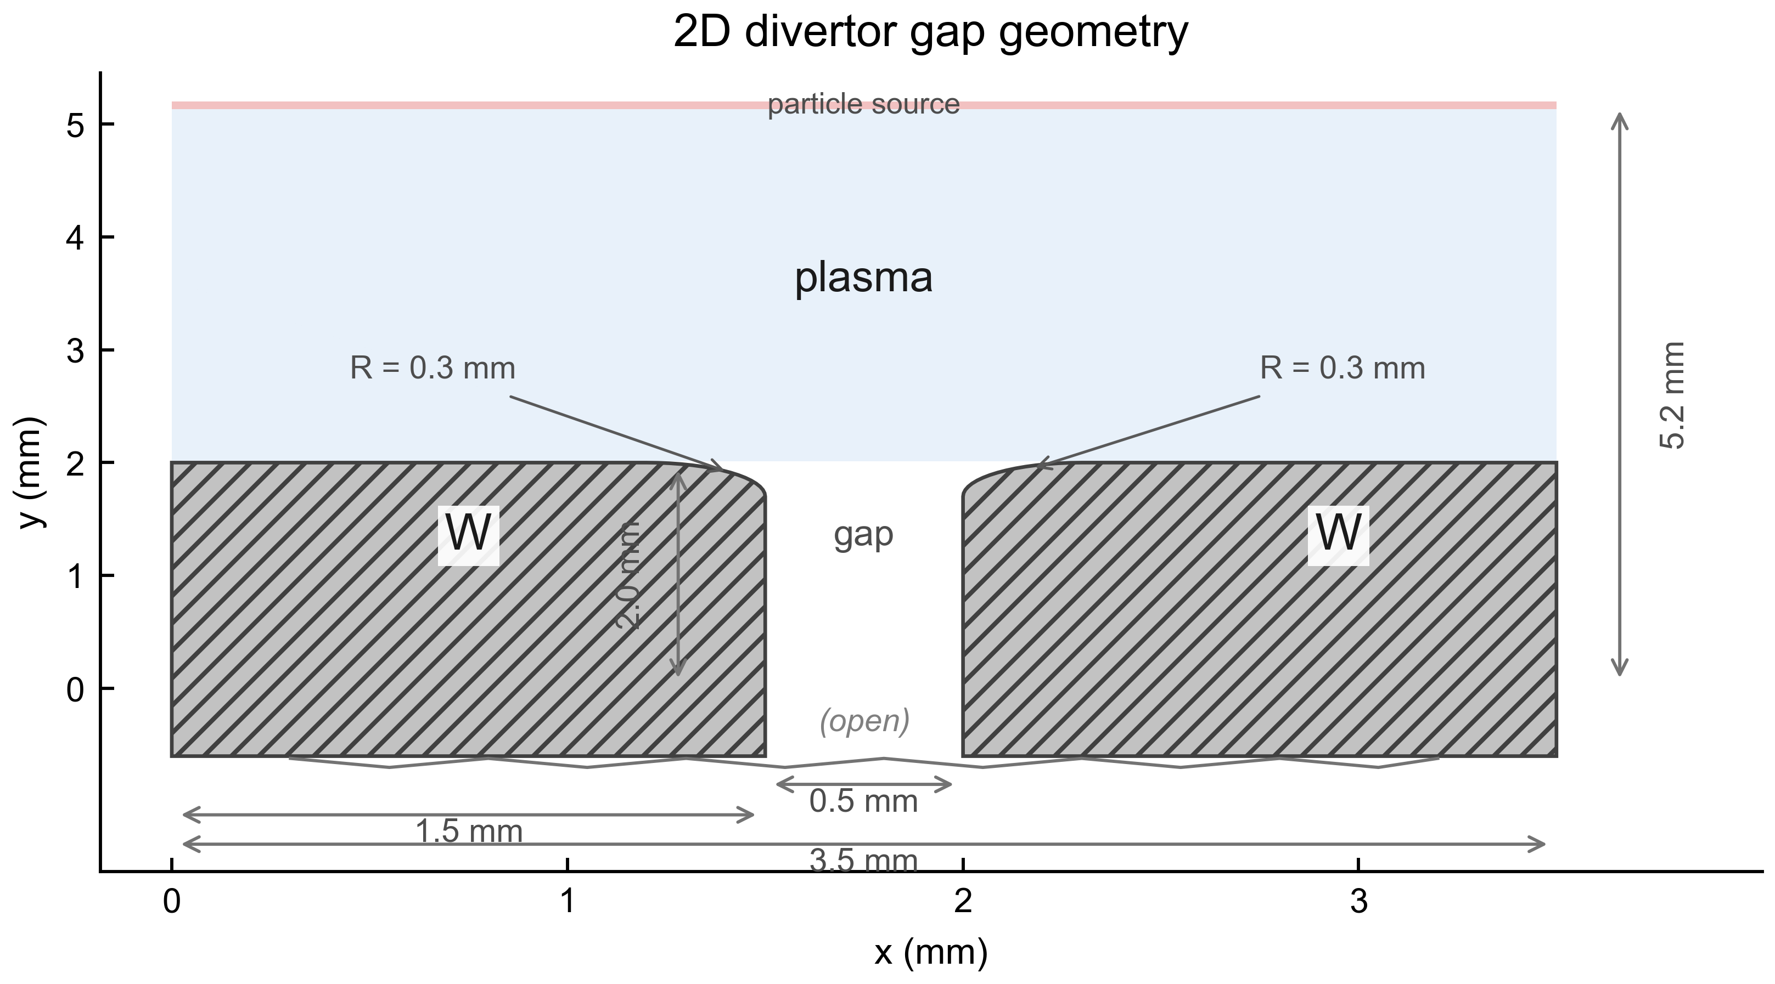
Summary
For the redeposition and impurity transport, a 1D neutral and impurity ion model is implemented with kinetic sheath and ionization/recombination reactions.
  The redeposition rate and self sputtering will be included.
  The impurity ion/neutral distribution could be coupled to the fluid code.
+ INGRID
Future work:
1. The 2D sheath module.
2. Hermes-3 and VANTAGE for impurity transport.

