Slide 1

The kinetic neutral model in MHD code JOREK
ECW2026
Daniël Maris
S.Q. Korving, D.C. van Vugt , G. Su, M. Szűcs, A. Cathey, Y.C. Liang, E. Carrà, E. Waagaard, M. Hölzl, S. Wiesen, F.J. Artola, the JOREK team
The views and opinions expressed herein do not necessarily reflect those of the ITER Organization.

Slide 2
Motivation
Do we really need another exhaust code?

Slide 3
The dream exhaust code
Wouldn't it be nice if … ?
that doesn’t exist
Kinetic neutrals (like EIRENE)
Self consistent turbulence (like Grillix)
Dynamics on s timescale (like SOLPS-ITER recently)
Self consistent MHD (like JOREK)
Multi-fluid (like Hermes-3)
Unstructured grid (like wide grid SOLPS-ITER)
3D capability (like SOLEdge3X)
Stellarator capability (like EMC3-EIRENE)
Computational speed (e.g. GPU) (like Hermes-3)
…
✔*
✖*
✔
✔
✖*
✔*
✔
✔*
✔*
*it's more complicated

Slide 4
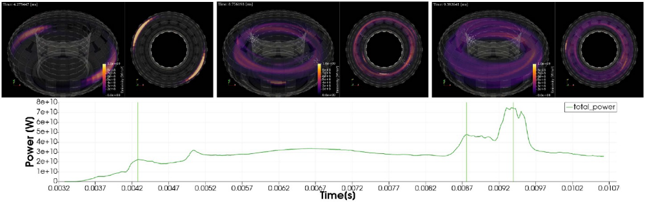
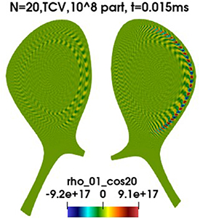
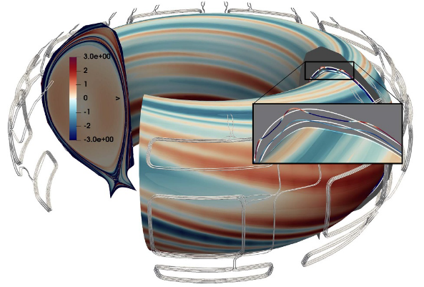
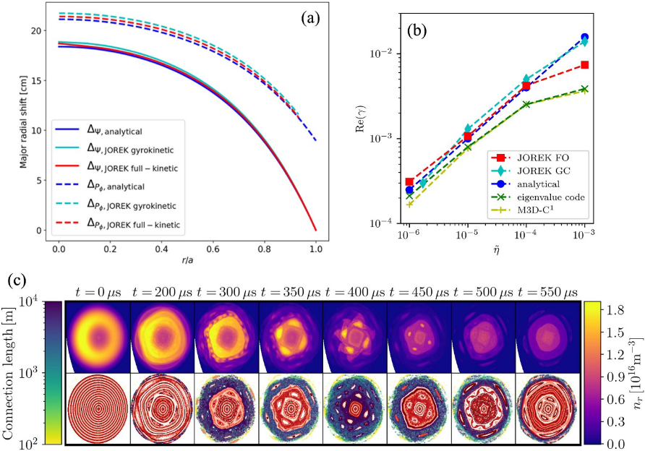
Where JOREK shines: MHD interaction and dynamics
MHD
Self consistent ELMs & burn-through
ELM surpressed regimes
Disruptions and mitigation
Dynamics
Both plasma and neutrals fully time-dependent
Optimized, so s timescale tractable
There’s more to JOREK…
→ Talk will focus on SOL applications
Transient heat loads from SPI
M. Hoelzl et al. NF 2026
Gyrokinetic NT/PT
M. Bécoulet et al. PPCF 2026
2-way coupled full-f REs
M. Hoelzl et al. NF 2026
RMP effects on W transport
M. Hoelzl et al. NF 2026

Slide 5
Current state
JOREK’s kinetic neutral model

Slide 6

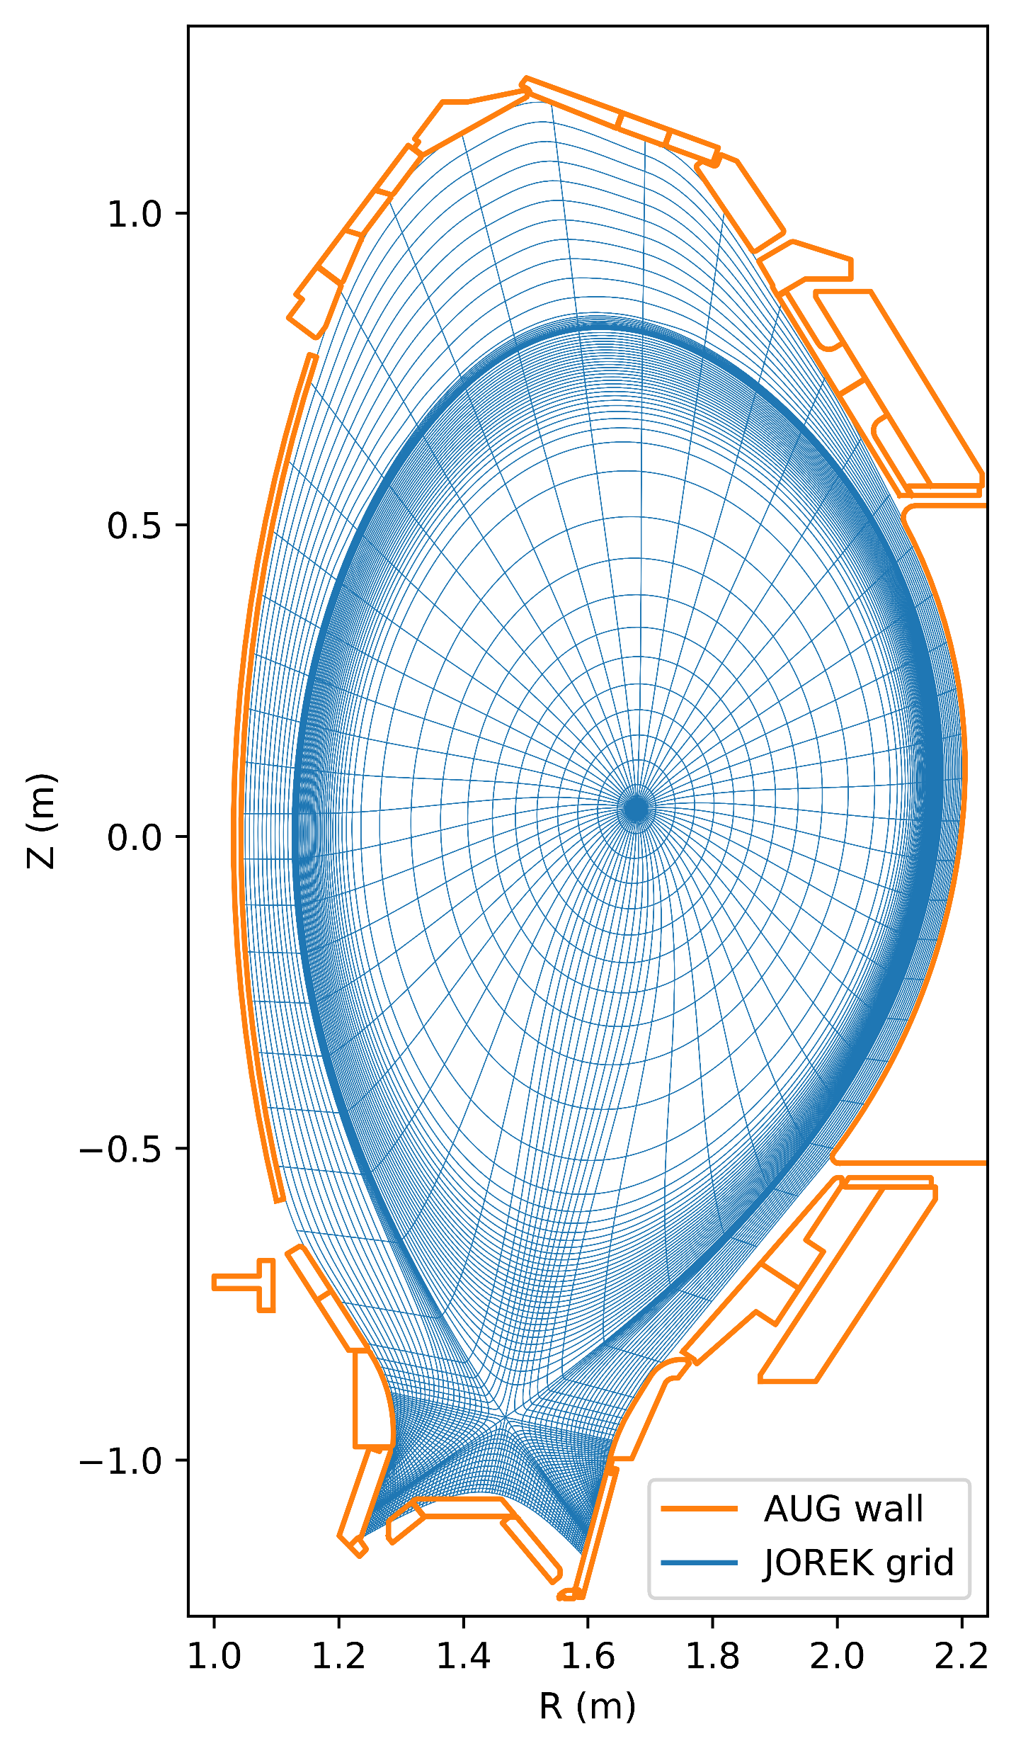
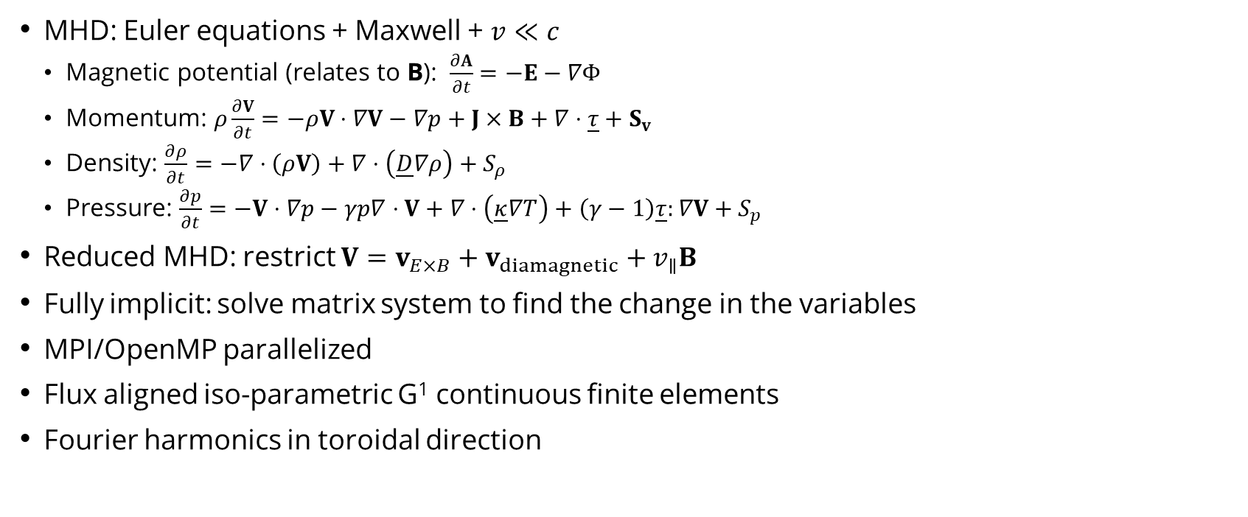
Meet
HELLO
my name is
JOREK, a massively parallel fully implicit non-linear extended magneto hydro dynamics (MHD) code
M. Hoelzl et al. NF 2021
MHD: Euler equations + Maxwell + $v≪c$
  Magnetic potential (relates to B): $\frac{∂A}{∂t}=−E−∇Φ$
  Momentum: $ρ\frac{∂V}{∂t}=−ρV⋅∇V−∇p+J×B+∇⋅\underline{τ}+S_{v}$
  Density: $\frac{∂ρ}{∂t}=−∇⋅\left(ρV\right)+∇⋅\left(\underline{D}∇ρ\right)+S_{ρ}$
  Pressure: $\frac{∂p}{∂t}=−V⋅∇p−γp∇⋅V+∇⋅\left(\underline{κ}∇T\right)+\left(γ−1\right)\underline{τ}:∇V+S_{p}$
Reduced MHD: restrict $V=v_{E×B}+v_{diamagnetic}+v_{∥}B$
Fully implicit: solve matrix system to find the change in the variables
MPI/OpenMP parallelized
Flux aligned iso-parametric G¹ continuous finite elements
Fourier harmonics in toroidal direction

Slide 7
History of (neutral) kinetics
2015-2019: Daan van Vugt
Study W impurity transport/production during ELMs
Built first version of kinetics in library style
2019-2023: Sven Korving
Continue W impurity transport/production
For sputtering need reasonable target plasma
Made kinetic neutral model
2023-2024: Sharp increase in kinetic user/developers
"In those days, chaos ruled the land. Everyone did what was right in their own executable on their own branch, and there were no regression tests."

Slide 8
Flexible particle framework
George Su et al.
Selection of input file:
! Deuterium neutral (D01)
part_group_configs(1)%coupling_scheme = 'ncs’
part_group_configs(1)%n_particles = 1d7
part_group_configs(1)%use_kin_ionisation = .t.
part_group_configs(1)%wall_act_configs(1)%type="reflection"
fluid_configs(1)%Z=-2
fluid_configs(1)%wall_act_configs(1)%type="wall recomb"
fluid_configs(1)%wall_act_configs(1)%target_group_id="D01"
fluid_configs(1)%wall_act_configs(1)%supers_weight_wall=1.d12
! Nitrogen impurities (N01)
part_group_configs(2)%coupling_scheme = 'ics'
part_group_configs(2)%n_particles = 1e6
part_group_configs(2)%use_kin_radiation = .t.
part_group_configs(2)%wall_act_configs(1)%type=“pump"
part_group_configs(2)%wall_act_configs(1)%weight_factor=0.7d0
part_group_configs(2)%puff_ctrl(1)%times = 0 1
part_group_configs(2)%puff_ctrl(1)%rates = 1.d21 1.d22
part_group_configs(2)%puff_ctrl(1)%supers_num_puff = 1000
“Our great leader sent our hero, George, on a quest"
Flexibly combine particle species:
  Neutrals
  Impurities
  Runaway electrons
  Fast particles (e.g. NBI, alpha particles)
Single executable, on main branch, in main model
Object oriented control from input file
  Species, initialization, #particles, physics flags
Regression tests, wiki section

Slide 9
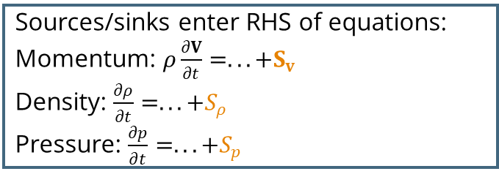
The kinetic neutral model
Create particles:
Wall recombination (/sputtering)
Volumetric recombination
Puffing
Creation
For each particle timestep
Array of Monte Carlo particles
  Position x, velocity v, weight w
  Particles typically live many fluid steps
Missing physics:
  molecular interactions
Simulation time: ~0.1s/day (AUG) on ~100CPUs
MPI/OpenMP parallelized
For each particle
Interpolate fluid quantities (at x)
Kinetic particles
Resolve ionization & CX (update v, w)
Inner loop
Push particle forward (update x)
Resolve reflection & pumping (/sputtering)
Do neutral collisions
Sources/sinks projected to FE grid
Smoothing to reduce MC noise
Proj.
Sources/sinks enter RHS of equations:
Momentum: $ρ\frac{∂V}{∂t}=...+S_{v}$
Density: $\frac{∂ρ}{∂t}=...+S_{ρ}$
Pressure: $\frac{∂p}{∂t}=...+S_{p}$
Fluid
Solve
Slide: 5

Slide 10
Parallelization
Every MPI rank has own particle array
No spatial ownership of particles
Calculations are OpenMP multithreaded
Rank 1
Rank 2
Rank 3
Cubic Bezier Finite Elements
D. van Vugt PhD Thesis 2019

Slide 11
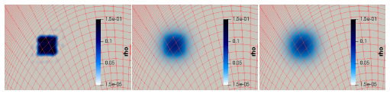
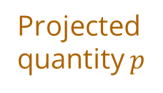
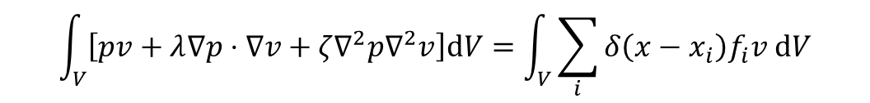
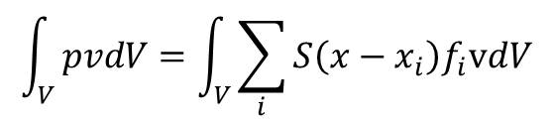
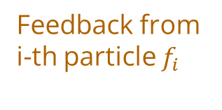



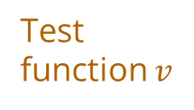

Efficient particle feedback projection
Usual FE weak form
JOREK
Shaping function
Smoothing
Hyper-smoothing
Test function $v$
Shaping function $S$
$$\int_{V}{\left[pv+λ∇p⋅∇v+ζ∇^{2}p∇^{2}v\right]dV}=\int_{V}{\sum_{i}{δ\left(x−x_{i}\right)f_{i}v dV}}$$
$$\int_{V}{pvdV=\int_{V}{\sum_{i}{S\left(x−x_{i}\right)f_{i}vdV}}}$$
Factorize once (think $p=A^{−1}RHS)$
Collapses to sum
No smoothing
w/ $λ$
w/ $λ$ and $ζ$
Projected quantity $p$
Feedback from i-th particle $f_{i}$
D. van Vugt PhD Thesis 2019

Slide 12
Current state
Recent work on kinetic neutral model

Slide 13



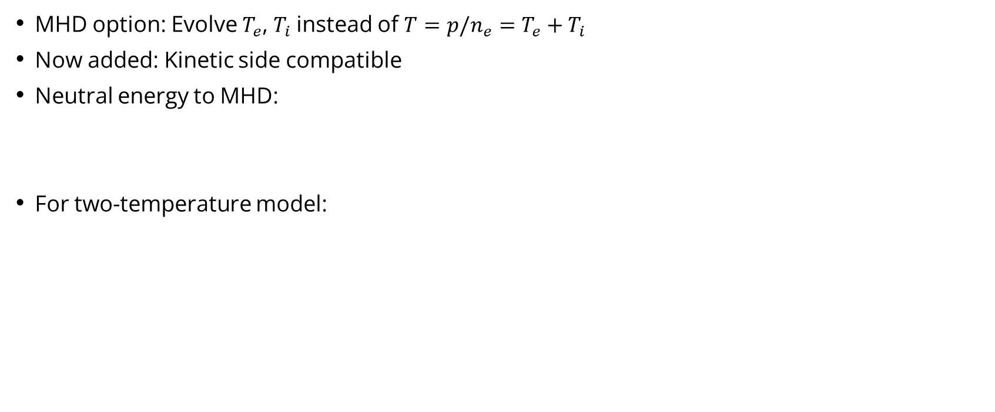




2T model implemented
Máté Szűcs,
Sven Korving
MHD option: Evolve $T_{e}$, $T_{i}$instead of $T=p/n_{e}=T_{e}+T_{i}$
Now added: Kinetic side compatible
Neutral energy to MHD:
For two-temperature model:
$$S_{E}^{ionization}$$
$$S_{E}^{CX}$$
$$S_{E}^{line radiation}$$
$$S_{E}=Γ^{ionization}\left(\frac{1}{2}m_{i}v_{n}^{2}−E_{bind}\right)+\frac{1}{2}w_{n}\left(v_{n,old}^{2}−v_{n,new}^{2}\right)+n_{e}w_{n}S_{PLT}Δt_{kinetic}$$
$$S_{E}^{ionization}$$
$$S_{E}^{line radiation}$$
$$S_{E}^{electron}={−Γ}^{ionization}E_{bind}+n_{e}w_{n}S_{PLT}Δt_{kinetic}$$
$$S_{E}^{ionization}$$
$$S_{E}^{CX}$$
$$S_{E}^{ion}=Γ^{ionization}\frac{1}{2}m_{i}v_{n}^{2}+\frac{1}{2}w_{n}\left(v_{n,old}^{2}−v_{n,new}^{2}\right)$$

Slide 14




Neutral self collisions - algorithm
Daniël Maris
Distribute particles into collisional cells
Pair up randomly (!)
Determine collision chance
Collide
Unlike BGK (EIRENE):
Conserves energy to machine accuracy
Cross-section model: variable hard sphere
Does not assume Maxwellian
Before
After
$${10}^{16}$$
$${10}^{16}$$
Collision
${10}^{16}$
${10}^{16}$
Collisional cell

Slide 15
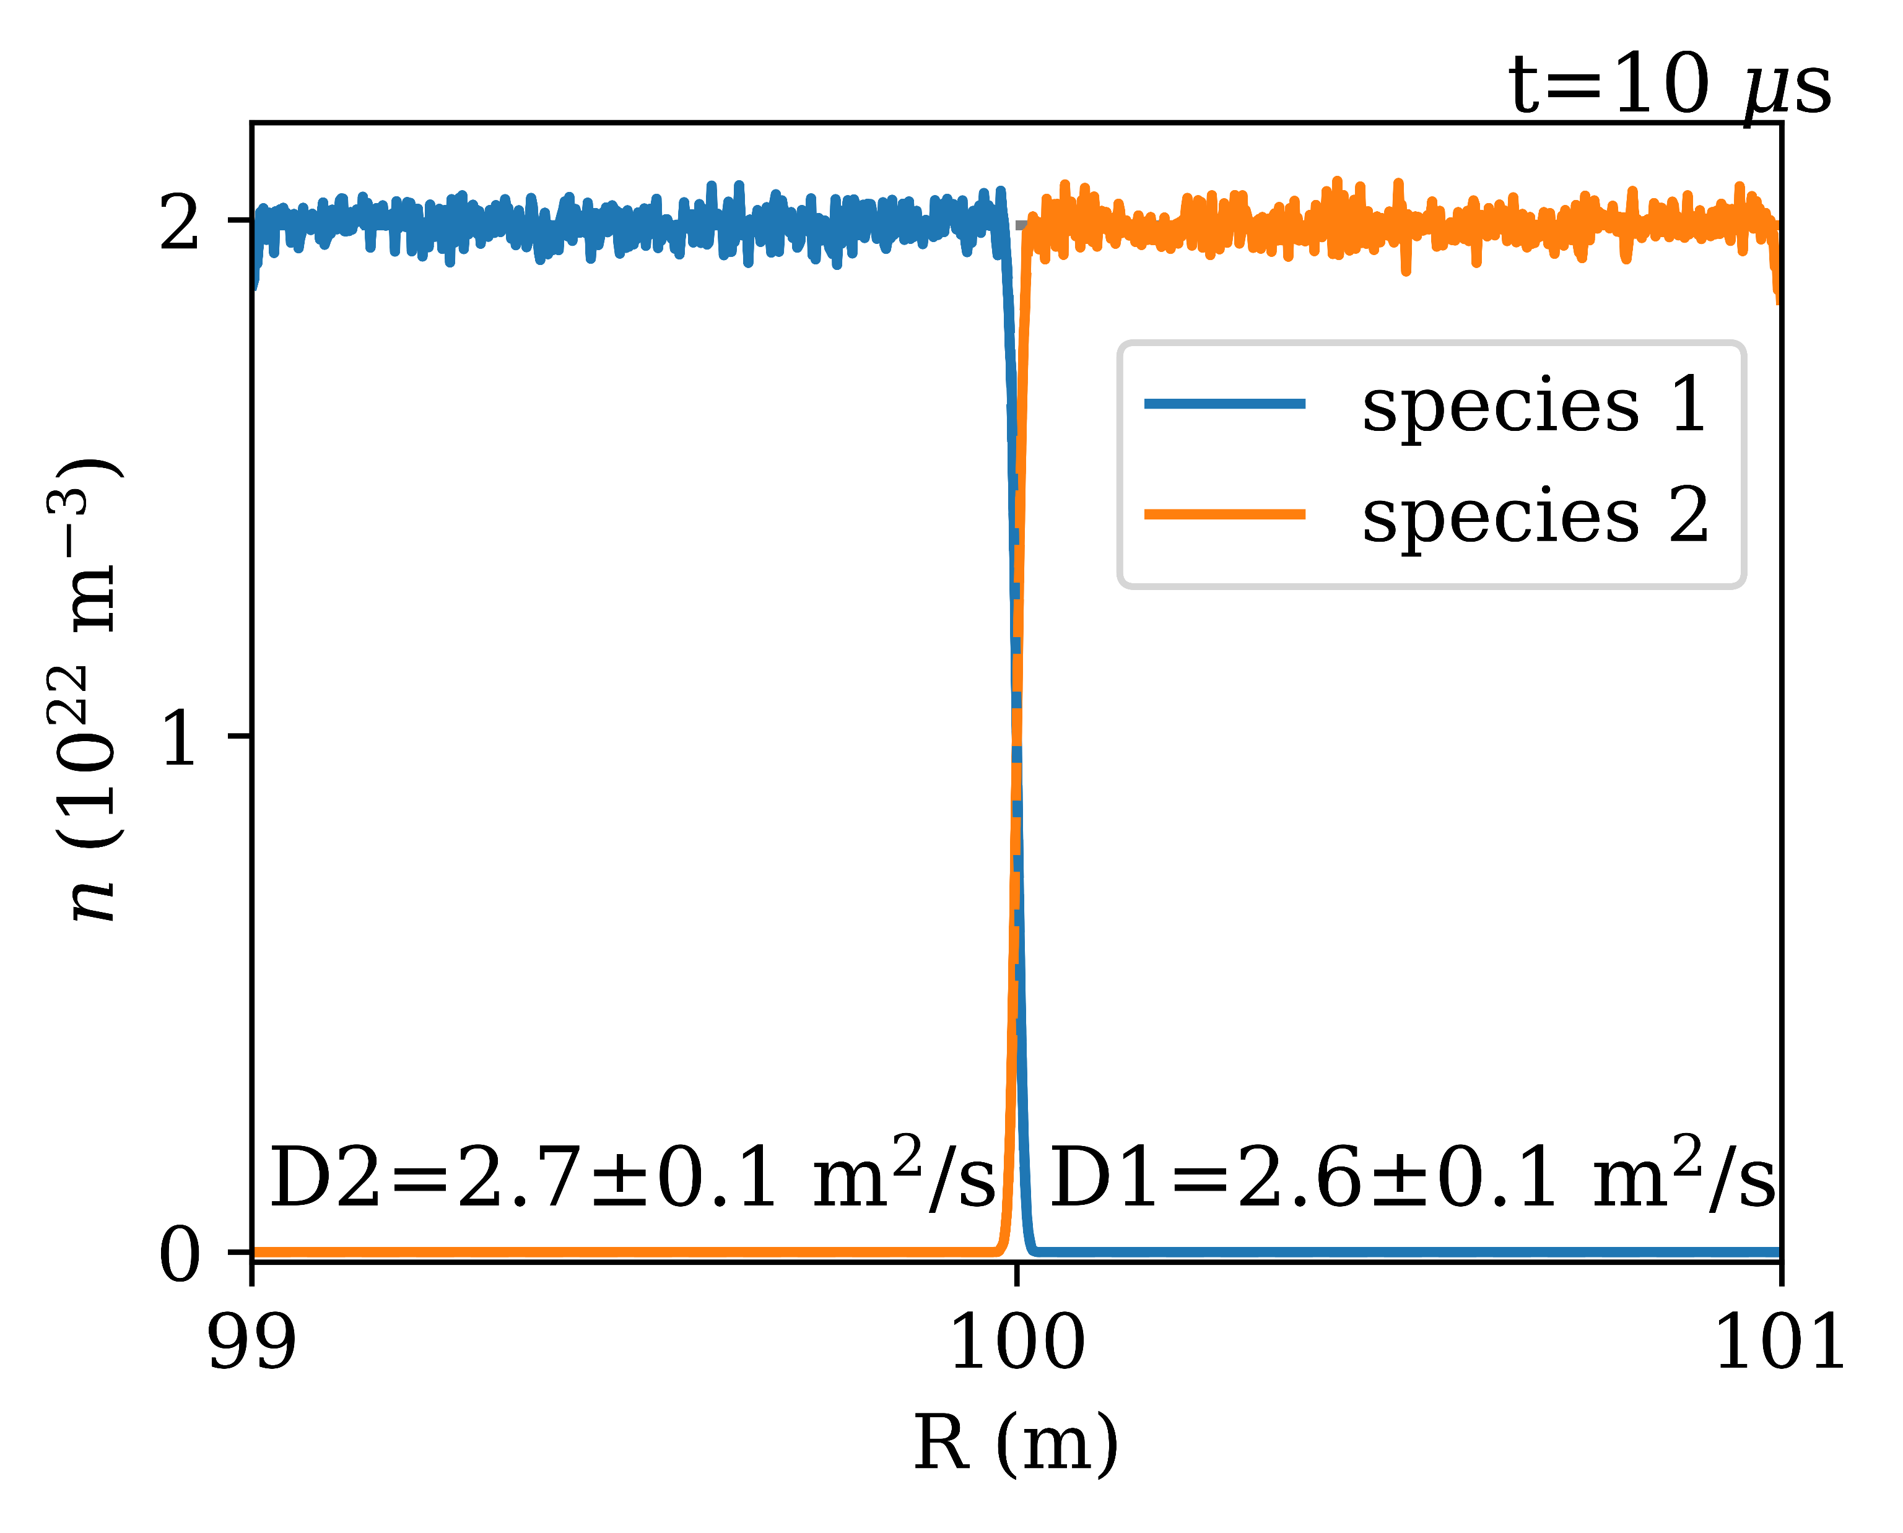
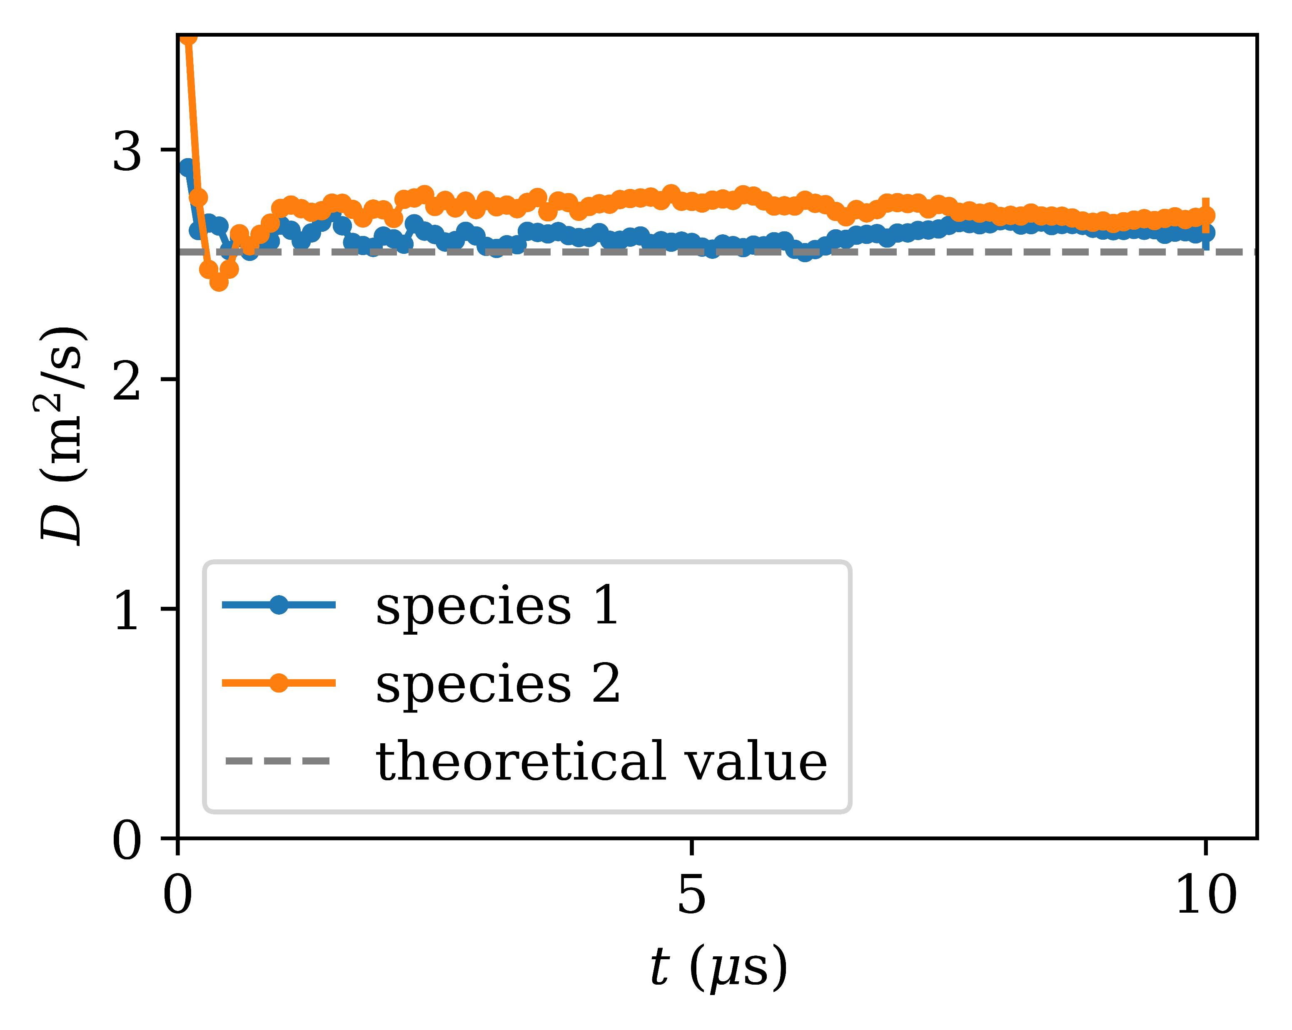
Neutral self collisions - correctly captures diffusion:

Slide 16
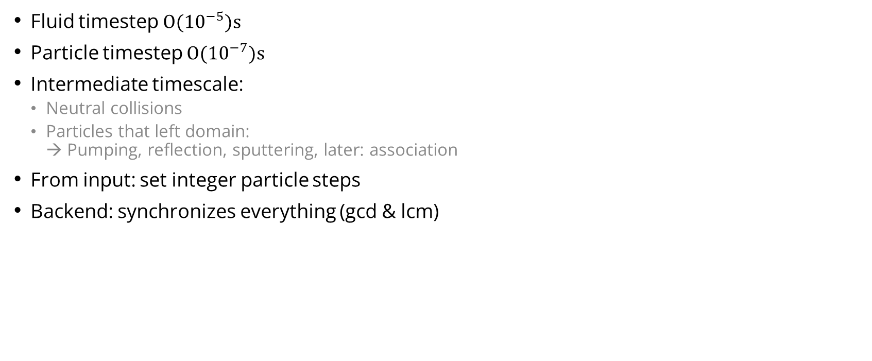
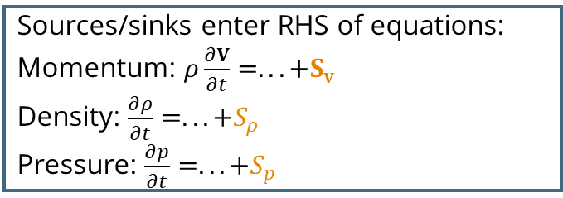
Intermediate timescales framework
Daniël Maris
Create particles:
Wall recombination (/sputtering)
Volumetric recombination
Puffing
Creation
For each particle timestep
For each particle
Fluid timestep $O({10}^{−5})s$
Particle timestep $O({10}^{−7})s$
Intermediate timescale:
  Neutral collisions
  Particles that left domain:
  → Pumping, reflection, sputtering, later: association
From input: set integer particle steps
Backend: synchronizes everything (gcd & lcm)
Interpolate fluid quantities (at x)
Kinetic particles
Resolve ionization & CX (update v, w)
Inner loop
Push particle forward (update x)
Resolve reflection & pumping (/sputtering)
Do neutral collisions
Sources/sinks projected to FE grid
Smoothing to reduce MC noise
Proj.
==============================================
Starting inner particle loop
==============================================
sim%time : 0.17036211345290475
tstep_fluid_si : 1.1855071080336503E-005
aim tstep_particles : 4.9999999999999998E-007
used tstep_part_adj : 4.9396129501402099E-007
nstep_inner_loop : 24
lcm, n_lcm_blocks : 4 6
gcd, inner_stepsize : 2 2
Sources/sinks enter RHS of equations:
Momentum: $ρ\frac{∂V}{∂t}=...+S_{v}$
Density: $\frac{∂ρ}{∂t}=...+S_{ρ}$
Pressure: $\frac{∂p}{∂t}=...+S_{p}$
Fluid
Solve

Slide 17
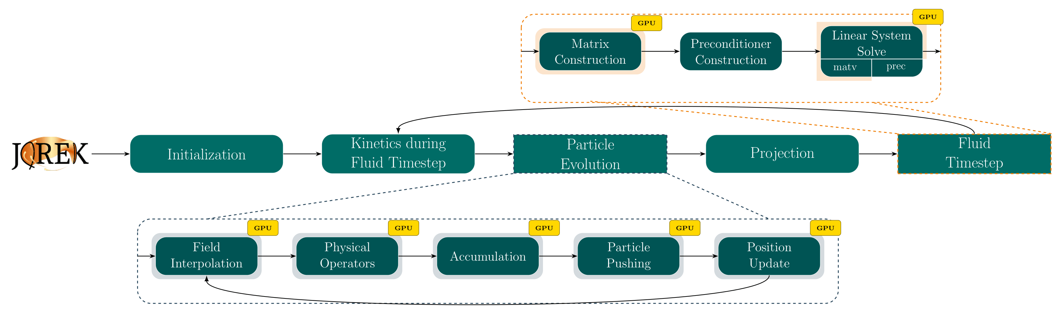
GPU acceleration – initial approach
Edoardo Carrà
JOREK is Fortran, so bad GPU support
OpenMP offloading: no code duplication
Runaway electron evolution only
4x speedup on production testcase
P. Rác et al PASC ’26 2026

Slide 18
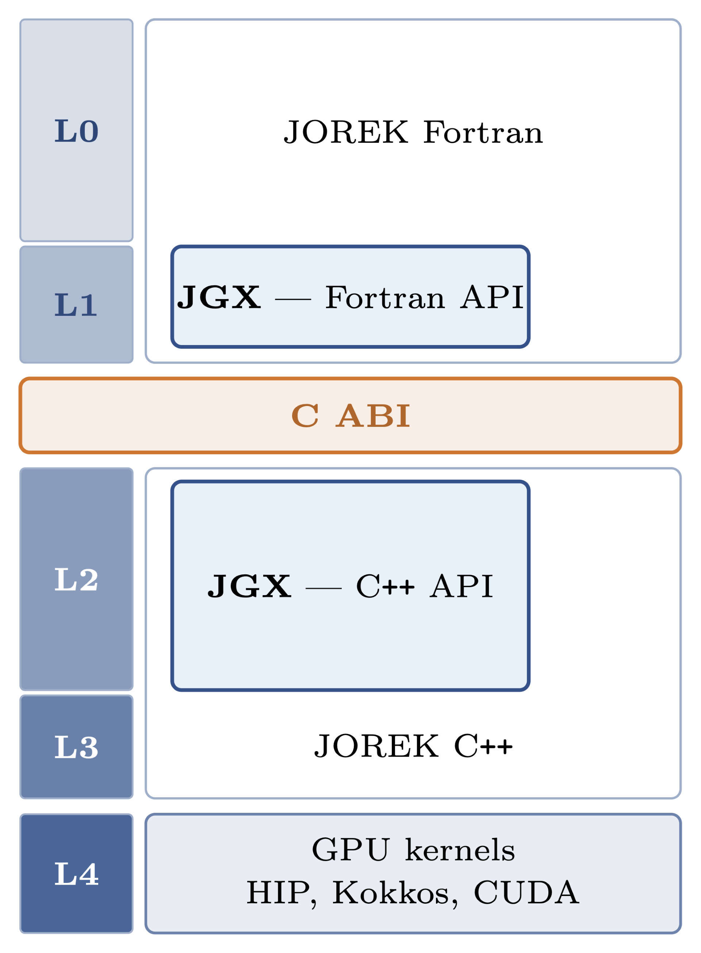
GPU acceleration – new design
Edoardo Carrà
OpenMP offloading limitations:
  Limited hardware control
  Compiler-dependent performance and maturity
Recent studies demonstrated up to 32× speedup (M. Arrigo) using HIP
→ developing JGX (JOREK GPU Acceleration) library:
  Fortran–C++ interoperability layer
  GPU-framework independent
  No code duplication
  Work for RE and FP

Slide 19
Stellarator compatibility
Elias Waagaard
Exhaust problem is unsolved challenge for future stellarators
Requires: neutrals, impurities, drifts and MHD in 3D stellarator geometry
Existing codes (e.g. EMC3-Eirene) do not couple all these
JOREK has stellarator plasma model
JOREK 3D with Fourier harmonics, so discrete divertor difficult
Kinetics is being prepared:
Kinetic – fluid coupling for stellarators
  Kinetics are reasonably model agnostic
  Source terms in stellarator model now implemented
  Ongoing testing
Sheath boundary conditions implemented for stellarators (next slide)

Slide 20
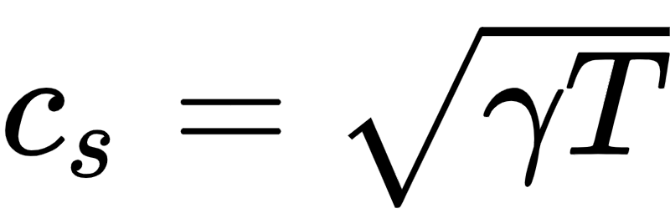
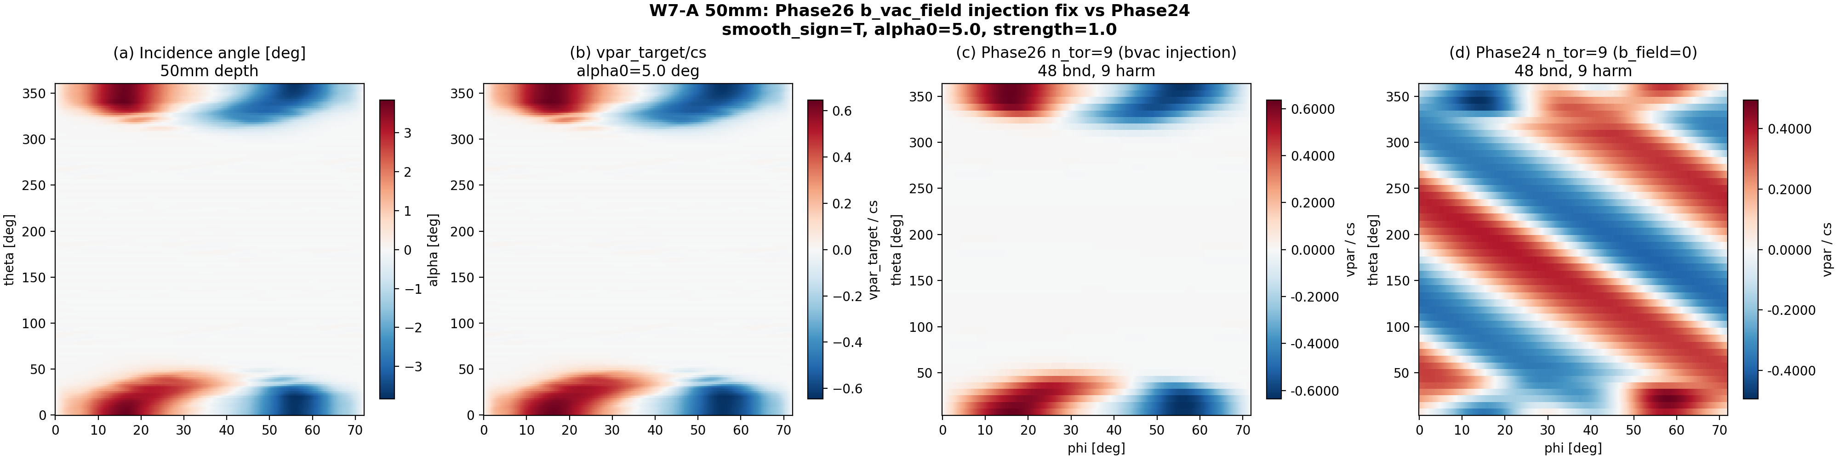
Stellarator compatibility
Sheath BC works
Elias Waagaard
Artificial divertor indent in W7-A stellarator grid → sharper angles
Parallel velocity correct, particle + heat fluxes conserved
Next step: test more complex geometries like W7-X
Expected from
JOREK – simulated

Slide 21
Current state
Issues

Slide 22
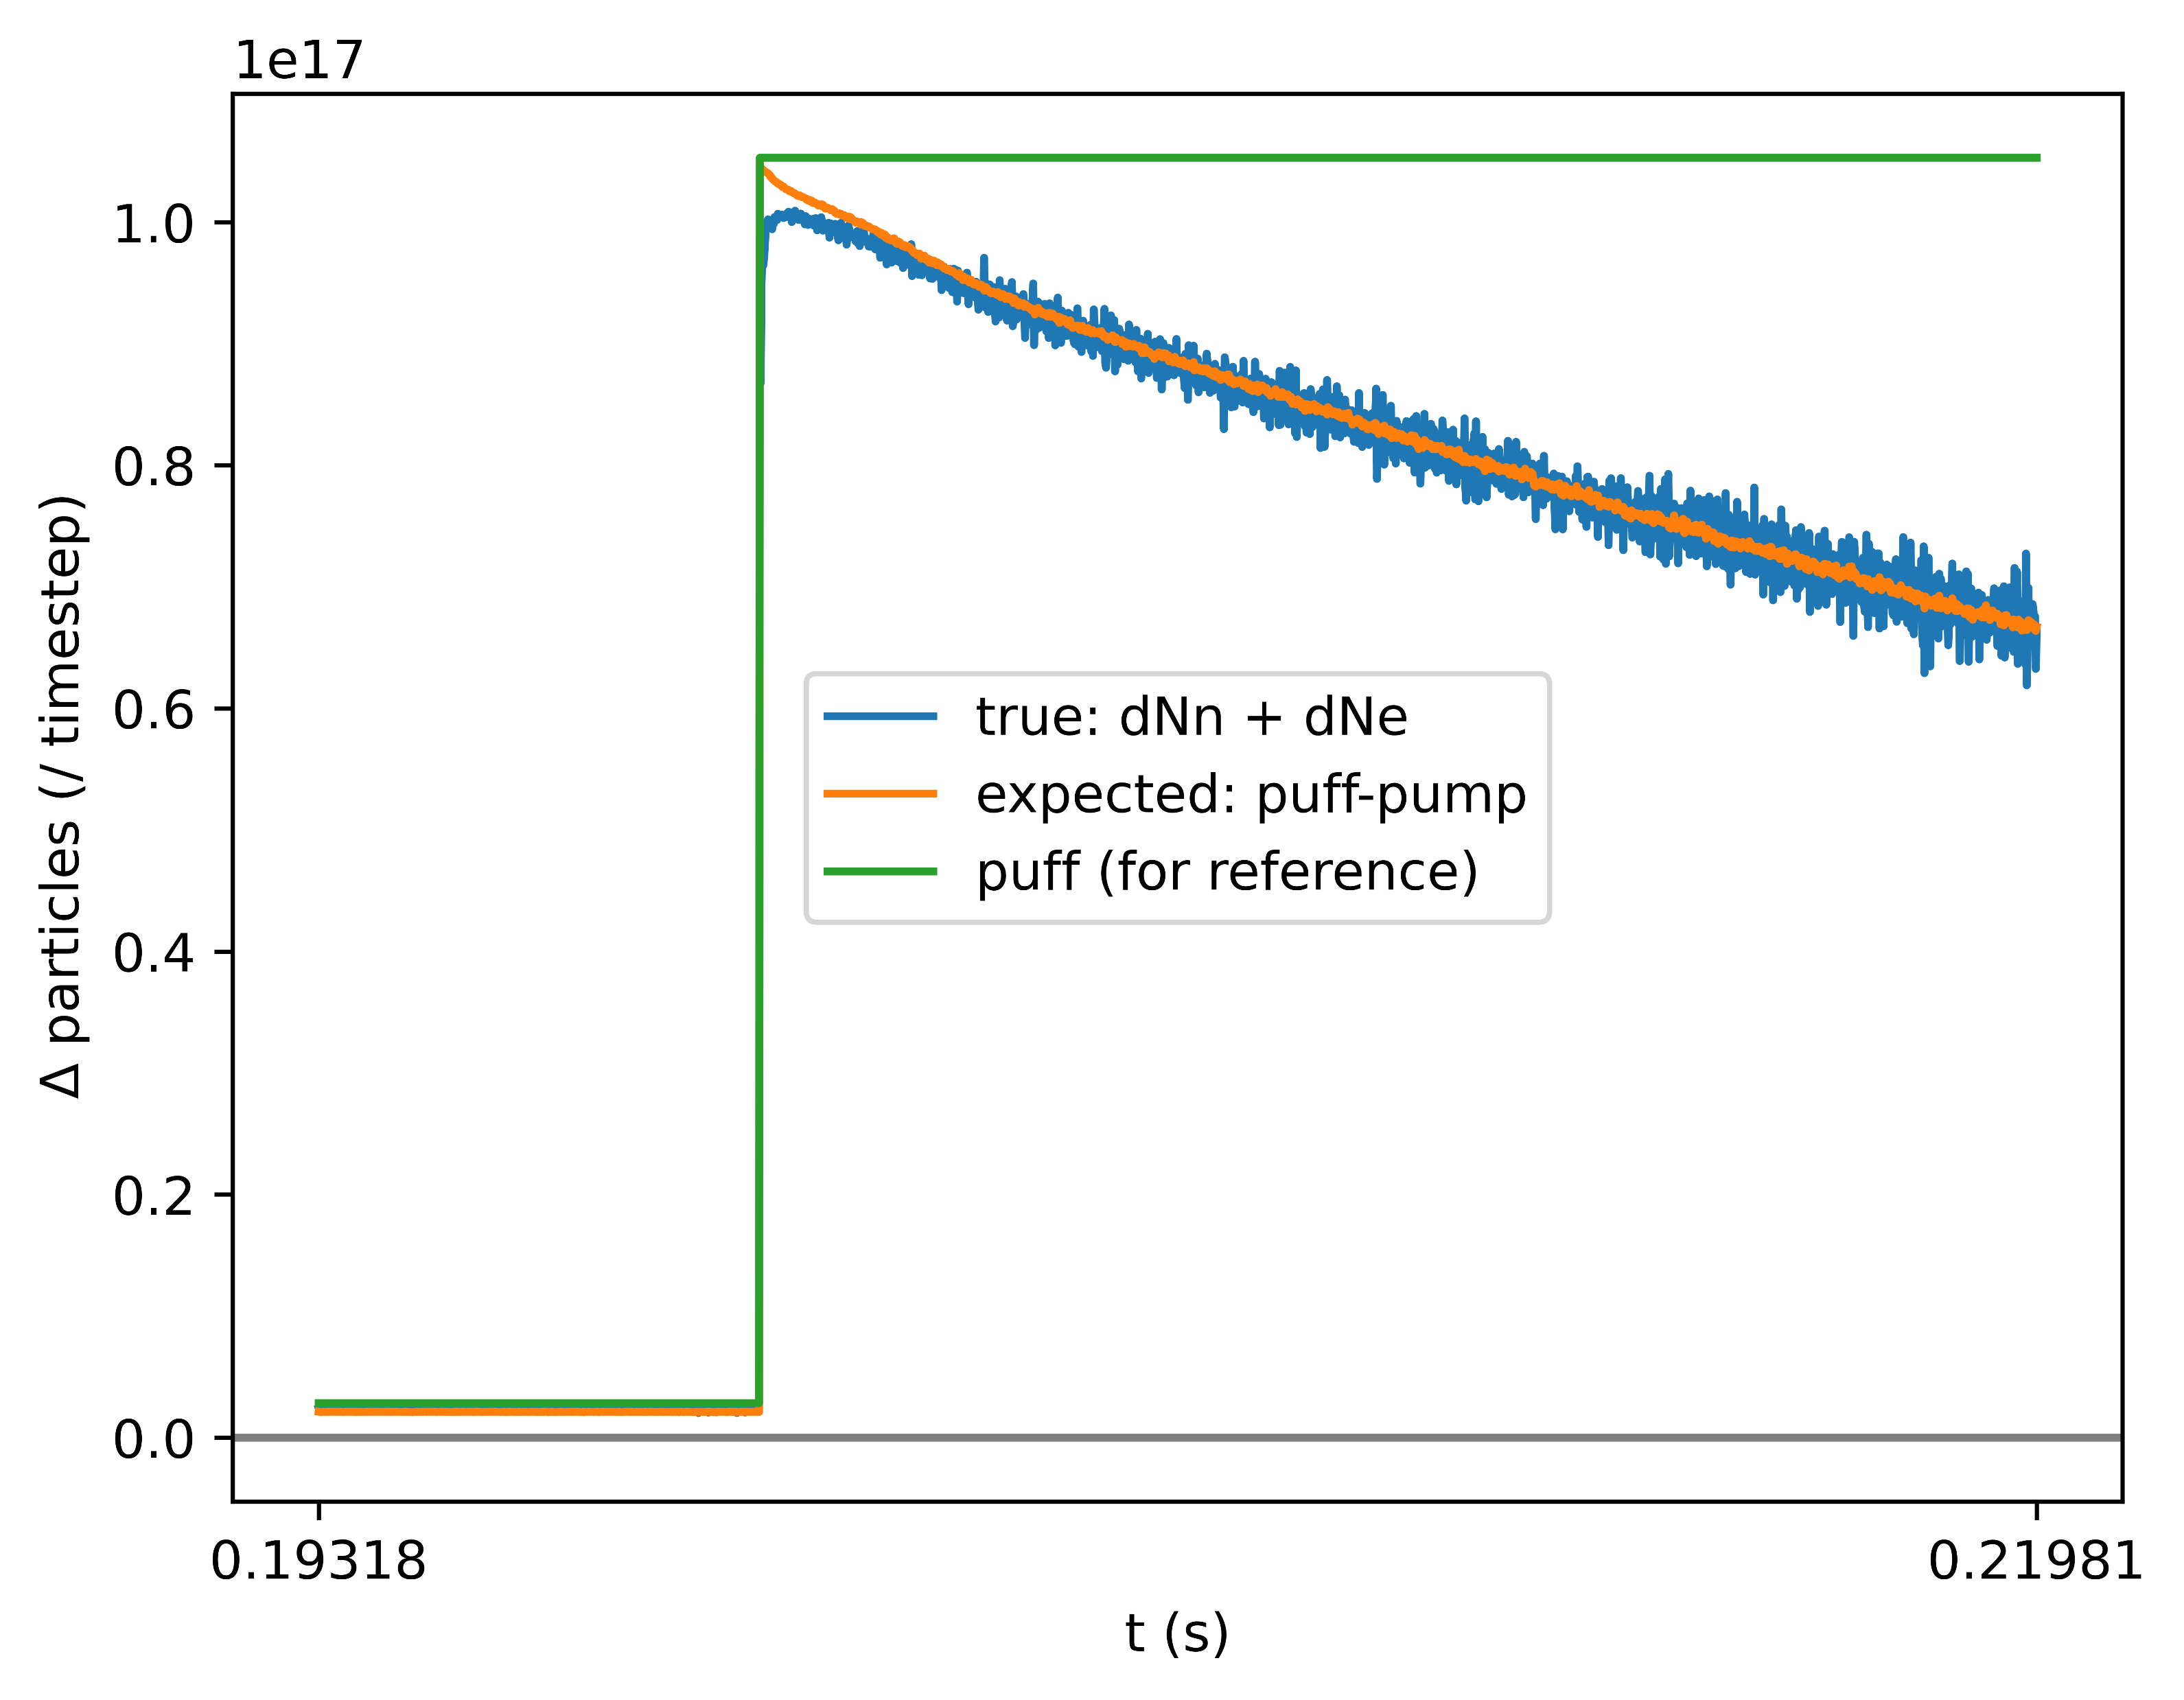
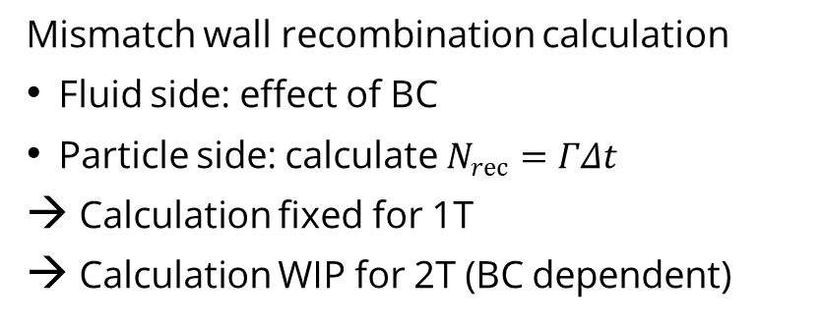
Issues: particle balance
Neutral particles lost due to bugs
→ Fixed
$$ΔN_{recomb}+ΔN_{puff}–ΔN_{ion}–ΔN_{pump}≠ΔN_{tot}?$$
Mismatch wall recombination calculation
Fluid side: effect of BC
Particle side: calculate $N_{rec}=ΓΔt$
Calculation fixed for 1T
Calculation WIP for 2T (BC dependent)

Slide 23
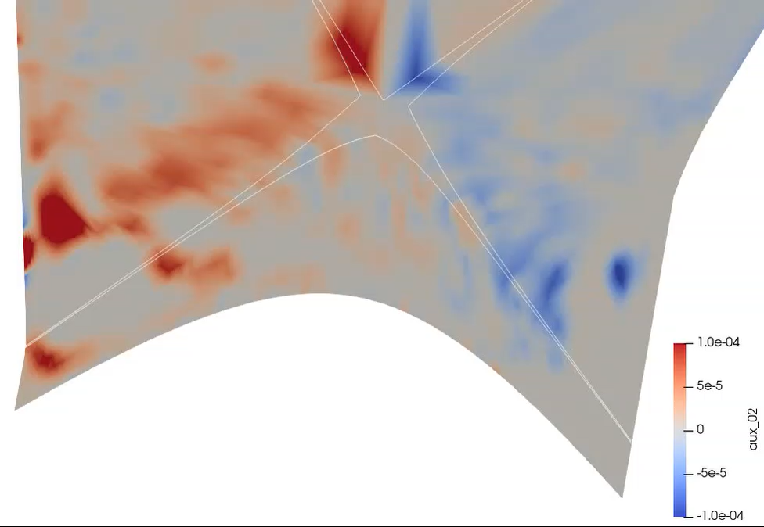
Issues: stability
Momentum source to plasma
Flickering momentum source
Implicit plasma, explicit neutrals
Particles see last plasma timestep
Accumulated drag > local momentum
Experience/solutions?
Idea: forward extrapolation of fields
Negative plasma density
Idea: implicit density source
Momentum source (a.u.)
Flickering

Slide 24
Results
Overview of code use

Slide 25
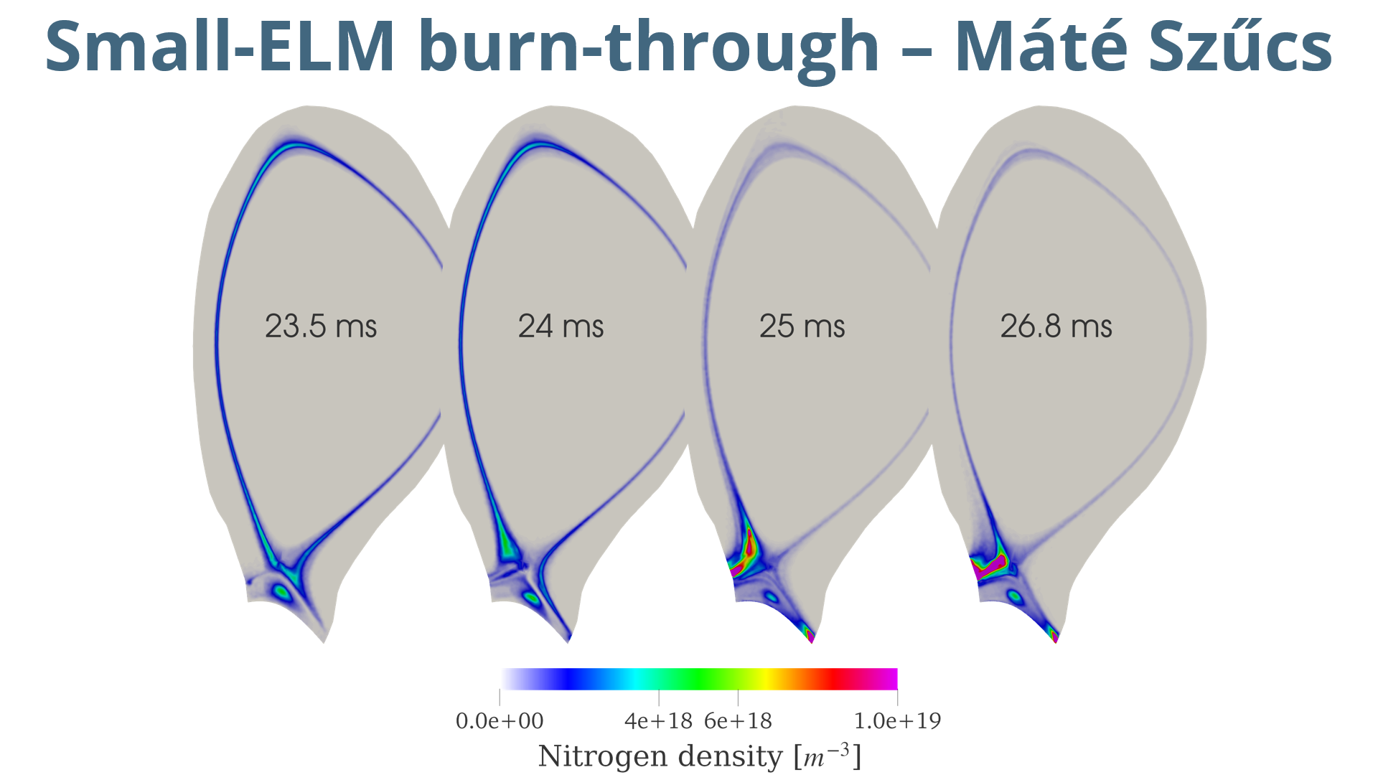
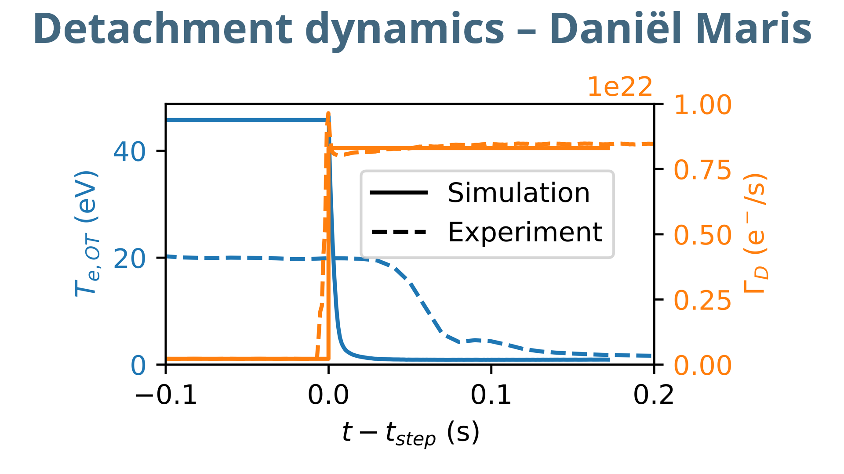
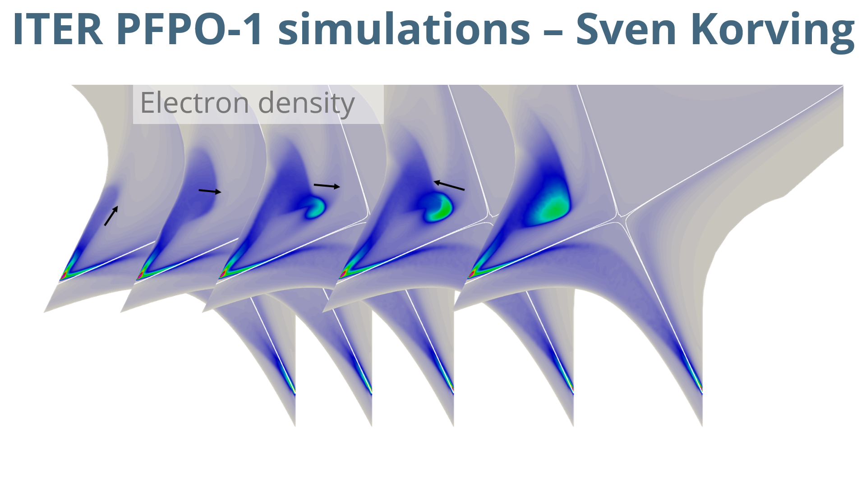
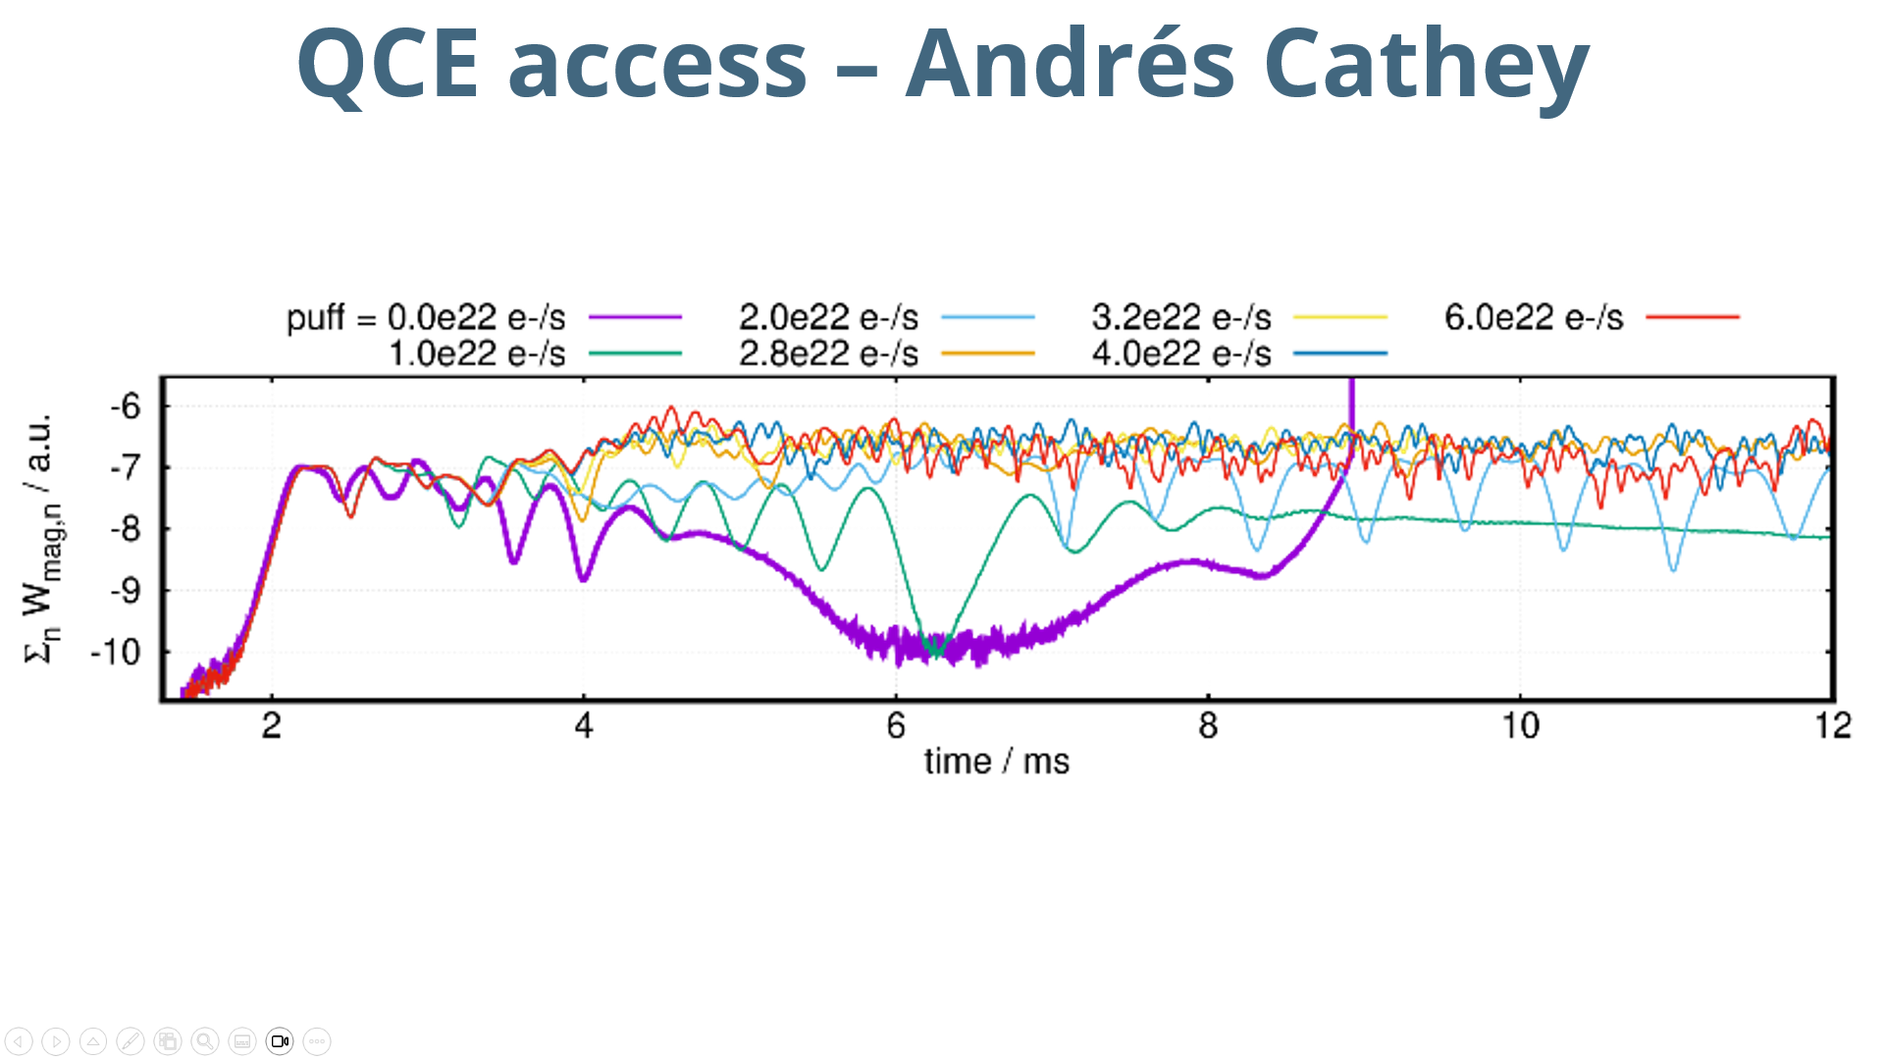
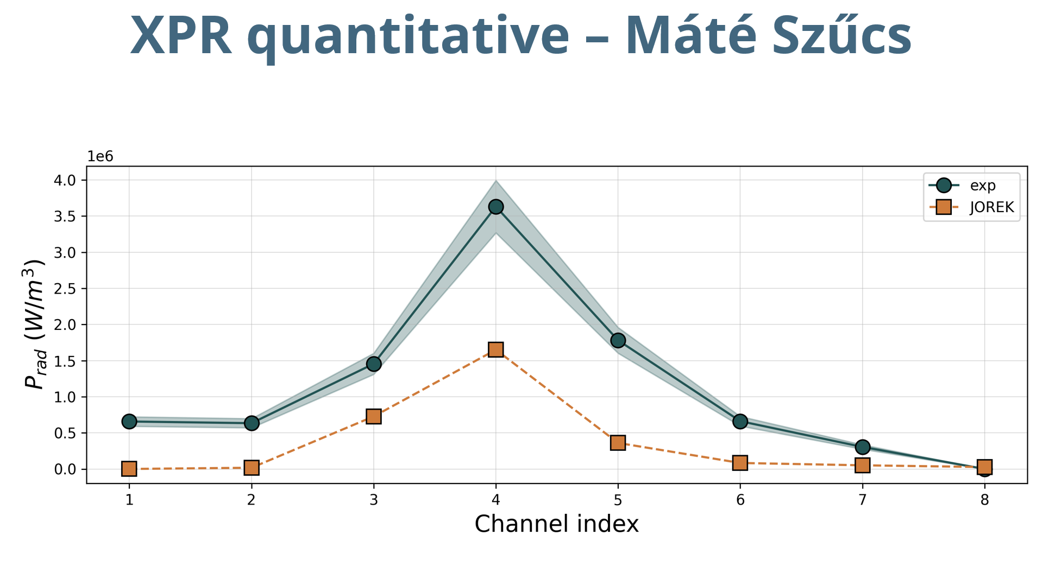
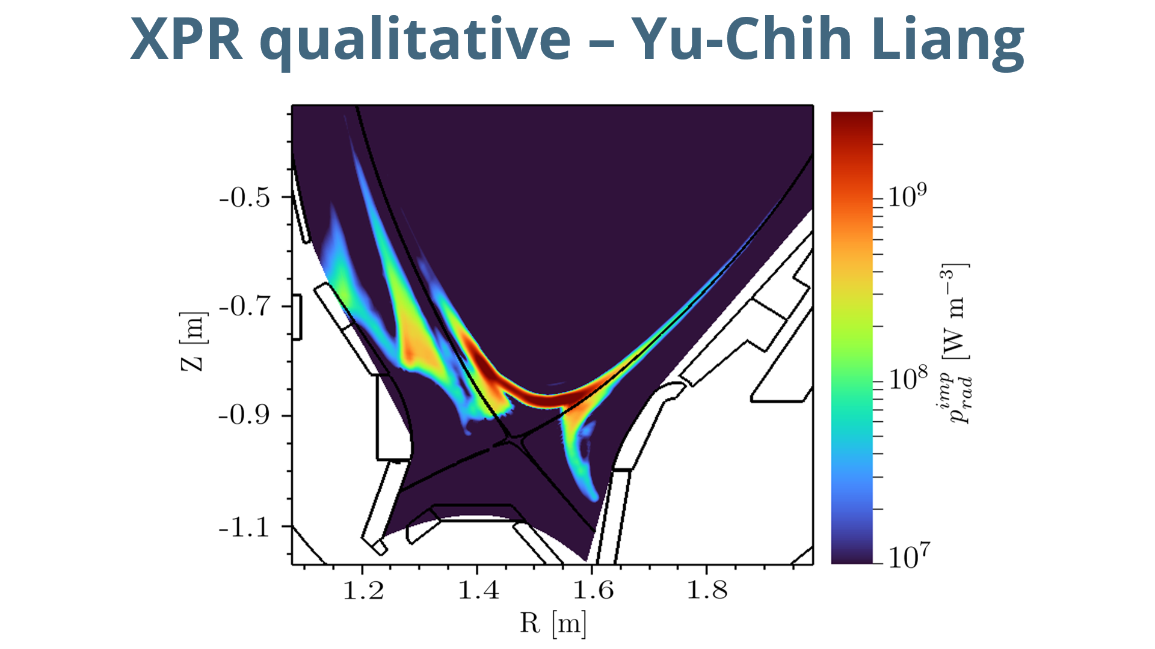
Overview of code use

Slide 26
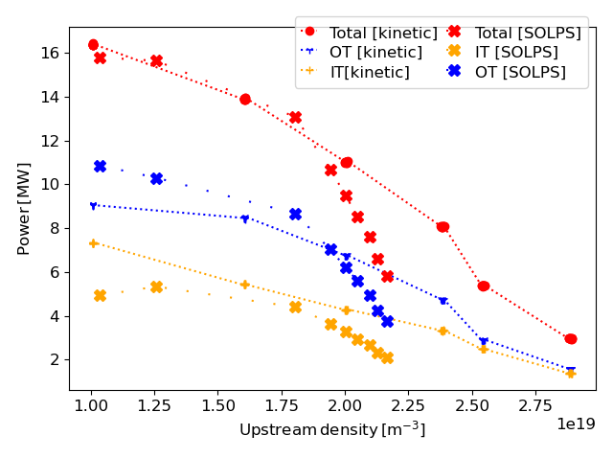
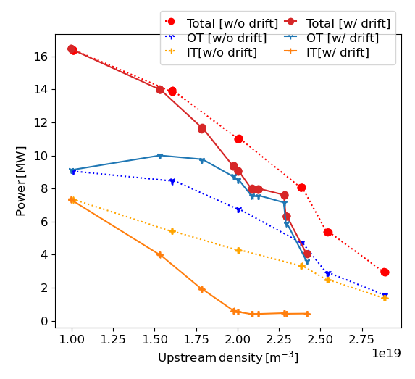
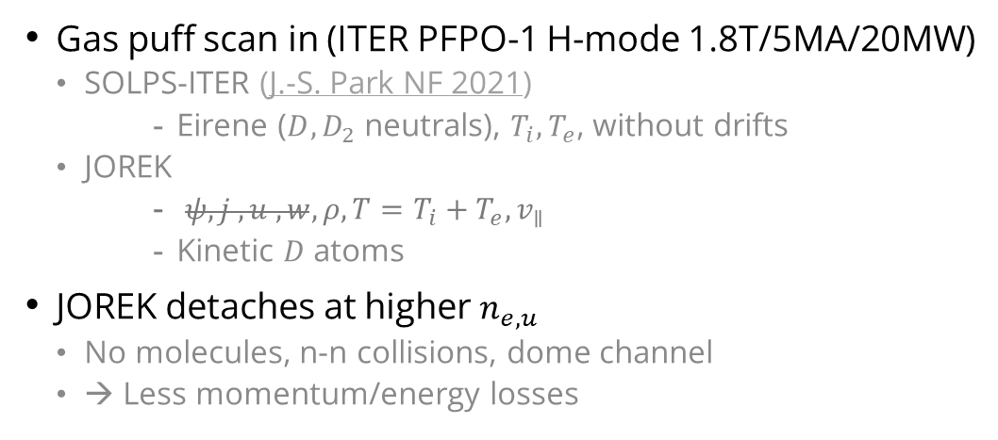
ITER PFPO-1 simulations – Sven Korving
Gas puff scan in (ITER PFPO-1 H-mode 1.8T/5MA/20MW)
  SOLPS-ITER (J.-S. Park NF 2021)
    Eirene ($D, D_{2}$ neutrals), $T_{i}, T_{e}$, without drifts
  JOREK
    $ψ, j , u , w, ρ, T=T_{i}+T_{e}, v_{∥}$
    Kinetic $D$ atoms
JOREK detaches at higher $n_{e,u}$
  No molecules, n-n collisions, dome channel
  → Less momentum/energy losses
Drifts cause stronger inner-outer asymmetry and stronger decrease of power to wall
  Strong transition coincides with formation HFSHD-region
S. Korving et al. PoP 2023
Notes:
Ask Sven Korving: transition he means 2.25e19?

Slide 27
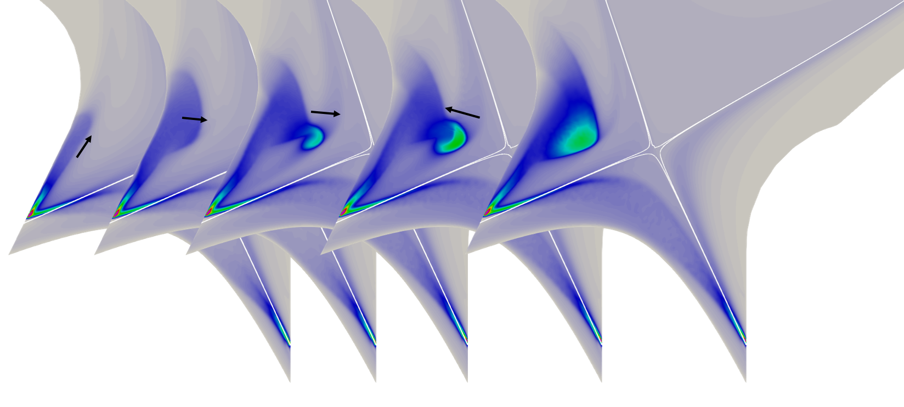
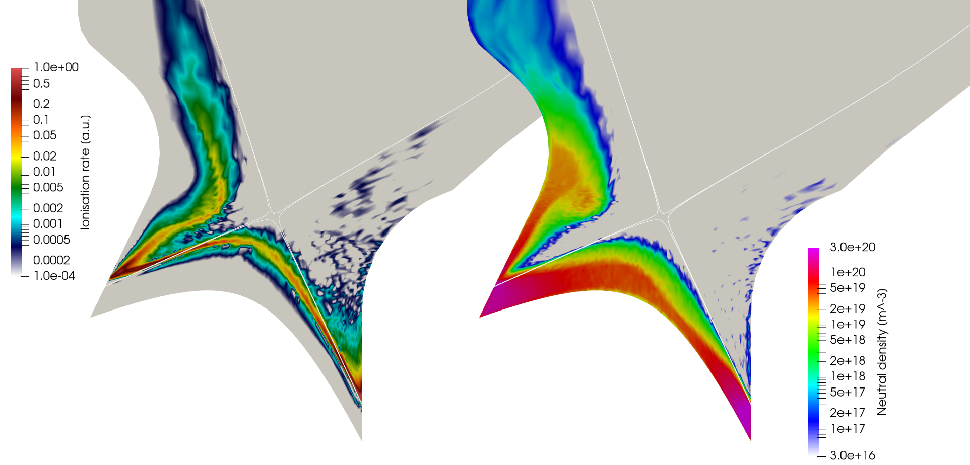
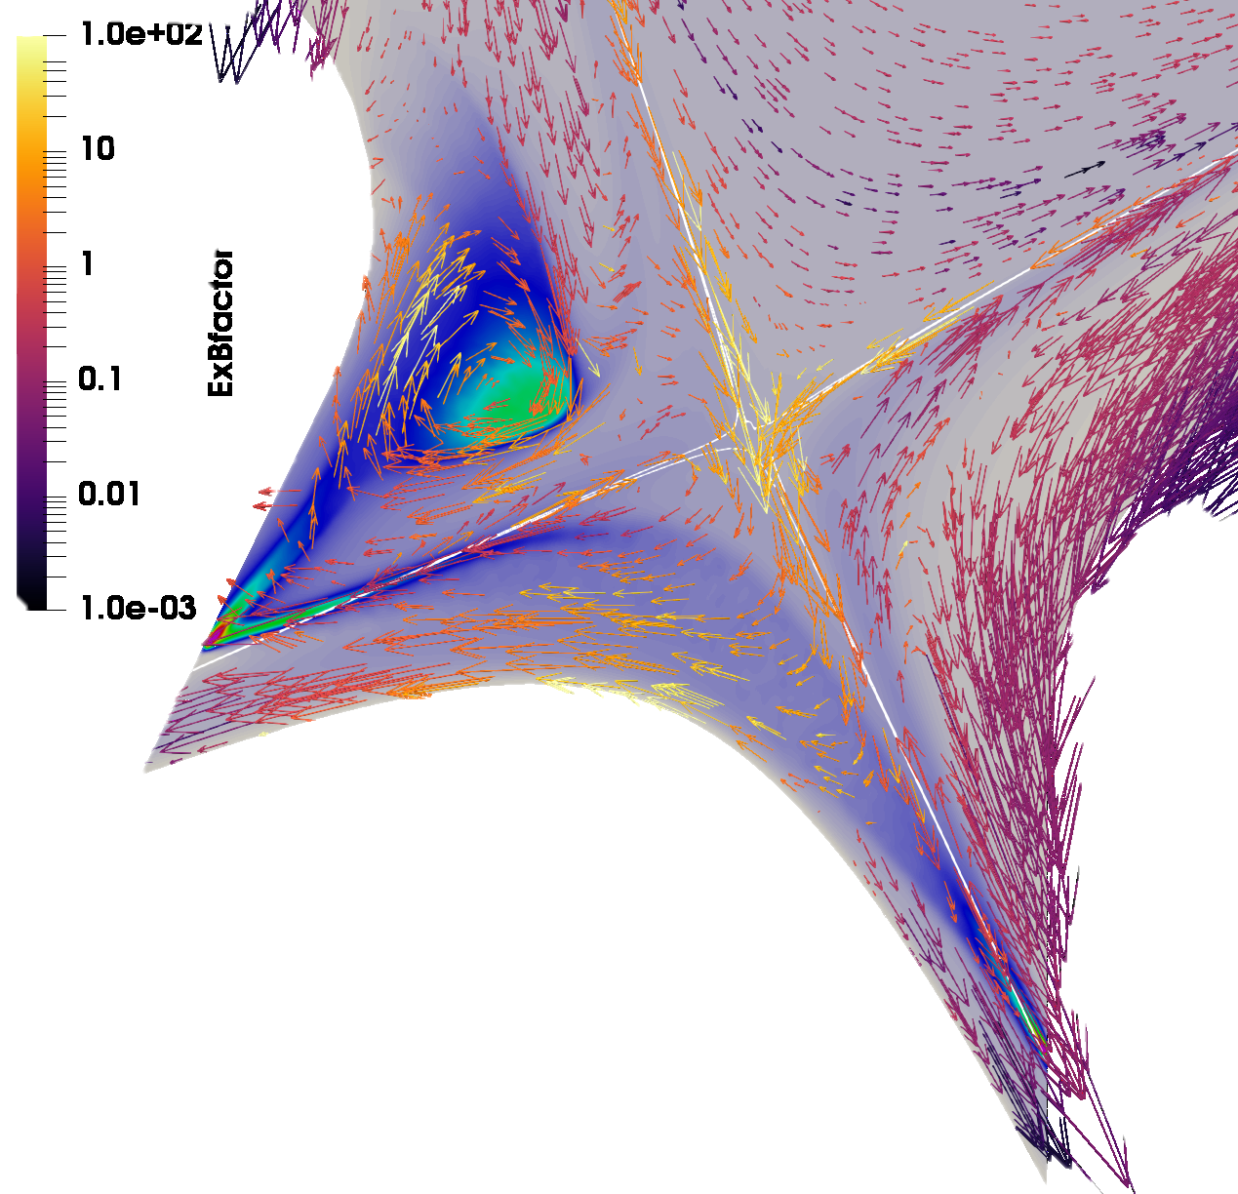
HFSHD-region formation in ITER
Sven Korving
Electron density
ExB drifts + neutrals drives formation
  HFSHD-region is driven by ExB vortex
  Redirection ion and heat flow
  Accumulates & mixes cold and hot plasma
  Stronger energy dissipation around vortex
Affects poloidal flow in the entire SOL
Ionisation rate
Neutral density
ExB flow
S. Korving et al. PoP 2023

Slide 28
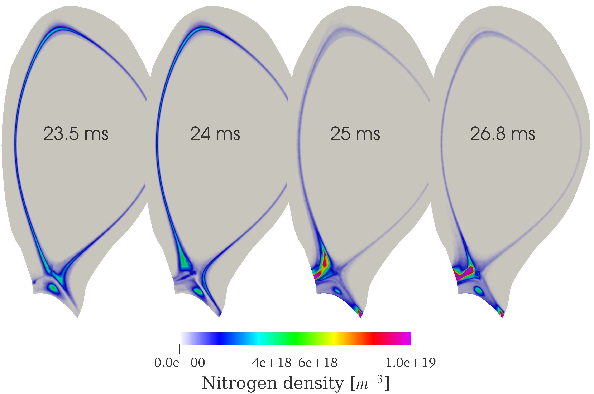
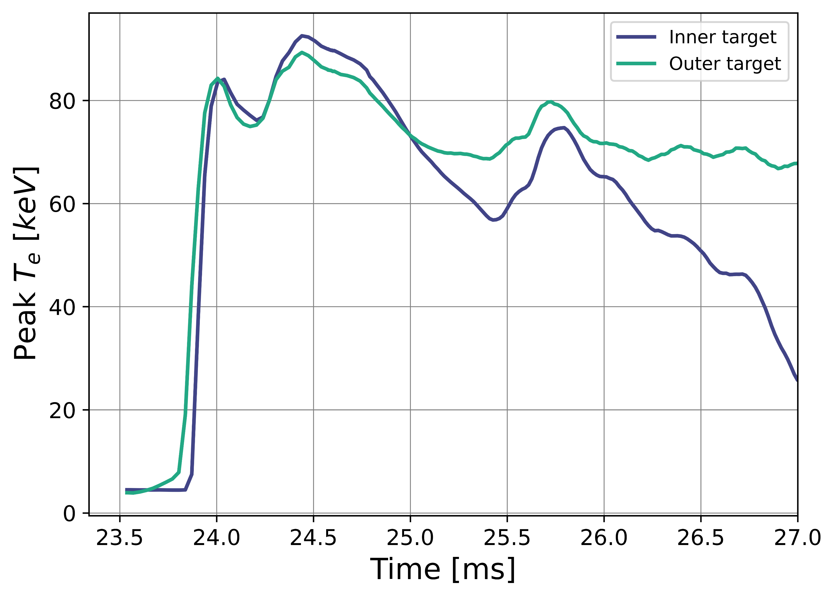
Small-ELM burn-through
Máté Szűcs
Re-attachment (as experiments)
Nitrogen flush-out (as experiments)
Peak divertor temperatures

Slide 29
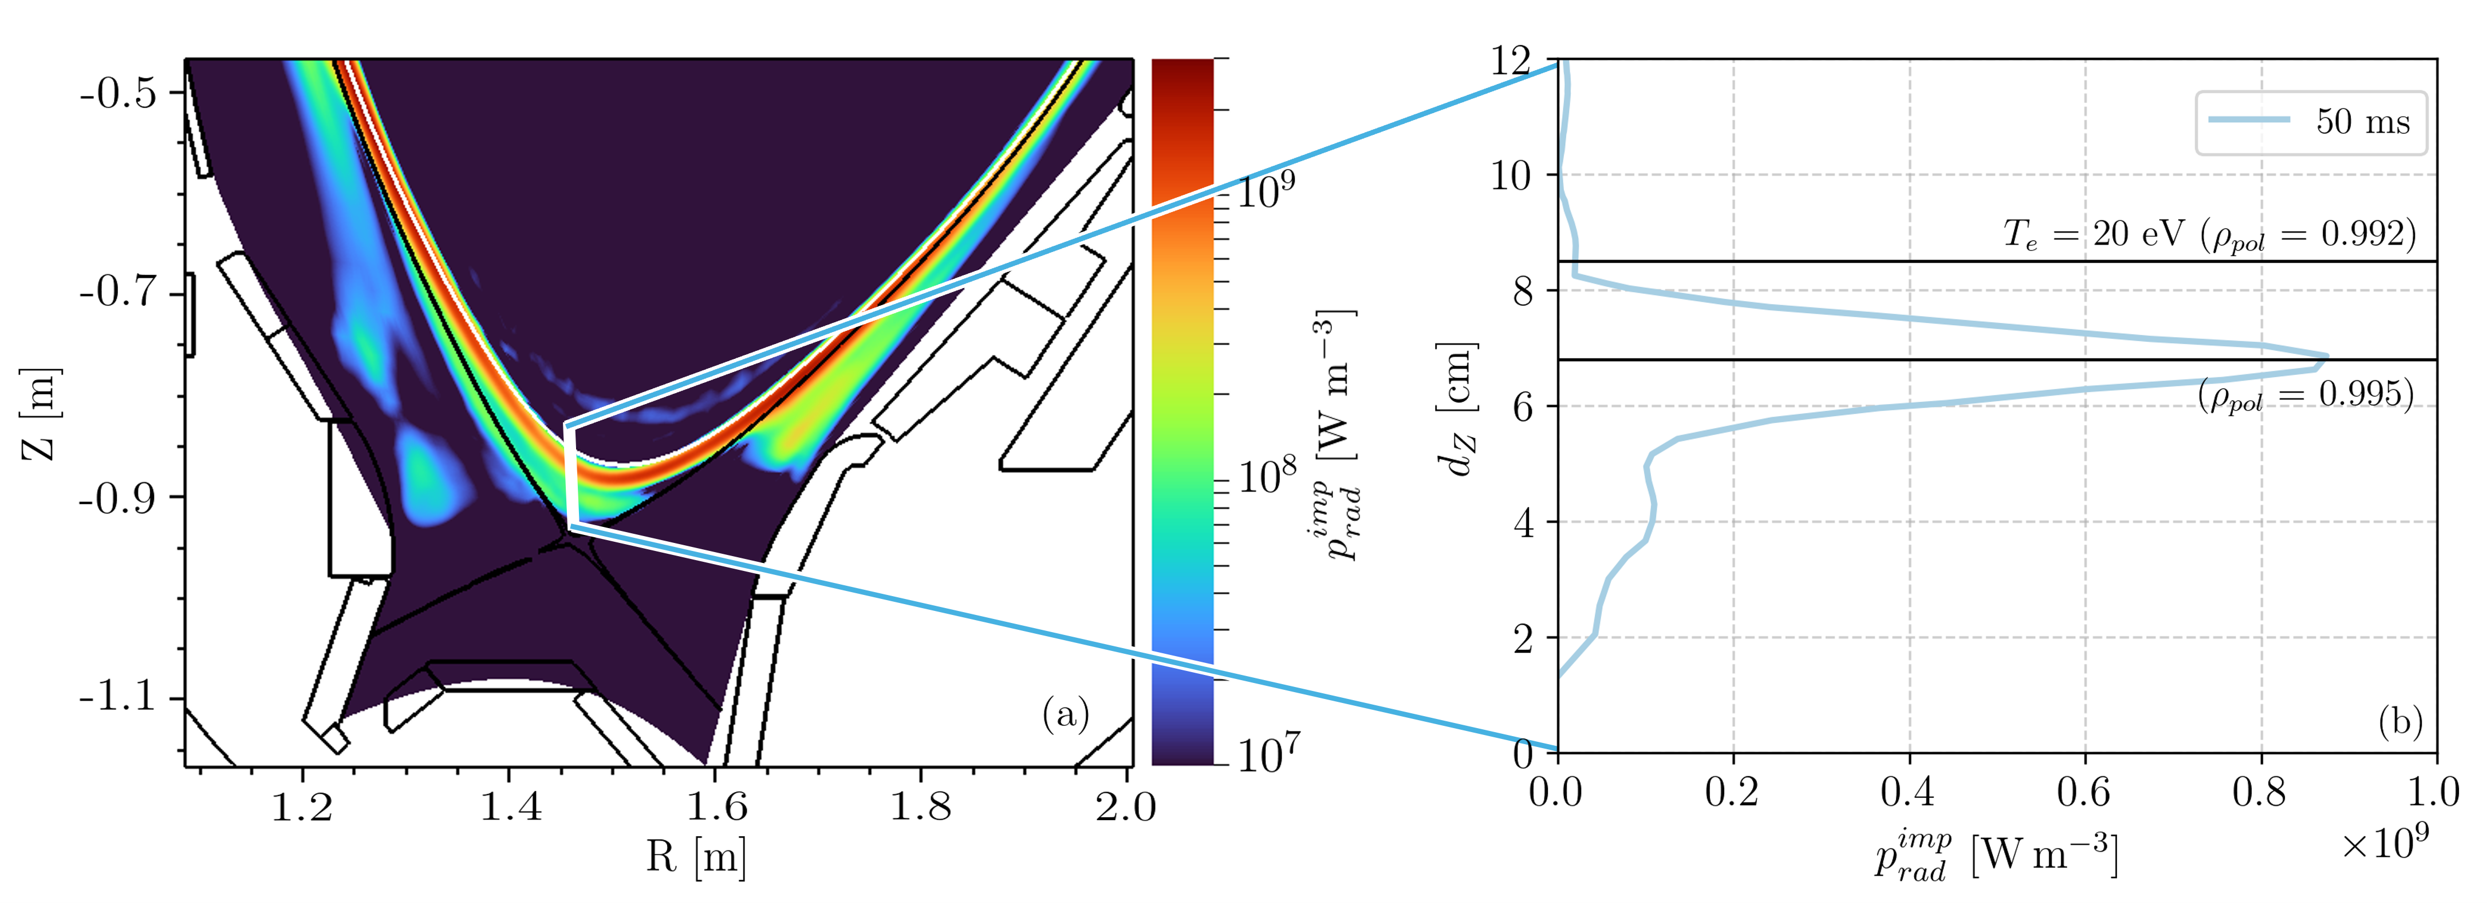
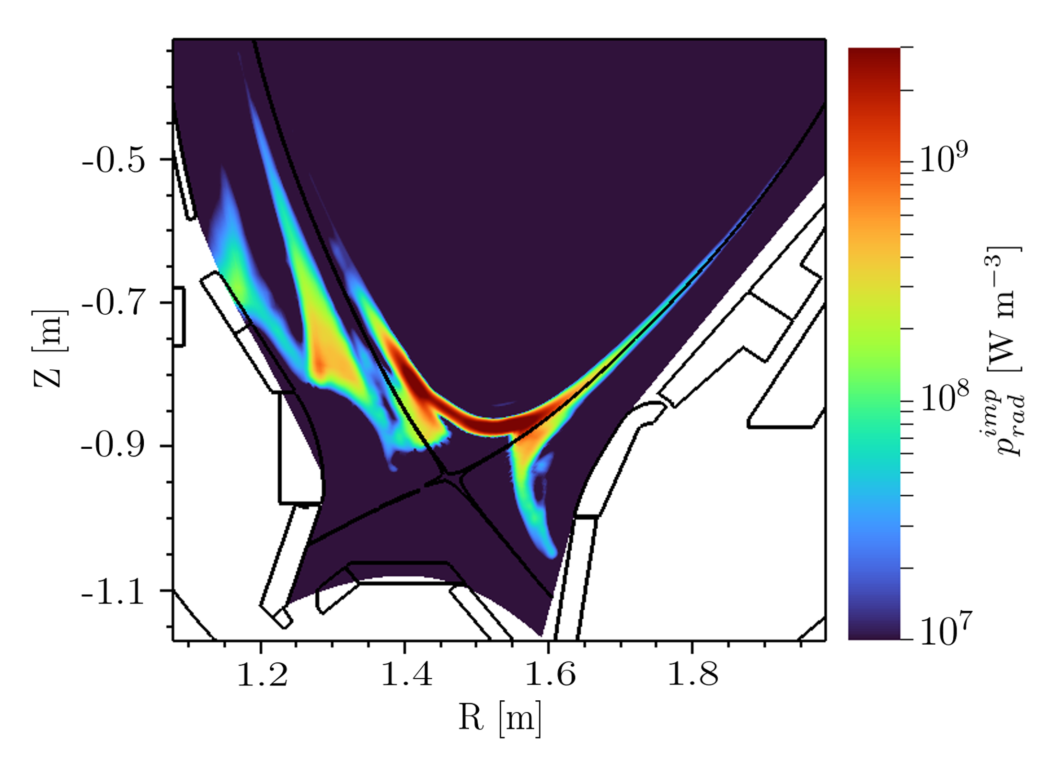
XPR formation in ASDEX Upgrade
Yu-Chih Liang
MHD + kinetic D neutrals & N impurities
Neoclassical impurity collisions
Stable XPR formation
Poloidally localised XPR (as exp.)
Impurity radiation
Impurity radiation
Y. C. Liang et al. PoP 2026

Slide 30
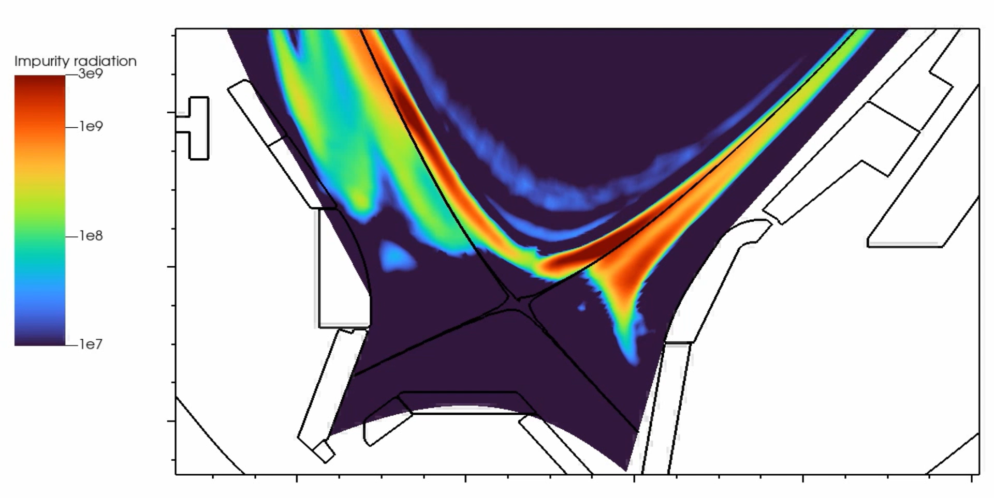
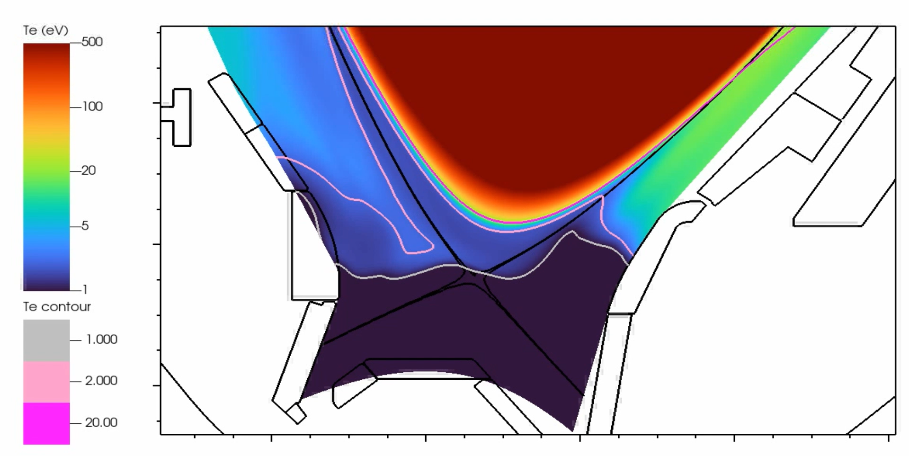
XPR transitions; loss and MARFE
Yu-Chih Liang
Decrease N seeding rate
XPR moves downward
Impurity radiation decays
Loss of XPR (as experiments)
Increase N seeding rate
XPR moves upward
T_{e} in XPR reduces to << 1 eV
MARFE formation (as experiments)
Impurity radiation
Electron temperature
Y. C. Liang et al. PoP 2026

Slide 31
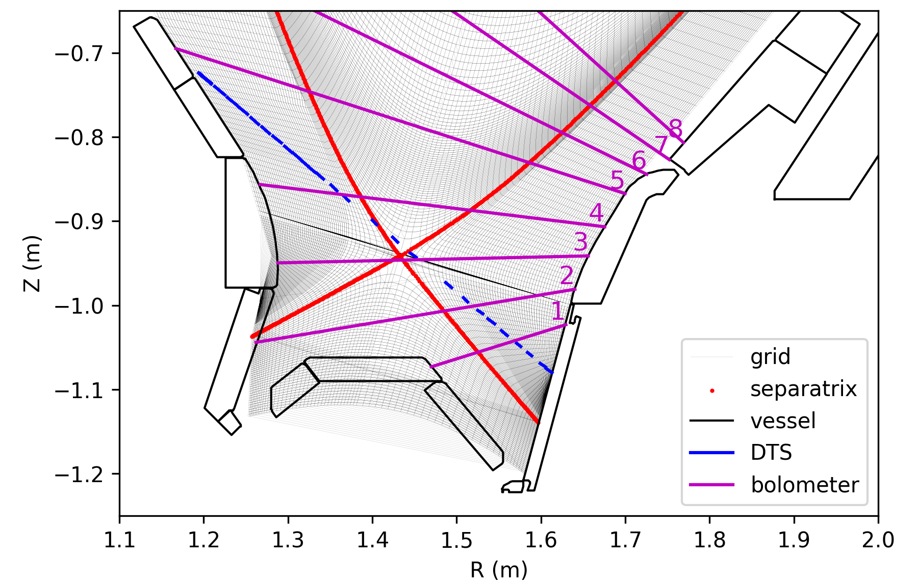
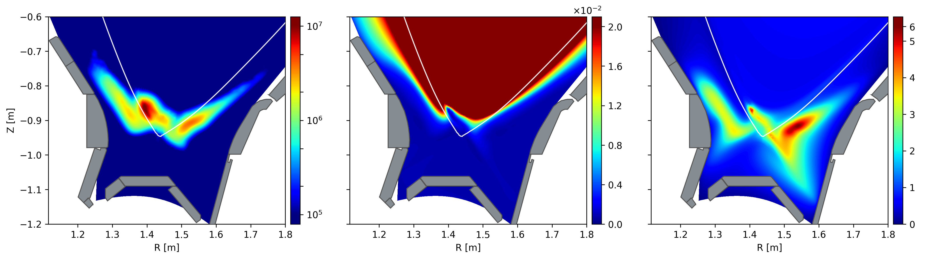
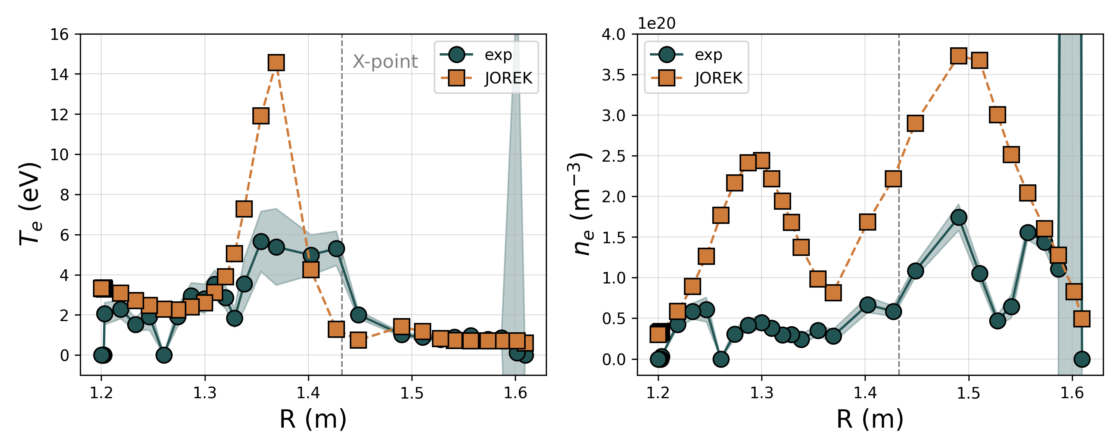
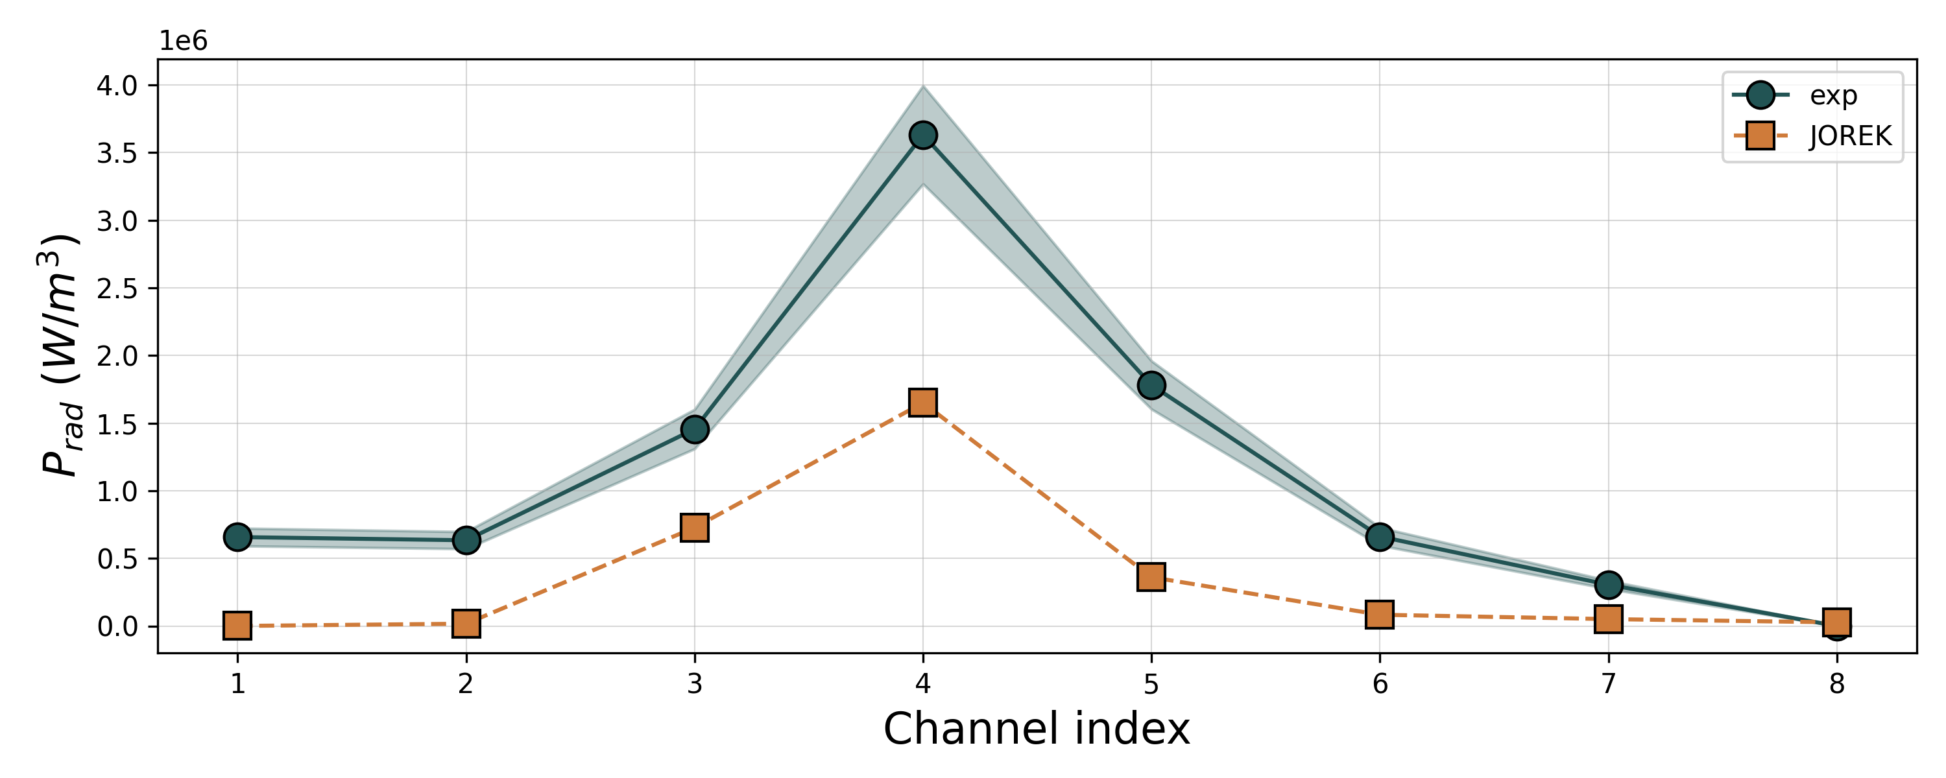
XPR quantitative validation AUG
Máté Szűcs
Prad
Te
ne
Notes:
synthetic diagnostics

Slide 32
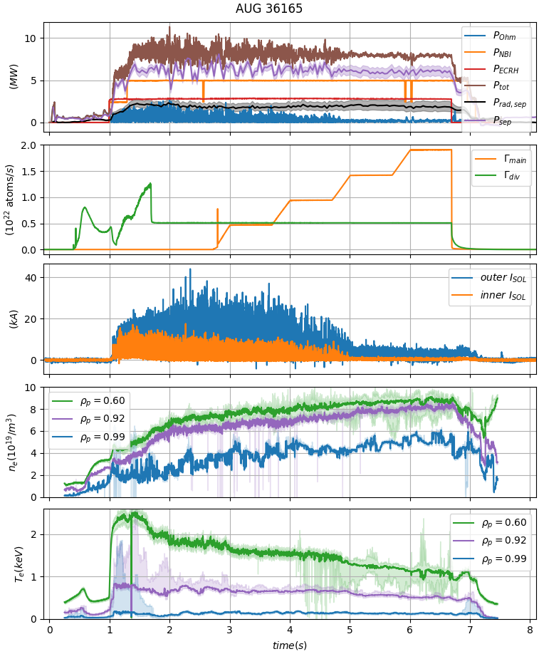
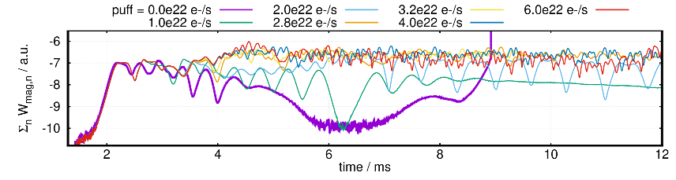
QCE access in ASDEX Upgrade
Andrés Cathey
QCE regime is a type-I ELM-free H-mode in AUG
AUG #36165: type-I ELMy to QCE regime
Transition follows from gas puff ramp
Kinetic neutrals at various puffing rates in JOREK
simulations result in a transition from type-I ELMs
to quasi-continuous pedestal instabilities
  Low gas puff (purple) results
  in type-I ELM onset
  Increasing gas puff
  shows quasi-continuous
  transport of instabilities
  (which are borne near
  the separatrix)
AUG #36165 gas puff ramp (top) and ELM monitor (bottom). Type-I ELMs give way to QCE regime as the separatrix density increases with stronger puffing.

Slide 33
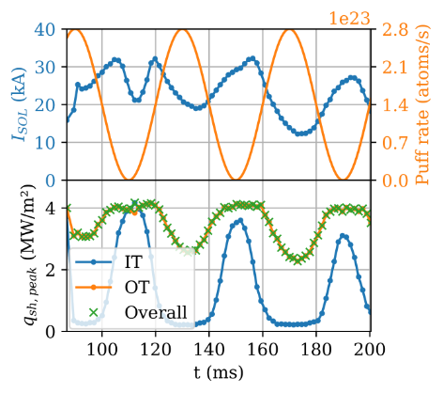



Detachment dynamics – proof of concept
Daniël Maris
Goal my PhD:
Numerical system identification for ITER
Proof of concept results:
ITER SRO phase
Promising but missing molecules, validation
Input: puff rate
Output: $I_{SOL}$
Model

Slide 34







Detachment dynamics validation attempt:
Quantitative mismatch
Plasma temperature
Plasma density
WPTE RT05, AUG #42651, collab F. Cursi
Attached -> detached dynamically
Dynamic simulation 0.17s
Mismatch: too attached, pipe dynamics
$$T_{e} \left(keV\right)$$
$$n_{e} \left({10}^{20}m^{−3}\right)$$

Slide 35




Detachment dynamics validation:
Qualitative agreement
Experiment:
Fast up, slow down of experiment radiation peak
XPR like
Simulation:
Fast up (60ms), slow down of T & D0 density
XPR like
Plasma temperature
$$T_{e} \left(keV\right)$$
Ionization (a.u.)
Ionization
Radiation peak in experiment
Simulation

Slide 36
Final words
Conclusion and outlook

Slide 37

Conclusion: JOREK shines
Thanks!
MHD
Dynamics
ELMs, surpression & burn-through
Fully time-dependent and optimized
Ionization (a.u.)
Maturing fast
Outlook
Flexible framework
Parallelized
Efficient feedback
2T, NNC, timescales
Develop JGX, stellarators
Sheath BC for current
Molecules
JOREK is open source, so do try at home!

