Slide 1
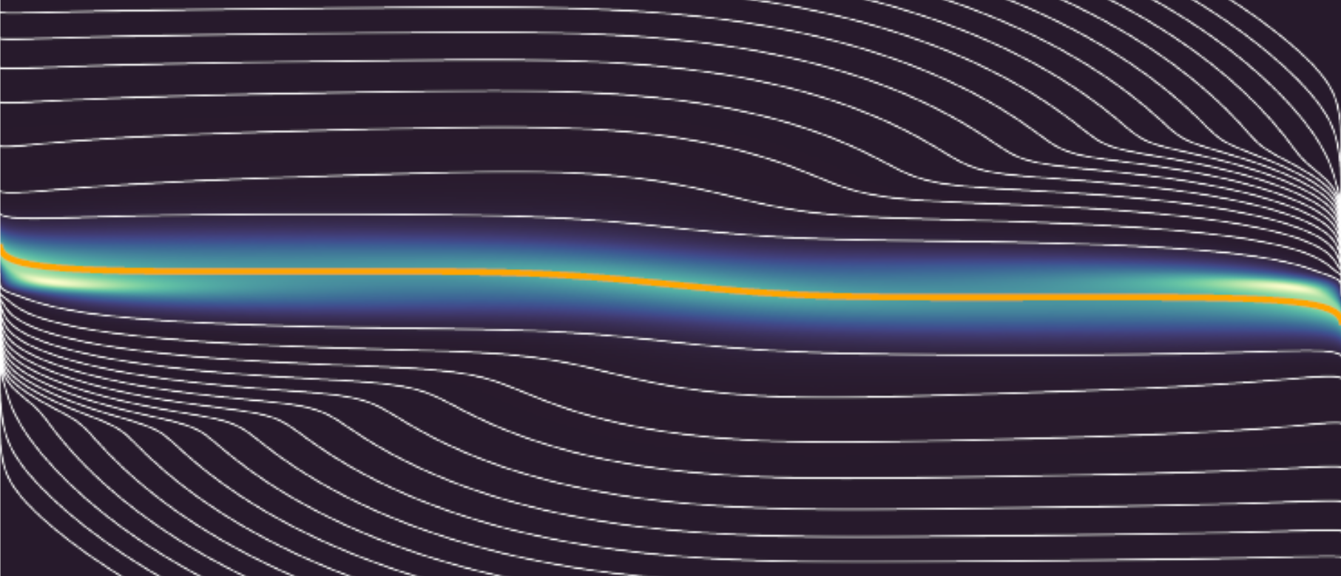
Kinetics for Transport (KfT)
1D1V demo of moment-kinetic approach to transport
J Omotani, F Parra, M Barnes, S Newton, M Hardman, M Abazorius, L McConnell

Slide 2
Overview
Aim : consistent transport timescale simulation of open and closed field line regions
Issues :
Strong parameter variation on open lines - issue for grid resolution
Sheath boundary effect
Momentum conservation
}
coupled through electrostatic potential - drifts affect divertor loading
Moment-kinetic approach :
Define shape function with known constant velocity moments
Solve consistent shape function evolution equation coupled to moment equations
Implementation :
Numerical framework Kinetics for Transport (KfT) : [https://github.com/KineticsforTransport/KfT]
Finite element (Chebyshev, Legendre), written in
[https://julialang.org]

Slide 3
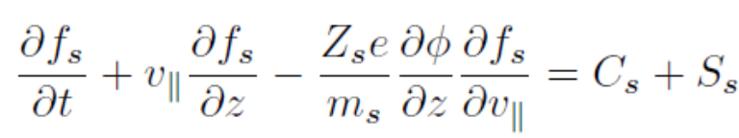
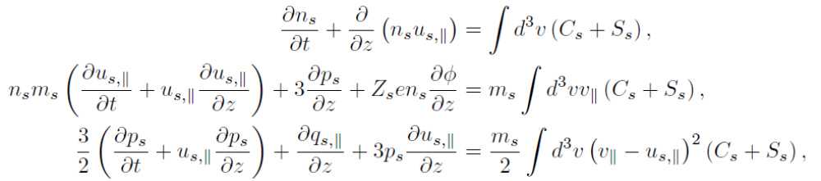
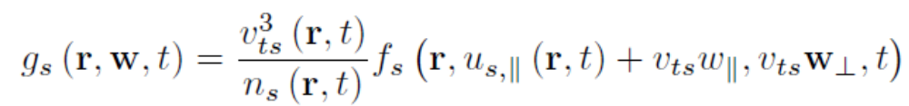
Moment-kinetic approach - 1D1V
Kinetic equation for a charged species
Transport equations :
- usual velocity moments of interest
Define shape function :
- shifted to local parallel flow frame
- normalised to satisfy fixed constraints on density, parallel momentum, energy

Slide 4
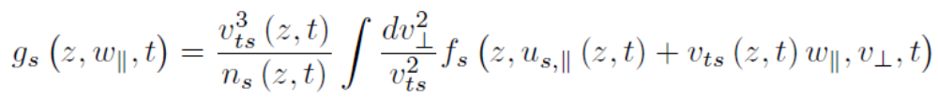
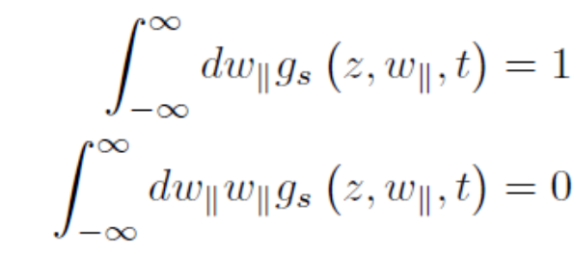
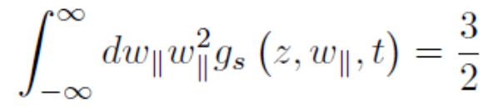
Moment-kinetic approach - 1D1V
Kinetic equation for a charged species
Transport equations :
- usual velocity moments of interest
Define shape function :
- shifted to local parallel flow frame
- marginalised in 1D1V
- normalised to satisfy fixed constraints on density, parallel momentum, energy

Slide 5
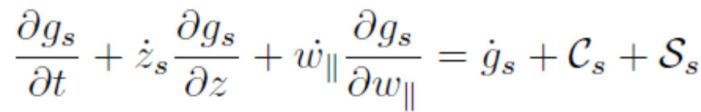
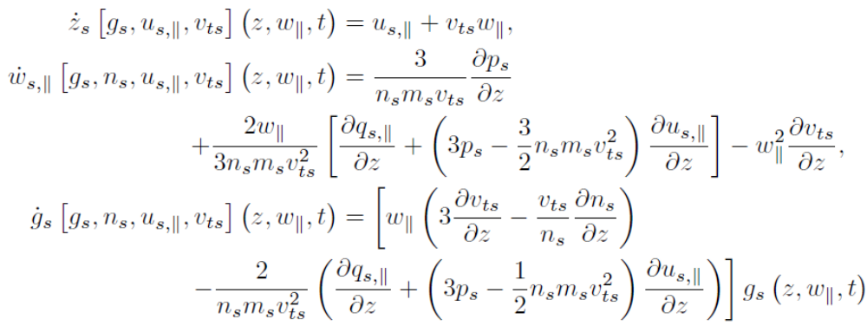
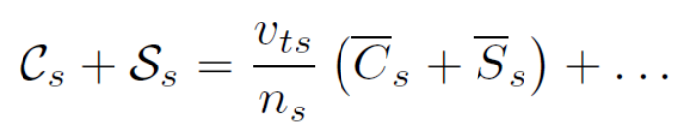
Moment-kinetic approach - 1D1V
Consistent (marginalised) shape function evolution equation
note for grid spacing
modified collision and source terms
- contain all marginalised contributions from
moment substitution [slide 15]

Slide 6
Moment-kinetic approach - electrons
Consistent (marginalised) shape function evolution equation
note for grid spacing
On ion dynamic timescales, light electrons → $∂_{t}g_{e}\sim 0$ - electron distribution pseudo-steady-state
- neglect terms consistently : flow $u_{e||}$comparable to $u_{i||}$, ion collisions with electrons …

Slide 7
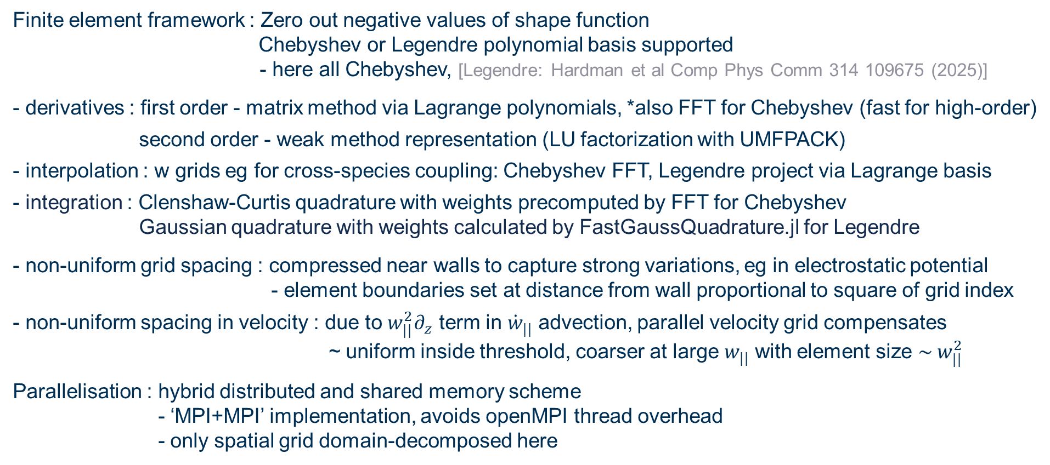
Implementation - KfT - grid
Finite element framework : Zero out negative values of shape function
Chebyshev or Legendre polynomial basis supported
- here all Chebyshev, [Legendre: Hardman et al Comp Phys Comm 314 109675 (2025)]
- derivatives : first order - matrix method via Lagrange polynomials, *also FFT for Chebyshev (fast for high-order)
second order - weak method representation (LU factorization with UMFPACK)
- interpolation : w grids eg for cross-species coupling: Chebyshev FFT, Legendre project via Lagrange basis
- integration : Clenshaw-Curtis quadrature with weights precomputed by FFT for Chebyshev
Gaussian quadrature with weights calculated by FastGaussQuadrature.jl for Legendre
- non-uniform grid spacing : compressed near walls to capture strong variations, eg in electrostatic potential
- element boundaries set at distance from wall proportional to square of grid index
- non-uniform spacing in velocity : due to $w_{||}^{2}∂_{z}$ term in ${\dot{w}}_{||}$ advection, parallel velocity grid compensates
~ uniform inside threshold, coarser at large $w_{||}$ with element size ${\sim w}_{||}^{2}$
Parallelisation : hybrid distributed and shared memory scheme
- ‘MPI+MPI’ implementation, avoids openMPI thread overhead
- only spatial grid domain-decomposed here
* gotcha : apply method just as in Boyd reduces order

Slide 8
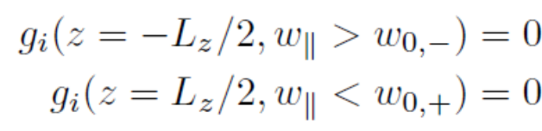

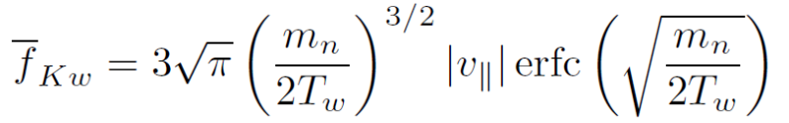
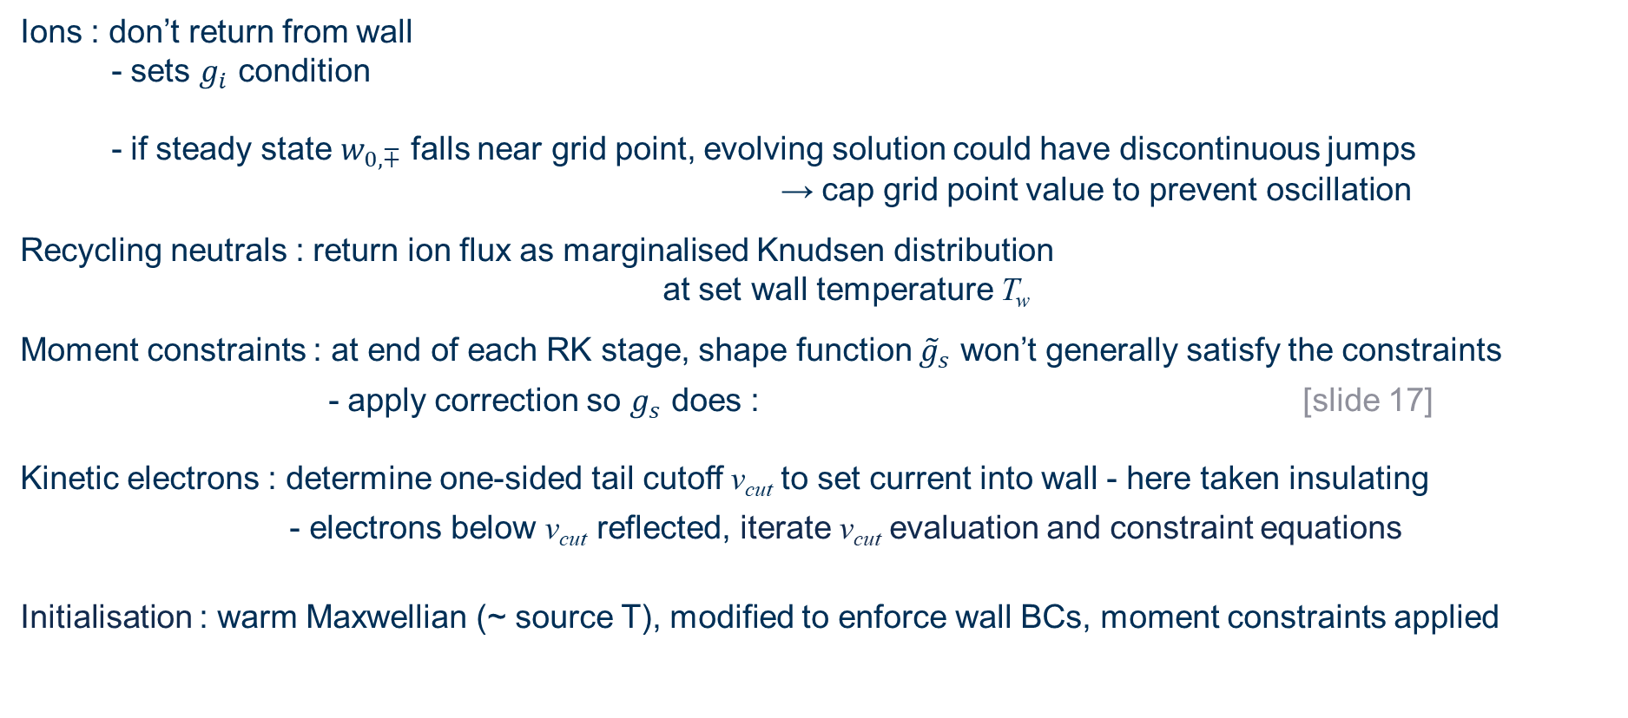
Implementation - KfT - BCs
Ions : don’t return from wall
- sets $g_{i}$ condition
- if steady state $w_{0,∓}$ falls near grid point, evolving solution could have discontinuous jumps
→ cap grid point value to prevent oscillation
Recycling neutrals : return ion flux as marginalised Knudsen distribution
at set wall temperature T_{w}
Moment constraints : at end of each RK stage, shape function ${\tilde{g}}_{s}$ won’t generally satisfy the constraints
- apply correction so $g_{s}$ does : [slide 17]
Kinetic electrons : determine one-sided tail cutoff v_{cut} to set current into wall - here taken insulating
- electrons below v_{cut} reflected, iterate v_{cut} evaluation and constraint equations
Initialisation : warm Maxwellian (~ source T), modified to enforce wall BCs, moment constraints applied

Slide 9
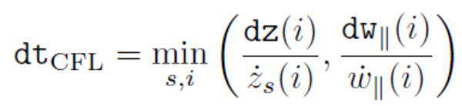
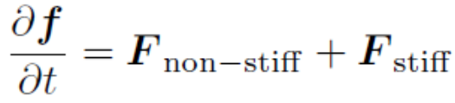
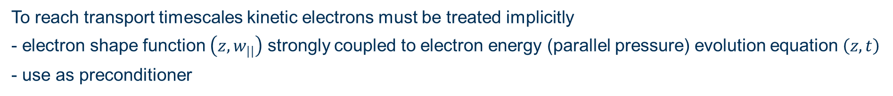
Implementation - KfT - time-advance
Explicit and semi-implicit time advance methods available
Generic RK methods with fixed or adaptive timestep
- cap at factor of CFL on grid
- error is mean over all independent variables, so not dominated by many points of shape function
To reach transport timescales kinetic electrons must be treated implicitly
- electron shape function $\left(z,w_{||}\right)$ strongly coupled to electron energy (parallel pressure) evolution equation $\left(z,t\right)$
- use as preconditioner
→ use IMplicitEXplicit Additive RK scheme
- other species, cross-field transport …. treated explicitly
- retain artificial time dependence in pseudo steady-state electron shape equation
- 2 methods working : pseudo-transient continuation or retain explicit time-derivative (no other small mass term)

Slide 10

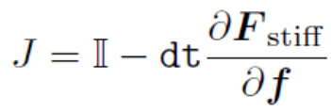

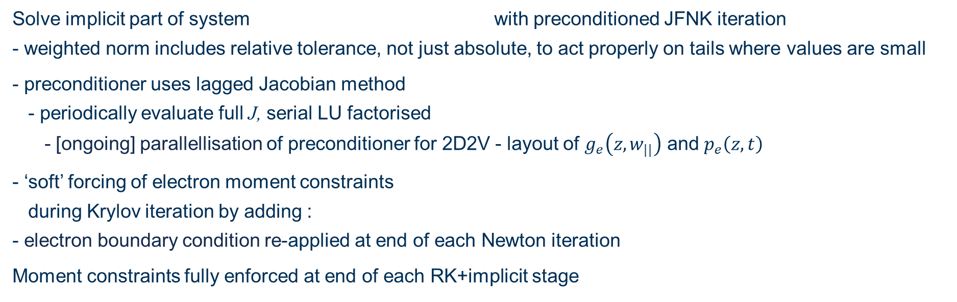
Implementation - KfT - IMEX ARK JFNK
IMplicitEXplicit Additive RK scheme
Solve implicit part of system with preconditioned JFNK iteration
- weighted norm includes relative tolerance, not just absolute, to act properly on tails where values are small
- preconditioner uses lagged Jacobian method
- periodically evaluate full J, serial LU factorised
- [ongoing] parallellisation of preconditioner for 2D2V - layout of $g_{e}\left(z,w_{||}\right)$ and $p_{e}\left(z,t\right)$
- ‘soft’ forcing of electron moment constraints
during Krylov iteration by adding :
- electron boundary condition re-applied at end of each Newton iteration
Moment constraints fully enforced at end of each RK+implicit stage

Slide 11
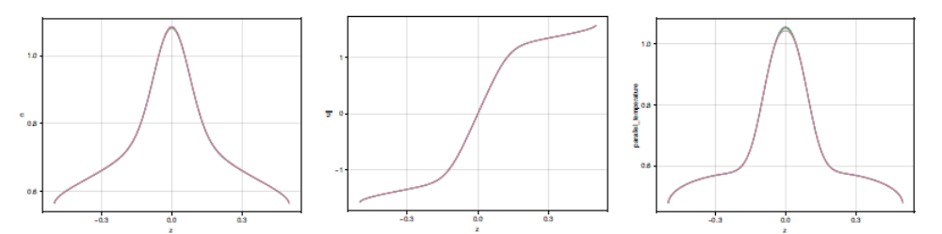
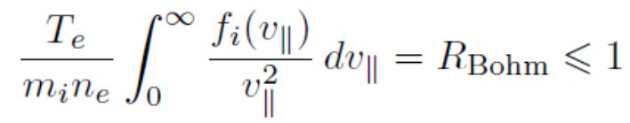
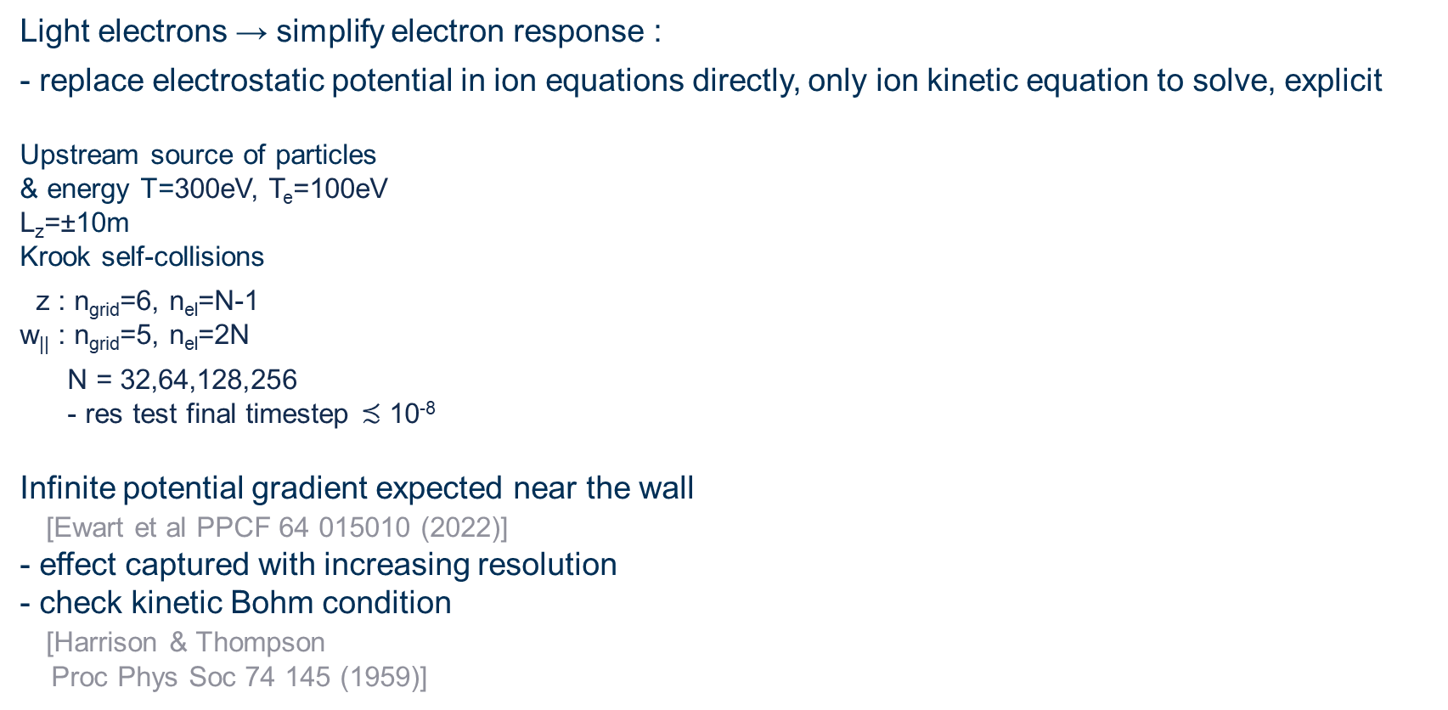
Example : adiabatic electrons
Light electrons → simplify electron response :
- replace electrostatic potential in ion equations directly, only ion kinetic equation to solve, explicit
Upstream source of particles
& energy T=300eV, T_{e}=100eV
L_{z}=±10m
Krook self-collisions
z : n_{grid}=6, n_{el}=N-1
w|| : n_{grid}=5, n_{el}=2N
N = 32,64,128,256
- res test final timestep $≾$ 10⁻⁸
Infinite potential gradient expected near the wall
[Ewart et al PPCF 64 015010 (2022)]
- effect captured with increasing resolution
- check kinetic Bohm condition
[Harrison & Thompson
Proc Phys Soc 74 145 (1959)]
n
u||
1.0
T||
1.0
1
0
-1
0.6
0.6
-0.3
0.0
0.3
-0.3
0.0
0.3
-0.3
0.0
0.3
z
R_{Bohm}
2.0
1.0
32
64
128
256
N

Slide 12
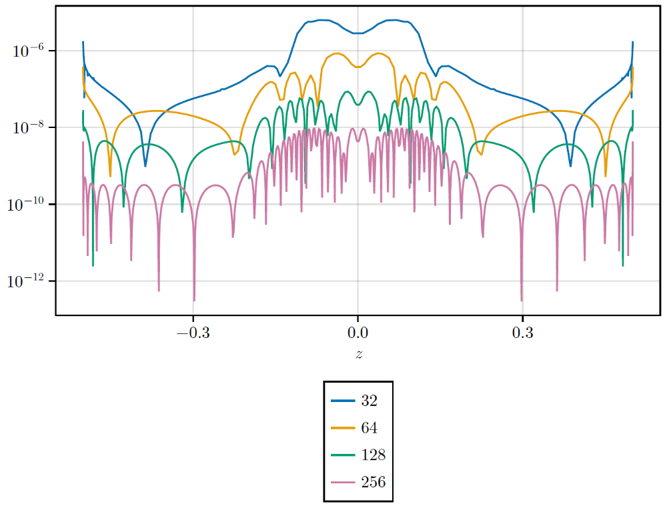

Example : …. convergence
$$f_{i} /{1.4×10}^{14}$$
Ion distribution function, N=256
white : contour 10^{-i}, i=1…16
Edges of map are edges of w|| grid
v = u_{i||} ±v_{ti} L_{w||}
orange : u_{i||}
Final moment constraint correction value (A-1)
- B,C similar
z

Slide 13
Example : …. convergence
$$f_{i} /{1.4×10}^{14}$$
Ion distribution function, N=256
white : contour 10^{-i}, i=1…16
Edges of map are edges of w|| grid
v = u_{i||} ±v_{ti} L_{w||}
orange : u_{i||}
Infinite gradients near wall
→ nonstandard convergence analysis
- RMS error decreases ~ N_{el}⁻²
- compressed z-grid → size element at wall ~ N_{el}⁻²
→ ? global accuracy linear in smallest element
- max error small
→ accuracy of dynamics away from sheath
much higher than global error estimate

Slide 14
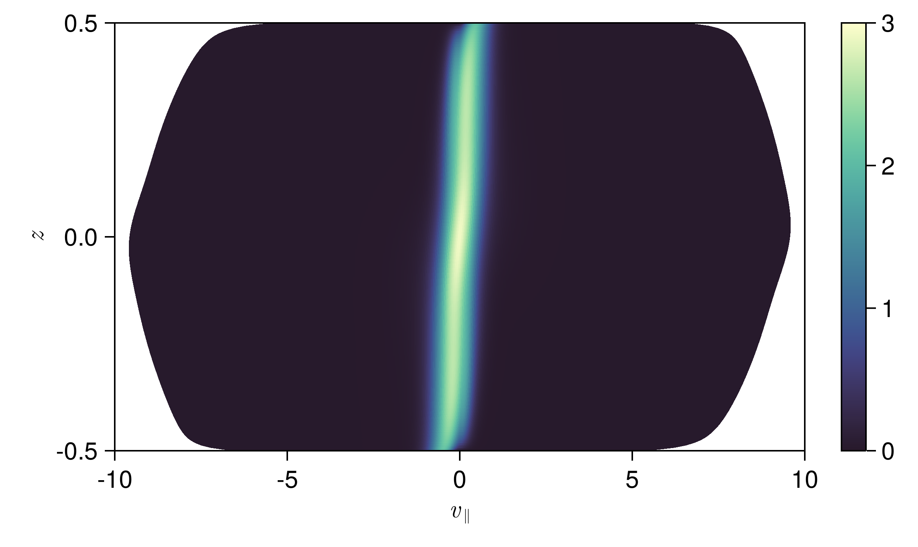
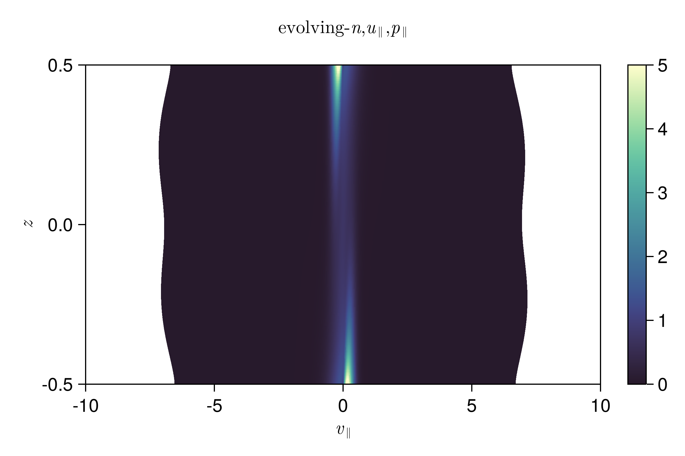
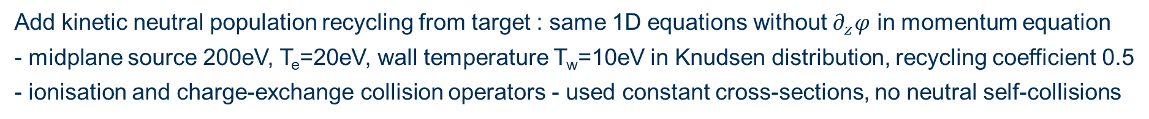

Example : …. + recycling neutrals
Add kinetic neutral population recycling from target : same 1D equations without $∂_{z}φ$ in momentum equation
- midplane source 200eV, T_{e}=20eV, wall temperature T_{w}=10eV in Knudsen distribution, recycling coefficient 0.5
- ionisation and charge-exchange collision operators - used constant cross-sections, no neutral self-collisions
f_{i}
$$f/{10}^{14}$$
f_{n}
midplane source 200eV, T_{e}=20eV
z : compressed near target
n_{grid}=9, n_{el}=32
w|| : uniform
n_{grid}=10, n_{el}=63
Periodic boundary conditions : implementation benchmark with decay of damped modes [Excalibur report link]
- deflation method used to find multiple solutions [Farrell et al SIAM J Sci Comput 37
A2026 (2015)]

Slide 15
Ongoing and future work
Papers in prep
1D1V - KfT framework, implementation and examples
1D1V - effect of collisionality, sources and convergence to collisional limit [McConnell et al, Sherwood`25]
1D2V - effect of field strength variation [McConnell et al, Sherwood`26, EPS`26]
Stability analysis of helical drift kinetic system with sheath [Parra et al, APS`25, Sherwood`26, Varenna`26]
2D2V solver
- MPI parallelisation of preconditioner
- benchmark loss rate in mirror geometry with model collisions
- benchmark to full-f solver
- cold ion demo of electric field formation in 2D geometry with open and closed field lines
Multi-ions
- complete implementation
- test model collision operators, explore cost of coupling to full Fokker-Planck collision operator
…. turbulence equations in development
JTO : gotchas

Slide 16
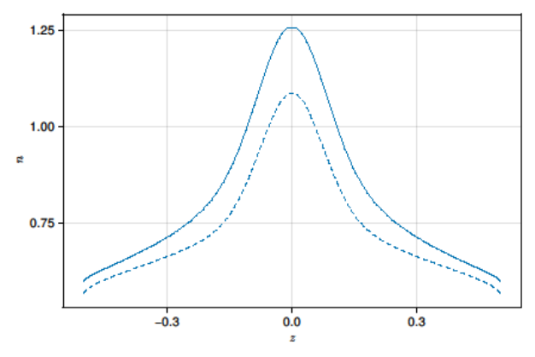
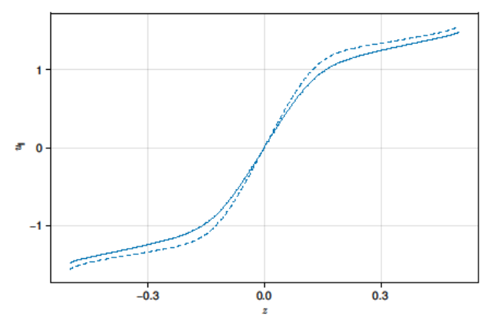
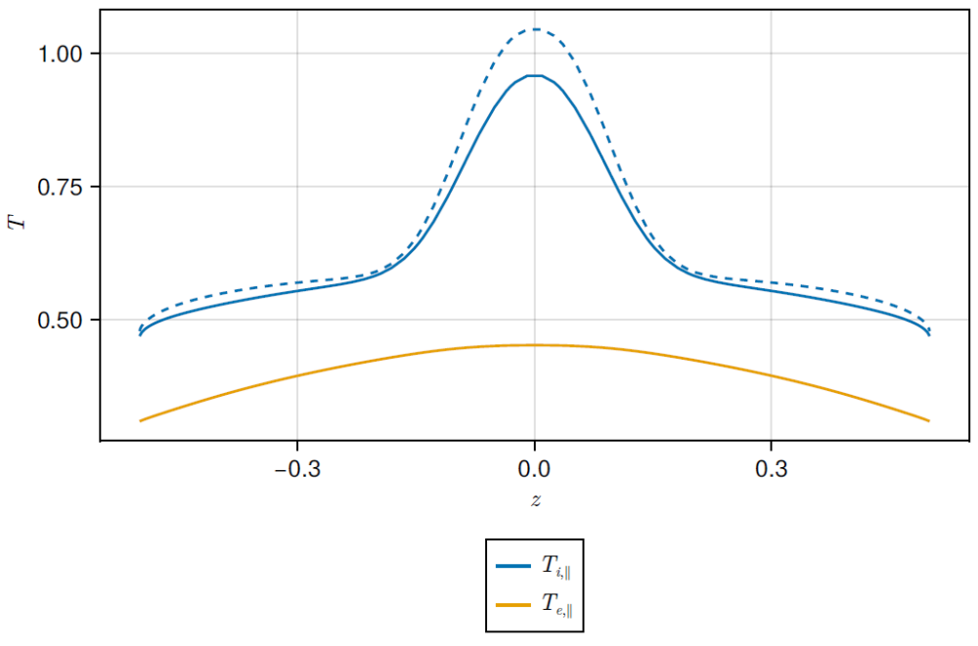
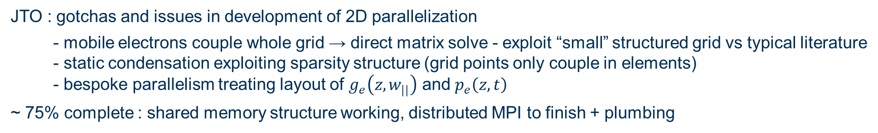
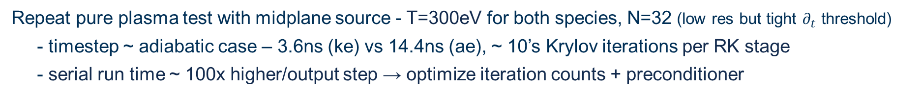
Example : kinetic ions and electrons
Repeat pure plasma test with midplane source - T=300eV for both species, N=32 (low res but tight $∂_{t}$ threshold)
- timestep ~ adiabatic case – 3.6ns (ke) vs 14.4ns (ae), ~ 10’s Krylov iterations per RK stage
- serial run time ~ 100x higher/output step → optimize iteration counts + preconditioner
kinetic
adiabatic
1.25
n
u||
1.0
1
0
0.75
0.5
-1
-0.3
0.0
0.3
z
-0.3
0.0
0.3
-0.3
0.0
0.3
JTO : gotchas and issues in development of 2D parallelization
- mobile electrons couple whole grid → direct matrix solve - exploit “small” structured grid vs typical literature
- static condensation exploiting sparsity structure (grid points only couple in elements)
- bespoke parallelism treating layout of $g_{e}\left(z,w_{||}\right)$ and $p_{e}\left(z,t\right)$
~ 75% complete : shared memory structure working, distributed MPI to finish + plumbing

Slide 17
Details ….

Slide 18

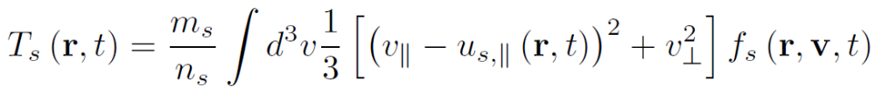
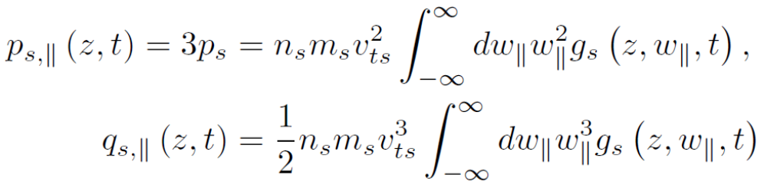
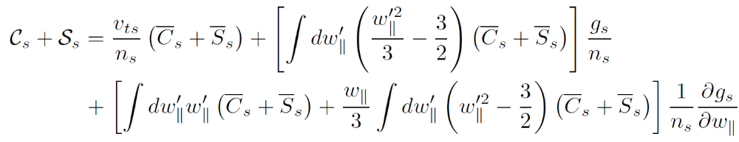
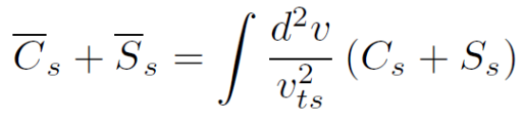
1D1V system - definitions
Modified sources collect all collision and source terms,
Write in terms of the marginalized contributions

Slide 19
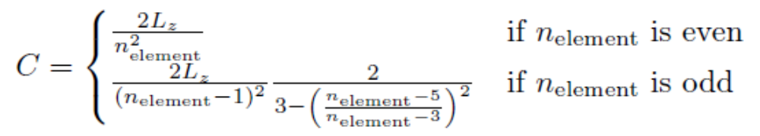
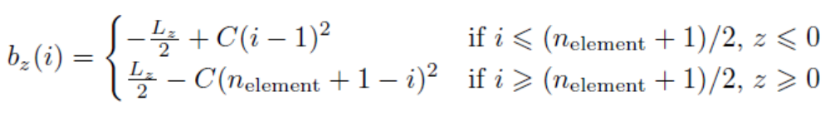
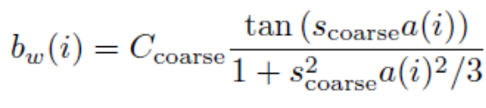
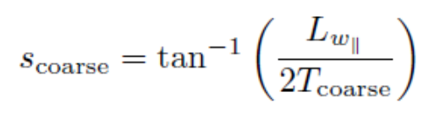
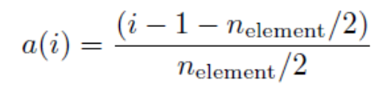
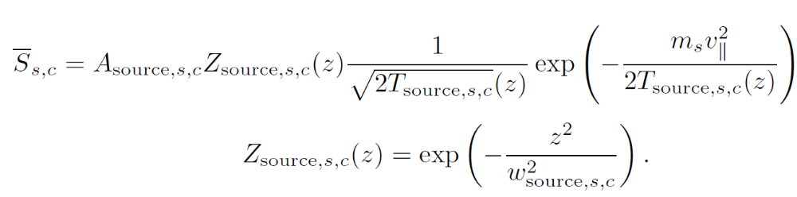
Implementation details
Non-uniform grid
Spatial grid : element boundaries $i=1 …n_{element}+1$
Velocity grid : element boundaries transition smoothly around T_{coarse} from uniform to $∝w_{||}^{2}$
Midplane source - marginalised form

Slide 20
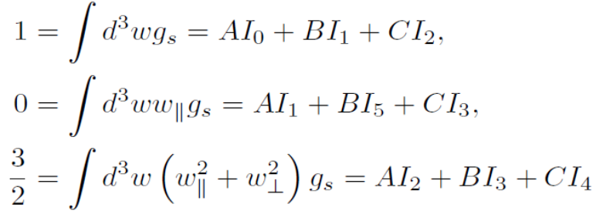
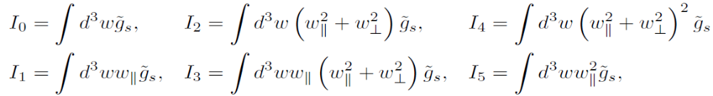
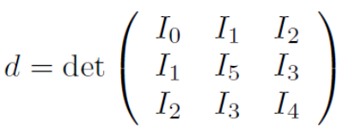
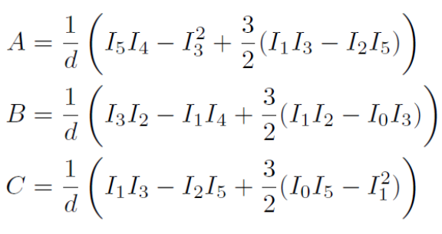
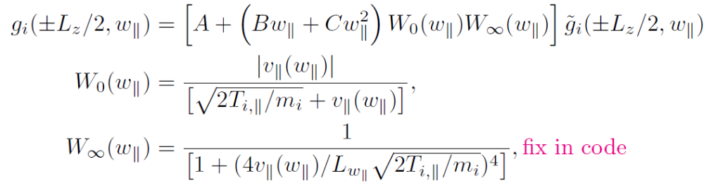
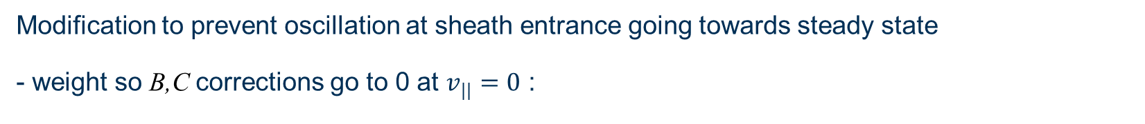
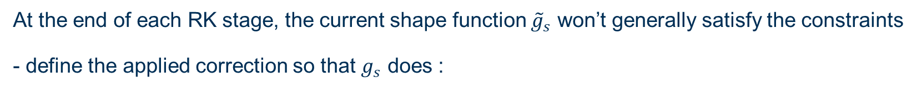
Implementation - moment constraints
At the end of each RK stage, the current shape function ${\tilde{g}}_{s}$ won’t generally satisfy the constraints
- define the applied correction so that $g_{s}$ does :
- 3x3 matrix inverse for A,B,C :
Modification to prevent oscillation at sheath entrance going towards steady state
- weight so B,C corrections go to 0 at $v_{||}=0$ :

