Slide 1

Dynamic system identification simulations of MAST-U using SOLPS-ITER
S. Kobussen^{1,3}, S. Wiesen¹
¹DIFFER - Dutch Institute for Fundamental Energy Research, De Zaale 20, 5612 AJ Eindhoven, The Netherlands
²Eindhoven University of Technology, Control Systems Technology, Eindhoven, The Netherlands
³Eindhoven University of Technology, Control Systems, Eindhoven, The Netherlands
Exhaust Code Workshop
October 2026

Slide 2
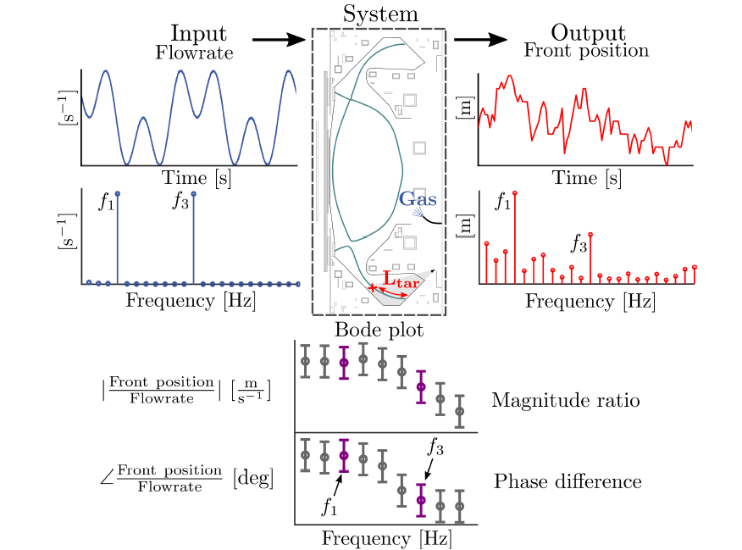
System Identification Experiments
Multisinal input on gas valve
Observe radiation front movement
Obtain linearized dynamics at excited frequencies
[1] M. van Berkel et al., Nucl. Fusion (2025).

Slide 3
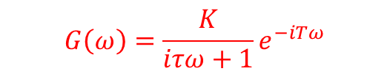
System Identification Experiments
$$G\left(ω\right)=\frac{K}{iτω+1}e^{−iTω}$$
Magnitude and phase
Fit some model → control
Works well for control, but…
Limited physical information
Hard to extrapolate to future reactors
FRFs needed for design
Can we reproduce this numerically?
[1] M. van Berkel et al., Nucl. Fusion (2025).

Slide 4
This Presentation: SOLPS-ITER
Previous work: DIV1D [2]
Reduced 1D SOL model
SOLPS-ITER [3]
2D mean-field
B2.5 ←→ Eirene
Table of contents:
General simulation setup
Frequency response results
  Advanced Fluid Neutrals (AFN) vs. Eirene
  Wide Grid vs. Narrow Grid
  Time-dependent vs. Quasi-Steady-State neutrals
Conclusions and future work
Can SOLPS-ITER reproduce SysID experiments on MAST-U?
  What level of fidelity is required?
[2] Derks et al, Nuclear Fusion (2026).
[3] Wiesen et al, Journal of nuclear materials (2015).

Slide 5
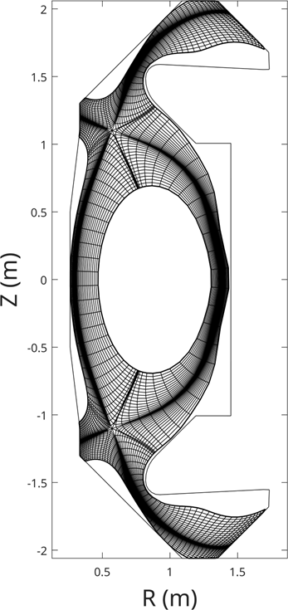


Step 1: Simulation setup
Narrow Grid (NG)
Wide Grid (WG)
Grid configurations:
  Narrow Grid (Carre2)
  Wide Grid (GOAT [4])
Gas valve at lower divertor
D only
No drifts
_{Gas Valve}
_{Gas Valve}
$$L_{tar}$$
$$L_{tar}$$
[4] S. Van den Kerkhof et al., Contributions to Plasma Physics, 64, (2024).

Slide 6
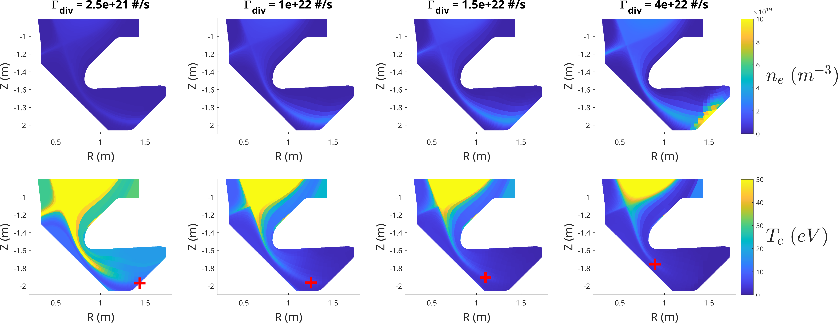

Step 2: Selecting operating point
$$L_{pol}$$

Slide 7
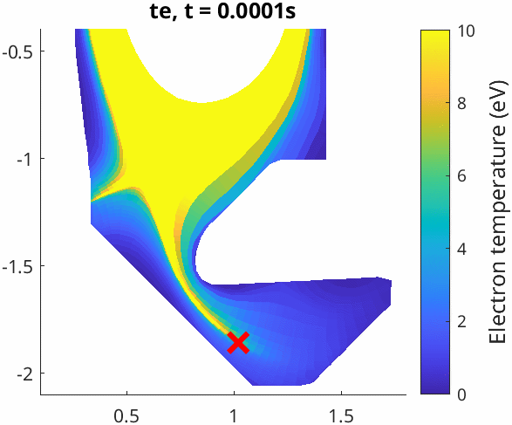
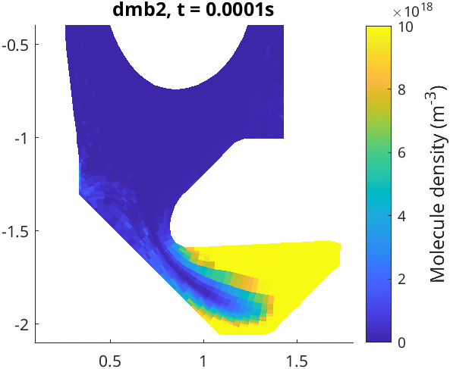


Step 3: Perturb around equilibrium
$$t_{e}$$
$$n_{m}$$

Slide 8
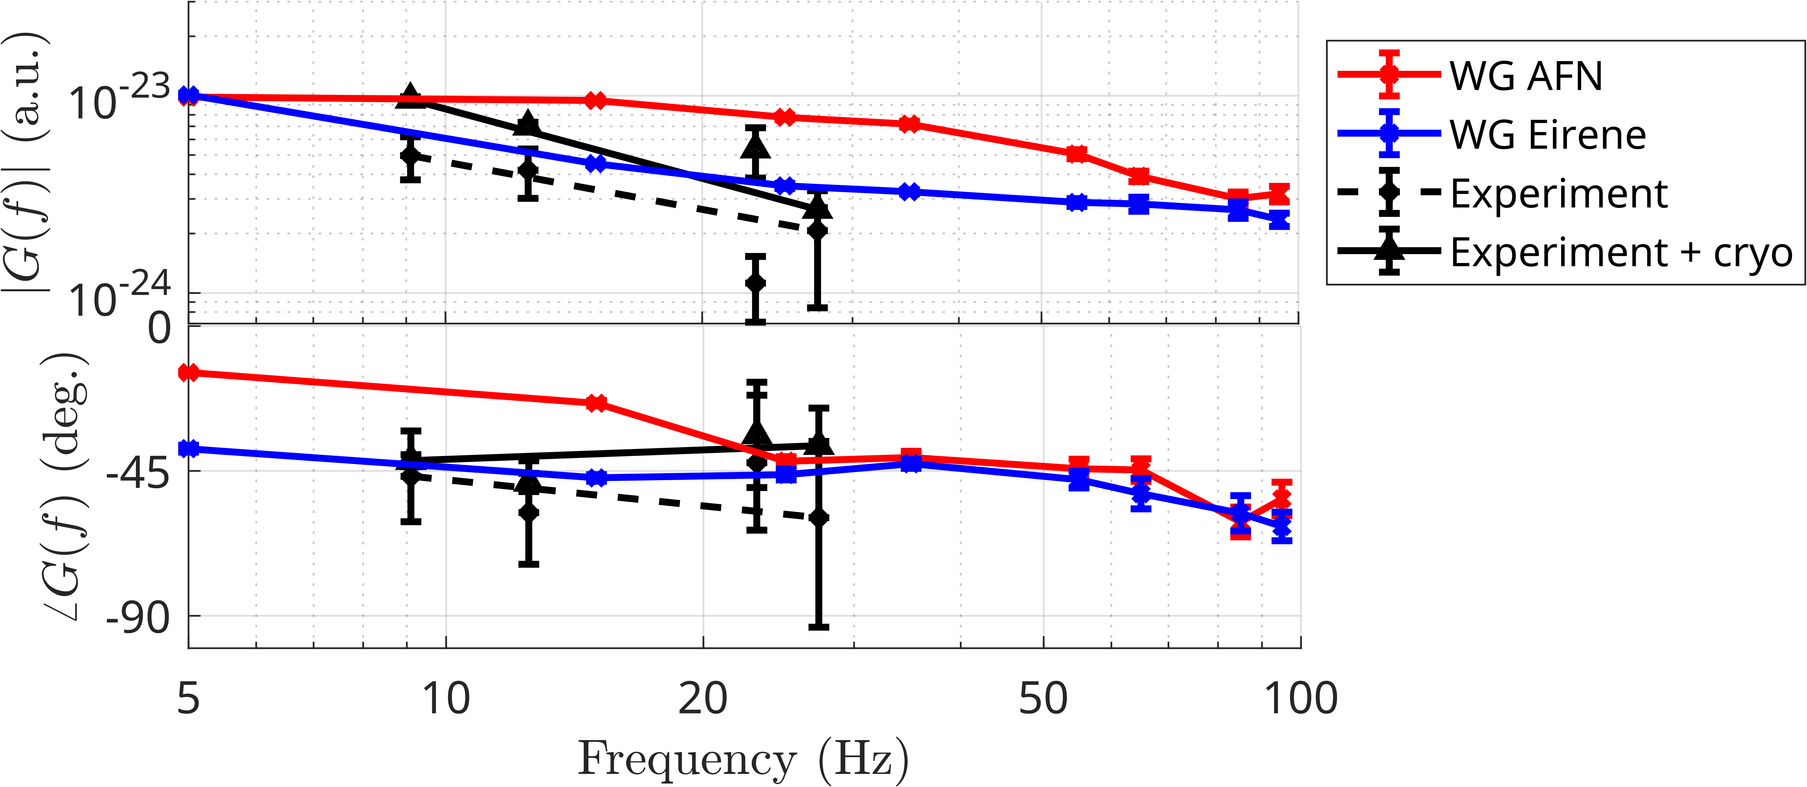
Results: AFN vs. Eirene
AFN:
<20 Hz: ~ 0º phase, constant magnitude
20-60 Hz: -45º phase
> 60 Hz: decreasing phase
Eirene (time dependent):
<50 Hz: - 45º phase, decreasing magnitude
> 50 Hz: decreasing phase
Kinetic neutrals improve correspondence with experiment!

Slide 9
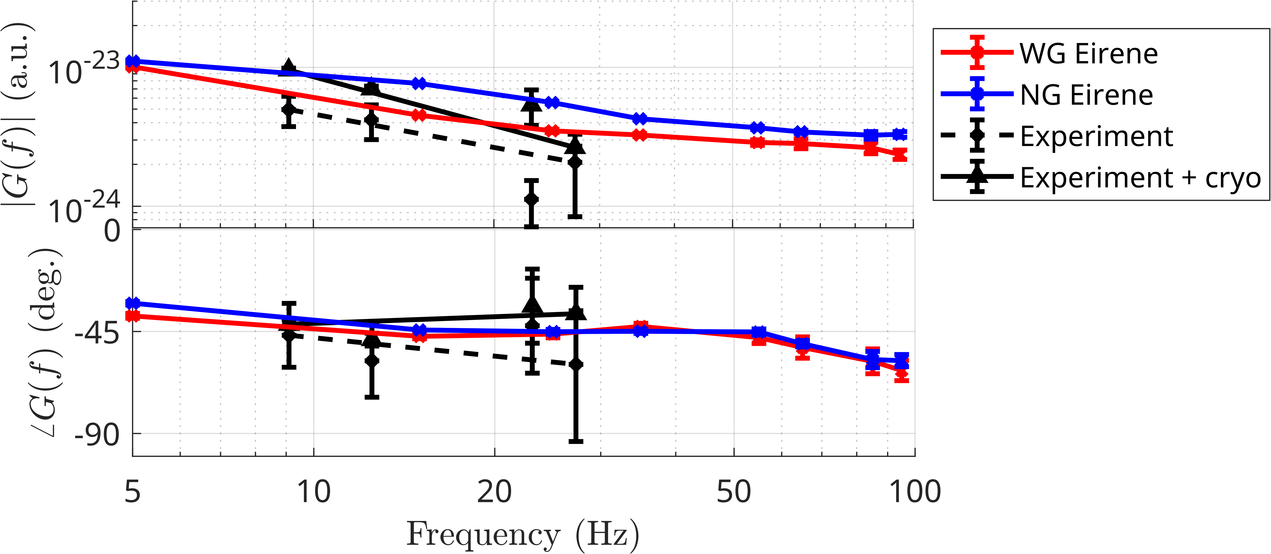
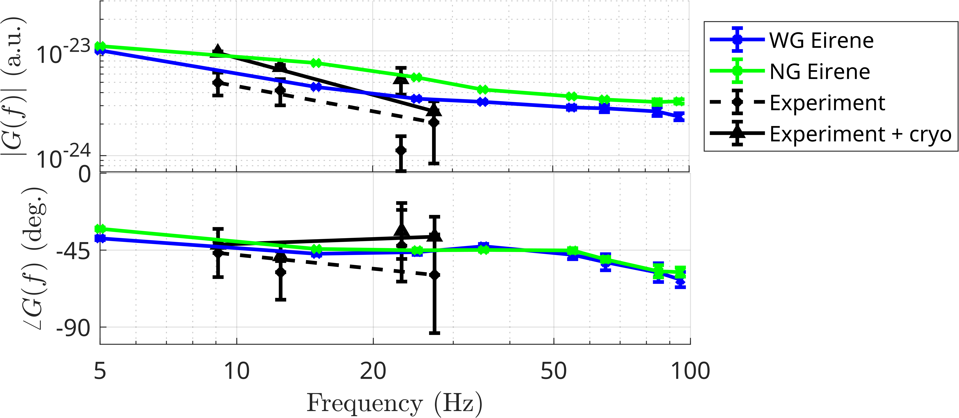
Results: Wide Grid vs. Narrow Grid
Difference in magnitude
Similar phase (only small difference at low f)
Difference may be larger for high T
NG
WG

Slide 10

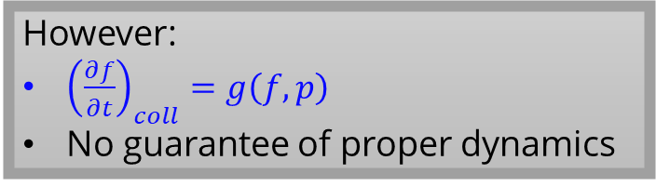
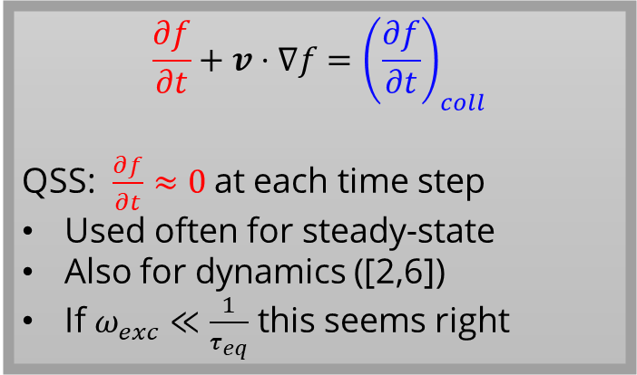



Results: Time-dependent vs. Quasi-Steady-State neutrals
$$\frac{∂f}{∂t}+v⋅∇f={\left(\frac{∂f}{∂t}\right)}_{coll}$$
QSS: $\frac{∂f}{∂t}≈0$at each time step
Used often for steady-state
Also for dynamics ([2,6])
If $ω_{exc}≪\frac{1}{τ_{eq}}$ this seems right
Eirene
B2.5
$$y(t)$$
$$u(t)$$
Eirene
$$u(t)$$
However:
${\left(\frac{∂f}{∂t}\right)}_{coll}=g\left(f,p\right)$
No guarantee of proper dynamics
B2.5
$$y(t)$$
[2] Derks et al, Nuclear Fusion (2026).
[5] Lore, et al. Nuclear Fusion, (2023).

Slide 11
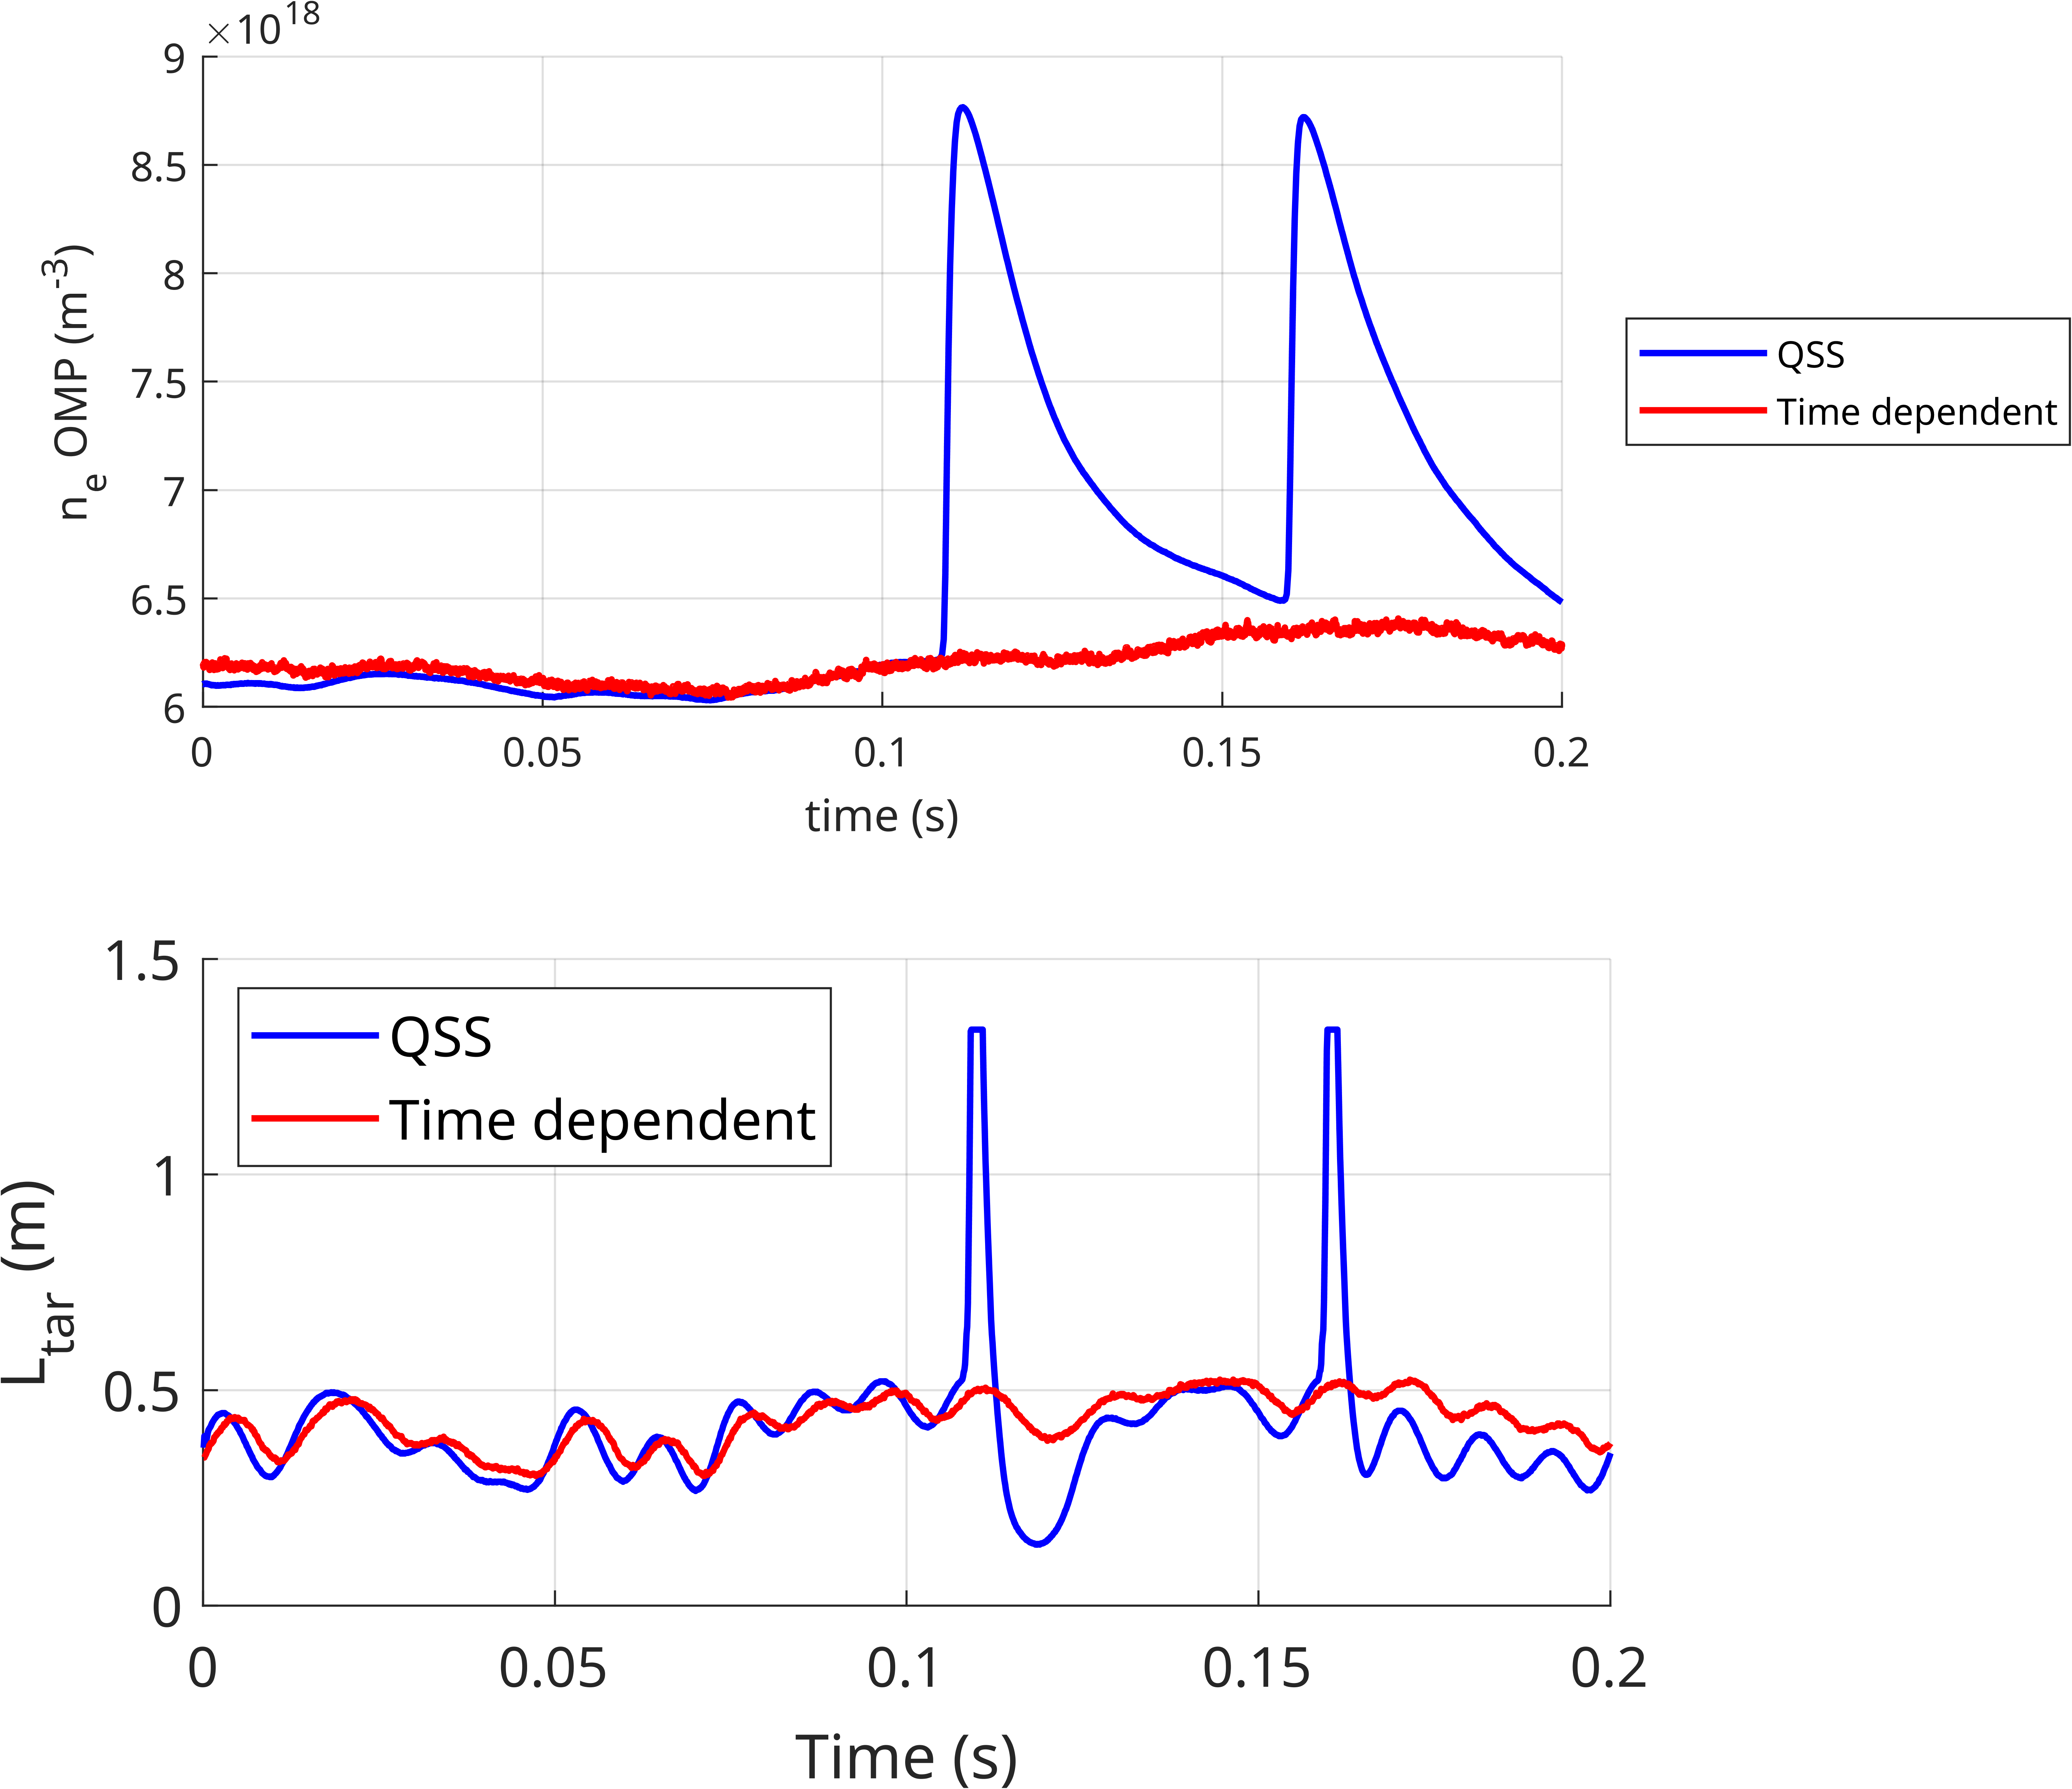
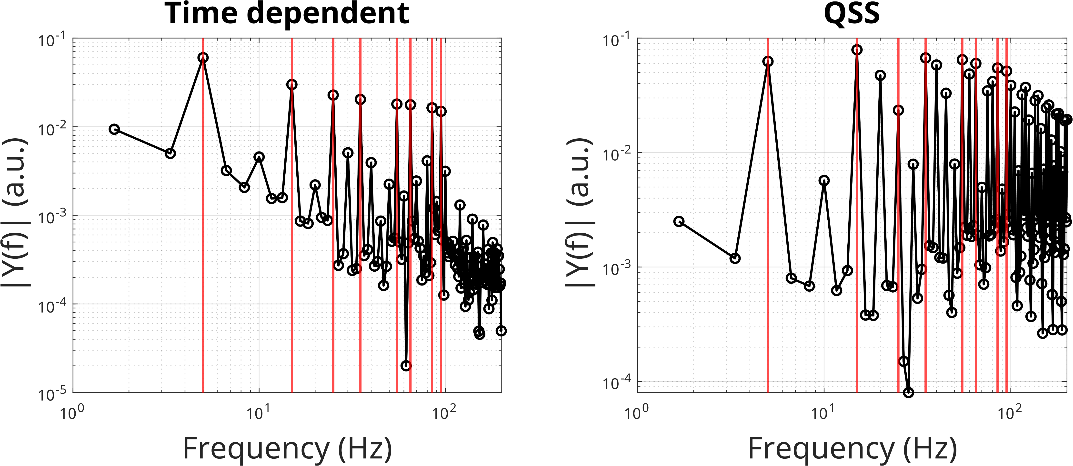
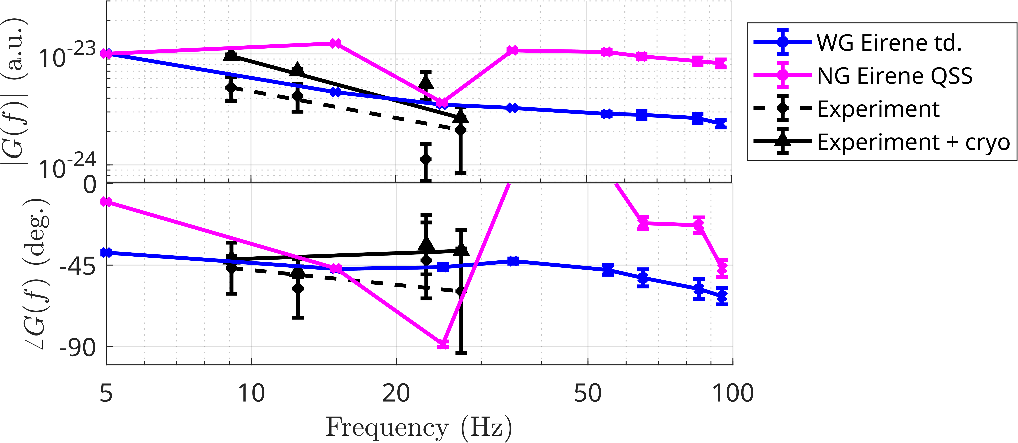
Time-dependent vs. Quasi-Steady-State neutrals
QSS introduces nonlinear behaviour

Slide 12
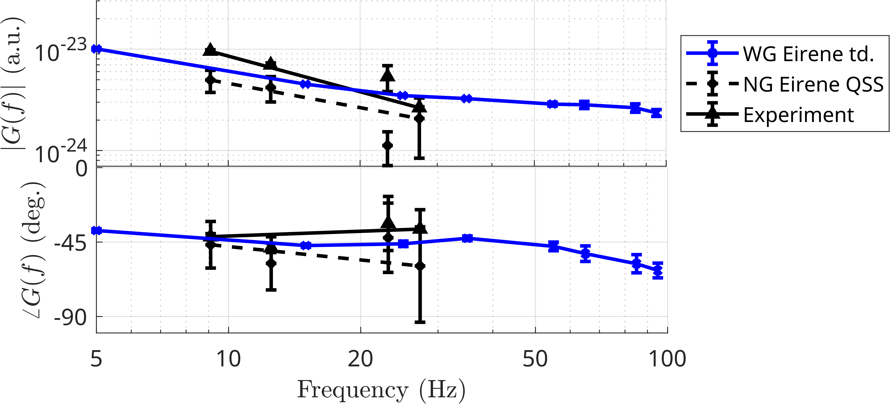

Conclusions and Future Work
Main take-aways:
SOLPS-ITER time-dependent can reproduce MAST-U FRF’s.
AFN predicts faster dynamics than experiments
QSS invalid for dynamic simulations
WG vs. NG cannot be distinguished at 5-100 Hz (but may deviate at lower frequencies)

Slide 13
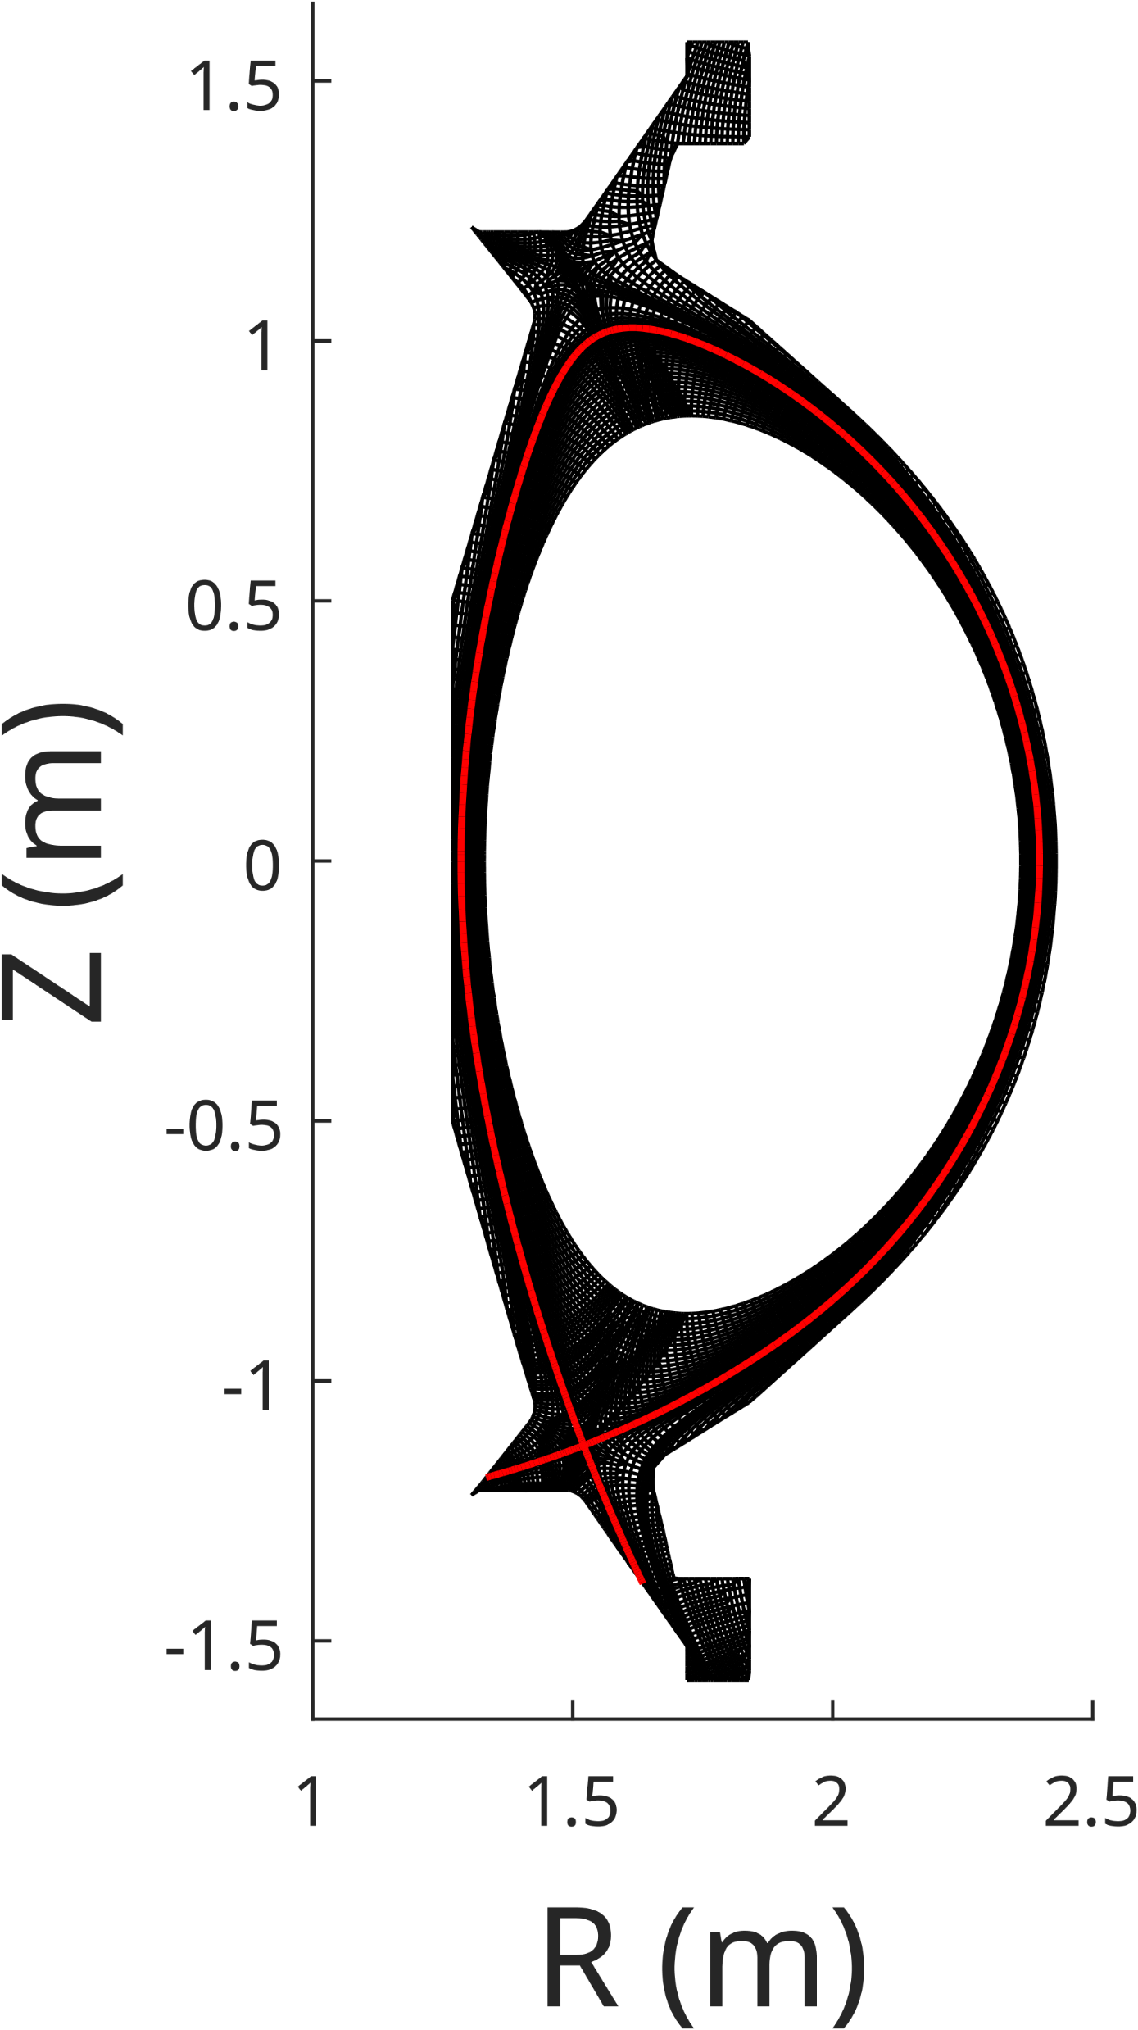
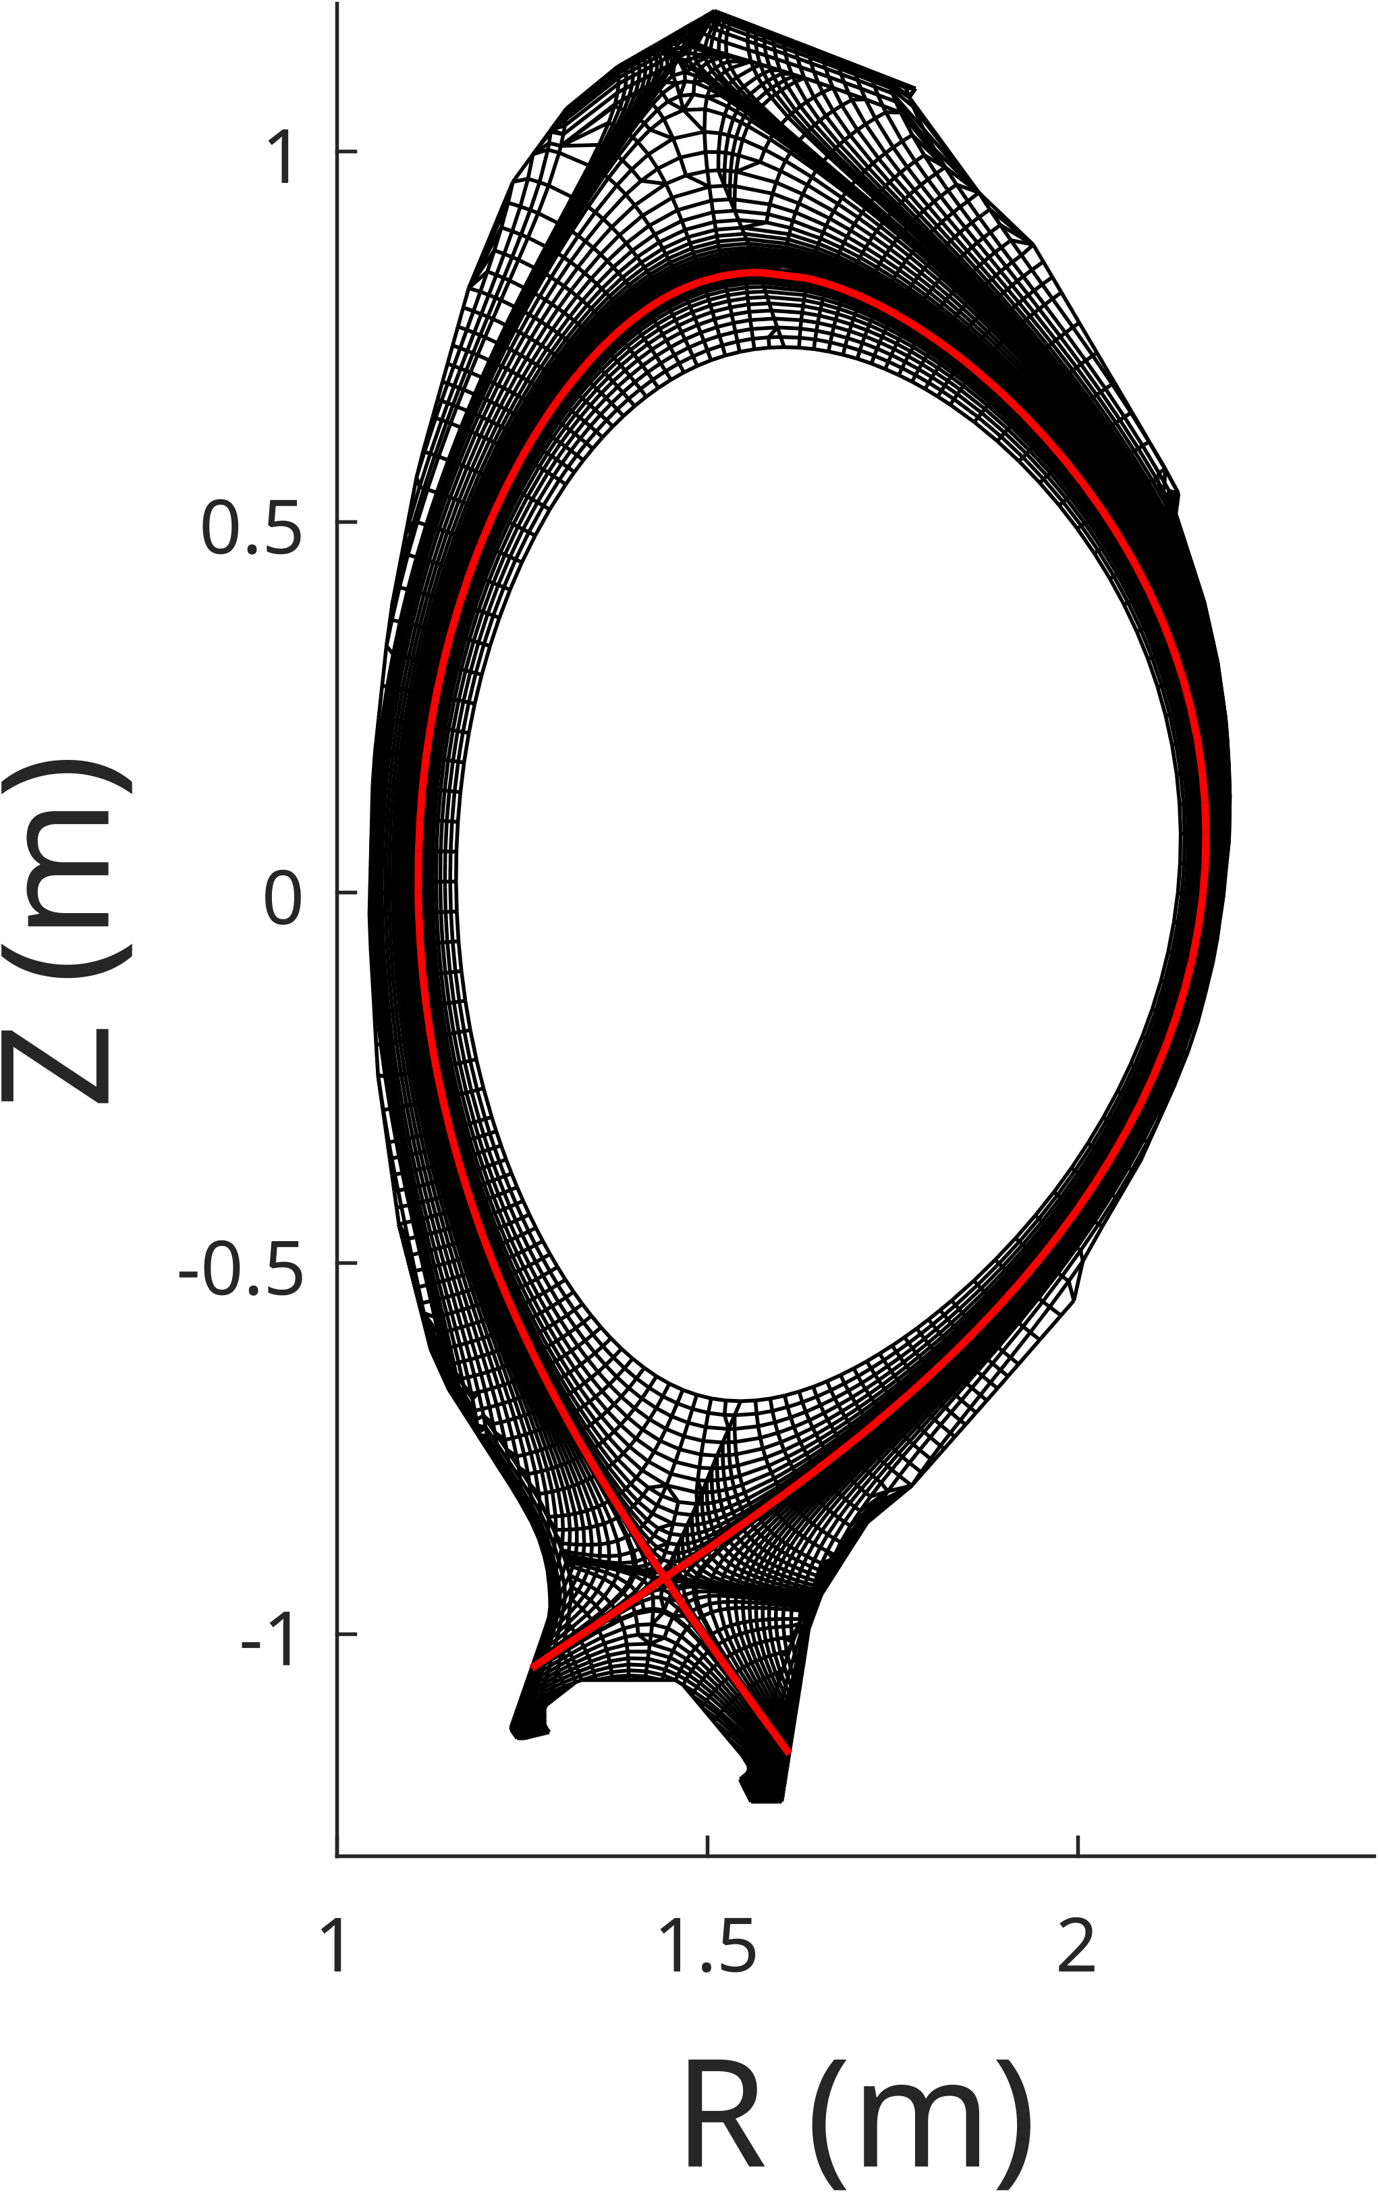
Conclusions and Future Work
Main take-aways:
SOLPS-ITER time-dependent can reproduce MAST-U FRF’s.
AFN predicts faster dynamics than experiments
QSS invalid for dynamic simulations
WG vs. NG cannot be distinguished at 5-100 Hz (but may deviate at lower frequencies)
Future work:
Validate on more devices (AUG)
Predictive simulations for SPARC, ITER, STEP etc.
Dynamic SOLPS database for NN?

Slide 14
Extra Slides

Slide 15
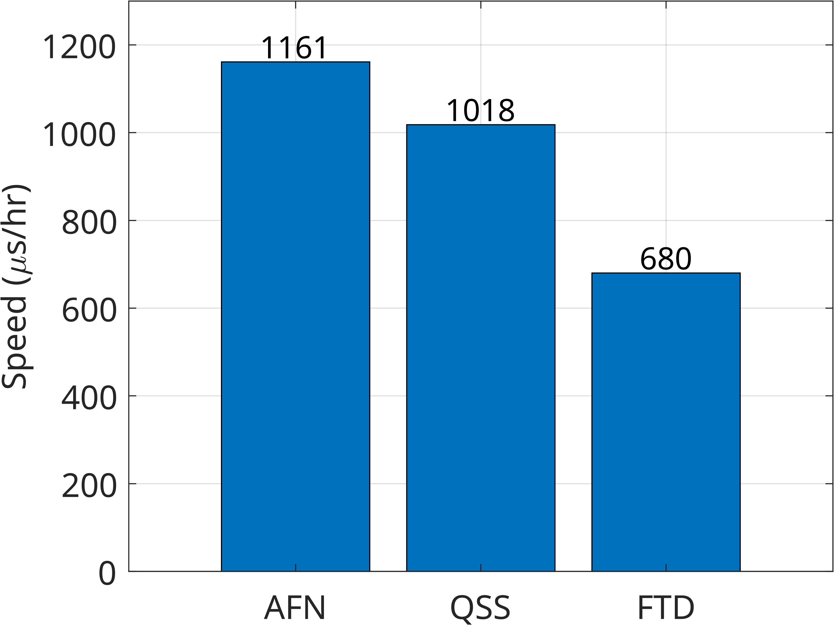
Computational speed
For 200 ms of plasma:
AFN WG: ~ 7 days (1 cpu)
QSS WG: ~ 8 days (32 cpus)
FTD WG: ~ 12 days (128 cpus)

Slide 16
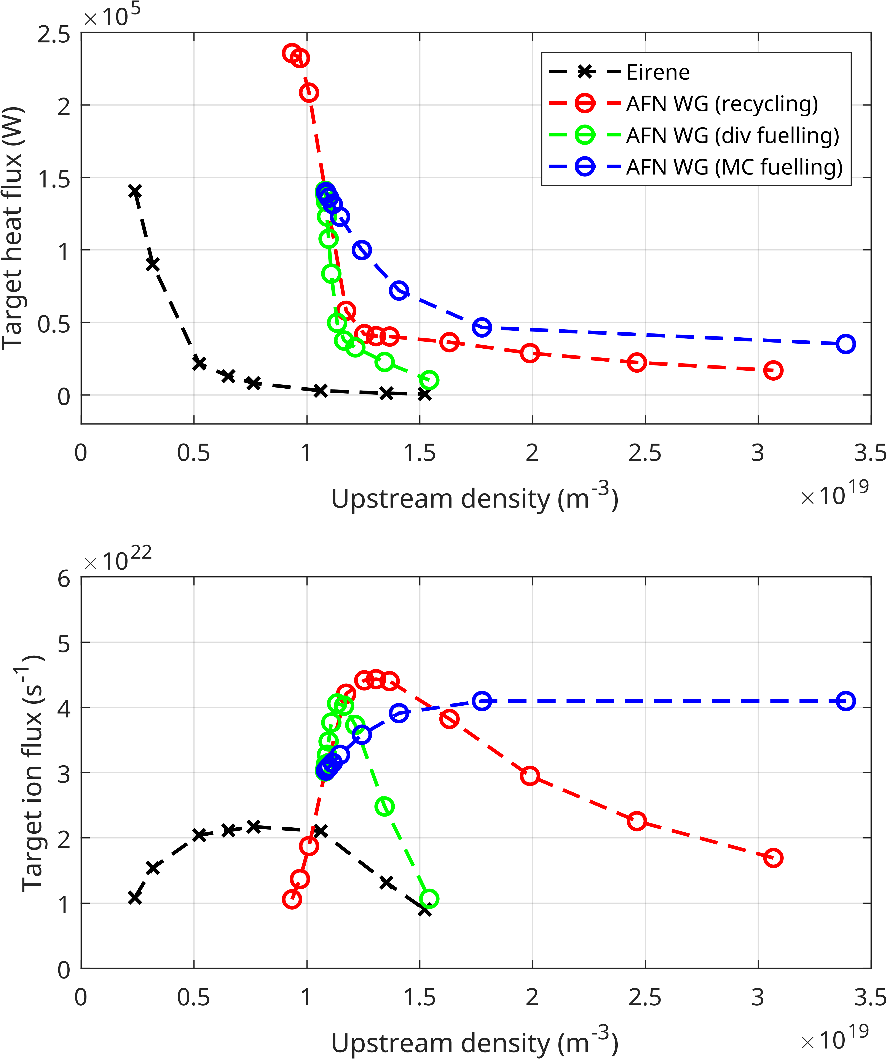
Steady state (AFN)
Density ramps using recycling coefficient, div fueling, and MC fueling
Compared to NG simulations (ref), w. kinetics / C impurities
Possible to transition into detachment (div, recycling)
Power starvation for MC
Similar absolute flux
Detachment onset at higher upstream density (due to core BC)

Slide 17
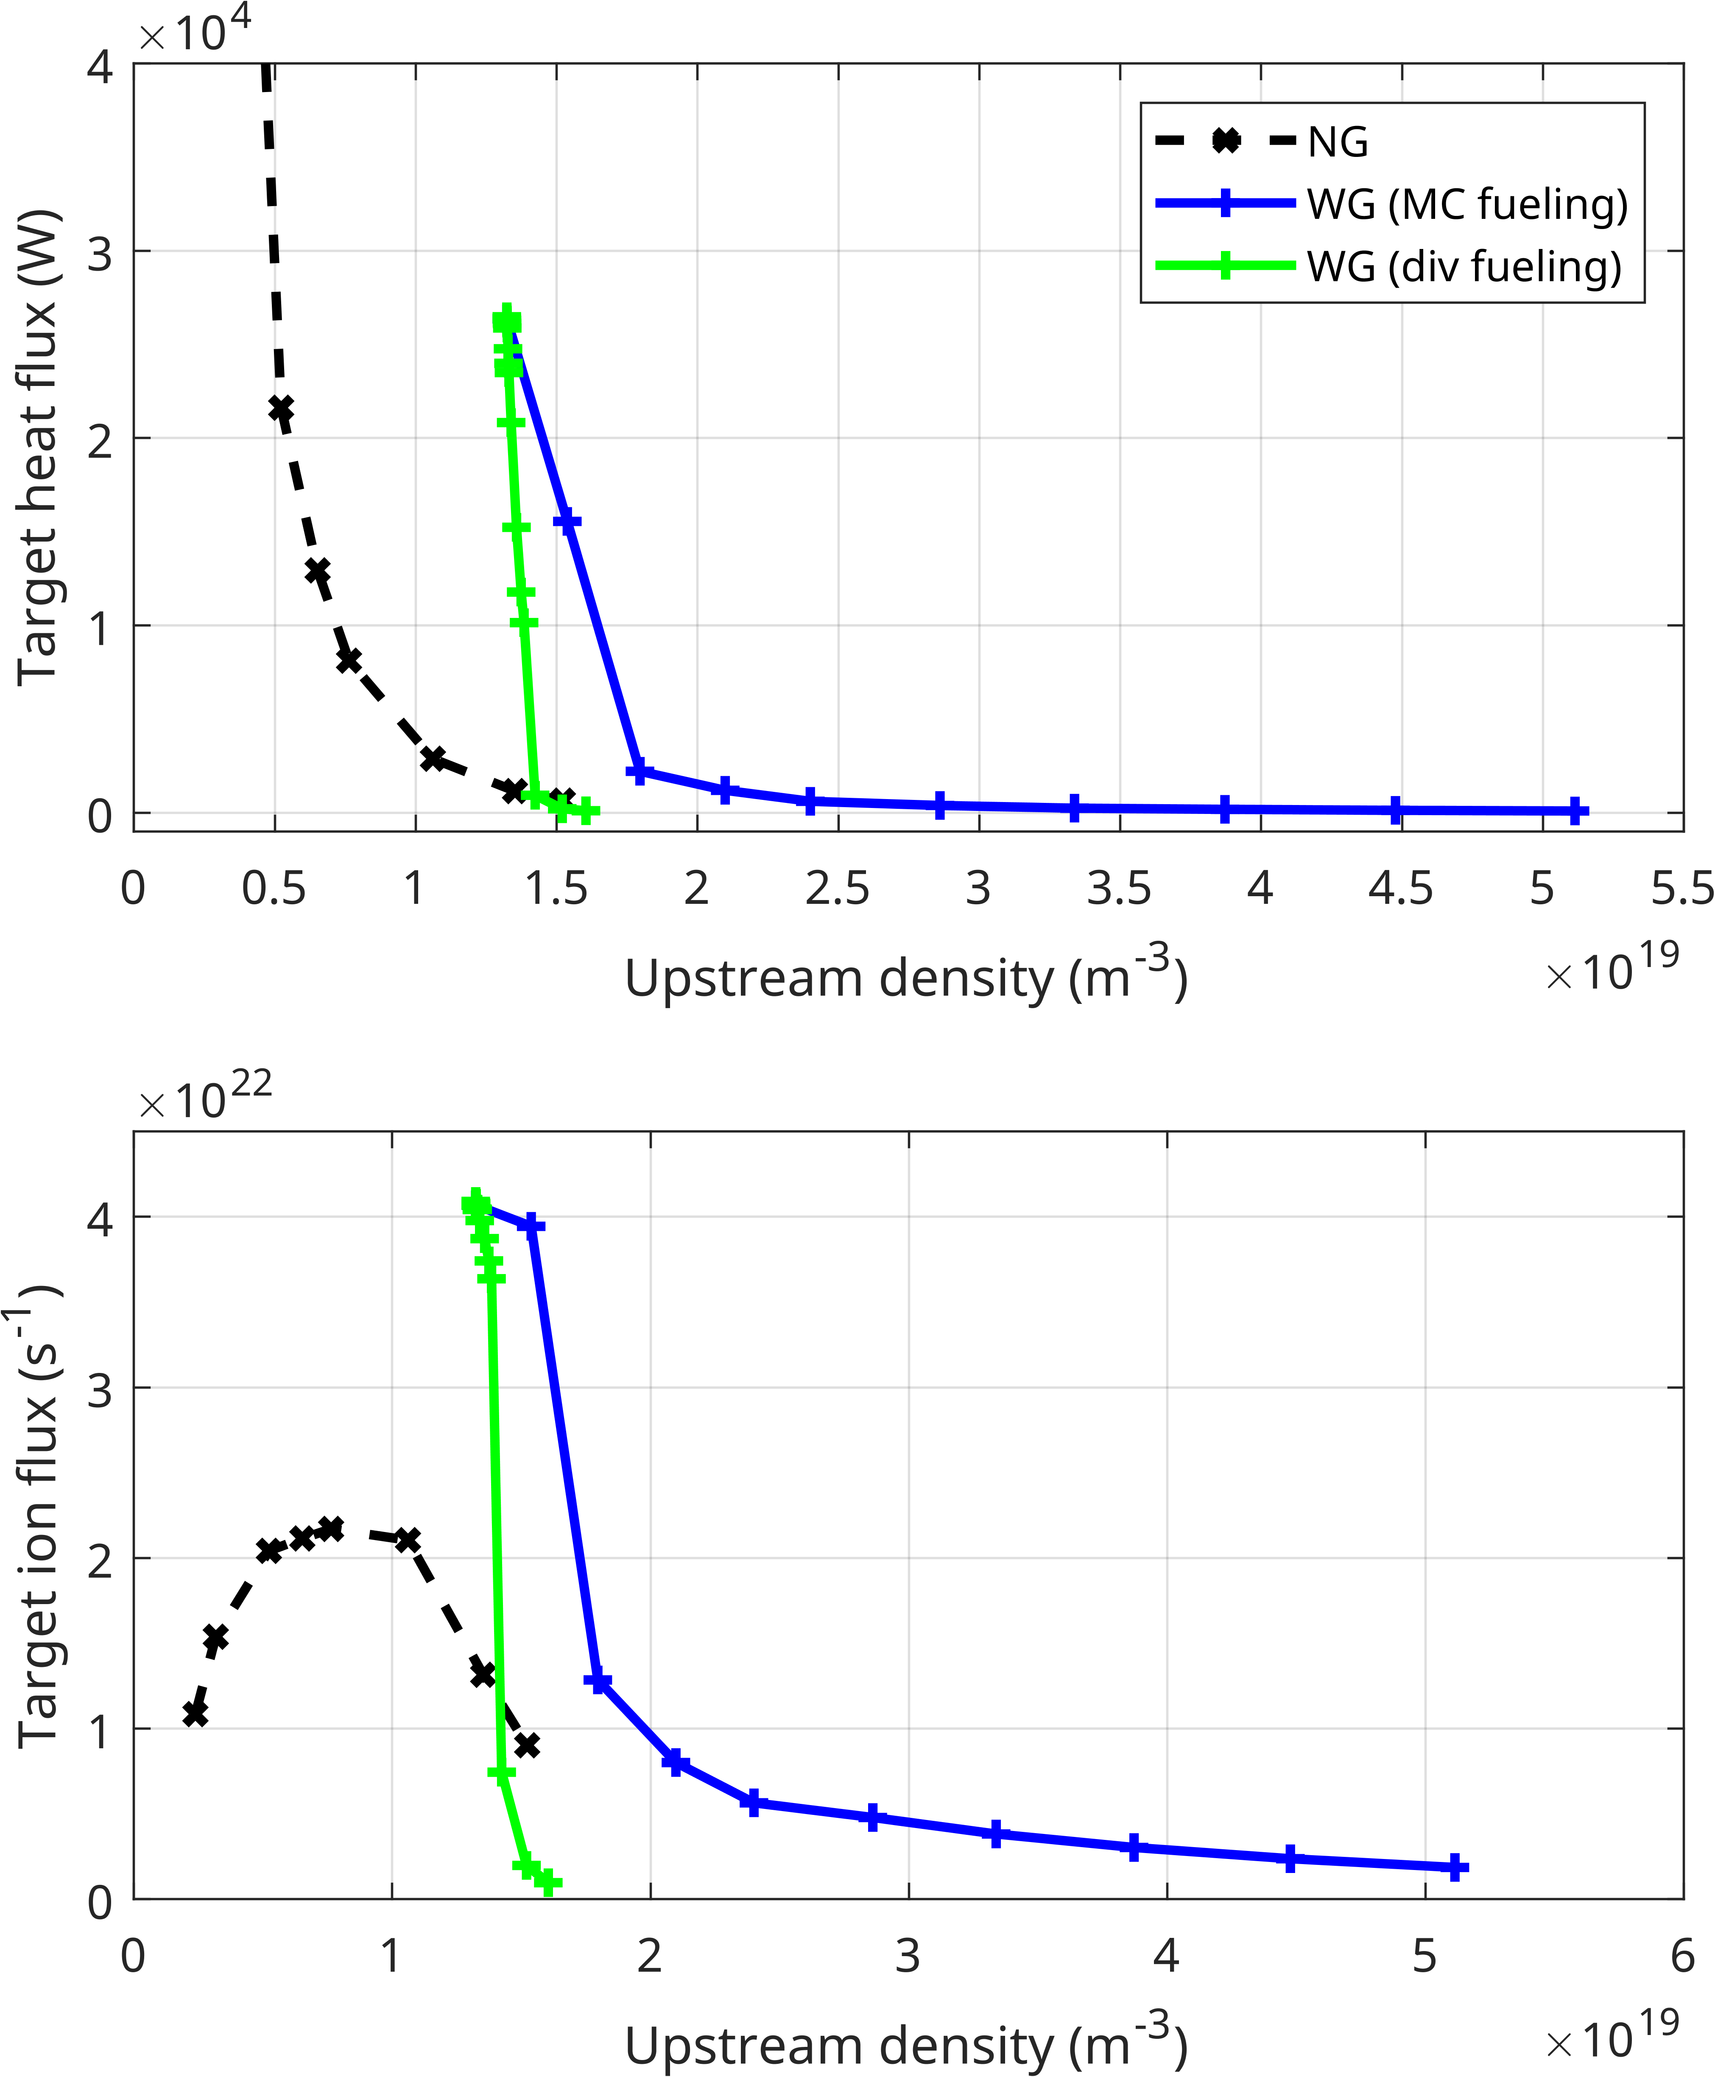
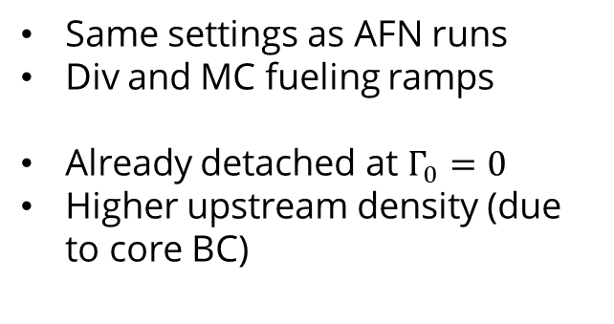
Steady state (kinetic neutrals)
Same settings as AFN runs
Div and MC fueling ramps
Already detached at $Γ_{0}=0$
Higher upstream density (due to core BC)

Slide 18
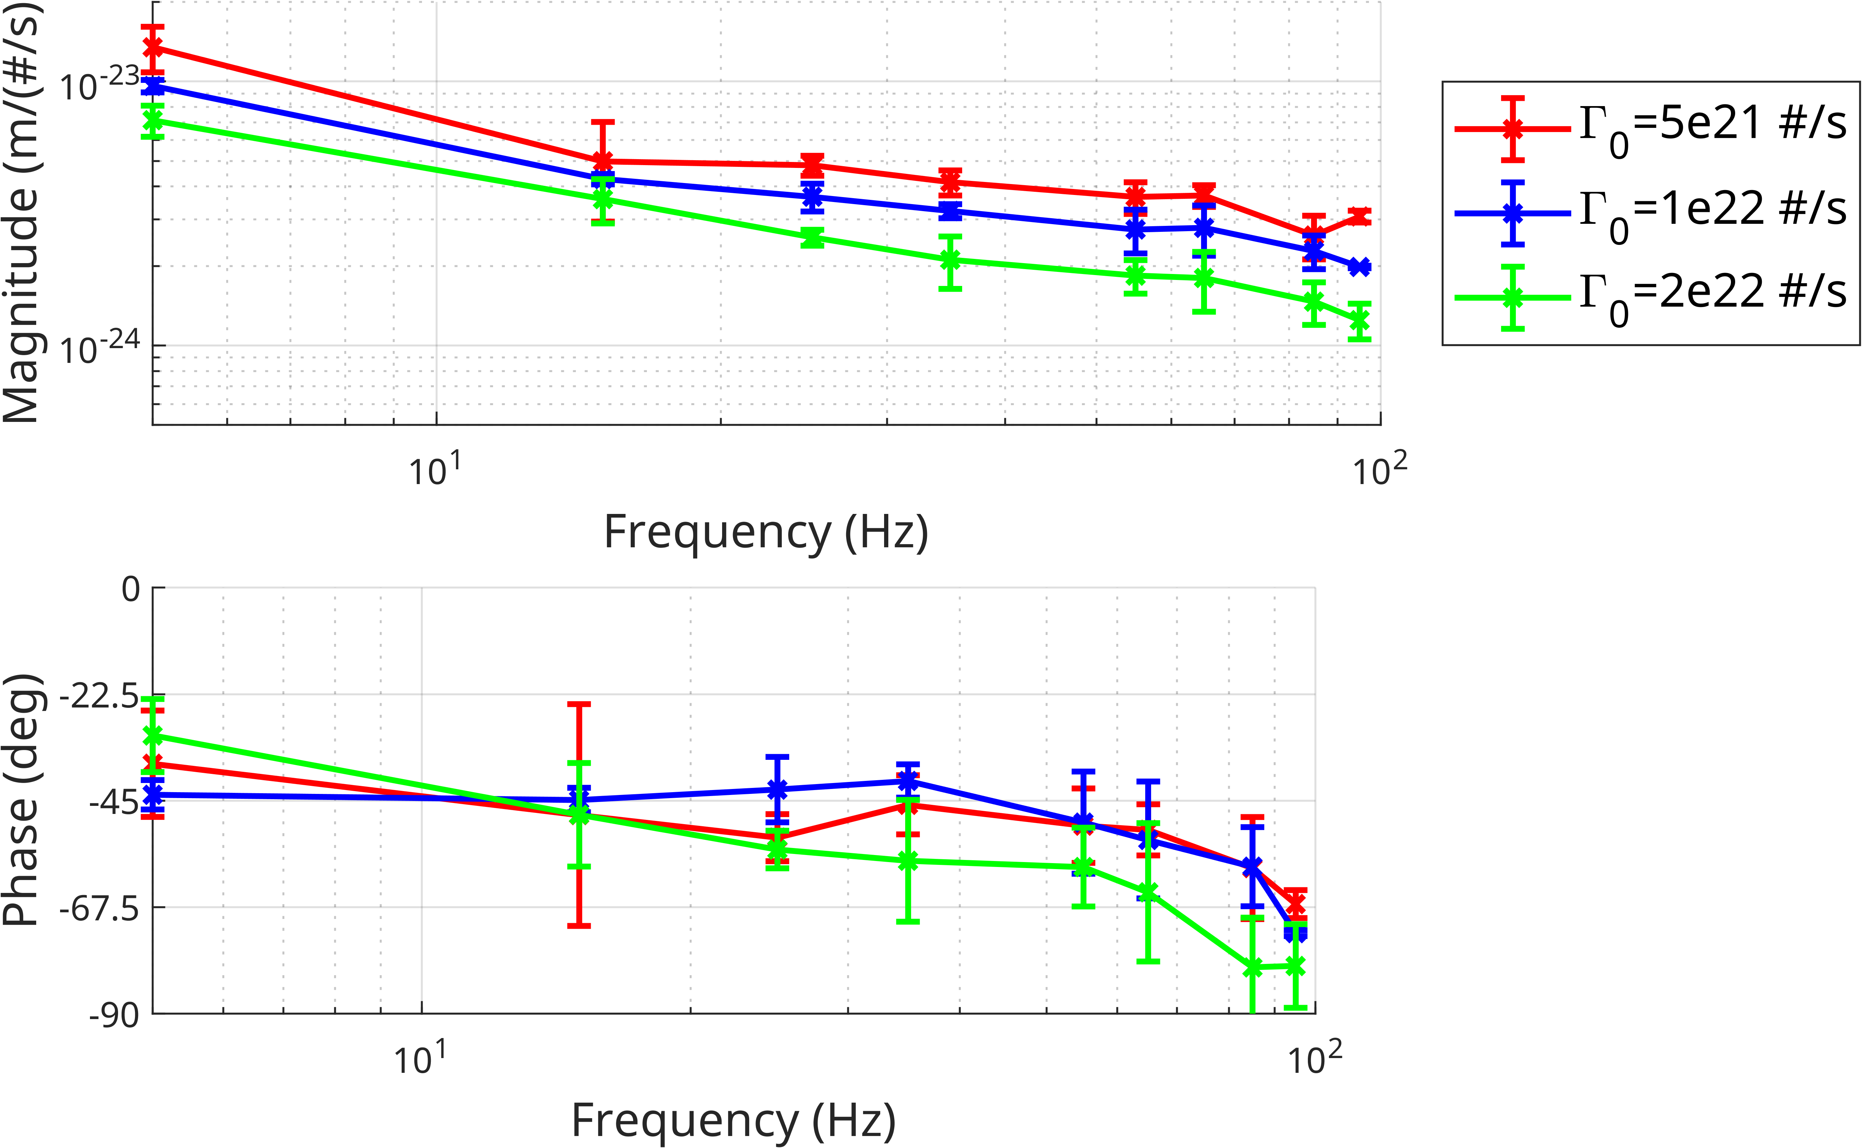
Simulation results: FRF’s
FTD simulations at different operating points

Slide 19
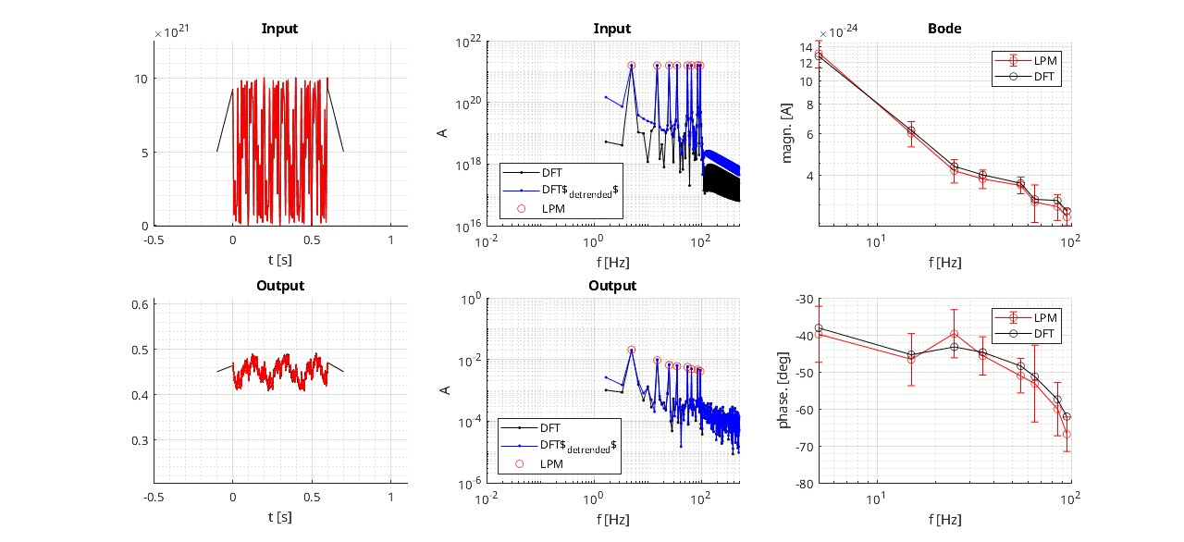
Simulation results: FRF’s

Slide 20
References
Van Berkel, M., Derks, G. L., Ceelen, L., Bosman, T., Kool, B., Ravensbergen, T., ... & Wiesen, S. (2025). Systematic multi-machine analysis of the exhaust time-dependent behavior in tokamaks. Nuclear Fusion. DOI 10.1088/1741-4326/ae30f1
Derks, G. L., et al. "A multi-model system-identification comparison with the global particle dynamics in TCV." Nuclear Fusion 66.6 (2026): 066010.
Wiesen, S., Reiter, D., Kotov, V., Baelmans, M., Dekeyser, W., Kukushkin, A. S., ... & Voskoboynikov, S. (2015). The new SOLPS-ITER code package. Journal of nuclear materials, 463, 480-484. https://doi.org/10.1016/j.jnucmat.2014.10.012
Van den Kerkhof, S., Vervloesem, N., Carli, S., & Dekeyser, W. (2024). Application of an automated grid deformation tool for divertor shape optimization in SOLPS‐ITER. Contributions to Plasma Physics, 64(7-8), e202300134.
LORE, J. D., et al. Time-dependent SOLPS-ITER simulations of the tokamak plasma boundary for model predictive control using SINDy. Nuclear Fusion, 2023, 63.4: 046015.
Notes:
We see from the comparison with experiments that

