Slide 1







On the challenge of kinetic neutrals modelling in reactor relevant conditions: characterization of the issues and possible solutions
Y. Marandet, PIIM Lab, CNRS/amU
S. Sureshkumar, CEA/IRFM
On behalf of the TSVV-K team
UKAEA exhaust workshop, Culham
Oct 6-9 2026

Slide 2
Introduction
Current status of the modelling
Gaps & Limitations : Physics
Gaps & Limitations : Performance
Take away messages

Slide 3
Neutral gas dynamics at the edge
Introduction

Slide 4
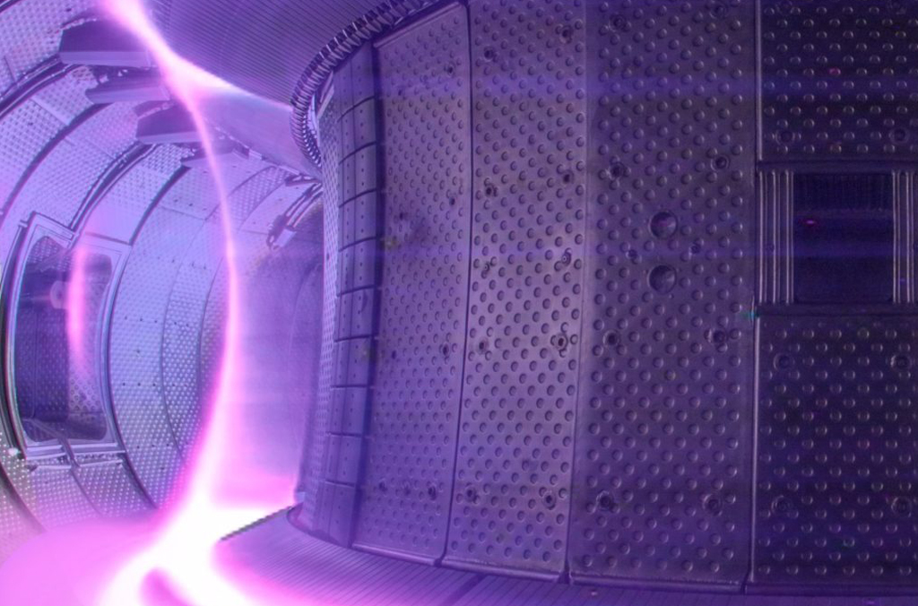
Neutrals 101
‘Neutrals’ mean many species : H, D, T, H₂, D₂, T₂, HD, HT, DT, He, W, B, …
Photons can be treated with the same formalism

Slide 5
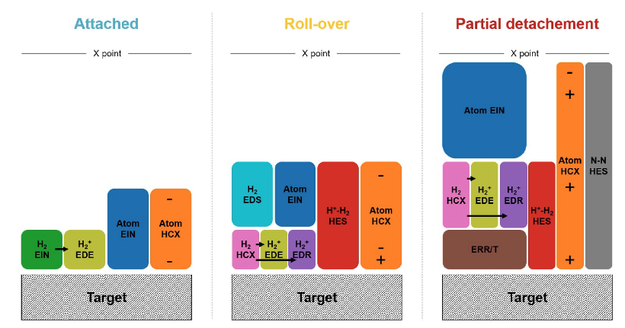
Neutrals 101
A&M processes mediate exchanges of particles, momentum, energy between neutrals and the
plasma : key for detachment process
ITER simulations; Rivals et al., NF 2025

Slide 6
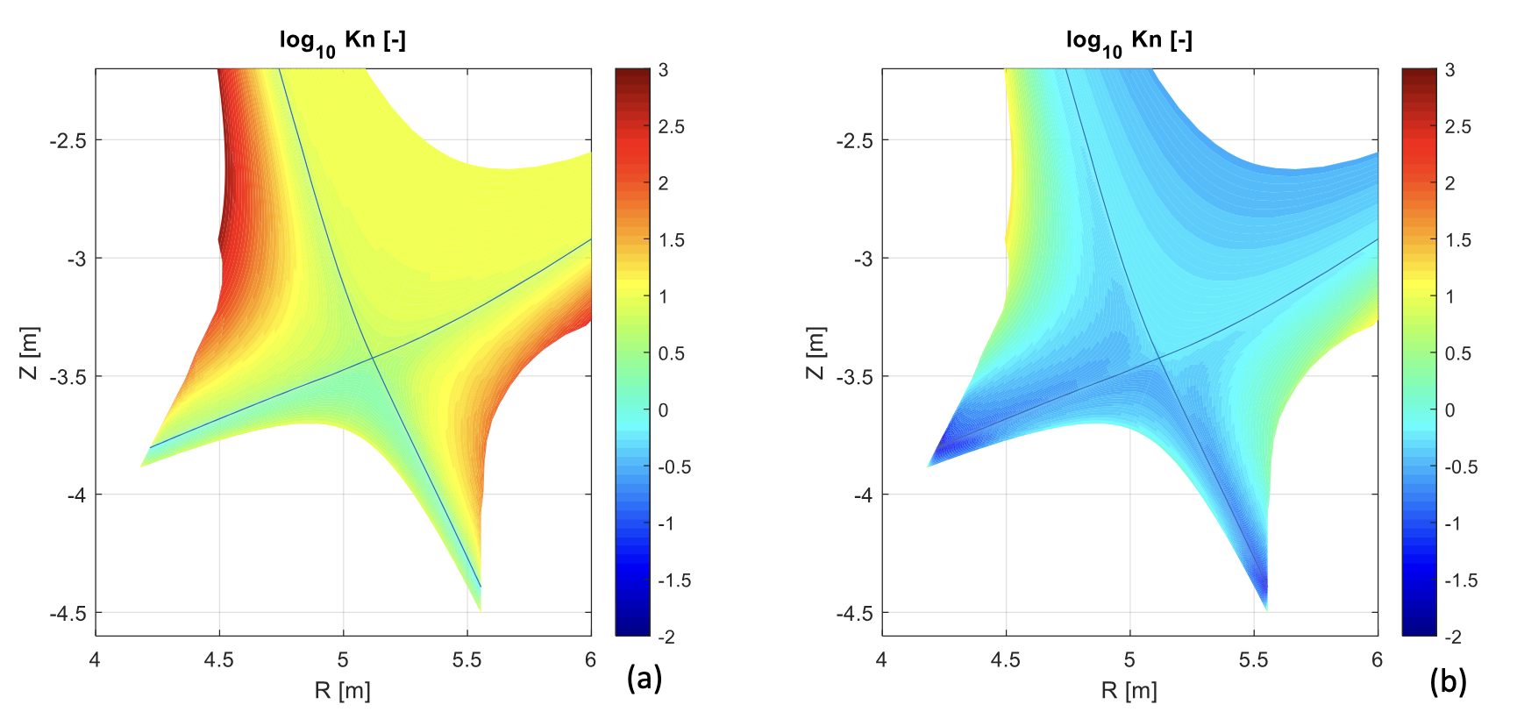
Neutrals 101
Neutrals often have long mean free paths compared to gradient length (Knudsen number Kn > 1)
But in large machines some regions in the divertor can become strongly collisional
Kn can vary by orders of magnitude over the computationnal grid
10³
10³
W. Van Uytven
Phd
Fluid limit : Kn < 0.1
10⁻²
10⁻²
Low density
Higher density

Slide 7
Driving forces behind demands on neutral modelling
Simulation of burning plasma scale machines (ITER) with mean field (transport) codes
Size of divertor increases, neutral length scales stay constant
Leads to challenging regimes, strong coupling between plasma and neutrals, Kn <<1 regions
Simplified plasma model, first principles neutrals : MW/m² on the PFCs
2) Simulation of current machines with higher fidelity plasma codes (TSVV3, TSVV4)
Size of meshes, time scales, interface to gyrokinetics, evolving HPC infrastructure
First principles plasma models, simplified neutrals : predict λ_{Q}
May lead to somewhat conflicting requirements (Soledge/Styx experience !), but ultimately the goal is to run turubulent simulations at reactor scale …
TSVV5/K deals with both drives, receives input from the wider SOLPS-ITER community through ISFN

Slide 8
Neutral gas dynamics at the edge
Current status of the modelling

Slide 9
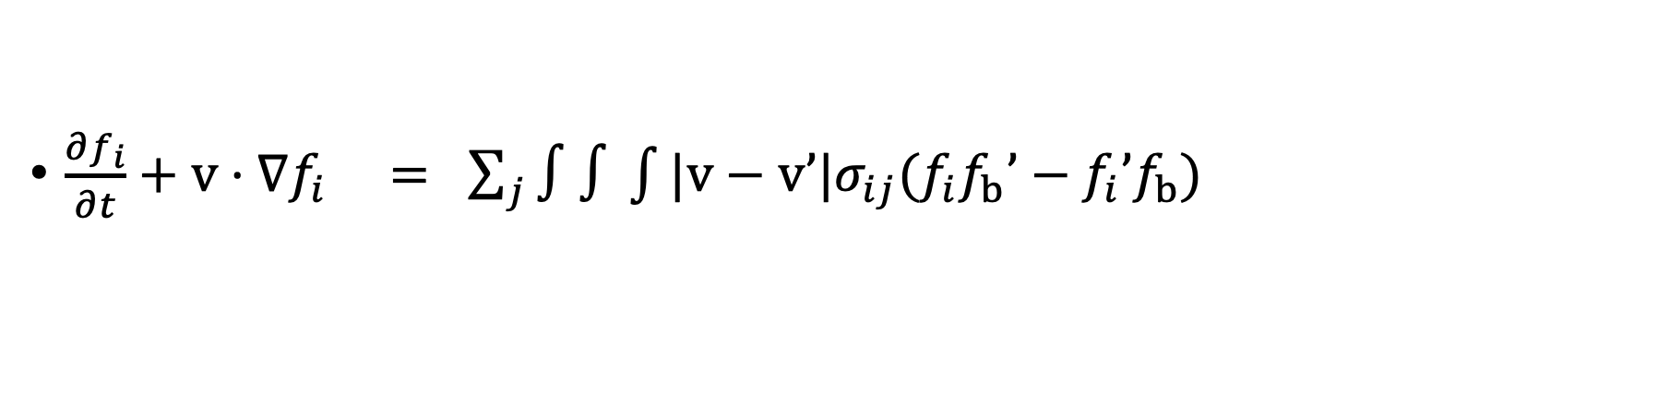

Kinetic description of neutral particle transport (K_{n}>1)
$\frac{∂f_{i}}{∂t}+v⋅∇f_{i} = \sum_{j}{∫∫\int{|v−v’|σ_{ij}{(f}_{i}f_{b}’−f_{i}’f_{b}})}$
Transport
characteristics = straight lines
A&M Physics, σ cross section for (in)elastic processes
j : ionisation, recomb, CX, elastic collisions, dissociation …
To solve for f_{i} you need :
A 3D3V kinetic solver (as in e.g. neutronics)
A&M Physics data (so far mostly effective Maxwellian rate coefficients)
${〈σ_{j}\text{v }⟩}_{eff}=∫dv’ |v−v’|σ(v−v’)f_{b}^{M}\left(T_{b}\right)$ [m³ s⁻¹]
PWI physics data (Boundary Conditions) : recycling coefficient, reflexion

Slide 10
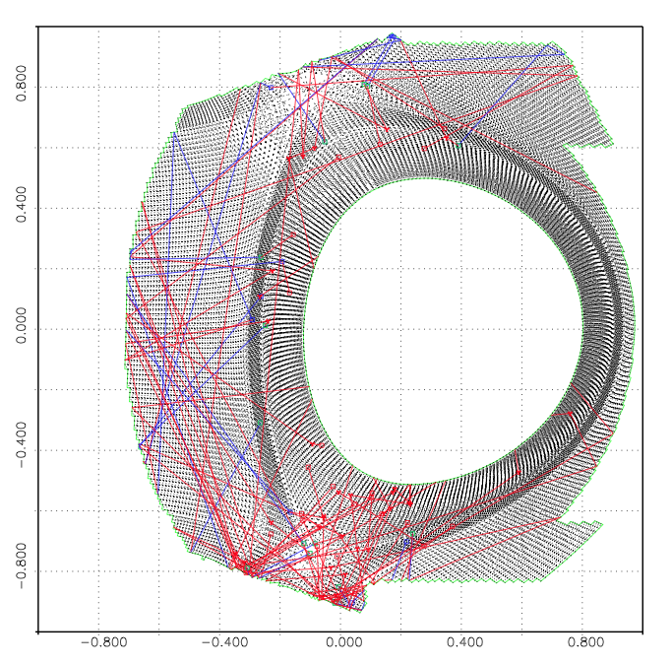
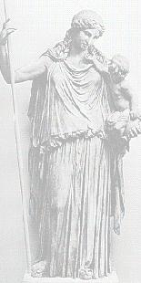

Monte Carlo implementation of neutral gas dynamics
Simulate neutral particle trajectories as a stochastic process
Compute the contributions of trajectories to estimators whose expected values are physical quantities
(moments of f)
Pros : full 6D kinetic calculation on a 3D grid
complex geometry, many species, complex BCs
embarrassingly parallel (OpenMP/MPI)
Cons : accuracy ~
$$1/\sqrt{N}$$
(N = number of trajectories)
CPU cost per trajectory increases with collisionality
Good knowledge on effect of statistical noise (bias,...) on simulations (Marandet 2015, Ghoos 2016, …)
Reference code in the community : EIRENE (D. Reiter, P. Boerner)

Slide 11
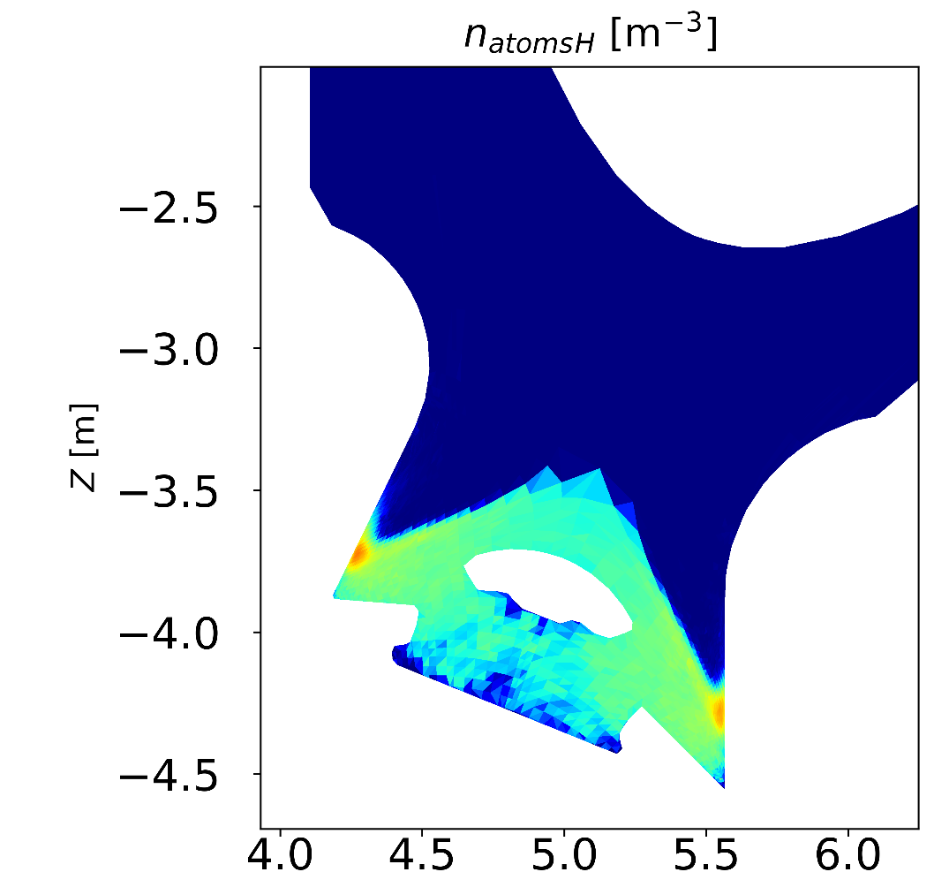
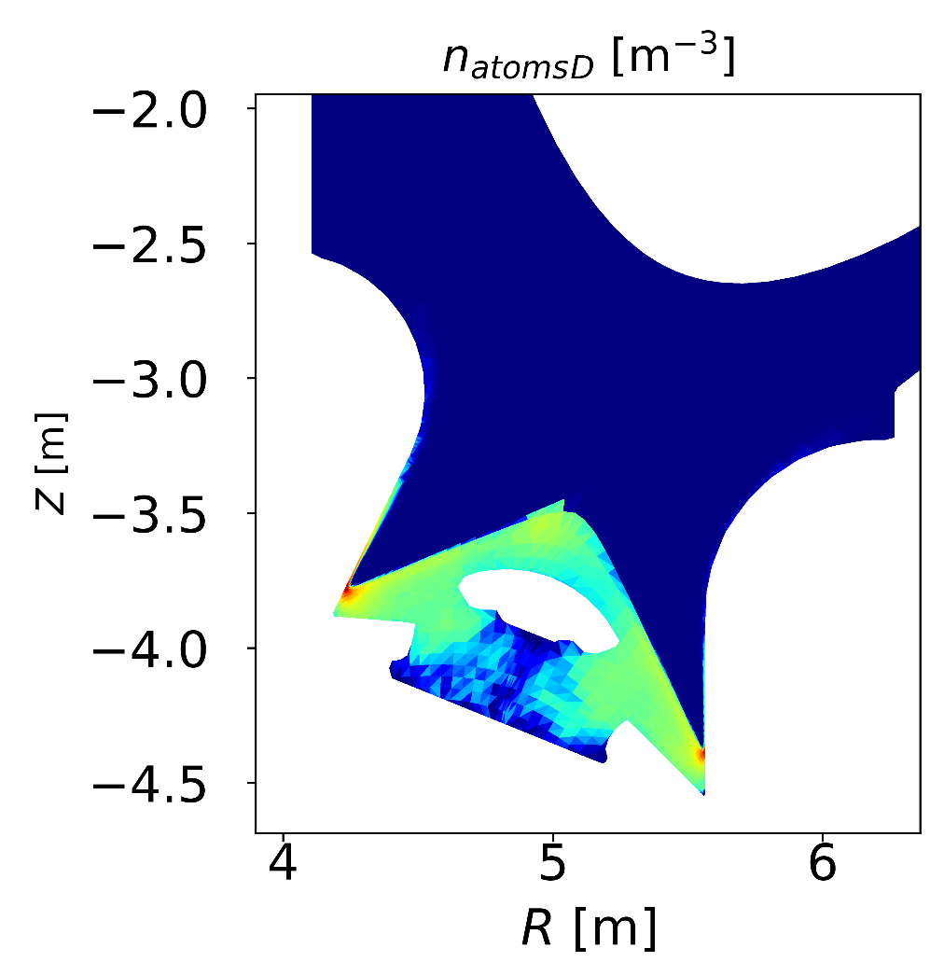
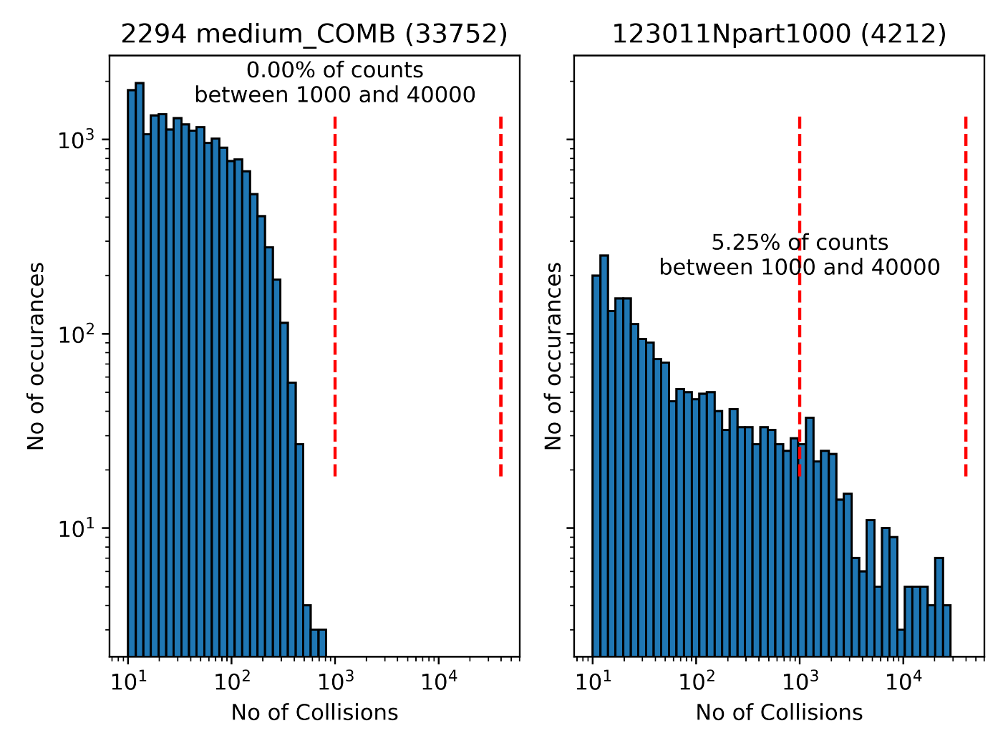
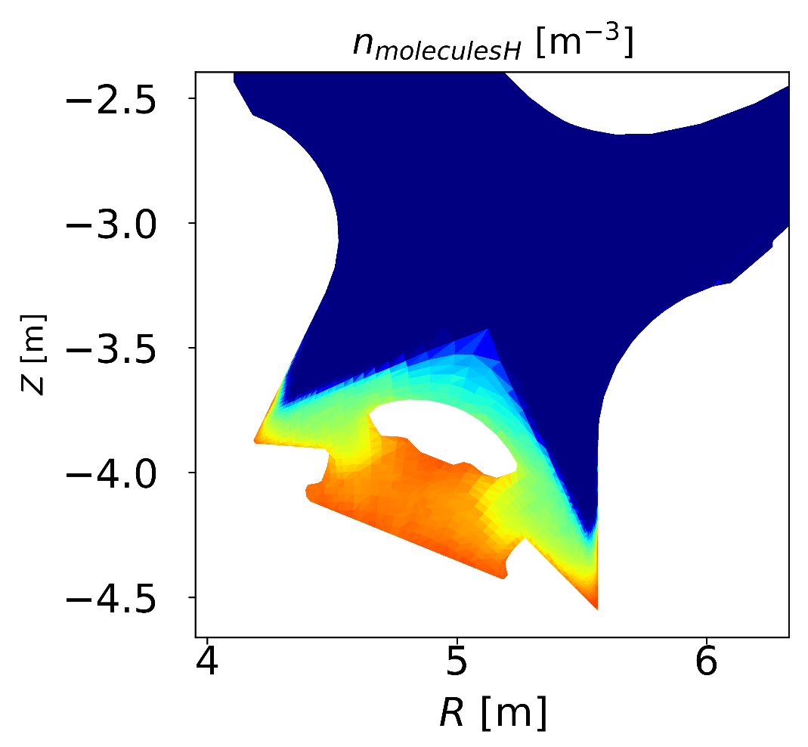
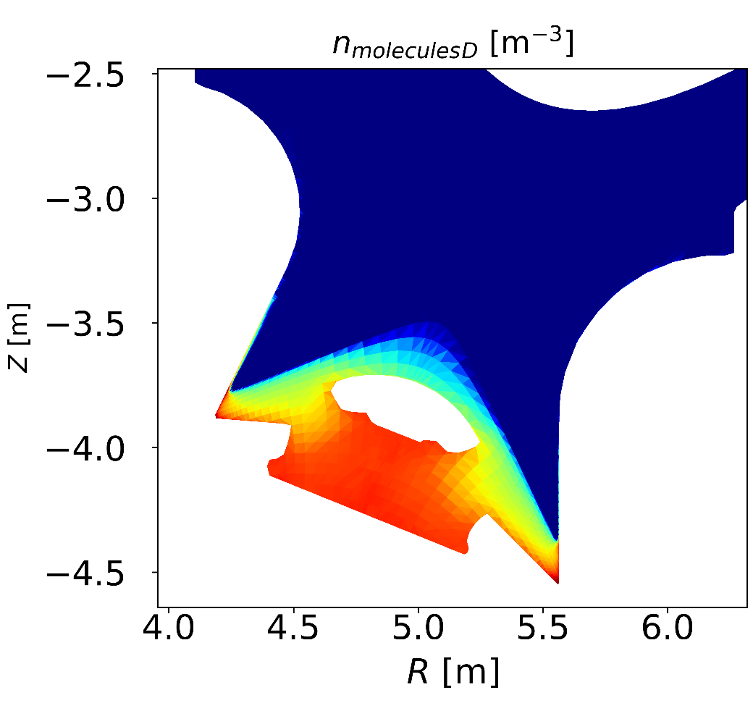
Exemple of ITER scale particle trajectory issues
MC solution of the kinetic problem becomes much more expensive in the Kn<<1 regime
Not so dissipative
more dissipative
S. Sureshkumar et al., ITER simulations

Slide 12
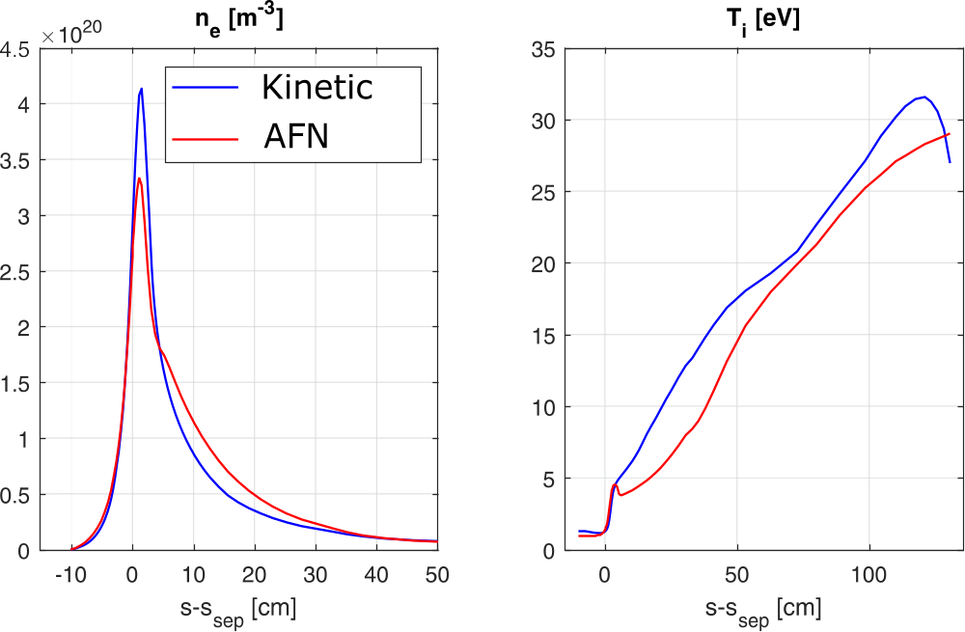
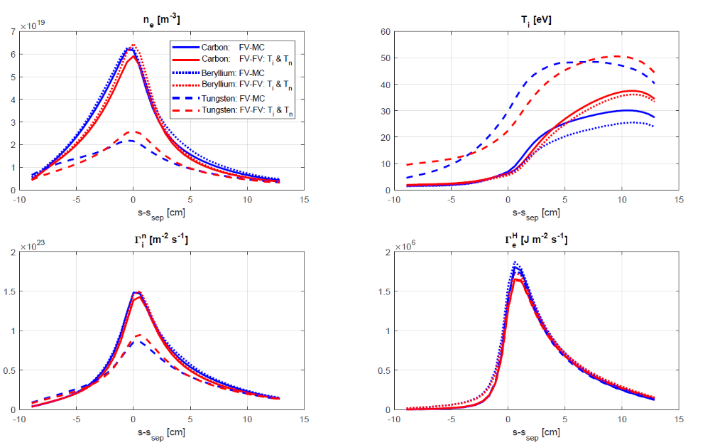

Hierarchy of models : Advanced Fluid models
Kinetic model too heavy and not necessary for scoping studies, control systems …
Fluid models should be accurate in the low Knudsen number regimes
For atoms, CX dominated regime. Follow a Champan-Enskog closure scheme
AND keep A&M sources/sinks and BC consistent with kinetics (Horsten 2017, Dekeyser 2024)
$Kn= \frac{λ}{L_{∇}} ≪$ 1
Very good agreement in ITER
at the highest collisionality
Reproduces dependency on
wall materials
Implemented in SOLPS-ITER
Partially in TSVV3 codes
For fluid codes, direct integration in
the solver as an additionnal species
Atoms only at this stage, molecules
dissociated at the target
[W. Van Uytven et al., NF 62 (2022)]

Slide 13
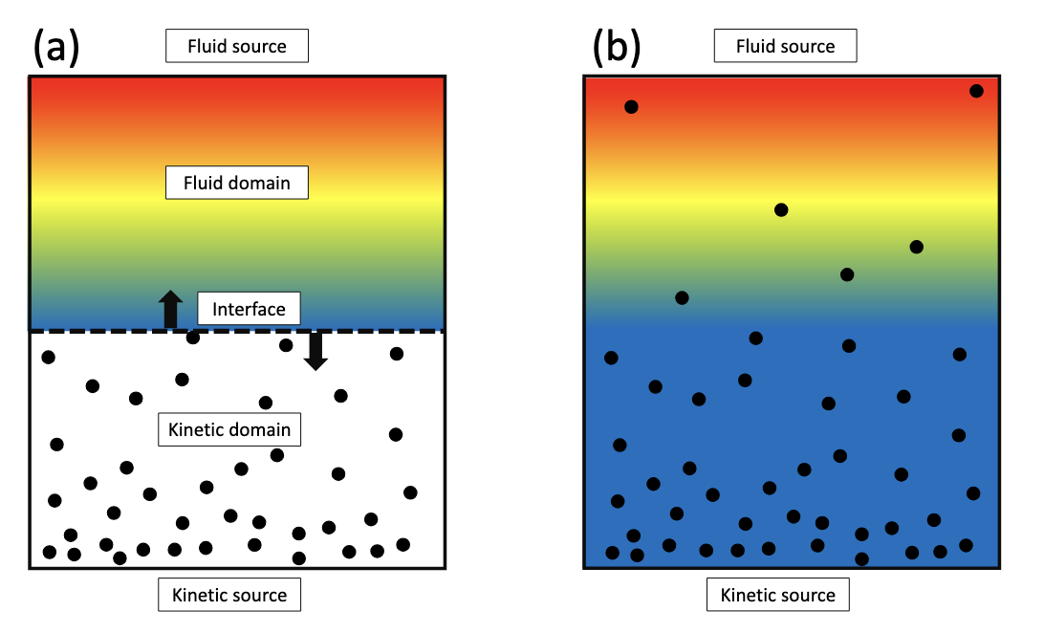
Hierarchy of models: Spatially Hybrid fluid kinetic models
The fluid approach is most accurate where MC is most costly (Kn<0.1), suggests going hybrid …
Strict separation
Co-existence
Kn
Karney, Stotler 1998
10⁻³
Fixed interface at the
Edge of the plasma grid
M. Blommaert et al.
Fluid phase
Evap.
Cond.
10⁻¹
Kinetic phase
BC
Evap. and Cond.
Rates = f(Kn)
M. Valentinuzzi, 2018
W. Van Uytven 2023
10²
Adapated from W. Van Uytven
If the transition zone is made sharp (strong Kn dependence of rates), the two phases model is an
an immersed boundary implementation of a strict separation model (D. Borodin et al., NF 2022)

Slide 14
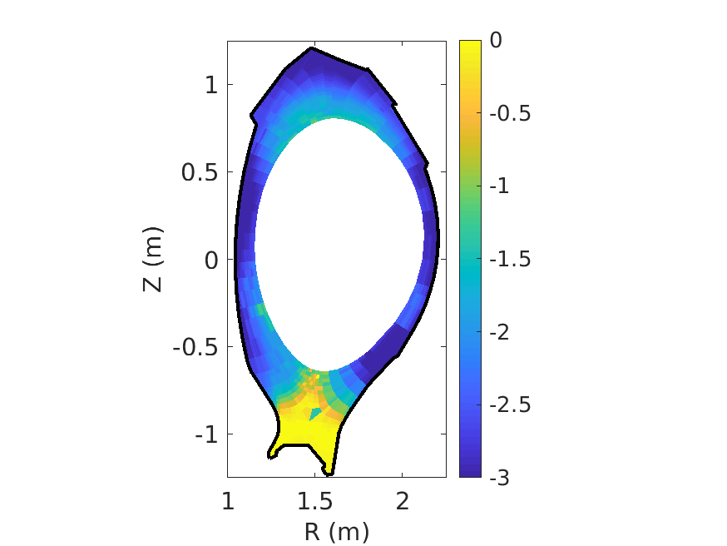
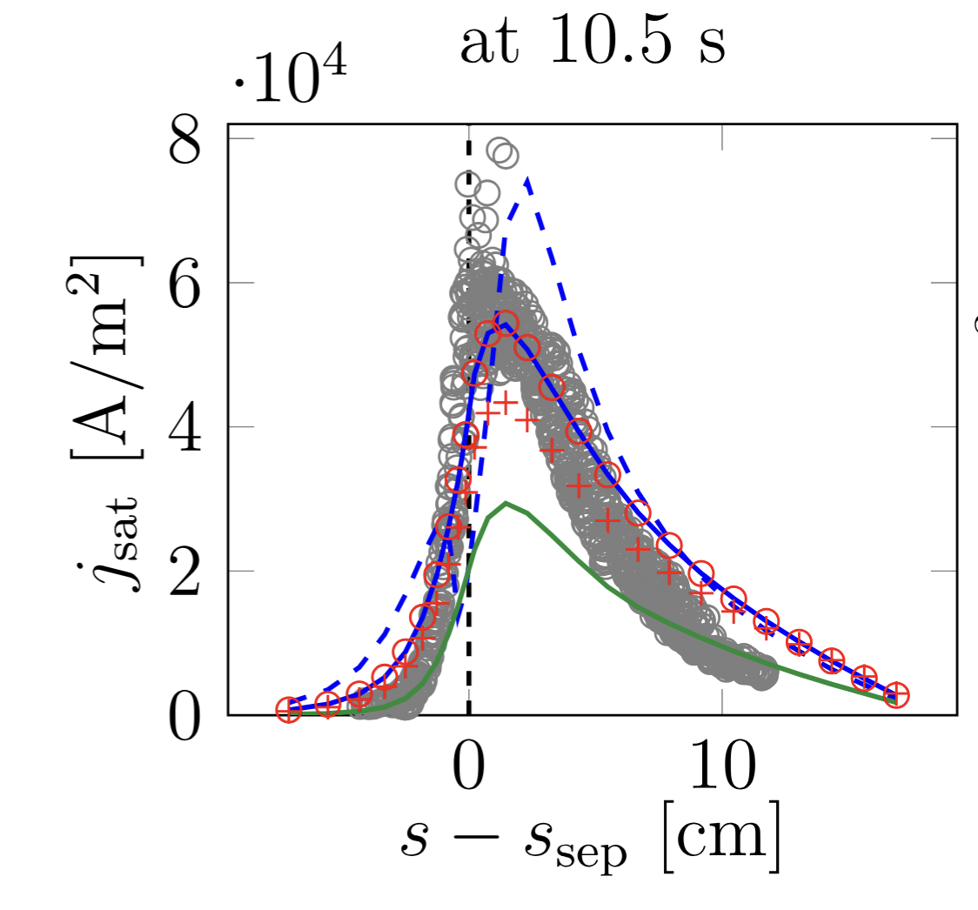


Spatially Hybrid fluid kinetic models for atoms
In practice :
  Launch all atoms kinetically (first flight effects!)
      Condense atoms to fluid (AFN) population when
N. Horsten et al., NME 2022
Kn^{t} = 100
Fluid
$$K_{n}^{p}<K_{n}^{t}$$
Kinetic
Kn^{t}=10²
Particle Knudsen number
transition criterion
Kn^{t}=10³
Evaporation not needed to get good agreement
Kinetic effects corrected by hybridization :
  Coupling to molecules and impurity neutrals
  Kinetic effects in low-collisional regions
Kn^{t} = 1
Trade-off accuracy vs. speed: up to factor 10 faster than fully kinetic simulations
But : kinetic molecules, present in hybrid simulations, become computational bottleneck
See Wim Van Uytven

Slide 15
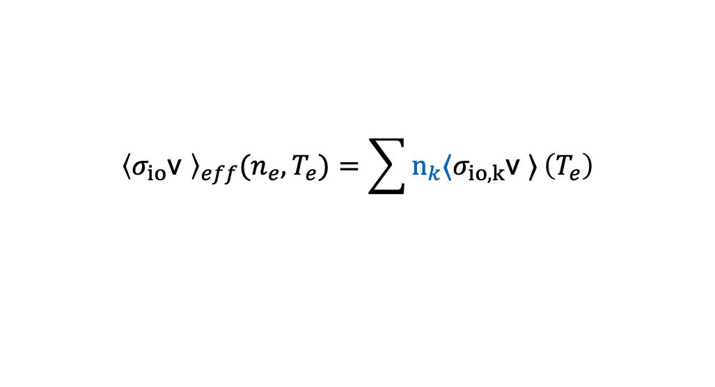
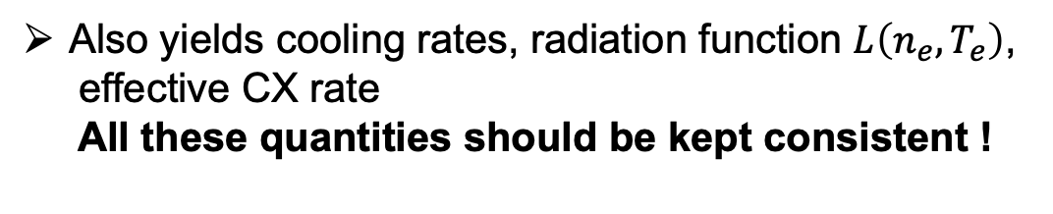
A&M physics : collisional radiative models
Neutrals do have internal states
Transport time scales >> excited state lifetime : local solution
A simple exemple, ionisation of D
$$\frac{∂n_{k}}{∂t}+∇⋅\left(n_{k}v\right)=populating processes − depopulating processes$$
Collisionnal excitation
Recombination
Collisional deexcitation
Spontaneous emission
Ionisation
n=∞
n=3
n=2
E
$$n_{k}=n_{k}\left(n_{e},T_{e}\right)$$
Also yields cooling rates, radiation function $L\left(n_{e},T_{e}\right)$,
effective CX rate
All these quantities should be kept consistent !
n=1
$${\left\langle σ_{io}\text{v }\right\rangle }_{eff}(n_{e},T_{e})=\sum{n_{k}〈σ_{io,k}\text{v }〉}\left(T_{e}\right)$$
One effective reaction rate = lots of underlying data
n_{k} population of the k^{th} level
Current situation : effective rates are precalculated
and are read as input data (Amjuel, Hydhel, ADAS …)

Slide 16

Radiation transport – the need to inline CRMs
In divertor conditions, especially for transitions involving the ground state, photon can be reabsorbed.
Can be a stabilizing factor in MARFE-like radiative instabilities (Kotov 2013)
New populating mechanisms depending on photon fluxes for each lines
$$n_{k}=n_{k}\left(n_{e},T_{e},I_{α},I_{β},⋯\right)$$
Compute photon transport and run the CRM before each neutral transport calculation, using photon fluxes from the previous step – inline CRM parallelized
n=3
n=2
E
Lyα
Lyβ
n=1
R. Chandra et al., PET-20, 2025

Slide 17
Neutral gas dynamics at the edge
Gaps & limitations :
Physics

Slide 18
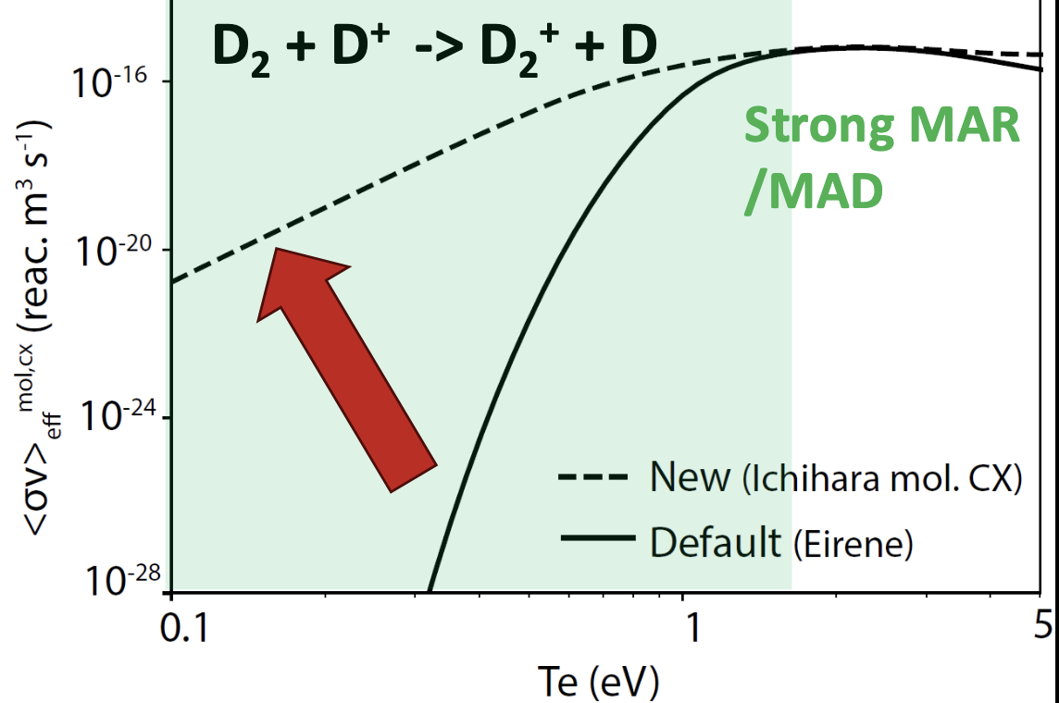
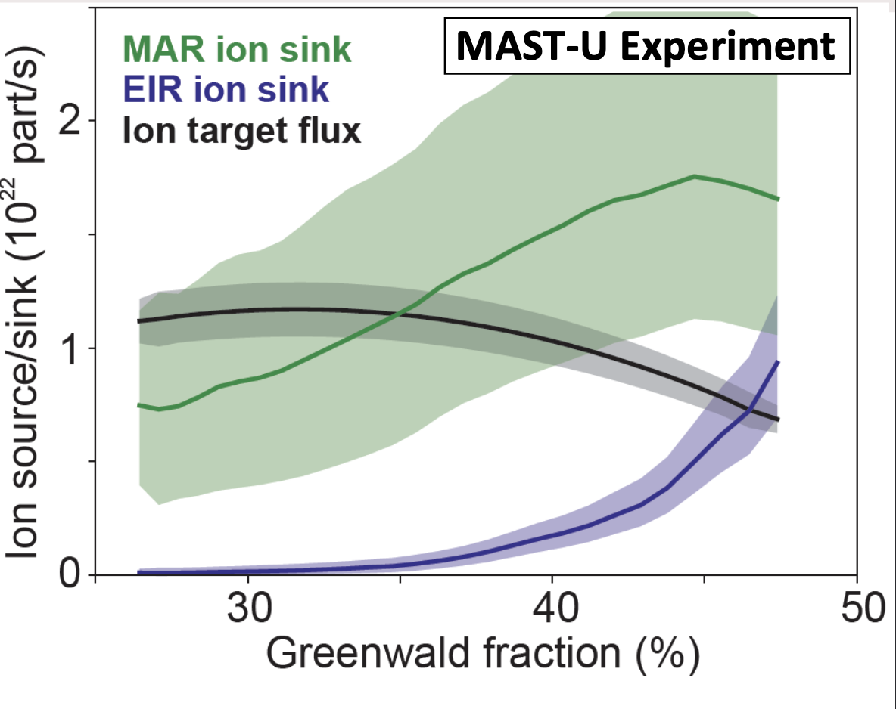

Status of A&M database : importance of MAR/MAD
Molecular CX can exacerbate D⁺ recombination (MAR) or D₂ dissociation (MAD)
MAR : Molecule Assisted Recombination
$$D^{+}+D_{2}→D+D_{2}^{+}$$
$$D_{2}^{+}{+ e}^{−}→D+D^{∗}$$
Strong differences between recent data and
EIRENE database on molecular CX
K. Verhaegh, NF 2023, 2024

Slide 19
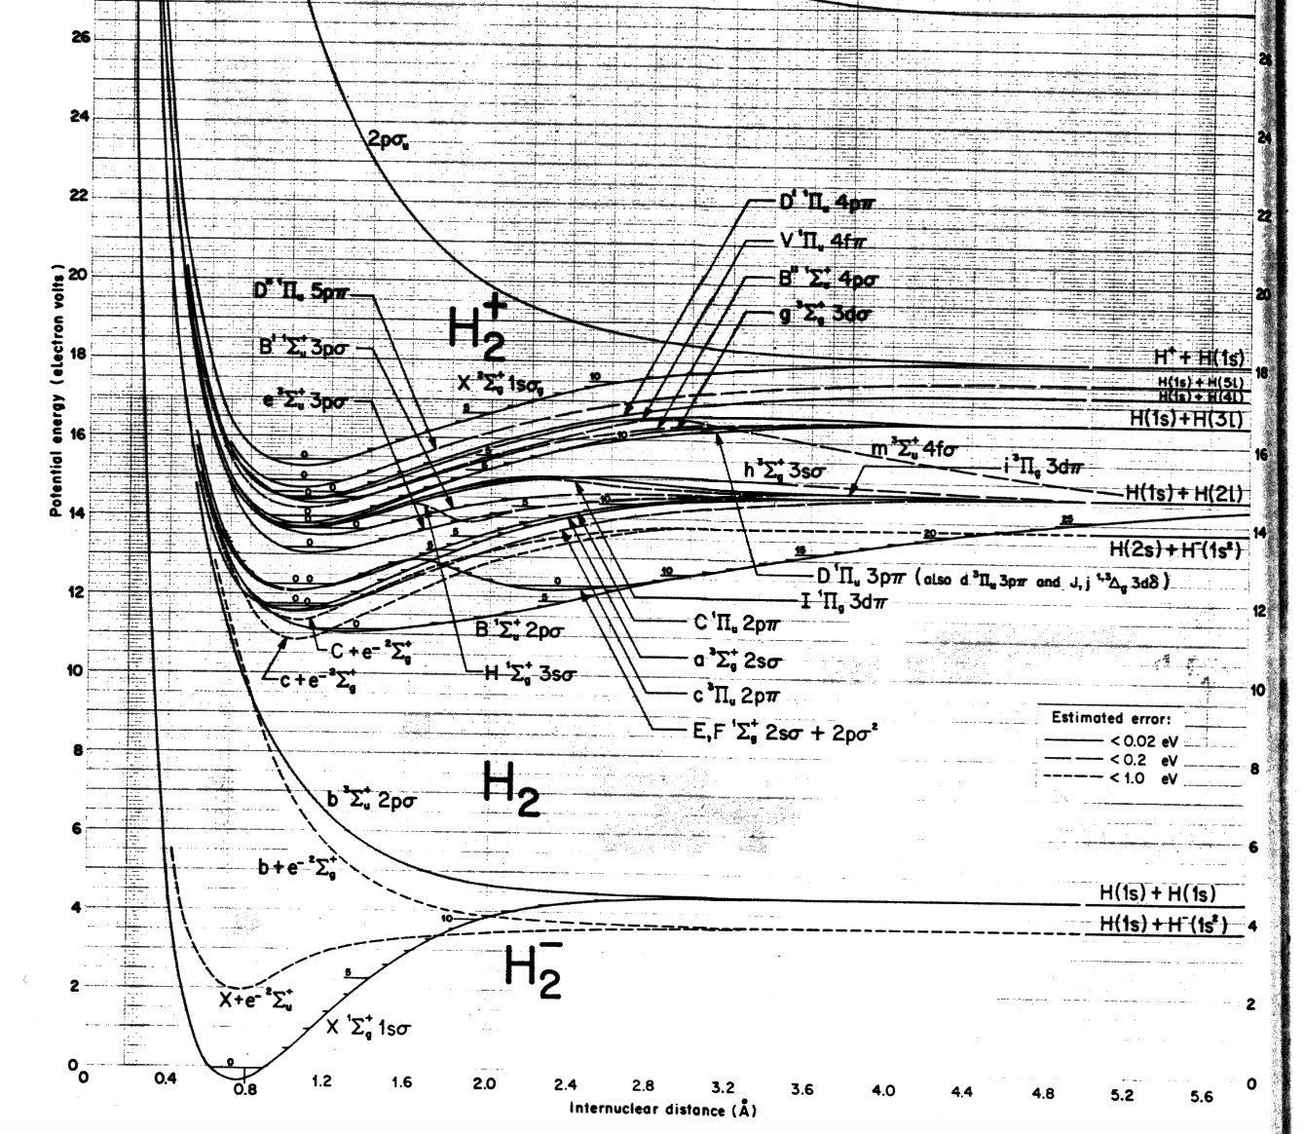
Status of A&M database : molecular processes
E
T.E. Sharp 1970
A lot more fun than for atoms (electron levels = f(R_{H-H}),
essentially isotope independent)
Dissociative states leading to H + H*, H⁺+H*, …
Coupling between atomic and molecular populations
Isotope dependant vibrationnal states(v=1-14 for H₂,
v=1-21 for D₂)
Transitions rate between electron states depend on
vibrationnal states (FC factors)
Vibrationnal state lifetime ~ transport time scales
- H₂(v) should be followed as individual species
- production mechanisms for H₂(v) at the surface must
be considered (Rutigliano’s 2011)
R

Slide 20
Status of A&M database : molecular processes
Sensitivity analysis on the current Fujimoto-Sawada CRM (1995) highlights the key role of:
Vibrational excitation ${ H}_{2}\left(v\right)+e^{−}→H_{2}\left(v’\right)+e^{−}$
Molecular CX $H^{+}+H_{2}\left(v\right)→H+H_{2}^{+}$ resonant for v=4 (H), v=6 (D), …
dissociative attachment ${ H}_{2}\left(v\right)+e^{−}→H_{2}^{−}→H+H^{−}$
New, much better-quality data now exist in the literature (Ichihara 2000, Laporta 2021 for H&D, Yacora)
These processes determine the vibrationnal distribution $f_{v}=f_{v}\left(T_{e},T_{i},n_{e},K_{m}\right)$. Presently, $f_{v}=f_{v}\left(T\right)$
Isotope effects are more involved than for atoms
Nevertheless, proper scalings exist except for dissociative attachment, which has a very strong
isotopic dependence (process much weaker for D and T than for H)
Refinements/additionnal processes can be important for diagnostic purposes (e.g. Fulcher band)
The main challenge is therefore integration of existing data into CRM models, and inlining
these models to account for parametric dependences. This is the primary focus in TSVV-K
Gyrokinetic code will require cross sections to recompute non-Maxwellian rates

Slide 21
Neutral gas dynamics at the edge
Gaps & limitations : performance

Slide 22
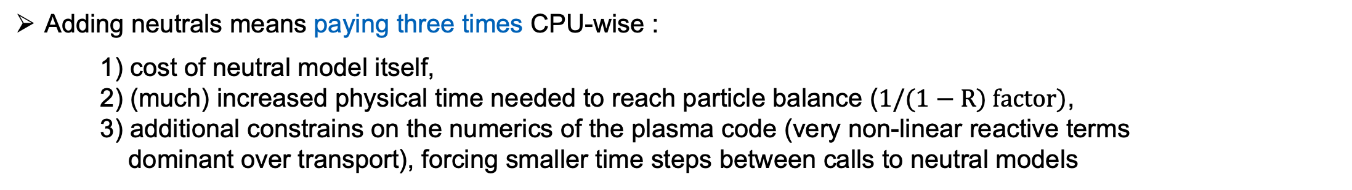
The cost of neutrals
Adding neutrals means paying three times CPU-wise :
1) cost of neutral model itself,
2) (much) increased physical time needed to reach particle balance ($1/(1−R) factor)$,
3) additional constrains on the numerics of the plasma code (very non-linear reactive terms
dominant over transport), forcing smaller time steps between calls to neutral models
In burning plasma machine conditions, with detached divertor, all three items become more severe
This regime is currently addressed only by mean field codes,
no compromise on the neutral physics if divertor heat load is the focus
2) and 3) are at the interface between plasma codes and neutral transport codes
Is the focus here. Can be addressed by
Accelerating EIRENE (ongoing refactoring, GPU – but massive undertaking )
Developing a deterministic kinetic solver ? Can the full physics be accommodated ?
Further developing fluid/kinetic hybrid models

Slide 23

The cost of neutrals
Adding neutrals means paying three times CPU-wise :
1) cost of neutral model itself,
2) (much) increased physical time needed to reach particle balance ( $1/(1−R) factor …)$,
3) additional constrains on the numerics of the plasma code (very non-linear reactive terms
dominant over transport), forcing smaller time steps between calls to neutral models
For 3D turbulence simulations of current devices, 2) is likely the most serious penalty provided the goal
is to converge global mean profiles.
Other technical issues become pressing:
- Memory becomes an issue (in EIRENE, dominated by tallies, i.e. input and output fields, ~ 100+)
OpenMP parallelisation on top of existing MPI : factor of 10 with good parallel efficiency
Ultimately domain decomposition will be mandatory (tested on the EIRON simplified model)
- Porting to GPU to use the same hardware as TSVV-B/C codes (and accelerate …)

Slide 24
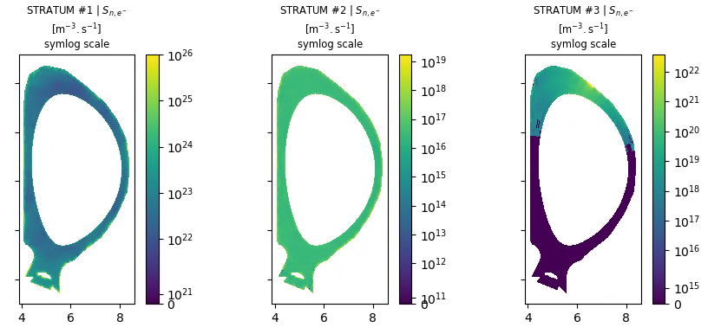
Improving interface to fluid codes : STYX2.0
STYX1.0 is the interface used in Soledeg3X-EIRENE since more than 10 years
STYX2.0 redevelopped from scratch to improve maintanability (separate repos), modularity, data
exchange, input format (JSON), HDF5 output. Joint work with TSVV3/B.
Basic version in final testing
Test with other plasma solver foreseen in
TSVV-B, making all the TSVV-K models available
SOLEDGE3X-STYX2.0 coupled run test run:
Particle source per stratum
TSSV-B : decoupling the plasma code grid
and the EIRENE grid
No need to run the neutrals on a Larmor radius
scale grid everywhere !
Strong reduction of memory footprint expected
N. Rivals

Slide 25
Neutral gas dynamics at the edge
Conclusions

Slide 26
Take away messages
Lots of progress in neutral gas modelling over the last years due to continued support through TSVV-K
Solving for kinetic neutrals is a complex multi-species 6D problem.
Such level of fidelity is mandatory for dissipative divertor studies
Especially taxing for ITER sized machines, the cost of the neutral model being only one of the factors
A hierarchy of models has been established, from kinetic to fluid with hybrids in between.
Allows to adjust the level of descriptions to the applications. Development still under way (molecules,
KDMC)
Going towards a domain decomposed and GPU kinetic solver will require continued support
and a committed consortium in the years to come. AI agentic coding may be the key.
In reactor conditions A&M physics become more complex, CRM models currently in use in EIRENE
are under revision and must be included in the code to account for key parametric dependences
(opacity, vibrational distribution)

Slide 27
Backup slides

Slide 28
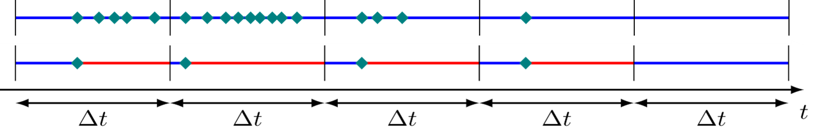
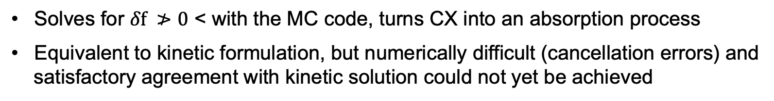
Other hybrid fluid kinetic approaches
Hybrid models without a fluid code : Kinetic Diffusion Monte Carlo
Standard MC
KDMC
collision
diffusion step
Hybrid model within the MC formulation, without the need for a fluid code (G. Samaey et al.)
Micro-Macro (δf) method : equivalent to kinetic formulation (N. Horsten et al., 2020)
Solves for $δf ≯0$ < with the MC code, turns CX into an absorption process
Equivalent to kinetic formulation, but numerically difficult (cancellation errors) and
satisfactory agreement with kinetic solution could not yet be achieved

Slide 29
Domain Decomposition
To reduce memory load per node, split the computational grid in subdomains and distribute domains among cores/nodes
These methods have been investigated in other fields, such as neutronics (origin of OpenMC)
Algorithm with original efficient termination scheme (fully asynchronous) implemented and tested in EIRON (paper submitted), results are promising
Provides a blueprint for implementation in EIRENE
Next big item : load balancing, may be addressed by calibration runs on coarser grid to allocate domains to processors in an optimal way

