Slide 1




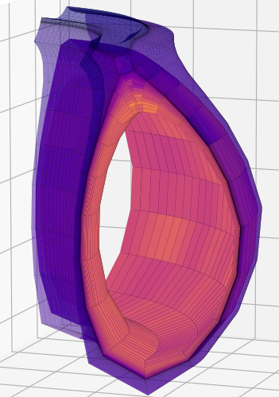
Electromagnetic Fluid Turbulence Simulations of Edge Tokamak Plasmas with Hermes-3
UKAEA Exhaust Code Workshop 2026
T Ashton-Key¹
Y. Andrew¹, B. Dudson², R. Kingham¹, E. Kim^{3,4}
1 Blackett Laboratory, Imperial College London, UK
2 Lawrence Livermore National Laboratory, USA
3 Fluid and Complex System Research Centre, Coventry University, UK
4 Nuclear Research Institute for Future Technology and Policy,
Seoul National University, Korea
e-mail (speaker): t.ashton-key22@imperial.ac.uk
Acknowledgement: I would like to thank Tokamak Energy for their support in pursuing this work. Work supported by EPSRC Centre for Doctoral Training in Nuclear Energy Futures, EP/S023844/1. Prepared in part by LLNL under Contract DE-AC52-07NA27344, using NERSC Perlmutter resources under project mp2. Hermes-3 (LLNL-CODE-845139) is available on Github under the GPL-3 license. This material is based upon work supported by the U.S. Department of Energy, Office of Science, Office of Fusion Energy Sciences, using the DIII-D National Fusion Facility, a DOE Office of Science user facility, under Award(s) DE-FC02-04ER54698.
Disclaimer: This report was prepared as an account of work sponsored by an agency of the United States Government. Neither the United States Government nor any agency thereof, nor any of their employees, makes any warranty, express or implied, or assumes any legal liability or responsibility for the accuracy, completeness, or usefulness of any information, apparatus, product, or process disclosed, or represents that its use would not infringe privately owned rights. Reference herein to any specific commercial product, process, or service by trade name, trademark, manufacturer, or otherwise does not necessarily constitute or imply its endorsement, recommendation, or favoring by the United States Government or any agency thereof. The views and opinions of authors expressed herein do not necessarily state or reflect those of the United States Government or any agency thereof.}

Slide 2
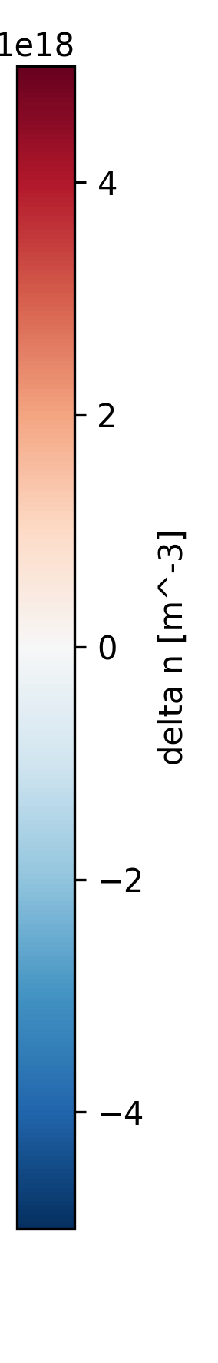
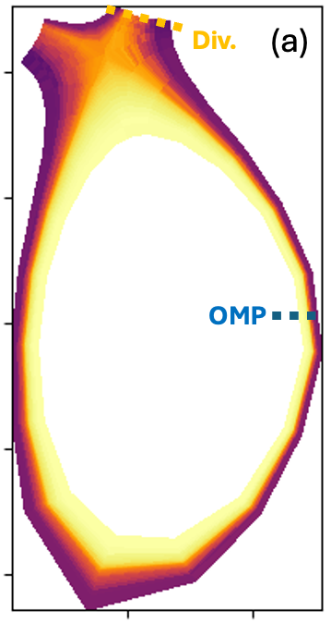
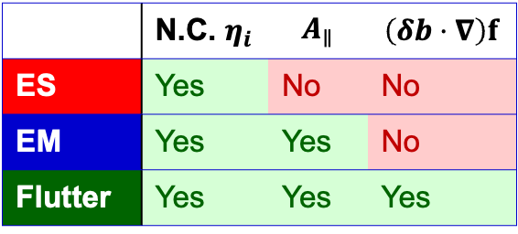
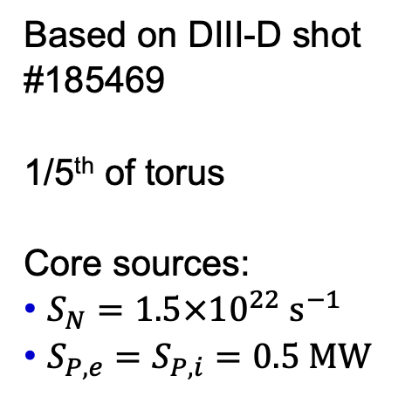
3D Turbulence Simulations with Hermes-3
Impact of EM features on Transport
    Three simulations:
 | N.C. $η_{i}$ | $$A_{∥}$$ | $$\left(δb⋅∇\right)f$$
ES | Yes | No | No
EM | Yes | Yes | No
Flutter | Yes | Yes | Yes
    Based on DIII-D shot #185469
    1/5th of torus
    Core sources:
      $S_{N}=1.5×{10}^{22} s^{−1}$
      $S_{P,e}=S_{P,i}=0.5 MW$
Notes:
Density fluctuation at OMP, in radial toroidal plane
Flutter has largest amplitude within separatrix
EM has largest amplitude in the SOL
ES has very regular turbulence
Strong flows

Slide 3
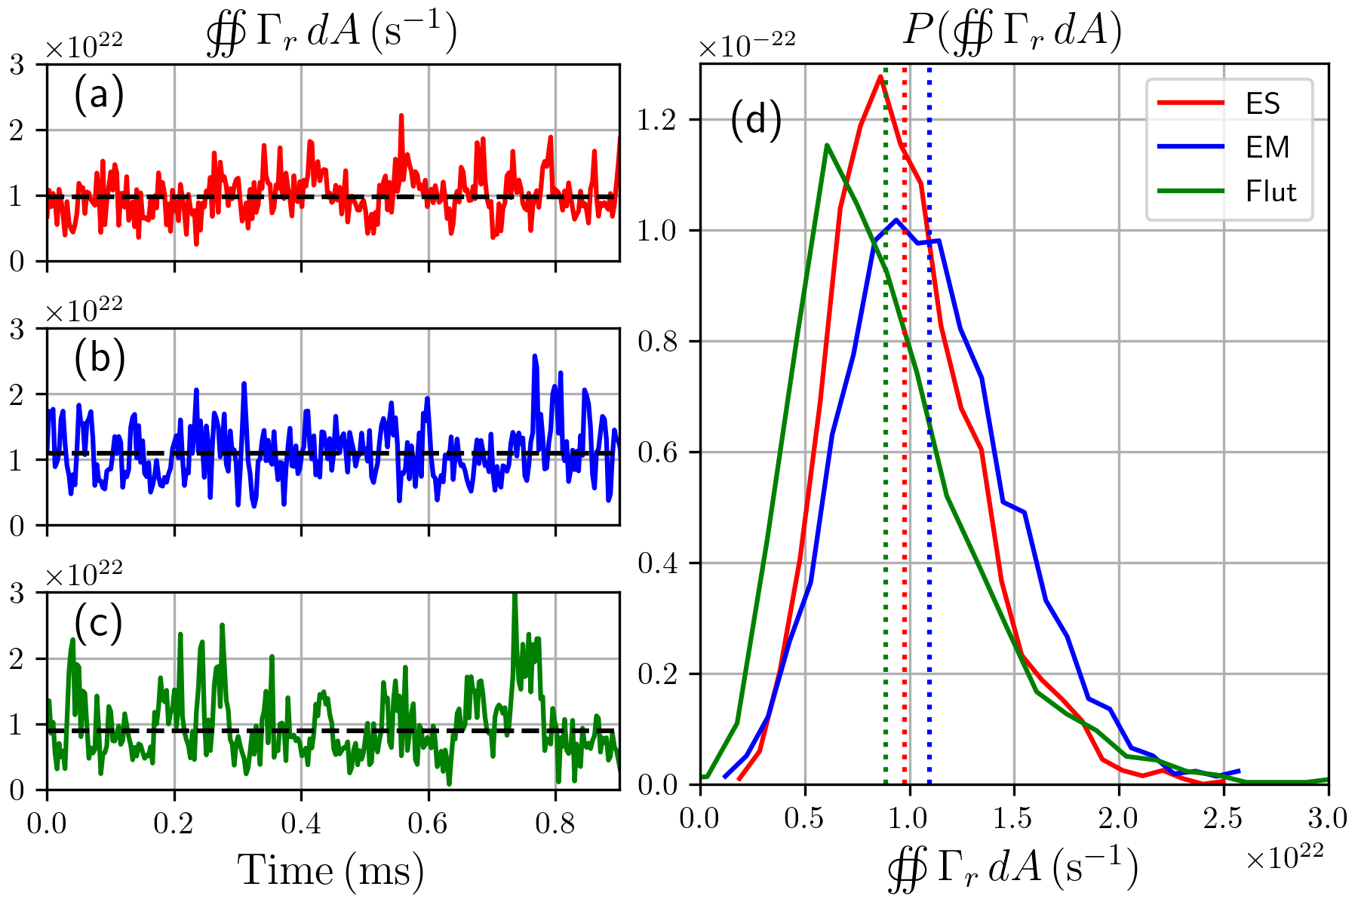
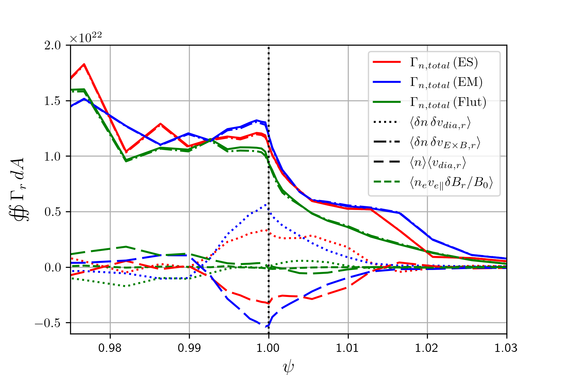
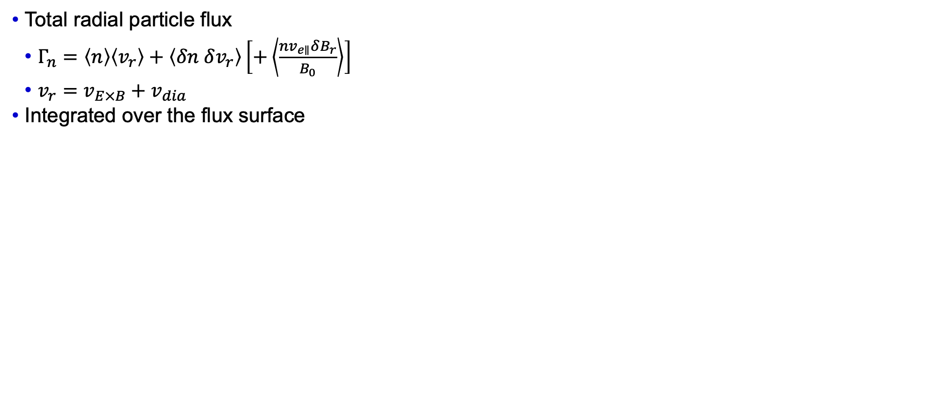
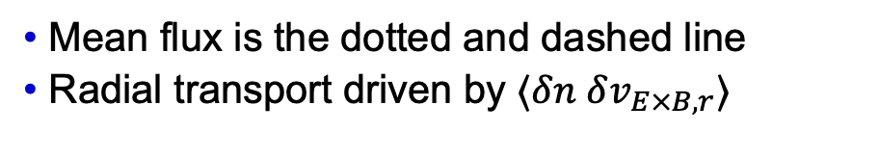

Transport analysis
Contributions to radial particle flux
Integrated particle flux at $ψ=0.999$
    Total radial particle flux
      $Γ_{n}=\left\langle n\right\rangle \left\langle v_{r}\right\rangle +\left\langle δn δv_{r}\right\rangle \left[+\left\langle \frac{nv_{e∥}δB_{r}}{B_{0}}\right\rangle \right]$
      $v_{r}=v_{E×B}+v_{dia}$
    Integrated over the flux surface
Radial profile of particle flux
    Mean flux is the dotted and dashed line
    Radial transport driven by $⟨δn δv_{E×B,r}⟩$

