Slide 1
Hermes-3 performance and neutral model update
M. Kryjak, B.D. Dudson, M. R. Hardman, C. MacMackin, H. Al Daas, N. Bootland, M. Tsagkaridis, S. Mijin, W. Saunders, J. Cook and J. Buchanan
Tokamak Energy project collaborators: M. Moscheni, L. Balbinot, J. Bryant, M. Romanelli
+ Hermes-3 collaborators, the rest of the VANTAGE team, and the international community

Slide 2
This talk
Hermes-3 performance journey
Brief kinetic neutral update

Slide 3





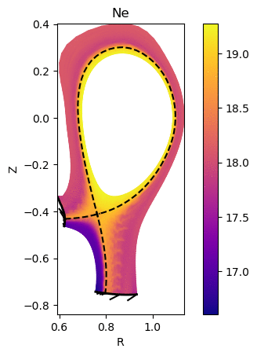
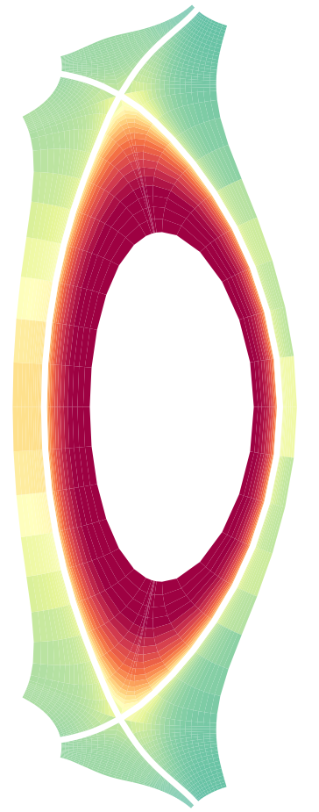
Hermes-3
  Developed for 3D/1D: Originally an evolution of SD1D/Hermes-2/STORM
  Focus of our work is 2D: catching up with SOLPS
Feature | Status
Language / portability / parallelism | C++ / GPU port in progress / MPI
Dimensions / time dependence | 1D, 2D, 3D steady and unsteady/time dependent
Numerical scheme | Fully implicit Newton-Krylov
Preconditioners | Physical and algebraic (LU/ILU)
Discretisation scheme | Conservative finite difference (like FV)
Discretisation order | Second order with slope limiters and Lax flux
Coordinate scheme | Fully field aligned or Flux Coordinate Independent (FCI)
Notes:
Intro to Hermes-3, recycle from old PPTs

Slide 4
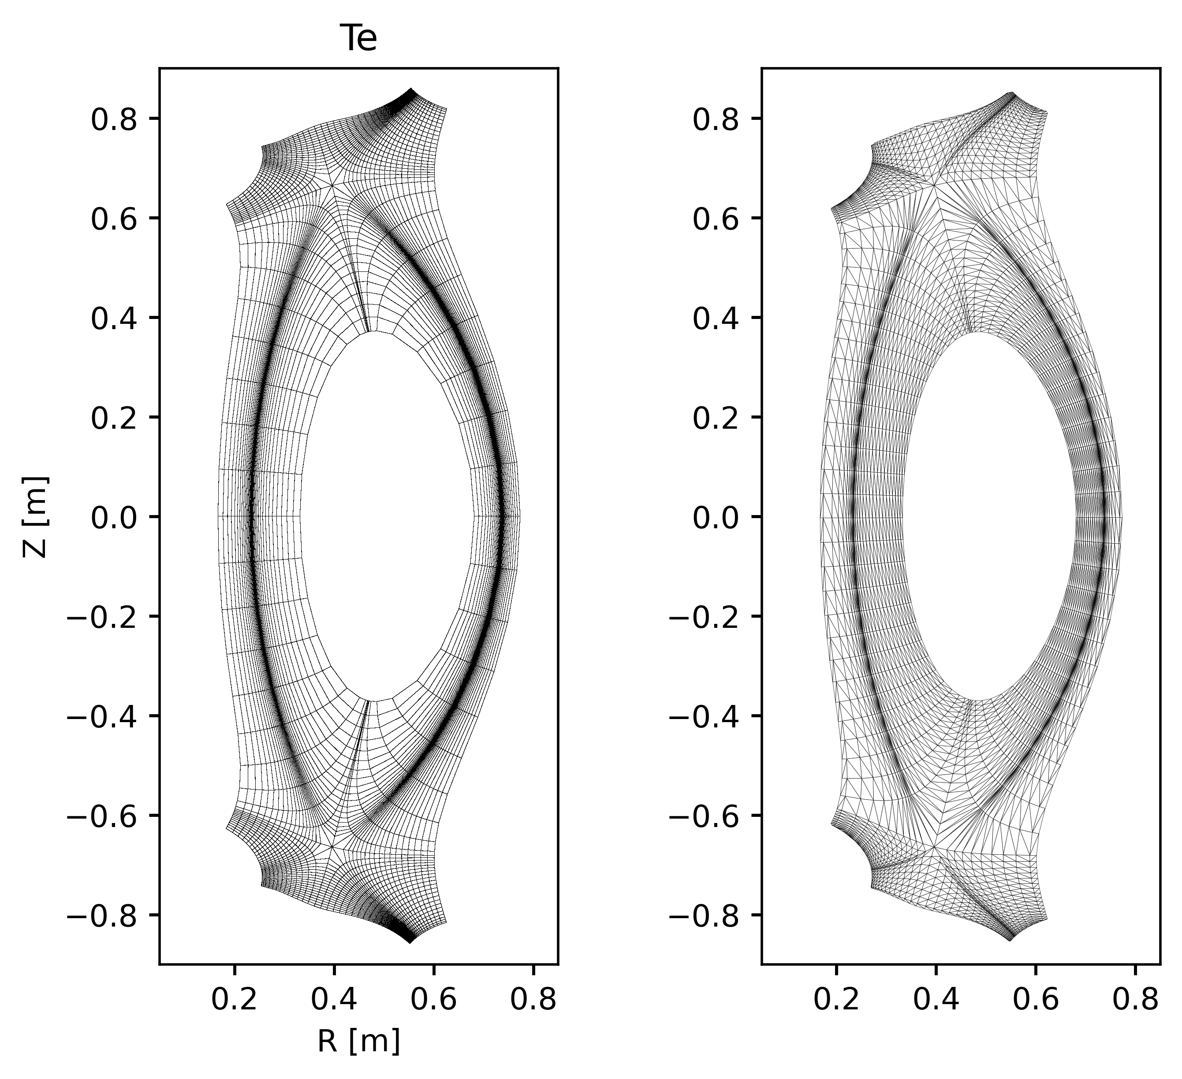
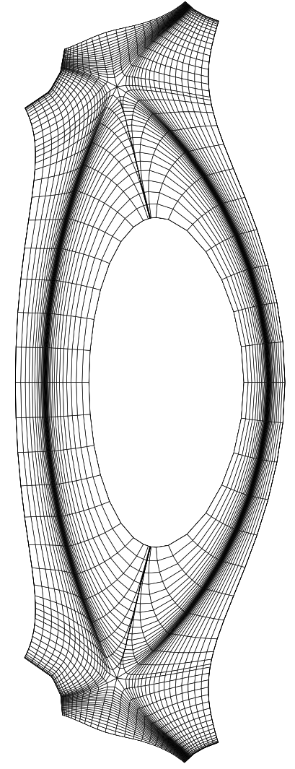
First Hermes-3 verification in 2D
Part of ongoing collaboration with Tokamak Energy (M. Moscheni, L. Balbinot, J. Bryant, M. Romanelli)
Hermes-3 fluid neutrals vs. SOLPS/SOLEDGE2D with EIRENE
Low fidelity: no currents, impurities, drifts
New Hermes-3 features:
Fast/thermal reflection, recycling
Decay length BC
Recycling at radial boundaries
Separate flux limiters for neutral diffusion, conduction, viscosity
Hermes-3
SOLPS-ITER
SOLEDGE2D
See L. Shih’s poster from earlier today for physics investigation

Slide 5
First Hermes-3 verification in 2D
Part of ongoing collaboration with Tokamak Energy (M. Moscheni, L. Balbinot, J. Bryant, M. Romanelli)
Hermes-3 fluid neutrals vs. SOLPS/SOLEDGE2D with EIRENE
Low fidelity: no currents, impurities, drifts
New Hermes-3 features:
Fast/thermal reflection, recycling
Decay length BC
Recycling at radial boundaries
Separate neutral flux limiters for diffusion, conduction, viscosity
Hermes-3
SOLPS-ITER
SOLEDGE2D
This caused extreme performance degradation!

Slide 6
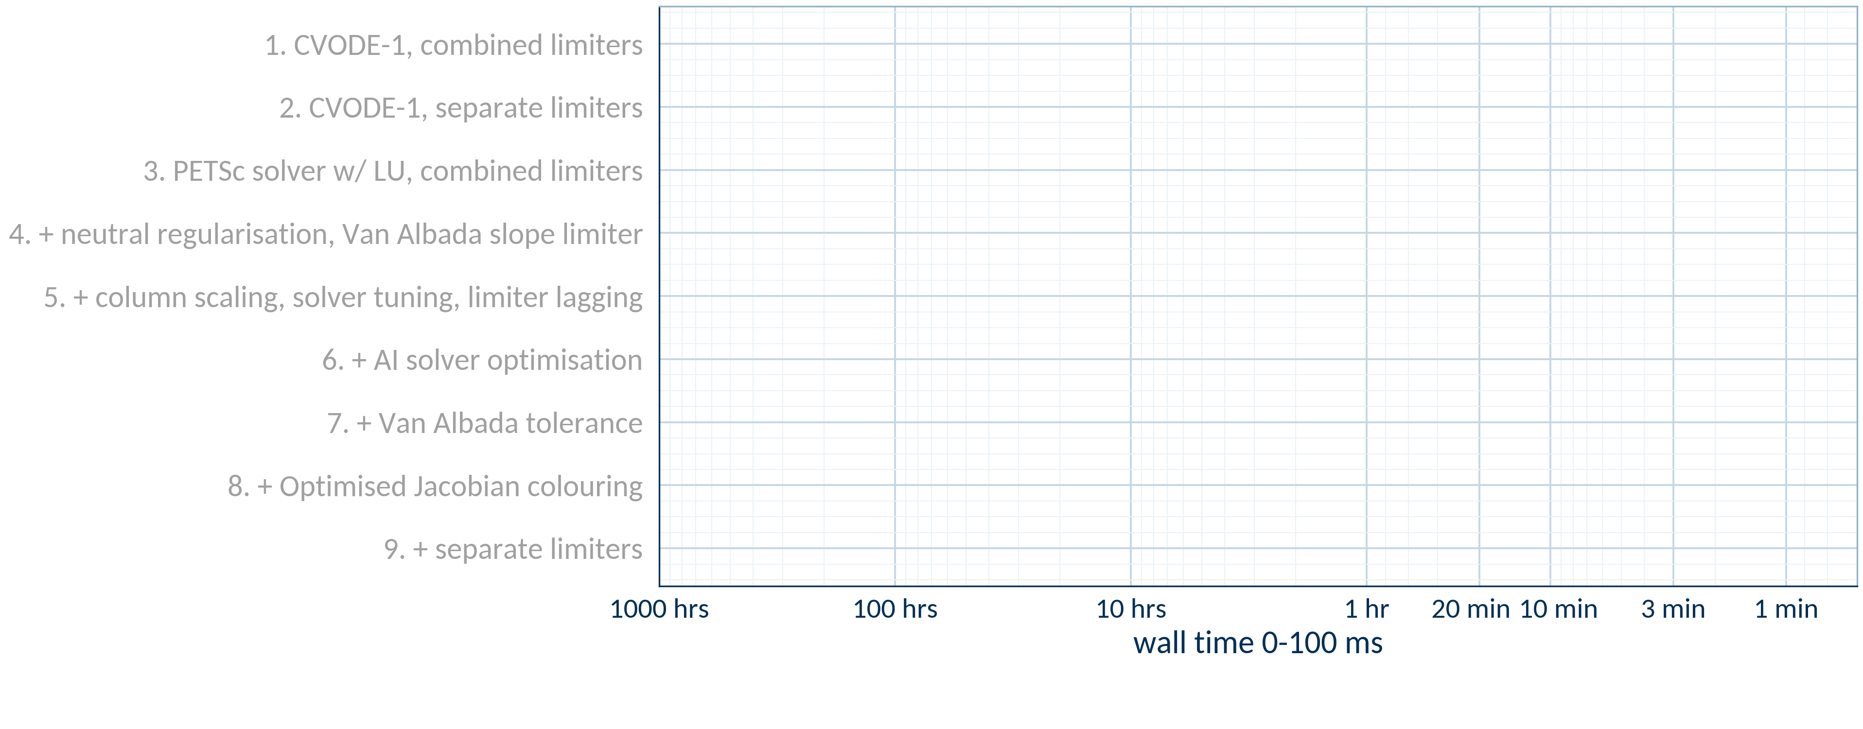
The performance journey…
Tests from scratch, 0-100ms, flat initialisation, 10 cores (MPI)

Slide 7
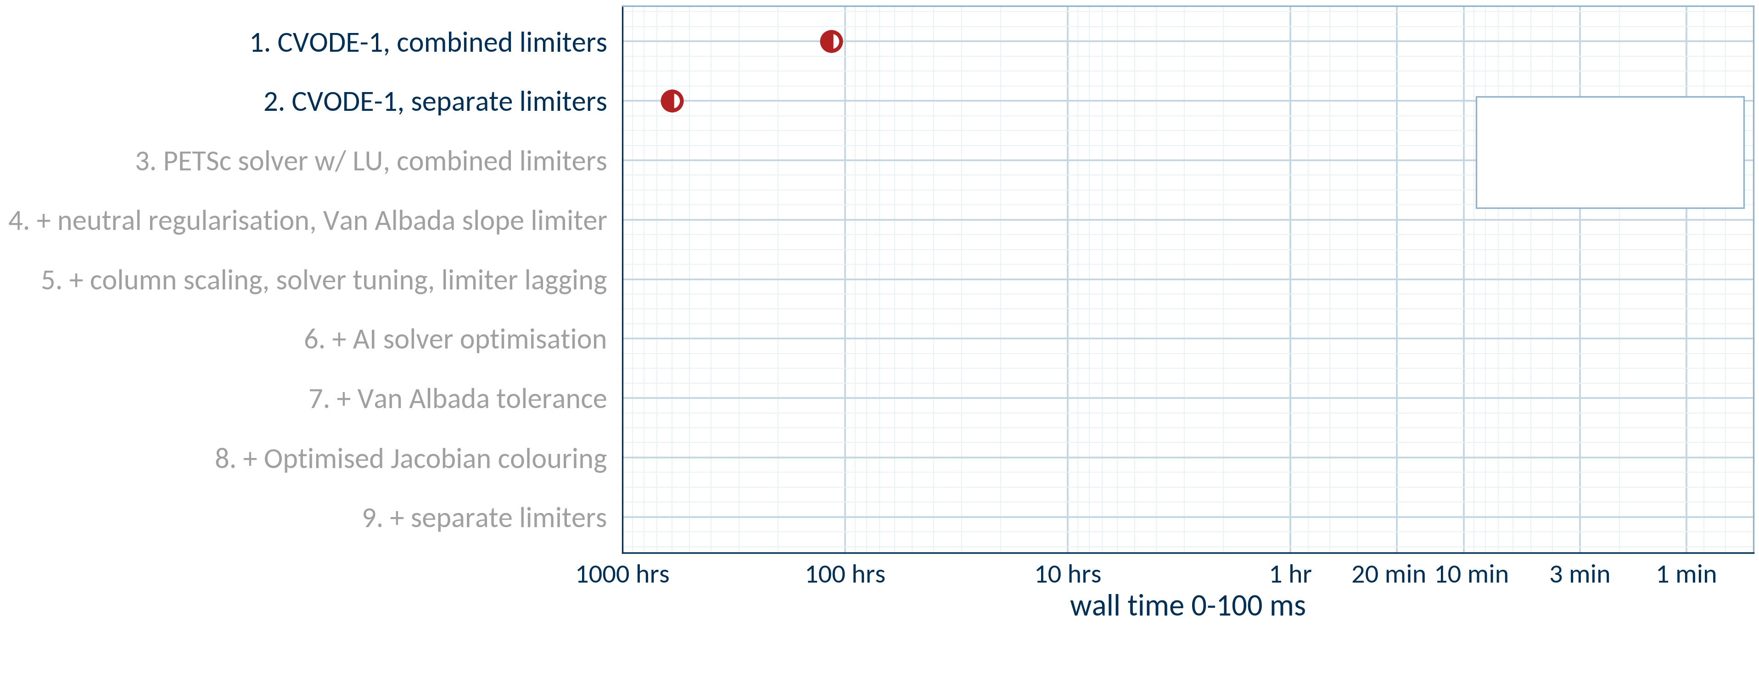
The performance journey…
Tests from scratch, 0-100ms, flat initialisation, 10 cores (MPI)
Full-resolution ST40
40x100 grid, flux limiter = 0.2
~600
hrs
●
measured
◐
extrapolated
Notes:
This is a hero slide: full run test 4 and test 5 performance, counting all improvements chronologically. We need:
CVODE-1 with combined limiters
CVODE-1 with separate limiters (unregularized)
SNES-MUMPS-1 with separate limiters
SNES-MUMPS-1 with separate limiters, regularisation
+ Van Albada
+ lagging of the limiter gradient
+ SNES-MUMPS-3
+ Jacobian colouring optimisation
+ Van Albada tolerance (Test5-failures)
For the slowest cases like the earliest ones, we may have to estimate due to time constraints.
This needs to be one big plot filling the entire slide. Y axis will be discrete and describe each change, newest/fastest at the top. X axis will be continuous and give average time to 100ms plasma time from scratch.

Slide 8
The performance journey…
Tests from scratch, 0-100ms, flat initialisation, 10 cores (MPI)
Many causes investigated:
Flooring/positivity issues
Operator bugs
Solver settings
Grid quality
Obscure numerical modes
Boundary conditions
All hit a roadblock until recent months!
~600
hrs
●
measured
◐
extrapolated
Notes:
This is a hero slide: full run test 4 and test 5 performance, counting all improvements chronologically. We need:
CVODE-1 with combined limiters
CVODE-1 with separate limiters (unregularized)
SNES-MUMPS-1 with separate limiters
SNES-MUMPS-1 with separate limiters, regularisation
+ Van Albada
+ lagging of the limiter gradient
+ SNES-MUMPS-3
+ Jacobian colouring optimisation
+ Van Albada tolerance (Test5-failures)
For the slowest cases like the earliest ones, we may have to estimate due to time constraints.
This needs to be one big plot filling the entire slide. Y axis will be discrete and describe each change, newest/fastest at the top. X axis will be continuous and give average time to 100ms plasma time from scratch.

Slide 9
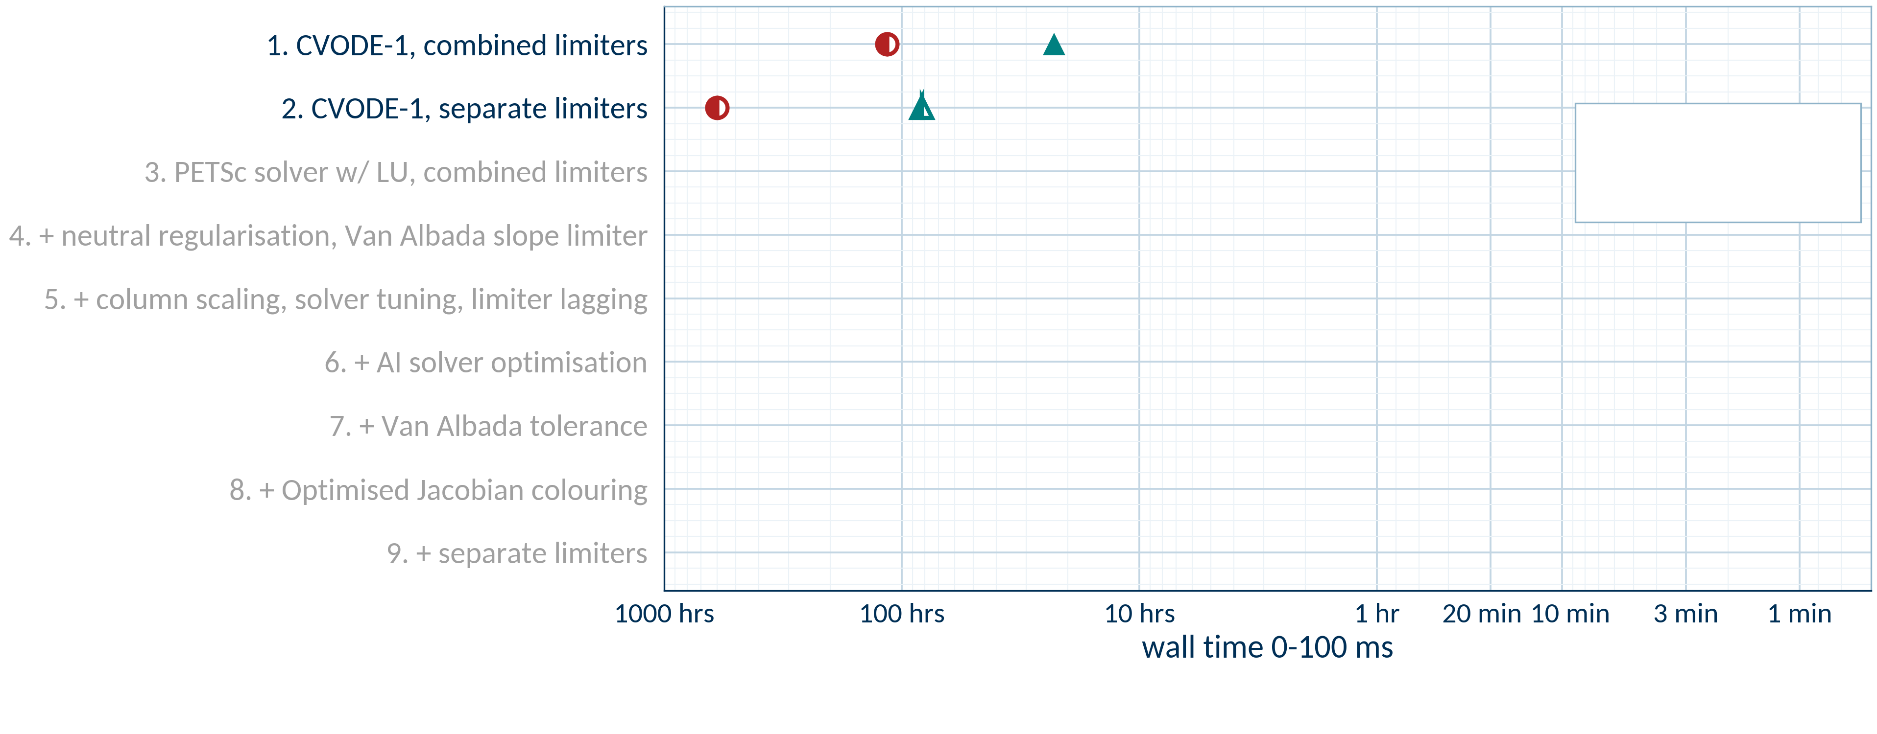
Testing at low resolution is more tractable
Low-resolution ST40
20x50 grid, flux limiter = 1.0
~600
hrs
~82
hrs
●
measured
◐
extrapolated
●
ST40, 40x100, flux limiter = 0.2
▲
ST40, 20x50, flux limiter = 1.0
Notes:
This is a hero slide: full run test 4 and test 5 performance, counting all improvements chronologically. We need:
CVODE-1 with combined limiters
CVODE-1 with separate limiters (unregularized)
SNES-MUMPS-1 with separate limiters
SNES-MUMPS-1 with separate limiters, regularisation
+ Van Albada
+ lagging of the limiter gradient
+ SNES-MUMPS-3
+ Jacobian colouring optimisation
+ Van Albada tolerance (Test5-failures)
For the slowest cases like the earliest ones, we may have to estimate due to time constraints.
This needs to be one big plot filling the entire slide. Y axis will be discrete and describe each change, newest/fastest at the top. X axis will be continuous and give average time to 100ms plasma time from scratch.

Slide 10


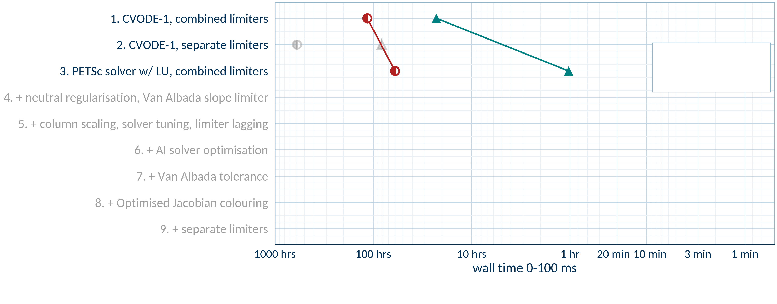
First breakthrough: full algebraic preconditioning using PETSc
Scheme: Backward Euler
Preconditioning: LU (MUMPS)
Timestep: adaptive
Collaboration with:
STFC team: H. Al Daas, A. Pillai, A. Sunderland, J. Castagna
●
measured
◐
extrapolated
~60
hrs
1
hr
●
ST40, 40x100, flux limiter = 0.2
▲
ST40, 20x50, flux limiter = 1.0
Notes:
This is a hero slide: full run test 4 and test 5 performance, counting all improvements chronologically. We need:
CVODE-1 with combined limiters
CVODE-1 with separate limiters (unregularized)
SNES-MUMPS-1 with separate limiters
SNES-MUMPS-1 with separate limiters, regularisation
+ Van Albada
+ lagging of the limiter gradient
+ SNES-MUMPS-3
+ Jacobian colouring optimisation
+ Van Albada tolerance (Test5-failures)
For the slowest cases like the earliest ones, we may have to estimate due to time constraints.
This needs to be one big plot filling the entire slide. Y axis will be discrete and describe each change, newest/fastest at the top. X axis will be continuous and give average time to 100ms plasma time from scratch.

Slide 11
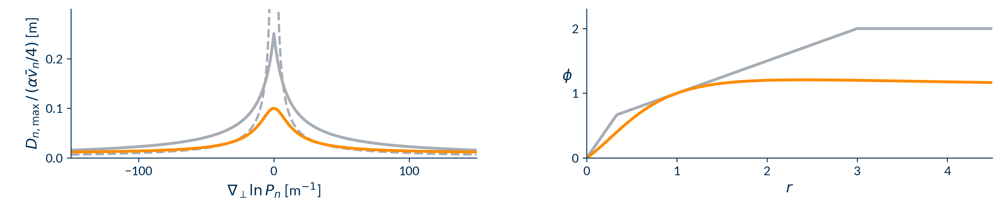

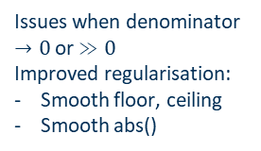
Reducing non-differentiability
#1 Neutral perp flux limiter: improve regularisation
#2: Slope limiter: switch to differentiable form
Kink
master
Monotonised Central (MC)
no regularisation
this work
Kink
Van Albada 1 (VA)
Slope limiters make advection more upwind when gradients change fast
Switch to Van Albada slope limiter:
Fully differentiable
More diffusive
$$D_{n,max}=\frac{α{\overline{v}}_{n}/4}{\left|∇_{⊥}lnP_{n}\right|}$$
Issues when denominator $→0$ or $≫0$
Improved regularisation:
Smooth floor, ceiling
Smooth abs()
More robust
More robust, faster
Prevents a lot of crashes
More accurate than previous approach
Similar or faster performance
Significant reduction in solver failures
More consistent, robust performance
Low-res ST40, flux limit α = 0.2–1.0, from scratch to 123.5 ms, one run per point. Scans: appendix.
Notes:
- Brief intro to slope limiters
Show why MC is non-differentiable and how Van Albada is
Scan comparison showing MC vs VA on shipped default regularisation – both physics results, wall time and wall time variability

Slide 12
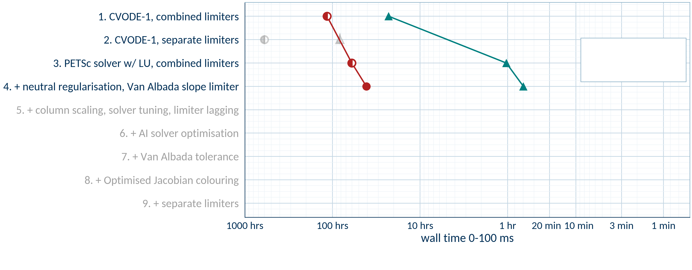
Reducing non-differentiability
●
measured
◐
extrapolated
41
hrs
40
min
●
ST40, 40x100, flux limiter = 0.2
▲
ST40, 20x50, flux limiter = 1.0

Slide 13
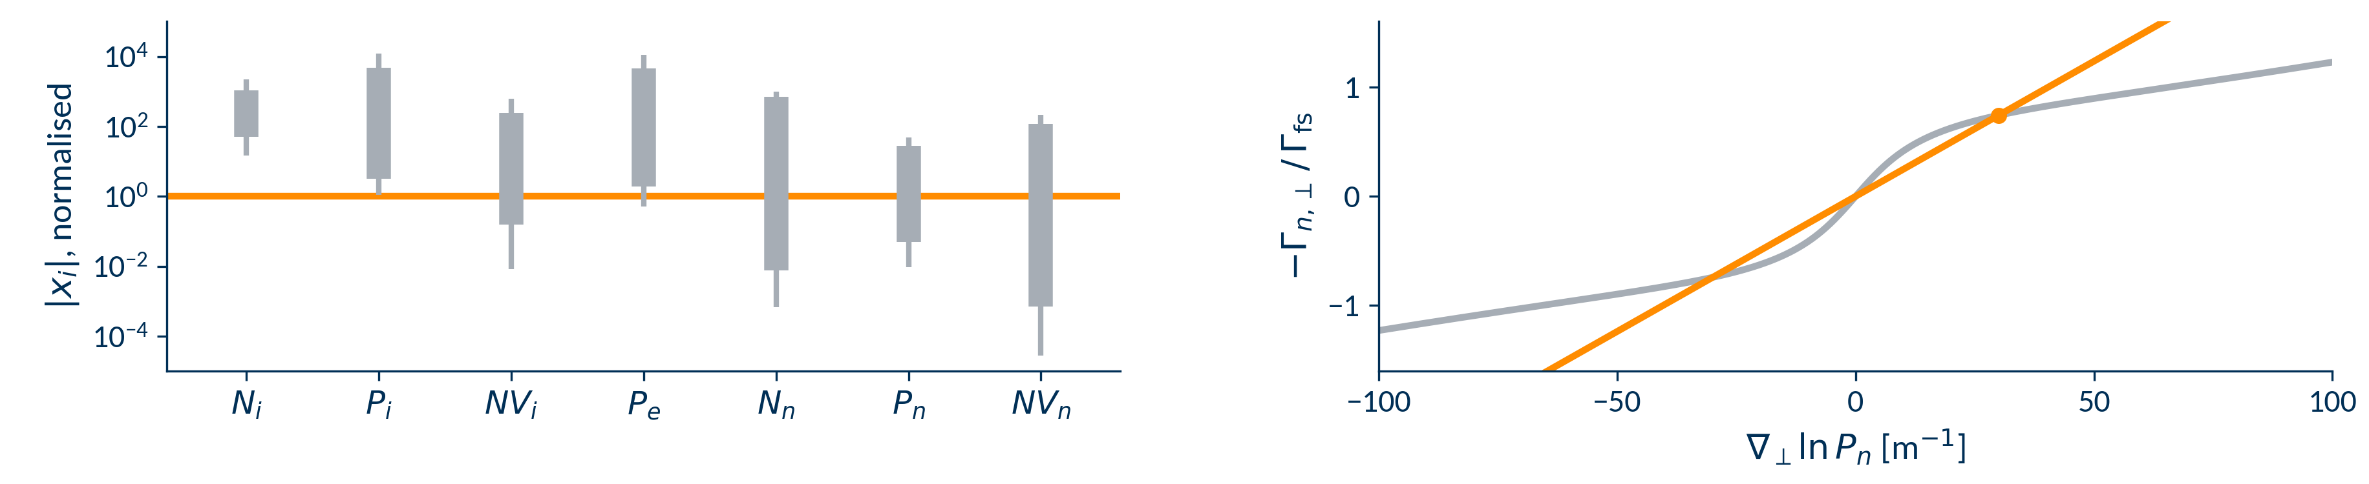





Column scaling and limiter lagging
#4: Neutral perp flux limiter:
Lag evaluation of $∇_{⊥}lnP_{n}$
#3: PETSc SNES solver
Column (variable) scaling
lagged $∝∇_{⊥}lnP_{n}$
after scaling
unlagged
$$Γ_{n,⊥}=−Γ_{fs} \frac{g}{1/L+R\left(g\right)}$$
with $g=∇_{⊥}lnP_{n}$, $Γ_{fs}=αN_{n}{\overline{v}}_{n}/4$
and $L=4D_{n,unlim}/\left(α{\overline{v}}_{n}\right)$
Periodically renormalise matrix passed to solver:
$${\hat{x}}_{i}=x_{i} / s_{i}, s_{i}=max\left(\left|x_{i}\right|, rtol\right)$$
Freeze gradient in denominator during linear/nonlinear iterations
~20x speedup
~20x speedup
ST40 to 100 ms (C. MacMackin, poster)
Speedup reduced when solver optimised
Left: low-res ST40 state at 100 ms. Right: low-res ST40, α = 0.2–1.0, solver without variable scaling, to 123.5 ms.
Notes:
Here we introduce the scale_vars work (SNES-MUMPS-3) and show that it can lead to significant speedups, but also say how it can lead to lagging causing issues
Note that this is C. MacMackin’s work

Slide 14
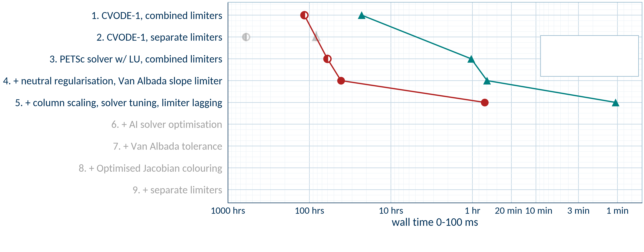
Column scaling and limiter lagging
Note: lagging and column scaling are not commutative – with a highly tuned solver, lagging can reduce performance.
●
measured
◐
extrapolated
42
min
63
sec
●
ST40, 40x100, flux limiter = 0.2
▲
ST40, 20x50, flux limiter = 1.0

Slide 15

Can we optimise solver settings with AI?
Problem
Idea
“Best” solver settings are a moving target
Solver tuning is tedious
Semi-autonomous exploration
re-run as the code changes
SNES solver has 865 parameters:
Intelligent search
With human help (initially)
binary
237
discrete
371
continuous
223
string
34
Black-box optimisation techniques not good at teaching
Interpretable, durable knowledge
Make lots of reports and talk to them
Developed during a hackathon with
Notes:
Philosophy of AI use: must be interpretable, I must learn to be a numerics expert, use it for exploration and then we do development/code use ourselves, etc.
Application: Hermes-solver-opt. Make simple flowchart to show how it works.
Slide must communicate that we are using AI responsibly and not as a black box, and that these are explorations to build on.
It must also show how much work we’ve put into all the skills, rules, guards, durable knowledge formats, beads etc.
Assume audience don’t know much about AI and may not trust it.
Include bit about hackathon trip to Google/google deepmind with their logo.

Slide 16
Agentic solver tuning framework
1 Study plan
2 Performance tests
3 Physics / performance check
4 Report
researcher
agent
researcher
0.1 ms
1 ms
100 ms
agent
researcher
✓
✗
AI
AI
AI
AI
AI
Many cheap short runs,
then full 0–100 ms run
Make sure steady-state answer unchanged
AI
AI
AI
adversarial agents
adversarial agents
iterate until reasonable plan, use findings to improve framework
Deterministic
Deterministic
Iterate until all is clear, use findings to improve framework
next study
The framework
Instructions
Skills
Guards
Knowledge store
3 files, 63 rules
10 skills, 1,550 lines
Runs, builds, overnight work
General agent behaviour control
How to run, analyse, report
Rules enforced by deterministic scripts
1,169 runs
33 claims
215 tasks
Developed during a hackathon with
Notes:
Philosophy of AI use: must be interpretable, I must learn to be a numerics expert, use it for exploration and then we do development/code use ourselves, etc.
Application: Hermes-solver-opt. Make simple flowchart to show how it works.
Slide must communicate that we are using AI responsibly and not as a black box, and that these are explorations to build on.
It must also show how much work we’ve put into all the skills, rules, guards, durable knowledge formats, beads etc.
Assume audience don’t know much about AI and may not trust it.
Include bit about hackathon trip to Google/google deepmind with their logo.

Slide 17

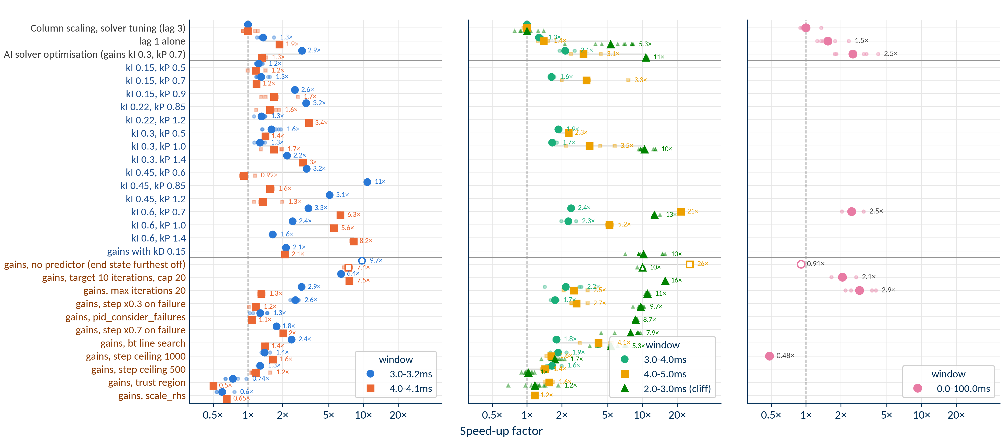
Example results of an overnight study (~700 runs)
Rung 0 (~0.1ms)
Rung 1 (1ms)
Rung 2 (100ms)
2.9x speedup across 5 repeats
1 ms
Notes:
Results of solver-opt S03, the wall time plot with the three rungs

Slide 18
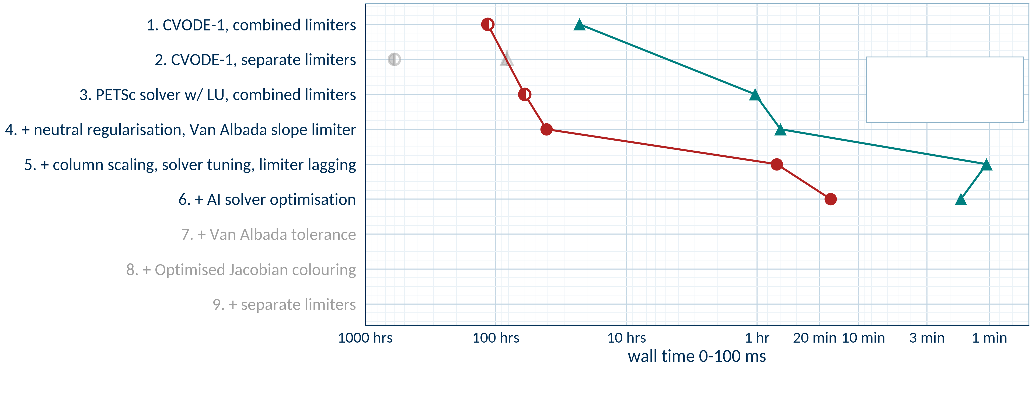
Solver tuning impact
●
measured
◐
extrapolated
16
min
99
sec
●
ST40, 40x100, flux limiter = 0.2
▲
ST40, 20x50, flux limiter = 1.0

Slide 19
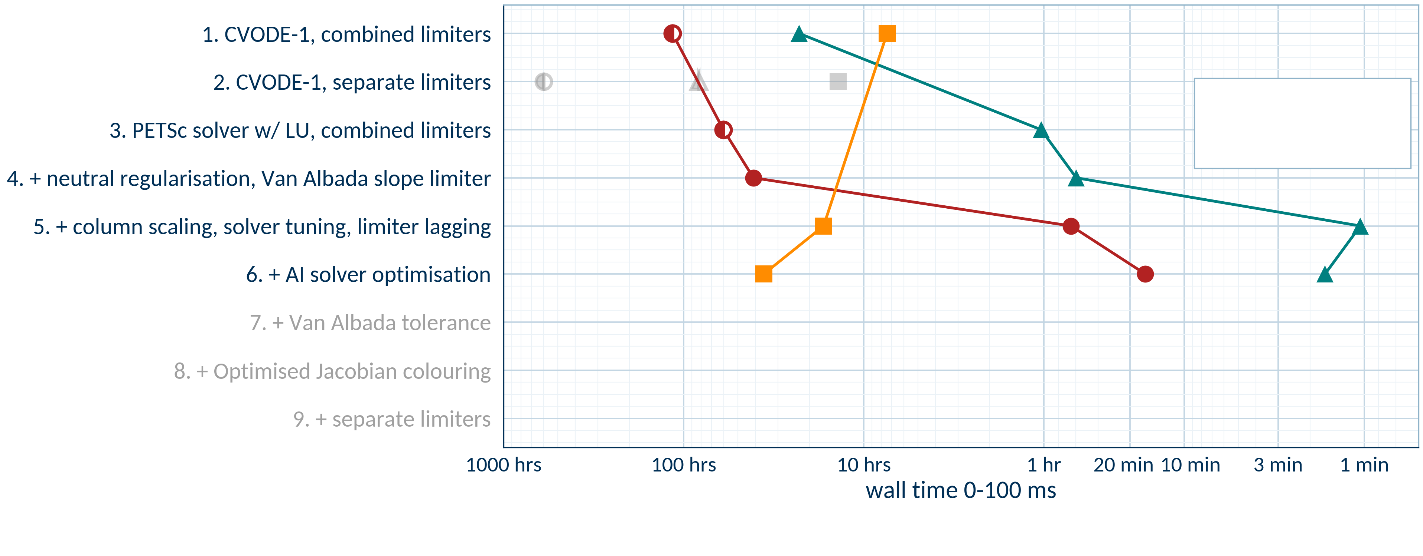
MAST-U performance gets worse!
●
measured
◐
extrapolated
36
hrs
16
min
99
sec
●
ST40, 40x100, flux limiter = 0.2
▲
ST40, 20x50, flux limiter = 1.0
■
MAST-U, 20x100, flux limiter = 1.0
Notes:
This is a hero slide: full run test 4 and test 5 performance, counting all improvements chronologically. We need:
CVODE-1 with combined limiters
CVODE-1 with separate limiters (unregularized)
SNES-MUMPS-1 with separate limiters
SNES-MUMPS-1 with separate limiters, regularisation
+ Van Albada
+ lagging of the limiter gradient
+ SNES-MUMPS-3
+ Jacobian colouring optimisation
+ Van Albada tolerance (Test5-failures)
For the slowest cases like the earliest ones, we may have to estimate due to time constraints.
This needs to be one big plot filling the entire slide. Y axis will be discrete and describe each change, newest/fastest at the top. X axis will be continuous and give average time to 100ms plasma time from scratch.

Slide 20

Can an agentic workflow investigate MAST-U performance?
1 Study plan
2 Edit code
3 Run & analyse
4 Report
agent
researcher
agent
researcher
AI
own branch
no push
AI
run
analyse
AI
AI
AI
AI
AI
AI
adversarial agents
upstream
adversarial agents
overnight, inside
agreed bounds
iterate until plan is reasonable
Local clone
Pushing disabled
iterate until all is clear
next study
Same framework
instructions
skills
guards
knowledge store
Pull request
Humans:
Use AI code as example
Implement separately
Notes:
This is now a flowchart of how the dev campaigns work

Slide 21
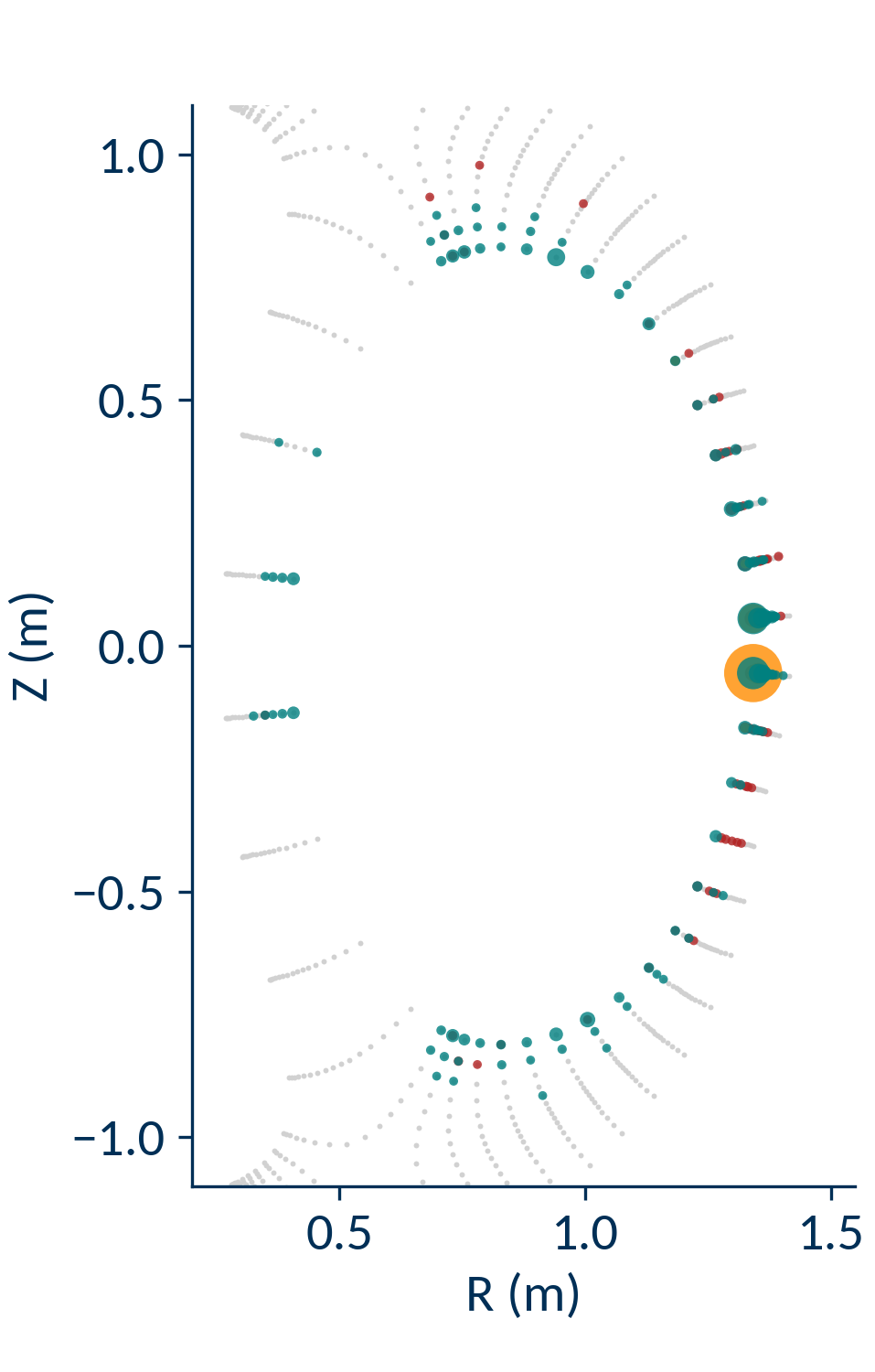
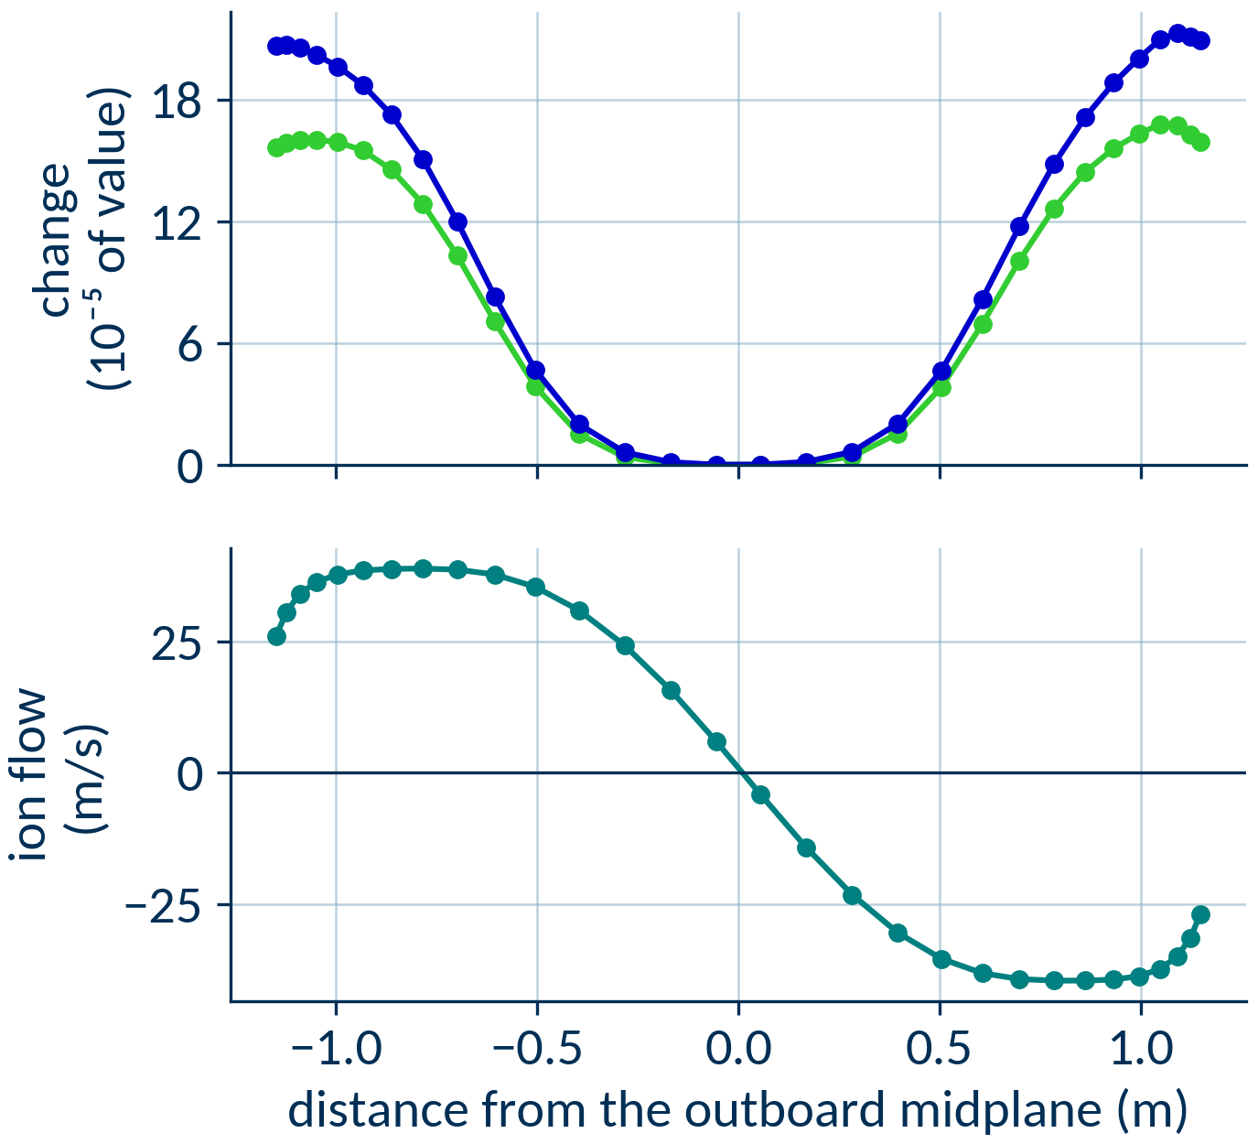
Overnight investigation
New solver failure diagnostics found failure hotspot: OMP
Pressure and density gradients extremely flat
● ion density
● ion pressure
● ion momentum
● neutral momentum
● other equations
Where failed solves start, 0–1 ms
Notes:
Problem: MAST-U is very slow
This is due to solver failures, so we investigated what caused them
Please show figure of failure locations from the test5-failures report as well as the gradients at midplane
Please mention what diagnostics were already available for this and what diagnostics were added
Say how the issue was isolated to the ion momentum equation in low gradient regions

Slide 22
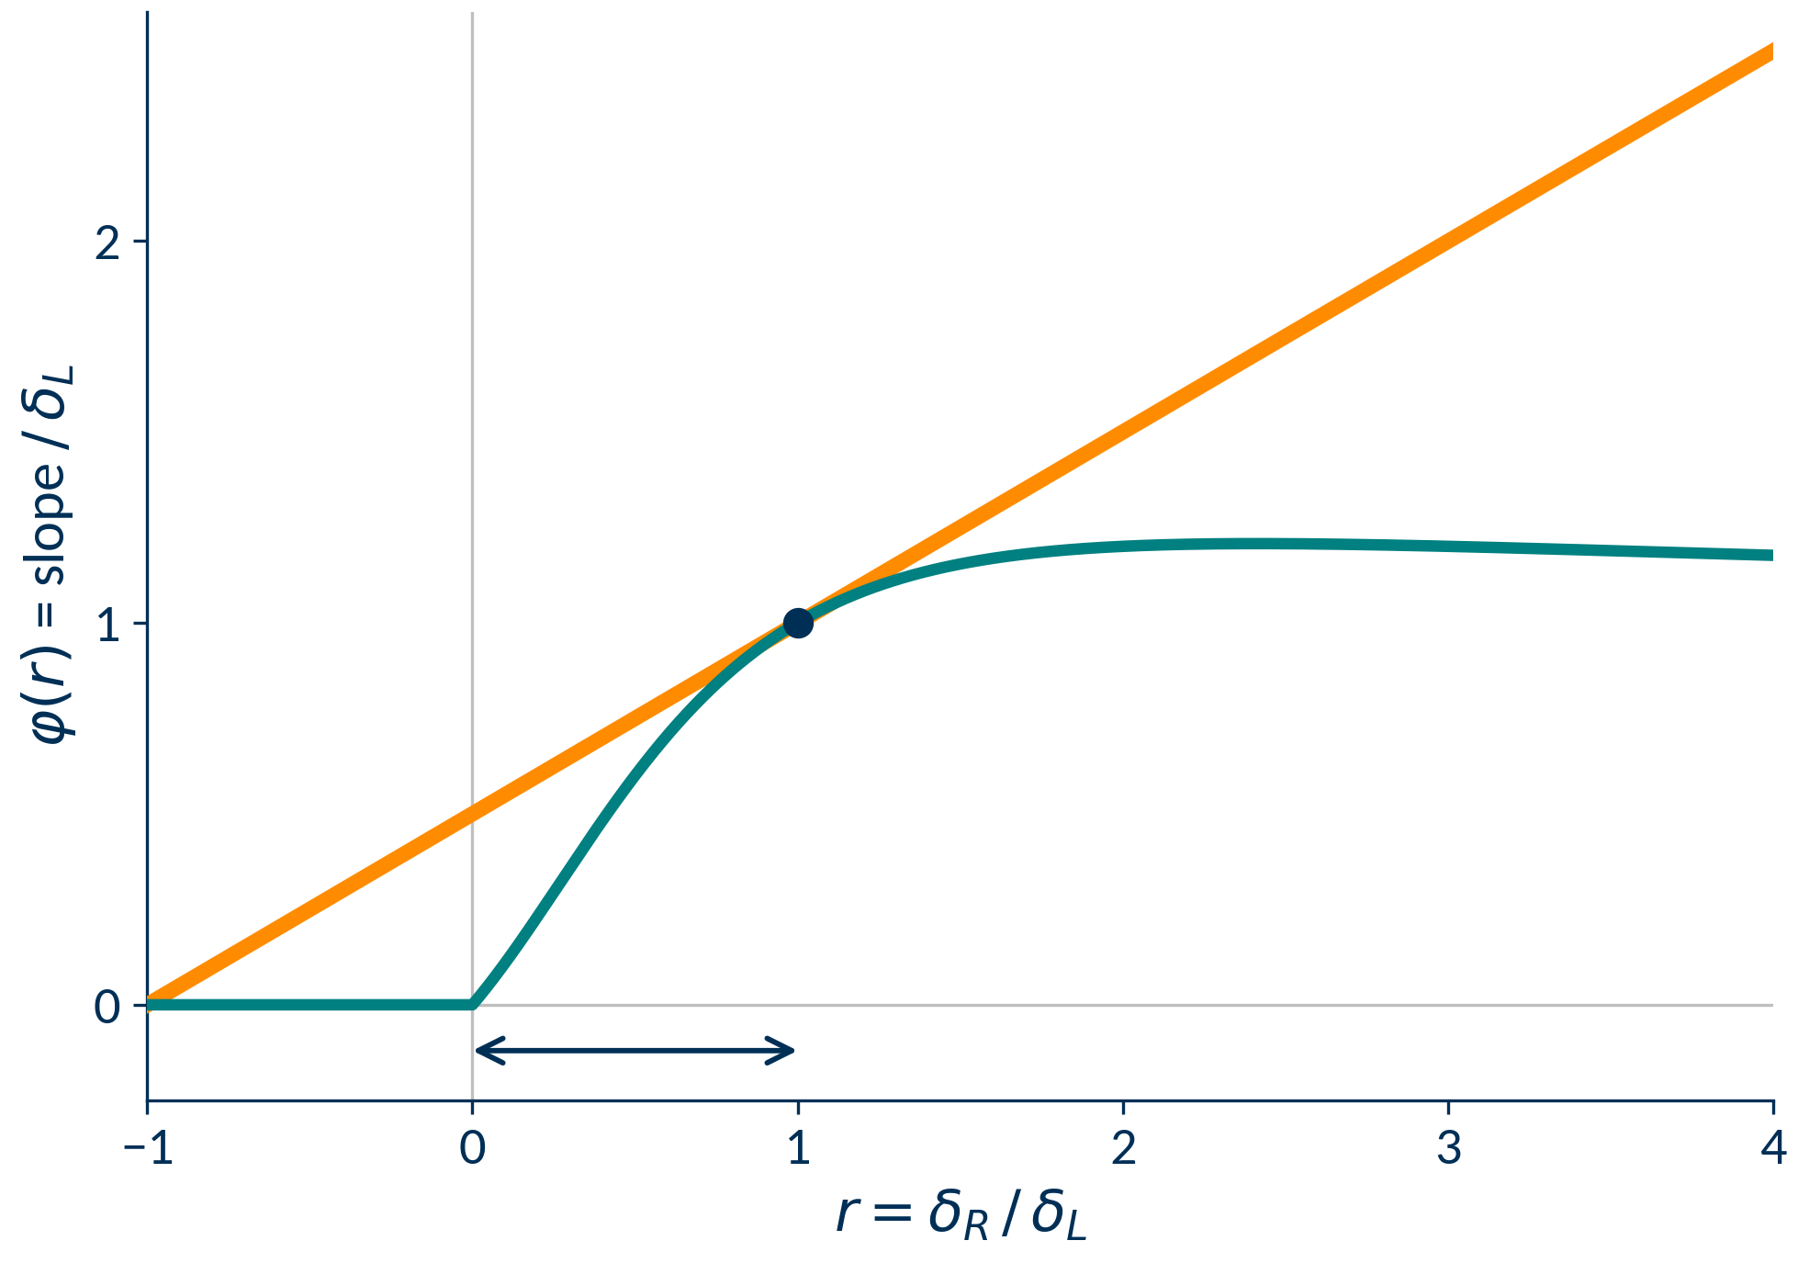
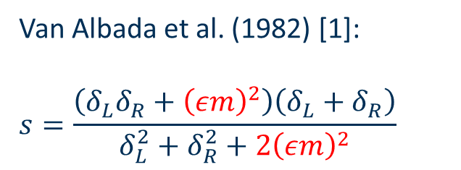
Solution found: slope limiter tolerance
Cell differences much smaller than Newton step -> noise leading to reconstruction chatter
Solution: smoothly disable limiter for small differences
with ε: central difference
van Albada (as run)
Van Albada et al. (1982) [1]:
$$s=\frac{\left(δ_{L}δ_{R}+{\left(εm\right)}^{2}\right)\left(δ_{L}+δ_{R}\right)}{δ_{L}^{2}+δ_{R}^{2}+2{\left(εm\right)}^{2}}$$
Slope limiter reconstruction chatter
[1] G. D. van Albada, B. van Leer and W. W. Roberts, Astron. Astrophys. 108, 76–84 (1982), eq. 37

Slide 23
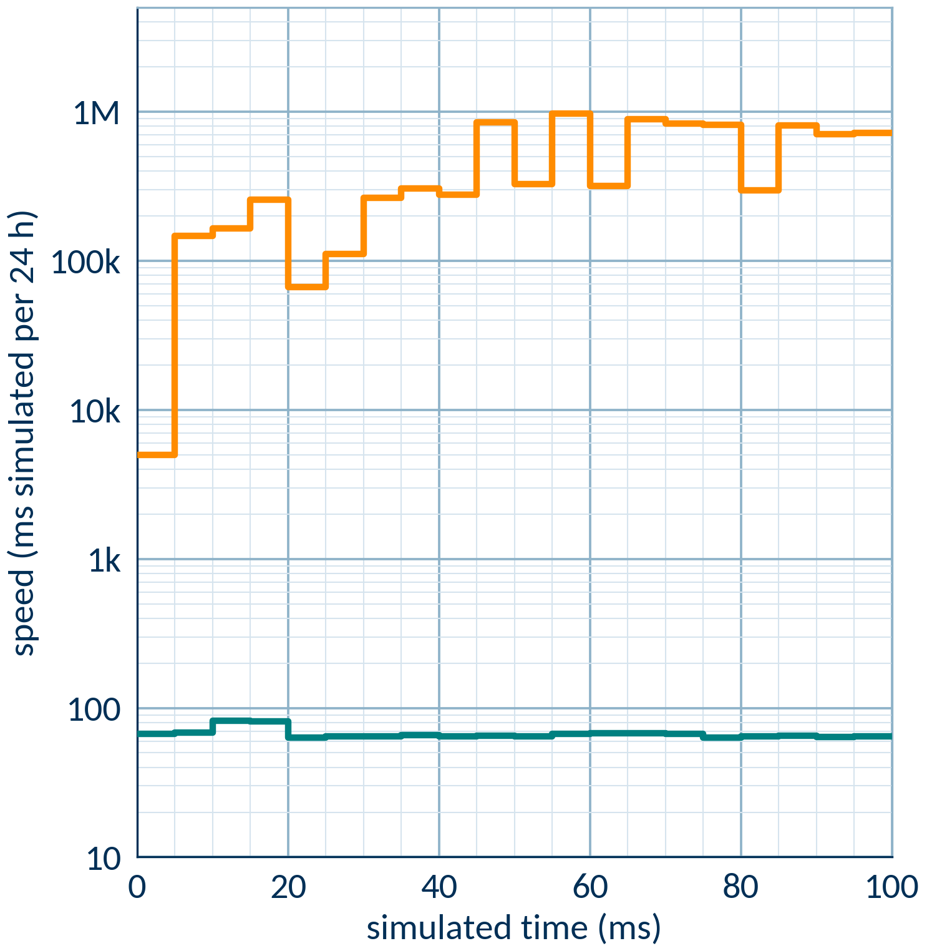
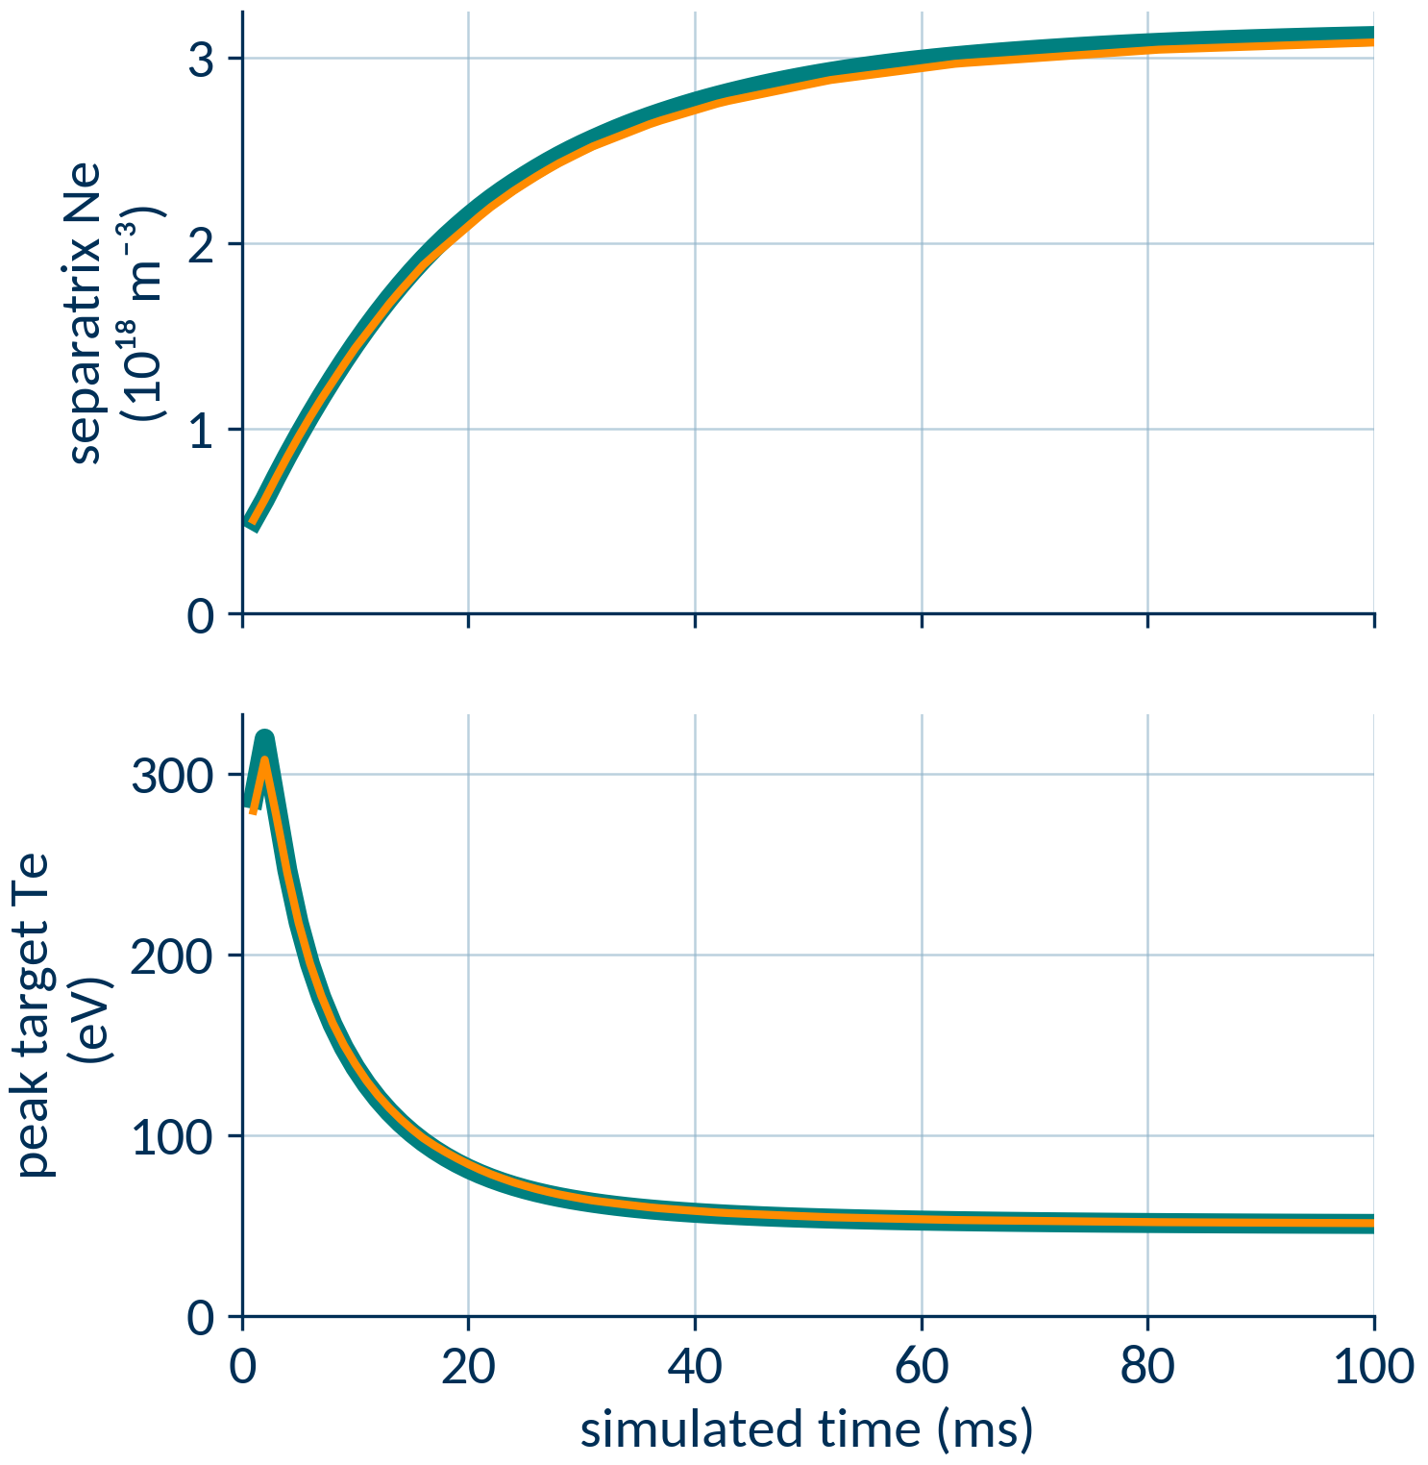
Results
Huge speedup!
Answer unchanged
Slope limiter fix: 121 s (!!)
Baseline: ~36 h
Notes:
Background: ST40 is now very fast, but MAST-U is still extremely slow
First serious test of autonomous Hermes-3 optimisation/development workflow (test5-failures)
Found that the Van Albada limiter was implemented without a crucial term from the original paper, causing a large sensitivity in flat gradients
Performance results: extreme speedup on MAST-U

Slide 24
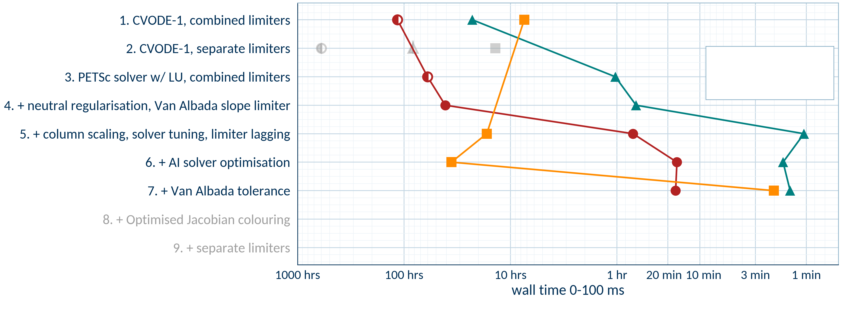
Impact of slope limiter tolerance
●
measured
◐
extrapolated
17
min
121
sec
85
sec
●
ST40, 40x100, flux limiter = 0.2
▲
ST40, 20x50, flux limiter = 1.0
■
MAST-U, 20x100, flux limiter = 1.0

Slide 25
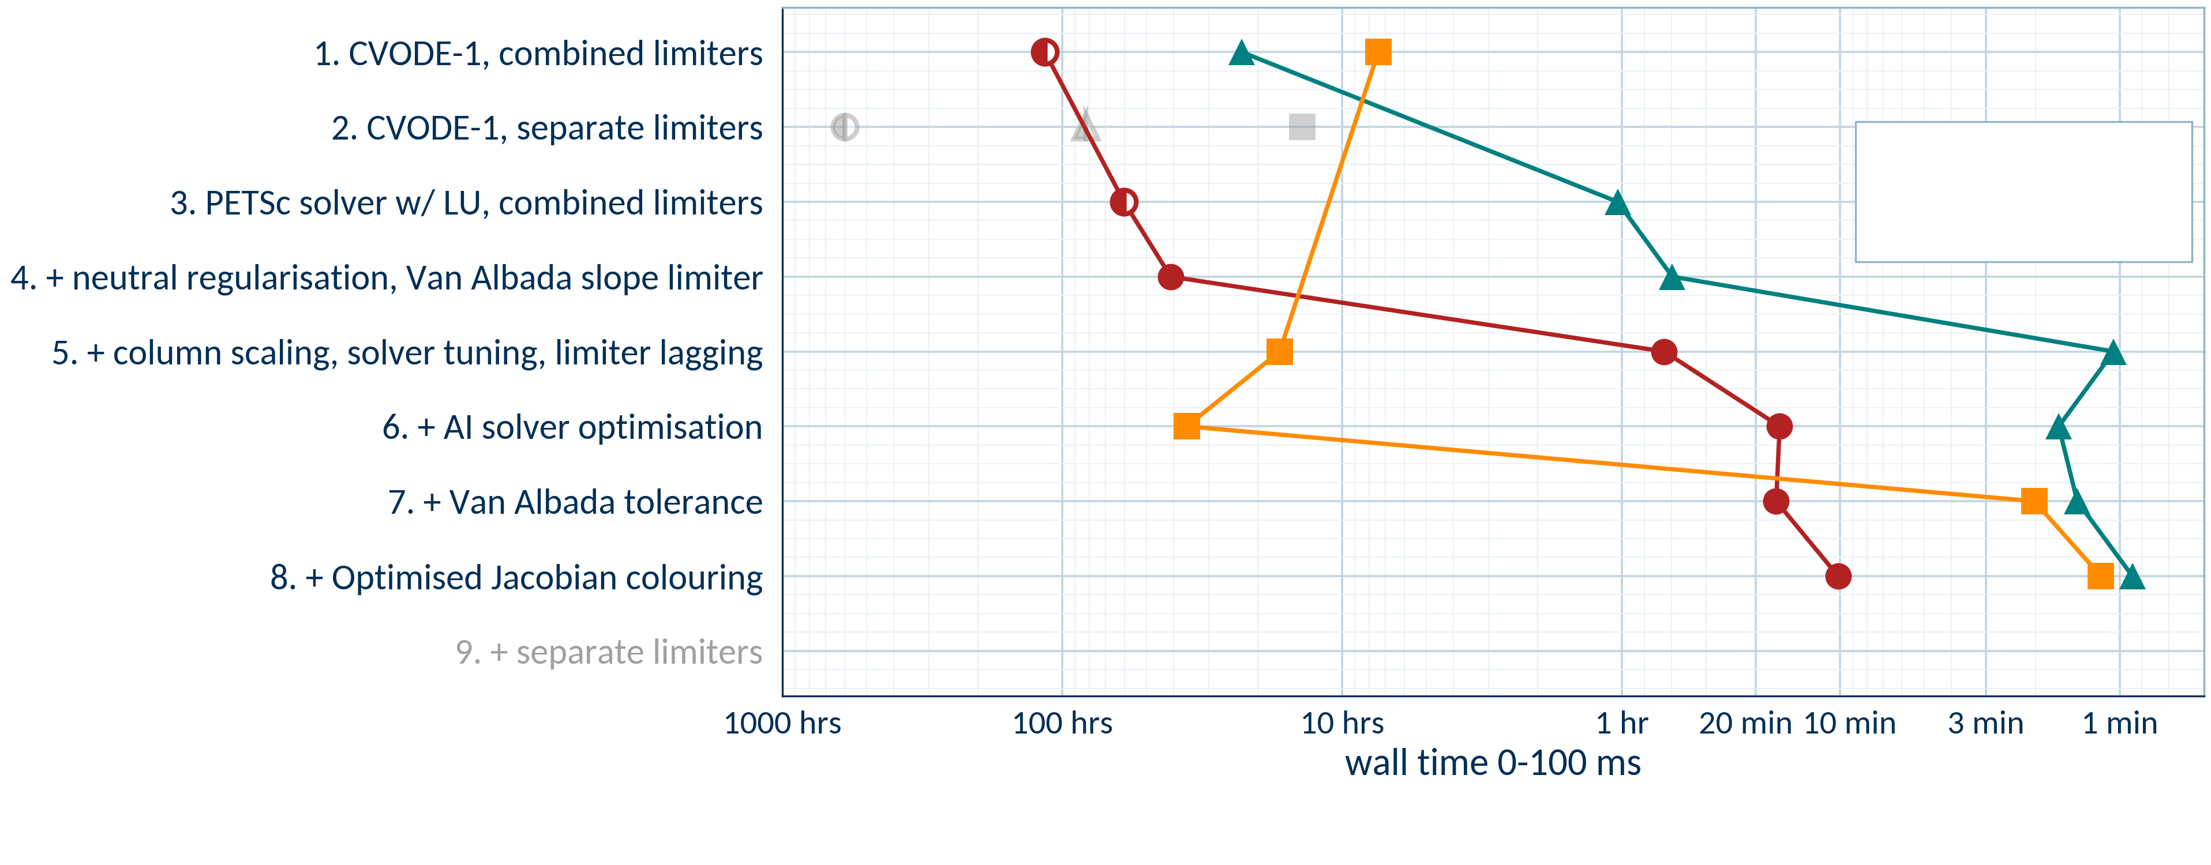
In appendix: Jacobian pattern optimisation
●
measured
◐
extrapolated
10
min
70
sec
54
sec
●
ST40, 40x100, flux limiter = 0.2
▲
ST40, 20x50, flux limiter = 1.0
■
MAST-U, 20x100, flux limiter = 1.0
Notes:
This is a hero slide: full run test 4 and test 5 performance, counting all improvements chronologically. We need:
CVODE-1 with combined limiters
CVODE-1 with separate limiters (unregularized)
SNES-MUMPS-1 with separate limiters
SNES-MUMPS-1 with separate limiters, regularisation
+ Van Albada
+ lagging of the limiter gradient
+ SNES-MUMPS-3
+ Jacobian colouring optimisation
+ Van Albada tolerance (Test5-failures)
For the slowest cases like the earliest ones, we may have to estimate due to time constraints.
This needs to be one big plot filling the entire slide. Y axis will be discrete and describe each change, newest/fastest at the top. X axis will be continuous and give average time to 100ms plasma time from scratch.

Slide 26
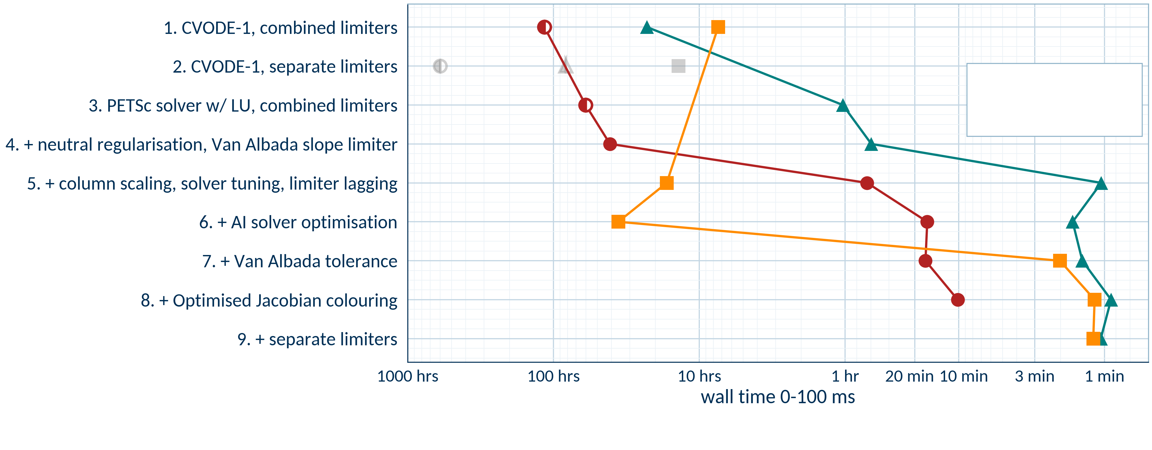
Finally, trying separate limiters again…
Performance solved apart from ST40 high resolution – see appendix.
●
measured
◐
extrapolated
10
min
72
sec
64
sec
●
ST40, 40x100, flux limiter = 0.2
▲
ST40, 20x50, flux limiter = 1.0
■
MAST-U, 20x100, flux limiter = 1.0
Notes:
This is a hero slide: full run test 4 and test 5 performance, counting all improvements chronologically. We need:
CVODE-1 with combined limiters
CVODE-1 with separate limiters (unregularized)
SNES-MUMPS-1 with separate limiters
SNES-MUMPS-1 with separate limiters, regularisation
+ Van Albada
+ lagging of the limiter gradient
+ SNES-MUMPS-3
+ Jacobian colouring optimisation
+ Van Albada tolerance (Test5-failures)
For the slowest cases like the earliest ones, we may have to estimate due to time constraints.
This needs to be one big plot filling the entire slide. Y axis will be discrete and describe each change, newest/fastest at the top. X axis will be continuous and give average time to 100ms plasma time from scratch.

Slide 27
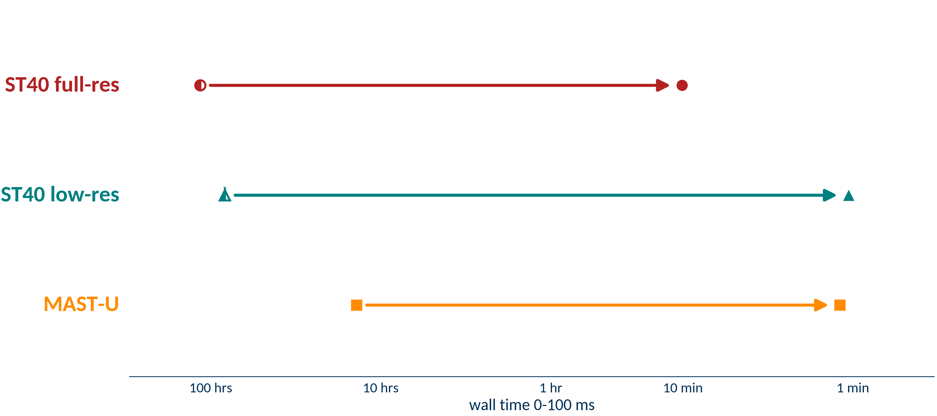
Overall speedup summary
Tests from scratch, 0-100ms, from flat profiles
~680× faster
~115 h
10 min
CVODE-1, combined limiters
all fixes, combined limiters
~4,700× faster
~82 h
1 min
CVODE-1, separate limiters
all fixes, separate limiters
700× faster
14 h
1 min
CVODE-1, separate limiters
all fixes, separate limiters
Notes:
This is a hero slide: full run test 4 and test 5 performance, counting all improvements chronologically. We need:
CVODE-1 with combined limiters
CVODE-1 with separate limiters (unregularized)
SNES-MUMPS-1 with separate limiters
SNES-MUMPS-1 with separate limiters, regularisation
+ Van Albada
+ lagging of the limiter gradient
+ SNES-MUMPS-3
+ Jacobian colouring optimisation
+ Van Albada tolerance (Test5-failures)
For the slowest cases like the earliest ones, we may have to estimate due to time constraints.
This needs to be one big plot filling the entire slide. Y axis will be discrete and describe each change, newest/fastest at the top. X axis will be continuous and give average time to 100ms plasma time from scratch.

Slide 28
Caveats
These cases are:
  Low fidelity (one main ion, no currents, no drifts)
  Small machines (MAST-U, ST40)
Performance gains not always transferable
  Most in this talk are not applicable to 3D turbulence
  More testing is required – different conditions, machines
Status: all PRs on Hermes-3 Github apart from slope limiter tolerance and Jacobian colouring pattern optimisation
Notes:
This is a hero slide: full run test 4 and test 5 performance, counting all improvements chronologically. We need:
CVODE-1 with combined limiters
CVODE-1 with separate limiters (unregularized)
SNES-MUMPS-1 with separate limiters
SNES-MUMPS-1 with separate limiters, regularisation
+ Van Albada
+ lagging of the limiter gradient
+ SNES-MUMPS-3
+ Jacobian colouring optimisation
+ Van Albada tolerance (Test5-failures)
For the slowest cases like the earliest ones, we may have to estimate due to time constraints.
This needs to be one big plot filling the entire slide. Y axis will be discrete and describe each change, newest/fastest at the top. X axis will be continuous and give average time to 100ms plasma time from scratch.

Slide 29
Conclusions
Fully implicit codes can be very sensitive to discontinuities
When those are resolved, fully implicit codes can be very fast
With experience from the performance project and help from agentic workflows, issues can be resolved at an accelerated pace
Notes:
This is a hero slide: full run test 4 and test 5 performance, counting all improvements chronologically. We need:
CVODE-1 with combined limiters
CVODE-1 with separate limiters (unregularized)
SNES-MUMPS-1 with separate limiters
SNES-MUMPS-1 with separate limiters, regularisation
+ Van Albada
+ lagging of the limiter gradient
+ SNES-MUMPS-3
+ Jacobian colouring optimisation
+ Van Albada tolerance (Test5-failures)
For the slowest cases like the earliest ones, we may have to estimate due to time constraints.
This needs to be one big plot filling the entire slide. Y axis will be discrete and describe each change, newest/fastest at the top. X axis will be continuous and give average time to 100ms plasma time from scratch.

Slide 30
Hermes-3 – VANTAGE coupling

Slide 31


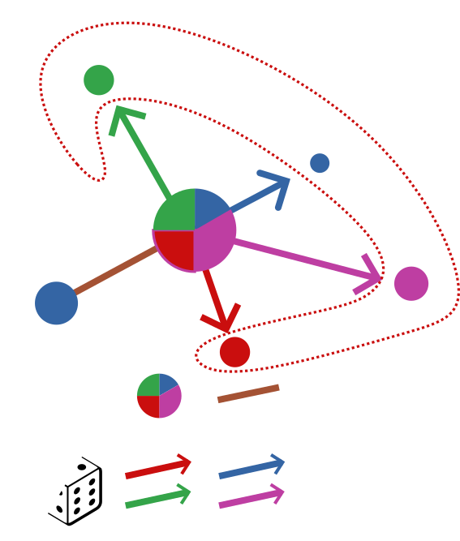
Introduction to VANTAGE
Kinetic neutral framework built on NESO-Particles
PIC/DSMC style particle scheme
Modern, scalable, GPU-native, performance-portable codebase
Key features already available:
  Atomic reactions
  Reflection and recycling/sources
  TRIM processes
  BGK collision models
  Particle population management
event-splitting and advection
event products/details
Notes:
Bits from Stefan’s talk
Benefits against EIRENE: performance-portable, DSMC capability, flexibility
Disadvantages: inherently less performant scheme for steady-state
Current capabilities

Slide 32
Initial implementation plan
Plasma
Neutrals
Initial objective: explicit coupling in 2D only
Hermes-3 and VANTAGE are both C++: linked and compiled together
    No need for separate interface
Anticipating to spend a lot of time on optimisation:
    Load balancing
    Linearisation schemes
Plasma iteration
Kinetic neutrals
Particle substeps
Plasma iteration
Linearised sources
Kinetic neutrals
Particle substeps
Plasma iteration
Linearised sources
⋮
Notes:
- Initial coupling scheme: explicit with linearisation
- Flowchart showing implementation plan and status

Slide 33
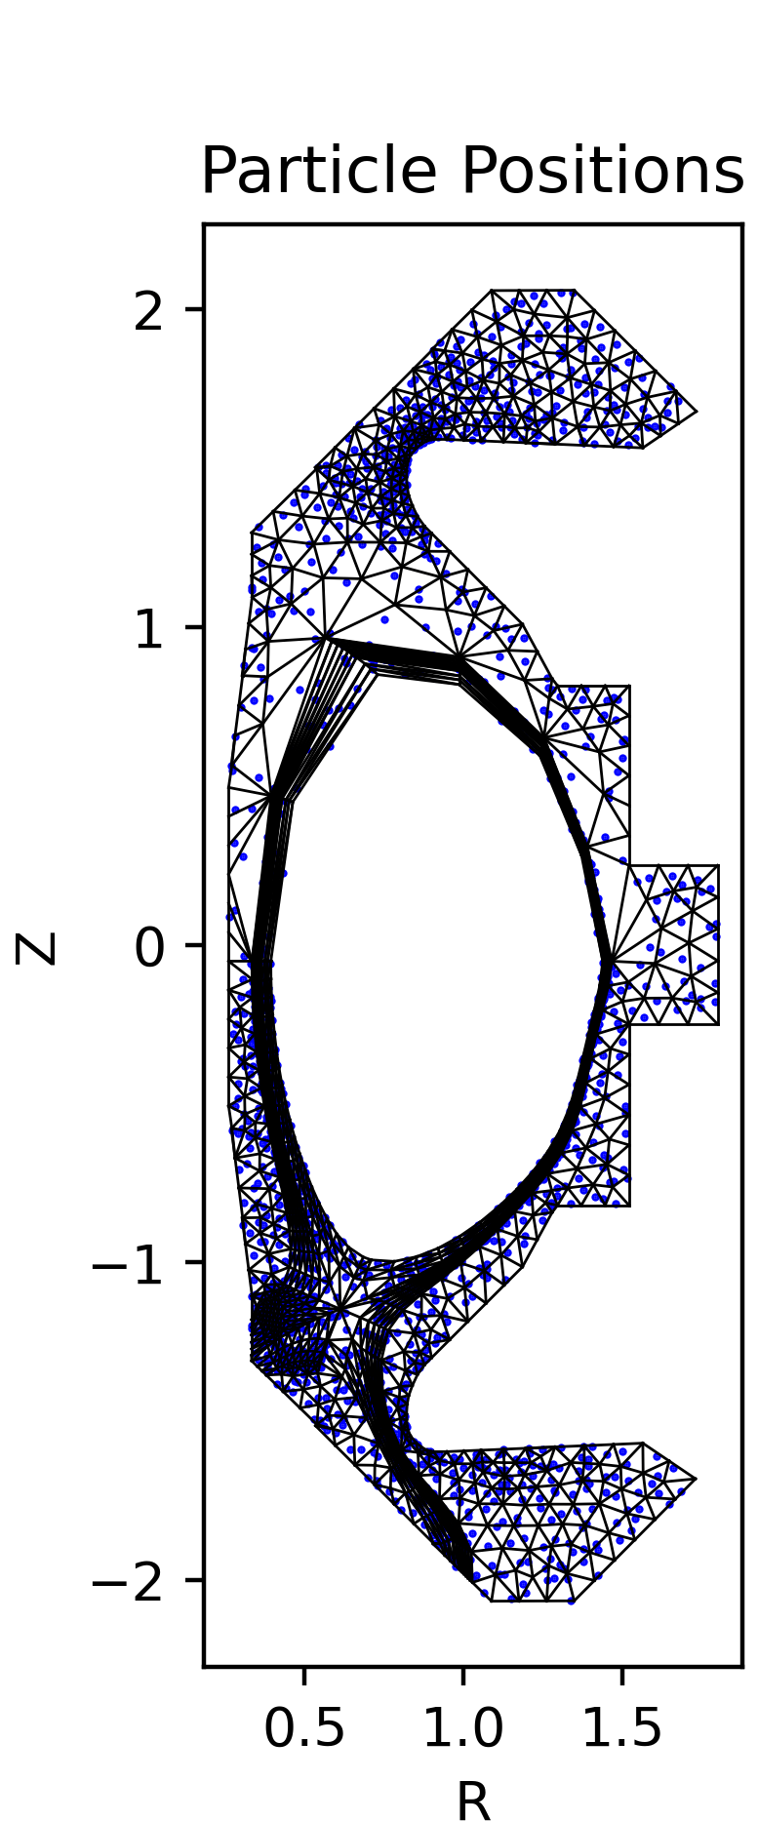
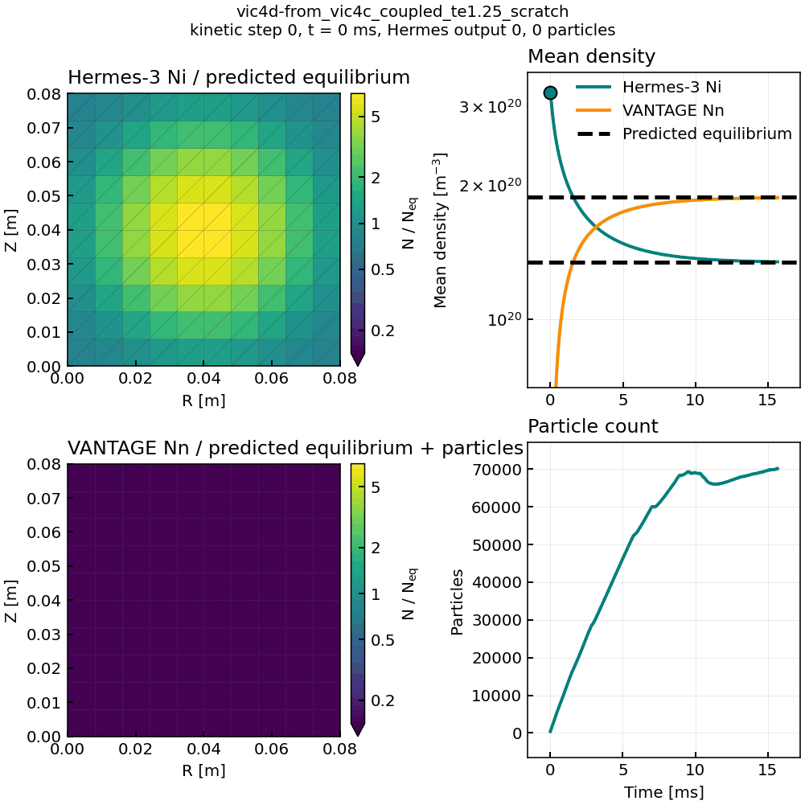
Current status
Particle advection in vessel grid
Density coupled
slab IZ/REC equilibration test
Milestone test plan
Triangular neutral grid
Coupled IZ/REC balance test (density channel)
Coupled IZ/REC balance test (all channels)
Field-aligned slab recycling test
Tokamak test (no vessel)
Higher fidelity tokamak test

Slide 34
Thank you - Questions
Summary of Hermes-3 projects:
Performance
Fluid neutrals
Kinetic neutrals
Impurities
Drifts
Solver optimisation in collab. with STFC (This talk, C. MacMackin, Thu 14:24)
Molecules (O. Parry, Wed 14:16)
VANTAGE coupling
(this talk)
JET neon-seeded baseline (new hire in 2027)
Work at LLNL (M. Tsagkaridis, B. Dudson Fri 09:40)
Physical preconditioning for neutrals (N. Bootland, Thu 14:12)
Verification/validation on MAST-U (L. Shih, Wed 14:24)
VANTAGE-Reactions
(S. Mijin, Wed 13:40)
Zhdanov implemented this FY (C. MacMackin)
Stellarator drifts simulations (T. Tork Tue 16:20)
GPU porting (J. Castagna, Thu 10:00)
Verification/validation on ST-40 (this talk)
Verification/validation for stellarators (A. Stier, Thu 14:16)

Slide 35
Appendix

Slide 36

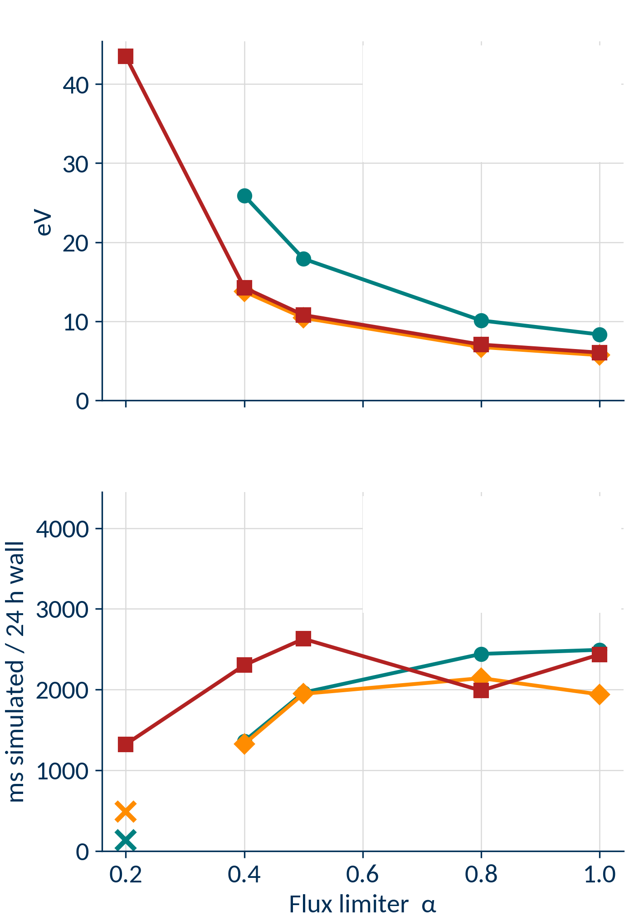

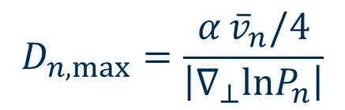




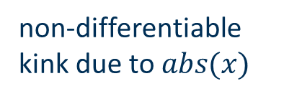
Lesson #1: regularise neutral limiter without changing physics
Peak outer target $T_{e}$
●
Old code
◆
No regularisation
■
This work
Regularisation affects answer less
$$D_{n,max}=\frac{α {\overline{v}}_{n}/4}{\left|∇_{⊥}lnP_{n}\right|}$$
Improvement
!
non-differentiable kink due to $abs(x)$
Make absolute smooth
$$\left|∇_{⊥}lnP_{n}\right|≈0$$
Average speed
!
●
Old code
saturated limiter turns diffusion into advection, operator is central
Add smooth ceiling
◆
No regularisation
$$\left|∇_{⊥}lnP_{n}\right|≫0$$
■
This work
!
Make floor smooth
$$\left|∇_{⊥}lnP_{n}\right|→0$$
$$D_{n,max}→∞$$
More robust, similar performance
did not finish
Notes:
One slide to present the optimise-neutral-fluxlim work but before van albada.
Maths to show why regularisation is needed:
When limiter saturated, diffusion becomes advective
Blow up to infinity at shallow gradients
Non-smooth abs()
Then performance results – the scan with no regularisation, scan with master, then scan with shipped default normalisation. both physics results, wall time and wall time variability

Slide 37
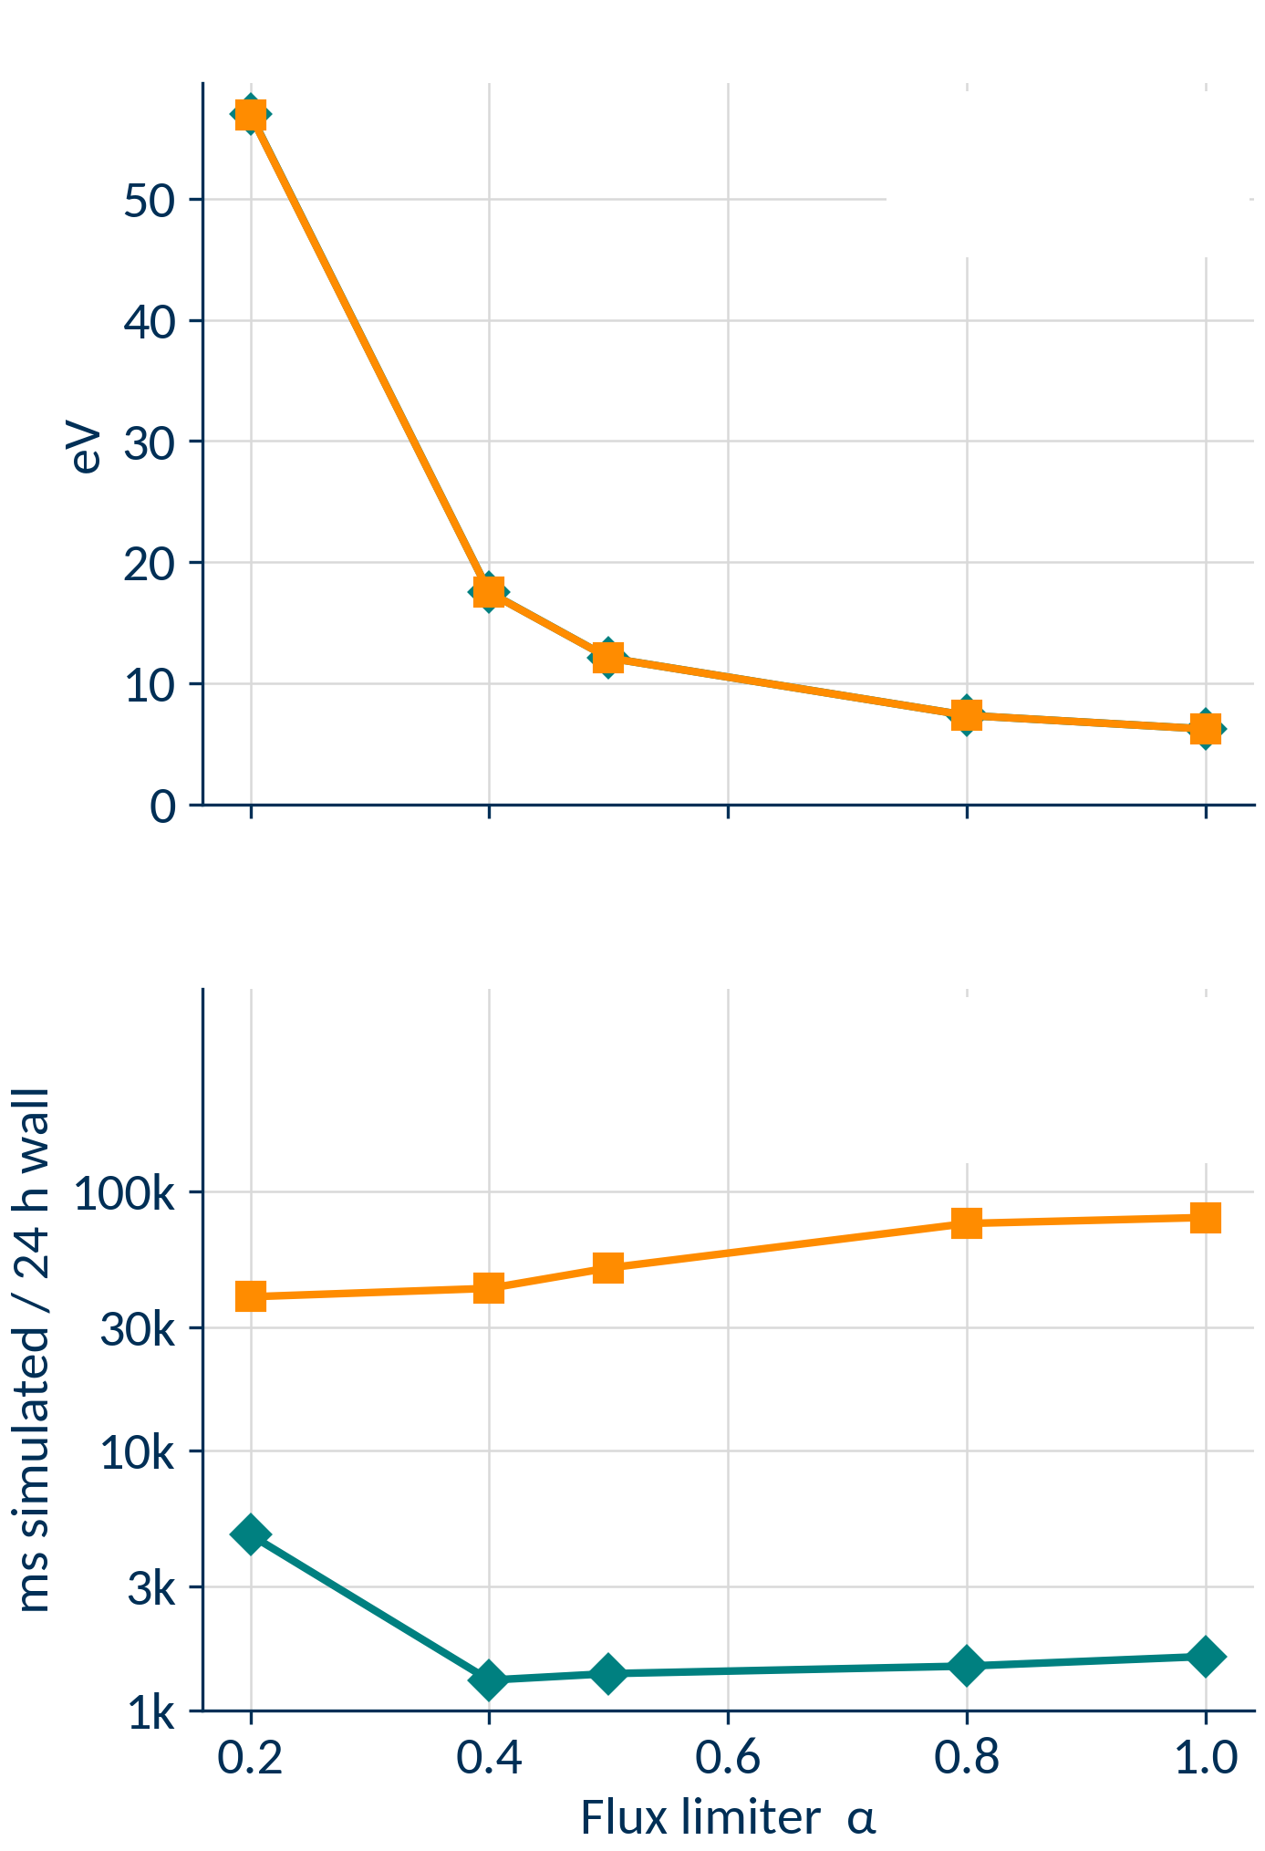

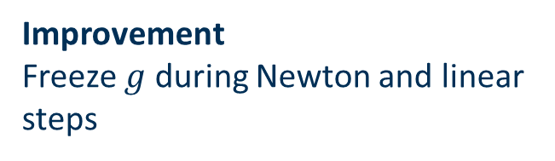

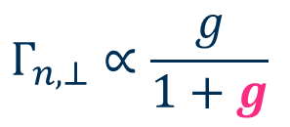

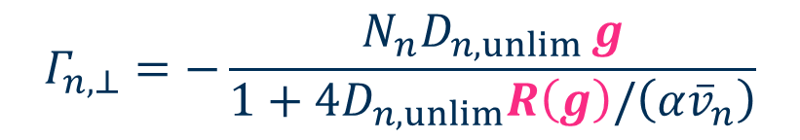
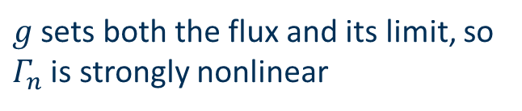
Lesson #2: lagging nonlinear terms
Peak outer target $T_{e}$
◆
Unlagged
■
Lagged
Neutral cross-field diffusive flux
Same answer, within 0.1%
$$Γ_{n,⊥}=−\frac{N_{n}D_{n,unlim} g}{1+4D_{n,unlim}R\left(g\right)/\left(α{\overline{v}}_{n}\right)}$$
$$g=∇_{⊥}lnP_{n}$$
$R\left(g\right)$: regularised $g$
!
$$Γ_{n,⊥}∝\frac{g}{1+g}$$
$g$ sets both the flux and its limit, so $Γ_{n}$ is strongly nonlinear
Average speed
◆
Unlagged
Improvement
Freeze $g$ during Newton and linear steps
■
Lagged
Lagging 8–51× faster
Notes:
Talk about why the gradient makes the limiter so nonlinear, and how lagging works.
Show results of lagging vs no lagging with separate limiters on floor 10.
Lagging gradient only.

Slide 38
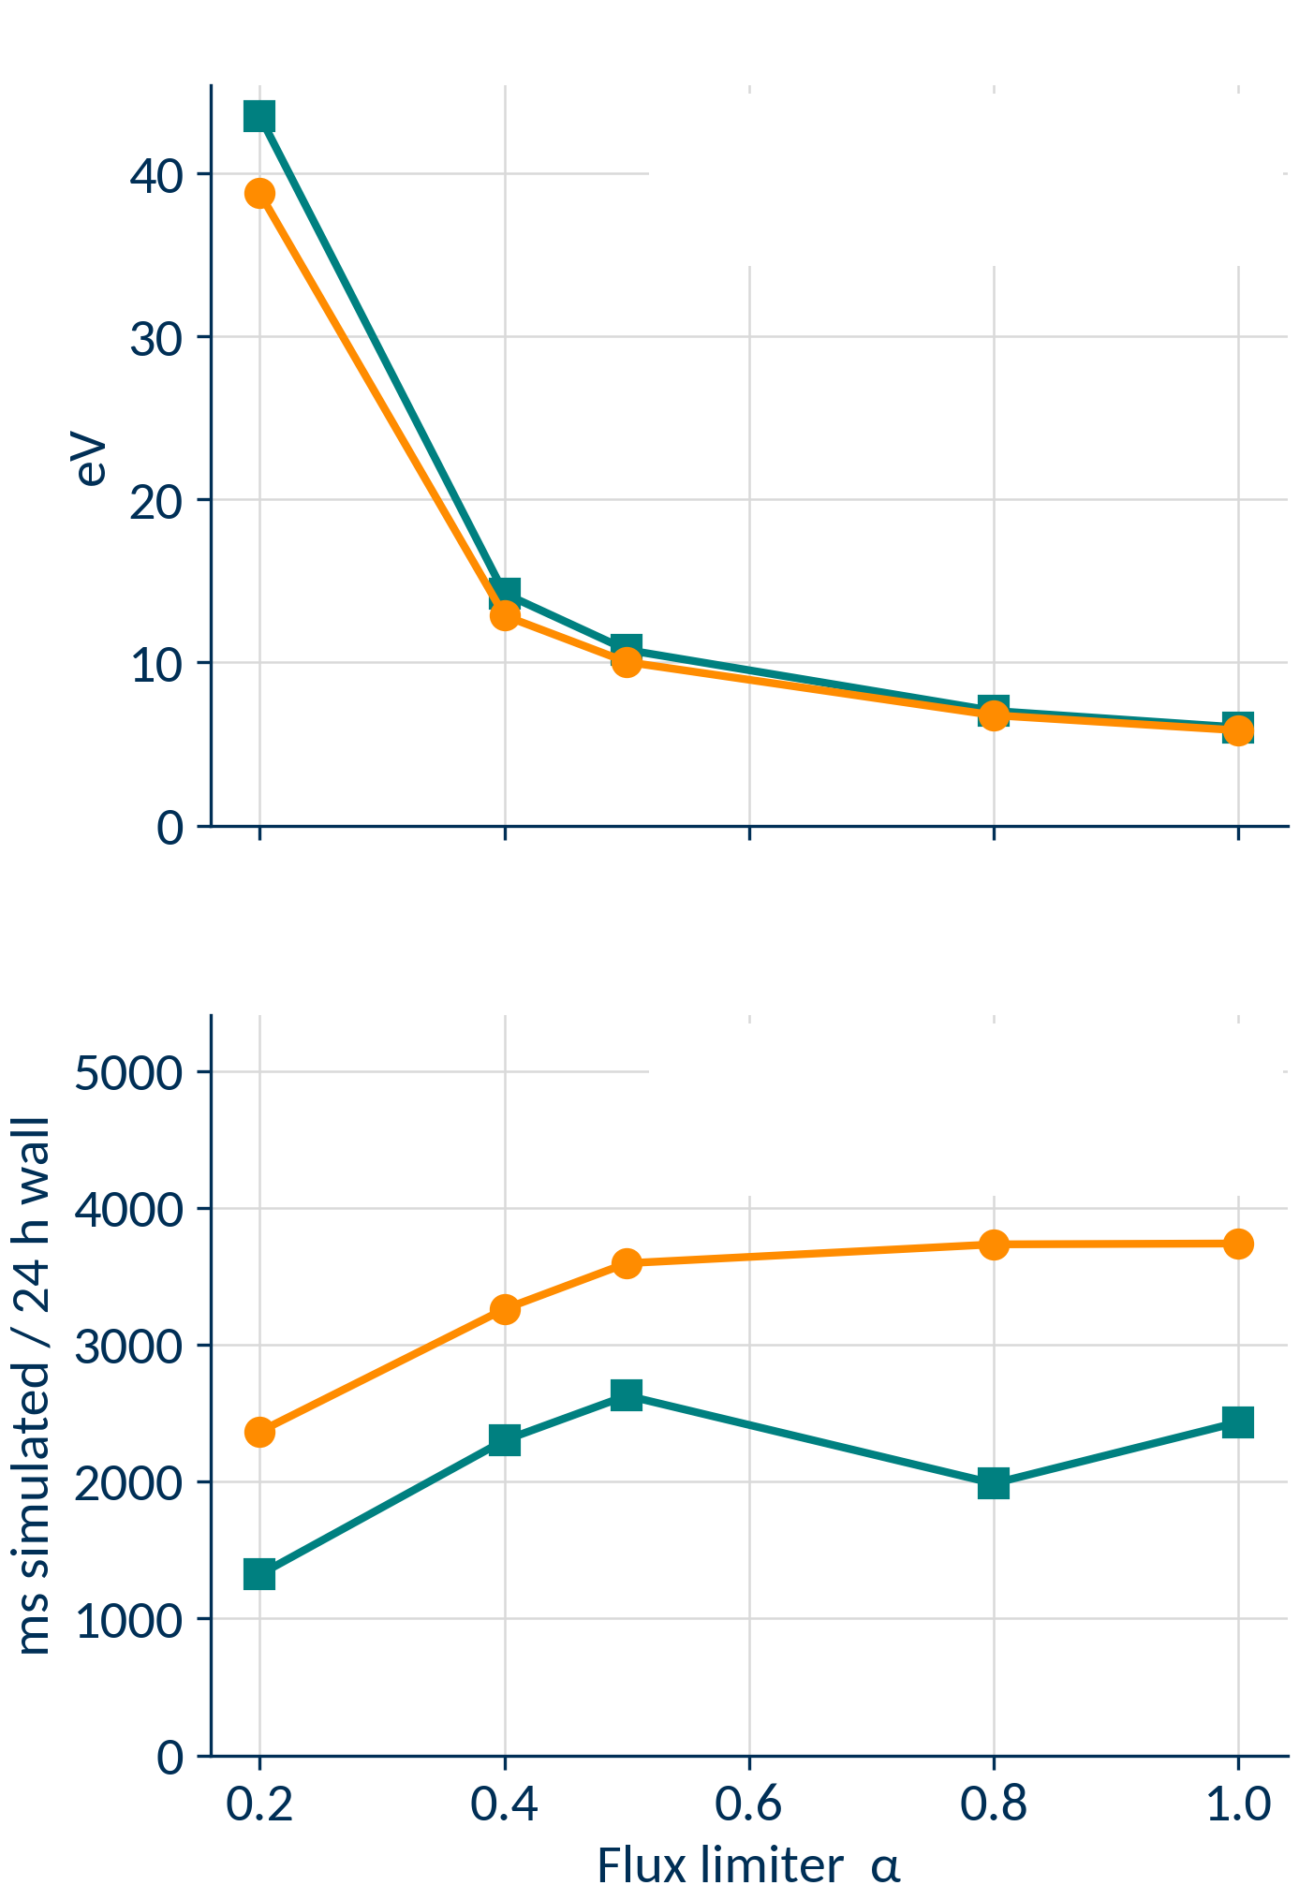
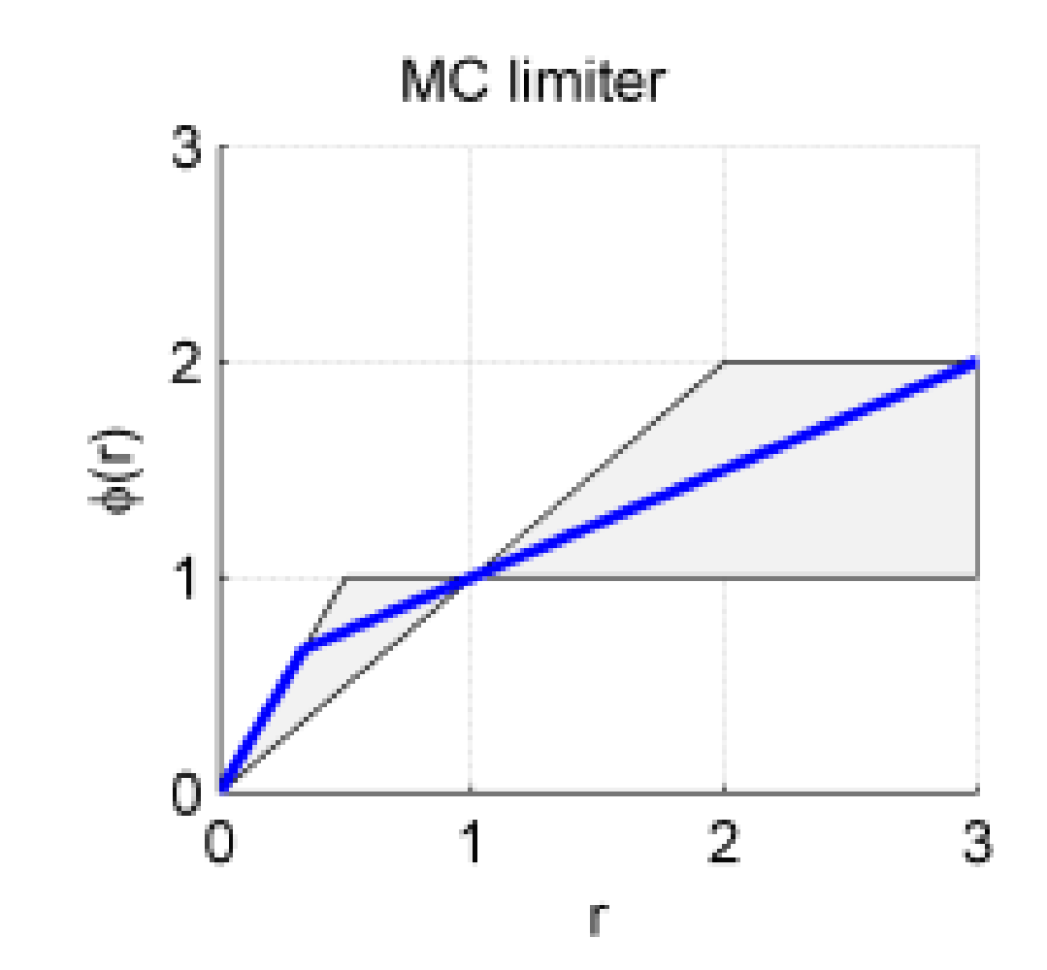
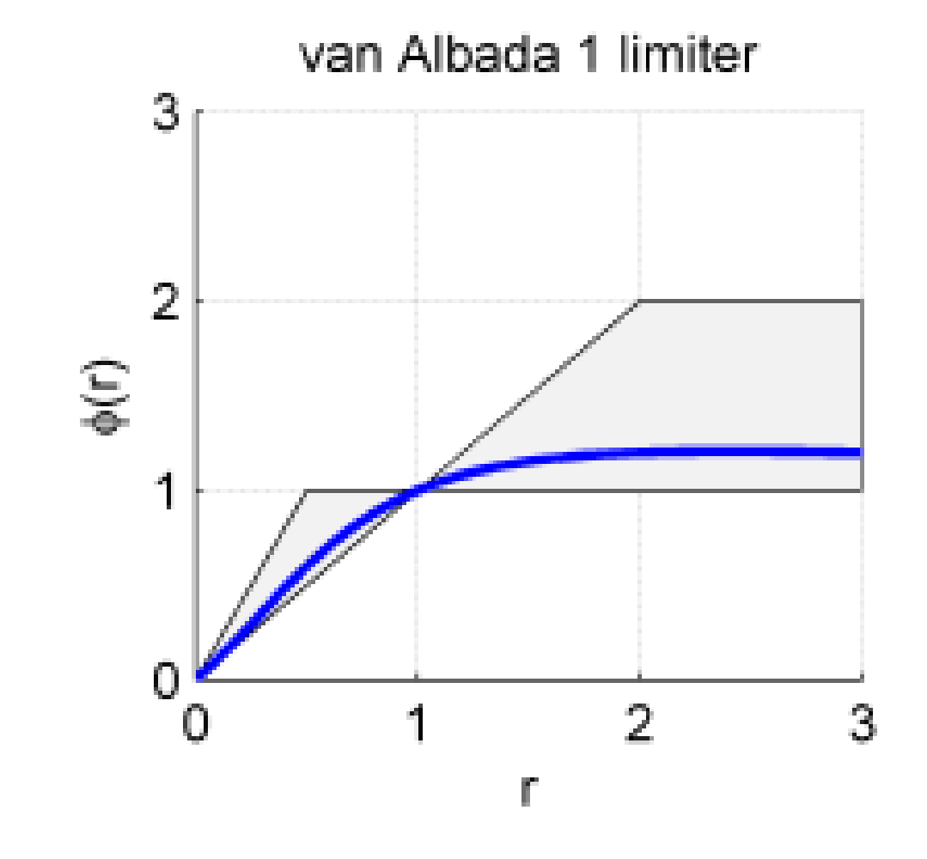
Lesson #3: slope limiter kinks
Peak outer target $T_{e}$
■
MC (shipped defaults)
●
Van Albada
Slope limiters: operators that dynamically change reconstruction order to improve robustness (similar to SOLPS hybrid scheme)
Very little impact on answer
!
MC, previous default
Improvement
Average speed
■
MC (shipped defaults)
●
Van Albada
More robust, faster performance
Non-differentiable kink
Van Albada: smooth curve, no corners
φ(r) plots: Wikipedia, "Flux limiter", by Griffgruff, CC BY-SA 3.0, cropped. Grey: second-order TVD region.
Notes:
- Brief intro to slope limiters
Show why MC is non-differentiable and how Van Albada is
Scan comparison showing MC vs VA on shipped default regularisation – both physics results, wall time and wall time variability

Slide 39
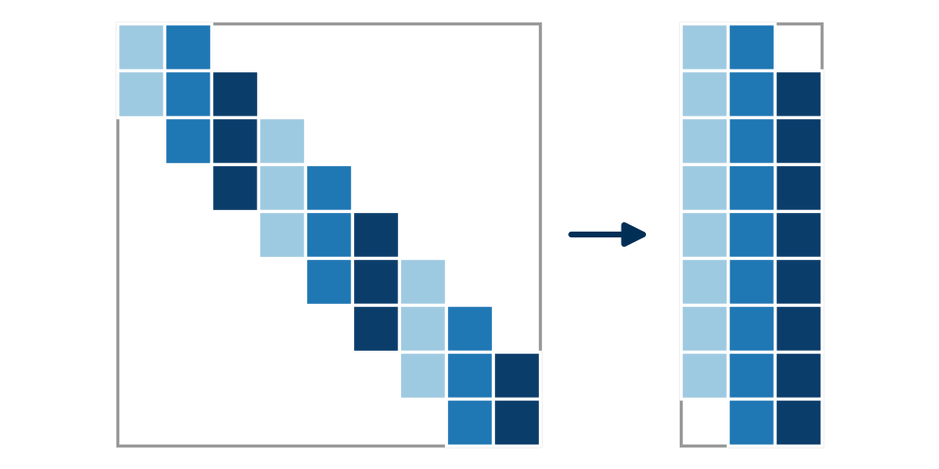
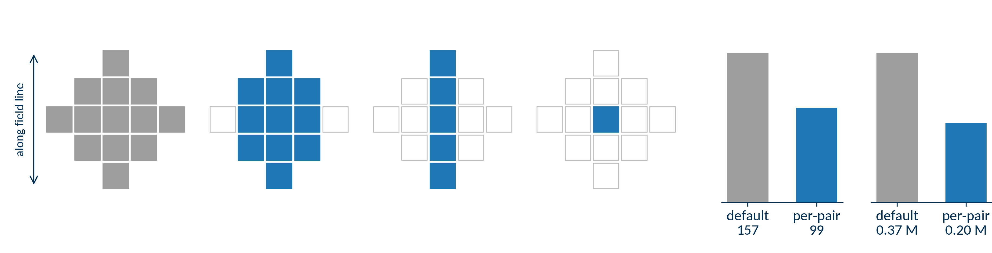
Fix 4: Jacobian colouring optimisation
Finite differences: one RHS evaluation per column
Columns that never share a row are perturbed together: one per colour
Fewer couplings → fewer colours → cheaper Jacobian
Full ST40 full res test run, 0–100 ms: 16 min → 9.5 min, 1.7× faster, same answer
RHS evaluations per Jacobian build
RHS evaluations per full run
13 cells
11 cells
5 cells
1 cell
assumed for
every field pair
neutral density eqn,
electron pressure
ion density eqn,
ion momentum
ion momentum eqn,
neutral pressure
Two runs each; end states within 0.1 %; 261 of 637 cells kept
Notes:
Brief intro to Jacobian colouring
Figure of new, calculated pairs, and the bar chart showing reduction in RHS evaluations
Single number of performance improvement

Slide 40
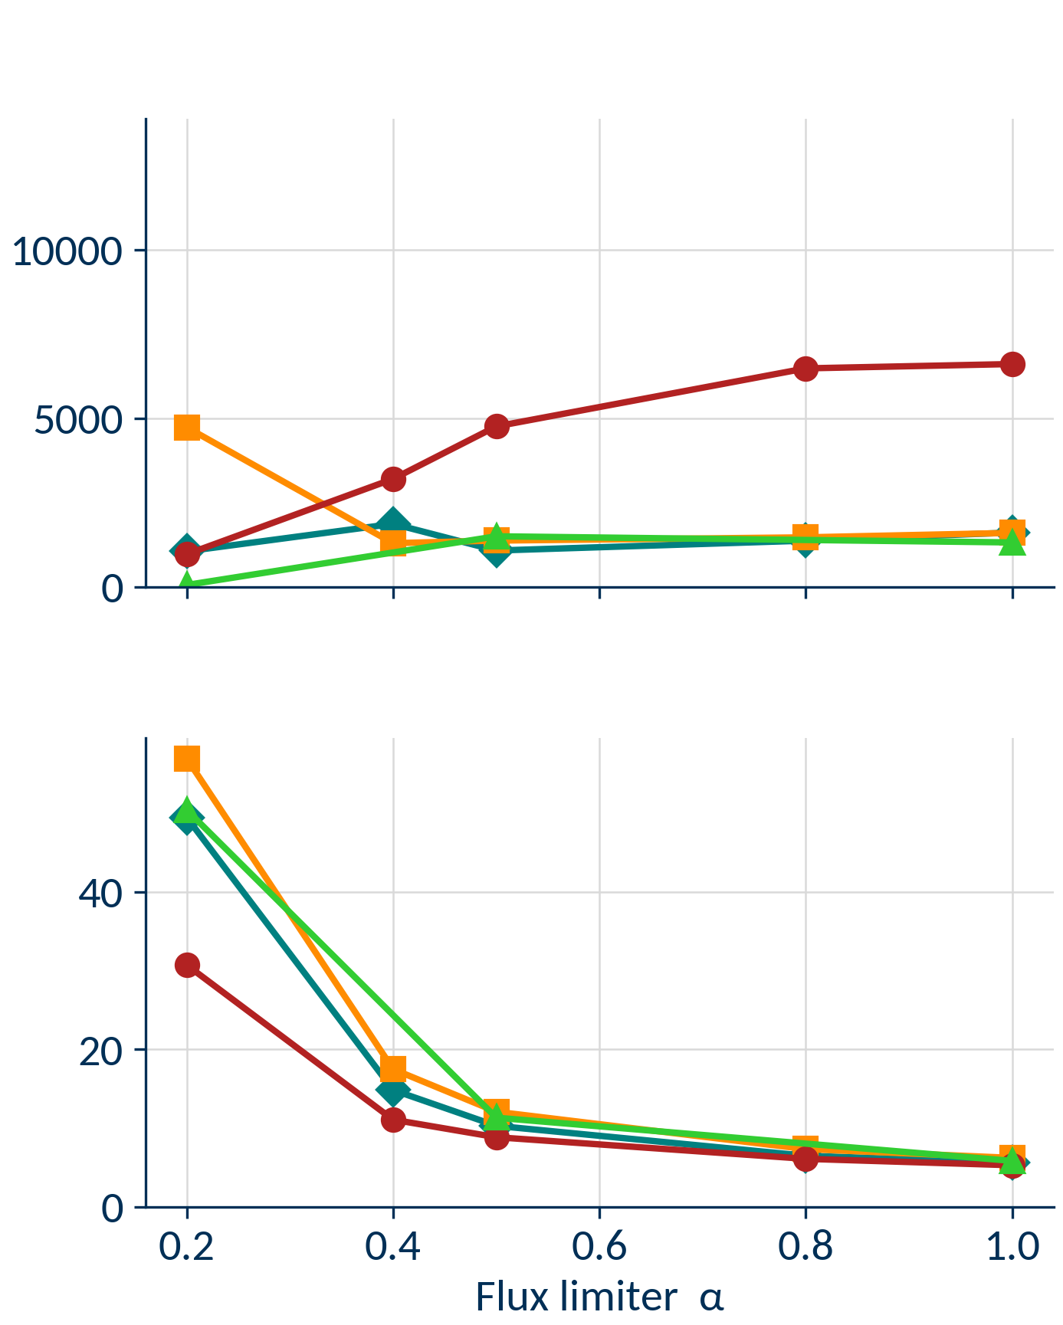

Extending to separate limiters
DATA STATUS No-regularisation arm
✓ flux limits 1.0, 0.5, 0.2 (splim20d, 20ea, 20f)
✗ flux limits 0.4, 0.8: prepared (splim20k, 20j), not queued
? 0.2 point: checkerboarding check open (fl-88d)
Average speed
[ms simulated / 24 h wall]
Separate limiters now a smaller slowdown
Performance penalty remains
Likely due to added nonlinearity
◆
Separate, minimal reg.
■
Separate, shipped reg.
●
Combined
▲
Separate, no regularisation
Peak outer target $T_{e}$ [eV]
Notes:
How the regularisation for parallel is scaled off perpendicular
How the viscosity regularisation is derived from the rest with vn_bar
Then scan comparison of separate limiters with little regularisation, then shipped regularisaton, and combined limiters. Same slides as the previous scan comparisons

Slide 41
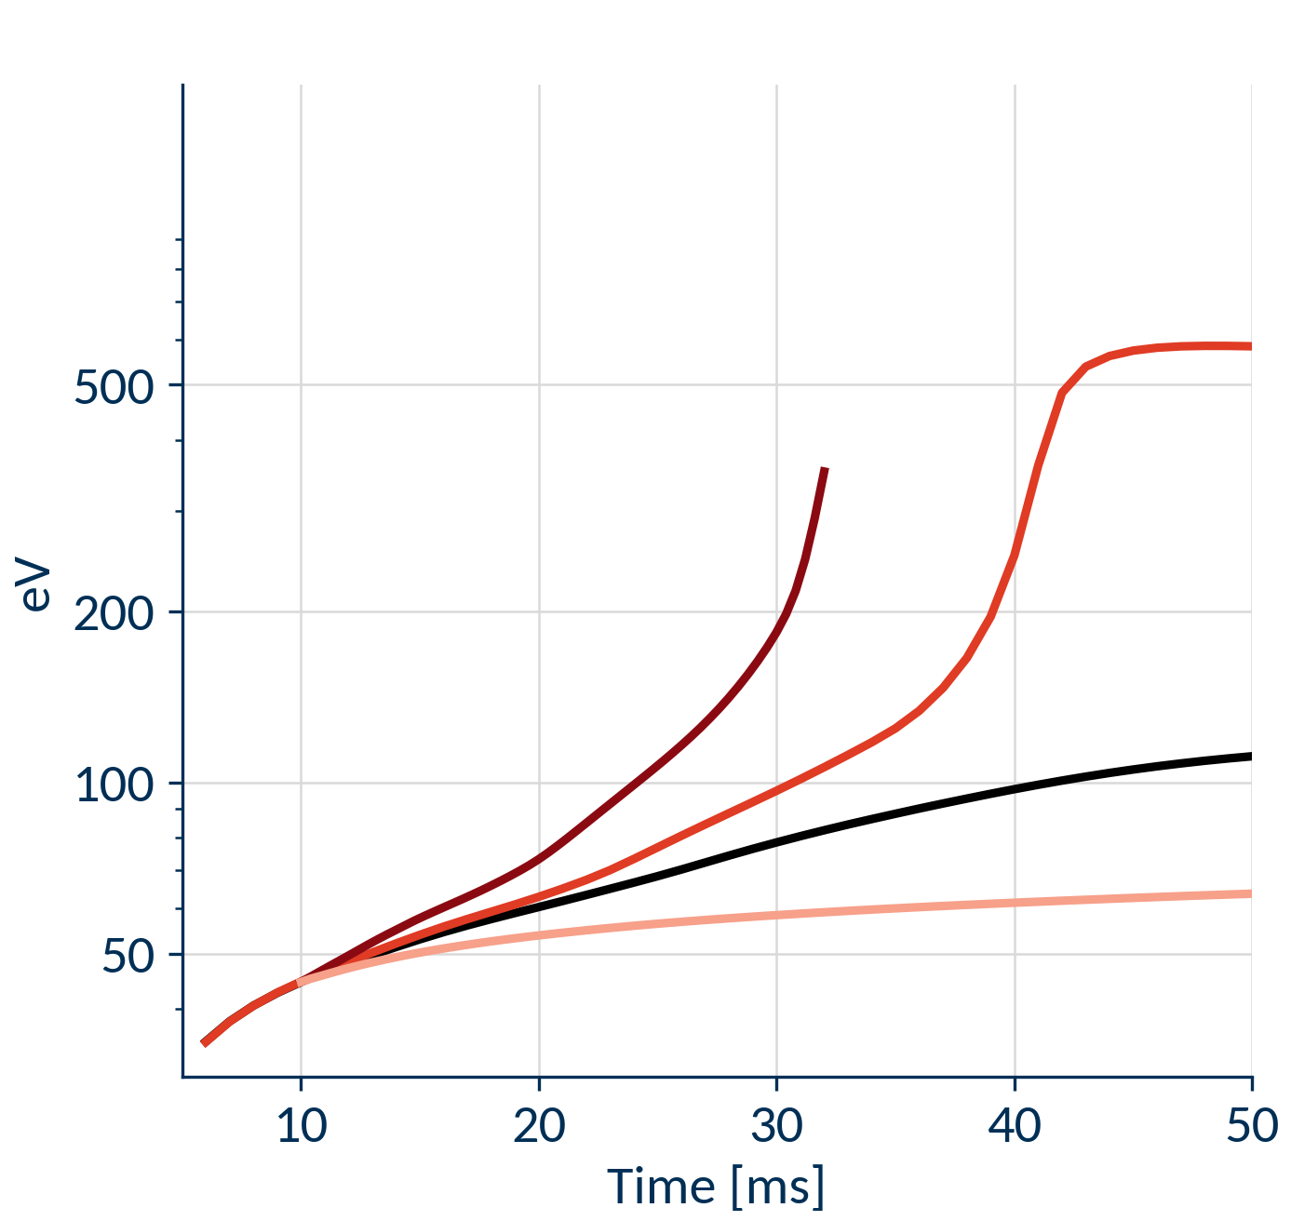
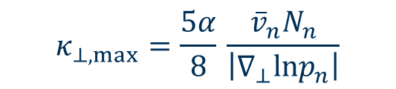



Separate limiters: a runaway to a hot SOL
Separate
Combined
$$κ_{⊥,max}=\frac{α}{2} \frac{{\overline{v}}_{n}N_{n}}{\left|∇_{⊥}lnT_{n}\right|}$$
$$κ_{⊥,max}=\frac{5α}{8} \frac{{\overline{v}}_{n}N_{n}}{\left|∇_{⊥}lnp_{n}\right|}$$
Separatrix $T_{e}$, outer midplane
steep $T_{n}$ gradient in outer divertor legs
■
Combined, all limits 0.2
Cross-field conduction limited
outer divertor legs, far SOL: ½ of combined
Heat trapped
in outer divertor legs
Neutrals hotter, thinner
at the same pressure
■
Separate, all limits 0.2
■
Separate, conduction limits 0.1
■
Separate, ⊥ conduction limiter off
feeds back
SOL hotter
sheath-limited
SOL starved
fewer particles
Less ionisation
0.7× by 30 ms
!
Hot SOL, 580 eV: solver stalls
Dashed: possible link, untested
Flux limit 0.2 unless stated; gradient floor 10 /m, ceiling 100 /m

Slide 42
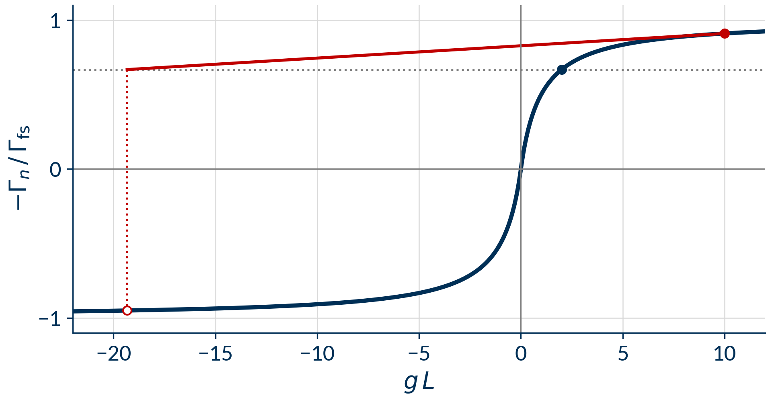
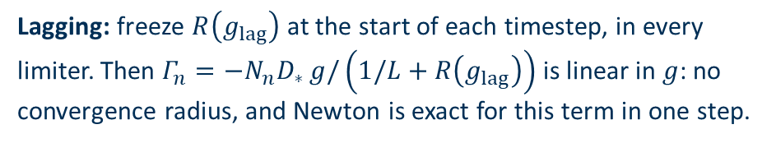
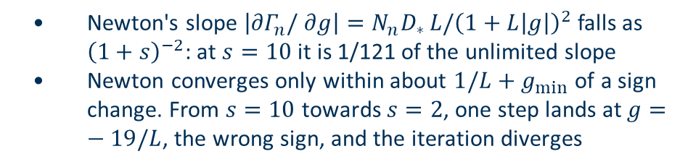
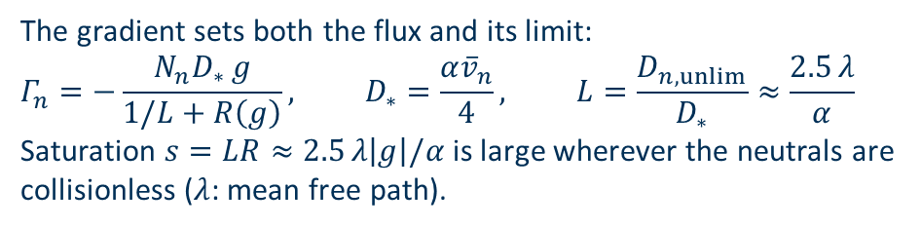
Appendix: why the limiter is so nonlinear
The gradient sets both the flux and its limit:
$$Γ_{n}=−\frac{N_{n}D_{∗} g}{1/L+R\left(g\right)}, D_{∗}=\frac{α{\overline{v}}_{n}}{4}, L=\frac{D_{n,unlim}}{D_{∗}}≈\frac{2.5 λ}{α}$$
Saturation $s=LR≈2.5 λ\left|g\right|/α$ is large wherever the neutrals are collisionless ($λ$: mean free path).
  Newton's slope $\left|∂Γ_{n}/∂g\right|=N_{n}D_{∗} L/{\left(1+L\left|g\right|\right)}^{2}$ falls as ${\left(1+s\right)}^{−2}$: at $s=10$ it is 1/121 of the unlimited slope
  Newton converges only within about $1/L+g_{min}$ of a sign change. From $s=10$ towards $s=2$, one step lands at $g=−19/L$, the wrong sign, and the iteration diverges
start
answer
one Newton step
Lagging: freeze $R\left(g_{lag}\right)$ at the start of each timestep, in every limiter. Then $Γ_{n}=−N_{n}D_{∗} g/\left(1/L+R\left(g_{lag}\right)\right)$ is linear in $g$: no convergence radius, and Newton is exact for this term in one step.
Sketch: floor and ceiling off ($R=\left|g\right|$); a single cell, whereas in the model each cell's $g$ also depends on its neighbours.

Slide 43
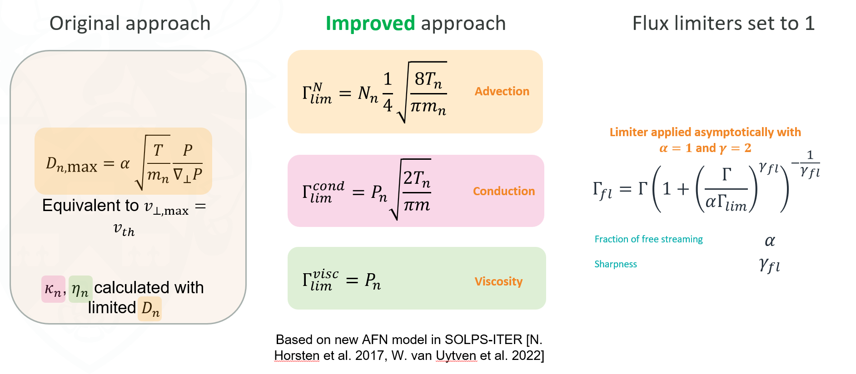
Separating flux limiters

