Slide 1
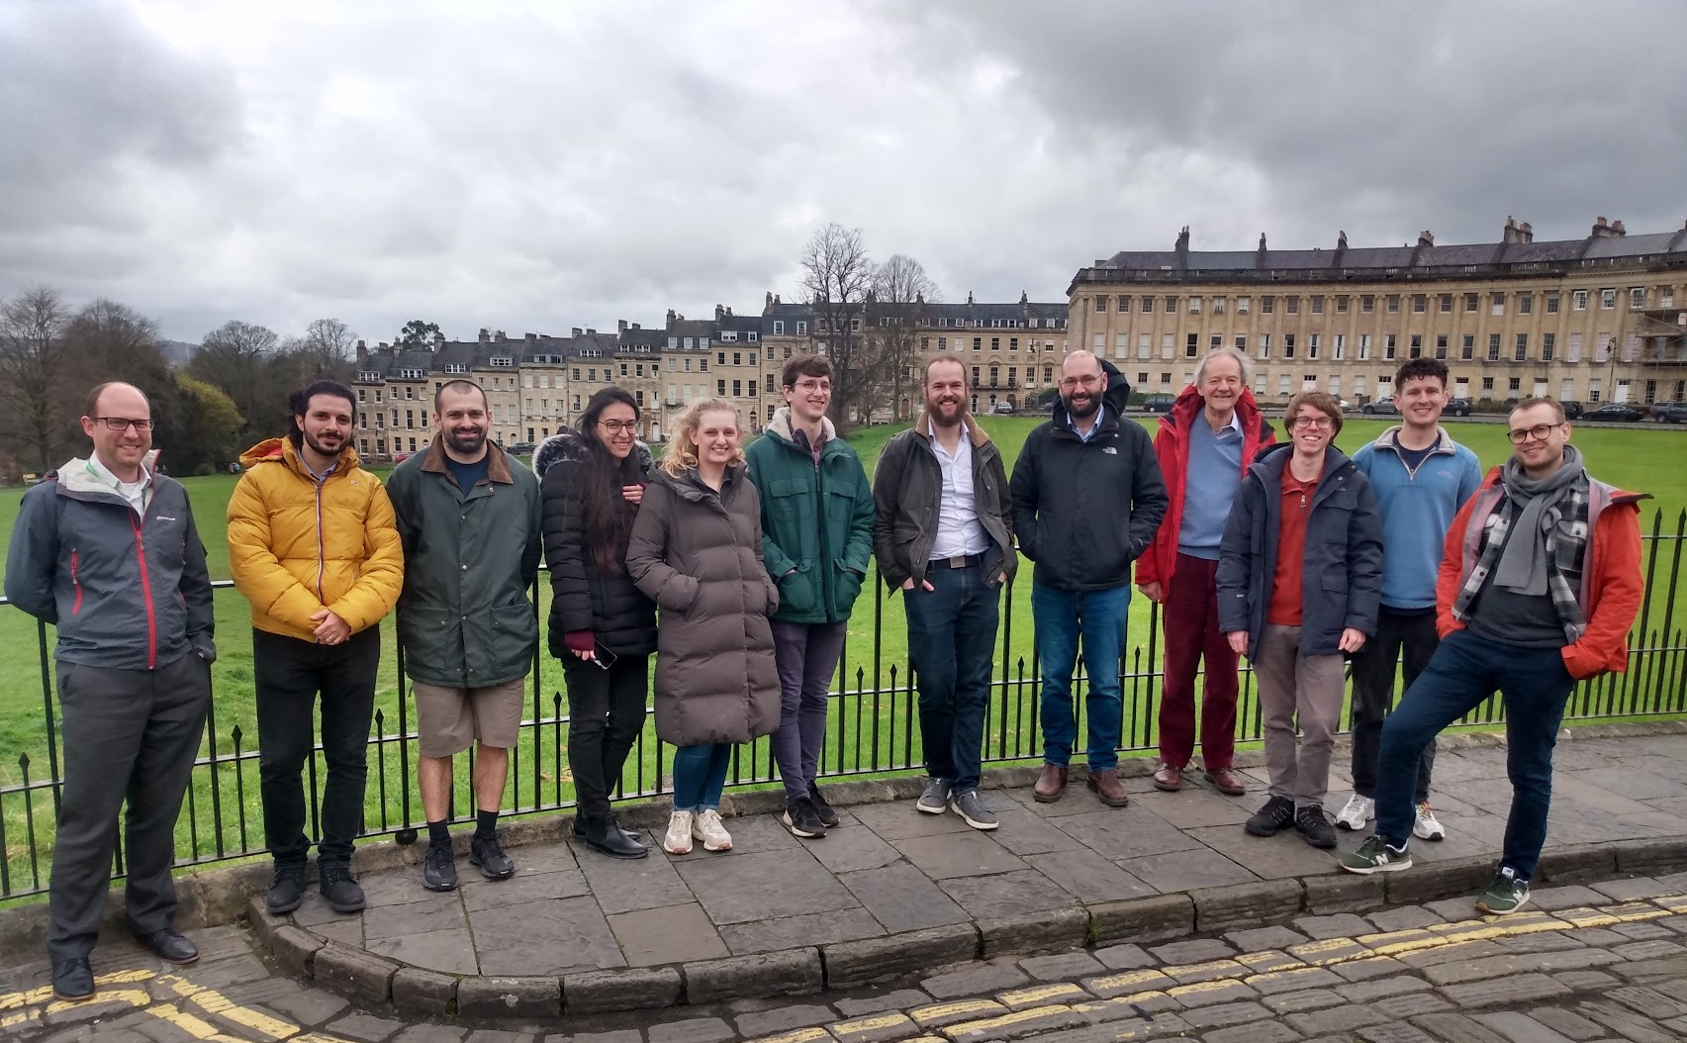
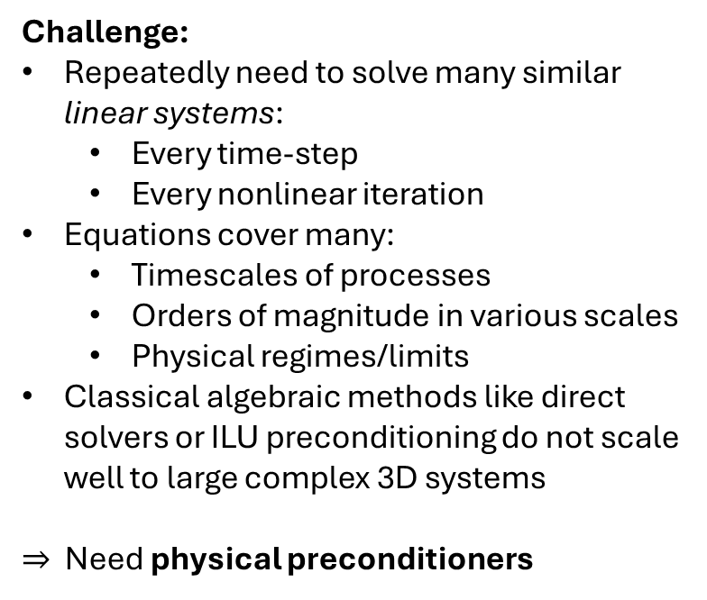
Physical preconditioning for neutrals in Hermes-3
Hussam Al Daas¹, Niall Bootland¹, Qian Xia², Mike Kryjak² and Ben Dudson³
¹ Science and Technology Facilities Council (STFC), Harwell Campus, UK; ² United Kingdom Atomic Energy Authority (UKAEA), Culham Campus, UK; ³ Lawrence Livermore National Laboratory (LLNL), Livermore CA 94550, USA
Objective:
Fast, efficient and accurate solvers for the neutral equations model in Hermes-3
Solve as a block in full plasma equations
Challenge:
Repeatedly need to solve many similar linear systems:
  Every time-step
  Every nonlinear iteration
Equations cover many:
  Timescales of processes
  Orders of magnitude in various scales
  Physical regimes/limits
Classical algebraic methods like direct solvers or ILU preconditioning do not scale well to large complex 3D systems
$⇒$ Need physical preconditioners
STFC Computational Mathematics @ RAL
Numerical Linear Algebra, Continuous Optimisation, Inverse Problems

Slide 2
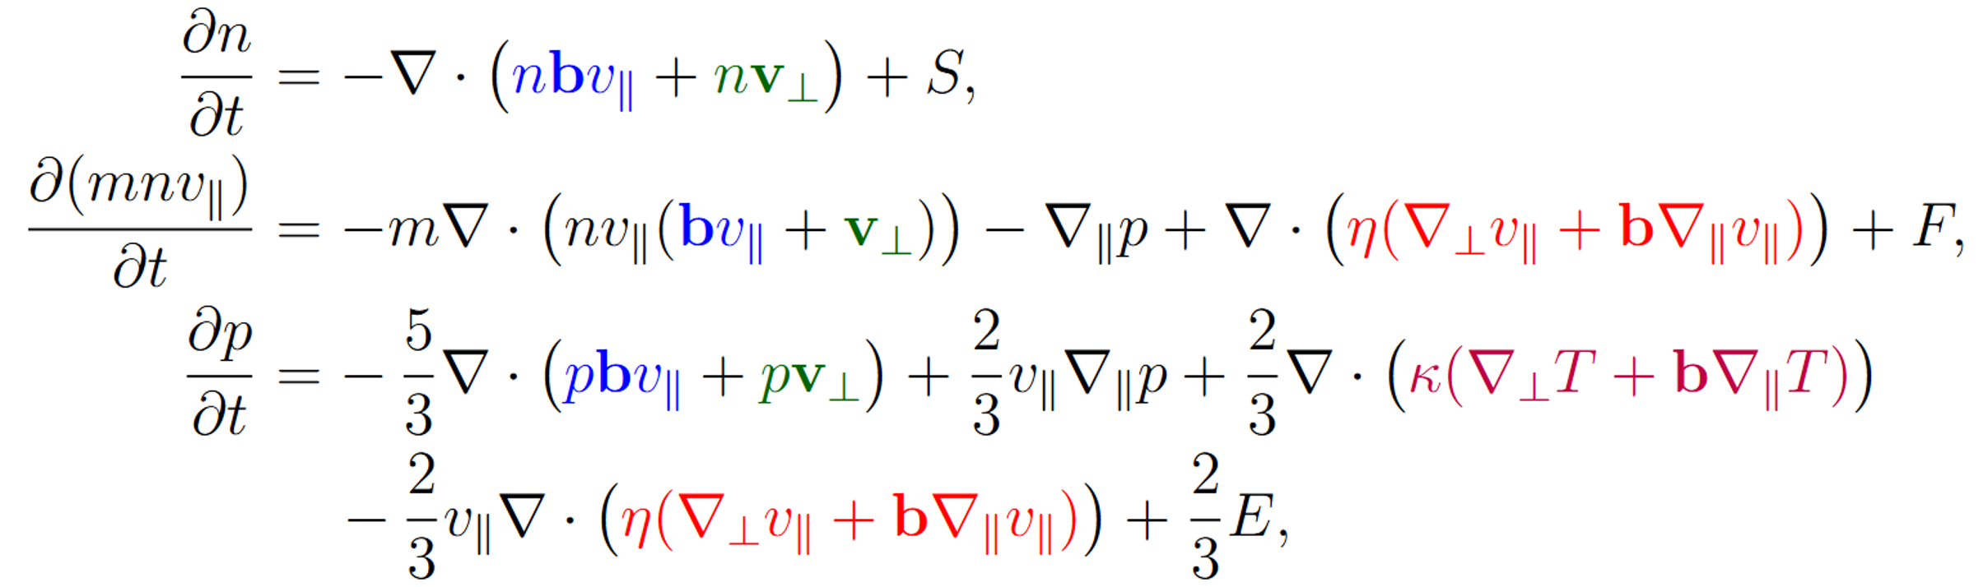
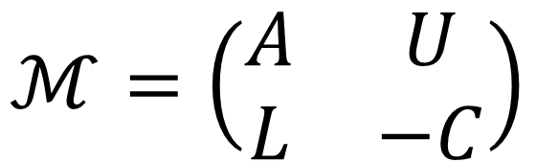
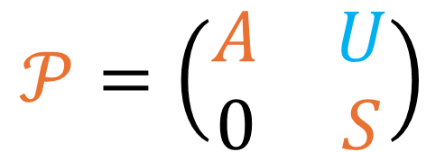
Physical preconditioning for neutrals in Hermes-3
Hussam Al Daas¹, Niall Bootland¹, Qian Xia², Mike Kryjak² and Ben Dudson³
¹ Science and Technology Facilities Council (STFC), Harwell Campus, UK; ² United Kingdom Atomic Energy Authority (UKAEA), Culham Campus, UK; ³ Lawrence Livermore National Laboratory (LLNL), Livermore CA 94550, USA
Neutral model for Hermes-3
First neglect red and blue terms as cross-field diffusion often the fastest timescale
$$ℳ=\left(\begin{matrix}A & U \\ L & −C\end{matrix}\right)$$
$$𝒫=\left(\begin{matrix}A & U \\ 0 & S\end{matrix}\right)$$
Schur complement
How do we approximate?
Form of linear system
Block preconditioner
orange = need to be able to invert efficiently

