Slide 1
Innovation Loans
UKAEA SME Event
Jonny Voon
Deputy Director, Innovation Loans, Innovate UK
Jonny.Voon@iuk.ukri.org

Slide 2
Turning Breakthrough
Ideas into Industry Giants
Notes:
Innovate UK’s vision is for a UK where breakthrough ideas can become industry leads – industry giants.
We are here to accelerate business innovation.
To back the UK's most promising deep tech companies. All the way from lab to market.
In the sectors where the UK has a genuine right to win.
But we are not just talking about backing companies. We are talking about creating new industries. Industrialising innovation.

Slide 4
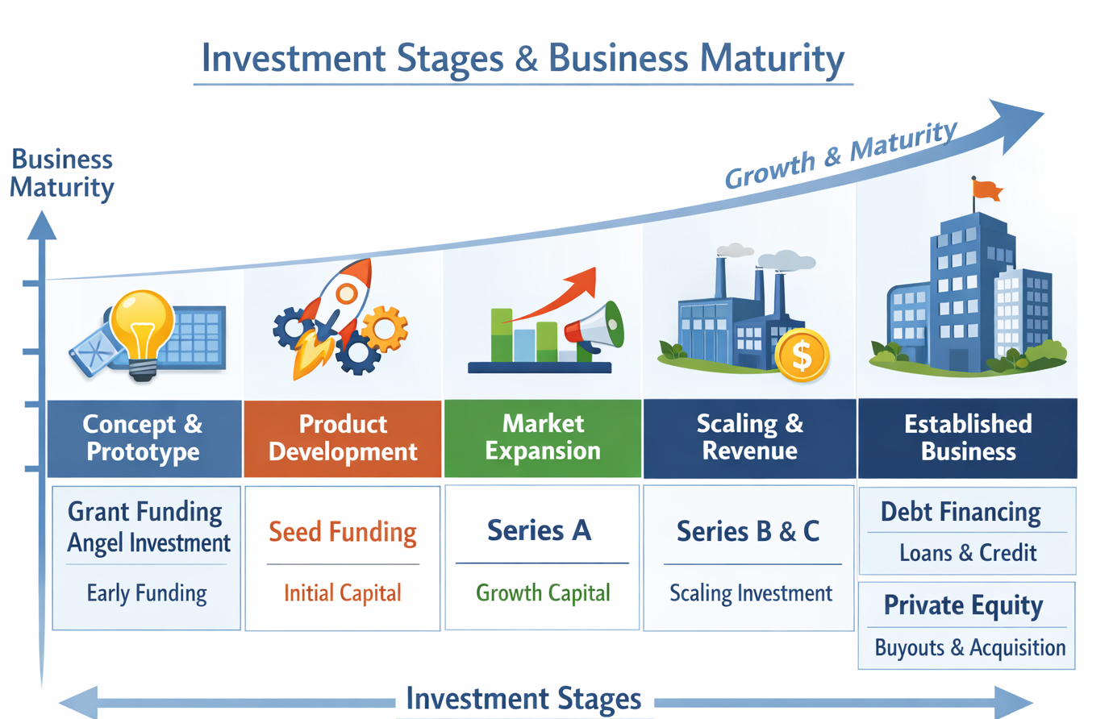
IN AN IDEAL WORLD
Business growth, maturity, and R&D journey will be linear, dove-tailed, and straight forwards.

Slide 5
DERISKING PRIVATE
WITH PUBLIC
Public Grants
Debt Finance
Debt Finance
Equity Investment
Equity Investment
Equity Investment
Founder Investment
Founder Investment

Slide 6
WHAT ARE
INNOVATION LOANS?
Debt financing for UK SMEs looking to scale their R&D ahead of commercialisation.

Slide 7
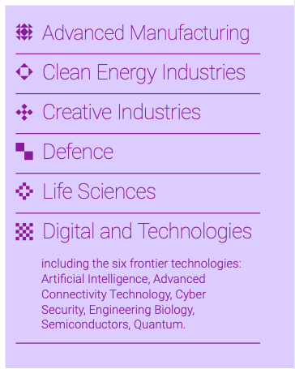
INNOVATION LOANS
WHO ARE THEY FOR?
UK SMEs looking to scale their late-stage R&D to achieve commercialisation.

Slide 8
Innovation Grants
Non-dilutive, non-debt financing
No repayments
Innovation Loans
Non-dilutive, debt-based financing
Loan + interest to be repaid within 7 years
Max 70%* of eligible costs can be claimed
Funding paid quarterly in arrears, once incurred and defrayed
Up to 100% of labour and capital costs can be claimed + working capital for pre-commercial sales & marketing
Funding drawn down in advance when in need
Investor Partnerships
Innovation grant + dilutive equity funding
No repayments
Effective 100%* of costs paid
In partnership with a qualified investor
Great for companies looking to scale
Great for companies looking for private finance
Great for start-ups looking to develop their idea
Level of R&D
Early stage
Later stage
* For industrial research. Other research categories will have lower percentages the closer you get to commercialisation.

Slide 9
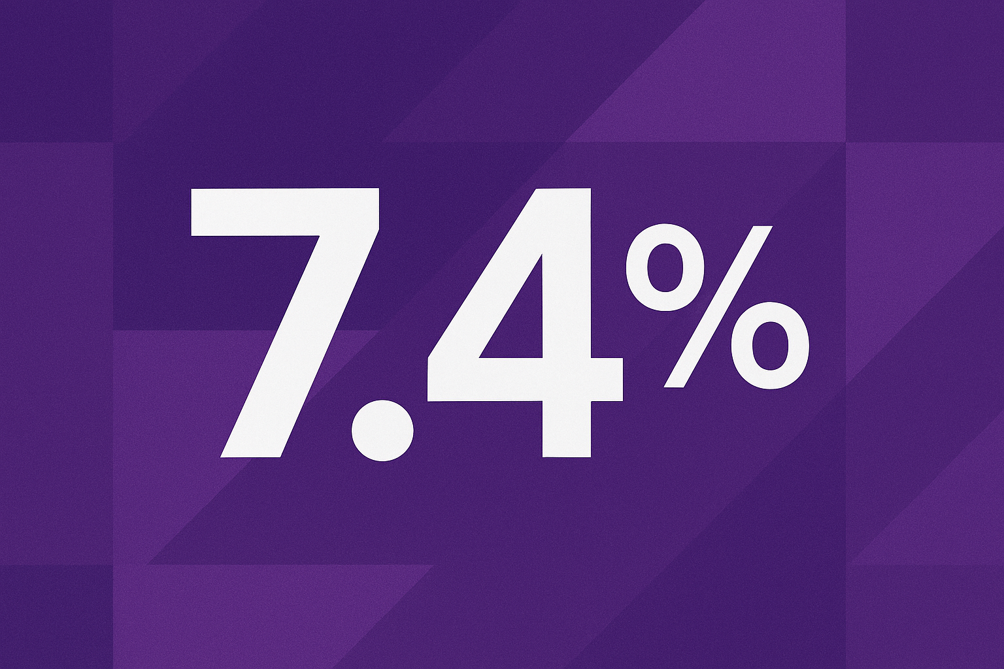

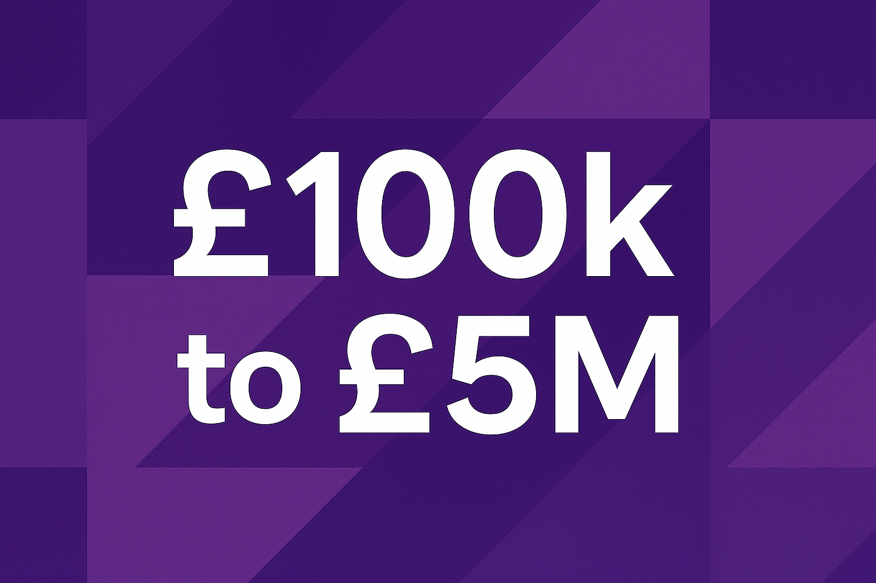
INNOVATION LOANS AT A GLANCE
Below-market interest rate.
3.7% reduced interest rate during R&D, with remaining 3.7% deferred to repayment period.
Borrowing term of up to 7 years.
No early repayment fees.
Up to 100% of eligible costs, drawn down in advance.
Can include up to 20% working capital, and pre-commercial sales and marketing costs

Slide 10
Availability Period
R&D & Pre-commercial Activity
Repayment Period
Repayment of Capital and Interest
Quarterly loan drawdowns in advance
Interest payable quarterly in arrears on amount borrowed
3.7% payable and 3.7% deferred to repayment period
Project monitoring by Monitoring Service Provider and Portfolio Team
Up to 5 years (R&D 3 years max)
No further drawdowns permitted
Deferred interest crystalised
Repayment of principal and deferred interest
Interest payable at 7.4%
Quarterly level payments
Monitoring by Portfolio Team
Up to 5 years
Maximum overall loan term of 7 years

Slide 11
BUT
IS IT RIGHT FOR YOU?
Probably not right Might be right
Just starting out as a business
Idea still at early prototype
Market traction not validated
Financially-precarious position
No thought-through investment plan
Just you
Trading for several years, good accounts
Looking to scale idea from TRL 7-9
Letters of Intent, trials, pilots, industry partnerships
Good cash & share capital position
Clear investment strategy, existing investors
Strong management team, board, advisors

Slide 12
INNOVATION LOANS
WHAT WE LOOK FOR
Is it innovative, the right TRL, within the Industrial Strategy sectors we’re prioritising?
Is the business – incl its plan, future investments, and forecasts - credible?
Commercial maturity vs traction | balanced against technology
Is it affordable?
Is there a clear need for public investment?

Slide 13
COMMERCIAL
VS
TECHNOLOGY
Commercial revenue from application of tech
Proven technology
Profitable SME/large business/multinational
Revenue from existing/other sources
Technology not proven
Strategic business pivot or expansion
Commercial Maturity
Technology Maturity
Pre-revenue
Technology not proven
Spin-out, very early-stage startup
Pre-revenue
Proven technology
Startup/Scaleup, looking for commercial opportunities

Slide 14
COMMERCIAL
VS
TECHNOLOGY
Commercial revenue from application of tech
Proven technology
Profitable SME/large business/multinational
Revenue from existing/other sources
Technology not proven
Strategic business pivot or expansion
Commercial Maturity
Technology Maturity
Pre-revenue
Technology not proven
Spin-out, very early-stage startup
Pre-revenue
Proven technology
Startup/Scaleup, looking for commercial opportunities

Slide 15
ADDITIONALITY vs
SUITABILITY
Cannot prove ability to repay
Position of Company
Cannot prove need
Need and ability to repay are displayed
Additionality
Key questions to consider:
Can the project be funded at this time from private market sources?
Would the same level of R&D happen without the Innovation Loan?
Suitability
Key questions to consider:
Is there sufficient equity capitalisation to support the overall business?
Is the funding strategy adequate?
When does the business generate revenues and/or breakeven?
Does the business maintain sufficient liquidity (cash)?
  will be able to pay interest each quarter
  will be able to repay the loan on time
  need public funding

Slide 16
OUR APPROACH TO DETAILED CREDIT CHECKS
Character:
  Likely commitment of the business to repay
Management team / people:
  Capability / capacity of the business as a whole
  Corporate governance
Liquidity / affordability: suitability of business for proposed loan
  Cashflow
  Interest and debt service coverage
  Leverage
  Sources of additional capital
  Balance sheet
Market:
  Route to market
  Resilience
  Competitor / market analysis
  Innovation risk
  Political / regulatory risk
Control culture:
  Awareness and management of risks
  Project spend control environment
The 5 Cs of Credit
Character (credit history)
Capacity to repay (the financial standing of the business)
Capital (the equity in the business)
Conditions (terms of the transaction)
Collateral (your security)

Slide 17
TWO RATINGS
ONE OUTCOME
Recommend | Credit concerns appear manageable from initial analysis
Marginal Recommend | Credit concerns exist, but more positive factors than negative
Marginal Decline | Credit concerns exist, but more negative factors than positive
Decline | Credit concerns are not likely be overcome
Credit Risk
Above innovation quality line (80%+) | Innovation, team, delivery, costs are strong/good value for money
Marginally above innovation quality line (70-79%) | Some parts of innovation, team, delivery, costs are good, but there are some concerns
Below innovation quality line (70%) | Innovation, team, delivery, costs are weak or poor value for money, and major concerns
Innovation Score

Slide 18
Risk appetite: Recommended
Innovation: Above quality line
Risk appetite: Marginal Recommend
Innovation: Above quality line
Risk appetite: Marginal Decline
Innovation: Above quality line
Risk appetite: Marginal Recommend
Innovation: Marginally above quality line
Risk appetite: Marginal Decline
Innovation: Marginally above quality line
Risk appetite: Any
Innovation: Below quality line
or
Risk appetite: Decline
Innovation: Any score

Slide 19
WHAT SHOULD YOU BE DOING
TO IMPROVE YOUR CHANCES?
Improve your liquidity position
  Tangible over intangible assets
  Current over fixed assets
  External capital investments over sweat equity/founder funds injection
Investment – don’t just rely on a single financial instrument. Focus on the long-term picture, not the lure of short-term pre-money valuations.
Consider using AI. But don’t rely on AI.

Slide 20
WHAT ELSE SHOULD
YOU BE DOING?
Team: do you have the right skills in place with the current team?
Board: who can you turn to for honest advice and guidance?
Commercial traction: do you have letters of intent, trials, pilots?
Commercial and financial model: have you planned for several scenarios?
Do you have clear phases for your business:
  Start – Scale – Grow - ?
Remember: Don’t let your ambition outrun your ability to operate

Slide 21
Questions?
Jonny.Voon@iuk.ukri.org

