Slide 1
Welcome and Intro
Gareth Wynn & Ryan Cload
UKFE Head of Commercial & Senior Commercial Manager

Slide 2

OFFICIAL PUBLIC - RECIPIENTS ONLY – UKAEA SUPPLIER DAY 30th September 2026 - © UKFE 2026

Slide 3
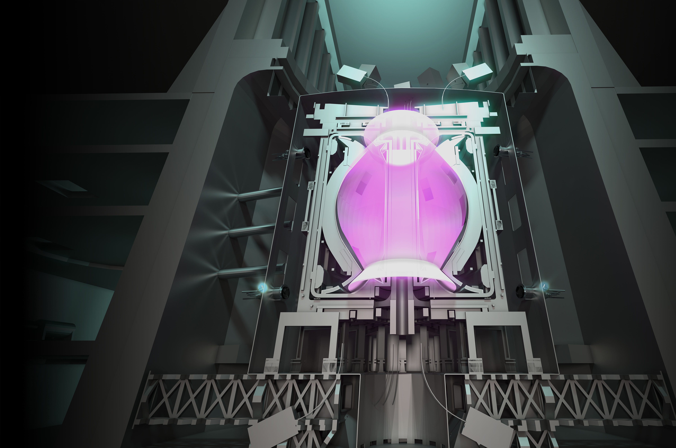


WHAT IS STEP FUSION?
Pioneering, prototype fusion powerplant that will demonstrate net energy, fuel self-sufficiency and
a route to the commercial viability of fusion.
Presently a UK government programme, driven through public-private partnership & international collaborations.
A fully peer-reviewed technical design, published in
The Royal Society Philosophical Transactions A.
OFFICIAL PUBLIC - RECIPIENTS ONLY – UKAEA SUPPLIER DAY 30th September 2026 - © UKFE 2026

Slide 4
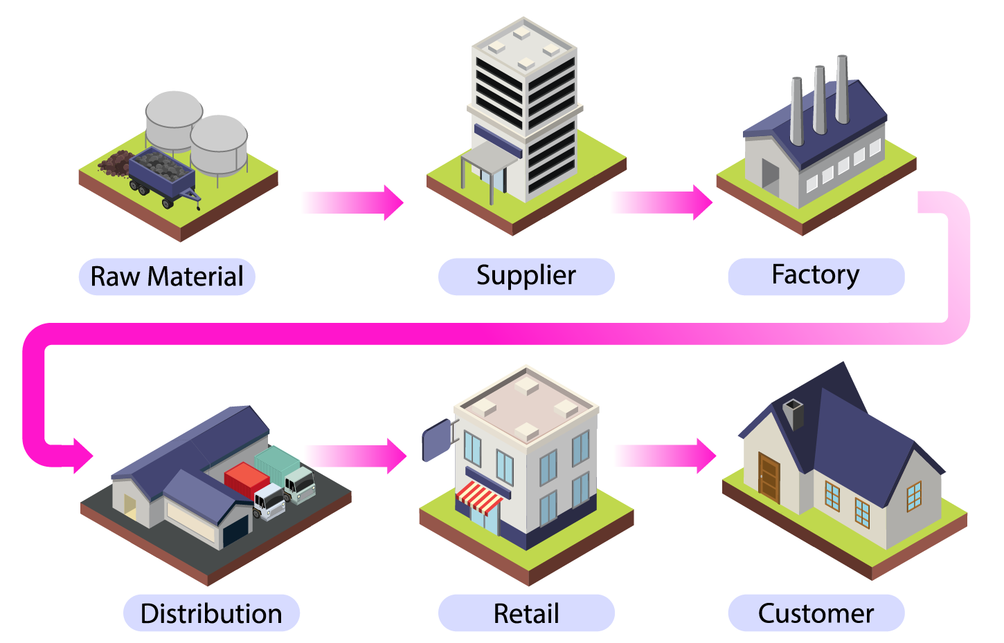
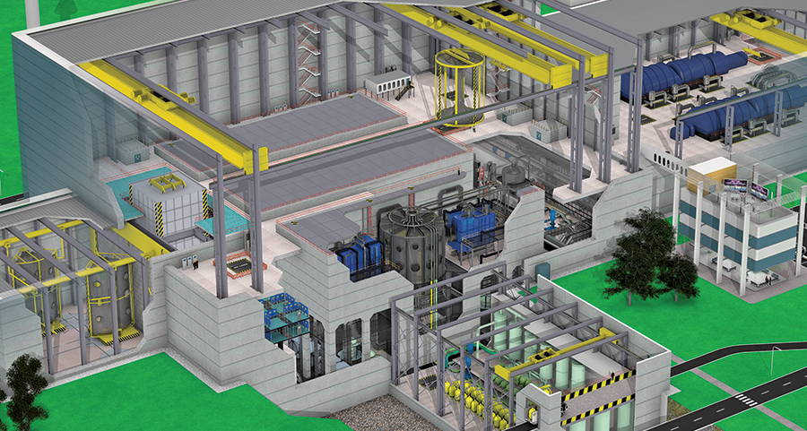
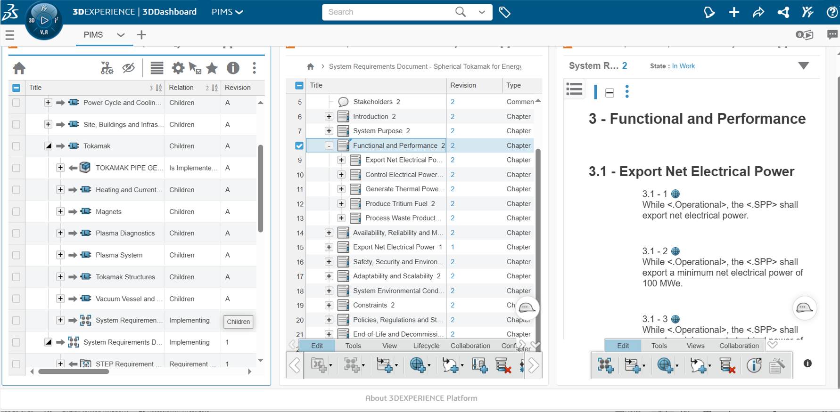
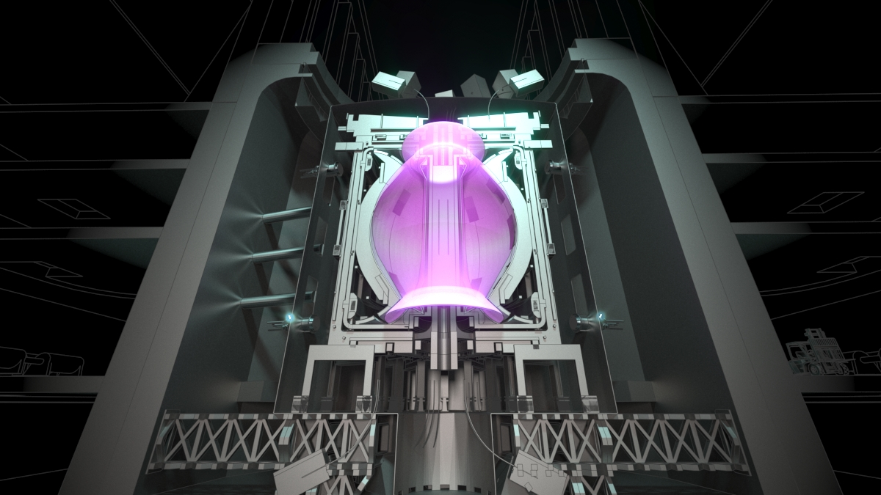
More than just a prototype…
Programme Overview
£
Increased social value
i.e. enriched lives and social justice
Thriving communities with sufficient
social, financial, natural and physical capital
PEOPLE:
Enabling a lifetime of contribution
PLACES:
Empowerment and investment for local communities
SOCIAL SECTOR:
Supporting charities and social enterprises
PRIVATE SECTOR:
Promoting business, finance and tech for good
PUBLIC SECTOR:
Ensuring collaborative commissioning
THE FIVE FOUNDATIONS OF SOCIAL VALUE:
Government action to strengthen these foundations
UK ECONOMIC VALUE
Exports, contracts, spin-offs
SOCIAL VALUE
Skills, jobs, investment,
regional infrastructure
INDUSTRIAL STRATEGY
Supply Chain
GLOBAL FUSION FACILITY
INFORMATION BASELINE
POWER PLANT DEMONSTRATION
OFFICIAL PUBLIC - RECIPIENTS ONLY – UKAEA SUPPLIER DAY 30th September 2026 - © UKFE 2026

Slide 5
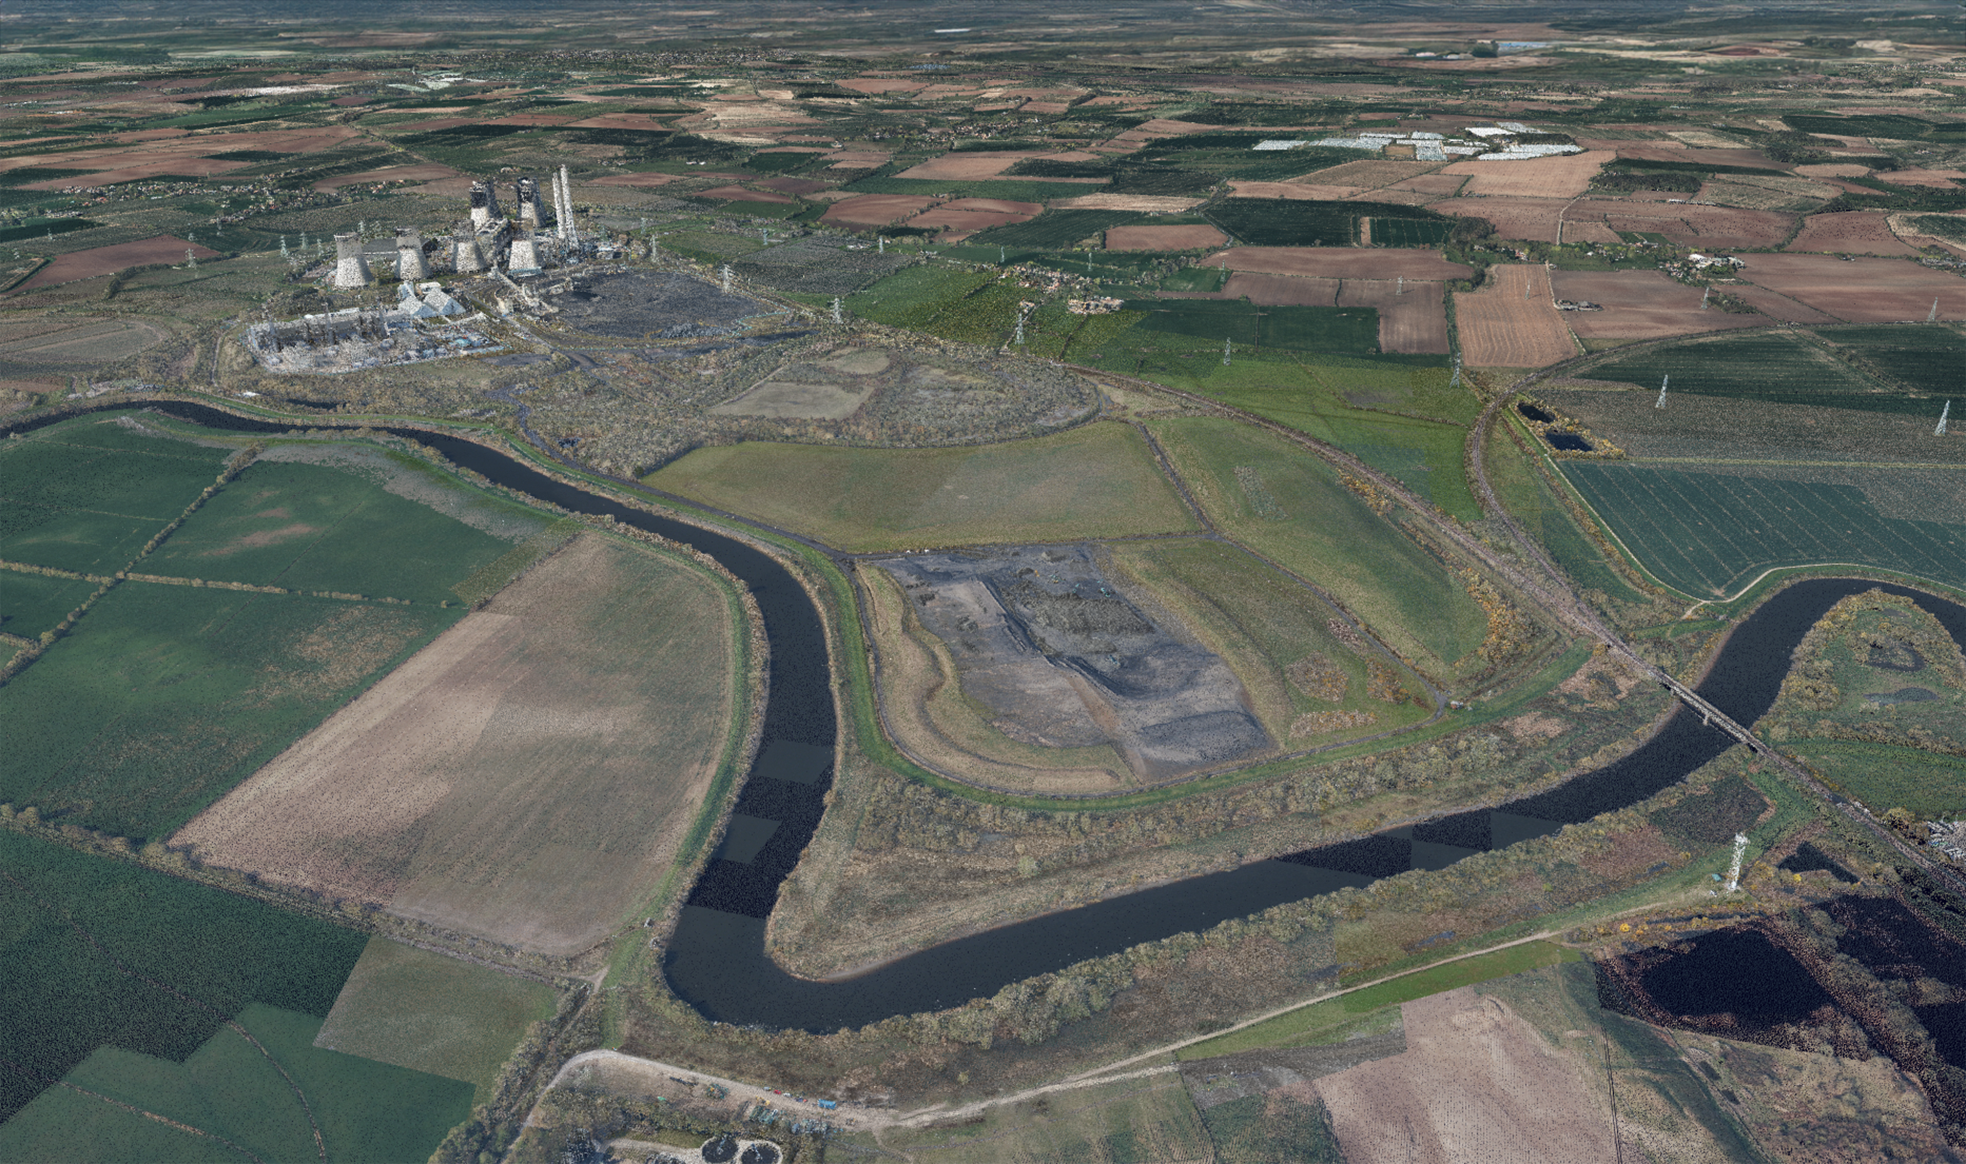
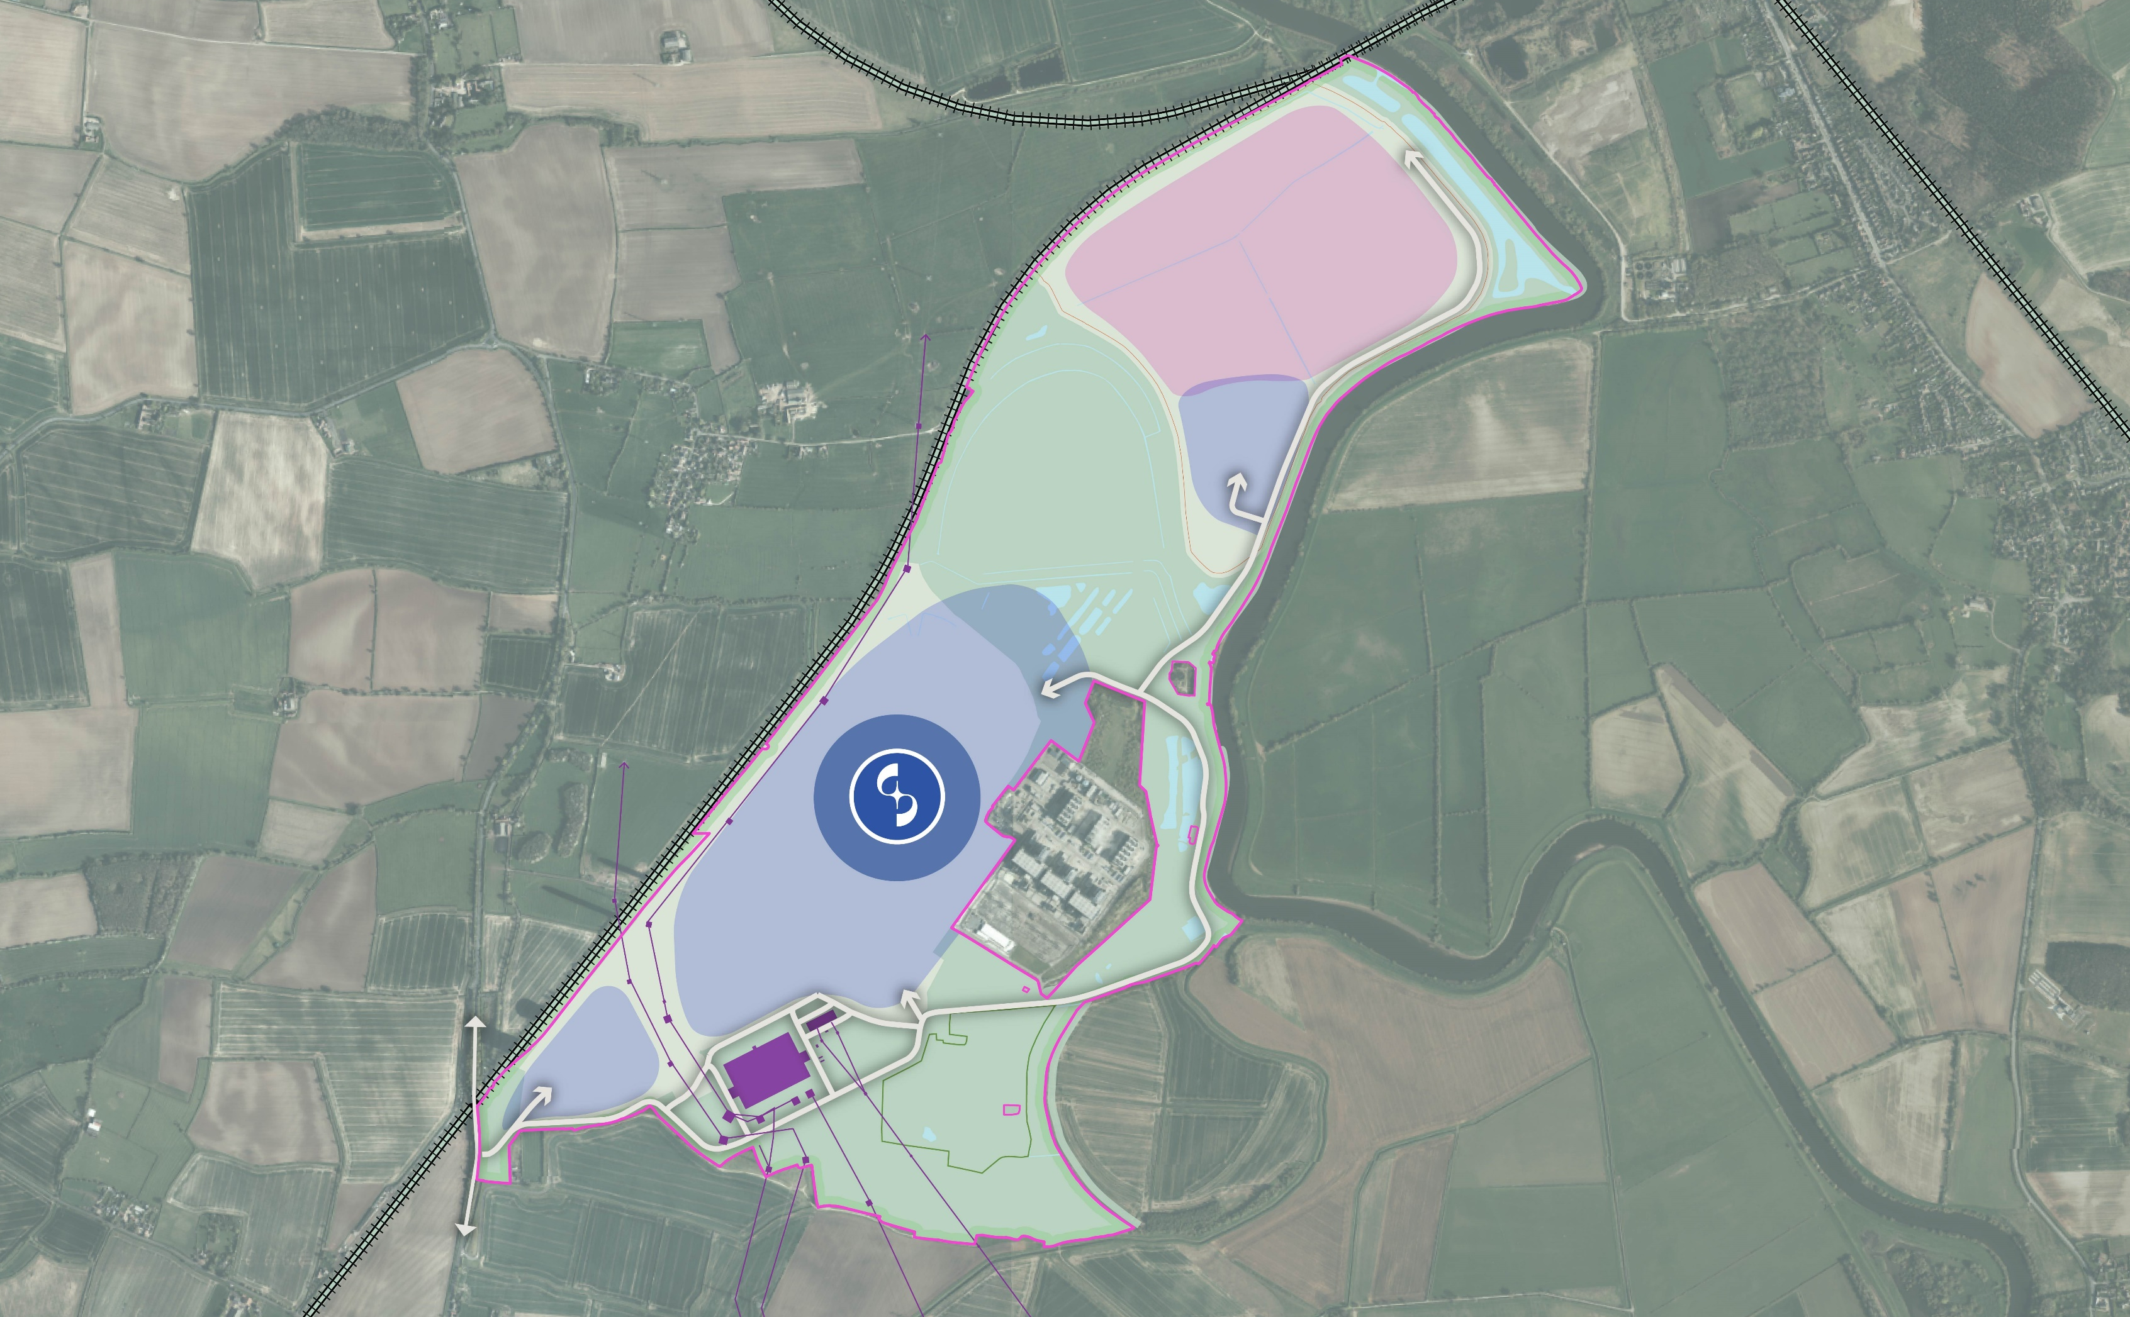


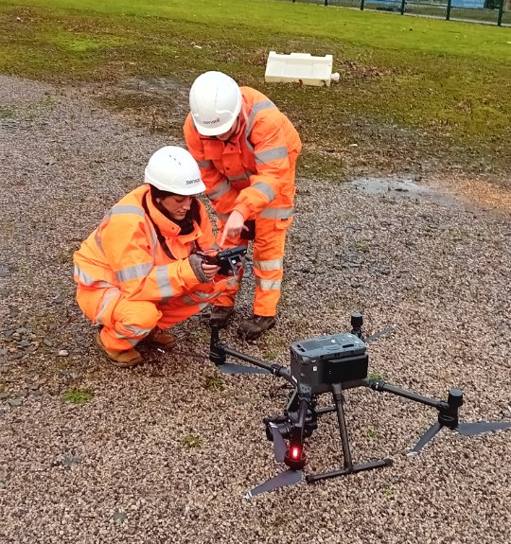

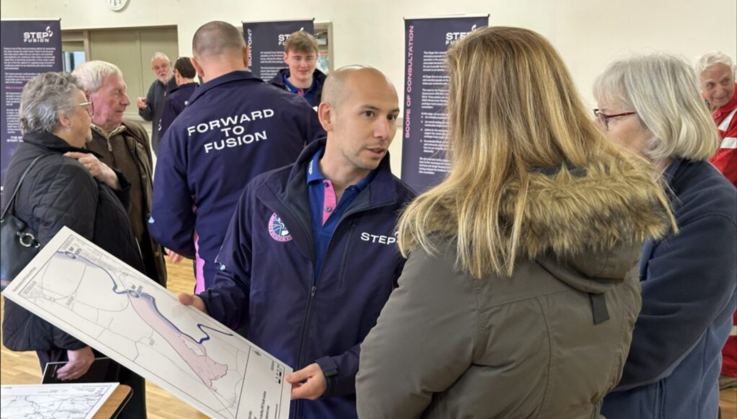

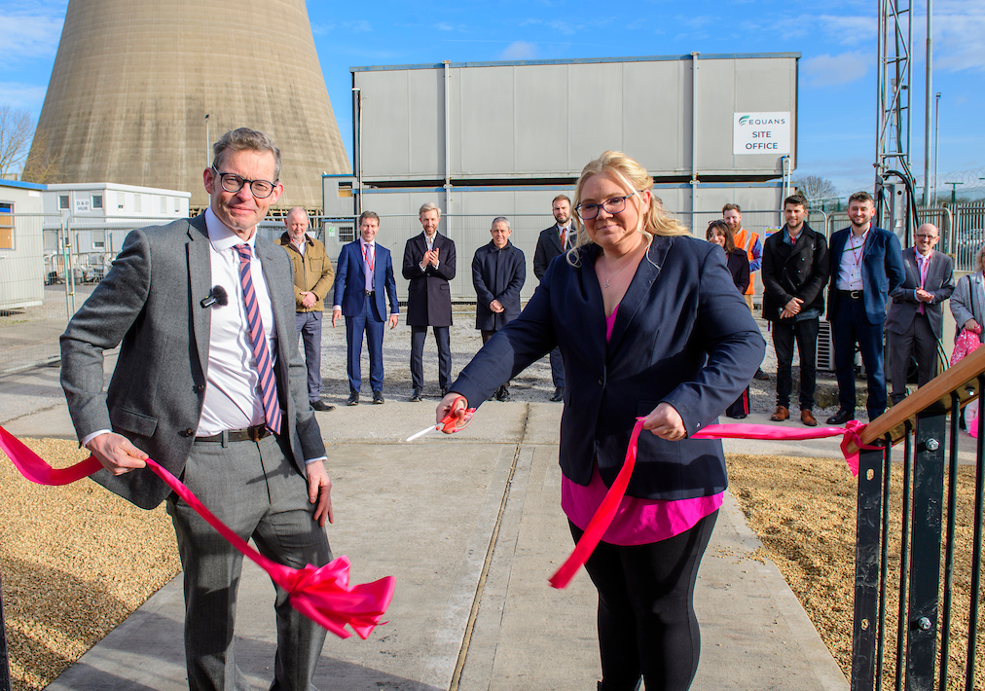
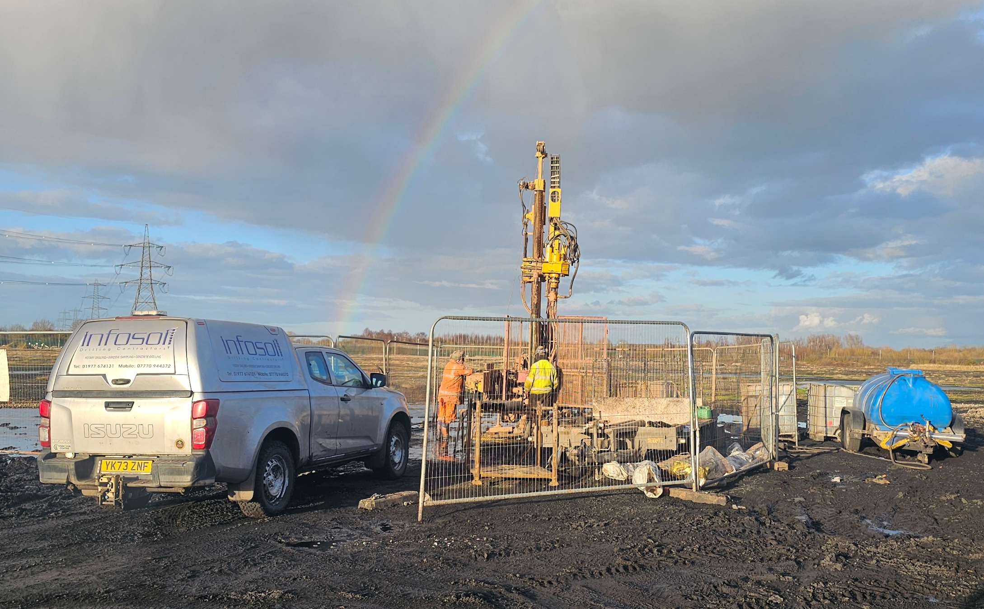

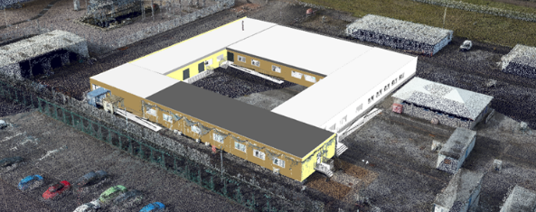

SITE - West Burton
MISSION TO FUSION
2
Tokamak Location Decision (South)
November 2025
3
Digital Representation of site, Sensat
Site Characterisation
(Ongoing)
1
DCO Stage 1 Public Consultation Launch
January 2026
3
4
First site office opened
Jan 2024
Office Expansion (White)
April 2026
Borehole studies
2023
2024
2025
2026
1
2
3
4
OFFICIAL PUBLIC - RECIPIENTS ONLY – UKAEA SUPPLIER DAY 30th September 2026 - © UKFE 2026
Notes:
Key points:
Site Selected in Oct 2022
First Offices opened in 2024
Site characterisation works ongoing. Sensat, Image & Boreholes studies.
Stakeholder engagement (Regional & Government)
Tokamak location Decision
DCO process, stage 1 consultation (Q1 2026, materials in preparation)
Office expansion, expected April 2026

Slide 6
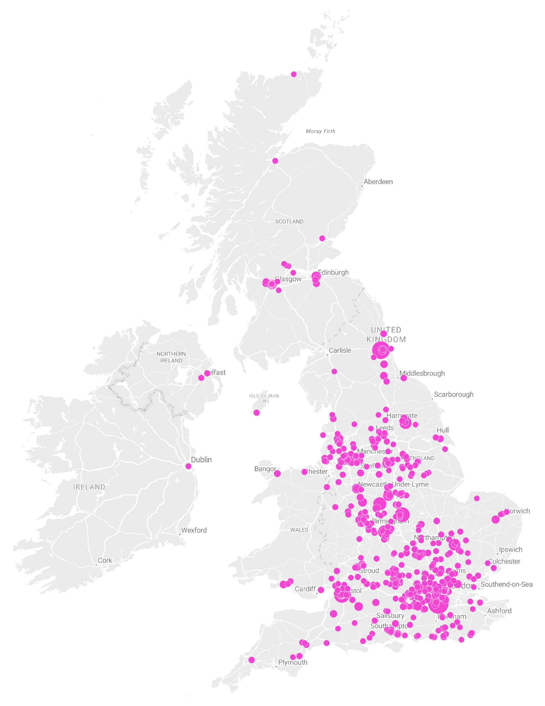
UKFE contribution so far
31
91
UK academic & international agreements
~£3.4m value
peer-reviewed papers
since 2022
Total industry spend
£125.5m
Inside the UK
£103.1m
49
421 FTE
West Burton local/regional suppliers
74% since 2023
High-skilled jobs
working on STEP
No. of contracts
854
521
£26.7m
Small to medium size Enterprise
SME Suppliers
(250 employees of fewer)
active contracts across STEP
BUBBLE SIZE INCREASES THE LARGER THE SPEND
OFFICIAL PUBLIC - RECIPIENTS ONLY – UKAEA SUPPLIER DAY 30th September 2026 - © UKFE 2026

Slide 7
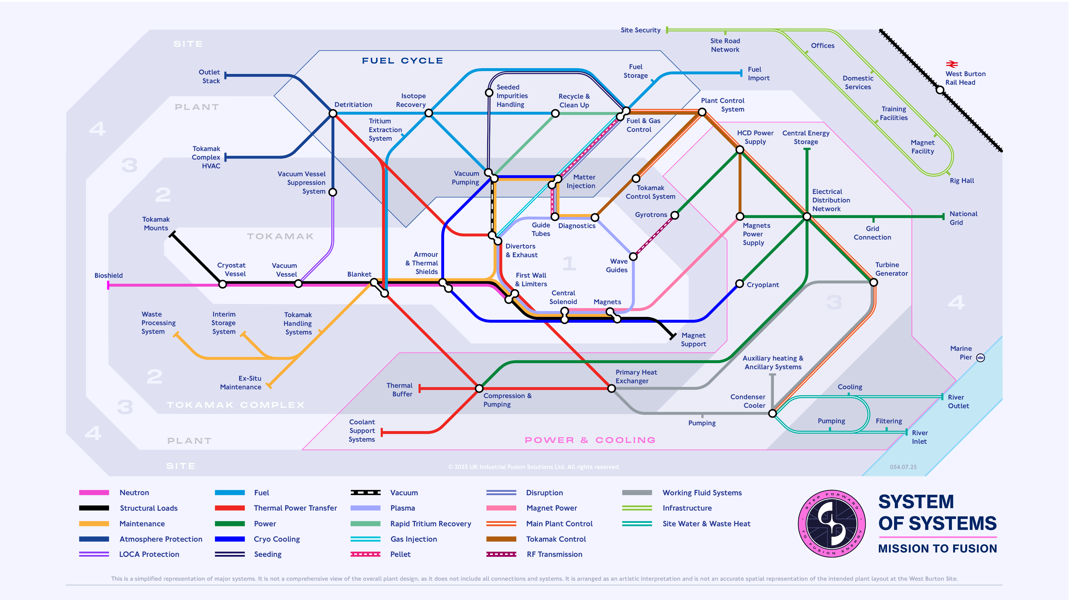
OFFICIAL PUBLIC - RECIPIENTS ONLY – UKAEA SUPPLIER DAY 30th September 2026 - © UKFE 2026

Slide 8
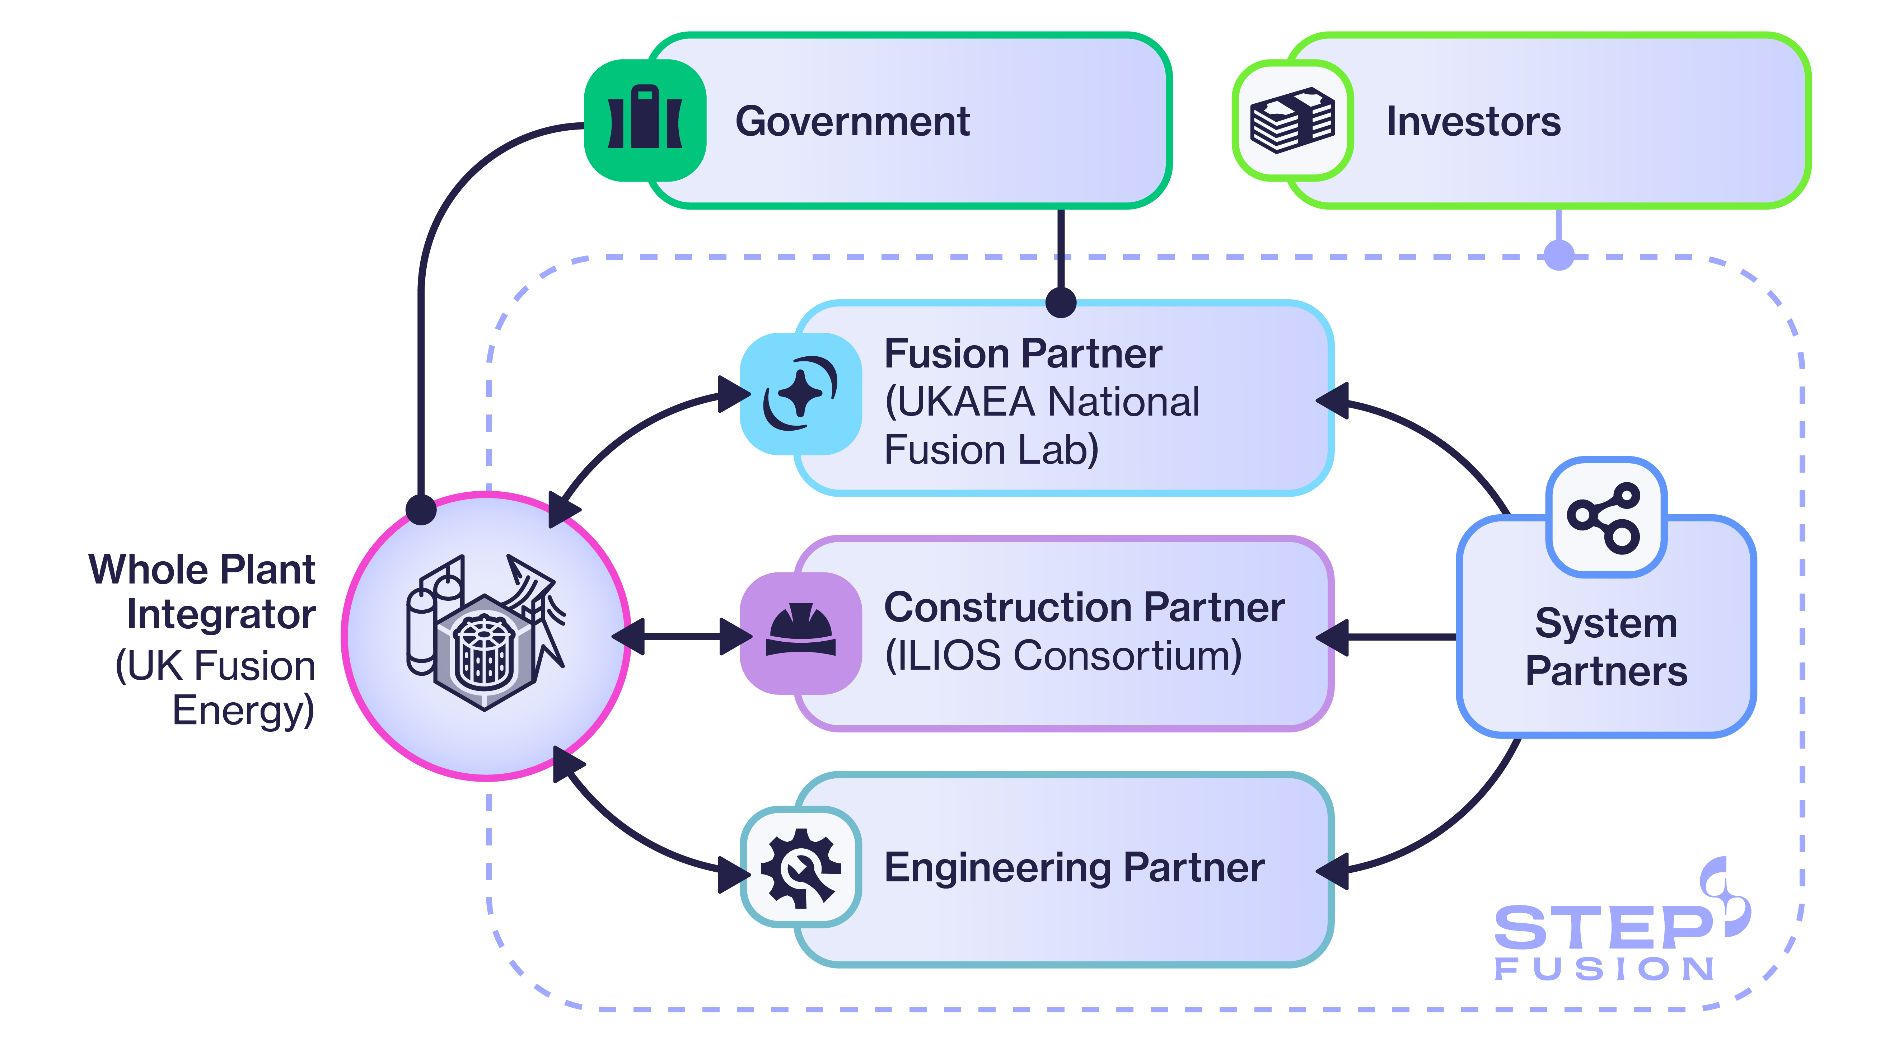
System Partner Structure
Test Operations Partner
Breeder Blanket System Partner
Systems Engineering and Whole Plant Integration Partner
Fusion Controls System Partner
Fuel Cycle System Partner
Embedded Engineering Resource Framework
OFFICIAL PUBLIC - RECIPIENTS ONLY – UKAEA SUPPLIER DAY 30th September 2026 - © UKFE 2026
Notes:
Slide to introduce the System Partner opportunities that the technical teams will present later this afternoon.
For the 6 opportunities they are on a spectrum from technology focussed particularly in the fusion specific area through to more general Engineering programme delivery capability
We are seeking a broad range of skills, capability and experience across these opportunities.
Many of the System partner roles have overlapping and complementary capabilities but across all of them is them is an exciting change to be part of an amazing programme

Slide 9
Procurement Routes/Contracts
UKFE
Open Procedures
Frameworks
Competitive Flexible
Direct Awards
Partner Supply Chains
Call-Offs
Performance Based
Fixed Price
Cost Reimbursable
OFFICIAL PUBLIC - RECIPIENTS ONLY – UKAEA SUPPLIER DAY 30th September 2026 - © UKFE 2026
Notes:
Slide to introduce the System Partner opportunities that the technical teams will present later this afternoon.
For the 6 opportunities they are on a spectrum from technology focussed particularly in the fusion specific area through to more general Engineering programme delivery capability
We are seeking a broad range of skills, capability and experience across these opportunities.
Many of the System partner roles have overlapping and complementary capabilities but across all of them is them is an exciting change to be part of an amazing programme

Slide 10
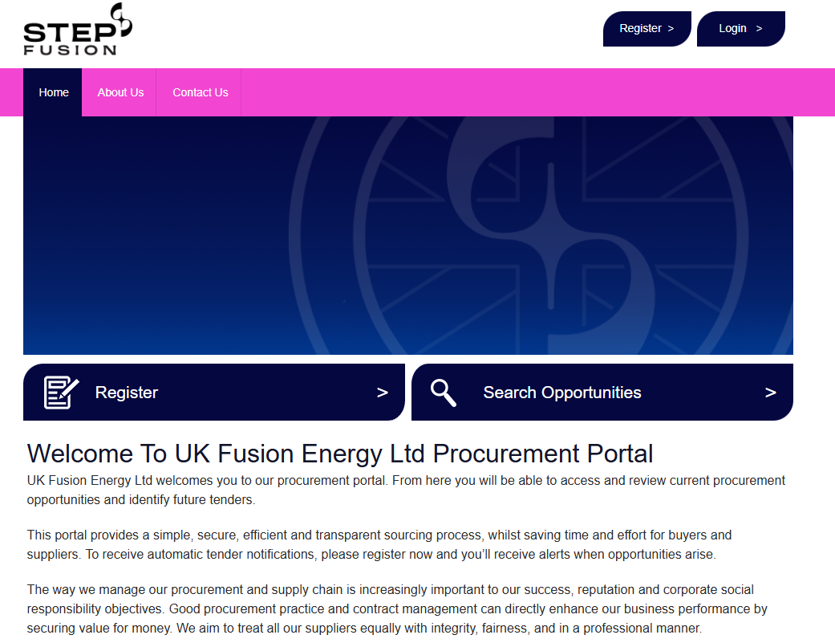
UKFE Procurement Portal
UK Fusion Energy Ltd – Procurement Portal
OFFICIAL PUBLIC - RECIPIENTS ONLY – UKAEA SUPPLIER DAY 30th September 2026 - © UKFE 2026

Slide 11
Supply Chain Requirements
Cyber Essentials (PPN014)
Requirement from Feb 2025
UKFE developing support for SMEs
Quality
Based around ISO 9001
Evolving standards
Finance Checks
Credit Report Checks
Physical Address and Contact Number
OFFICIAL PUBLIC - RECIPIENTS ONLY – UKAEA SUPPLIER DAY 30th September 2026 - © UKFE 2026
Notes:
Slide to introduce the System Partner opportunities that the technical teams will present later this afternoon.
For the 6 opportunities they are on a spectrum from technology focussed particularly in the fusion specific area through to more general Engineering programme delivery capability
We are seeking a broad range of skills, capability and experience across these opportunities.
Many of the System partner roles have overlapping and complementary capabilities but across all of them is them is an exciting change to be part of an amazing programme

Slide 12
Onboarding Process - UKFE
Open Tender Completed/Direct Award Completed
New Setup Request
Qualifying Checks Made (UKFE/UKAEA)
Contract Signing (Conditional on setup requirements)
Supplier Approved
Added to ERP
Expectation 6 weeks
OFFICIAL PUBLIC - RECIPIENTS ONLY – UKAEA SUPPLIER DAY 30th September 2026 - © UKFE 2026
Notes:
Slide to introduce the System Partner opportunities that the technical teams will present later this afternoon.
For the 6 opportunities they are on a spectrum from technology focussed particularly in the fusion specific area through to more general Engineering programme delivery capability
We are seeking a broad range of skills, capability and experience across these opportunities.
Many of the System partner roles have overlapping and complementary capabilities but across all of them is them is an exciting change to be part of an amazing programme

